Slide 1
GCSE (2017-19)
Revision Past Paper Questions
(Edexcel)
Go back to home screen to select a topic
Go back to topic screen to select a question
‘Solutions’
Go to the mark scheme for that question
Go back to the question from the mark scheme
Or go back to first solutions
Or see more solutions
Next

Slide 2
Notes on operating this resource
When creating this, I used and to quickly navigate between slides directly before or after the slide in question.
As some mark schemes give additional notes, you can continue to see answers by clicking but you will not return to the original question with one click of .
To view the original question again, continue to click which should take you back.
Next

Slide 3
Notes on this resource and the GCSE exam
To maximise visibility, the working space for many questions was reduced to enlarge questions as much as possible. It is therefore recommended that pupils complete these questions on a separate piece of paper, rather than the PowerPoint itself. Although questions that require you to work on them have been edited to let you print off.
Where the official scheme of work has not been too helpful (comments such as ‘correct graph’) I have added correct solutions on the diagrams or axes. These should, however, not turn up if you wanted to print out the slides to work on (as is often the case with these style of questions).
There were issues when grouping some topics either into ‘Algebra’ or ‘Number’ as, although the majority of questions were based numerically, some were set with algebraic constants to test understanding behind the method (usually towards the end of a paper). If you cannot find a topic in ‘Algebra’, the best bet would be to look in ‘Number’ and vice versa.
Similarly, to practise some harder algebraic skills you may want to try some of the later questions within the ‘Number’ topics such as Ratio, Surds and Standard Form, or see the ‘show that’ section.
Within each major topic (Algebra, number etc.) there is a lot of overlap and some questions may appear in more than one sub-category. If you want to practice a particular skill that is a part b) section, you may want to first reveal the answer to part a), or practice questions from earlier in that paper where there is less overlap.
Next

Slide 4
Notes on this resource and the GCSE exam
Some topics which appear a lot (such as rounding) have not been duplicated. Instead, questions which only and specifically deal with this issue are listed in that topic.
I have included all show that/ prove questions within the ‘show that…/ prove’ section as these can help support mathematical structures of answers. Traditional prove questions are highlighted in purple here too.
While not being on the new syllabus (2017) Questions do seem to have changed since this was brought in, with more crossovers between sub-topics and some especially hard questions towards the end of papers.
Finally, please bear in mind the size of this resource. I have undoubtedly made mistakes when putting it together. If you notice anything or have any suggestions to make it even better, please contact me on twitter and I will update it.
All Questions were found online on the mathsmadeeasy website or maths genie – links to videos for solutions are also on this site if you are confused from the mark scheme.
Any secure papers requiring passwords for entry were not used to keep them secure and for potential mock use.

Slide 5
Notes on Edexcel Papers
There are generally just over 20 Questions per paper, with more complex and problem solving questions towards the end. There are 80 marks on each 90 minute paper (meaning an average of 4 marks per question, a minute per mark).
The use of ratios is a common tool within questions to add another level of complexity. These are not duplicated in the ratio topic at every occurrence.

Slide 6
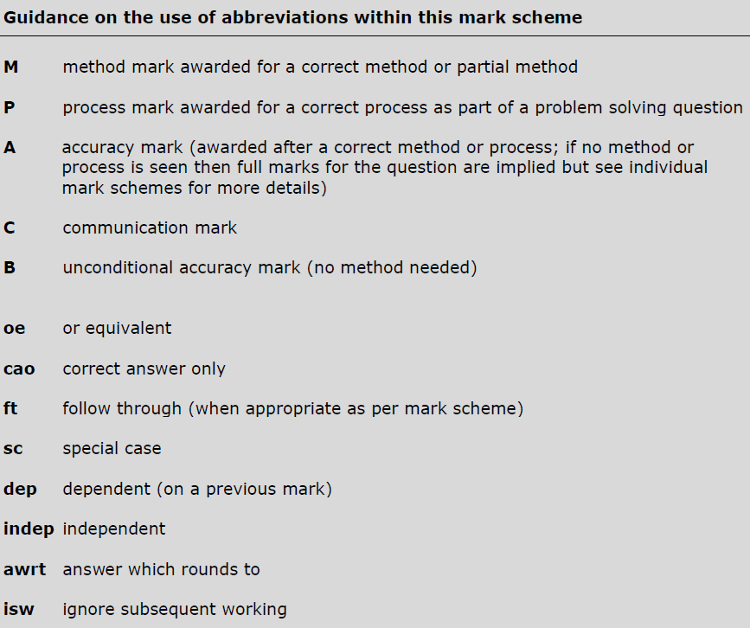
Notes on Edexcel Mark scheme notes
Next

Slide 7
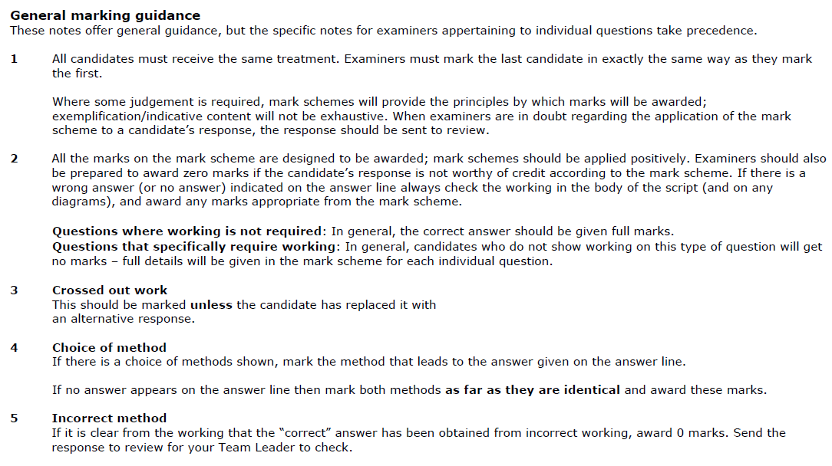
Notes on Edexcel Mark scheme notes
Next

Slide 8
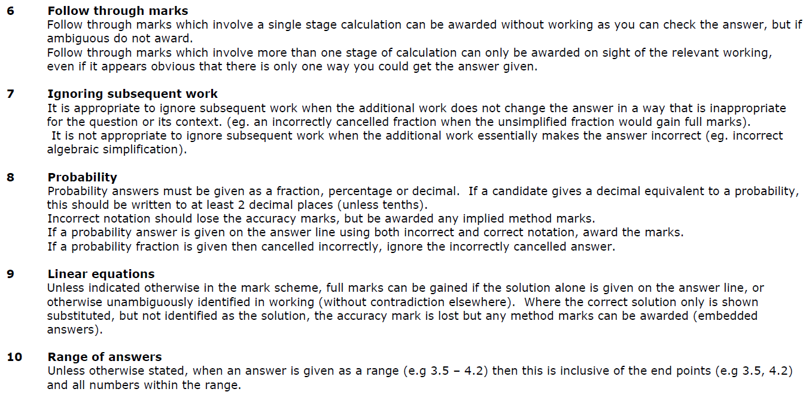
Notes on Edexcel Mark scheme notes

Slide 9
Notes on AQA Papers
There are generally around 28 Questions per paper, with more complex and problem solving questions towards the end. There are 80 marks on each 90 minute paper (meaning an average of 2.86 marks per question, a minute per mark).
The first few (4) questions are generally quick multiple choice one-markers to test understanding concepts. There are normally a two or three more of these later in the paper as well.
As well as these, there are a lot of 1 mark questions to test quick knowledge throughout the papers. To quickly identify these, I have highlighted them light orange.
When in doubt on where marks can be awarded, there are generally notes at the end of each question’s part in the mark scheme (after any alternative approaches if they apply).

Slide 10
Edexcel Notes
Home
Edexcel Mark scheme guide
Algebra
Show that…/ Proof
Probability, Sets & Statistics
Number
Shape & Space

Slide 11
Notes on Algebra Questions for Edexcel
Algebra
There is a lot of overlap between sub-topics
Some concepts, such as ‘solving basic equation’, may appear all over the exam. To reduce this space becoming overcrowded, additional hyperlinks are listed at the bottom of each page to other sub-topics that still use this skill as a key building block to their own solutions.
To practice more algebraic skills later questions from the Number Topic often contain algebra as this demonstrates a wider understanding of the steps involved.
Drawing other non-linear graphs and understanding them, as well as their roots are grouped in the Drawing and using graphs sub-topic

Slide 12
Algebra
Algebra
Simplifying Basic Expressions
Expanding Brackets
Substitution
Drawing and Using Graphs
Solving Simple Equations
Factorising
Algebraic Fractions
Linear Graphs & Gradients
Forming Equations
Solving Quadratics
Quadratic Inequalities
Linear Inequalities
Manipulating Formulae/ Changing the Subject
Completing the Square
Functions
Graphical Transformations
Simultaneous Equations
Indices
Sequences
Iterations
Notes

Slide 13
Simplifying Basic Expressions
Algebra
Simplifying Basic Expressions
Spec 2
2H Q3

Slide 14
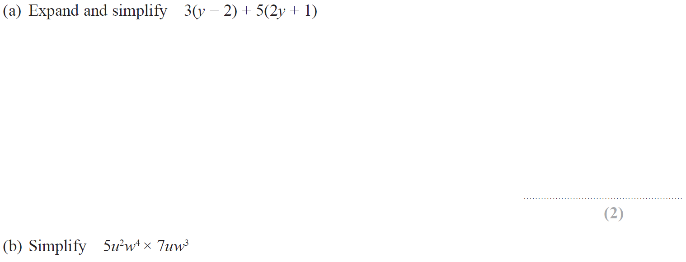
Algebra
Simplifying Basic Expressions
Specimen Set 2 2H Q3

Slide 15
Algebra
Simplifying Basic Expressions
Specimen Set 2 2H Q3
A
B

Slide 16
Indices
Algebra
Indices
May 2017
1H Q12
SAM
1H Q10
Nov 2018
1H Q1
June 2017
2H Q18
Spec 1
1H Q10
Nov 2018
1H Q14
Nov 2017
1H Q10
Spec 2
1H Q1
Nov 2018
3H Q9
Nov 2017
2H Q6
Spec 2
1H Q15
May 2019
1H Q8
May 2018
1H Q9
Spec 2
2H Q3
June 2019
3H Q12
June 2018
2H Q1
Rewriting as another power
Properties of Numbers
Negative & fractional
See also:
Differentiation
Standard Form

Slide 17
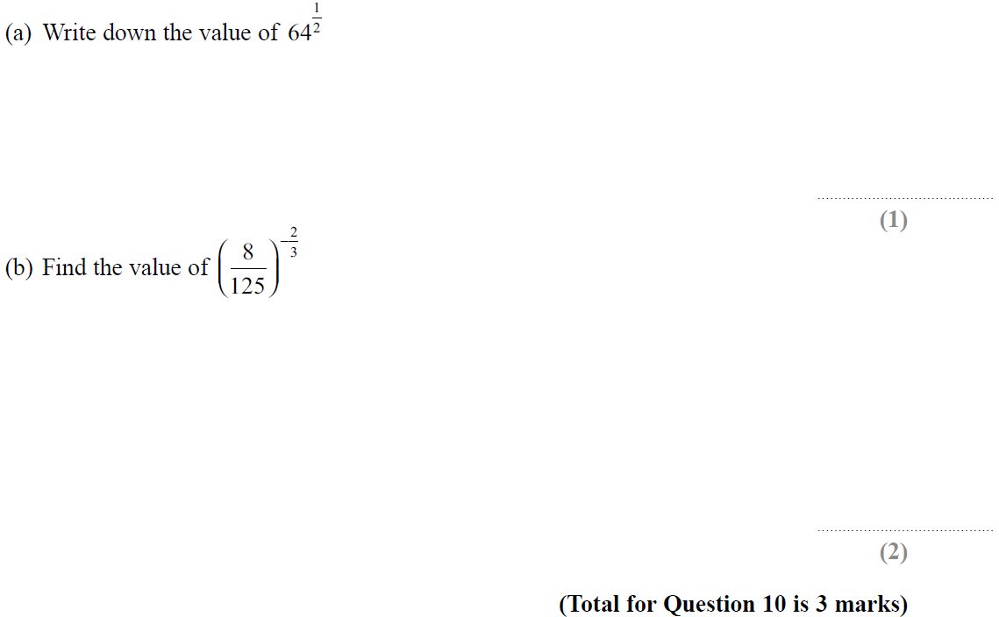
Algebra
Indices
SAM 1H Q10

Slide 18
Algebra
Indices
SAM 1H Q10
A
B

Slide 19
Algebra
Indices
Specimen Set 1 1H Q10

Slide 20
Algebra
Indices
Specimen Set 1 1H Q10
A

Slide 21
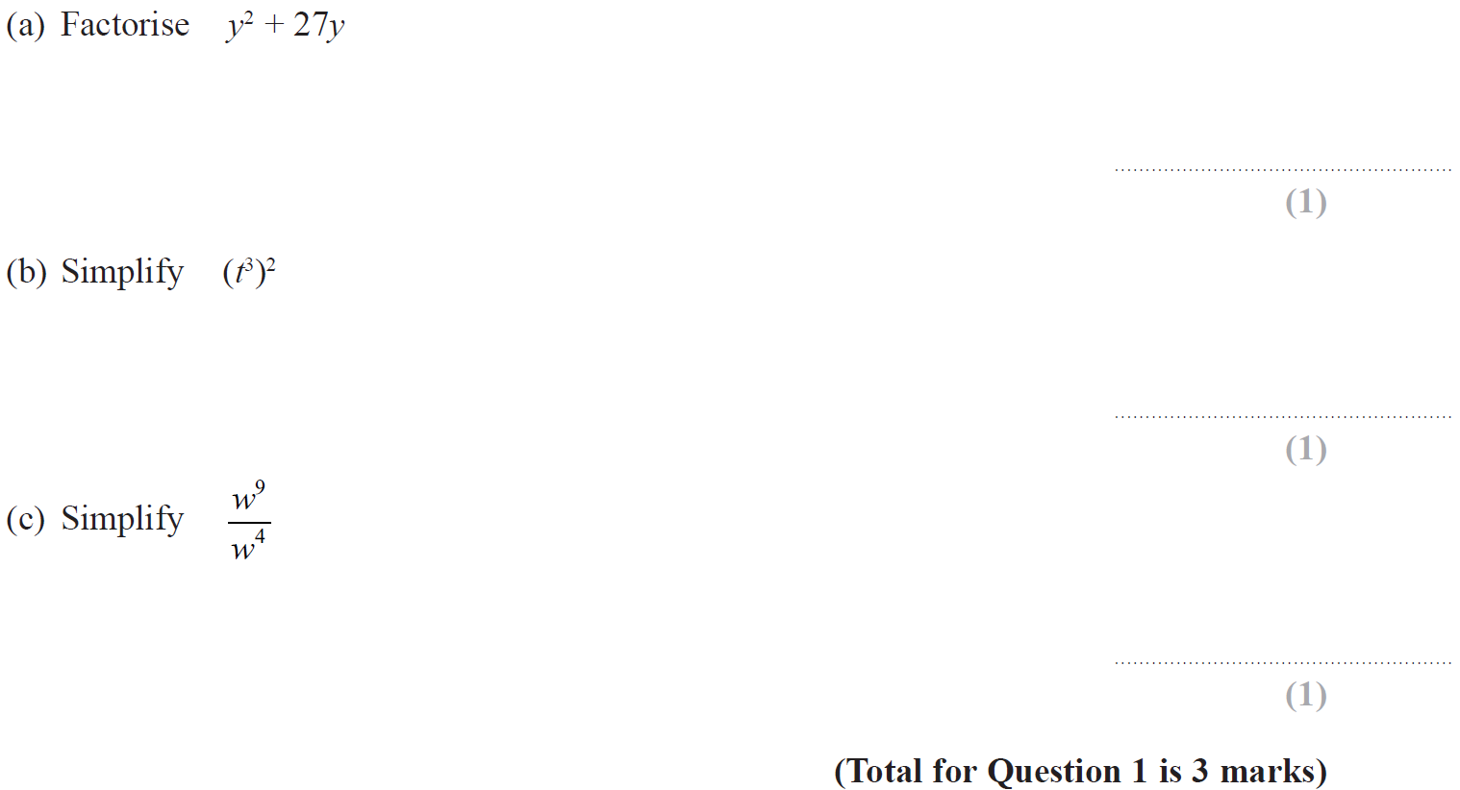
Algebra
Indices
Specimen Set 2 1H Q1

Slide 22
Algebra
Indices
Specimen Set 2 1H Q1
A
B
C

Slide 23
Algebra
Indices
Specimen Set 2 1H Q15

Slide 24
Algebra
Indices
Specimen Set 2 1H Q15
A
B
C

Slide 25
Algebra
Indices
Specimen Set 2 2H Q3

Slide 26
Algebra
Indices
Specimen Set 2 2H Q3
A
B

Slide 27
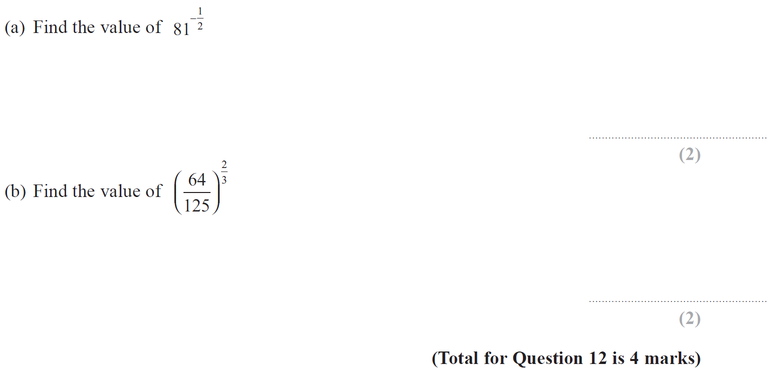
Algebra
Indices
May 2017 1H Q12

Slide 28
Algebra
Indices
May 2017 1H Q12
A
B

Slide 29
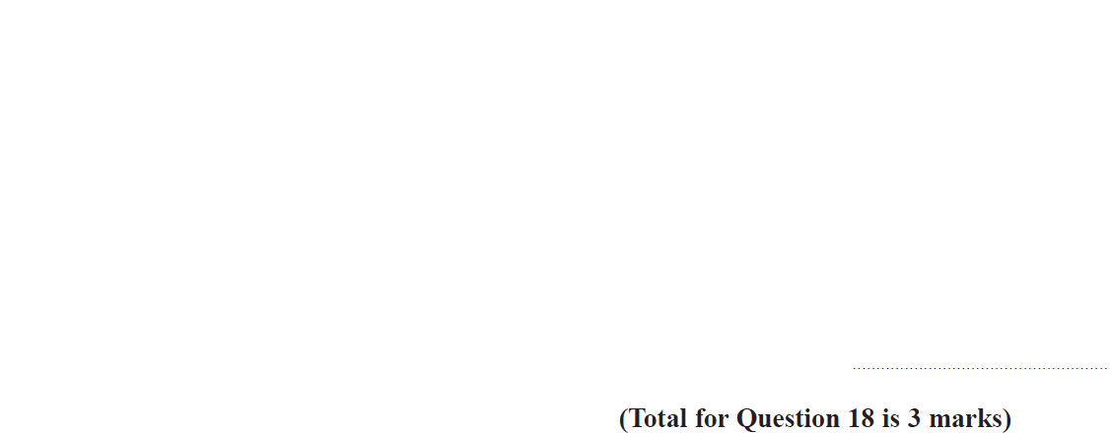
Algebra
Indices
June 2017 2H Q18

Slide 30
Algebra
Indices
June 2017 2H Q18
A

Slide 31
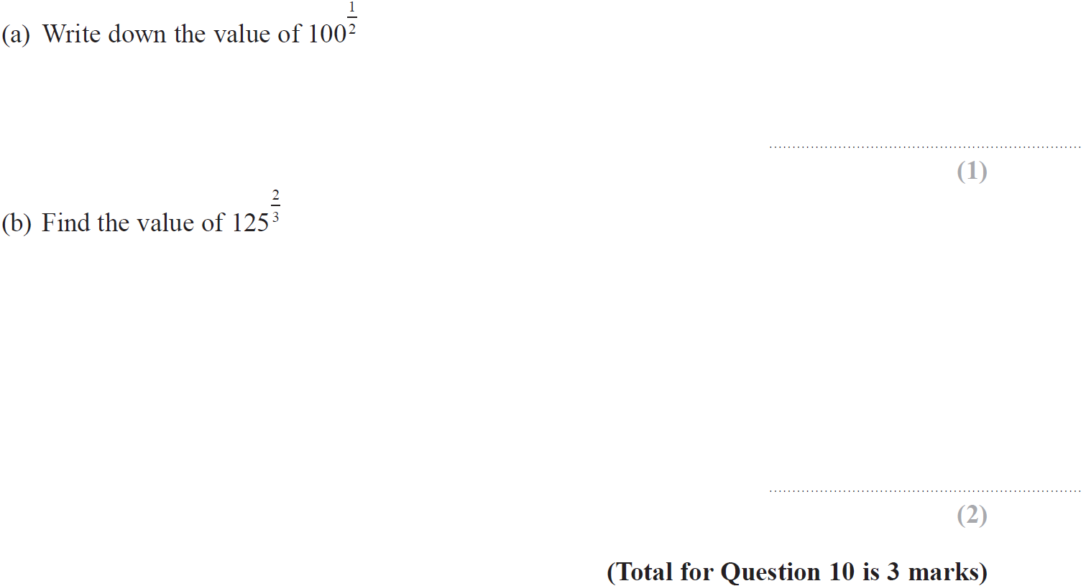
Algebra
Indices
Nov 2017 1H Q10

Slide 32
Algebra
Indices
Nov 2017 1H Q10
A
B

Slide 33
Algebra
Indices
Nov 2017 2H Q6

Slide 34
Algebra
Indices
Nov 2017 2H Q6
A
B
C

Slide 35
Algebra
Indices
May 2018 1H Q9

Slide 36
Algebra
Indices
May 2018 1H Q9
A
B
C

Slide 37
Algebra
Indices
June 2018 2H Q1

Slide 38
Algebra
Indices
June 2018 2H Q1
A
B
C

Slide 39
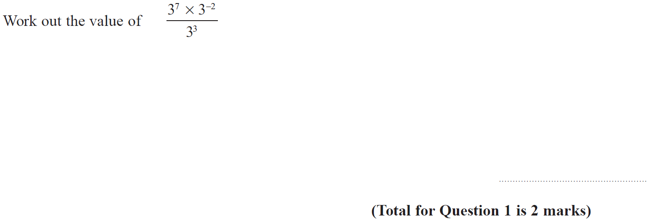
Algebra
Indices
Nov 2018 1H Q1

Slide 40
Algebra
Indices
Nov 2018 1H Q1
A

Slide 41
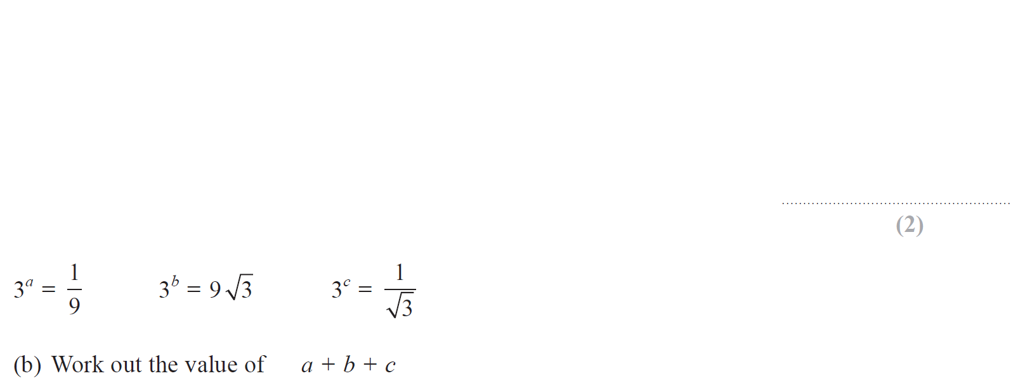
Algebra
Indices
Nov 2018 1H Q14

Slide 42
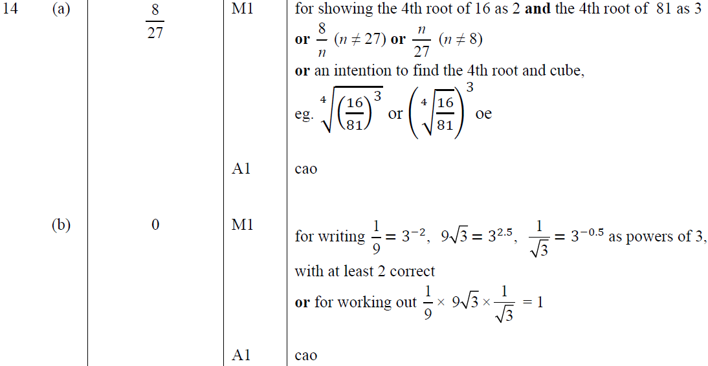
Algebra
Indices
Nov 2018 1H Q14
A
B

Slide 43
Algebra
Indices
Nov 2018 3H Q9

Slide 44
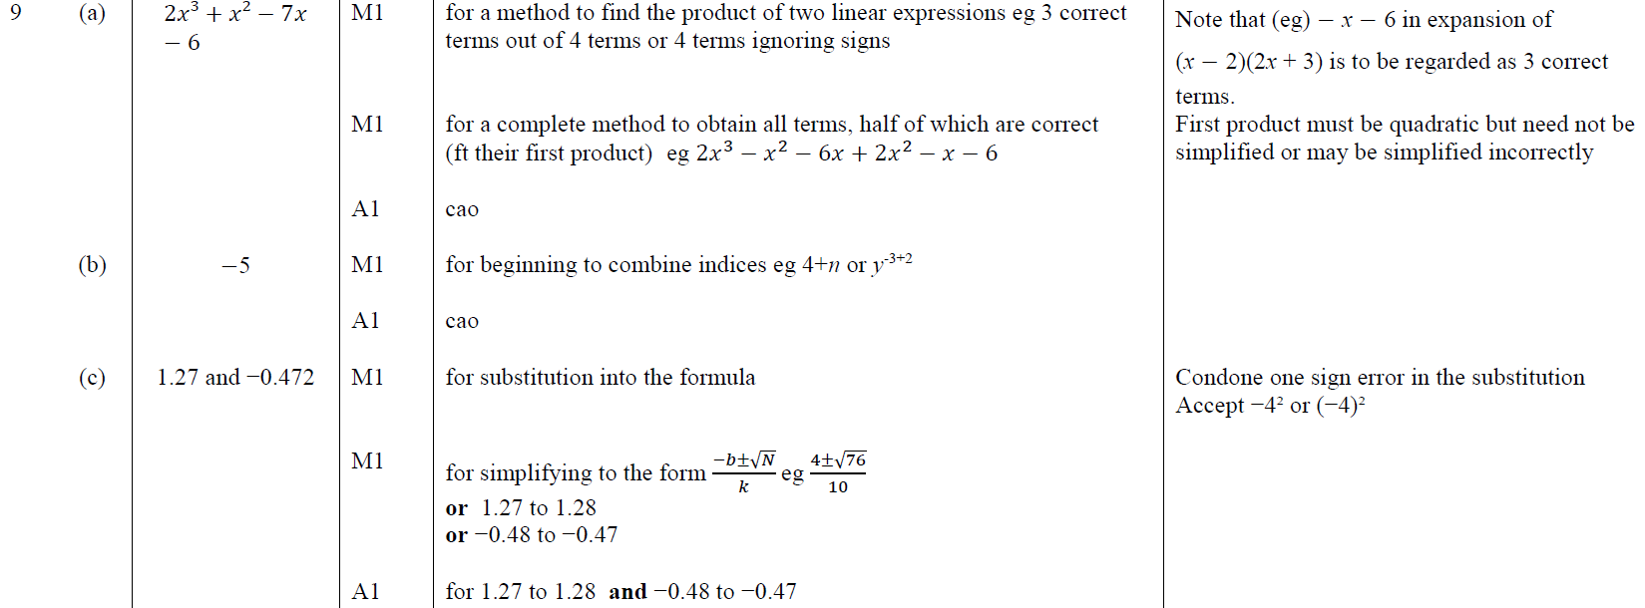
Algebra
Indices
Nov 2018 3H Q9
A
B
C

Slide 45
Algebra
Indices
May 2019 1H Q8

Slide 46
Algebra
Indices
May 2019 1H Q8
A
B
C
A SF
B SF
C SF

Slide 47
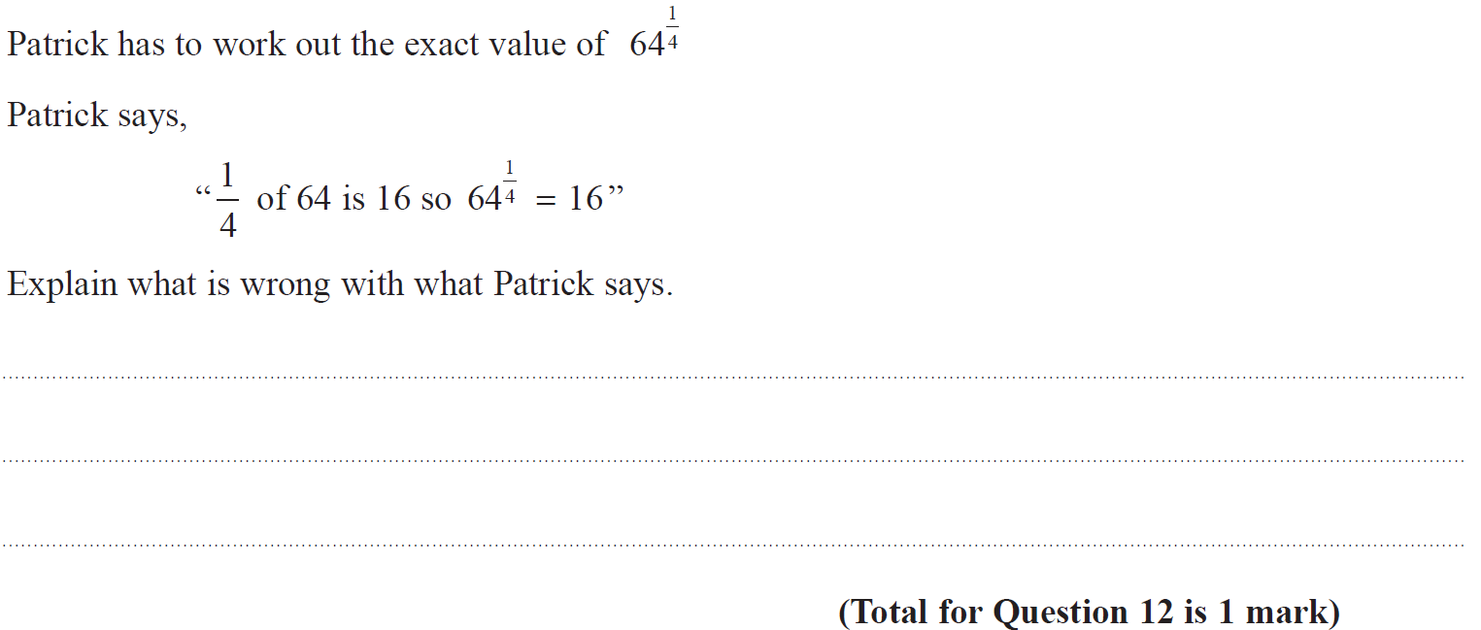
Algebra
Indices
June 2019 3H Q12

Slide 48
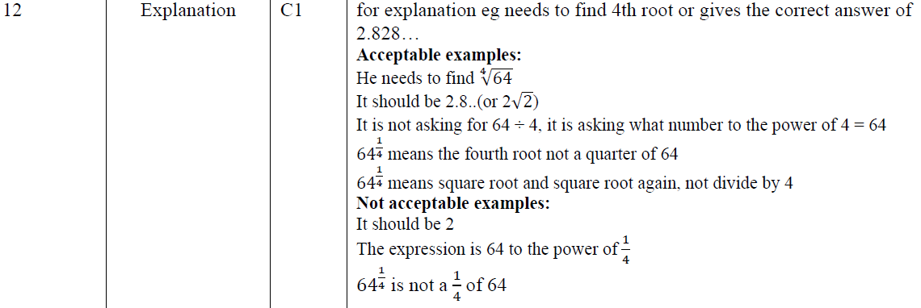
Algebra
Indices
June 2019 3H Q12
A
A SF

Slide 49
Linear Graphs & Gradients
Algebra
Linear Graphs & Gradients
SAM
1H Q25
May 2017
1H Q6
May 2018
1H Q19
Spec 1
1H Q23
May 2017
1H Q18
June 2018
2H Q3
Spec 1
2H Q23
June 2017
2H Q23
Nov 2018
2H Q6
Spec 1
3H Q3
Nov 2017
1H Q19
Nov 2018
2H Q18
Spec 1
3H Q7
Nov 2017
2H Q19
June 2019
2H Q2
Spec 2
1H Q22
May 2018
1H Q6
June 2019
2H Q16
Mainly Co-ordinates
With equation of circle and tangents
Simultaneous Equations
See also:
Linear Inequalities
Time-Series

Slide 50
Algebra
Linear Graphs & Gradients
SAM 1H Q25

Slide 51
Algebra
Linear Graphs & Gradients
SAM 1H Q25
A

Slide 52
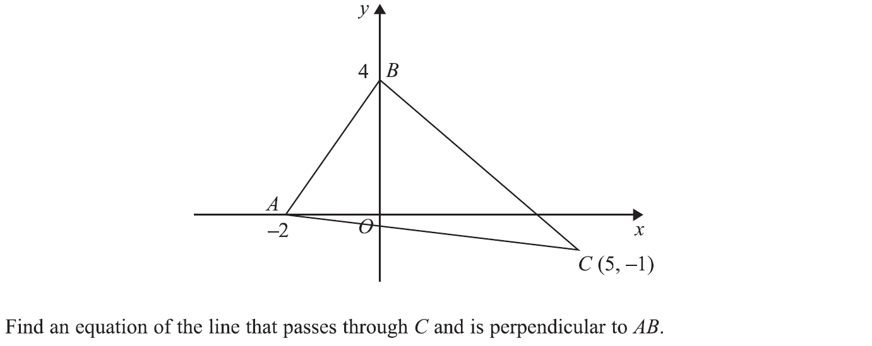
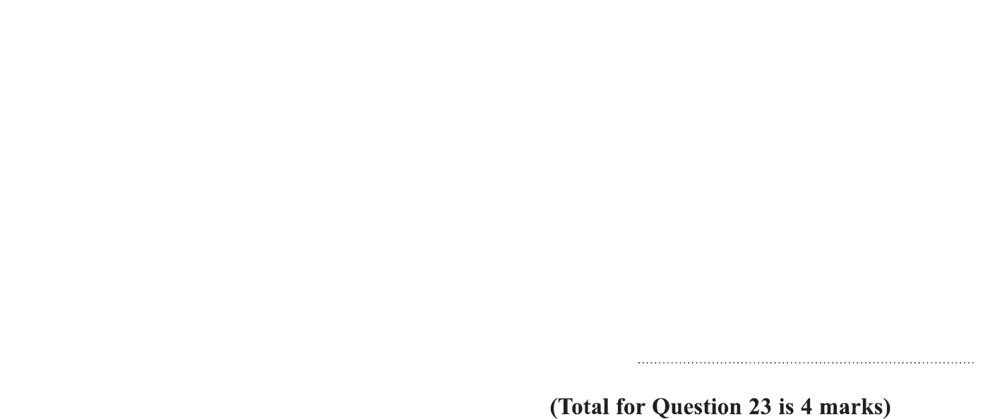
Algebra
Linear Graphs & Gradients
Specimen Set 1 1H Q23

Slide 53
Algebra
Linear Graphs & Gradients
Specimen Set 1 1H Q23
A

Slide 54
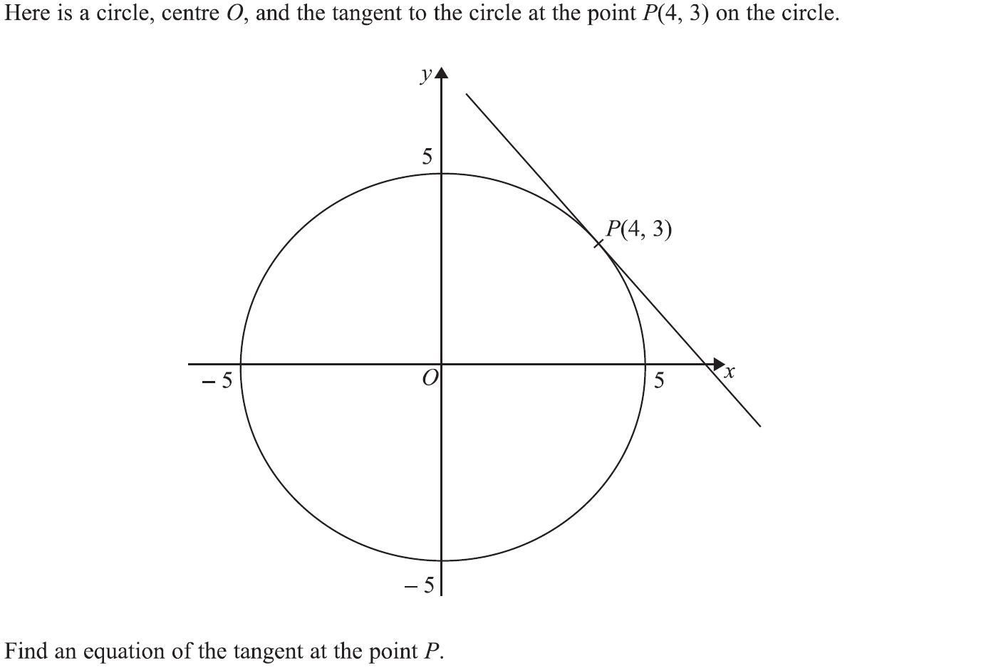
Algebra
Linear Graphs & Gradients
Specimen Set 1 2H Q23

Slide 55
Algebra
Linear Graphs & Gradients
Specimen Set 1 2H Q23
A

Slide 56
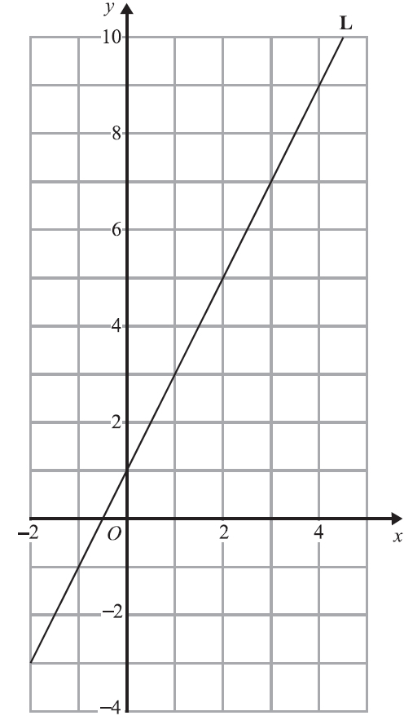
Algebra
Linear Graphs & Gradients
Specimen Set 1 3H Q3

Slide 57
Algebra
Linear Graphs & Gradients
Specimen Set 1 3H Q3
A

Slide 58
Algebra
Linear Graphs & Gradients
Specimen Set 1 3H Q7

Slide 59
Algebra
Linear Graphs & Gradients
Specimen Set 1 3H Q7
A

Slide 60
Algebra
Linear Graphs & Gradients
Specimen Set 2 1H Q22

Slide 61
Algebra
Linear Graphs & Gradients
Specimen Set 2 1H Q22
A

Slide 62
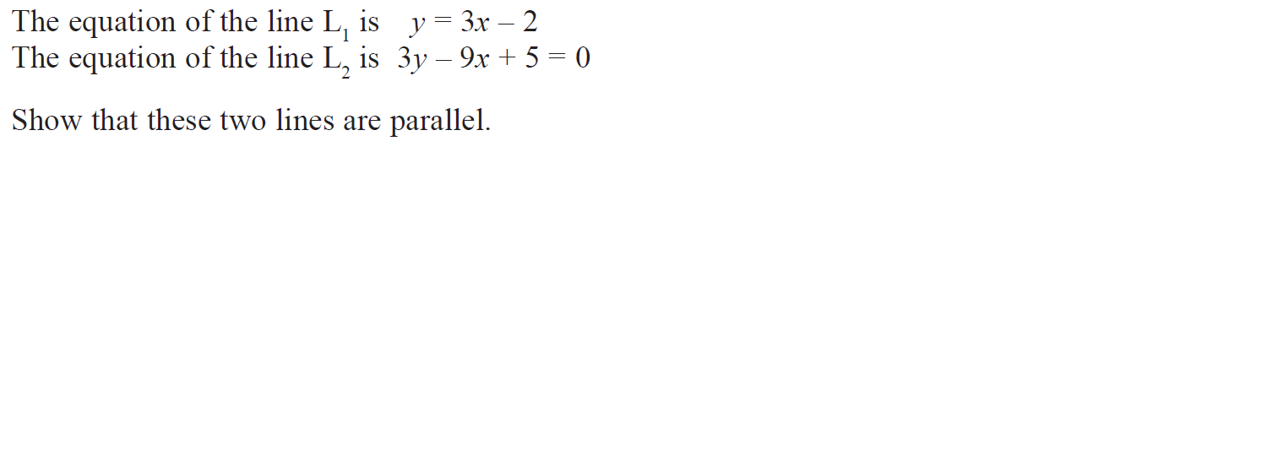
Algebra
Linear Graphs & Gradients
May 2017 1H Q6

Slide 63
Algebra
Linear Graphs & Gradients
May 2017 1H Q6
A

Slide 64
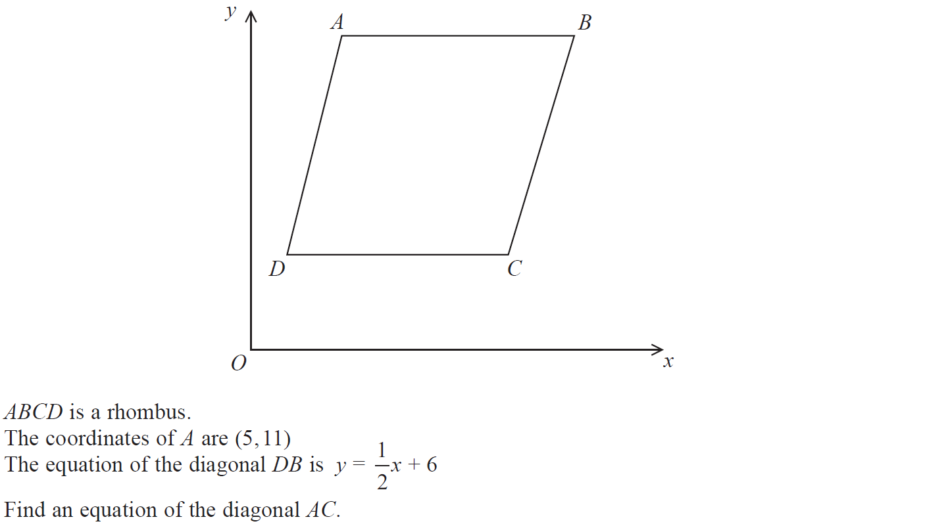
Algebra
Linear Graphs & Gradients
May 2017 1H Q18

Slide 65
Algebra
Linear Graphs & Gradients
May 2017 1H Q18
A

Slide 66
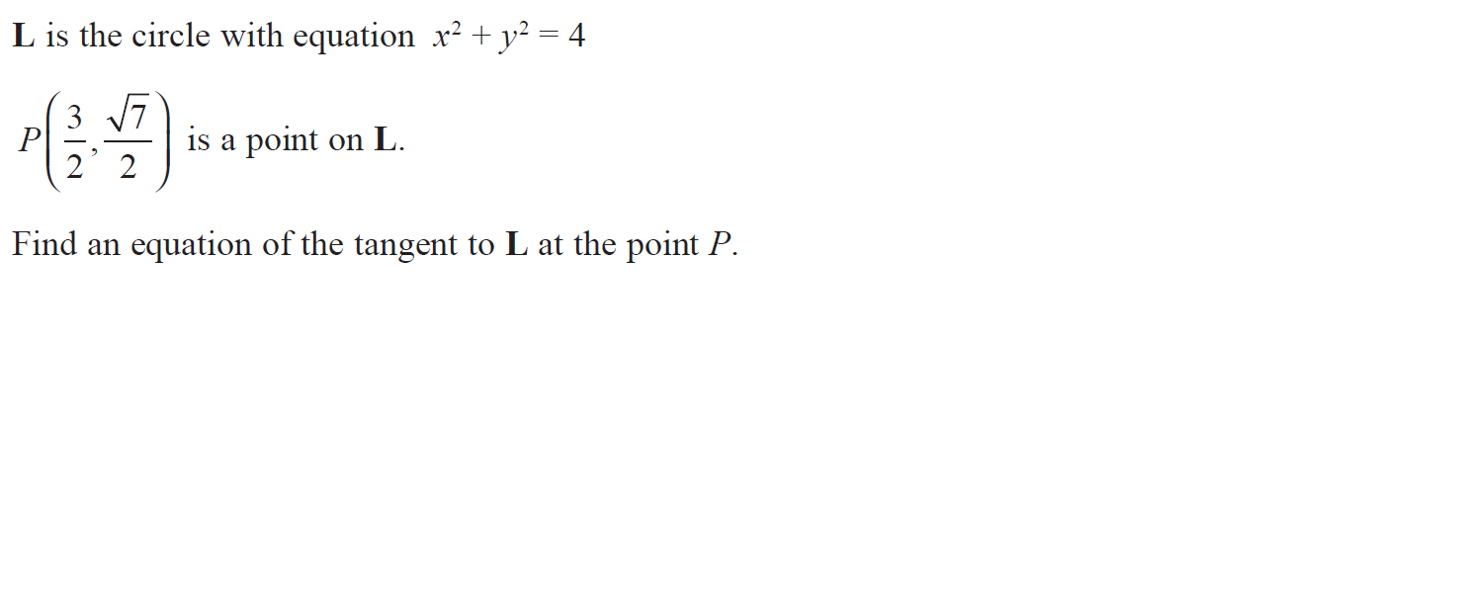
Algebra
Linear Graphs & Gradients
June 2017 2H Q23

Slide 67
Algebra
Linear Graphs & Gradients
June 2017 2H Q23
A

Slide 68
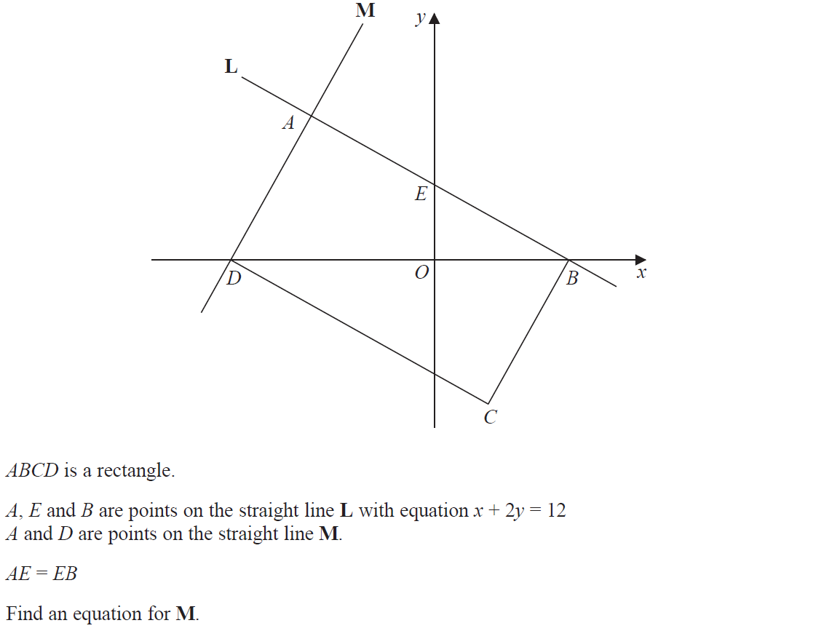
Algebra
Linear Graphs & Gradients
Nov 2017 1H Q19

Slide 69
Algebra
Linear Graphs & Gradients
Nov 2017 1H Q19
A

Slide 70
Algebra
Linear Graphs & Gradients
Nov 2017 2H Q19

Slide 71
Algebra
Linear Graphs & Gradients
Nov 2017 2H Q19
A

Slide 72
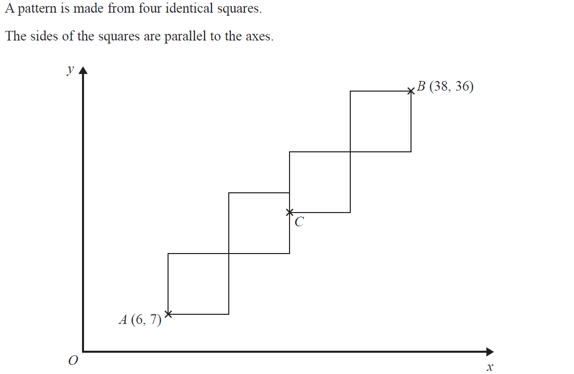
Algebra
Linear Graphs & Gradients
May 2018 1H Q6

Slide 73
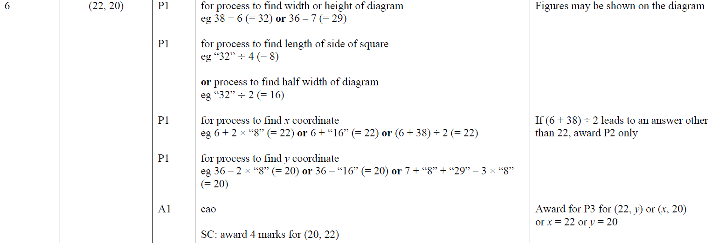
Algebra
Linear Graphs & Gradients
May 2018 1H Q6
A

Slide 74
Algebra
Linear Graphs & Gradients
May 2018 1H Q19

Slide 75
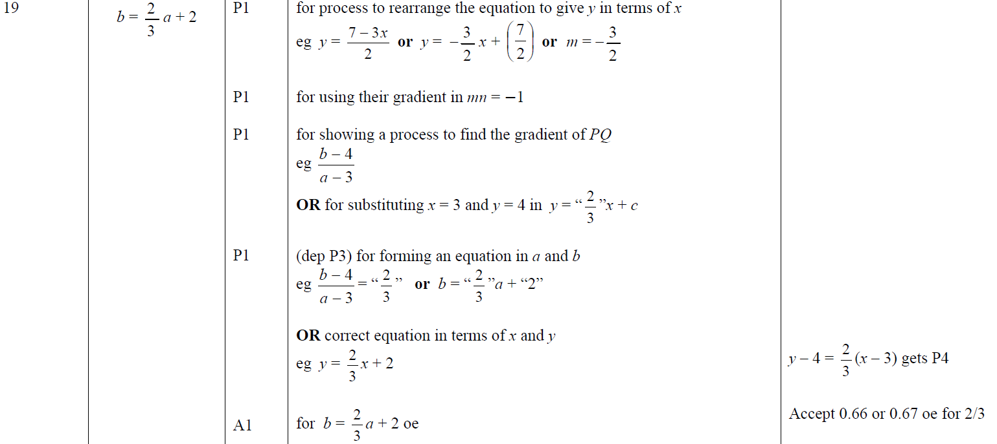
Algebra
Linear Graphs & Gradients
May 2018 1H Q19
A

Slide 76
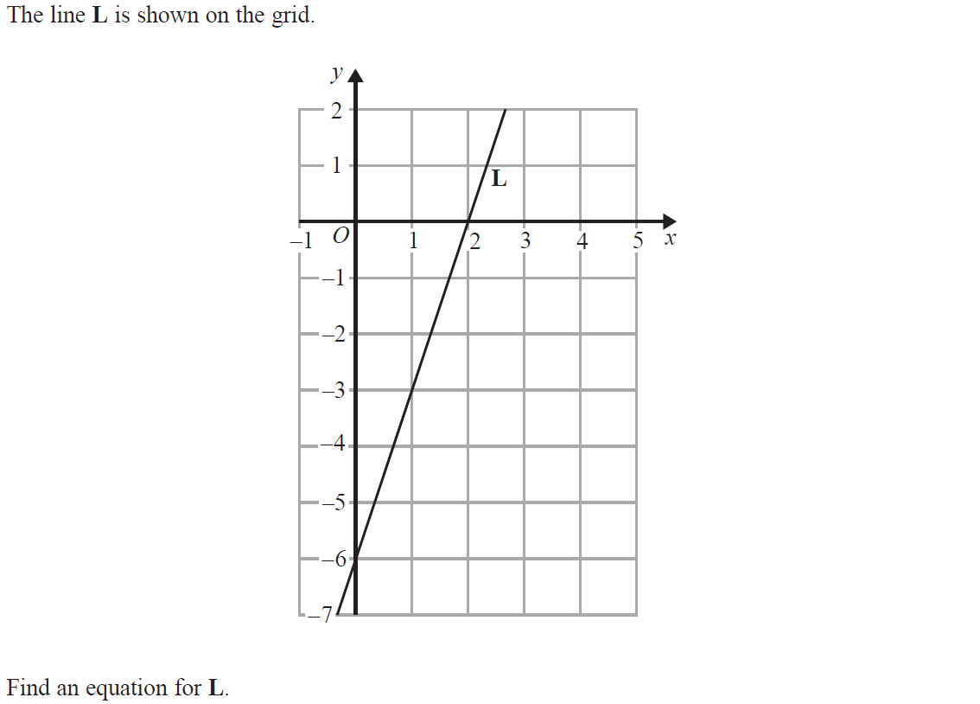
Algebra
Linear Graphs & Gradients
June 2018 2H Q3

Slide 77
Algebra
Linear Graphs & Gradients
June 2018 2H Q3
A

Slide 78
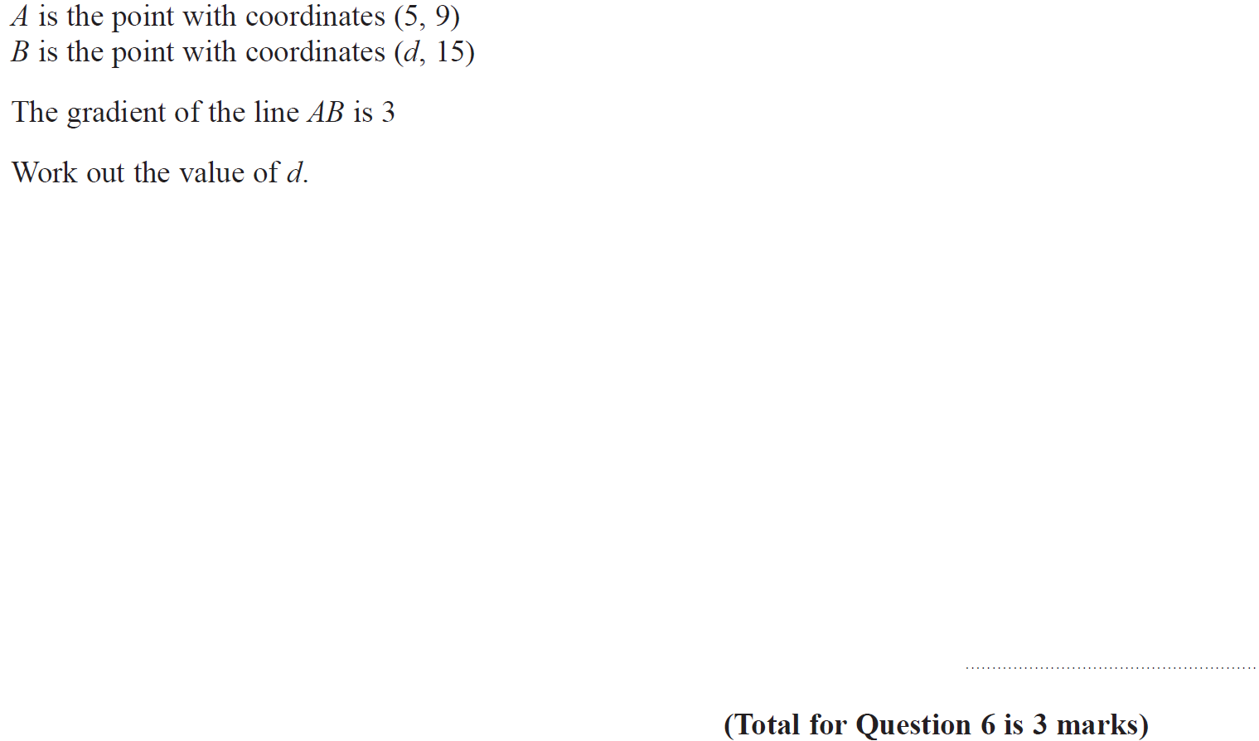
Algebra
Linear Graphs & Gradients
Nov 2018 2H Q6

Slide 79
Algebra
Linear Graphs & Gradients
Nov 2018 2H Q6
A

Slide 80
Algebra
Linear Graphs & Gradients
Nov 2018 2H Q18

Slide 81
Algebra
Linear Graphs & Gradients
Nov 2018 2H Q18
A

Slide 82
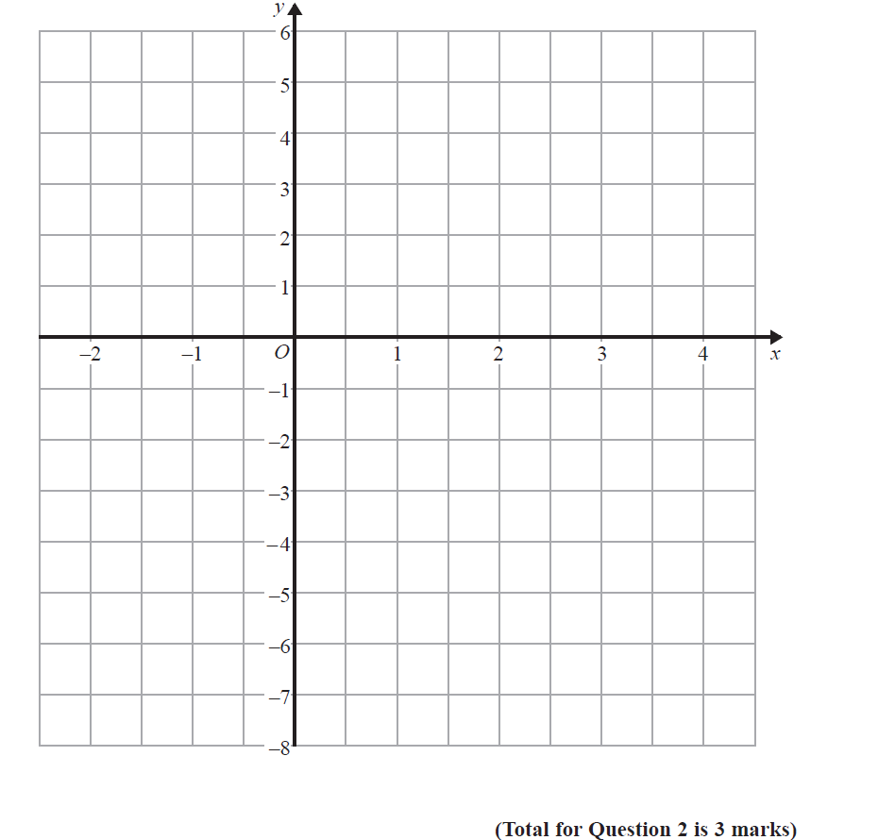
Algebra
Linear Graphs & Gradients
June 2019 2H Q2

Slide 83
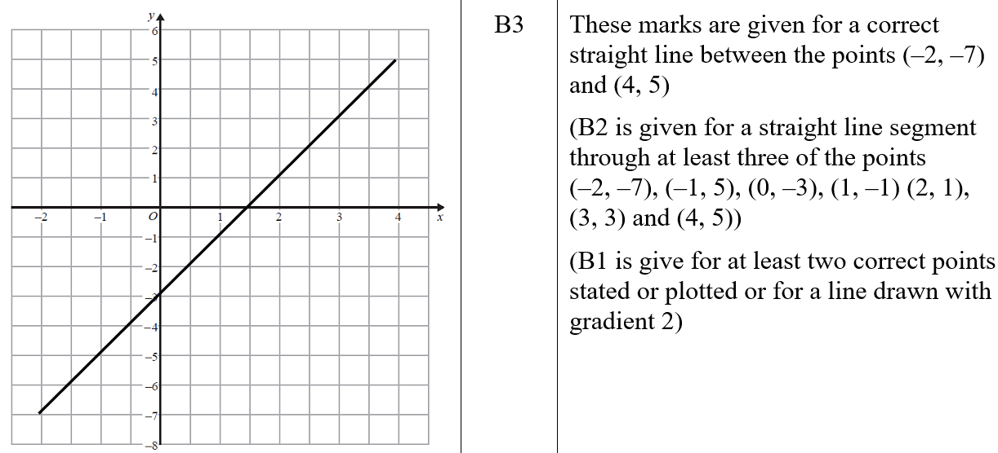
Algebra
Linear Graphs & Gradients
June 2019 2H Q2
A
A SF

Slide 84
Algebra
Linear Graphs & Gradients
June 2019 2H Q16

Slide 85
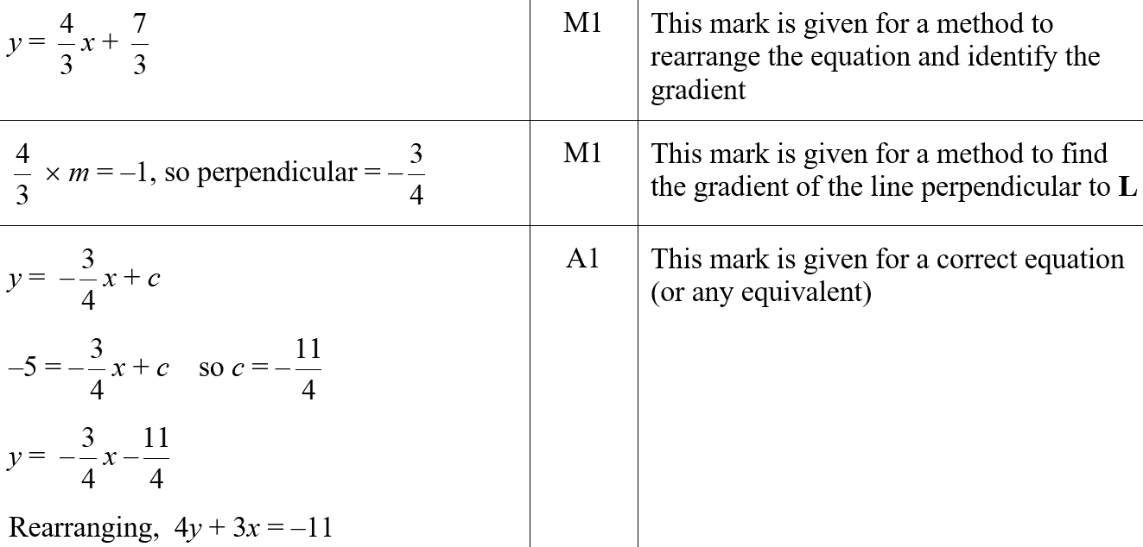
Algebra
Linear Graphs & Gradients
June 2019 2H Q16
A
A SF

Slide 86
Drawing and Using Graphs
Algebra
Drawing and Using Graphs
June 2017 2H Q14
Nov 2018 1H Q17
June 2017 2H Q20
Nov 2018 2H Q14
June 2017 3H Q20
SAM
3H Q17
Nov 2018 2H Q15
Nov 2017 1H Q7
Spec 1
1H Q16
Nov 2018 3H Q3
June 2018 2H Q5
June 2019 3H Q17
June 2018 2H Q12
June 2019 3H Q21
June 2018 2H Q16
Intercepts and roots
Circles
Recognising shapes of graphs
See also:
Graphical Transformations

Slide 87
Algebra
Drawing and Using Graphs
SAM 3H Q17

Slide 88
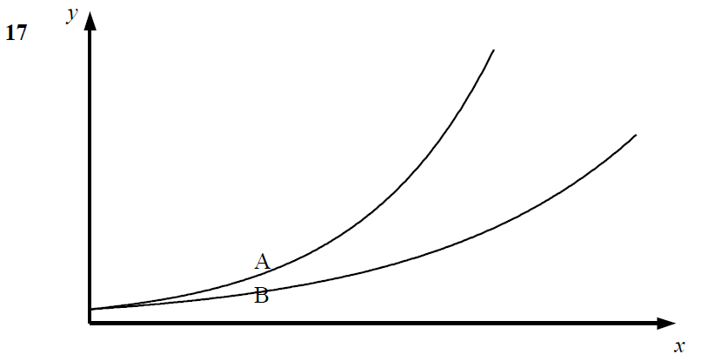
Algebra
Drawing and Using Graphs
SAM 3H Q17
A
B
C

Slide 89
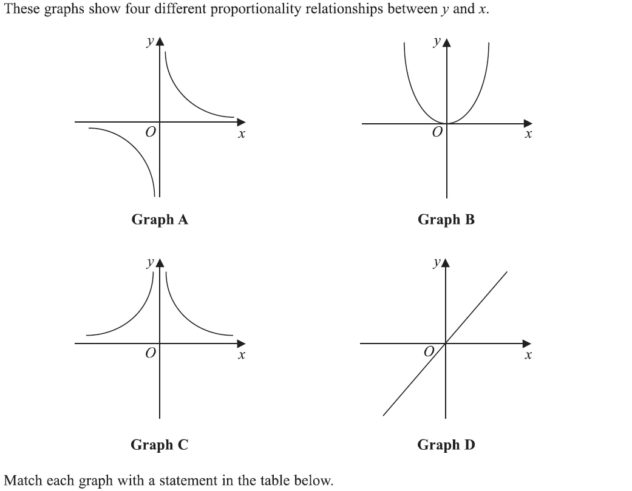
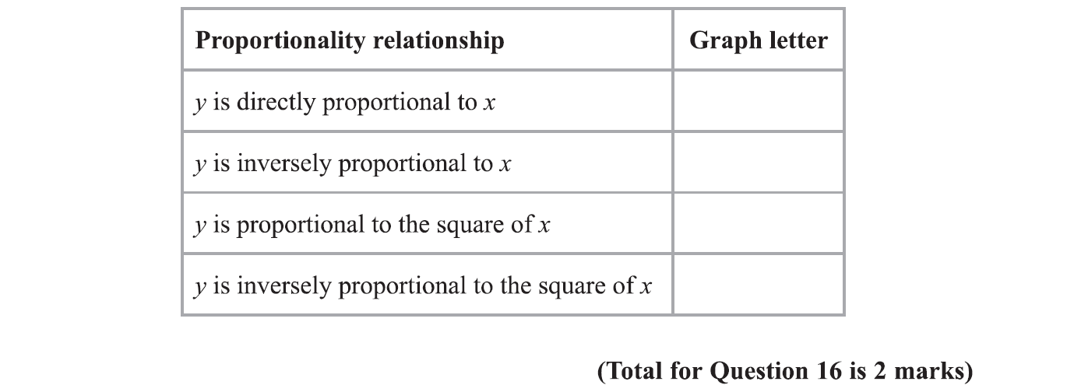
Algebra
Drawing and Using Graphs
Specimen Set 1 1H Q16

Slide 90
Algebra
Drawing and Using Graphs
Specimen Set 1 1H Q16
A

Slide 91
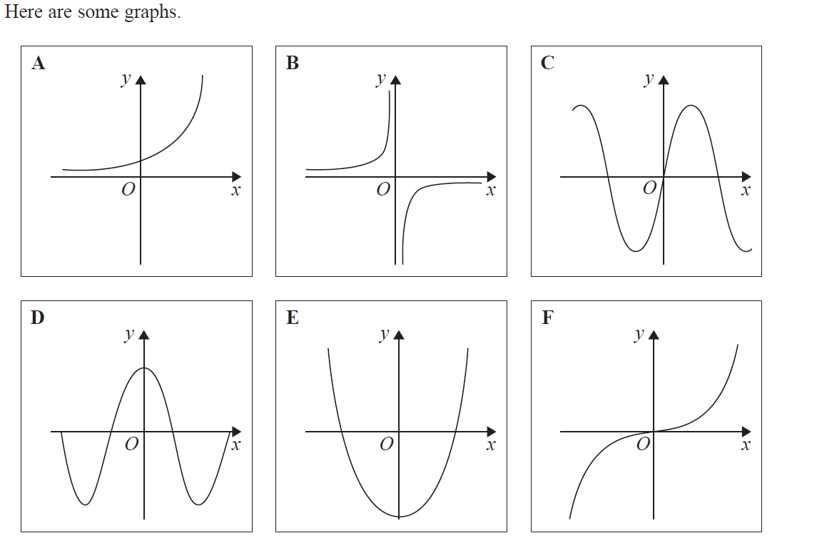
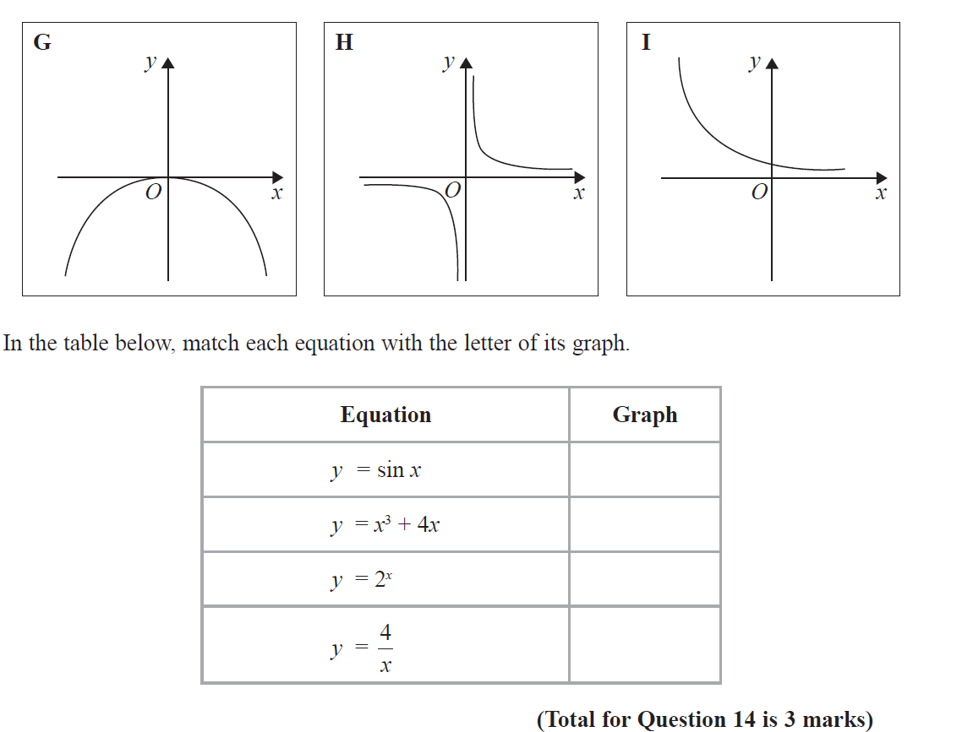
Algebra
Drawing and Using Graphs
June 2017 2H Q14

Slide 92
Algebra
Drawing and Using Graphs
June 2017 2H Q14
A

Slide 93
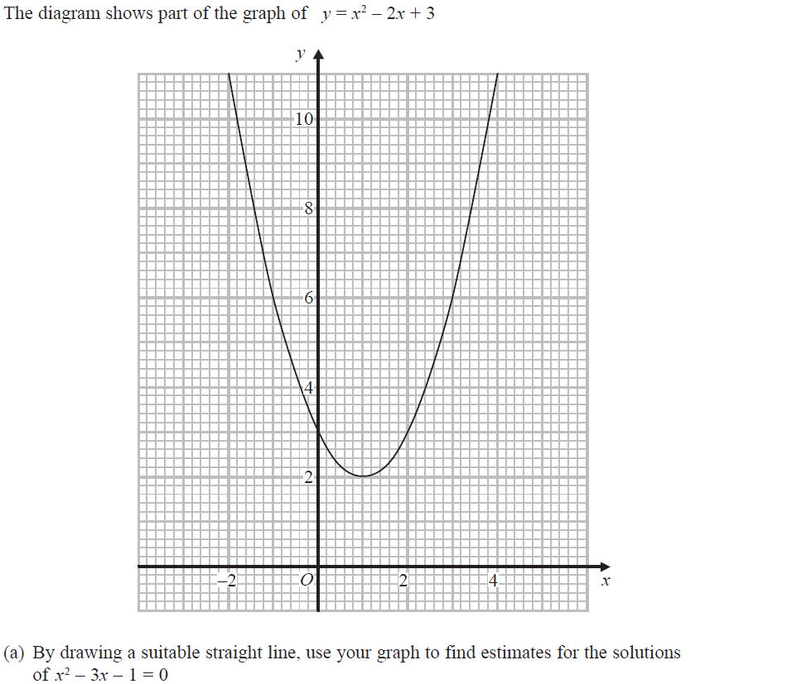
Algebra
Drawing and Using Graphs
June 2017 2H Q20
Reveal Line for (a)

Slide 94
Algebra
Drawing and Using Graphs
June 2017 2H Q20
A
B

Slide 95
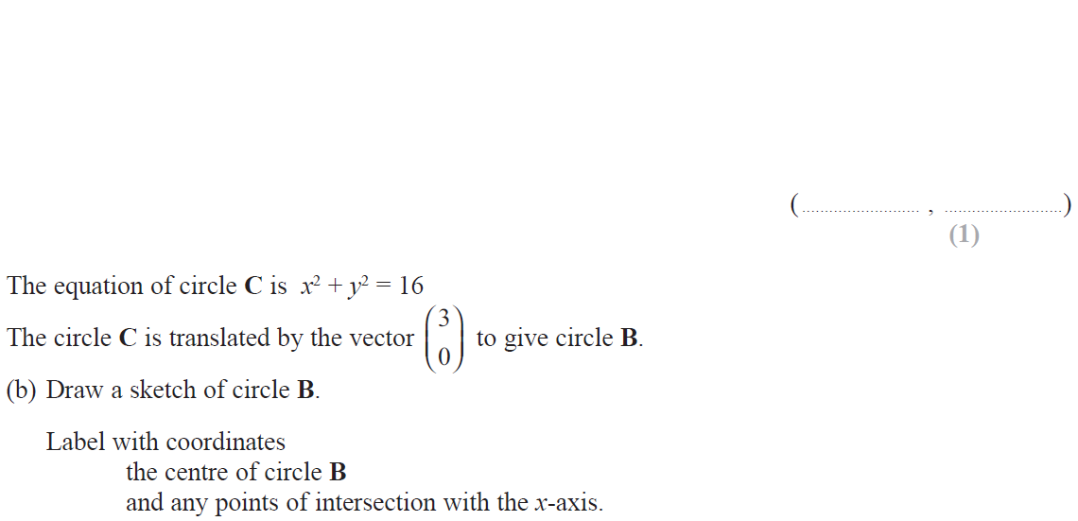
Algebra
Drawing and Using Graphs
June 2017 3H Q20

Slide 96
Algebra
Drawing and Using Graphs
June 2017 3H Q20
A
B

Slide 97
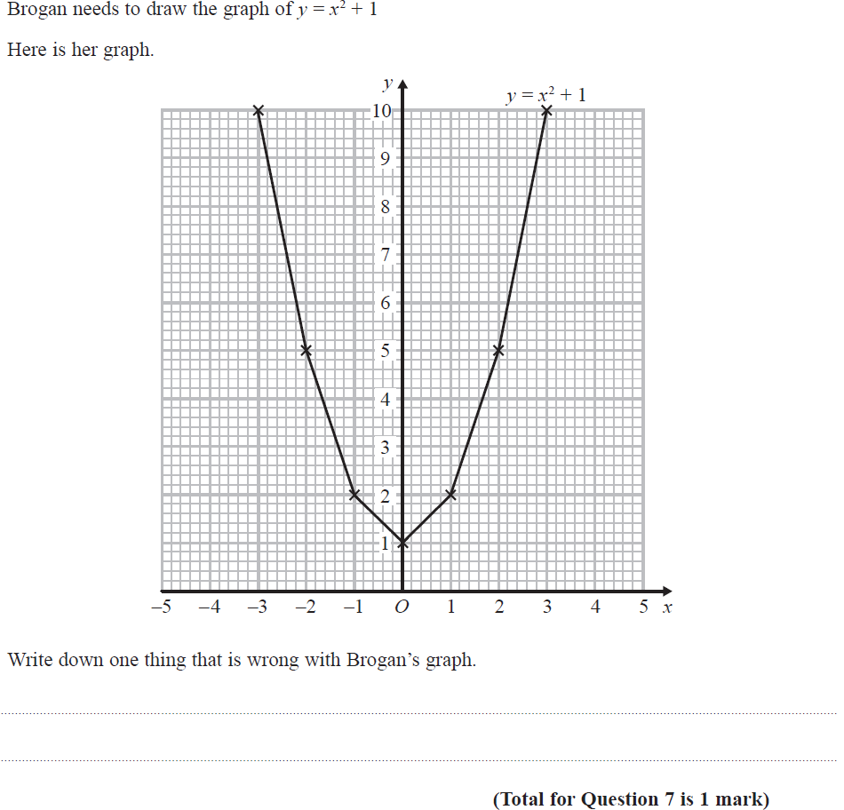
Algebra
Drawing and Using Graphs
Nov 2017 1H Q7

Slide 98
Algebra
Drawing and Using Graphs
Nov 2017 1H Q7
A

Slide 99
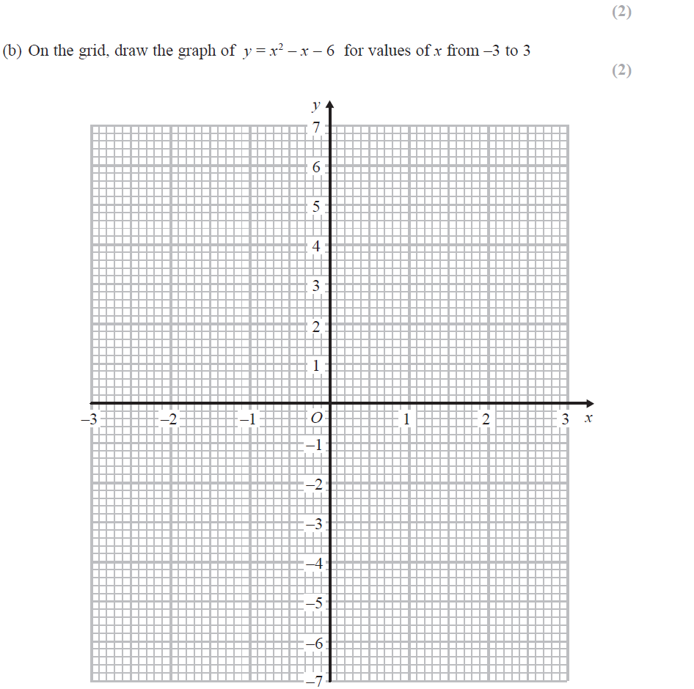
Algebra
Drawing and Using Graphs
June 2018 2H Q5
Reveal Line for (b)

Slide 100
Algebra
Drawing and Using Graphs
June 2018 2H Q5
A
B
C

Slide 101
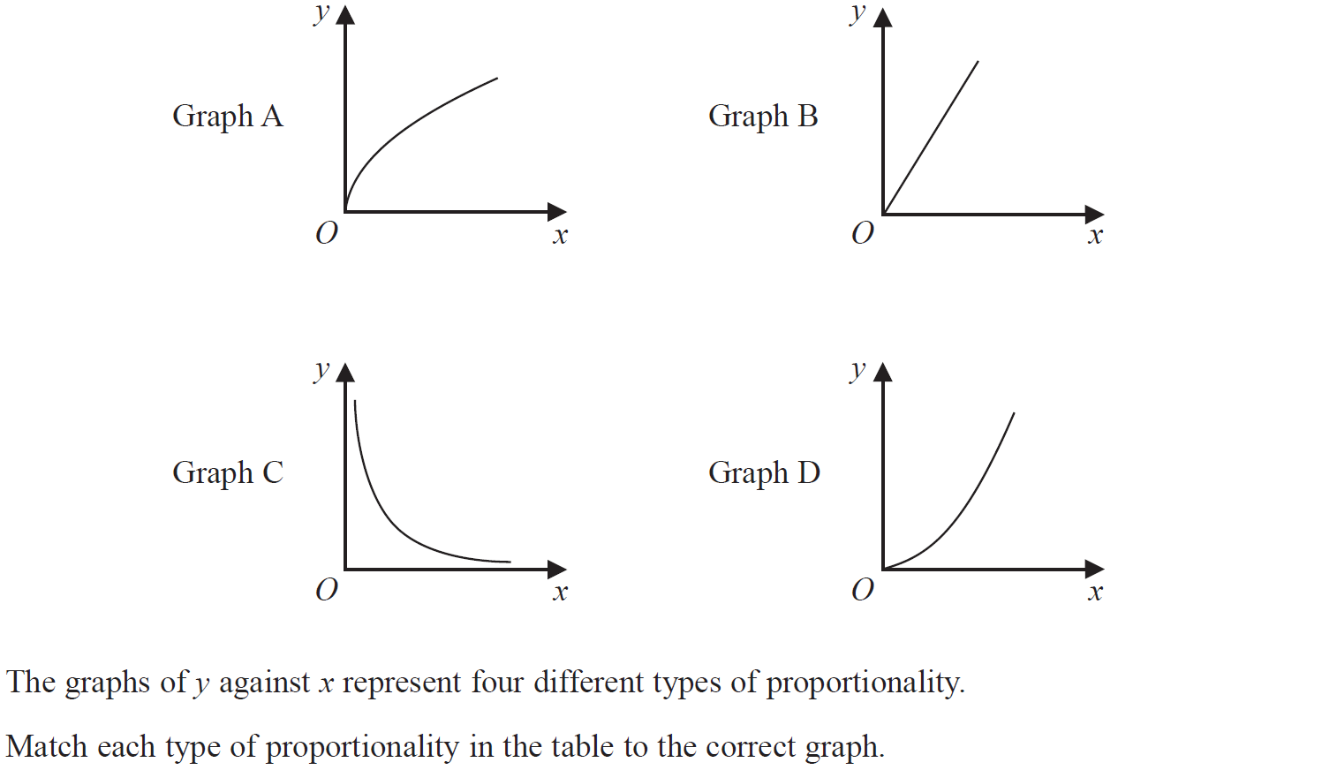
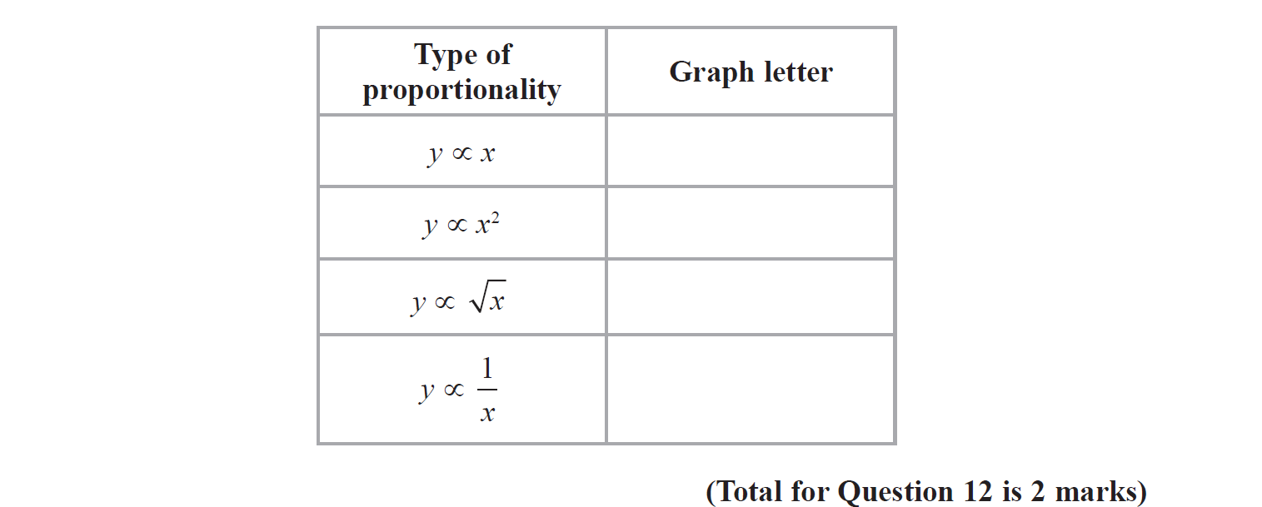
Algebra
Drawing and Using Graphs
June 2018 2H Q12

Slide 102
Algebra
Drawing and Using Graphs
June 2018 2H Q12
A

Slide 103
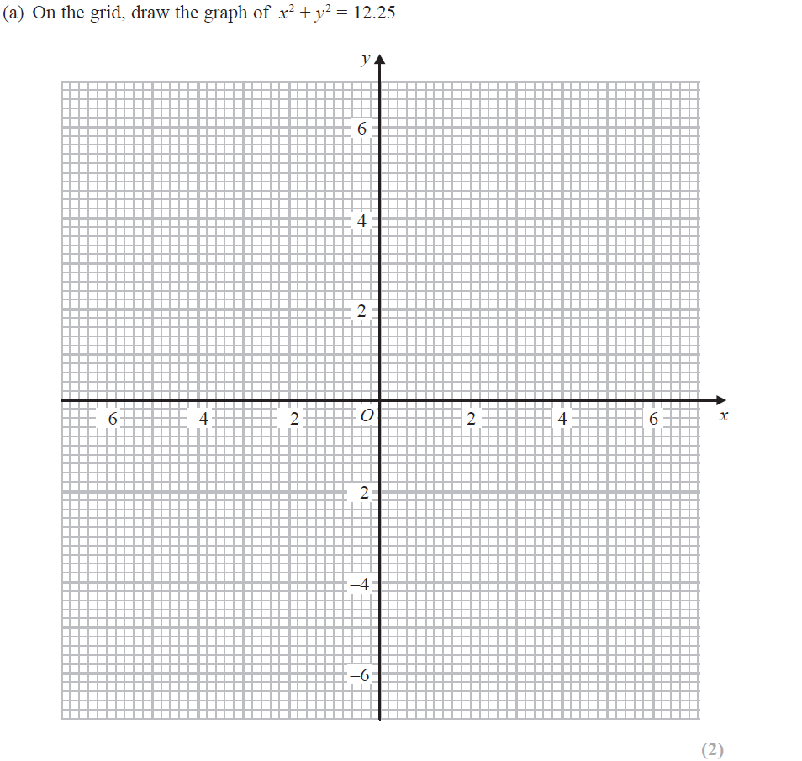
Algebra
Drawing and Using Graphs
June 2018 2H Q16
Reveal Line (a)
Reveal Line 2x+y=1

Slide 104
Algebra
Drawing and Using Graphs
June 2018 2H Q16
A
B

Slide 105
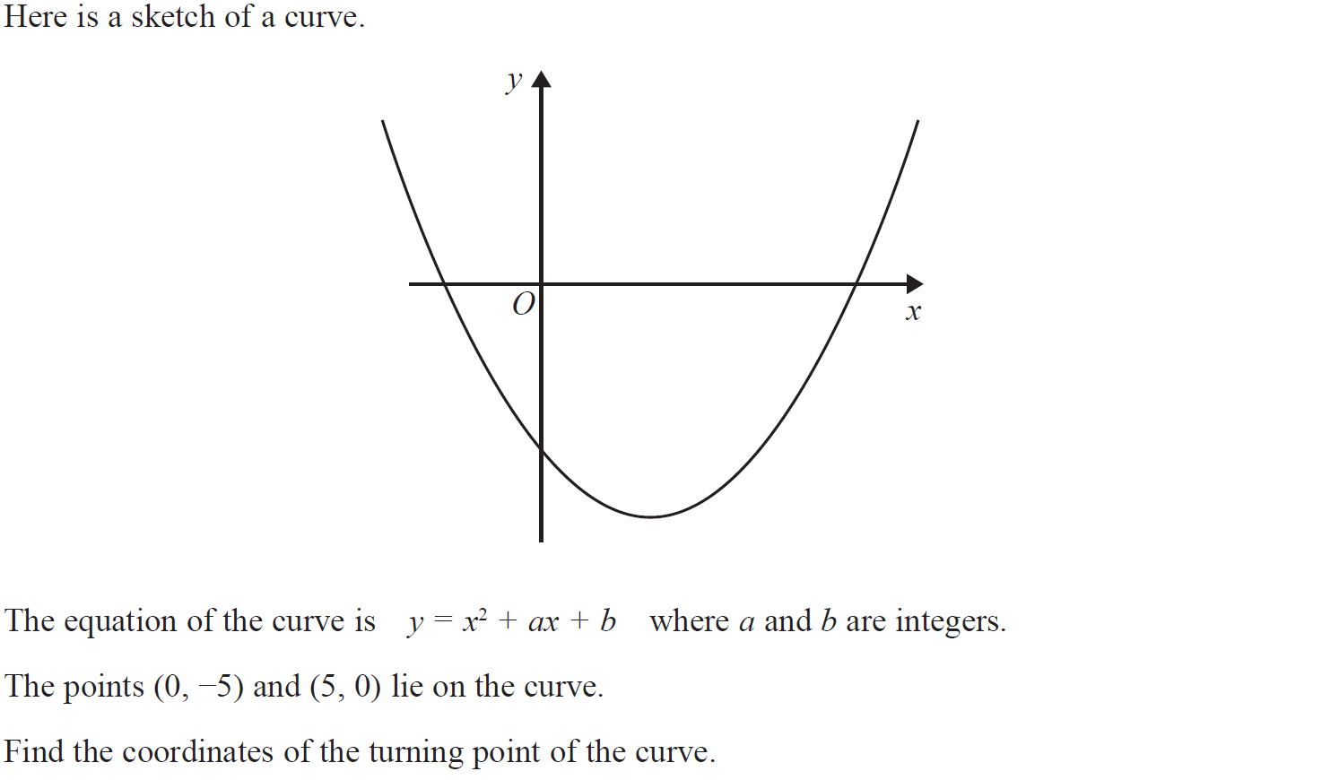
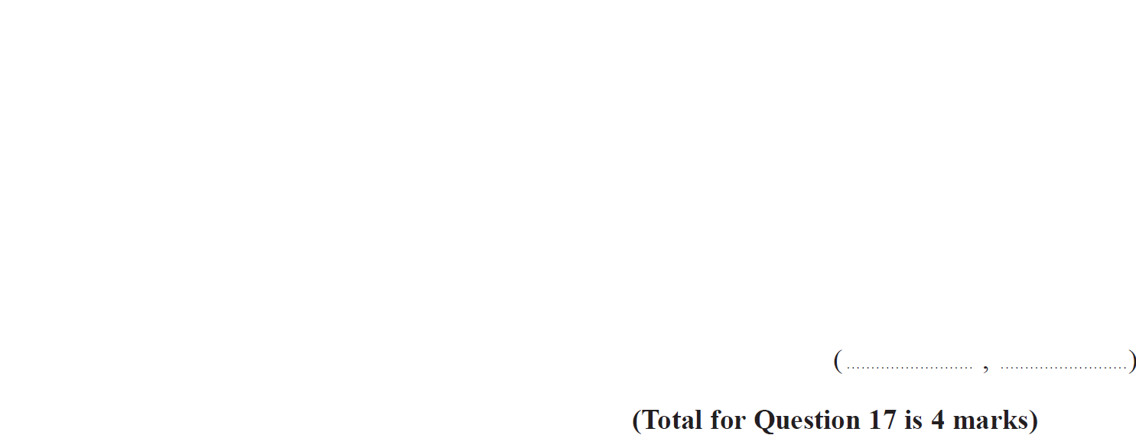
Algebra
Drawing and Using Graphs
Nov 2018 1H Q17

Slide 106
Algebra
Drawing and Using Graphs
Nov 2018 1H Q17
A

Slide 107
Algebra
Drawing and Using Graphs
Nov 2018 2H Q14
Reveal Line

Slide 108
Algebra
Drawing and Using Graphs
Nov 2018 2H Q14
A

Slide 109
Algebra
Drawing and Using Graphs
Nov 2018 2H Q15

Slide 110
Algebra
Drawing and Using Graphs
Nov 2018 2H Q15
A

Slide 111
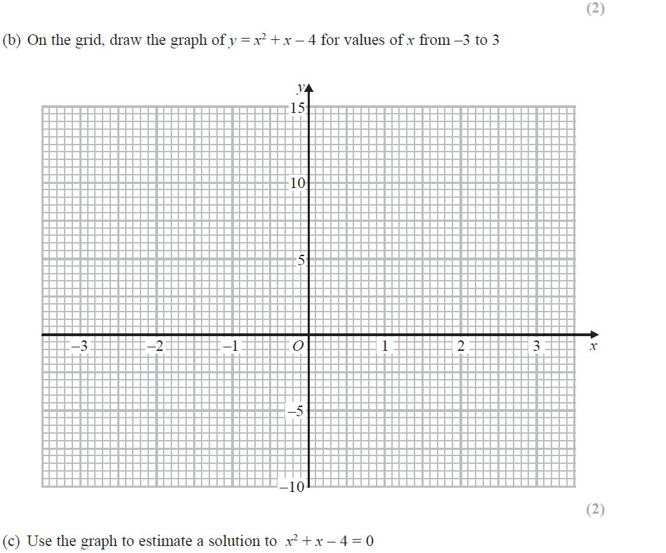
Algebra
Drawing and Using Graphs
Nov 2018 3H Q3
Reveal Graph (b)

Slide 112
Algebra
Drawing and Using Graphs
Nov 2018 3H Q3
A
B
C

Slide 113
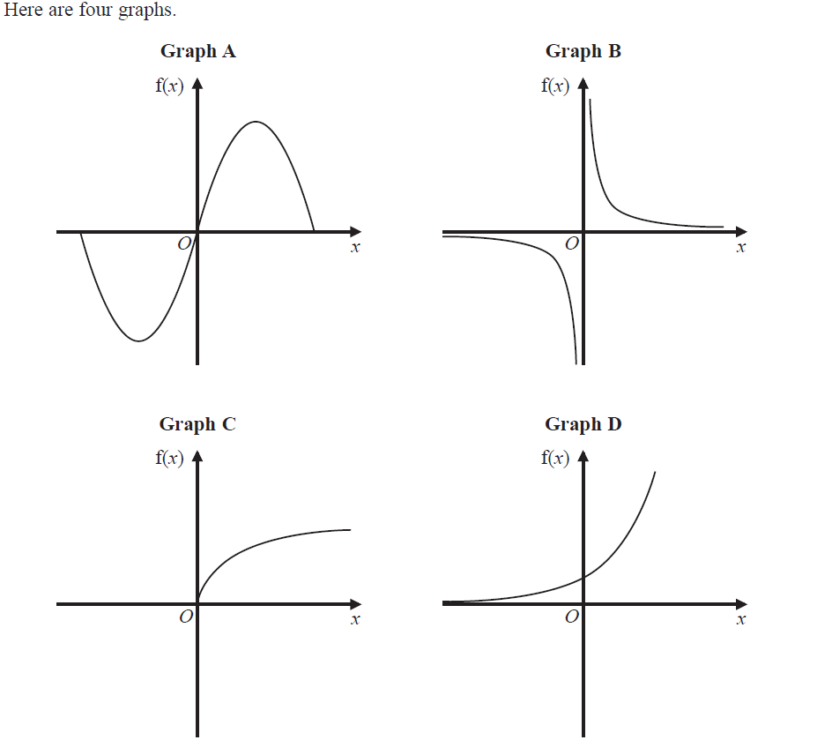
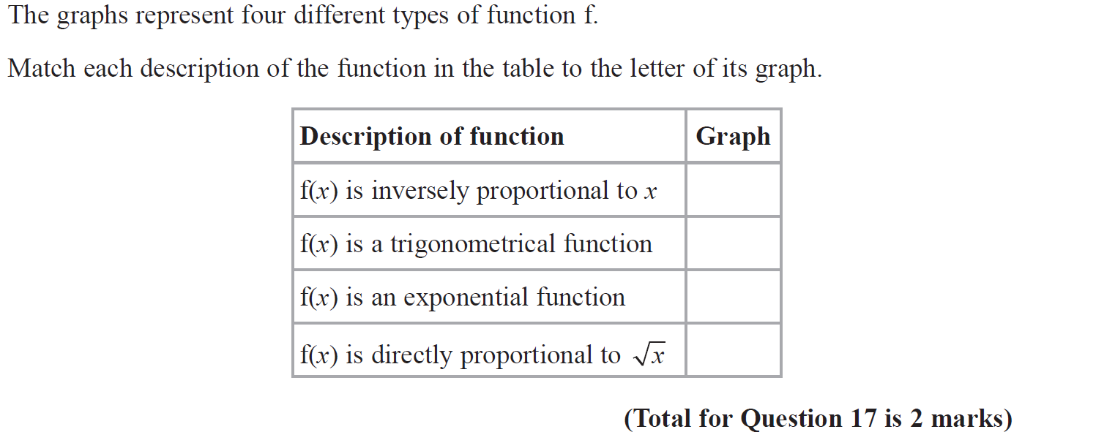
Algebra
Drawing and Using Graphs
June 2019 3H Q17

Slide 114
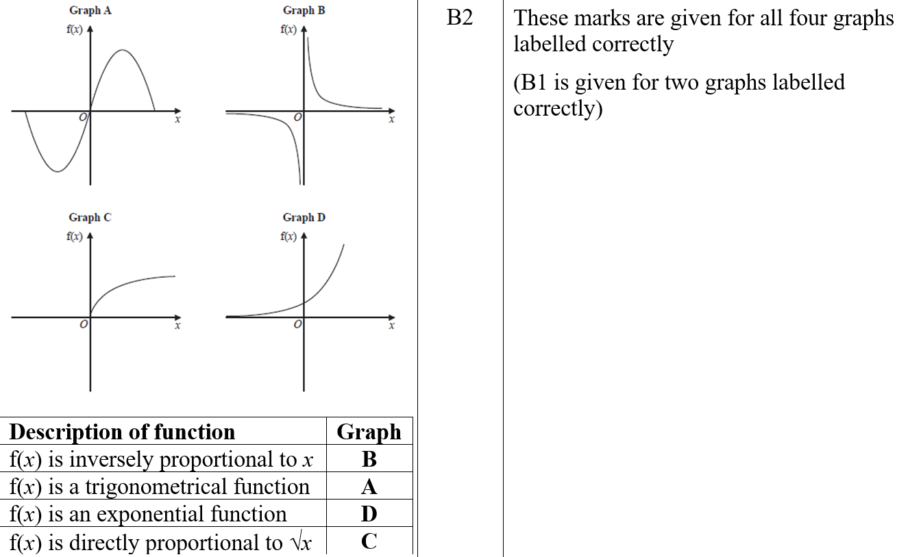
Algebra
Drawing and Using Graphs
June 2019 3H Q17
A
A SF

Slide 115
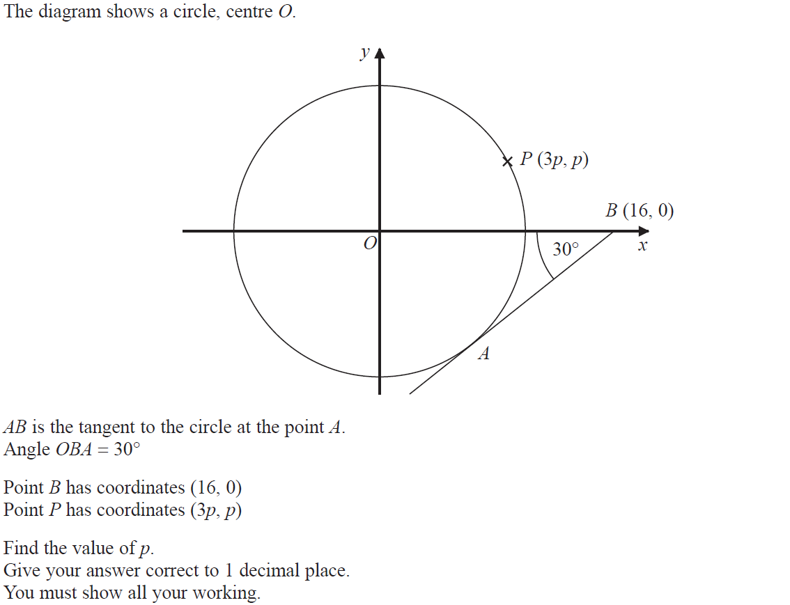
Algebra
Drawing and Using Graphs
June 2019 3H Q22

Slide 116
Algebra
Drawing and Using Graphs
June 2019 3H Q22
A
A SF

Slide 117
Substitution
Algebra
Substitution
Nov 2018 1H Q2
Sequences
Iterations
See also:
Upper & Lower Bounds
Direct & Inverse Proportion
Drawing & Using Graphs
Volume & Surface Area
Functions

Slide 118
Algebra
Substitution
Nov 2018 1H Q2

Slide 119
Algebra
Substitution
Nov 2018 1H Q2
A
B

Slide 120
Solving Simple Equations
Algebra
Solving Simple Equations
Spec 2
2H Q8
Nov 2017 2H Q1
June 2018 3H Q7
Linear Inequalities
Sequences
See also:
Forming Equations
Substitution
Algebraic Fractions

Slide 121
Algebra
Solving Simple Equations
Specimen Set 2 2H Q8

Slide 122
Algebra
Solving Simple Equations
Specimen Set 2 2H Q8
A
B

Slide 123
Algebra
Solving Simple Equations
Nov 2017 2H Q1

Slide 124
Algebra
Solving Simple Equations
Nov 2017 2H Q1
A

Slide 125
Algebra
Solving Simple Equations
June 2018 3H Q7

Slide 126
Algebra
Solving Simple Equations
June 2018 3H Q7
A

Slide 127
Graphical Transformations
Algebra
Graphical Transformations
June 2017 3H Q20
SAM
2H Q19
May 2018 1H Q18
Spec 1
3H Q16
Nov 2018 1H Q18
Spec 2
2H Q19
June 2019 3H Q15
See also:
Completing the Square

Slide 128
Algebra
Graphical Transformations
SAM 2H Q19
Reveal Graph (a)
Reveal Graph (b)

Slide 129
Algebra
Graphical Transformations
SAM 2H Q19
A
B
I think this should be (-2,3)

Slide 130
Algebra
Graphical Transformations
Specimen Set 1 3H Q16

Slide 131
Algebra
Graphical Transformations
Specimen Set 1 3H Q16
A

Slide 132
Algebra
Graphical Transformations
Specimen Set 2 2H Q19
Reveal Graph (i)
Reveal Graph (ii)

Slide 133
Algebra
Graphical Transformations
Specimen Set 2 2H Q19
A
B

Slide 134
Algebra
Graphical Transformations
June 2017 3H Q20

Slide 135
Algebra
Graphical Transformations
June 2017 3H Q20
A
B

Slide 136
Algebra
Graphical Transformations
May 2018 1H Q18
Reveal Graph

Slide 137
Algebra
Graphical Transformations
May 2018 1H Q18
A

Slide 138
Algebra
Graphical Transformations
Nov 2018 1H Q18
Reveal Graph (a)

Slide 139
Algebra
Graphical Transformations
Nov 2018 1H Q18
A
B

Slide 140
Algebra
Graphical Transformations
June 2019 3H Q15

Slide 141
Algebra
Graphical Transformations
June 2019 3H Q15
A
A SF

Slide 142
Linear Inequalities
Algebra
Linear Inequalities
June 2017
3H Q13
SAM
3H Q9
Nov 2017
2H Q14
Spec 1
3H Q10
May 2018
1H Q20
June 2019
2H Q2
Graphical

Slide 143
Algebra
Linear Inequalities
SAM 3H Q9

Slide 144
Algebra
Linear Inequalities
SAM 3H Q9
A
B
C

Slide 145
Algebra
Linear Inequalities
Specimen Set 1 3H Q10
Reverse regions:
Show
Hide
Show
Hide
Show
Hide
Show
Hide
Show
Hide
R

Slide 146
Algebra
Linear Inequalities
Specimen Set 1 3H Q10
A

Slide 147
Algebra
Linear Inequalities
June 2017 3H Q13

Slide 148
Algebra
Linear Inequalities
June 2017 3H Q13
A

Slide 149
Algebra
Linear Inequalities
Nov 2017 2H Q14
Reverse regions:
Show
Hide
Show
Hide
Show
Hide
Show
Hide
Show
Hide
R

Slide 150
Algebra
Linear Inequalities
Nov 2017 2H Q14
A

Slide 151
Algebra
Linear Inequalities
May 2018 1H Q20

Slide 152
Algebra
Linear Inequalities
May 2018 1H Q20
A

Slide 153
Algebra
Linear Inequalities
June 2019 2H Q2

Slide 154
Algebra
Linear Inequalities
June 2019 2H Q2
A
B
A SF
B SF

Slide 155
Sequences
Algebra
Sequences
SAM
2H Q3
June 2017 2H Q22
SAM
3H Q3
Nov 2017 2H Q23
SAM
3H Q17
June 2018 3H Q16
Spec 1
2H Q17
June 2019 3H Q16
Spec 1
3H Q22
Quadratic
Geometric

Slide 156
Algebra
Sequences
SAM 2H Q3

Slide 157
Algebra
Sequences
SAM 2H Q3
A
B

Slide 158
Algebra
Sequences
SAM 3H Q3

Slide 159
Algebra
Sequences
SAM 3H Q3
A
B
C

Slide 160
Algebra
Sequences
SAM 3H Q17

Slide 161
Algebra
Sequences
SAM 3H Q17
A
B
C

Slide 162
Algebra
Sequences
Specimen Set 1 2H Q17

Slide 163
Algebra
Sequences
Specimen Set 1 2H Q17
A

Slide 164
Algebra
Sequences
Specimen Set 1 3H Q22

Slide 165
Algebra
Sequences
Specimen Set 1 3H Q22
A

Slide 166
Algebra
Sequences
June 2017 2H Q22

Slide 167
Algebra
Sequences
June 2017 2H Q22
A

Slide 168
Algebra
Sequences
Nov 2017 2H Q23

Slide 169
Algebra
Sequences
Nov 2017 2H Q23
A
B

Slide 170
Algebra
Sequences
June 2018 3H Q16

Slide 171
Algebra
Sequences
June 2018 3H Q16
A
B

Slide 172
Algebra
Sequences
June 2019 3H Q16

Slide 173
Algebra
Sequences
June 2019 3H Q16
A
A SF

Slide 174
Iterations
Algebra
Iterations
SAM
3H Q3
June 2017 3H Q16
SAM
3H Q14
Nov 2017 2H Q18
Spec 1
2H Q21
Nov 2017 3H Q15
Spec 1
3H Q21
June 2018 3H Q18
Spec 2
2H Q13
Nov 2018 3H Q13
Context

Slide 175
Algebra
Iterations
SAM 3H Q3

Slide 176
Algebra
Iterations
SAM 3H Q3
A
B
C

Slide 177
Algebra
Iterations
SAM 3H Q14

Slide 178
Algebra
Iterations
SAM 3H Q14
A
B
C

Slide 179
Algebra
Iterations
Specimen Set 1 2H Q21

Slide 180
Algebra
Iterations
Specimen Set 1 2H Q21
A

Slide 181
Algebra
Iterations
Specimen Set 1 3H Q21

Slide 182
Algebra
Iterations
Specimen Set 1 3H Q21
A
B
C

Slide 183
Algebra
Iterations
Specimen Set 2 2H Q13

Slide 184
Algebra
Iterations
Specimen Set 2 2H Q13
A

Slide 185
Algebra
Iterations
June 2017 3H Q16

Slide 186
Algebra
Iterations
June 2017 3H Q16
A
B

Slide 187
Algebra
Iterations
Nov 2017 2H Q18

Slide 188
Algebra
Iterations
Nov 2017 2H Q18
A

Slide 189
Algebra
Iterations
Nov 2017 3H Q15

Slide 190
Algebra
Iterations
Nov 2017 3H Q15
A
B
C
D

Slide 191
Algebra
Iterations
June 2018 3H Q18

Slide 192
Algebra
Iterations
June 2018 3H Q18
A
B
C

Slide 193
Algebra
Iterations
Nov 2018 3H Q13

Slide 194
Algebra
Iterations
Nov 2018 3H Q13
A

Slide 195
Manipulating Formulae/ Changing the Subject
Algebra
Manipulating Formulae/ Changing the Subject
SAM
1H Q17
June 2017 3H Q14
Spec 1
1H Q13
Nov 2018 1H Q2
Spec 1
2H Q1
June 2019 2H Q15
Spec 2
3H Q3
Iterations
See also:
Volume & Surface Area
Forming Equations
Functions

Slide 196
Algebra
Manipulating Formulae/ Changing the Subject
SAM 1H Q17

Slide 197
Algebra
Manipulating Formulae/ Changing the Subject
SAM 1H Q17
A

Slide 198
Algebra
Manipulating Formulae/ Changing the Subject
Specimen Set 1 1H Q13

Slide 199
Algebra
Manipulating Formulae/ Changing the Subject
Specimen Set 1 1H Q13
A

Slide 200
Algebra
Manipulating Formulae/ Changing the Subject
Specimen Set 1 2H Q1

Slide 201
Algebra
Manipulating Formulae/ Changing the Subject
Specimen Set 1 2H Q1
A

Slide 202
Algebra
Manipulating Formulae/ Changing the Subject
Specimen Set 2 3H Q3

Slide 203
Algebra
Manipulating Formulae/ Changing the Subject
Specimen Set 2 3H Q3
A

Slide 204
Algebra
Manipulating Formulae/ Changing the Subject
June 2017 3H Q14

Slide 205
Algebra
Manipulating Formulae/ Changing the Subject
June 2017 3H Q14
A
B

Slide 206
Algebra
Manipulating Formulae/ Changing the Subject
Nov 2018 1H Q2

Slide 207
Algebra
Manipulating Formulae/ Changing the Subject
Nov 2018 1H Q2
A
B

Slide 208
Algebra
Manipulating Formulae/ Changing the Subject
June 2019 2H Q15

Slide 209
Algebra
Manipulating Formulae/ Changing the Subject
June 2019 2H Q15
A
A SF

Slide 210
Forming Equations
Algebra
Forming Equations
SAM
1H Q8
Spec 1
2H Q19
May 2017 1H Q4
SAM
2H Q9
Nov 2017 1H Q23
Spec 2
1H Q9
Nov 2017 1H Q2
SAM
3H Q3
Nov 2017 3H Q6
Spec 2
1H Q11
Nov 2017 1H Q6
Spec 1
1H Q1
June 2018 3H Q19
Spec 2
3H Q7
Nov 2017 1H Q11
Spec 1
1H Q4
See also:
Show that…
Direct & Inverse Proportion
Sequences

Slide 211
Algebra
Forming Equations
SAM 1H Q8

Slide 212
Algebra
Forming Equations
SAM 1H Q8
A

Slide 213
Algebra
Forming Equations
SAM 2H Q9

Slide 214
Algebra
Forming Equations
SAM 2H Q9
A

Slide 215
Algebra
Forming Equations
SAM 3H Q3

Slide 216
Algebra
Forming Equations
SAM 3H Q3
A
B
C

Slide 217
Algebra
Forming Equations
Specimen Set 1 1H Q1

Slide 218
Algebra
Forming Equations
Specimen Set 1 1H Q1
A

Slide 219
Algebra
Forming Equations
Specimen Set 1 1H Q4

Slide 220
Algebra
Forming Equations
Specimen Set 1 1H Q4
A

Slide 221
Algebra
Forming Equations
Specimen Set 1 2H Q19

Slide 222
Algebra
Forming Equations
Specimen Set 1 2H Q19
A

Slide 223
Algebra
Forming Equations
Specimen Set 2 1H Q9

Slide 224
Algebra
Forming Equations
Specimen Set 2 1H Q9
A

Slide 225
Algebra
Forming Equations
Specimen Set 2 1H Q11

Slide 226
Algebra
Forming Equations
Specimen Set 2 1H Q11
A

Slide 227
Algebra
Forming Equations
Specimen Set 2 3H Q7

Slide 228
Algebra
Forming Equations
Specimen Set 2 3H Q7
A

Slide 229
Algebra
Forming Equations
May 2017 1H Q4

Slide 230
Algebra
Forming Equations
May 2017 1H Q4
A

Slide 231
Algebra
Forming Equations
Nov 2017 1H Q2

Slide 232
Algebra
Forming Equations
Nov 2017 1H Q2
A

Slide 233
Algebra
Forming Equations
Nov 2017 1H Q6

Slide 234
Algebra
Forming Equations
Nov 2017 1H Q6
A

Slide 235
Algebra
Forming Equations
Nov 2017 1H Q11

Slide 236
Algebra
Forming Equations
Nov 2017 1H Q11
A

Slide 237
Algebra
Forming Equations
Nov 2017 1H Q23

Slide 238
Algebra
Forming Equations
Nov 2017 1H Q23
A

Slide 239
Algebra
Forming Equations
Nov 2017 3H Q6

Slide 240
Algebra
Forming Equations
Nov 2017 3H Q6
A

Slide 241
Algebra
Forming Equations
June 2018 3H Q19

Slide 242
Algebra
Forming Equations
June 2018 3H Q19
A

Slide 243
Completing the Square
Algebra
Completing the Square
Spec 1
3H Q11
Nov 2017 3H Q13
Spec 2
3H Q22
May 2019 1H Q19
Transforming Quadratics
See also:
Functions

Slide 244
Algebra
Completing the Square
Specimen Set 1 3H Q11

Slide 245
Algebra
Completing the Square
Specimen Set 1 3H Q11
A

Slide 246
Algebra
Completing the Square
Specimen Set 2 3H Q22

Slide 247
Algebra
Completing the Square
Specimen Set 2 3H Q22
A
B

Slide 248
Algebra
Completing the Square
Nov 2017 3H Q13

Slide 249
Algebra
Completing the Square
Nov 2017 3H Q13
A

Slide 250
Algebra
Completing the Square
May 2019 1H Q19

Slide 251
Algebra
Completing the Square
May 2019 1H Q19
(i)
(ii)
(i) SF
(ii) SF

Slide 252
Simultaneous Equations
Algebra
Simultaneous Equations
May 2017
1H Q20
Nov 2018
1H Q17
SAM
2H Q20
June 2017
3H Q2
Nov 2018
2H Q18
Spec 1
1H Q4
Nov 2017
1H Q11
Nov 2018
2H Q19
Spec 2
3H Q11
Nov 2017
3H Q19
May 2019
1H Q10
Nov 2018
1H Q6
June 2019
3H Q20
Quadratic
Graphical

Slide 253
Algebra
Simultaneous Equations
SAM 2H Q20

Slide 254
Algebra
Simultaneous Equations
SAM 2H Q20
A

Slide 255
Algebra
Simultaneous Equations
Specimen Set 1 1H Q4

Slide 256
Algebra
Simultaneous Equations
Specimen Set 1 1H Q4
A

Slide 257
Algebra
Simultaneous Equations
Specimen Set 2 3H Q11

Slide 258
Algebra
Simultaneous Equations
Specimen Set 2 3H Q11
A

Slide 259
Algebra
Simultaneous Equations
May 2017 1H Q20

Slide 260
Algebra
Simultaneous Equations
May 2017 1H Q20
A

Slide 261
Algebra
Simultaneous Equations
June 2017 3H Q2

Slide 262
Algebra
Simultaneous Equations
June 2017 3H Q2
A

Slide 263
Algebra
Simultaneous Equations
Nov 2017 1H Q11

Slide 264
Algebra
Simultaneous Equations
Nov 2017 1H Q11
A

Slide 265
Algebra
Simultaneous Equations
Nov 2017 3H Q19

Slide 266
Algebra
Simultaneous Equations
Nov 2017 3H Q19
A

Slide 267
Algebra
Simultaneous Equations
Nov 2018 1H Q6

Slide 268
Algebra
Simultaneous Equations
Nov 2018 1H Q6
A

Slide 269
Algebra
Simultaneous Equations
Nov 2018 1H Q17

Slide 270
Algebra
Simultaneous Equations
Nov 2018 1H Q17
A

Slide 271
Algebra
Simultaneous Equations
Nov 2018 2H Q18

Slide 272
Algebra
Simultaneous Equations
Nov 2018 2H Q18
A

Slide 273
Algebra
Simultaneous Equations
Nov 2018 3H Q19

Slide 274
Algebra
Simultaneous Equations
Nov 2018 3H Q19
A

Slide 275
Algebra
Simultaneous Equations
May 2019 1H Q10

Slide 276
Algebra
Simultaneous Equations
May 2019 1H Q10
A
A SF

Slide 277
Algebra
Simultaneous Equations
June 2019 3H Q20

Slide 278
Algebra
Simultaneous Equations
June 2019 3H Q20
A

Slide 279
Algebra
Simultaneous Equations
June 2019 3H Q20
A SF

Slide 280
Algebra
Simultaneous Equations
June 2019 3H Q20
A SF

Slide 281
Solving Quadratics
Algebra
Solving Quadratics
Nov 2017
2H Q16
SAM
3H Q11
June 2018
3H Q19
Spec 2
1H Q17
Nov 2018
1H Q22
Spec 2
2H Q21
Nov 2018
3H Q9
Spec 2
3H Q21
May 2019
1H Q17
Completing the Square
See also:
Simultaneous Equations
Quadratic Inequalities

Slide 282
Algebra
Solving Quadratics
SAM 3H Q11

Slide 283
Algebra
Solving Quadratics
SAM 3H Q11
A

Slide 284
Algebra
Solving Quadratics
Specimen Set 2 1H Q17

Slide 285
Algebra
Solving Quadratics
Specimen Set 2 1H Q17
A

Slide 286
Algebra
Solving Quadratics
Specimen Set 2 2H Q21

Slide 287
Algebra
Solving Quadratics
Specimen Set 2 2H Q21
A

Slide 288
Algebra
Solving Quadratics
Specimen Set 2 3H Q21

Slide 289
Algebra
Solving Quadratics
Specimen Set 2 3H Q21
A
B

Slide 290
Algebra
Solving Quadratics
Nov 2017 2H Q16

Slide 291
Algebra
Solving Quadratics
Nov 2017 2H Q16
A

Slide 292
Algebra
Solving Quadratics
June 2018 3H Q19

Slide 293
Algebra
Solving Quadratics
June 2018 3H Q19
A

Slide 294
Algebra
Solving Quadratics
Nov 2018 1H Q22

Slide 295
Algebra
Solving Quadratics
Nov 2018 1H Q22
A

Slide 296
Algebra
Solving Quadratics
Nov 2018 3H Q9

Slide 297
Algebra
Solving Quadratics
Nov 2018 3H Q9
A
B
C

Slide 298
Algebra
Solving Quadratics
May 2019 1H Q17

Slide 299
Algebra
Solving Quadratics
May 2019 1H Q17
A
A SF

Slide 300
Quadratic Inequalities
Algebra
Quadratic Inequalities
June 2017
3H Q19
Nov 2017
1H Q23
SAM
1H Q19
May 2018
1H Q20
Spec 2
1H Q21
Nov 2018
2H Q19
June 2019
3H Q18

Slide 301
Algebra
Quadratic Inequalities
SAM 1H Q19

Slide 302
Algebra
Quadratic Inequalities
SAM 1H Q19
A

Slide 303
Algebra
Quadratic Inequalities
Specimen Set 2 1H Q21

Slide 304
Algebra
Quadratic Inequalities
Specimen Set 2 1H Q21
A

Slide 305
Algebra
Quadratic Inequalities
June 2017 3H Q19

Slide 306
Algebra
Quadratic Inequalities
June 2017 3H Q19
A

Slide 307
Algebra
Quadratic Inequalities
Nov 2017 1H Q23

Slide 308
Algebra
Quadratic Inequalities
Nov 2017 1H Q23
A

Slide 309
Algebra
Quadratic Inequalities
May 2018 1H Q20

Slide 310
Algebra
Quadratic Inequalities
May 2018 1H Q20
A

Slide 311
Algebra
Quadratic Inequalities
Nov 2018 2H Q19

Slide 312
Algebra
Quadratic Inequalities
Nov 2018 2H Q19
A

Slide 313
Algebra
Quadratic Inequalities
June 2019 3H Q18

Slide 314
Algebra
Quadratic Inequalities
June 2019 3H Q18
A
B
A SF
B SF

Slide 315
Factorising
Algebra
Factorising
SAM
1H Q16
SAM
3H Q9
May 2018 1H Q15
Spec 1
3H Q6
Nov 2018 1H Q10
Spec 2
1H Q1
See also:
Algebraic Fractions
Solving Quadratics

Slide 316
Algebra
Factorising
SAM 1H Q16

Slide 317
Algebra
Factorising
SAM 1H Q16
A

Slide 318
Algebra
Factorising
SAM 3H Q9

Slide 319
Algebra
Factorising
SAM 3H Q9
A
B
C

Slide 320
Algebra
Factorising
Specimen Set 1 3H Q6

Slide 321
Algebra
Factorising
Specimen Set 1 3H Q6
A

Slide 322
Algebra
Factorising
Specimen Set 2 1H Q1

Slide 323
Algebra
Factorising
Specimen Set 2 1H Q1
A
B
C

Slide 324
Algebra
Factorising
May 2018 1H Q15

Slide 325
Algebra
Factorising
May 2018 1H Q15
A
B

Slide 326
Algebra
Factorising
Nov 2018 1H Q10

Slide 327
Algebra
Factorising
Nov 2018 1H Q10
A
B

Slide 328
Expanding Brackets
Algebra
Expanding Brackets
May 2017
1H Q4
SAM
1H Q2
May 2017
1H Q10
Spec 1
2H Q13
Nov 2017
1H Q23
Spec 1
2H Q18
June 2018
3H Q2
Spec 2
2H Q3
Nov 2018
3H Q9
June 2019
3H Q18
Triple Brackets
See also:
Surds
Solving Simple Equations

Slide 329
Algebra
Expanding Brackets
SAM 1H Q2

Slide 330
Algebra
Expanding Brackets
SAM 1H Q2
A

Slide 331
Algebra
Expanding Brackets
Specimen Set 1 2H Q13

Slide 332
Algebra
Expanding Brackets
Specimen Set 1 2H Q13
A

Slide 333
Algebra
Expanding Brackets
Specimen Set 1 2H Q18

Slide 334
Algebra
Expanding Brackets
Specimen Set 1 2H Q18
A

Slide 335
Algebra
Expanding Brackets
Specimen Set 2 2H Q3

Slide 336
Algebra
Expanding Brackets
Specimen Set 2 2H Q3
A
B

Slide 337
Algebra
Expanding Brackets
May 2017 1H Q4

Slide 338
Algebra
Expanding Brackets
Nov 2017 1H Q23
A

Slide 339
Algebra
Expanding Brackets
May 2017 1H Q10

Slide 340
Algebra
Expanding Brackets
May 2017 1H Q10
A

Slide 341
Algebra
Expanding Brackets
Nov 2017 1H Q23

Slide 342
Algebra
Forming Equations
Nov 2017 1H Q23
A

Slide 343
Algebra
Expanding Brackets
June 2018 3H Q2

Slide 344
Algebra
Expanding Brackets
June 2018 3H Q2
A

Slide 345
Algebra
Expanding Brackets
Nov 2018 3H Q9

Slide 346
Algebra
Expanding Brackets
Nov 2018 3H Q9
A
B
C

Slide 347
Algebra
Expanding Brackets
June 2019 3H Q18

Slide 348
Algebra
Expanding Brackets
June 2019 3H Q18
A
B
A SF
B SF

Slide 349
Algebraic Fractions
Algebra
Algebraic Fractions
SAM
2H Q16
June 2017
2H Q11
Nov 2018
1H Q10
Spec 2
1H Q20
Spec 1
1H Q14
June 2017
2H Q19
Nov 2018
2H Q12
Spec 2
2H Q21
Spec 1
1H Q15
June 2017
3H Q14
May 2019
1H Q17
Spec 2
3H Q15
Spec 1
3H Q14
May 2018
1H Q17
June 2019
2H Q13
See also:
Multiple Events

Slide 350
Algebra
Algebraic Fractions
SAM 2H Q16

Slide 351
Algebra
Algebraic Fractions
SAM 2H Q16
A

Slide 352
Algebra
Algebraic Fractions
Specimen Set 1 1H Q14

Slide 353
Algebra
Algebraic Fractions
Specimen Set 1 1H Q14
A

Slide 354
Algebra
Algebraic Fractions
Specimen Set 1 1H Q15

Slide 355
Algebra
Algebraic Fractions
Specimen Set 1 1H Q15
A

Slide 356
Algebra
Algebraic Fractions
Specimen Set 1 3H Q14

Slide 357
Algebra
Algebraic Fractions
Specimen Set 1 3H Q14
A

Slide 358
Algebra
Algebraic Fractions
Specimen Set 2 1H Q20

Slide 359
Algebra
Algebraic Fractions
Specimen Set 2 1H Q20
A

Slide 360
Algebra
Algebraic Fractions
Specimen Set 2 2H Q21

Slide 361
Algebra
Algebraic Fractions
Specimen Set 2 2H Q21
A

Slide 362
Algebra
Algebraic Fractions
Specimen Set 2 3H Q15

Slide 363
Algebra
Algebraic Fractions
Specimen Set 2 3H Q15
A

Slide 364
Algebra
Algebraic Fractions
June 2017 2H Q11

Slide 365
Algebra
Algebraic Fractions
June 2017 2H Q11
A

Slide 366
Algebra
Algebraic Fractions
June 2017 2H Q19

Slide 367
Algebra
Algebraic Fractions
June 2017 2H Q19
A

Slide 368
Algebra
Algebraic Fractions
June 2017 3H Q14

Slide 369
Algebra
Algebraic Fractions
June 2017 3H Q14
A
B

Slide 370
Algebra
Algebraic Fractions
May 2018 1H Q17

Slide 371
Algebra
Algebraic Fractions
May 2018 1H Q17
A

Slide 372
Algebra
Algebraic Fractions
Nov 2018 1H Q10

Slide 373
Algebra
Algebraic Fractions
Nov 2018 1H Q10
A
B

Slide 374
Algebra
Algebraic Fractions
Nov 2018 2H Q12

Slide 375
Algebra
Algebraic Fractions
Nov 2018 2H Q12
A
B

Slide 376
Algebra
Algebraic Fractions
May 2019 1H Q17

Slide 377
Algebra
Algebraic Fractions
May 2019 1H Q17
A
A SF

Slide 378
Algebra
Algebraic Fractions
June 2019 2H Q13

Slide 379
Algebra
Algebraic Fractions
June 2019 2H Q13
A
A SF

Slide 380
Functions
Algebra
Functions
May 2017
1H Q11*
SAM
2H Q7*
Nov 2017
2H Q22
SAM
3H Q10
June 2018
2H Q11
Spec 1
2H Q18
Nov 2018
1H Q19
Spec 2
2H Q9
Nov 2018
3H Q10
May 2019
1H Q21
With graphs
*mainly graphs

Slide 381
Algebra
Functions
SAM 2H Q7

Slide 382
Algebra
Functions
SAM 2H Q7
A
B
C

Slide 383
Algebra
Functions
SAM 3H Q10

Slide 384
Algebra
Functions
SAM 3H Q10
A
B

Slide 385
Algebra
Functions
Specimen Set 1 2H Q18

Slide 386
Algebra
Functions
Specimen Set 1 2H Q18
A

Slide 387
Algebra
Functions
Specimen Set 2 2H Q9

Slide 388
Algebra
Functions
Specimen Set 2 2H Q9
A
B
C

Slide 389
Algebra
Functions
May 2017 1H Q11

Slide 390
Algebra
Functions
May 2017 1H Q11
A
B
C

Slide 391
Algebra
Functions
Nov 2017 2H Q22

Slide 392
Algebra
Functions
Nov 2017 2H Q22
A

Slide 393
Algebra
Functions
June 2018 2H Q11

Slide 394
Algebra
Functions
June 2018 2H Q11
A
B

Slide 395
Algebra
Functions
Nov 2018 1H Q19

Slide 396
Algebra
Functions
Nov 2018 1H Q19
A
B

Slide 397
Algebra
Functions
Nov 2018 3H Q10

Slide 398
Algebra
Functions
Nov 2018 3H Q10
A
B
C

Slide 399
Algebra
Functions
May 2019 1H Q21

Slide 400
Algebra
Functions
May 2019 1H Q21
A
B
A SF
B SF

Slide 401
Show that…/ Proof
Show that…/ Proof
(algebraic)
SAM
1H Q18
Spec 1
2H Q13
May 2017
1H Q4
Nov 2017
1H Q3
Nov 2017
3H Q19
Nov 2018
3H Q14
SAM
2H Q14
Spec 1
3H Q22
May 2017
1H Q6
Nov 2017
1H Q6
May 2018
1H Q12
Nov 2018
3H Q15
SAM
2H Q16
Spec 2
1H Q9
May 2017
1H Q10
Nov 2017
1H Q14
June 2018
2H Q13
May 2019
1H Q13
SAM
3H Q3
Spec 2
1H Q20
May 2017
1H Q16
Nov 2017
1H Q17
Nov 2018
1H Q7
May 2019
1H Q21
Spec 1
1H Q15
Spec 2
3H Q7
May 2017
1H Q22
Nov 2017
3H Q11
Nov 2018
2H Q11
June 2019
3H Q18
Spec 1
1H Q20
Spec 2
3H Q17
June 2017
3H Q5
Nov 2017
3H Q14
Nov 2018
3H Q4
Proof of algebraic properties
Circle Theorems
Vectors
Iterations
Similar Shapes
Proof
see also:
Recurring Decimals
Fractions
Surds

Slide 402
Show that…/ Proof
SAM 1H Q18

Slide 403
Show that…/ Proof
SAM 1H Q18
A

Slide 404
Show that…/ Proof
SAM 2H Q14

Slide 405
Show that…/ Proof
SAM 2H Q14
A

Slide 406
Show that…/ Proof
SAM 2H Q16

Slide 407
Show that…/ Proof
SAM 2H Q16
A

Slide 408
Show that…/ Proof
SAM 3H Q3

Slide 409
Show that…/ Proof
SAM 3H Q3
A
B
c

Slide 410
Show that…/ Proof
Specimen Set 1 1H Q15

Slide 411
Show that…/ Proof
Specimen Set 1 1H Q15
A

Slide 412
Show that…/ Proof
Specimen Set 1 1H Q20

Slide 413
Show that…/ Proof
Specimen Set 1 1H Q20
A

Slide 414
Show that…/ Proof
Specimen Set 1 2H Q13

Slide 415
Show that…/ Proof
Specimen Set 1 2H Q13
A

Slide 416
Show that…/ Proof
Specimen Set 1 2H Q24

Slide 417
Show that…/ Proof
Specimen Set 1 2H Q24
A

Slide 418
Show that…/ Proof
Specimen Set 1 3H Q22

Slide 419
Show that…/ Proof
Specimen Set 1 3H Q22
A

Slide 420
Show that…/ Proof
Specimen Set 2 1H Q9

Slide 421
Show that…/ Proof
Specimen Set 2 1H Q9
A

Slide 422
Show that…/ Proof
Specimen Set 2 1H Q20

Slide 423
Show that…/ Proof
Specimen Set 2 1H Q20
A

Slide 424
Show that…/ Proof
Specimen Set 2 3H Q7

Slide 425
Show that…/ Proof
Specimen Set 2 3H Q7
A

Slide 426
Show that…/ Proof
Specimen Set 2 3H Q17

Slide 427
Show that…/ Proof
Specimen Set 2 3H Q17
A

Slide 428
Show that…/ Proof
May 2017 1H Q4

Slide 429
Show that…/ Proof
May 2017 1H Q4
A

Slide 430
Show that…/ Proof
May 2017 1H Q6

Slide 431
Show that…/ Proof
May 2017 1H Q6
A

Slide 432
Show that…/ Proof
May 2017 1H Q10

Slide 433
Show that…/ Proof
May 2017 1H Q10
A

Slide 434
Show that…/ Proof
May 2017 1H Q16

Slide 435
Show that…/ Proof
May 2017 1H Q16
A

Slide 436
Show that…/ Proof
May 2017 1H Q22

Slide 437
Show that…/ Proof
May 2017 1H Q22
A

Slide 438
Show that…/ Proof
June 2017 2H Q15

Slide 439
Show that…/ Proof
June 2017 2H Q15
A

Slide 440
Show that…/ Proof
June 2017 3H Q5

Slide 441
Show that…/ Proof
June 2017 3H Q5
A

Slide 442
Show that…/ Proof
Nov 2017 1H Q3

Slide 443
Show that…/ Proof
Nov 2017 1H Q3
A

Slide 444
Show that…/ Proof
Nov 2017 1H Q6

Slide 445
Show that…/ Proof
Nov 2017 1H Q6
A

Slide 446
Show that…/ Proof
Nov 2017 1H Q14

Slide 447
Show that…/ Proof
Nov 2017 1H Q14
A

Slide 448
Show that…/ Proof
Nov 2017 1H Q17

Slide 449
Show that…/ Proof
Nov 2017 1H Q17
A

Slide 450
Show that…/ Proof
Nov 2017 3H Q11

Slide 451
Show that…/ Proof
Nov 2017 3H Q11
A
B
C

Slide 452
Show that…/ Proof
Nov 2017 3H Q14

Slide 453
Show that…/ Proof
Nov 2017 3H Q14
A

Slide 454
Show that…/ Proof
Nov 2017 3H Q19

Slide 455
Show that…/ Proof
Nov 2017 3H Q19
A

Slide 456
Show that…/ Proof
Nov 2017 3H Q20

Slide 457
Show that…/ Proof
Nov 2017 3H Q20
A

Slide 458
Show that…/ Proof
May 2018 1H Q12

Slide 459
Show that…/ Proof
May 2018 1H Q12
A

Slide 460
Show that…/ Proof
June 2018 2H Q13

Slide 461
Show that…/ Proof
June 2018 2H Q13
A
B

Slide 462
Show that…/ Proof
Nov 2018 1H Q7

Slide 463
Show that…/ Proof
Nov 2018 1H Q7
A

Slide 464
Show that…/ Proof
Nov 2018 2H Q11

Slide 465
Show that…/ Proof
Nov 2018 2H Q11
A

Slide 466
Show that…/ Proof
Nov 2018 2H Q21

Slide 467
Show that…/ Proof
Nov 2018 2H Q21
A

Slide 468
Show that…/ Proof
Nov 2018 3H Q4

Slide 469
Show that…/ Proof
Nov 2018 3H Q4
A
B

Slide 470
Show that…/ Proof
Nov 2018 3H Q14

Slide 471
Show that…/ Proof
Nov 2018 3H Q14
A

Slide 472
Show that…/ Proof
Nov 2018 3H Q15

Slide 473
Show that…/ Proof
Nov 2018 3H Q15
A

Slide 474
Show that…/ Proof
May 2019 1H Q13

Slide 475
Show that…/ Proof
Nov 2018 3H Q15
A
A SF

Slide 476
Show that…/ Proof
May 2019 1H Q21

Slide 477
Show that…/ Proof
May 2019 1H Q21
A
B
A SF
B SF

Slide 478
Show that…/ Proof
June 2019 3H Q18

Slide 479
Show that…/ Proof
June 2019 3H Q18
A
B
A SF
B SF

Slide 480
Notes on Number Questions for Edexcel
Number
There is again a large overlap between a lot of sub-topics, which knowledge of multiple concepts such as percentages, fractions and decimals all required to solve a single question (particularly later on in papers). For this reason an extra sub topic was created.
Ratio and basic proportion cover a variety of different questions with extremely similar steps used when solving them. As similar approaches can be used for all of them, I did not create multiple sub-topics.
Decimals, Fractions percentages (and ratios to a lesser extent) are all use commonly through the probability topic.
Properties of numbers largely deals with prime factor decomposition and using this to find the HCF and LCM of numbers
Compound measures often deal with densities or speed.

Slide 481
Number
Number
Using a Calculator/ BIDMAS
Standard Form
Surds
Properties of Numbers
Rounding & Estimation
Upper & Lower Bounds
Recurring Decimals
Combinations
Fractions
Percentages
Decimals
FDPR mixed context
Ratio & Basic Proportion
Direct & Inverse Proportion
Compound Measures
Notes

Slide 482
Using a Calculator/ BIDMAS
Number
Using a Calculator / BIDMAS
Spec 1
2H Q12
Nov 2017 2H Q8
Spec 1
3H Q15
Nov 2018 3H Q1
Spec 1
2H Q16
June 2019 3H Q7

Slide 483
Number
Using a Calculator / BIDMAS
Specimen Set 1 2H Q12

Slide 484
Number
Using a Calculator / BIDMAS
Specimen Set 1 2H Q12
A
B

Slide 485
Number
Using a Calculator / BIDMAS
Specimen Set 1 3H Q15

Slide 486
Number
Using a Calculator / BIDMAS
Specimen Set 1 3H Q15
A
B

Slide 487
Number
Using a Calculator / BIDMAS
Specimen Set 2 2H Q16

Slide 488
Number
Using a Calculator / BIDMAS
Specimen Set 2 2H Q16
(i)
(ii)

Slide 489
Number
Using a Calculator / BIDMAS
Nov 2017 2H Q8

Slide 490
Number
Using a Calculator / BIDMAS
Nov 2017 2H Q8
A
B

Slide 491
Number
Using a Calculator / BIDMAS
Nov 2018 3H Q1

Slide 492
Number
Using a Calculator / BIDMAS
Nov 2018 3H Q1
A
B

Slide 493
Number
Using a Calculator / BIDMAS
June 2019 3H Q7

Slide 494
Number
Using a Calculator / BIDMAS
June 2019 3H Q7
A
A SF

Slide 495
Standard Form
Number
Standard Form
May 2017
1H Q8
SAM
1H Q9
June 2017
2H Q10
SAM
1H Q11
Nov 2017
3H Q7
SAM
3H Q8
June 2018
3H Q9
Spec 1
1H Q8
Nov 2018
2H Q7
Spec 1
3H Q19
May 2019
1H Q8
Spec 2
3H Q10
June 2019
2H Q8
June 2019
3H Q11

Slide 496
Number
Standard Form
SAM 1H Q9

Slide 497
Number
Standard Form
SAM 1H Q9
A

Slide 498
Number
Standard Form
SAM 1H Q11

Slide 499
Number
Standard Form
SAM 1H Q11
A
B

Slide 500
Number
Standard Form
SAM 3H Q8

Slide 501
Number
Standard Form
SAM 3H Q8
A

Slide 502
Number
Standard Form
Specimen Set 1 1H Q8

Slide 503
Number
Standard Form
Specimen Set 1 1H Q8
A
B

Slide 504
Number
Standard Form
Specimen Set 1 3H Q19

Slide 505
Number
Standard Form
Specimen Set 1 3H Q19
A
B

Slide 506
Number
Standard Form
Specimen Set 2 3H Q10

Slide 507
Number
Standard Form
Specimen Set 2 3H Q10
A

Slide 508
Number
Standard Form
May 2017 1H Q8

Slide 509
Number
Standard Form
June 2017 2H Q10
A
B

Slide 510
Number
Standard Form
June 2017 2H Q10

Slide 511
Number
Standard Form
June 2017 2H Q10
A
B
C

Slide 512
Number
Standard Form
Nov 2017 3H Q7

Slide 513
Number
Standard Form
Nov 2017 3H Q7
A

Slide 514
Number
Standard Form
June 2018 3H Q9

Slide 515
Number
Standard Form
June 2018 3H Q9
A
B

Slide 516
Number
Standard Form
Nov 2018 2H Q7

Slide 517
Number
Standard Form
Nov 2018 2H Q7
A
B

Slide 518
Number
Standard Form
May 2019 1H Q8

Slide 519
Number
Standard Form
May 2019 1H Q8
A
B
C
A SF
B SF
C SF

Slide 520
Number
Standard Form
June 2019 2H Q8

Slide 521
Number
Standard Form
June 2019 2H Q8
A
B
A SF
B SF

Slide 522
Number
Standard Form
June 2019 3H Q11

Slide 523
Number
Standard Form
June 2019 3H Q11
A
B
A SF
B SF

Slide 524
Surds
Number
Surds
Nov 2017 1H Q21
SAM
1H Q23
May 2018 1H Q13
Spec 1
1H Q19
June 2018 2H Q20
Spec 2
1H Q14
Nov 2018 1H Q20
Spec 2
2H Q18
May 2019 1H Q18
See also:
Trig Exact Values & Graphs
Solving Quadratics (non-calc)

Slide 525
Number
Surds
SAM 1H Q23

Slide 526
Number
Surds
SAM 1H Q23
A

Slide 527
Number
Surds
Specimen Set 1 1H Q19

Slide 528
Number
Surds
Specimen Set 1 1H Q19
A

Slide 529
Number
Surds
Specimen Set 2 1H Q14

Slide 530
Number
Surds
Specimen Set 2 1H Q14
A

Slide 531
Number
Surds
Specimen Set 2 2H Q18

Slide 532
Number
Surds
Specimen Set 2 2H Q18
A

Slide 533
Number
Surds
Nov 2017 1H Q21

Slide 534
Number
Surds
Nov 2017 1H Q21
A

Slide 535
Number
Surds
May 2018 1H Q13

Slide 536
Number
Surds
May 2018 1H Q13
A

Slide 537
Number
Surds
June 2018 2H Q20

Slide 538
Number
Surds
June 2018 2H Q20
A
B

Slide 539
Number
Surds
Nov 2018 1H Q20

Slide 540
Number
Surds
Nov 2018 1H Q20
A

Slide 541
Number
Surds
May 2019 1H Q18

Slide 542
Number
Surds
May 2019 1H Q18
A
B
A SF
B SF

Slide 543
Properties of Numbers
Number
Properties of Numbers
May 2017
1H Q2
Nov 2017
1H Q1
June 2018
2H Q2
SAM
3H Q6
June 2018
3H Q10
May 2019
1H Q3
June 2019
2H Q17
Prime factors/ HCF/ LCM
See also:
Sets
Proof

Slide 544
Number
Properties of Numbers
SAM 3H Q6

Slide 545
Number
Properties of Numbers
SAM 3H Q6
A

Slide 546
Number
Properties of Numbers
May 2017 1H Q2

Slide 547
Number
Properties of Numbers
May 2017 1H Q2
A

Slide 548
Number
Properties of Numbers
Nov 2017 1H Q1

Slide 549
Number
Properties of Numbers
Nov 2017 1H Q1
A

Slide 550
Number
Properties of Numbers
June 2018 2H Q2

Slide 551
Number
Properties of Numbers
June 2018 2H Q2
A
B

Slide 552
Number
Properties of Numbers
June 2018 3H Q10

Slide 553
Number
Properties of Numbers
June 2018 3H Q10
A

Slide 554
Number
Properties of Numbers
May 2019 1H Q3

Slide 555
Number
Properties of Numbers
May 2019 1H Q3
A
A SF

Slide 556
Number
Properties of Numbers
June 2019 2H Q17

Slide 557
Number
Properties of Numbers
June 2019 2H Q17
A
B
A SF
B SF

Slide 558
Combinations
Number
Combinations
June 2017
3H Q11
SAM
3H Q15
Nov 2017
2H Q15
Spec 1
3H Q13
June 2018
3H Q14
Spec 2
2H Q12
Nov 2018
2H Q11
May 2019
1H Q16

Slide 559
Number
Combinations
SAM 3H Q15

Slide 560
Number
Combinations
SAM 3H Q15
A
B

Slide 561
Number
Combinations
Specimen Set 1 3H Q13

Slide 562
Number
Combinations
Specimen Set 1 3H Q13
A

Slide 563
Number
Combinations
Specimen Set 2 2H Q12

Slide 564
Number
Combinations
Specimen Set 2 2H Q12
A
B

Slide 565
Number
Combinations
June 2017 3H Q11

Slide 566
Number
Combinations
June 2017 3H Q11
A

Slide 567
Number
Combinations
Nov 2017 1H Q15

Slide 568
Number
Combinations
Nov 2017 1H Q15
A
B

Slide 569
Number
Combinations
June 2018 3H Q14

Slide 570
Number
Combinations
June 2018 3H Q14
A

Slide 571
Number
Combinations
Nov 2018 2H Q11

Slide 572
Number
Combinations
Nov 2018 2H Q11
A

Slide 573
Number
Combinations
May 2019 1H Q16

Slide 574
Number
Combinations
May 2019 1H Q16
A
B
A SF
B SF

Slide 575
Rounding & Estimation
Number
Rounding
SAM
1H Q11
May 2017 1H Q15
Spec 1
1H Q8
Nov 2017 2H Q8
Spec 2
1H Q8
Nov 2018 3H Q1
Spec 2
2H Q16
May 2019 1H Q8

Slide 576
Number
Rounding
SAM 1H Q11

Slide 577
Number
Rounding
SAM 1H Q11
A
B

Slide 578
Number
Rounding
Specimen Set 1 1H Q8

Slide 579
Number
Rounding
Specimen Set 1 1H Q8
A
B

Slide 580
Number
Rounding
Specimen Set 2 1H Q8

Slide 581
Number
Rounding
Specimen Set 2 1H Q8
A

Slide 582
Number
Rounding
Specimen Set 2 2H Q16

Slide 583
Number
Rounding
Specimen Set 2 2H Q16
(i)
(ii)

Slide 584
Number
Rounding
May 2017 1H Q15

Slide 585
Number
Rounding
May 2017 1H Q15
A
B

Slide 586
Number
Rounding
Nov 2017 2H Q8

Slide 587
Number
Rounding
Nov 2017 2H Q8
A
B

Slide 588
Number
Rounding
Nov 2018 3H Q1

Slide 589
Number
Rounding
Nov 2018 3H Q1
A
B

Slide 590
Number
Rounding
May 2019 1H Q8

Slide 591
Number
Rounding
May 2019 1H Q8
A
B
C
A SF
B SF
C SF

Slide 592
Upper & Lower Bounds
Number
Upper & Lower Bounds
SAM
2H Q18
June 2017
2H Q7
June 2018
2H Q21
Spec 1
2H Q22
June 2017
3H Q17
Nov 2018
2H Q9
Spec 1
3H Q2
Nov 2017
1H Q13
Nov 2018
2H Q18
Spec 2
2H Q17
Nov 2017
3H Q5
June 2019
2H Q6
Spec 2
3H Q4
Nov 2017
3H Q16
June 2019
3H Q19

Slide 593
Number
Upper & Lower Bounds
SAM 2H Q18

Slide 594
Number
Upper & Lower Bounds
SAM 2H Q18
A

Slide 595
Number
Upper & Lower Bounds
Specimen Set 1 2H Q22

Slide 596
Number
Upper & Lower Bounds
Specimen Set 1 2H Q22
A

Slide 597
Number
Upper & Lower Bounds
Specimen Set 1 3H Q2

Slide 598
Number
Upper & Lower Bounds
Specimen Set 1 3H Q2
A

Slide 599
Number
Upper & Lower Bounds
Specimen Set 2 2H Q17

Slide 600
Number
Upper & Lower Bounds
Specimen Set 2 2H Q17
A

Slide 601
Number
Upper & Lower Bounds
Specimen Set 2 3H Q4

Slide 602
Number
Upper & Lower Bounds
Specimen Set 2 3H Q4
A

Slide 603
Number
Upper & Lower Bounds
June 2017 2H Q7

Slide 604
Number
Upper & Lower Bounds
June 2017 2H Q7
A

Slide 605
Number
Upper & Lower Bounds
June 2017 3H Q17

Slide 606
Number
Upper & Lower Bounds
June 2017 3H Q17
A
B

Slide 607
Number
Upper & Lower Bounds
Nov 2017 1H Q13

Slide 608
Number
Upper & Lower Bounds
Nov 2017 1H Q13
A

Slide 609
Number
Upper & Lower Bounds
Nov 2017 3H Q5

Slide 610
Number
Upper & Lower Bounds
Nov 2017 3H Q5
A
B

Slide 611
Number
Upper & Lower Bounds
Nov 2017 3H Q16

Slide 612
Number
Upper & Lower Bounds
Nov 2017 3H Q16
A

Slide 613
Number
Upper & Lower Bounds
June 2018 2H Q21

Slide 614
Number
Upper & Lower Bounds
June 2018 2H Q21
A

Slide 615
Number
Upper & Lower Bounds
Nov 2018 2H Q9

Slide 616
Number
Upper & Lower Bounds
Nov 2018 2H Q9
A

Slide 617
Number
Upper & Lower Bounds
Nov 2018 3H Q18

Slide 618
Number
Upper & Lower Bounds
Nov 2018 3H Q18
A

Slide 619
Number
Upper & Lower Bounds
June 2019 2H Q6

Slide 620
Number
Upper & Lower Bounds
June 2019 2H Q6
A
A SF

Slide 621
Number
Upper & Lower Bounds
June 2019 3H Q19

Slide 622
Number
Upper & Lower Bounds
June 2019 3H Q19
A
B
A SF
B SF

Slide 623
Fractions
Number
Fractions
Nov 2017
3H Q5
Spec 1
2H Q12
May 2018
1H Q1
Spec 2
1H Q6
May 2019
1H Q9
Tree Diagrams
Context
See also
FDPR mixed context
Basic Probability
Multiple Events

Slide 624
Number
Fractions
Specimen Set 1 2H Q12

Slide 625
Number
Fractions
Specimen Set 1 2H Q12
A
B

Slide 626
Number
Fractions
Specimen Set 2 1H Q6

Slide 627
Number
Fractions
Specimen Set 2 1H Q6
A
B

Slide 628
Number
Fractions
Nov 2017 3H Q5

Slide 629
Number
Fractions
Nov 2017 3H Q5
A
B

Slide 630
Number
Fractions
May 2018 1H Q1

Slide 631
Number
Fractions
May 2018 1H Q1
A
B

Slide 632
Number
Fractions
May 2019 1H Q9

Slide 633
Number
Fractions
May 2019 1H Q9
A
A SF

Slide 634
Ratio & Basic Proportion
Number
Ratio & Basic Proportion
SAM
2H Q1
Spec 1
2H Q7
June 2017 3H Q12
Nov 2017 3H Q4
Nov 2018 2H Q17
SAM
2H Q8
Spec 2
1H Q5
Nov 2017 1H Q2
May 2018 1H Q2
Nov 2018 3H Q6
SAM
3H Q2
Spec 2
2H Q6
Nov 2017 1H Q13
May 2018 1H Q8
May 2019 1H Q2
June 2019 2H Q17
Spec 1
1H Q10
Spec 2
2H Q21
Nov 2017 1H Q14
June 2018 2H Q12
May 2019 1H Q6
June 2019 3H Q9
Spec 1
1H Q16
Spec 2
3H Q1
Nov 2017 2H Q9
Nov 2018 1H Q4
May 2019 1H Q17
Spec 1
2H Q2
Spec 2
3H Q6
Nov 2017 3H Q2
Nov 2018 2H Q10
June 2019 2H Q7
Inverse Proportion in context
Proportion Graphs
See also
FDPR mixed context
Pie Charts
Similar Shapes

Slide 635
Number
Ratio & Basic Proportion
SAM 2H Q1

Slide 636
Number
Ratio & Basic Proportion
SAM 2H Q1
A

Slide 637
Number
Ratio & Basic Proportion
SAM 2H Q8

Slide 638
Number
Ratio & Basic Proportion
SAM 2H Q8
A

Slide 639
Number
Ratio & Basic Proportion
SAM 3H Q2

Slide 640
Number
Ratio & Basic Proportion
SAM 3H Q2
A
B
C

Slide 641
Number
Ratio & Basic Proportion
Specimen Set 1 1H Q10

Slide 642
Number
Ratio & Basic Proportion
Specimen Set 1 1H Q10
A
B

Slide 643
Number
Ratio & Basic Proportion
Specimen Set 1 1H Q16

Slide 644
Number
Ratio & Basic Proportion
Specimen Set 1 1H Q16
A

Slide 645
Number
Ratio & Basic Proportion
Specimen Set 1 2H Q2

Slide 646
Number
Ratio & Basic Proportion
Specimen Set 1 2H Q2
A

Slide 647
Number
Ratio & Basic Proportion
Specimen Set 1 2H Q7

Slide 648
Number
Ratio & Basic Proportion
Specimen Set 1 2H Q7
A

Slide 649
Number
Ratio & Basic Proportion
Specimen Set 2 1H Q5

Slide 650
Number
Ratio & Basic Proportion
Specimen Set 2 1H Q5
A

Slide 651
Number
Ratio & Basic Proportion
Specimen Set 2 2H Q6

Slide 652
Number
Ratio & Basic Proportion
Specimen Set 2 2H Q6
A

Slide 653
Number
Ratio & Basic Proportion
Specimen Set 2 2H Q21

Slide 654
Number
Ratio & Basic Proportion
Specimen Set 2 2H Q21
A

Slide 655
Number
Ratio & Basic Proportion
Specimen Set 2 3H Q1

Slide 656
Number
Ratio & Basic Proportion
Specimen Set 2 3H Q1
A

Slide 657
Number
Ratio & Basic Proportion
Specimen Set 2 3H Q6

Slide 658
Number
Ratio & Basic Proportion
Specimen Set 2 3H Q6
A
B

Slide 659
Number
Ratio & Basic Proportion
June 2017 3H Q12

Slide 660
Number
Ratio & Basic Proportion
June 2017 3H Q12
A

Slide 661
Number
Ratio & Basic Proportion
Nov 2017 1H Q2

Slide 662
Number
Ratio & Basic Proportion
Nov 2017 1H Q2
A

Slide 663
Number
Ratio & Basic Proportion
Nov 2017 1H Q13

Slide 664
Number
Ratio & Basic Proportion
Nov 2017 1H Q13
A

Slide 665
Number
Ratio & Basic Proportion
Nov 2017 1H Q14

Slide 666
Number
Ratio & Basic Proportion
Nov 2017 1H Q14
A

Slide 667
Number
Ratio & Basic Proportion
Nov 2017 2H Q9

Slide 668
Number
Ratio & Basic Proportion
Nov 2017 2H Q9
A

Slide 669
Number
Ratio & Basic Proportion
Nov 2017 3H Q2

Slide 670
Number
Ratio & Basic Proportion
Nov 2017 3H Q2
A

Slide 671
Number
Ratio & Basic Proportion
Nov 2017 3H Q4

Slide 672
Number
Ratio & Basic Proportion
Nov 2017 3H Q4
A

Slide 673
Number
Ratio & Basic Proportion
May 2018 1H Q2

Slide 674
Number
Ratio & Basic Proportion
May 2018 1H Q2
A

Slide 675
Number
Ratio & Basic Proportion
May 2018 1H Q8

Slide 676
Number
Ratio & Basic Proportion
May 2018 1H Q8
A

Slide 677
Number
Ratio & Basic Proportion
June 2018 2H Q12

Slide 678
Number
Ratio & Basic Proportion
June 2018 2H Q12
A

Slide 679
Number
Ratio & Basic Proportion
Nov 2018 1H Q4

Slide 680
Number
Ratio & Basic Proportion
Nov 2018 1H Q4
A
B

Slide 681
Number
Ratio & Basic Proportion
Nov 2018 2H Q10

Slide 682
Number
Ratio & Basic Proportion
Nov 2018 2H Q10
A

Slide 683
Number
Ratio & Basic Proportion
Nov 2018 2H Q17

Slide 684
Number
Ratio & Basic Proportion
Nov 2018 2H Q17
A

Slide 685
Number
Ratio & Basic Proportion
Nov 2018 3H Q6

Slide 686
Number
Ratio & Basic Proportion
Nov 2018 3H Q6
A

Slide 687
Number
Ratio & Basic Proportion
May 2019 1H Q2

Slide 688
Number
Ratio & Basic Proportion
May 2019 1H Q2
A
B
A SF
B SF

Slide 689
Number
Ratio & Basic Proportion
May 2019 1H Q6

Slide 690
Number
Ratio & Basic Proportion
May 2019 1H Q6
A
A SF

Slide 691
Number
Ratio & Basic Proportion
May 2019 1H Q17

Slide 692
Number
Ratio & Basic Proportion
May 2019 1H Q17
A
A SF

Slide 693
Number
Ratio & Basic Proportion
June 2019 2H Q7

Slide 694
Number
Ratio & Basic Proportion
June 2019 2H Q7
A
A SF

Slide 695
Number
Ratio & Basic Proportion
June 2019 2H Q17

Slide 696
Number
Ratio & Basic Proportion
June 2019 2H Q17
A
B
A SF
B SF

Slide 697
Number
Ratio & Basic Proportion
June 2019 3H Q9

Slide 698
Number
Ratio & Basic Proportion
June 2019 3H Q9
A
A SF

Slide 699
Compound Measures
Number
Compound Measures
SAM
1H Q4
June 2017
2H Q4
June 2018
2H Q21
SAM
1H Q12
June 2017
3H Q6
Nov 2018
1H Q5
SAM
2H Q4
June 2017
3H Q17
Nov 2018
2H Q20
SAM
2H Q22
Nov 2017
1H Q9
Nov 2018
3H Q5
Spec 1
1H Q2
Nov 2017
3H Q3
Nov 2018
3H Q18
Spec 1
1H Q12
May 2018
1H Q4
June 2019
3H Q13
Spec 2
3H Q12
June 2018
2H Q6
See also:
Time-Series

Slide 700
Number
Compound Measures
SAM 1H Q4

Slide 701
Number
Compound Measures
SAM 1H Q4
A
B

Slide 702
Number
Compound Measures
SAM 1H Q12

Slide 703
Number
Compound Measures
SAM 1H Q12
A

Slide 704
Number
Compound Measures
SAM 2H Q4

Slide 705
Number
Compound Measures
SAM 2H Q4
A

Slide 706
Number
Compound Measures
SAM 2H Q22

Slide 707
Number
Compound Measures
SAM 2H Q22
A

Slide 708
Number
Compound Measures
Specimen Set 1 1H Q2

Slide 709
Number
Compound Measures
Specimen Set 1 1H Q2
A

Slide 710
Number
Compound Measures
Specimen Set 1 1H Q12

Slide 711
Number
Compound Measures
Specimen Set 1 1H Q12
A

Slide 712
Number
Compound Measures
Specimen Set 2 3H Q12

Slide 713
Number
Compound Measures
Specimen Set 2 3H Q12
A

Slide 714
Number
Compound Measures
June 2017 2H Q4

Slide 715
Number
Compound Measures
June 2017 2H Q4
A
B

Slide 716
Number
Compound Measures
June 2017 3H Q6

Slide 717
Number
Compound Measures
June 2017 3H Q6
A

Slide 718
Number
Compound Measures
June 2017 3H Q17

Slide 719
Number
Compound Measures
June 2017 3H Q17
A
B

Slide 720
Number
Compound Measures
Nov 2017 1H Q9

Slide 721
Number
Compound Measures
Nov 2017 1H Q9
A

Slide 722
Number
Compound Measures
Nov 2017 3H Q3

Slide 723
Number
Compound Measures
Nov 2017 3H Q3
A

Slide 724
Number
Compound Measures
May 2018 1H Q4

Slide 725
Number
Compound Measures
May 2018 1H Q4
A
B

Slide 726
Number
Compound Measures
June 2018 2H Q6

Slide 727
Number
Compound Measures
June 2018 2H Q6
A

Slide 728
Number
Compound Measures
June 2018 2H Q21

Slide 729
Number
Compound Measures
June 2018 2H Q21
A

Slide 730
Number
Compound Measures
Nov 2018 1H Q5

Slide 731
Number
Compound Measures
Nov 2018 1H Q5
A
B

Slide 732
Number
Compound Measures
Nov 2018 2H Q20

Slide 733
Number
Compound Measures
Nov 2018 2H Q20
A

Slide 734
Number
Compound Measures
Nov 2018 3H Q5

Slide 735
Number
Compound Measures
Nov 2018 3H Q5
A
B

Slide 736
Number
Compound Measures
Nov 2018 3H Q18

Slide 737
Number
Compound Measures
Nov 2018 3H Q18
A

Slide 738
Number
Compound Measures
June 2019 3H Q13

Slide 739
Number
Compound Measures
June 2019 3H Q13
A
A SF

Slide 740
Direct & Inverse Proportion
Number
Direct & Inverse Proportion
SAM
2H Q13
May 2017
1H Q13
Spec 1
2H Q15
Nov 2017
1H Q16
Spec 2
1H Q10
May 2018
1H Q14
Spec 2
2H Q14
Nov 2018
3H Q14
Spec 2
3H Q6
May 2019
1H Q20

Slide 741
Number
Direct & Inverse Proportion
SAM 2H Q13

Slide 742
Number
Direct & Inverse Proportion
SAM 2H Q13
A

Slide 743
Number
Direct & Inverse Proportion
Specimen Set 1 2H Q15

Slide 744
Number
Direct & Inverse Proportion
Specimen Set 1 2H Q15
A

Slide 745
Number
Direct & Inverse Proportion
Specimen Set 2 1H Q10

Slide 746
Number
Direct & Inverse Proportion
Specimen Set 2 1H Q10
A

Slide 747
Number
Direct & Inverse Proportion
Specimen Set 2 2H Q14

Slide 748
Number
Direct & Inverse Proportion
Specimen Set 2 2H Q14
A

Slide 749
Number
Direct & Inverse Proportion
Specimen Set 2 3H Q6

Slide 750
Number
Direct & Inverse Proportion
Specimen Set 2 3H Q6
A
B

Slide 751
Number
Direct & Inverse Proportion
May 2017 1H Q13

Slide 752
Number
Direct & Inverse Proportion
May 2017 1H Q13
A
B

Slide 753
Number
Direct & Inverse Proportion
Nov 2017 1H Q16

Slide 754
Number
Direct & Inverse Proportion
Nov 2017 1H Q16
A

Slide 755
Number
Direct & Inverse Proportion
May 2018 1H Q14

Slide 756
Number
Direct & Inverse Proportion
May 2018 1H Q14
A

Slide 757
Number
Direct & Inverse Proportion
Nov 2018 3H Q14

Slide 758
Number
Direct & Inverse Proportion
Nov 2018 3H Q14
A

Slide 759
Number
Direct & Inverse Proportion
May 2019 1H Q20

Slide 760
Number
Direct & Inverse Proportion
May 2019 1H Q20
A
A SF

Slide 761
Decimals
Number
Decimals
May 2017
1H Q3
SAM
1H Q1
Nov 2017
1H Q8
Nov 2017
3H Q5
Tree Diagrams
See also
FDPR mixed context
Basic Probability
Multiple Events

Slide 762
Number
Decimals
SAM 1H Q1

Slide 763
Number
Decimals
SAM 1H Q1
A

Slide 764
Number
Decimals
May 2017 1H Q3

Slide 765
Number
Decimals
May 2017 1H Q3
A

Slide 766
Number
Decimals
Nov 2017 1H Q8

Slide 767
Number
Decimals
Nov 2017 1H Q8
A

Slide 768
Number
Decimals
Nov 2017 3H Q5

Slide 769
Number
Decimals
Nov 2017 3H Q5
A
B

Slide 770
FDPR mixed context
Number
FDPR mixed context
May 2017
1H Q14
SAM
1H Q5
June 2017
2H Q2
SAM
3H Q5*
June 2017
3H Q4
Spec 2
1H Q7
June 2018
2H Q4
May 2019
1H Q12
Fractions
Decimals
Percentages
Ratios
*Just problem solving in context

Slide 771
Number
FDPR mixed context
SAM 1H Q5

Slide 772
Number
FDPR mixed context
SAM 1H Q5
A

Slide 773
Number
FDPR mixed context
SAM 3H Q5

Slide 774
Number
FDPR mixed context
SAM 3H Q5
A

Slide 775
Number
FDPR mixed context
Specimen Set 2 1H Q7

Slide 776
Number
FDPR mixed context
Specimen Set 2 1H Q7
A

Slide 777
Number
FDPR mixed context
May 2017 1H Q14

Slide 778
Number
FDPR mixed context
May 2017 1H Q14
A

Slide 779
Number
FDPR mixed context
May 2017 2H Q2

Slide 780
Number
FDPR mixed context
May 2017 2H Q2
A

Slide 781
Number
FDPR mixed context
June 2017 3H Q4

Slide 782
Number
FDPR mixed context
June 2017 3H Q4
A

Slide 783
Number
FDPR mixed context
June 2018 2H Q4

Slide 784
Number
FDPR mixed context
June 2018 2H Q4
A

Slide 785
Number
FDPR mixed context
May 2019 1H Q12

Slide 786
Number
FDPR mixed context
May 2019 1H Q12
A
A SF

Slide 787
Percentages
Number
Percentages
SAM
1H Q15
May 2017
1H Q9
May 2018
1H Q3
SAM
2H Q10
June 2017
2H Q6
June 2018
2H Q6
Spec 1
2H Q6
June 2017
3H Q10
June 2018
2H Q9
Nov 2018
3H Q2
Spec 1
2H Q13
Nov 2017
2H Q2
June 2018
3H Q11
June 2019
3H Q2
Spec 1
3H Q8
Nov 2017
2H Q13
Nov 2018
1H Q3
June 2019
3H Q10
Spec 2
2H Q10
Nov 2017
2H Q18
Nov 2018
1H Q11
Spec 2
3H Q9
Nov 2017
3H Q9
Nov 2018
2H Q4
Best Buys
Compound/ Repeated Change
See also:
FDPR mixed context
Sequences (geometric)

Slide 788
Number
Percentages
SAM 1H Q15

Slide 789
Number
Percentages
SAM 1H Q15
A

Slide 790
Number
Percentages
SAM 2H Q10

Slide 791
Number
Percentages
SAM 2H Q10
A
B

Slide 792
Number
Percentages
Specimen Set 1 2H Q6

Slide 793
Number
Percentages
Specimen Set 1 2H Q6
A

Slide 794
Number
Percentages
Specimen Set 1 2H Q15

Slide 795
Number
Percentages
Specimen Set 1 2H Q15
A

Slide 796
Number
Percentages
Specimen Set 1 3H Q8

Slide 797
Number
Percentages
Specimen Set 1 3H Q8
A
B

Slide 798
Number
Percentages
Specimen Set 2 2H Q10

Slide 799
Number
Percentages
Specimen Set 2 2H Q10
A
B (i)
B (ii)

Slide 800
Number
Percentages
Specimen Set 2 3H Q9

Slide 801
Number
Percentages
Specimen Set 2 3H Q9
A
B

Slide 802
Number
Percentages
May 2017 1H Q9

Slide 803
Number
Percentages
May 2017 1H Q9
A

Slide 804
Number
Percentages
June 2017 2H Q6

Slide 805
Number
Percentages
June 2017 2H Q6
A

Slide 806
Number
Percentages
June 2017 3H Q10

Slide 807
Number
Percentages
June 2017 3H Q10
A

Slide 808
Number
Percentages
Nov 2017 2H Q2

Slide 809
Number
Percentages
Nov 2017 2H Q2
A

Slide 810
Number
Percentages
Nov 2017 2H Q13

Slide 811
Number
Percentages
Nov 2017 2H Q13
A
B

Slide 812
Number
Percentages
Nov 2017 2H Q18

Slide 813
Number
Percentages
Nov 2017 2H Q18
A

Slide 814
Number
Percentages
Nov 2017 3H Q9

Slide 815
Number
Percentages
Nov 2017 3H Q9
A
B

Slide 816
Number
Percentages
May 2018 1H Q3

Slide 817
Number
Percentages
May 2018 1H Q3
A

Slide 818
Number
Percentages
June 2018 2H Q6

Slide 819
Number
Percentages
June 2018 2H Q6
A

Slide 820
Number
Percentages
June 2018 2H Q9

Slide 821
Number
Percentages
June 2018 2H Q9
A

Slide 822
Number
Percentages
June 2018 3H Q11

Slide 823
Number
Percentages
June 2018 3H Q11
A

Slide 824
Number
Percentages
Nov 2018 1H Q3

Slide 825
Number
Percentages
Nov 2018 1H Q3
A

Slide 826
Number
Percentages
Nov 2018 1H Q11

Slide 827
Number
Percentages
Nov 2018 1H Q11
A

Slide 828
Number
Percentages
Nov 2018 2H Q4

Slide 829
Number
Percentages
Nov 2018 2H Q4
A
B

Slide 830
Number
Percentages
Nov 2018 3H Q2

Slide 831
Number
Percentages
Nov 2018 3H Q2
A

Slide 832
Number
Percentages
June 2019 3H Q2

Slide 833
Number
Percentages
June 2019 3H Q2
A
A SF

Slide 834
Number
Percentages
June 2019 3H Q10

Slide 835
Number
Percentages
June 2019 3H Q10
A
A SF

Slide 836
Recurring Decimals
Number
Recurring Decimals
June 2017 2H Q16
SAM
2H Q15
Nov 2017 1H Q8
Spec 2
3H Q19
Nov 2017 1H Q15

Slide 837
Number
Recurring Decimals
SAM 2H Q15

Slide 838
Number
Recurring Decimals
SAM 2H Q15
A

Slide 839
Number
Recurring Decimals
Specimen Set 2 3H Q19

Slide 840
Number
Recurring Decimals
Specimen Set 2 3H Q19
A

Slide 841
Number
Recurring Decimals
June 2017 2H Q16

Slide 842
Number
Recurring Decimals
June 2017 2H Q16
A

Slide 843
Number
Recurring Decimals
Nov 2017 1H Q8

Slide 844
Number
Recurring Decimals
Nov 2017 1H Q8
A

Slide 845
Number
Recurring Decimals
Nov 2017 1H Q15

Slide 846
Number
Recurring Decimals
Nov 2017 1H Q15
A

Slide 847
Notes on Shape & Space Questions for Edexcel
Shape & Space
Advanced Trig refers to the cosine and sine rules, as well as the formula for the area of a triangle
Basic Trig, as with Pythagoras only refer to the use of 2D right angled triangles (although these may be in a 3D context). There are lots of questions which require both trigonometry and Pythagoras in their approach.
There is a large crossover between ‘Angles in Polygons’ and ‘Angles (Including Parallel Lines)’ with many questions requiring angle property knowledge of certain types of quadrilaterals
The topic of constructions (and loci) has not come up yet.
I have included cylinder questions within the Prisms sub-topic due to ease of grouping questions together.
The sectors questions highlighted in orange are only those questions where the angle is not easily divisible from 360 (90 and 60 are not highlighted)

Slide 848
Shape & Space
Shape & Space
Angles and Properties of Polygons
Angles (Including Parallel Lines)
Vectors
Transformations of Shapes
Circle Theorems
Constructions
Similar Shapes
Volume & Surface Area
2D Area & Perimeter
Circles & Sectors
Prisms
Basic Trigonometry
Advanced Trigonometry
Pythagoras
Trig Exact Values & Graphs
Notes
Many Q’s require Trig & Pythag

Slide 849
Angles and Properties of Polygons
Shape & Space
Polygons
May 2017
1H Q18
SAM
1H Q8
June 2017
3H Q5
SAM
3H Q13
Nov 2017
2H Q12
Spec 2
2H Q4
June 2018
3H Q8
June 2019
3H Q5
Properties of Quadrilaterals

Slide 850
Shape & Space
Polygons
SAM 1H Q8

Slide 851
Shape & Space
Polygons
SAM 1H Q8
A

Slide 852
Shape & Space
Polygons
SAM 3H Q13

Slide 853
Shape & Space
Polygons
SAM 3H Q13
A

Slide 854
Shape & Space
Polygons
Specimen Set 2 2H Q4

Slide 855
Shape & Space
Polygons
Specimen Set 2 2H Q4
A

Slide 856
Shape & Space
Polygons
May 2017 1H Q18

Slide 857
Shape & Space
Polygons
May 2017 1H Q18
A

Slide 858
Shape & Space
Polygons
June 2017 3H Q5

Slide 859
Shape & Space
Polygons
June 2017 3H Q5
A

Slide 860
Shape & Space
Polygons
Nov 2017 2H Q12

Slide 861
Shape & Space
Polygons
Nov 2017 2H Q12
A

Slide 862
Shape & Space
Polygons
June 2018 3H Q8

Slide 863
Shape & Space
Polygons
June 2018 3H Q8
A

Slide 864
Shape & Space
Polygons
June 2019 3H Q5

Slide 865
Shape & Space
Polygons
June 2019 3H Q5
A

Slide 866
Shape & Space
Polygons
June 2019 3H Q5
A SF

Slide 867
Angles (Including Parallel Lines)
Shape & Space
Angles (Including Parallel Lines)
SAM
1H Q3
Nov 2017
1H Q3
Spec 1
1H Q1
Nov 2017
3H Q20
Spec 1
2H Q9
Bearings
Parallel lines
See Also:
Similar shapes (congruent triangles)

Slide 868
Shape & Space
Angles (Including Parallel Lines)
SAM 1H Q3

Slide 869
Shape & Space
Angles (Including Parallel Lines)
SAM 1H Q3
A

Slide 870
Shape & Space
Angles (Including Parallel Lines)
Specimen Set 1 1H Q1

Slide 871
Shape & Space
Angles (Including Parallel Lines)
Specimen Set 1 1H Q1
A

Slide 872
Shape & Space
Angles (Including Parallel Lines)
Specimen Set 1 2H Q9

Slide 873
Shape & Space
Angles (Including Parallel Lines)
Specimen Set 1 2H Q9
A

Slide 874
Shape & Space
Angles (Including Parallel Lines)
Nov 2017 1H Q3

Slide 875
Shape & Space
Angles (Including Parallel Lines)
Nov 2017 1H Q3
A

Slide 876
Shape & Space
Angles (Including Parallel Lines)
Nov 2017 3H Q20

Slide 877
Shape & Space
Angles (Including Parallel Lines)
Nov 2017 3H Q20
A

Slide 878
Transformations of Shapes
Shape & Space
Transformations of Shapes
June 2017
2H Q9
Nov 2018
1H Q13
SAM
1H Q20
Nov 2017
1H Q18
Nov 2018
2H Q8
Spec 2
2H Q1
Nov 2017
2H Q5
Nov 2018
3H Q20
Spec 2
3H Q13
May 2018
1H Q7
May 2019
1H Q5
June 2018
2H Q7
June 2019
3H Q8
Invariant Points & Lines
See also:
Graphical Transformations

Slide 879
Shape & Space
Transformations of Shapes
SAM 1H Q20
Reveal Shape B
B

Slide 880
Shape & Space
Transformations of Shapes
SAM 1H Q20
A
B

Slide 881
Shape & Space
Transformations of Shapes
Specimen Set 2 2H Q1

Slide 882
Shape & Space
Transformations of Shapes
Specimen Set 2 2H Q1
A

Slide 883
Shape & Space
Transformations of Shapes
Specimen Set 2 3H Q13
Reveal Shape

Slide 884
Shape & Space
Transformations of Shapes
Specimen Set 2 3H Q13
A

Slide 885
Shape & Space
Transformations of Shapes
June 2017 2H Q9
C
D
Reveal Shape B
Reveal Shape C
Reveal Shape D
Reveal Shape E
B
E

Slide 886
Shape & Space
Transformations of Shapes
June 2017 2H Q9
A

Slide 887
Shape & Space
Transformations of Shapes
Nov 2017 1H Q18
Reveal Shape Q
Q

Slide 888
Shape & Space
Transformations of Shapes
Nov 2017 1H Q18
A

Slide 889
Shape & Space
Transformations of Shapes
Nov 2017 2H Q5
Reveal Shape A
A
Reveal Shape B
B

Slide 890
Shape & Space
Transformations of Shapes
Nov 2017 2H Q5
A
B

Slide 891
Shape & Space
Transformations of Shapes
May 2018 1H Q7
R
Reveal Shape R
Reveal Shape S
S

Slide 892
Shape & Space
Transformations of Shapes
May 2018 1H Q7
A

Slide 893
Shape & Space
Transformations of Shapes
June 2018 2H Q7
Reveal Shape A’
A’

Slide 894
Shape & Space
Transformations of Shapes
June 2018 2H Q7
A

Slide 895
Shape & Space
Transformations of Shapes
Nov 2018 1H Q13

Slide 896
Shape & Space
Transformations of Shapes
Nov 2018 1H Q13
A

Slide 897
Shape & Space
Transformations of Shapes
Nov 2018 2H Q8
Reveal Shape Q
Reveal Shape R
Q
R

Slide 898
Shape & Space
Transformations of Shapes
Nov 2018 2H Q8
A

Slide 899
Shape & Space
Transformations of Shapes
Nov 2018 3H Q20
Reveal Shape A’
A’’
Reveal Shape A’’
A’

Slide 900
Shape & Space
Transformations of Shapes
Nov 2018 3H Q20
A

Slide 901
Shape & Space
Transformations of Shapes
May 2019 1H Q5

Slide 902
Shape & Space
Transformations of Shapes
May 2019 1H Q5
A
A SF

Slide 903
Shape & Space
Transformations of Shapes
June 2019 3H Q8

Slide 904
Shape & Space
Transformations of Shapes
June 2019 3H Q8
A
B
A SF
B SF

Slide 905
Constructions
Shape & Space
Constructions
No Questions to date

Slide 906
Vectors
Shape & Space
Vectors
May 2017
1H Q19
SAM
3H Q18
Nov 2017
3H Q21
Spec 1
1H Q22
June 2018
2H Q10
Spec 2
3H Q20
Nov 2018
1H Q21
June 2019
2H Q20
Show/ Prove that

Slide 907
Shape & Space
Vectors
SAM 3H Q18

Slide 908
Shape & Space
Vectors
SAM 3H Q18
A

Slide 909
Shape & Space
Vectors
Specimen Set 1 1H Q22

Slide 910
Shape & Space
Vectors
Specimen Set 1 1H Q22
A

Slide 911
Shape & Space
Vectors
Specimen Set 2 3H Q20

Slide 912
Shape & Space
Vectors
Specimen Set 2 3H Q20
A

Slide 913
Shape & Space
Vectors
May 2017 1H Q19

Slide 914
Shape & Space
Vectors
May 2017 1H Q19
A

Slide 915
Shape & Space
Vectors
Nov 2017 3H Q21

Slide 916
Shape & Space
Vectors
Nov 2017 3H Q21
A

Slide 917
Shape & Space
Vectors
June 2018 2H Q10
Reveal example for (a)

Slide 918
Shape & Space
Vectors
June 2018 2H Q10
A
B

Slide 919
Shape & Space
Vectors
Nov 2018 1H Q21

Slide 920
Shape & Space
Vectors
Nov 2018 1H Q21
A

Slide 921
Shape & Space
Vectors
June 2019 2H Q20

Slide 922
Shape & Space
Vectors
June 2019 2H Q20
A
B

Slide 923
Shape & Space
Vectors
June 2019 2H Q20
A SF
B SF

Slide 924
Similar Shapes
Shape & Space
Similar Shapes
SAM
1H Q13
SAM
1H Q18
May 2017
1H Q21
June 2018
3H Q19
SAM
3H Q13
June 2017
2H Q5
June 2018
3H Q21
Spec 1
1H Q17
Nov 2017
1H Q22
Nov 2018
1H Q15
Spec 1
2H Q14
Nov 2017
3H Q14
June 2019
2H Q9
Spec 1
3H Q20
June 2018
3H Q13
Spec 2
1H Q12
SF in area and volume
Congruent triangles (proof)

Slide 925
Shape & Space
Similar Shapes
SAM 1H Q13

Slide 926
Shape & Space
Similar Shapes
SAM 1H Q13
A

Slide 927
Shape & Space
Similar Shapes
SAM 1H Q18

Slide 928
Shape & Space
Similar Shapes
SAM 1H Q18
A

Slide 929
Shape & Space
Similar Shapes
SAM 3H Q13

Slide 930
Shape & Space
Similar Shapes
SAM 3H Q13
A

Slide 931
Shape & Space
Similar Shapes
Specimen Set 1 1H Q17

Slide 932
Shape & Space
Similar Shapes
Specimen Set 1 1H Q17
A

Slide 933
Shape & Space
Similar Shapes
Specimen Set 1 2H Q14

Slide 934
Shape & Space
Similar Shapes
Specimen Set 1 2H Q14
A

Slide 935
Shape & Space
Similar Shapes
Specimen Set 1 3H Q20

Slide 936
Shape & Space
Similar Shapes
Specimen Set 1 3H Q20
A

Slide 937
Shape & Space
Similar Shapes
Specimen Set 2 1H Q12

Slide 938
Shape & Space
Similar Shapes
Specimen Set 2 1H Q12
A

Slide 939
Shape & Space
Similar Shapes
May 2017 1H Q21

Slide 940
Shape & Space
Similar Shapes
May 2017 1H Q21
A

Slide 941
Shape & Space
Similar Shapes
June 2017 2H Q5

Slide 942
Shape & Space
Similar Shapes
June 2017 2H Q5
A
B

Slide 943
Shape & Space
Similar Shapes
Nov 2017 1H Q22

Slide 944
Shape & Space
Similar Shapes
Nov 2017 1H Q22
A

Slide 945
Shape & Space
Similar Shapes
Nov 2017 3H Q14

Slide 946
Shape & Space
Similar Shapes
Nov 2017 3H Q14
A

Slide 947
Shape & Space
Similar Shapes
June 2018 3H Q13

Slide 948
Shape & Space
Similar Shapes
June 2018 3H Q13
A

Slide 949
Shape & Space
Similar Shapes
June 2018 3H Q19

Slide 950
Shape & Space
Similar Shapes
June 2018 3H Q19
A

Slide 951
Shape & Space
Similar Shapes
June 2018 3H Q21

Slide 952
Shape & Space
Similar Shapes
June 2018 3H Q21
A
B

Slide 953
Shape & Space
Similar Shapes
Nov 2018 1H Q15

Slide 954
Shape & Space
Similar Shapes
Nov 2018 1H Q15
A

Slide 955
Shape & Space
Similar Shapes
June 2019 2H Q9

Slide 956
Shape & Space
Similar Shapes
June 2019 2H Q9
A
B
A SF
B SF

Slide 957
Volume & Surface Area
Shape & Space
Volume & Surface Area
SAM
1H Q6
May 2017
1H Q15
SAM
2H Q22
June 2017
2H Q3
SAM
3H Q16
May 2018
1H Q5
Spec 1
1H Q18
June 2018
2H Q19
Spec 1
3H Q17
Nov 2018
2H Q20
Spec 2
1H Q11
May 2019
1H Q4
Spec 2
3H Q2
May 2019
1H Q15
Viewing angles
With Formulae
See also:
Prisms

Slide 958
Shape & Space
Volume & Surface Area
SAM 1H Q6

Slide 959
Shape & Space
Volume & Surface Area
SAM 1H Q6
A
3 cm
2 cm
4 cm
2 cm
2 cm
3 cm
5 cm

Slide 960
Shape & Space
Volume & Surface Area
SAM 2H Q22

Slide 961
Shape & Space
Volume & Surface Area
SAM 2H Q22
A

Slide 962
Shape & Space
Volume & Surface Area
SAM 3H Q16

Slide 963
Shape & Space
Volume & Surface Area
SAM 3H Q16
A

Slide 964
Shape & Space
Volume & Surface Area
Specimen Set 1 1H Q18

Slide 965
Shape & Space
Volume & Surface Area
Specimen Set 1 1H Q18
A

Slide 966
Shape & Space
Volume & Surface Area
Specimen Set 1 3H Q17

Slide 967
Shape & Space
Volume & Surface Area
Specimen Set 1 3H Q17
A

Slide 968
Shape & Space
Volume & Surface Area
Specimen Set 2 1H Q11

Slide 969
Shape & Space
Volume & Surface Area
Specimen Set 2 1H Q11
A

Slide 970
Shape & Space
Volume & Surface Area
Specimen Set 2 3H Q2
Reveal plan
Hide plan

Slide 971
Shape & Space
Volume & Surface Area
Specimen Set 2 3H Q2
A

Slide 972
Shape & Space
Volume & Surface Area
May 2017 1H Q15

Slide 973
Shape & Space
Volume & Surface Area
May 2017 1H Q15
A
B

Slide 974
Shape & Space
Volume & Surface Area
June 2017 2H Q3
Front
Side
Reveal front
Reveal side
Hide front
Hide side

Slide 975
Shape & Space
Volume & Surface Area
June 2017 2H Q3
A

Slide 976
Shape & Space
Volume & Surface Area
May 2018 1H Q5
Reveal front
Hide front

Slide 977
Shape & Space
Volume & Surface Area
May 2018 1H Q5
A
B

Slide 978
Shape & Space
Volume & Surface Area
June 2018 2H Q19

Slide 979
Shape & Space
Volume & Surface Area
June 2018 2H Q19
A

Slide 980
Shape & Space
Volume & Surface Area
Nov 2018 2H Q20

Slide 981
Shape & Space
Volume & Surface Area
Nov 2018 2H Q20
A

Slide 982
Shape & Space
Volume & Surface Area
May 2019 1H Q4

Slide 983
Shape & Space
Volume & Surface Area
May 2019 1H Q4
A
A SF

Slide 984
Shape & Space
Volume & Surface Area
May 2019 1H Q15

Slide 985
Shape & Space
Volume & Surface Area
May 2019 1H Q15
A
A SF

Slide 986
Prisms
Shape & Space
Prisms
Spec 1
1H Q5
Nov 2018
3H Q8
Spec 2
1H Q9
June 2019
2H Q4
Spec 2
3H Q8
June 2019
3H Q9
Cylinders
See also:
Volume & Surface Area

Slide 987
Shape & Space
Prisms
Specimen Set 1 1H Q5

Slide 988
Shape & Space
Prisms
Specimen Set 1 1H Q5
A

Slide 989
Shape & Space
Prisms
Specimen Set 2 1H Q9

Slide 990
Shape & Space
Prisms
Specimen Set 2 1H Q9
A

Slide 991
Shape & Space
Prisms
Specimen Set 2 3H Q8

Slide 992
Shape & Space
Prisms
Specimen Set 2 3H Q8
A
B

Slide 993
Shape & Space
Prisms
Nov 2018 3H Q8

Slide 994
Shape & Space
Prisms
Nov 2018 3H Q8
A

Slide 995
Shape & Space
Prisms
June 2019 2H Q4

Slide 996
Shape & Space
Prisms
June 2019 2H Q4
A
A SF

Slide 997
Shape & Space
Prisms
June 2019 3H Q6

Slide 998
Shape & Space
Prisms
June 2019 3H Q6
A

Slide 999
Shape & Space
Prisms
June 2019 3H Q6
A SF

Slide 1000
2D Area & Perimeter
Shape & Space
2D Area & Perimeter
June 2017 2H Q21
SAM
2H Q9
Spec 1
3H Q5
Nov 2017 1H Q23
SAM
3H Q1
Spec 2
1H Q2
May 2018 1H Q8
Spec 1
1H Q4
Spec 2
1H Q18
June 2018 3H Q3
Spec 1
2H Q19
Spec 2
3H Q7
Nov 2018 2H Q5
May 2019 1H Q7
Time-Series
See also:
Circles & Sectors
Prisms
Advanced Trigonometry

Slide 1001
Shape & Space
2D Area & Perimeter
SAM 2H Q9

Slide 1002
Shape & Space
2D Area & Perimeter
SAM 2H Q9
A

Slide 1003
Shape & Space
2D Area & Perimeter
SAM 3H Q1

Slide 1004
Shape & Space
2D Area & Perimeter
SAM 3H Q1
A

Slide 1005
Shape & Space
2D Area & Perimeter
Specimen Set 1 1H Q4

Slide 1006
Shape & Space
2D Area & Perimeter
Specimen Set 1 1H Q4
A

Slide 1007
Shape & Space
2D Area & Perimeter
Specimen Set 1 2H Q19

Slide 1008
Shape & Space
2D Area & Perimeter
Specimen Set 1 2H Q19
A

Slide 1009
Shape & Space
2D Area & Perimeter
Specimen Set 1 3H Q5

Slide 1010
Shape & Space
2D Area & Perimeter
Specimen Set 1 3H Q5
A
B

Slide 1011
Shape & Space
2D Area & Perimeter
Specimen Set 2 1H Q2

Slide 1012
Shape & Space
2D Area & Perimeter
Specimen Set 2 1H Q2
A

Slide 1013
Shape & Space
2D Area & Perimeter
Specimen Set 2 1H Q18

Slide 1014
Shape & Space
2D Area & Perimeter
Specimen Set 2 1H Q18
A

Slide 1015
Shape & Space
2D Area & Perimeter
Specimen Set 2 3H Q7

Slide 1016
Shape & Space
2D Area & Perimeter
Specimen Set 2 3H Q7
A

Slide 1017
Shape & Space
2D Area & Perimeter
June 2017 2H Q21

Slide 1018
Shape & Space
2D Area & Perimeter
June 2017 2H Q21
A

Slide 1019
Shape & Space
2D Area & Perimeter
Nov 2017 1H Q23

Slide 1020
Shape & Space
2D Area & Perimeter
Nov 2017 1H Q23
A

Slide 1021
Shape & Space
2D Area & Perimeter
May 2018 1H Q8

Slide 1022
Shape & Space
2D Area & Perimeter
May 2018 1H Q8
A

Slide 1023
Shape & Space
2D Area & Perimeter
June 2018 3H Q3

Slide 1024
Shape & Space
2D Area & Perimeter
June 2018 3H Q3
A

Slide 1025
Shape & Space
2D Area & Perimeter
Nov 2018 2H Q5

Slide 1026
Shape & Space
2D Area & Perimeter
Nov 2018 2H Q5
A

Slide 1027
Shape & Space
2D Area & Perimeter
May 2019 1H Q7

Slide 1028
Shape & Space
2D Area & Perimeter
May 2019 1H Q7
A
A SF

Slide 1029
Circles & Sectors
Shape & Space
Circles & Sectors
SAM
2H Q17
June 2017 2H Q17
Nov 2017 2H Q20
SAM
3H Q1
June 2017 3H Q18
Nov 2018 1H Q7
Spec 1
2H Q8
Nov 2017 1H Q4
Nov 2018 2H Q13
Spec 2
2H Q7
Nov 2017 2H Q3
Nov 2018 3H Q16
Spec 2
3H Q16
Nov 2017 2H Q11
June 2019 2H Q12
Drawing and Using Graphs
Sectors
See also:
Prisms
Volume & Surface Area

Slide 1030
Shape & Space
Circles & Sectors
SAM 2H Q17

Slide 1031
Shape & Space
Circles & Sectors
SAM 2H Q17
A

Slide 1032
Shape & Space
Circles & Sectors
SAM 3H Q1

Slide 1033
Shape & Space
Circles & Sectors
SAM 3H Q1
A

Slide 1034
Shape & Space
Circles & Sectors
Specimen Set 1 2H Q8

Slide 1035
Shape & Space
Circles & Sectors
Specimen Set 1 2H Q8
A

Slide 1036
Shape & Space
Circles & Sectors
Specimen Set 2 2H Q7

Slide 1037
Shape & Space
Circles & Sectors
Specimen Set 2 2H Q7
A

Slide 1038
Shape & Space
Circles & Sectors
Specimen Set 2 3H Q16

Slide 1039
Shape & Space
Circles & Sectors
Specimen Set 2 3H Q16
A

Slide 1040
Shape & Space
Circles & Sectors
June 2017 2H Q17

Slide 1041
Shape & Space
Circles & Sectors
June 2017 2H Q17
A

Slide 1042
Shape & Space
Circles & Sectors
June 2017 3H Q18

Slide 1043
Shape & Space
Circles & Sectors
June 2017 3H Q18
A

Slide 1044
Shape & Space
Circles & Sectors
Nov 2017 1H Q4

Slide 1045
Shape & Space
Circles & Sectors
Nov 2017 1H Q4
A

Slide 1046
Shape & Space
Circles & Sectors
Nov 2017 2H Q3

Slide 1047
Shape & Space
Circles & Sectors
Nov 2017 2H Q3
A
B

Slide 1048
Shape & Space
Circles & Sectors
Nov 2017 2H Q11

Slide 1049
Shape & Space
Circles & Sectors
Nov 2017 2H Q11
A

Slide 1050
Shape & Space
Circles & Sectors
Nov 2017 2H Q20

Slide 1051
Shape & Space
Circles & Sectors
Nov 2017 2H Q20
A

Slide 1052
Shape & Space
Circles & Sectors
Nov 2018 1H Q7

Slide 1053
Shape & Space
Circles & Sectors
Nov 2018 1H Q7
A

Slide 1054
Shape & Space
Circles & Sectors
Nov 2018 2H Q13

Slide 1055
Shape & Space
Circles & Sectors
Nov 2018 2H Q13
A

Slide 1056
Shape & Space
Circles & Sectors
Nov 2018 3H Q16

Slide 1057
Shape & Space
Circles & Sectors
Nov 2018 3H Q16
A

Slide 1058
Shape & Space
Circles & Sectors
June 2019 2H Q12

Slide 1059
Shape & Space
Circles & Sectors
June 2019 2H Q12
A
A SF

Slide 1060
Circle Theorems
Shape & Space
Circle Theorems
June 2017 2H Q15
SAM
2H Q11
Nov 2018 1H Q12
Nov 2017 3H Q20
Spec 1
2H Q24
Nov 2018 2H Q21
May 2018 1H Q11
Spec 2
2H Q20
June 2019 2H Q18
June 2018 2H Q13
Proof
See Also:
Linear Graphs & Gradients (circle tangents)

Slide 1061
Shape & Space
Circle Theorems
SAM 2H Q11

Slide 1062
Shape & Space
Circle Theorems
SAM 2H Q11
A

Slide 1063
Shape & Space
Circle Theorems
Specimen Set 1 2H Q24

Slide 1064
Shape & Space
Circle Theorems
Specimen Set 1 2H Q24
A

Slide 1065
Shape & Space
Circle Theorems
Specimen Set 2 2H Q20

Slide 1066
Shape & Space
Circle Theorems
Specimen Set 2 2H Q20
A

Slide 1067
Shape & Space
Circle Theorems
June 2017 2H Q15

Slide 1068
Shape & Space
Circle Theorems
June 2017 2H Q15
A

Slide 1069
Shape & Space
Circle Theorems
Nov 2017 3H Q20

Slide 1070
Shape & Space
Circle Theorems
Nov 2017 3H Q20
A

Slide 1071
Shape & Space
Circle Theorems
May 2018 1H Q11

Slide 1072
Shape & Space
Circle Theorems
May 2018 1H Q11
A

Slide 1073
Shape & Space
Circle Theorems
June 2018 2H Q13

Slide 1074
Shape & Space
Circle Theorems
June 2018 2H Q13
A
B

Slide 1075
Shape & Space
Circle Theorems
Nov 2018 1H Q12

Slide 1076
Shape & Space
Circle Theorems
Nov 2018 1H Q12
A

Slide 1077
Shape & Space
Circle Theorems
Nov 2018 2H Q21

Slide 1078
Shape & Space
Circle Theorems
Nov 2018 2H Q21
A

Slide 1079
Shape & Space
Circle Theorems
June 2019 2H Q18

Slide 1080
Shape & Space
Circle Theorems
June 2019 2H Q18
A
A SF

Slide 1081
Basic Trigonometry
Shape & Space
Basic Trigonometry
June 2017
2H Q21*
Nov 2018
2H Q13*
June 2017
3H Q7
Nov 2018
3H Q6
SAM
2H Q2
June 2017
3H Q18
Nov 2018
3H Q12
SAM
3H Q16
Nov 2017
2H Q7
June 2019
2H Q5
Spec 1
3H Q9
Nov 2017
2H Q20
June 2019
2H Q19
June 2018
2H Q18
June 2019
3H Q21
June 2018
3H Q5
3D
*May use Pythagoras instead

Slide 1082
Shape & Space
Basic Trigonometry
SAM 2H Q2

Slide 1083
Shape & Space
Basic Trigonometry
SAM 2H Q2
A

Slide 1084
Shape & Space
Basic Trigonometry
SAM 3H Q16

Slide 1085
Shape & Space
Basic Trigonometry
SAM 3H Q16
A

Slide 1086
Shape & Space
Basic Trigonometry
Specimen Set 1 3H Q9

Slide 1087
Shape & Space
Basic Trigonometry
Specimen Set 1 3H Q9
A

Slide 1088
Shape & Space
Basic Trigonometry
June 2017 2H Q21

Slide 1089
Shape & Space
Basic Trigonometry
June 2017 2H Q21
A

Slide 1090
Shape & Space
Basic Trigonometry
June 2017 3H Q7

Slide 1091
Shape & Space
Basic Trigonometry
June 2017 3H Q7
A

Slide 1092
Shape & Space
Basic Trigonometry
June 2017 3H Q18

Slide 1093
Shape & Space
Basic Trigonometry
June 2017 3H Q18
A

Slide 1094
Shape & Space
Basic Trigonometry
Nov 2017 2H Q7

Slide 1095
Shape & Space
Basic Trigonometry
Nov 2017 2H Q7
A

Slide 1096
Shape & Space
Basic Trigonometry
Nov 2017 2H Q20

Slide 1097
Shape & Space
Basic Trigonometry
Nov 2017 2H Q20
A

Slide 1098
Shape & Space
Basic Trigonometry
June 2018 2H Q18

Slide 1099
Shape & Space
Basic Trigonometry
June 2018 2H Q18
A

Slide 1100
Shape & Space
Basic Trigonometry
June 2018 3H Q5

Slide 1101
Shape & Space
Basic Trigonometry
June 2018 3H Q5
A
B

Slide 1102
Shape & Space
Basic Trigonometry
Nov 2018 2H Q13

Slide 1103
Shape & Space
Basic Trigonometry
Nov 2018 2H Q13
A

Slide 1104
Shape & Space
Basic Trigonometry
Nov 2018 3H Q6

Slide 1105
Shape & Space
Basic Trigonometry
Nov 2018 3H Q6
A

Slide 1106
Shape & Space
Basic Trigonometry
Nov 2018 3H Q12

Slide 1107
Shape & Space
Basic Trigonometry
Nov 2018 3H Q12
A

Slide 1108
Shape & Space
Basic Trigonometry
June 2019 2H Q5

Slide 1109
Shape & Space
Basic Trigonometry
June 2019 2H Q5
A
A SF

Slide 1110
Shape & Space
Basic Trigonometry
June 2019 2H Q19

Slide 1111
Shape & Space
Basic Trigonometry
June 2019 2H Q19
A
A SF

Slide 1112
Shape & Space
Basic Trigonometry
June 2019 3H Q21

Slide 1113
Shape & Space
Basic Trigonometry
June 2019 3H Q21
A
A SF

Slide 1114
Trig Exact Values & Graphs
Shape & Space
Trig Exact Values & Graphs
Nov 2017
1H Q20
Nov 2018
1H Q8
Spec 1
1H Q7
Nov 2018
3H Q11
Spec 2
2H Q19
May 2019
1H Q14
June 2019
3H Q21
Graphs

Slide 1115
Shape & Space
Trig Exact Values & Graphs
Specimen Set 1 1H Q7

Slide 1116
Shape & Space
Trig Exact Values & Graphs
Specimen Set 1 1H Q7
A
B

Slide 1117
Shape & Space
Trig Exact Values & Graphs
Specimen Set 2 2H Q19
Reveal Graph (i)
Reveal Graph (ii)

Slide 1118
Shape & Space
Trig Exact Values & Graphs
Specimen Set 2 2H Q19
A
B

Slide 1119
Shape & Space
Trig Exact Values & Graphs
Nov 2017 1H Q20

Slide 1120
Shape & Space
Trig Exact Values & Graphs
Nov 2017 1H Q20
A

Slide 1121
Shape & Space
Trig Exact Values & Graphs
Nov 2018 1H Q8

Slide 1122
Shape & Space
Trig Exact Values & Graphs
Nov 2018 1H Q8
A
B

Slide 1123
Shape & Space
Trig Exact Values & Graphs
Nov 2018 3H Q11

Slide 1124
Shape & Space
Trig Exact Values & Graphs
Nov 2018 3H Q11
A

Slide 1125
Shape & Space
Trig Exact Values & Graphs
May 2019 1H Q14

Slide 1126
Shape & Space
Trig Exact Values & Graphs
May 2019 1H Q14
A
A SF

Slide 1127
Shape & Space
Trig Exact Values & Graphs
June 2019 3H Q21

Slide 1128
Shape & Space
Trig Exact Values & Graphs
June 2019 3H Q21
A
A SF

Slide 1129
Advanced Trigonometry
Shape & Space
Advanced Trigonometry
May 2017
1H Q22
Nov 2018
2H Q13
June 2017
2H Q17
SAM
2H Q21
Nov 2018
3H Q16
June 2017
3H Q15
Spec 2
3H Q21
June 2019
3H Q14
Nov 2017
3H Q17
June 2019
3H Q23
June 2018
3H Q17
Area

Slide 1130
Shape & Space
Advanced Trigonometry
SAM 2H Q21

Slide 1131
Shape & Space
Advanced Trigonometry
SAM 2H Q21
A
B

Slide 1132
Shape & Space
Advanced Trigonometry
Specimen Set 2 3H Q21

Slide 1133
Shape & Space
Advanced Trigonometry
Specimen Set 2 3H Q21
A

Slide 1134
Shape & Space
Advanced Trigonometry
May 2017 1H Q22

Slide 1135
Shape & Space
Advanced Trigonometry
May 2017 1H Q22
A

Slide 1136
Shape & Space
Advanced Trigonometry
June 2017 2H Q17

Slide 1137
Shape & Space
Advanced Trigonometry
June 2017 2H Q17
A

Slide 1138
Shape & Space
Advanced Trigonometry
June 2017 3H Q15

Slide 1139
Shape & Space
Advanced Trigonometry
June 2017 3H Q15
A

Slide 1140
Shape & Space
Advanced Trigonometry
Nov 2017 3H Q17

Slide 1141
Shape & Space
Advanced Trigonometry
Nov 2017 3H Q17
A

Slide 1142
Shape & Space
Advanced Trigonometry
June 2018 3H Q17

Slide 1143
Shape & Space
Advanced Trigonometry
June 2018 3H Q17
A

Slide 1144
Shape & Space
Advanced Trigonometry
Nov 2018 2H Q13

Slide 1145
Shape & Space
Advanced Trigonometry
Nov 2018 2H Q13
A

Slide 1146
Shape & Space
Advanced Trigonometry
Nov 2018 3H Q16

Slide 1147
Shape & Space
Advanced Trigonometry
Nov 2018 3H Q16
A

Slide 1148
Shape & Space
Advanced Trigonometry
June 2019 3H Q14

Slide 1149
Shape & Space
Advanced Trigonometry
June 2019 3H Q14
A
A SF

Slide 1150
Shape & Space
Advanced Trigonometry
June 2019 3H Q23

Slide 1151
Shape & Space
Advanced Trigonometry
June 2019 3H Q23
A

Slide 1152
Shape & Space
Advanced Trigonometry
June 2019 3H Q23
A SF

Slide 1153
Pythagoras
Shape & Space
Pythagoras
May 2017
1H Q5
SAM
2H Q6
June 2017
2H Q21*
SAM
3H Q16
June 2017
3H Q8
Spec 1
2H Q19
Nov 2017
2H Q7
Spec 1
3H Q12
Nov 2018
2H Q13*
Spec 2
1H Q4
Nov 2018
3H Q12
Spec 2
2H Q17
June 2019
2H Q19
Spec 2
3H Q7**
June 2019
3H Q8
3D
*May use Trigonometry instead
**Proof of Pythagoras with areas

Slide 1154
Shape & Space
Pythagoras
SAM 2H Q6

Slide 1155
Shape & Space
Pythagoras
SAM 2H Q6
A

Slide 1156
Shape & Space
Pythagoras
SAM 3H Q16

Slide 1157
Shape & Space
Pythagoras
SAM 3H Q16
A

Slide 1158
Shape & Space
Pythagoras
Specimen Set 1 2H Q19

Slide 1159
Shape & Space
Pythagoras
Specimen Set 1 2H Q19
A

Slide 1160
Shape & Space
Pythagoras
Specimen Set 1 3H Q12

Slide 1161
Shape & Space
Pythagoras
Specimen Set 1 3H Q12
A

Slide 1162
Shape & Space
Pythagoras
Specimen Set 2 1H Q4

Slide 1163
Shape & Space
Pythagoras
Specimen Set 2 1H Q4
A

Slide 1164
Shape & Space
Pythagoras
Specimen Set 2 2H Q17

Slide 1165
Shape & Space
Pythagoras
Specimen Set 2 2H Q17
A

Slide 1166
Shape & Space
Pythagoras
Specimen Set 2 3H Q7

Slide 1167
Shape & Space
Pythagoras
Specimen Set 2 3H Q7
A

Slide 1168
Shape & Space
Pythagoras
May 2017 1H Q5

Slide 1169
Shape & Space
Pythagoras
May 2017 1H Q5
A

Slide 1170
Shape & Space
Pythagoras
June 2017 2H Q21

Slide 1171
Shape & Space
Pythagoras
June 2017 2H Q21
A

Slide 1172
Shape & Space
Pythagoras
June 2017 3H Q8

Slide 1173
Shape & Space
Pythagoras
June 2017 3H Q8
A

Slide 1174
Shape & Space
Pythagoras
Nov 2017 2H Q7

Slide 1175
Shape & Space
Pythagoras
Nov 2017 2H Q7
A

Slide 1176
Shape & Space
Pythagoras
Nov 2018 2H Q13

Slide 1177
Shape & Space
Pythagoras
Nov 2018 2H Q13
A

Slide 1178
Shape & Space
Pythagoras
Nov 2018 3H Q12

Slide 1179
Shape & Space
Pythagoras
Nov 2018 3H Q12
A

Slide 1180
Shape & Space
Pythagoras
June 2019 2H Q19

Slide 1181
Shape & Space
Pythagoras
June 2019 2H Q19
A
A SF

Slide 1182
Shape & Space
Pythagoras
June 2019 3H Q8

Slide 1183
Shape & Space
Pythagoras
June 2019 3H Q8
A
B
A SF
B SF

Slide 1184
Notes on Probability, Sets & Statistics Questions for Edexcel
Probability, Sets & Statistics
Basic Probability refers to single events and there are several questions which go on to ask for expected outcomes
As tree diagrams deal with multiple events, this method may be a popular approach to the multiple events questions, but the ‘tree diagram’ sub-topic contains questions which require a tree diagram to be drawn or analysed.
Probability also appears regularly in and sets questions, where questions involving conditional probability may be seen.
There are different ways to represent data – Those listed appear most frequently, but there are one or two others which have appeared on the odd occasion and these have been starred in similar topics.

Slide 1185
Probability, Sets & Statistics
Probability, Sets & Statistics
Cumulative Frequency
Basic Probability
Box-Plots
Grouped Data
Multiple Events
Frequency Polygons
Averages*
Tree Diagrams
Scatter Diagrams & Correlation
Histograms
Sets
Pie Charts
Time-Series
Notes
*Including IQR for discrete data

Slide 1186
Basic Probability
Probability, Sets & Statistics
Basic Probability
June 2017
2H Q1
June 2018
3H Q6
Nov 2017
2H Q4
SAM
1H Q7
Nov 2018
2H Q16
Nov 2017
3H Q8
Spec 1
1H Q3
May 2019
1H Q1
Nov 2017
3H Q10
Spec 1
1H Q6
May 2019
1H Q22
May 2018
1H Q16
June 2019
2H Q3
June 2018
2H Q8
Probability Space
Experimental/ using samples
See also:
Multiple Events
Sets

Slide 1187
Probability, Sets & Statistics
Basic Probability
SAM 1H Q7

Slide 1188
Probability, Sets & Statistics
Basic Probability
SAM 1H Q7
A

Slide 1189
Probability, Sets & Statistics
Basic Probability
Specimen Set 1 1H Q3

Slide 1190
Probability, Sets & Statistics
Basic Probability
Specimen Set 1 1H Q3
A

Slide 1191
Probability, Sets & Statistics
Basic Probability
Specimen Set 1 1H Q6

Slide 1192
Probability, Sets & Statistics
Basic Probability
Specimen Set 1 1H Q6
A
B
C

Slide 1193
Probability, Sets & Statistics
Basic Probability
June 2017 2H Q1

Slide 1194
Probability, Sets & Statistics
Basic Probability
June 2017 2H Q1
A

Slide 1195
Probability, Sets & Statistics
Basic Probability
Nov 2017 2H Q4

Slide 1196
Probability, Sets & Statistics
Basic Probability
Nov 2017 2H Q4
A

Slide 1197
Probability, Sets & Statistics
Basic Probability
Nov 2017 3H Q8

Slide 1198
Probability, Sets & Statistics
Basic Probability
Nov 2017 3H Q8
A
B

Slide 1199
Probability, Sets & Statistics
Basic Probability
Nov 2017 3H Q10

Slide 1200
Probability, Sets & Statistics
Basic Probability
Nov 2017 3H Q10
A
B

Slide 1201
Probability, Sets & Statistics
Basic Probability
May 2018 1H Q16

Slide 1202
Probability, Sets & Statistics
Basic Probability
May 2018 1H Q16
A

Slide 1203
Probability, Sets & Statistics
Basic Probability
June 2018 2H Q8

Slide 1204
Probability, Sets & Statistics
Basic Probability
June 2018 2H Q8
A

Slide 1205
Probability, Sets & Statistics
Basic Probability
June 2018 3H Q6

Slide 1206
Probability, Sets & Statistics
Basic Probability
June 2018 3H Q6
A
B

Slide 1207
Probability, Sets & Statistics
Basic Probability
Nov 2018 2H Q16

Slide 1208
Probability, Sets & Statistics
Basic Probability
Nov 2018 2H Q16
A
B

Slide 1209
Probability, Sets & Statistics
Basic Probability
May 2019 1H Q1

Slide 1210
Probability, Sets & Statistics
Basic Probability
May 2019 1H Q1
A
B
A SF
B SF

Slide 1211
Probability, Sets & Statistics
Basic Probability
May 2019 1H Q22

Slide 1212
Probability, Sets & Statistics
Basic Probability
May 2019 1H Q22
A
A SF

Slide 1213
Probability, Sets & Statistics
Basic Probability
June 2019 2H Q3

Slide 1214
Probability, Sets & Statistics
Basic Probability
June 2019 2H Q3
(i)
(ii)
(i) SF
(ii) SF

Slide 1215
Multiple Events
Probability, Sets & Statistics
Multiple Events
SAM
1H Q24
May 2017
1H Q17
Spec 1
1H Q21
May 2017
2H Q21
Spec 1
3H Q18
Nov 2017
3H Q8
Spec 2
1H Q3
Nov 2018
1H Q22
Spec 2
1H Q16
Nov 2018
2H Q16
Spec 2
3H Q21
Algebraic modelling
See also:
Tree Diagrams

Slide 1216
Probability, Sets & Statistics
Multiple Events
SAM 1H Q24

Slide 1217
Probability, Sets & Statistics
Multiple Events
SAM 1H Q24
A

Slide 1218
Probability, Sets & Statistics
Multiple Events
Specimen Set 1 1H Q21

Slide 1219
Probability, Sets & Statistics
Multiple Events
Specimen Set 1 1H Q21
A

Slide 1220
Probability, Sets & Statistics
Multiple Events
Specimen Set 1 3H Q18

Slide 1221
Probability, Sets & Statistics
Multiple Events
Specimen Set 1 3H Q18
A

Slide 1222
Probability, Sets & Statistics
Multiple Events
Specimen Set 2 1H Q3

Slide 1223
Probability, Sets & Statistics
Multiple Events
Specimen Set 2 1H Q3
A
B

Slide 1224
Probability, Sets & Statistics
Multiple Events
Specimen Set 2 1H Q16

Slide 1225
Probability, Sets & Statistics
Multiple Events
Specimen Set 2 1H Q16
A

Slide 1226
Probability, Sets & Statistics
Multiple Events
Specimen Set 2 3H Q22

Slide 1227
Probability, Sets & Statistics
Multiple Events
Specimen Set 2 3H Q22
A
B

Slide 1228
Probability, Sets & Statistics
Multiple Events
May 2017 1H Q17

Slide 1229
Probability, Sets & Statistics
Multiple Events
May 2017 1H Q17
A

Slide 1230
Probability, Sets & Statistics
Multiple Events
Nov 2017 2H Q21

Slide 1231
Probability, Sets & Statistics
Multiple Events
Nov 2017 2H Q21
A
B

Slide 1232
Probability, Sets & Statistics
Multiple Events
Nov 2017 3H Q8

Slide 1233
Probability, Sets & Statistics
Multiple Events
Nov 2017 3H Q8
A
B

Slide 1234
Probability, Sets & Statistics
Multiple Events
Nov 2018 1H Q22

Slide 1235
Probability, Sets & Statistics
Multiple Events
Nov 2018 1H Q22
A

Slide 1236
Probability, Sets & Statistics
Multiple Events
Nov 2018 2H Q16

Slide 1237
Probability, Sets & Statistics
Multiple Events
Nov 2018 2H Q16
A
B

Slide 1238
Tree Diagrams
Probability, Sets & Statistics
Tree Diagrams
June 2017 2H Q12
Nov 2017 3H Q12
SAM
2H Q12
June 2018 2H Q15
Spec 1
2H Q11
June 2018 3H Q4
June 2019 2H Q10
See also:
Multiple Events

Slide 1239
Probability, Sets & Statistics
Tree Diagrams
SAM 2H Q12
$$0.3$$
Reveal tree diagram
$$0.4$$
$$0.7$$
$$0.6$$
$$0.8$$
Hide tree diagram
$$0.2$$

Slide 1240
Probability, Sets & Statistics
Tree Diagrams
SAM 2H Q12
A
B

Slide 1241
Probability, Sets & Statistics
Tree Diagrams
Specimen Set 1 2H Q11

Slide 1242
Probability, Sets & Statistics
Tree Diagrams
Specimen Set 1 2H Q11
A
B

Slide 1243
Probability, Sets & Statistics
Tree Diagrams
June 2017 2H Q12

Slide 1244
Probability, Sets & Statistics
Tree Diagrams
June 2017 2H Q12
A
B

Slide 1245
Probability, Sets & Statistics
Tree Diagrams
Nov 2017 3H Q12

Slide 1246
Probability, Sets & Statistics
Tree Diagrams
Nov 2017 3H Q12
A

Slide 1247
Probability, Sets & Statistics
Tree Diagrams
June 2018 2H Q15
$$0.67$$
Reveal tree diagram
$$0.33$$
$$0.35$$
Hide tree diagram
$$0.55$$
$$0.65$$

Slide 1248
Probability, Sets & Statistics
Tree Diagrams
June 2018 2H Q15
A
B

Slide 1249
Probability, Sets & Statistics
Tree Diagrams
June 2018 3H Q4

Slide 1250
Probability, Sets & Statistics
Tree Diagrams
June 2018 3H Q4
A

Slide 1251
Probability, Sets & Statistics
Tree Diagrams
June 2019 2H Q10

Slide 1252
Probability, Sets & Statistics
Tree Diagrams
June 2019 2H Q10
A
B
ASF
B SF

Slide 1253
Sets
Probability, Sets & Statistics
Sets
June 2017 3H Q1
SAM
3H Q12
June 2018 3H Q20
Spec 2
2H Q5
Nov 2018 2H Q1
June 2019 2H Q1

Slide 1254
Probability, Sets & Statistics
Sets
SAM 3H Q12

Slide 1255
Probability, Sets & Statistics
Sets
SAM 3H Q12
A
B

Slide 1256
Probability, Sets & Statistics
Sets
Specimen Set 2 2H Q5

Slide 1257
Probability, Sets & Statistics
Sets
Specimen Set 2 2H Q5
A (i)
A (ii)
B

Slide 1258
Probability, Sets & Statistics
Sets
June 2017 3H Q1

Slide 1259
Probability, Sets & Statistics
Sets
June 2017 3H Q1
A
B

Slide 1260
Probability, Sets & Statistics
Sets
June 2018 3H Q20

Slide 1261
Probability, Sets & Statistics
Sets
June 2018 3H Q20
A

Slide 1262
Probability, Sets & Statistics
Sets
Nov 2018 2H Q1

Slide 1263
Probability, Sets & Statistics
Sets
Nov 2018 2H Q1
A
B

Slide 1264
Probability, Sets & Statistics
Sets
June 2019 3H Q1

Slide 1265
Probability, Sets & Statistics
Sets
June 2019 3H Q1
A
B
A SF
B SF

Slide 1266
Cumulative Frequency
Probability, Sets & Statistics
Cumulative Frequency
June 2017
2H Q8
SAM
3H Q7
Nov 2017
3H Q11
Spec 2
2H Q11
Nov 2018
1H Q9
June 2019
2H Q11

Slide 1267
Probability, Sets & Statistics
Cumulative Frequency
SAM 3H Q7
Show Graph
Hide Graph

Slide 1268
Probability, Sets & Statistics
Cumulative Frequency
SAM 3H Q7
A
B
C

Slide 1269
Probability, Sets & Statistics
Cumulative Frequency
Specimen Set 2 2H Q11

Slide 1270
Probability, Sets & Statistics
Cumulative Frequency
Specimen Set 2 2H Q11
A
B

Slide 1271
Probability, Sets & Statistics
Cumulative Frequency
June 2017 2H Q8

Slide 1272
Probability, Sets & Statistics
Cumulative Frequency
June 2017 2H Q8
A

Slide 1273
Probability, Sets & Statistics
Cumulative Frequency
Nov 2017 3H Q11

Slide 1274
Probability, Sets & Statistics
Cumulative Frequency
Nov 2017 3H Q11
A
B
C

Slide 1275
Probability, Sets & Statistics
Cumulative Frequency
Nov 2018 1H Q9

Slide 1276
Probability, Sets & Statistics
Cumulative Frequency
Nov 2018 1H Q9
A
B
C

Slide 1277
Probability, Sets & Statistics
Cumulative Frequency
June 2019 2H Q11

Slide 1278
Probability, Sets & Statistics
Cumulative Frequency
June 2019 2H Q11
A
B
C
A SF
B SF
C SF

Slide 1279
Box-Plots
Probability, Sets & Statistics
Box-Plots
June 2017
3H Q9
Nov 2017
1H Q12
SAM
1H Q14
May 2018
1H Q10
Nov 2018
1H Q9

Slide 1280
Probability, Sets & Statistics
Box-Plots
SAM 1H Q14

Slide 1281
Probability, Sets & Statistics
Box-Plots
SAM 1H Q14
A
B

Slide 1282
Probability, Sets & Statistics
Box-Plots
June 2017 3H Q9

Slide 1283
Probability, Sets & Statistics
Box-Plots
June 2017 3H Q9
A
B
C

Slide 1284
Probability, Sets & Statistics
Box-Plots
Nov 2017 1H Q12

Slide 1285
Probability, Sets & Statistics
Box-Plots
Nov 2017 1H Q12
A
B

Slide 1286
Probability, Sets & Statistics
Box-Plots
May 2018 1H Q10

Slide 1287
Probability, Sets & Statistics
Box-Plots
May 2018 1H Q10
A
B

Slide 1288
Probability, Sets & Statistics
Box-Plots
Nov 2018 1H Q9

Slide 1289
Probability, Sets & Statistics
Box-Plots
Nov 2018 1H Q9
A
B
C

Slide 1290
Frequency Polygons
Probability, Sets & Statistics
Frequency Polygons
Nov 2017
2H Q1
Spec 1
2H Q4
Nov 2018
3H Q7
June 2019
3H Q3

Slide 1291
Probability, Sets & Statistics
Frequency Polygons
Specimen Set 1 2H Q4

Slide 1292
Probability, Sets & Statistics
Frequency Polygons
Specimen Set 1 2H Q4
A
B

Slide 1293
Probability, Sets & Statistics
Frequency Polygons
Nov 2017 3H Q1
Reveal Graph (b)

Slide 1294
Probability, Sets & Statistics
Frequency Polygons
Nov 2017 3H Q1
A
B

Slide 1295
Probability, Sets & Statistics
Frequency Polygons
Nov 2018 3H Q7
Reveal Graph

Slide 1296
Probability, Sets & Statistics
Frequency Polygons
Nov 2018 3H Q7
A

Slide 1297
Probability, Sets & Statistics
Frequency Polygons
June 2019 3H Q3

Slide 1298
Probability, Sets & Statistics
Frequency Polygons
June 2019 3H Q3
A
B
A SF
B SF

Slide 1299
Grouped Data
Probability, Sets & Statistics
Grouped Data
June 2017 3H Q3
Nov 2017 1H Q5
SAM
2H Q5
Nov 2017 3H Q1
Spec 1
2H Q4
June 2018 2H Q17
Spec 1
3H Q4
Nov 2018 3H Q4
June 2019 3H Q3
Discrete Data

Slide 1300
Probability, Sets & Statistics
Grouped Data
SAM 2H Q5

Slide 1301
Probability, Sets & Statistics
Grouped Data
SAM 2H Q5
A
B

Slide 1302
Probability, Sets & Statistics
Grouped Data
Specimen Set 1 2H Q4

Slide 1303
Probability, Sets & Statistics
Grouped Data
Specimen Set 1 2H Q4
A
B

Slide 1304
Probability, Sets & Statistics
Grouped Data
Specimen Set 1 3H Q4

Slide 1305
Probability, Sets & Statistics
Grouped Data
Specimen Set 1 3H Q4
A
B

Slide 1306
Probability, Sets & Statistics
Grouped Data
June 2017 3H Q3

Slide 1307
Probability, Sets & Statistics
Grouped Data
June 2017 3H Q3
A
B

Slide 1308
Probability, Sets & Statistics
Grouped Data
Nov 2017 1H Q5

Slide 1309
Probability, Sets & Statistics
Grouped Data
Nov 2017 1H Q5
A
B

Slide 1310
Probability, Sets & Statistics
Grouped Data
Nov 2017 3H Q1
Reveal Graph (b)

Slide 1311
Probability, Sets & Statistics
Grouped Data
Nov 2017 3H Q1
A
B

Slide 1312
Probability, Sets & Statistics
Grouped Data
June 2018 2H Q17

Slide 1313
Probability, Sets & Statistics
Grouped Data
June 2018 2H Q17
A
B

Slide 1314
Probability, Sets & Statistics
Grouped Data
Nov 2018 3H Q4

Slide 1315
Probability, Sets & Statistics
Grouped Data
Nov 2018 3H Q4
A
B

Slide 1316
Probability, Sets & Statistics
Grouped Data
June 2019 3H Q3

Slide 1317
Probability, Sets & Statistics
Grouped Data
June 2019 3H Q3
A
B
A SF
B SF

Slide 1318
Averages
Probability, Sets & Statistics
Averages
SAM
2H Q5
May 2017
1H Q7
Spec 1
1H Q9
June 2017
3H Q3
Spec 1
2H Q3
Nov 2017
1H Q5
Spec 1
2H Q4
Nov 2018
4H Q4
Spec 1
3H Q4
May 2019
1H Q11
Spec 2
1H Q13
IQR
Table of Data

Slide 1319
Probability, Sets & Statistics
Averages
SAM 2H Q5

Slide 1320
Probability, Sets & Statistics
Averages
SAM 2H Q5
A
B

Slide 1321
Probability, Sets & Statistics
Averages
Specimen Set 1 1H Q9

Slide 1322
Probability, Sets & Statistics
Averages
Specimen Set 1 1H Q9
A

Slide 1323
Probability, Sets & Statistics
Averages
Specimen Set 1 2H Q3

Slide 1324
Probability, Sets & Statistics
Averages
Specimen Set 1 2H Q3
A

Slide 1325
Probability, Sets & Statistics
Averages
Specimen Set 1 2H Q4

Slide 1326
Probability, Sets & Statistics
Averages
Specimen Set 1 2H Q4
A
B

Slide 1327
Probability, Sets & Statistics
Averages
Specimen Set 1 3H Q4

Slide 1328
Probability, Sets & Statistics
Averages
Specimen Set 1 3H Q4
A
B

Slide 1329
Probability, Sets & Statistics
Averages
Specimen Set 2 1H Q13

Slide 1330
Probability, Sets & Statistics
Averages
Specimen Set 2 1H Q13
A

Slide 1331
Probability, Sets & Statistics
Averages
May 2017 1H Q7

Slide 1332
Probability, Sets & Statistics
Averages
May 2017 1H Q7
A

Slide 1333
Probability, Sets & Statistics
Averages
June 2017 3H Q3

Slide 1334
Probability, Sets & Statistics
Averages
June 2017 3H Q3
A
B

Slide 1335
Probability, Sets & Statistics
Averages
Nov 2017 1H Q5

Slide 1336
Probability, Sets & Statistics
Averages
Nov 2017 1H Q5
A
B

Slide 1337
Probability, Sets & Statistics
Averages
Nov 2018 3H Q4

Slide 1338
Probability, Sets & Statistics
Averages
Nov 2018 3H Q4
A
B

Slide 1339
Probability, Sets & Statistics
Averages
May 2019 1H Q11

Slide 1340
Probability, Sets & Statistics
Averages
May 2019 1H Q11
A
B
C
A SF
B SF
C SF

Slide 1341
Histograms
Probability, Sets & Statistics
Histograms
June 2017 2H Q13
SAM
1H Q22
Nov 2017 2H Q17
Spec 1
2H Q16
June 2018 2H Q17
Spec 2
1H Q19
Nov 2018 3H Q4*
Spec 2
3H Q14
Nov 2018 3H Q17
June 2019 3H Q21
Frequency Diagram*

Slide 1342
Probability, Sets & Statistics
Histograms
SAM 1H Q22

Slide 1343
Probability, Sets & Statistics
Histograms
SAM 1H Q22
A

Slide 1344
Probability, Sets & Statistics
Histograms
Specimen Set 1 2H Q16

Slide 1345
Probability, Sets & Statistics
Histograms
Specimen Set 1 2H Q16
A

Slide 1346
Probability, Sets & Statistics
Histograms
Specimen Set 2 1H Q19

Slide 1347
Probability, Sets & Statistics
Histograms
Specimen Set 2 1H Q19
(i)
(ii)

Slide 1348
Probability, Sets & Statistics
Histograms
Specimen Set 2 3H Q14
Frequency Density
1 2 3 4 5
Reveal Histogram
90 100 110 120 130 140
Speed km/h

Slide 1349
Probability, Sets & Statistics
Histograms
Specimen Set 2 3H Q14
A
B

Slide 1350
Probability, Sets & Statistics
Histograms
June 2017 2H Q13

Slide 1351
Probability, Sets & Statistics
Histograms
June 2017 2H Q13
A

Slide 1352
Probability, Sets & Statistics
Histograms
Nov 2017 2H Q17
Frequency Density
1 2 3 4 5 6 7 8 9 10 11
Reveal Histogram

Slide 1353
Probability, Sets & Statistics
Histograms
Nov 2017 2H Q17
A
B

Slide 1354
Probability, Sets & Statistics
Histograms
June 2018 2H Q17

Slide 1355
Probability, Sets & Statistics
Histograms
June 2018 2H Q17
A
B

Slide 1356
Probability, Sets & Statistics
Histograms
Nov 2018 3H Q4

Slide 1357
Probability, Sets & Statistics
Histograms
Nov 2018 3H Q4
A
B

Slide 1358
Probability, Sets & Statistics
Histograms
Nov 2018 3H Q17
Frequency Density
1 2 3 4 5 6 7
Reveal Histogram

Slide 1359
Probability, Sets & Statistics
Histograms
Nov 2018 3H Q17
A
B

Slide 1360
Probability, Sets & Statistics
Histograms
June 2019 3H Q21

Slide 1361
Probability, Sets & Statistics
Histograms
June 2019 3H Q21
A

Slide 1362
Probability, Sets & Statistics
Histograms
June 2019 3H Q21
A SF

Slide 1363
Time-Series
Probability, Sets & Statistics
Time-Series
SAM
1H Q21
Spec 1
2H Q20
Nov 2017 2H Q10
June 2018 3H Q15
Spec 1
2H Q3
Spec 2
2H Q2
Nov 2017 3H Q18
June 2019 2H Q14
Spec 1
2H Q5
Spec 2
2H Q15
June 2018 2H Q14
June 2019 3H Q4
Spec 1
2H Q10
Spec 2
3H Q18
June 2018 3H Q12
Tangents/ Gradients
Trapeziums
See also:
Frequency Polygons

Slide 1364
Probability, Sets & Statistics
Time-Series
SAM 1H Q21

Slide 1365
Probability, Sets & Statistics
Time-Series
SAM 1H Q21
A
B

Slide 1366
Probability, Sets & Statistics
Time-Series
Specimen Set 1 2H Q3

Slide 1367
Probability, Sets & Statistics
Time-Series
Specimen Set 1 2H Q3
A

Slide 1368
Probability, Sets & Statistics
Time-Series
Specimen Set 1 2H Q5
Reveal Graph

Slide 1369
Probability, Sets & Statistics
Time-Series
Specimen Set 1 2H Q5
A
B

Slide 1370
Probability, Sets & Statistics
Time-Series
Specimen Set 1 2H Q10

Slide 1371
Probability, Sets & Statistics
Time-Series
Specimen Set 1 2H Q10
A
B

Slide 1372
Probability, Sets & Statistics
Time-Series
Specimen Set 1 2H Q20

Slide 1373
Probability, Sets & Statistics
Time-Series
Specimen Set 1 2H Q20
A
B

Slide 1374
Probability, Sets & Statistics
Time-Series
Specimen Set 2 2H Q2

Slide 1375
Probability, Sets & Statistics
Time-Series
Specimen Set 2 2H Q2
A
B (i)
B (i)

Slide 1376
Probability, Sets & Statistics
Time-Series
Specimen Set 2 2H Q15

Slide 1377
Probability, Sets & Statistics
Time-Series
Specimen Set 2 2H Q15
A
B
C

Slide 1378
Probability, Sets & Statistics
Time-Series
Specimen Set 2 3H Q18

Slide 1379
Probability, Sets & Statistics
Time-Series
Specimen Set 2 3H Q18
A
B

Slide 1380
Probability, Sets & Statistics
Time-Series
Nov 2017 2H Q10

Slide 1381
Probability, Sets & Statistics
Time-Series
Nov 2017 2H Q10
A
B

Slide 1382
Probability, Sets & Statistics
Time-Series
Nov 2017 3H Q18

Slide 1383
Probability, Sets & Statistics
Time-Series
Nov 2017 3H Q18
A
B

Slide 1384
Probability, Sets & Statistics
Time-Series
June 2018 2H Q14

Slide 1385
Probability, Sets & Statistics
Time-Series
June 2018 2H Q14
A

Slide 1386
Probability, Sets & Statistics
Time-Series
June 2018 3H Q12

Slide 1387
Probability, Sets & Statistics
Time-Series
June 2018 3H Q12
A
B
C

Slide 1388
Probability, Sets & Statistics
Time-Series
June 2018 3H Q15

Slide 1389
Probability, Sets & Statistics
Time-Series
June 2018 3H Q15
A
B

Slide 1390
Probability, Sets & Statistics
Time-Series
June 2019 2H Q14

Slide 1391
Probability, Sets & Statistics
Time-Series
June 2019 2H Q14
A (i)
A (ii)
B

Slide 1392
Probability, Sets & Statistics
Time-Series
June 2019 2H Q14
A (i)
A (ii)
B

Slide 1393
Probability, Sets & Statistics
Time-Series
June 2019 3H Q4

Slide 1394
Probability, Sets & Statistics
Time-Series
June 2019 3H Q4
A
A SF

Slide 1395
Pie Charts
Probability, Sets & Statistics
Pie Charts
Nov 2017 2H Q11
June 2019 3H Q21

Slide 1396
Probability, Sets & Statistics
Pie Charts
Nov 2017 2H Q11

Slide 1397
Probability, Sets & Statistics
Pie Charts
Nov 2017 2H Q11
A

Slide 1398
Probability, Sets & Statistics
Pie Charts
June 2019 3H Q21

Slide 1399
Probability, Sets & Statistics
Pie Charts
June 2019 3H Q21
A

Slide 1400
Probability, Sets & Statistics
Pie Charts
June 2019 3H Q21
A SF

Slide 1401
Scatter Diagrams & Correlation
Probability, Sets & Statistics
Scatter Diagrams & Correlation
SAM
3H Q4
May 2017 1H Q1
Spec 1
3H Q1
June 2018 3H Q1
Spec 2
3H Q5
Nov 2018 2H Q2

Slide 1402
Probability, Sets & Statistics
Scatter Diagrams & Correlation
SAM 3H Q4

Slide 1403
Probability, Sets & Statistics
Scatter Diagrams & Correlation
SAM 3H Q4
A
B

Slide 1404
Probability, Sets & Statistics
Scatter Diagrams & Correlation
Specimen Set 1 3H Q1

Slide 1405
Probability, Sets & Statistics
Scatter Diagrams & Correlation
Specimen Set 1 3H Q1
A
B (i)
B (ii)
C
D

Slide 1406
Probability, Sets & Statistics
Scatter Diagrams & Correlation
Specimen Set 2 3H Q5

Slide 1407
Probability, Sets & Statistics
Scatter Diagrams & Correlation
Specimen Set 2 3H Q5
A
B

Slide 1408
Probability, Sets & Statistics
Scatter Diagrams & Correlation
May 2017 1H Q1

Slide 1409
Probability, Sets & Statistics
Scatter Diagrams & Correlation
May 2017 1H Q1
A
B
C
D

Slide 1410
Probability, Sets & Statistics
Scatter Diagrams & Correlation
June 2018 3H Q1

Slide 1411
Probability, Sets & Statistics
Scatter Diagrams & Correlation
June 2018 3H Q1
A
B
C

Slide 1412
Probability, Sets & Statistics
Scatter Diagrams & Correlation
Nov 2018 2H Q2

Slide 1413
Probability, Sets & Statistics
Scatter Diagrams & Correlation
Nov 2018 2H Q2
A

