Slide 1




GCSE (2017-19)
Revision Past Paper Questions
(AQA)
Go back to home screen to select a topic
Go back to topic screen to select a question
‘Solutions’
Go to the mark scheme for that question
Go back to the question from the mark scheme
Or go back to first solutions
Or see more solutions
Next

Slide 2
Notes on operating this resource
When creating this, I used and to quickly navigate between slides directly before or after the slide in question.
As some mark schemes give additional notes, you can continue to see answers by clicking but you will not return to the original question with one click of .
To view the original question again, continue to click which should take you back.
Next

Slide 3
Notes on this resource and the GCSE exam
To maximise visibility, the working space for many questions was reduced to enlarge questions as much as possible. It is therefore recommended that pupils complete these questions on a separate piece of paper, rather than the PowerPoint itself. Although questions that require you to work on them have been edited to let you print off.
Where the official scheme of work has not been too helpful (comments such as ‘correct graph’) I have added correct solutions on the diagrams or axes. These should, however, not turn up if you wanted to print out the slides to work on (as is often the case with these style of questions).
There were issues when grouping some topics either into ‘Algebra’ or ‘Number’ as, although the majority of questions were based numerically, some were set with algebraic constants to test understanding behind the method (usually towards the end of a paper). If you cannot find a topic in ‘Algebra’, the best bet would be to look in ‘Number’ and vice versa.
Similarly, to practise some harder algebraic skills you may want to try some of the later questions within the ‘Number’ topics such as Ratio, Surds and Standard Form, or see the ‘show that’ section.
Within each major topic (Algebra, number etc.) there is a lot of overlap and some questions may appear in more than one sub-category. If you want to practice a particular skill that is a part b) section, you may want to first reveal the answer to part a), or practice questions from earlier in that paper where there is less overlap.
Next

Slide 4
Notes on this resource and the GCSE exam
Some topics which appear a lot (such as rounding) have not been duplicated. Instead, questions which only and specifically deal with this issue are listed in that topic.
I have included all show that/ prove questions within the ‘show that…/ prove’ section as these can help support mathematical structures of answers. Traditional prove questions are highlighted in purple here too.
While not being on the new syllabus (2017) Questions do seem to have changed since this was brought in, with more crossovers between sub-topics and some especially hard questions towards the end of papers.
Finally, please bear in mind the size of this resource. I have undoubtedly made mistakes when putting it together. If you notice anything or have any suggestions to make it even better, please contact me on twitter and I will update it.
All Questions were found online on the mathsmadeeasy website or maths genie – links to videos for solutions are also on this site if you are confused from the mark scheme.
Any secure papers requiring passwords for entry were not used to keep them secure and for potential mock use.

Slide 5
Notes on AQA Papers
There are generally around 28 Questions per paper, with more complex and problem solving questions towards the end. There are 80 marks on each 90 minute paper (meaning an average of 2.86 marks per question, a minute per mark).
The first few (4) questions are generally quick multiple choice one-markers to test understanding concepts. There are normally a two or three more of these later in the paper as well.
As well as these, there are a lot of 1 mark questions to test quick knowledge throughout the papers. To quickly identify these, I have highlighted them light orange.
When in doubt on where marks can be awarded, there are generally notes at the end of each question’s part in the mark scheme (after any alternative approaches if they apply).

Slide 6
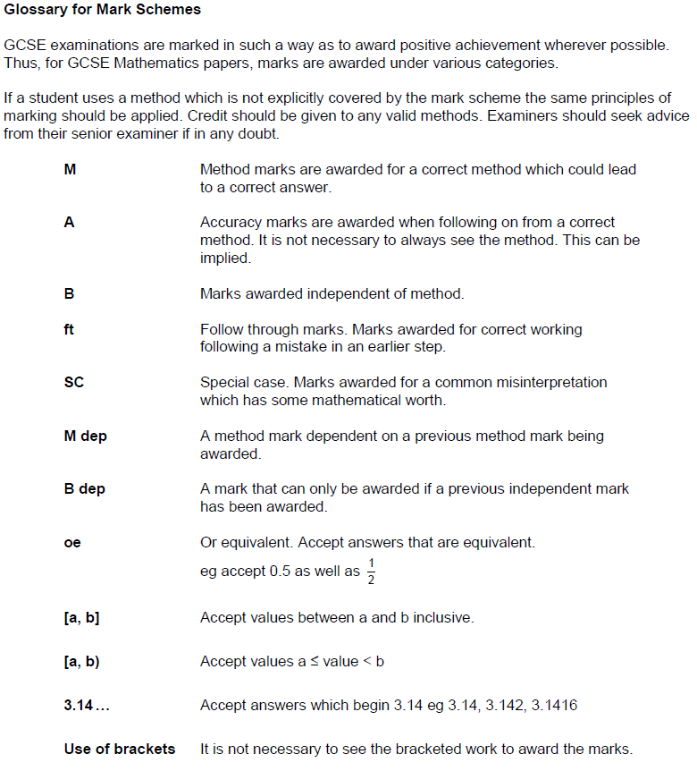
Notes on AQA Mark scheme notes
Next

Slide 7
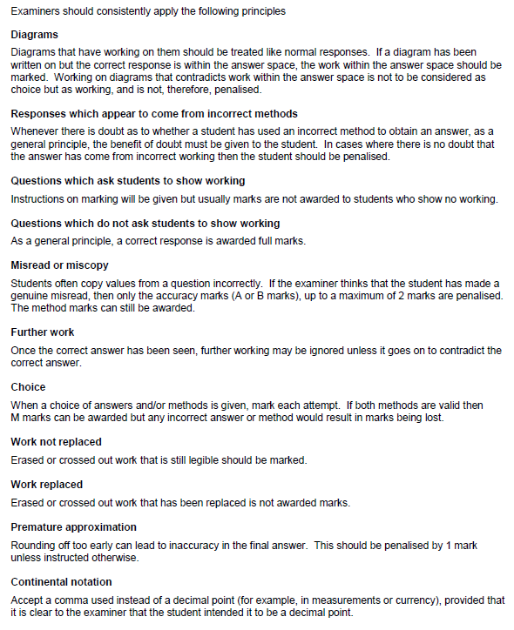
Notes on AQA Mark scheme notes

Slide 8
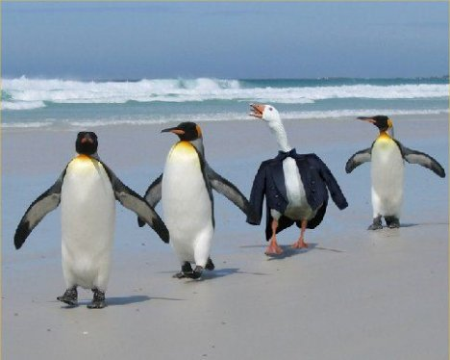
AQA Notes
Home
AQA Mark scheme guide
Algebra
Show that…/ Proof
Probability, Sets & Statistics
Number
Shape & Space

Slide 9
Notes on Algebra Questions for AQA
Algebra
There is a lot of overlap between sub-topics and with the ‘number’ topic
Indices questions often ask to interpret the values of indices and could be considered more of a ‘number’ topic, but there are still many questions which require algebraic manipulation skills.
Quadratic Inequality questions are generally in form of functions
Other quadratic questions require you to understand the general shape and there is a lot of overlap with other graphs and when they may cross axes.
Drawing other non-linear graphs and understanding them, as well as their roots are grouped in the Drawing and using graphs sub-topic

Slide 10
Algebra
Algebra
Simplifying Basic Expressions
Expanding Brackets
Substitution
Drawing and Using Graphs
Solving Simple Equations
Factorising
Algebraic Fractions
Linear Graphs & Gradients
Forming Equations
Solving Quadratics
Quadratic Inequalities
Linear Inequalities
Manipulating Formulae/ Changing the Subject
Completing the Square
Functions
Graphical Transformations
Simultaneous Equations
Indices
Sequences
Iterations
Notes

Slide 11
Simplifying Basic Expressions
Algebra
Simplifying Basic Expressions
May 2018
1H Q3
SAM
2H Q3
1 Marker
Nov 2018
1H Q3

Slide 12

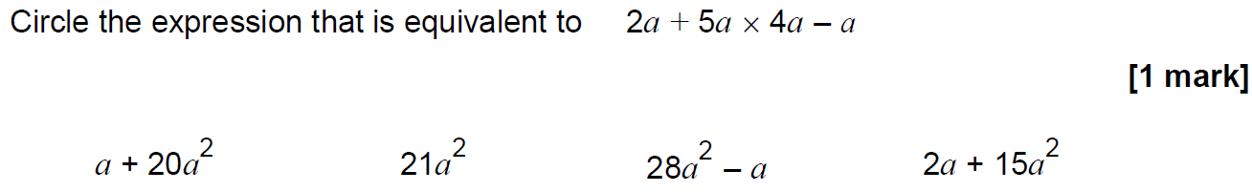
Algebra
Simplifying Basic Expressions
SAM 2H Q3

Slide 13
Algebra
Simplifying Basic Expressions
SAM 2H Q3
A

Slide 14
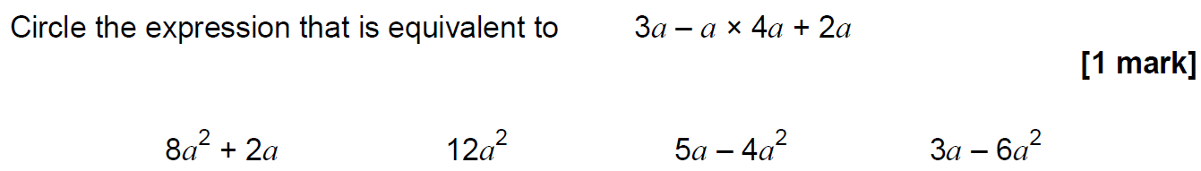
Algebra
Simplifying Basic Expressions
May 2018 1H Q3

Slide 15
Algebra
Simplifying Basic Expressions
May 2018 1H Q3
A

Slide 16
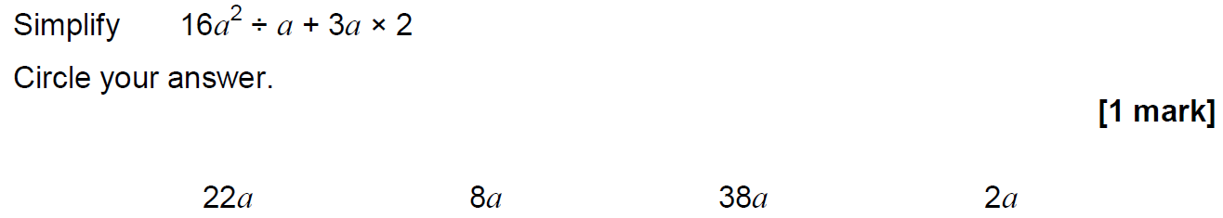
Algebra
Simplifying Basic Expressions
Nov 2018 1H Q3

Slide 17
Algebra
Simplifying Basic Expressions
Nov 2018 1H Q3
A

Slide 18
Indices
Algebra
Indices
May 2017
1H Q1
Nov 2017
1H Q30
Nov 2018
1H Q1
May 2017
1H Q24
Nov 2017
3H Q21
Nov 2018
1H Q9
SAM
1H Q2
June 2017
3H Q12
Nov 2017
3H Q28
Nov 2018
1H Q16
1 Marker
SAM
3H Q14
Nov 2017
1H Q1
May 2018
1H Q1
Nov 2018
1H Q17
Nov 2017
1H Q3
May 2018
1H Q24
Nov 2018
3H Q17
Nov 2017
1H Q6
June 2018
2H Q18
Rewriting as another power
Properties of Numbers
Negative & fractional
See also:
Differentiation
Standard Form

Slide 19
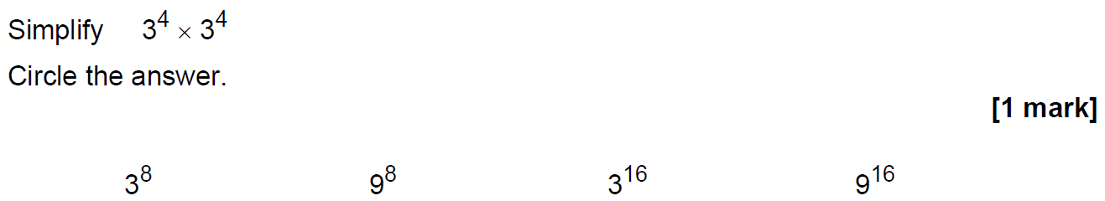
Algebra
Indices
SAM 1H Q2

Slide 20
Algebra
Indices
SAM 1H Q2
A

Slide 21
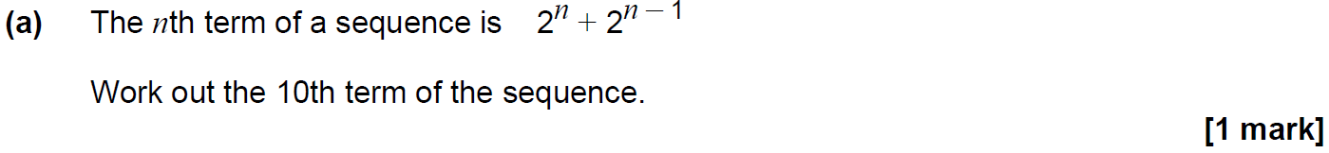
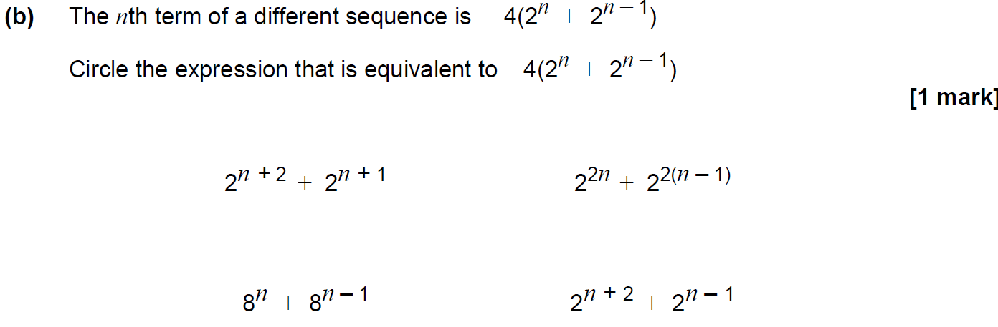
Algebra
Indices
SAM 3H Q14

Slide 22
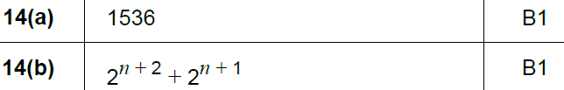
Algebra
Indices
SAM 3H Q14
A
B

Slide 23
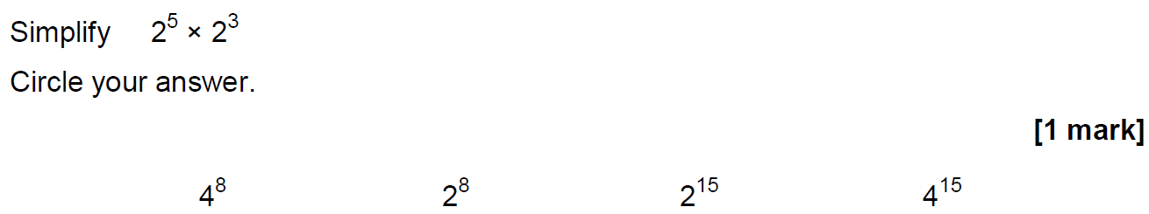
Algebra
Indices
May 2017 1H Q1

Slide 24
Algebra
Indices
May 2017 1H Q1
A

Slide 25
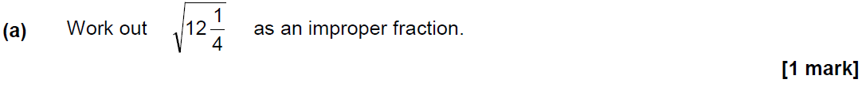
Algebra
Indices
May 2017 1H Q24

Slide 26
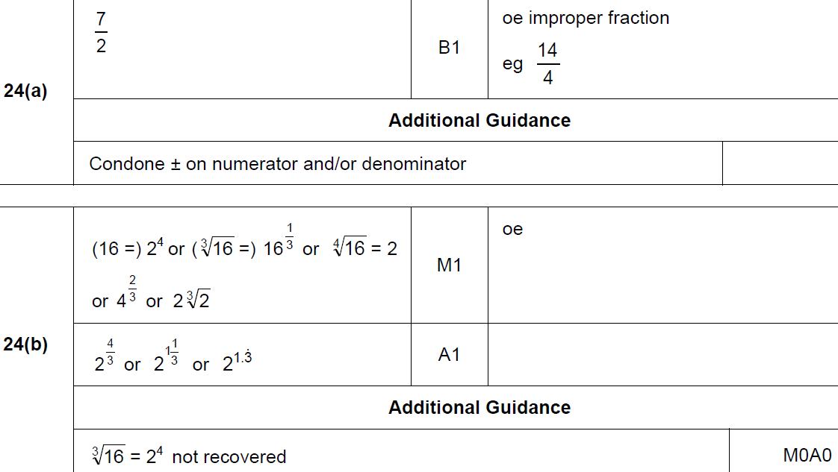
Algebra
Indices
May 2017 1H Q24
A
B

Slide 27
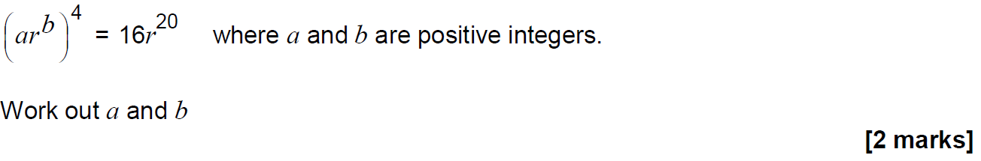
Algebra
Indices
June 2017 3H Q12

Slide 28
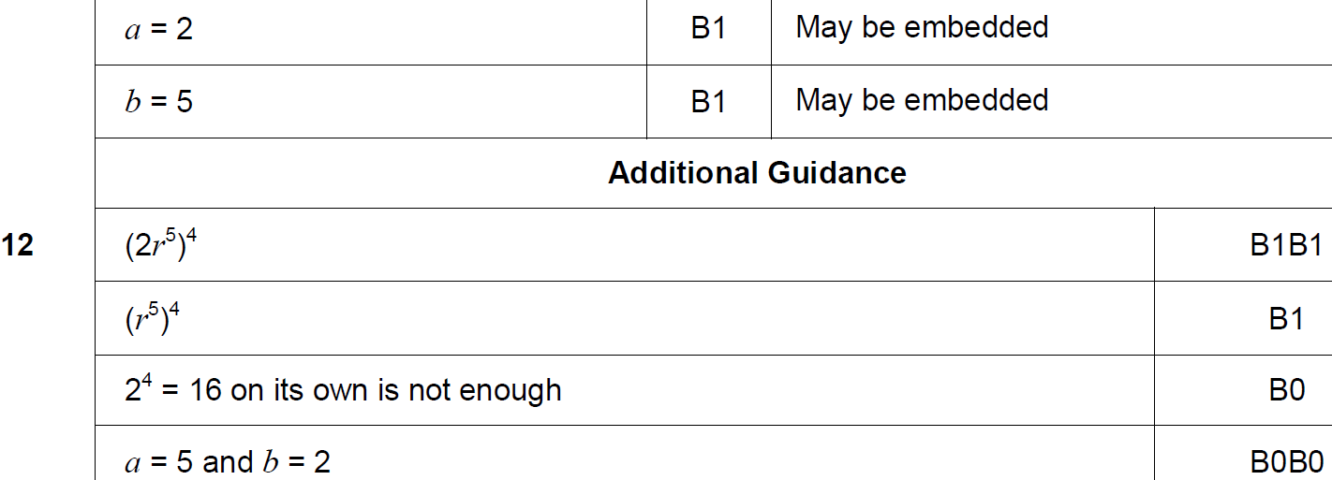
Algebra
Indices
June 2017 3H Q12
A

Slide 29
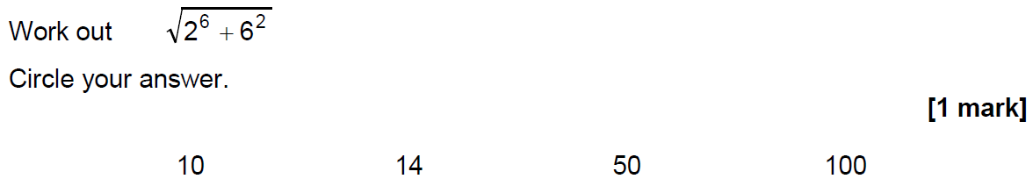
Algebra
Indices
Nov 2017 1H Q1

Slide 30
Algebra
Indices
Nov 2017 1H Q1
A

Slide 31
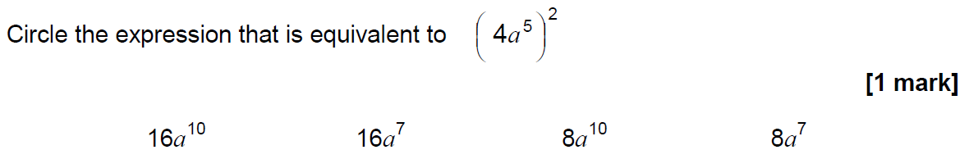
Algebra
Indices
Nov 2017 1H Q3

Slide 32
Algebra
Indices
Nov 2017 1H Q3
A

Slide 33
Algebra
Indices
Nov 2017 1H Q6

Slide 34
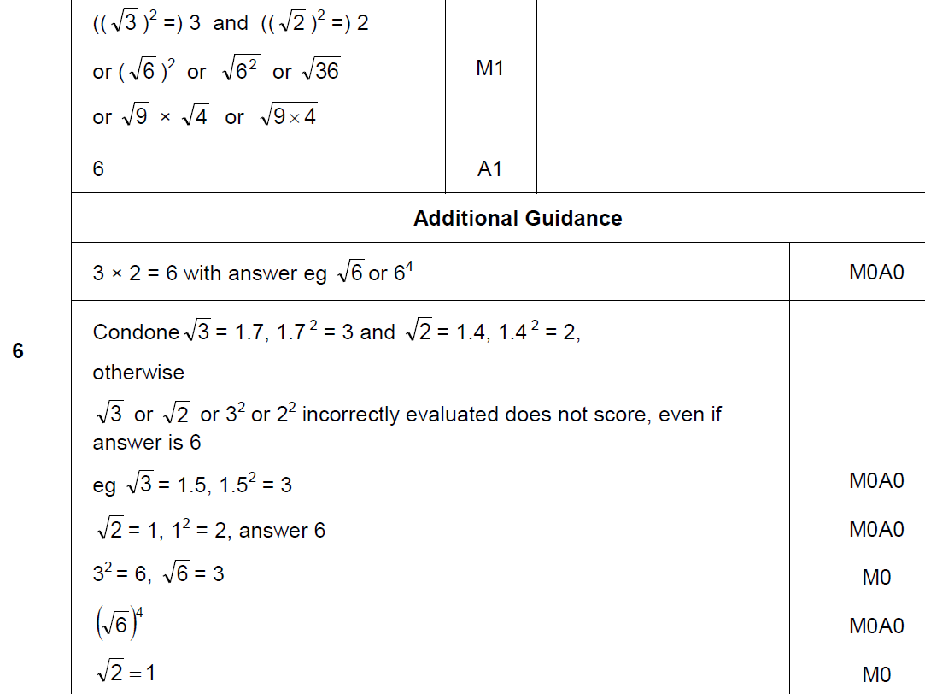
Algebra
Indices
Nov 2017 1H Q6
A

Slide 35
Algebra
Indices
Nov 2017 1H Q30

Slide 36
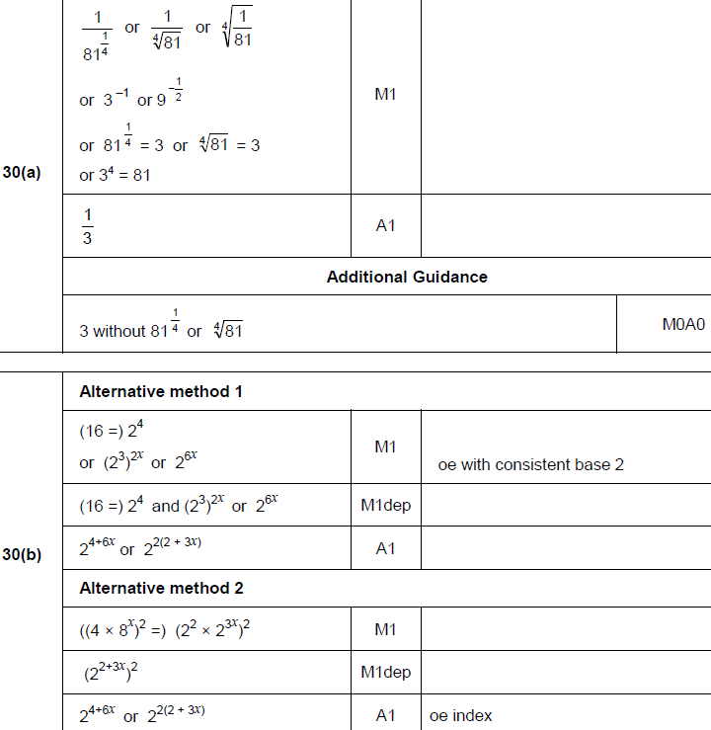
Algebra
Indices
Nov 2017 1H Q30
A
B

Slide 37
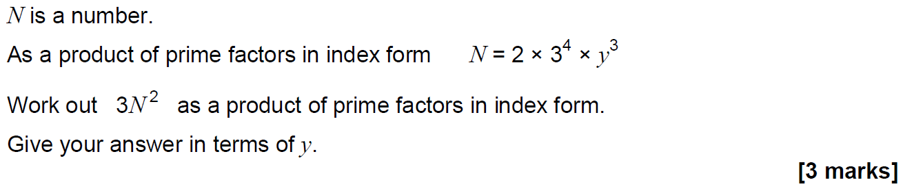
Algebra
Indices
Nov 2017 3H Q21

Slide 38
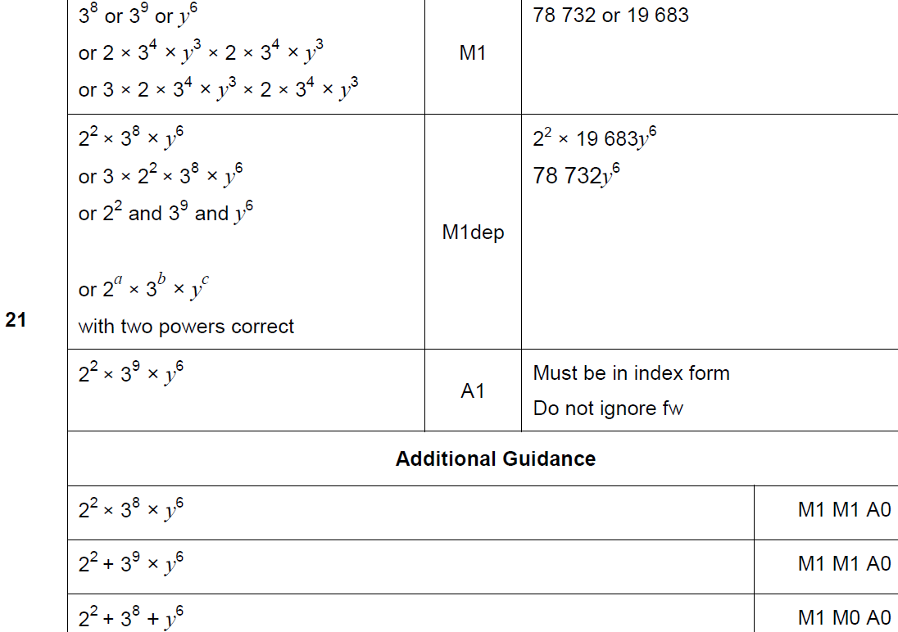
Algebra
Indices
Nov 2017 3H Q21
A

Slide 39
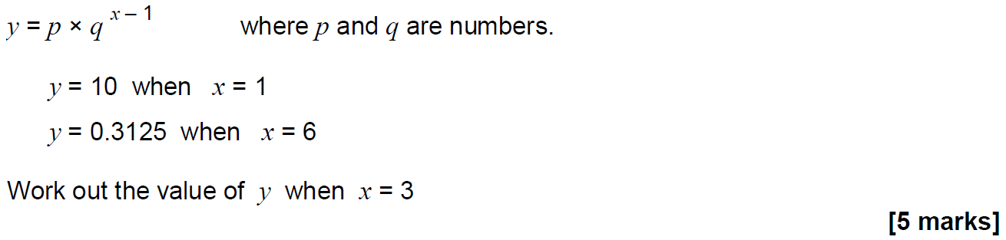
Algebra
Indices
Nov 2017 3H Q28

Slide 40
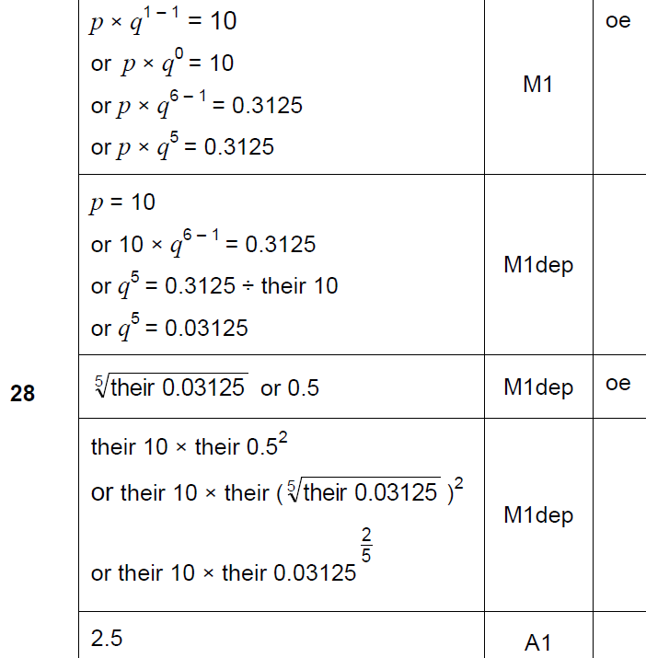
Algebra
Indices
Nov 2017 3H Q28
A

Slide 41
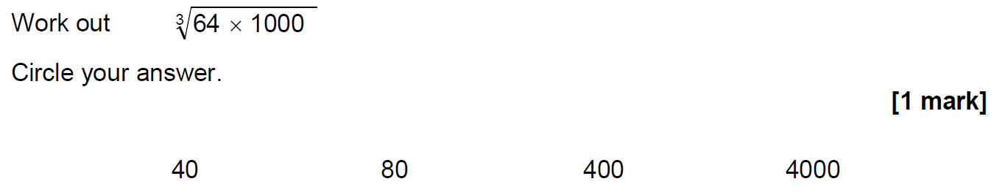
Algebra
Indices
May 2018 1H Q1

Slide 42
Algebra
Indices
May 2018 1H Q1
A

Slide 43
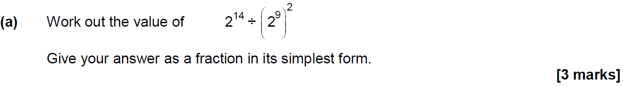
Algebra
Indices
May 2018 1H Q24

Slide 44
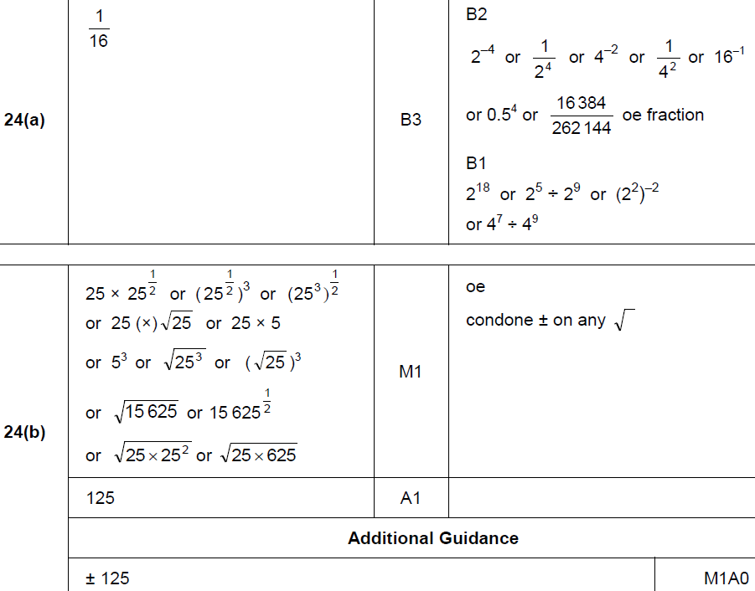
Algebra
Indices
May 2018 1H Q24
A
B

Slide 45
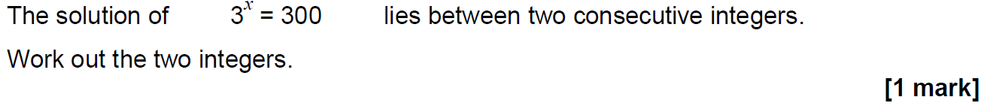
Algebra
Indices
June 2018 2H Q18

Slide 46
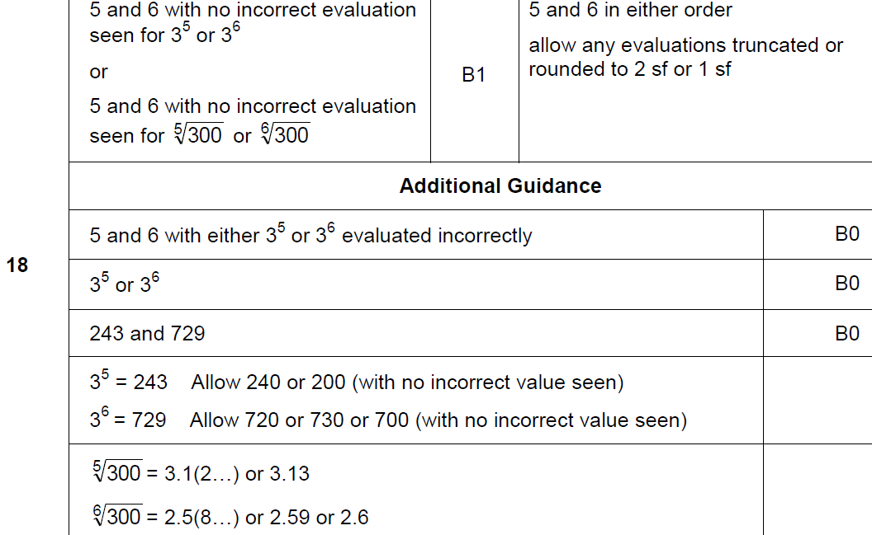
Algebra
Indices
June 2018 2H Q18
A

Slide 47
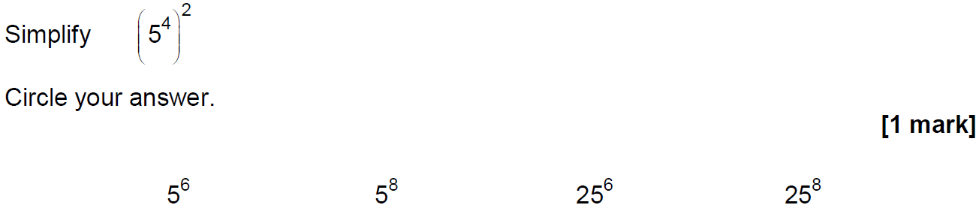
Algebra
Indices
Nov 2018 1H Q1

Slide 48
Algebra
Indices
Nov 2018 1H Q1
A

Slide 49
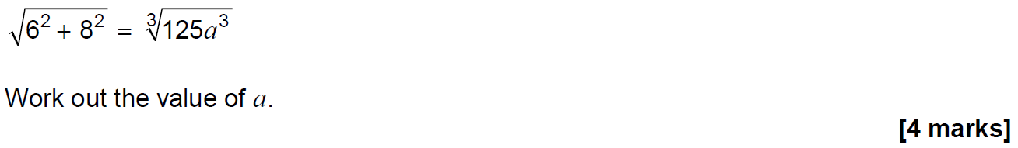
Algebra
Indices
Nov 2018 1H Q9

Slide 50
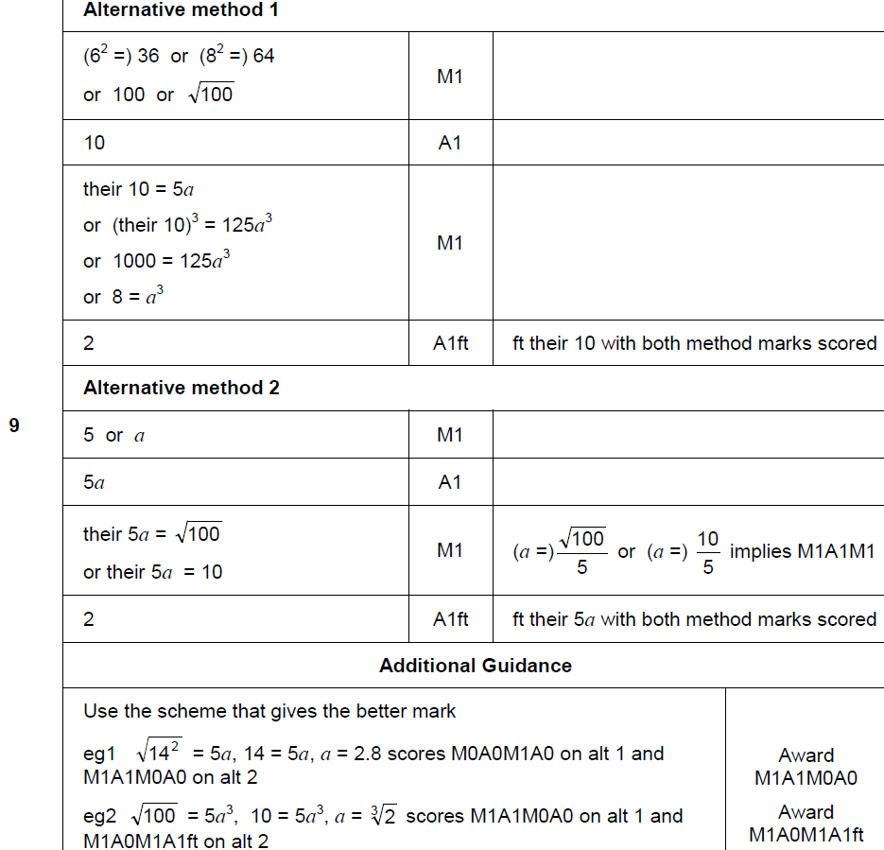
Algebra
Indices
Nov 2018 1H Q9
A

Slide 51
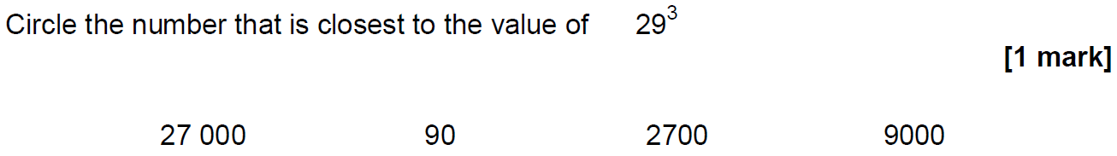
Algebra
Indices
Nov 2018 1H Q16

Slide 52
Algebra
Indices
Nov 2018 1H Q16
A

Slide 53
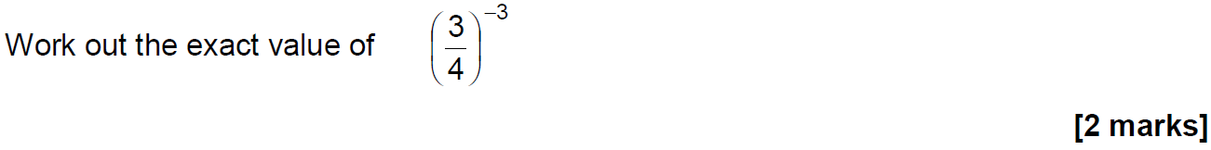
Algebra
Indices
Nov 2018 1H Q17

Slide 54
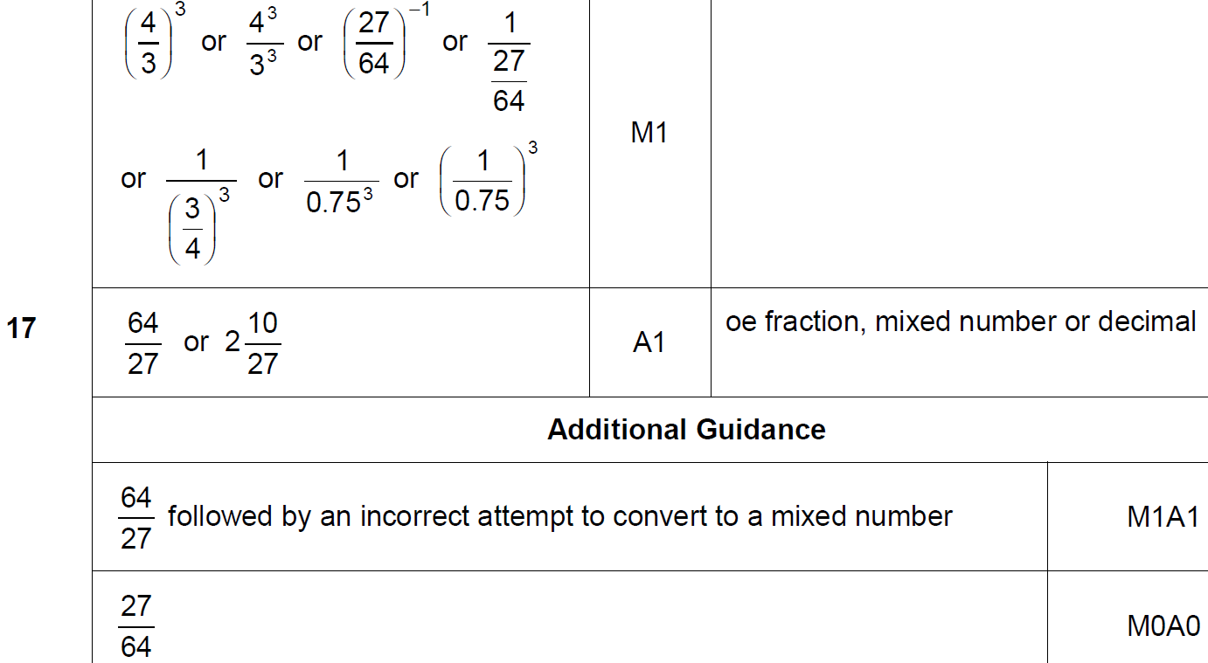
Algebra
Indices
Nov 2018 1H Q17
A

Slide 55
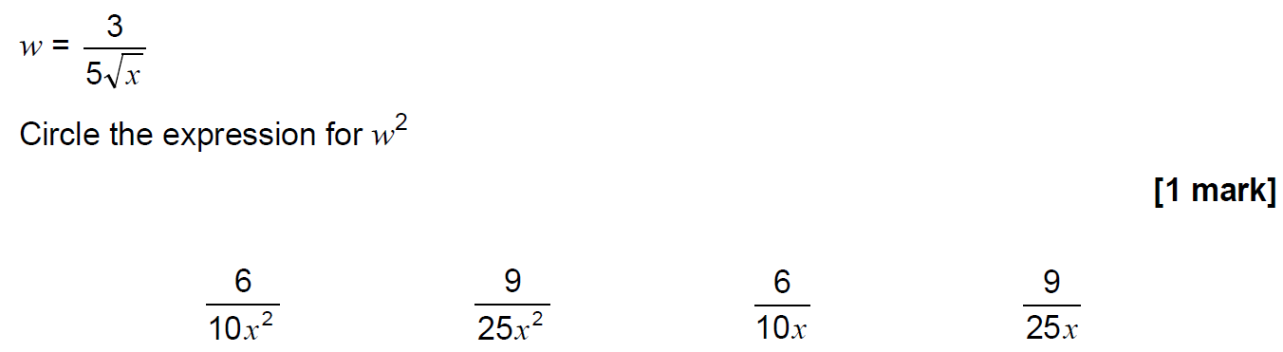
Algebra
Indices
Nov 2018 3H Q17

Slide 56
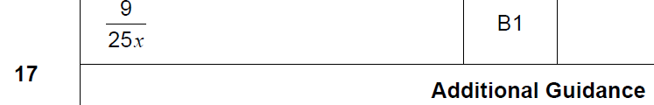
Algebra
Indices
Nov 2018 3H Q17
A

Slide 57
Linear Graphs & Gradients
Algebra
Linear Graphs & Gradients
May 2017
1H Q17
May 2018
1H Q7
May 2017
1H Q27
SAM
1H Q4
June 2018
2H Q12
June 2017
2H Q3
SAM
1H Q28
June 2018
3H Q8
June 2017
2H Q14
1 Marker
SAM
2H Q4
June 2018
3H Q19
Nov 2017
1H Q21
SAM
3H Q28*
June 2018
3H Q28
Nov 2017
1H Q28
Mainly Pythagoras*
Nov 2018
2H Q2
Nov 2017
3H Q4
Mainly Co-ordinates
With equation of circle and tangents
Simultaneous Equations
See also:
Linear Inequalities
Time-Series

Slide 58
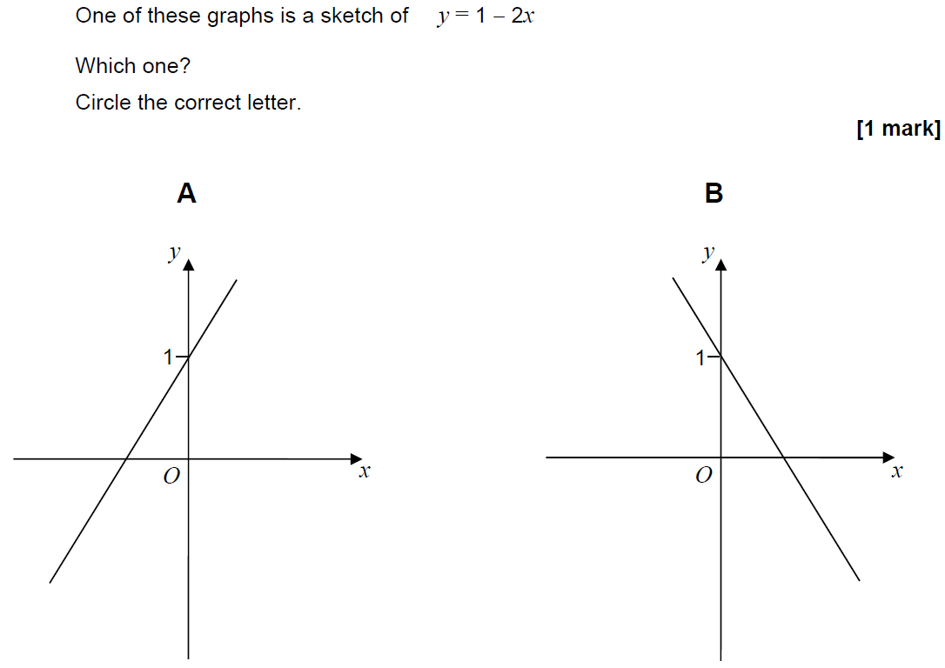
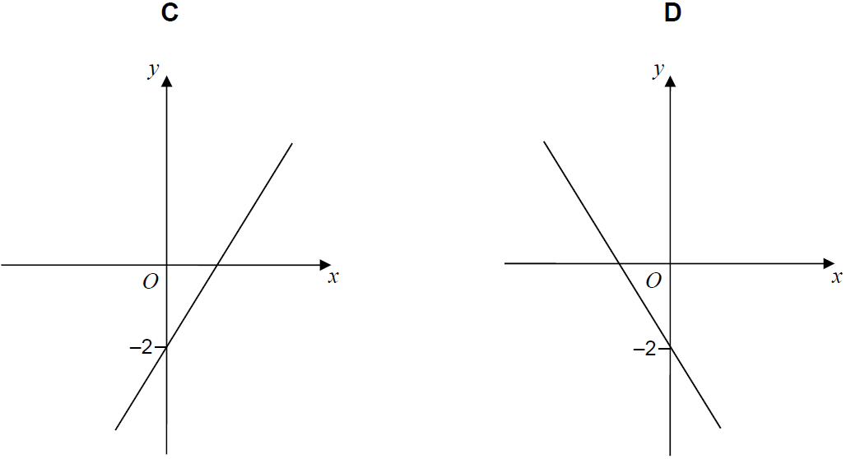
Algebra
Linear Graphs & Gradients
SAM 1H Q4

Slide 59
Algebra
Linear Graphs & Gradients
SAM 1H Q4
A

Slide 60
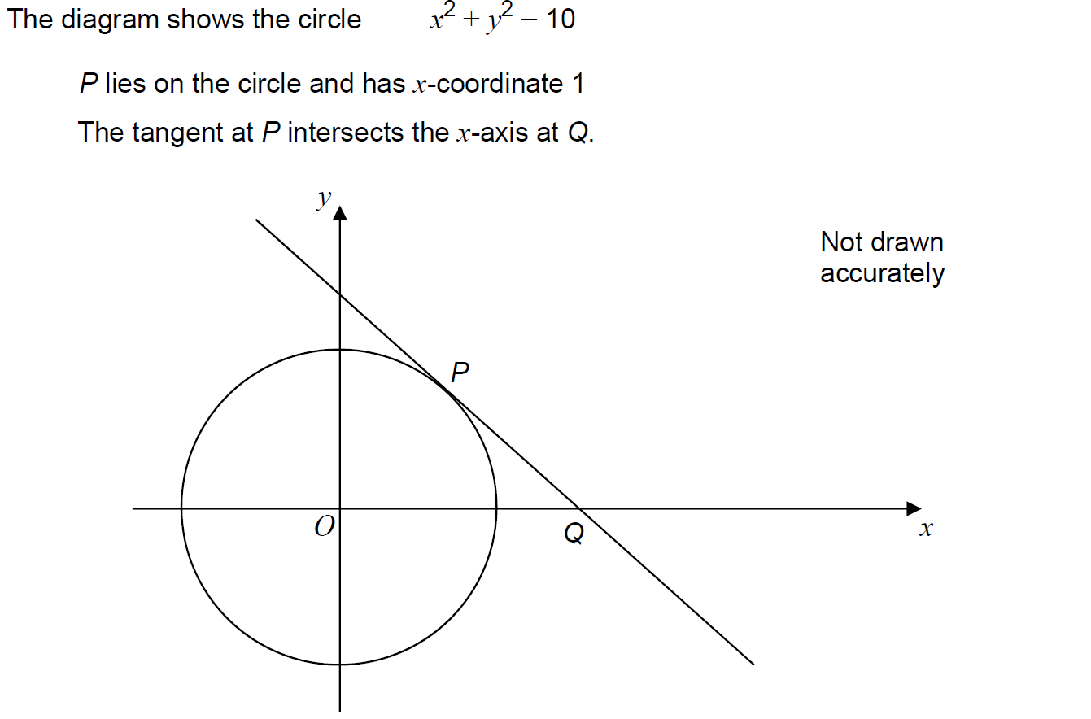
Algebra
Linear Graphs & Gradients
SAM 1H Q28

Slide 61
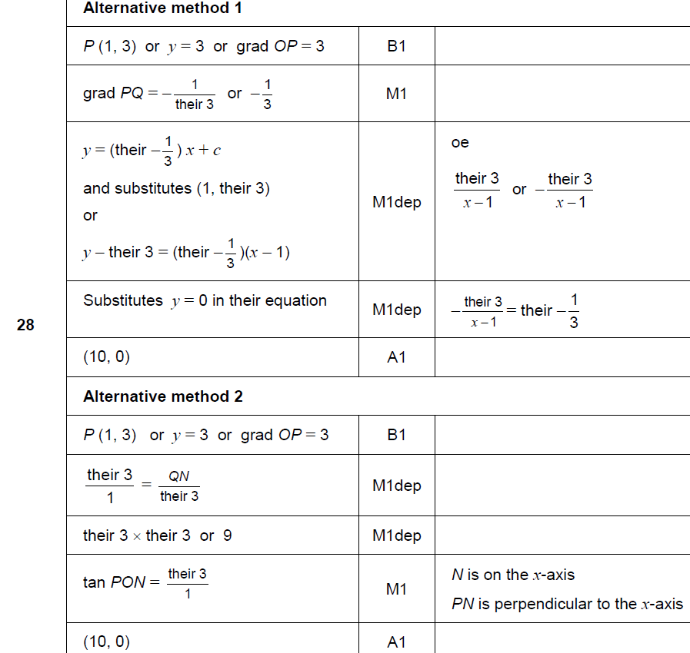
Algebra
Linear Graphs & Gradients
SAM 1H Q28
A

Slide 62
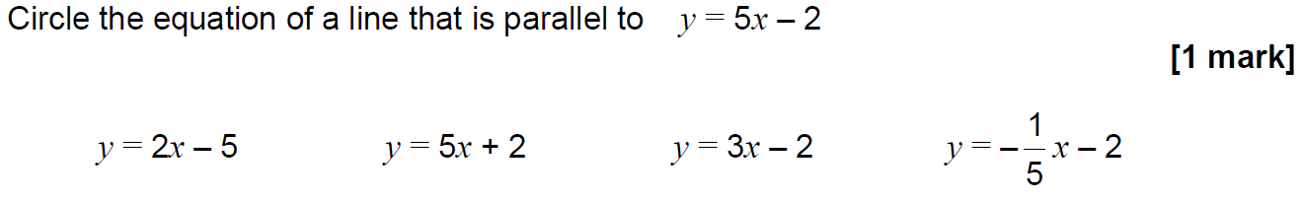
Algebra
Linear Graphs & Gradients
SAM 2H Q4

Slide 63
Algebra
Linear Graphs & Gradients
SAM 2H Q4
A

Slide 64
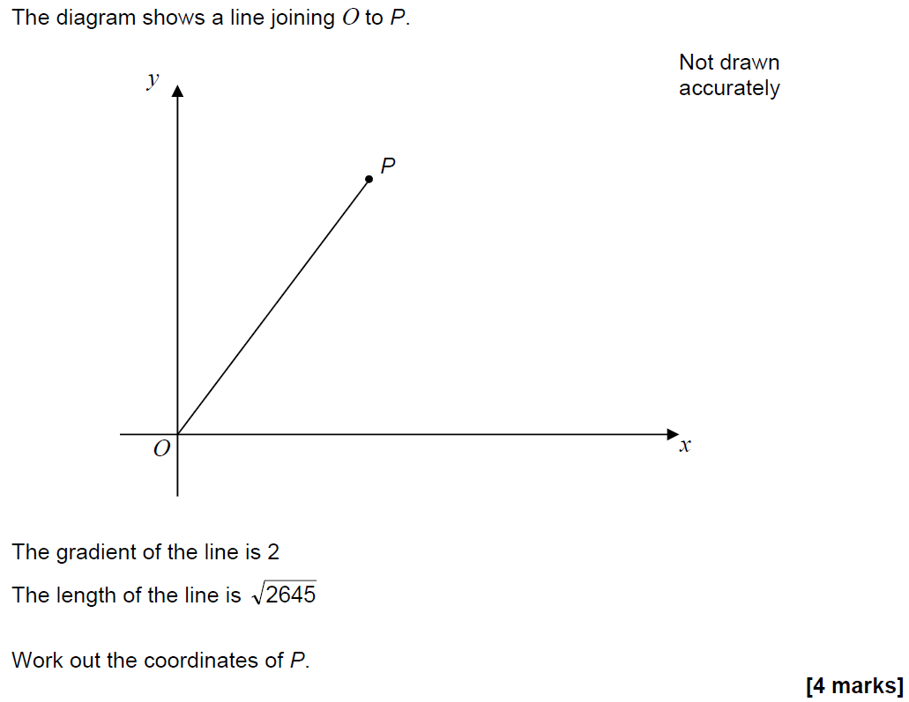
Algebra
Linear Graphs & Gradients
SAM 3H Q28

Slide 65
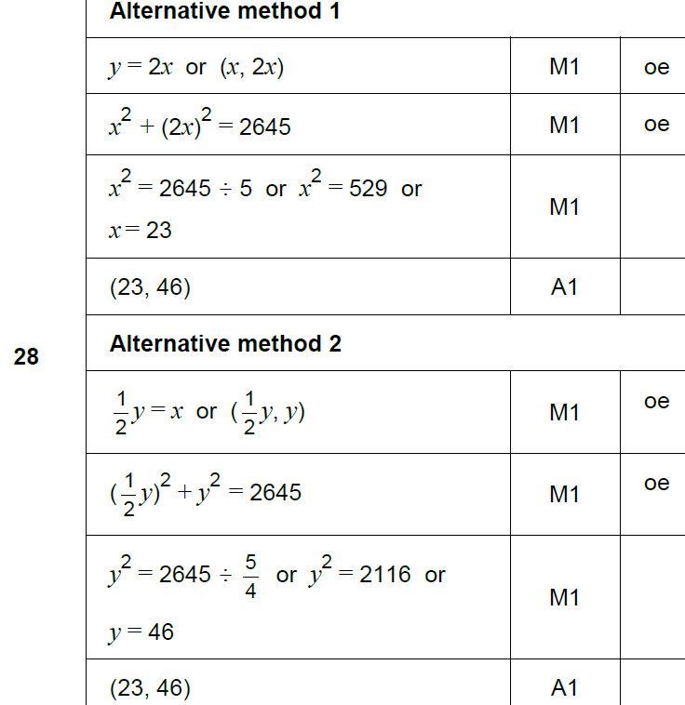
Algebra
Linear Graphs & Gradients
SAM 3H Q28
A

Slide 66
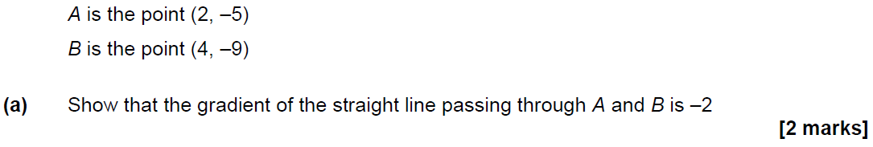
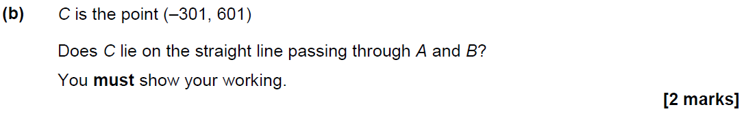
Algebra
Linear Graphs & Gradients
May 2017 1H Q17

Slide 67
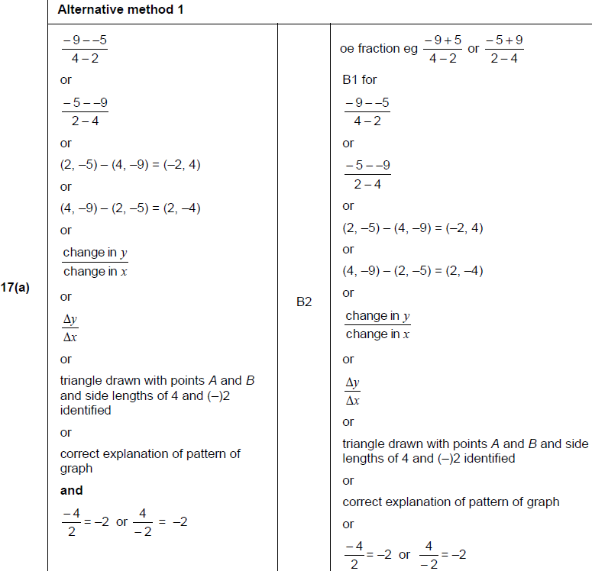
Algebra
Linear Graphs & Gradients
May 2017 1H Q17
A

Slide 68
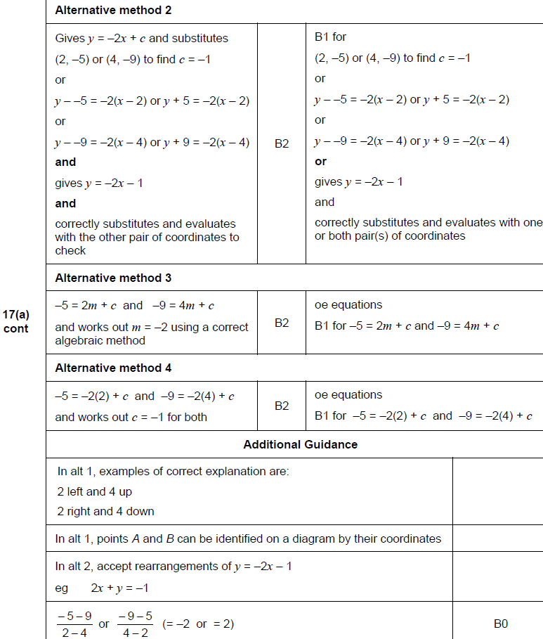
Algebra
Linear Graphs & Gradients
May 2017 1H Q17
A Alternatives

Slide 69
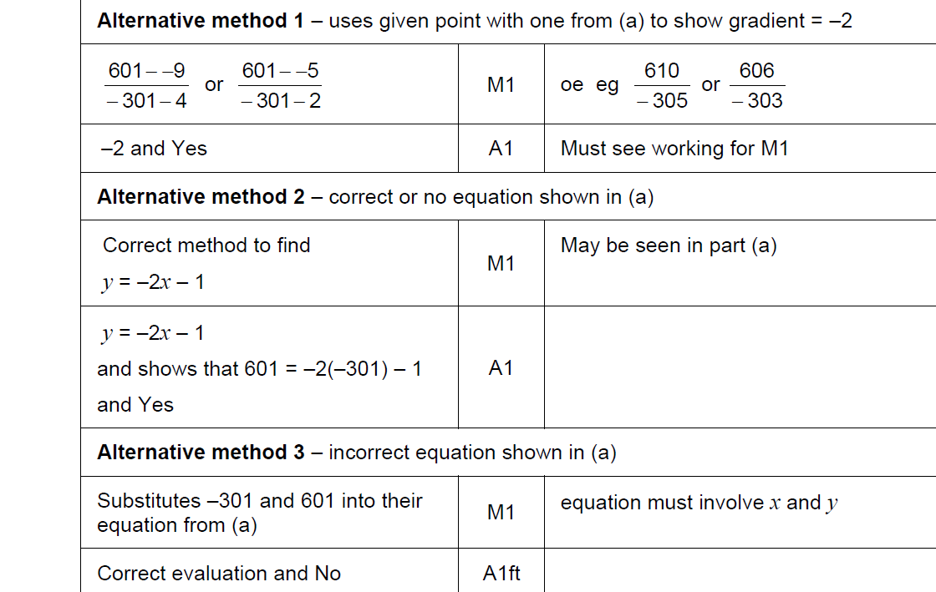
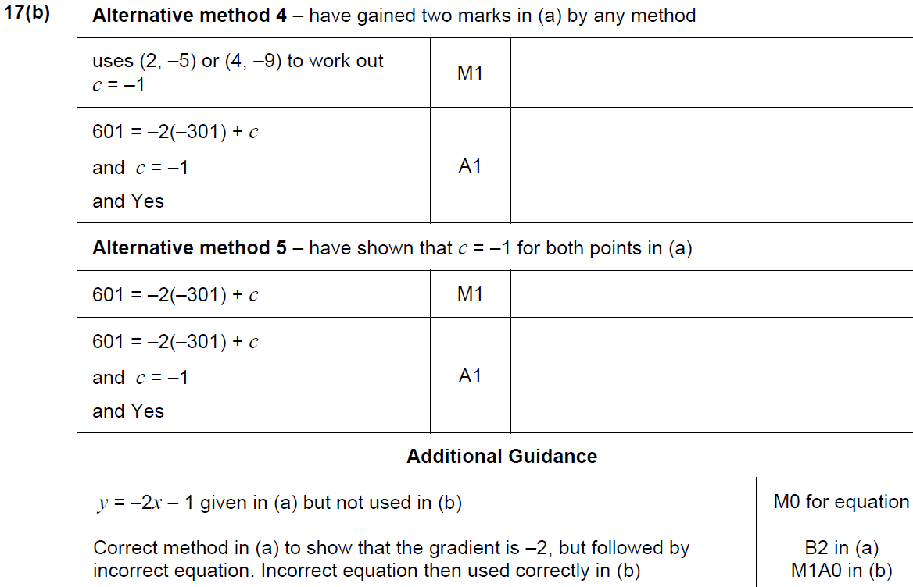
Algebra
Linear Graphs & Gradients
May 2017 1H Q17
B

Slide 70
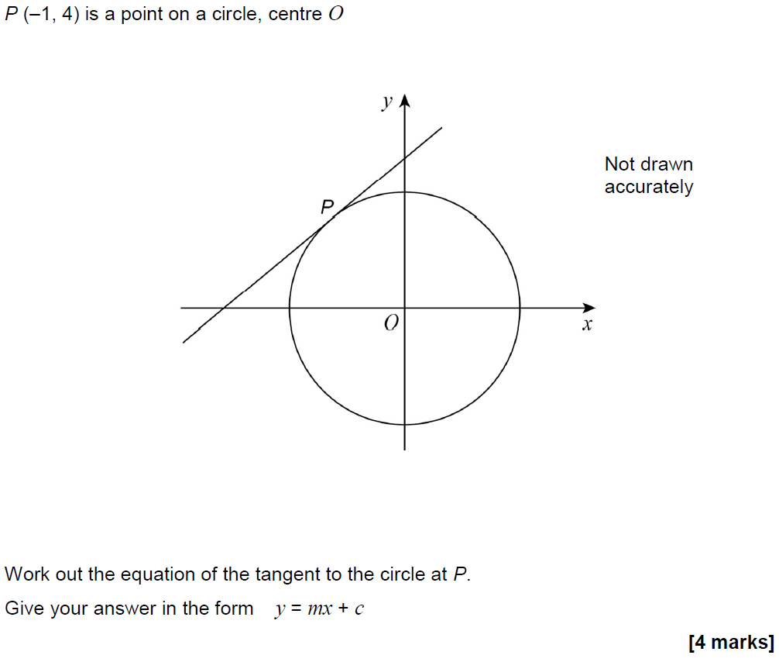
Algebra
Linear Graphs & Gradients
May 2017 1H Q27

Slide 71

Algebra
Linear Graphs & Gradients
May 2017 1H Q27
A

Slide 72

Algebra
Linear Graphs & Gradients
June 2017 2H Q3

Slide 73

Algebra
Linear Graphs & Gradients
June 2017 2H Q3
A

Slide 74

Algebra
Linear Graphs & Gradients
June 2017 2H Q14

Slide 75

Algebra
Linear Graphs & Gradients
June 2017 2H Q14
A

Slide 76

Algebra
Linear Graphs & Gradients
June 2017 2H Q14
A notes

Slide 77

Algebra
Linear Graphs & Gradients
Nov 2017 1H Q21

Slide 78

Algebra
Linear Graphs & Gradients
Nov 2017 1H Q21
A

Slide 79



Algebra
Linear Graphs & Gradients
Nov 2017 1H Q28

Slide 80

Algebra
Linear Graphs & Gradients
Nov 2017 1H Q28
A
B
C

Slide 81

Algebra
Linear Graphs & Gradients
Nov 2017 1H Q28
D

Slide 82

Algebra
Linear Graphs & Gradients
Nov 2017 3H Q4

Slide 83

Algebra
Linear Graphs & Gradients
Nov 2017 3H Q4
A

Slide 84

Algebra
Linear Graphs & Gradients
May 2018 1H Q7

Slide 85

Algebra
Linear Graphs & Gradients
May 2018 1H Q7
A

Slide 86

Algebra
Linear Graphs & Gradients
May 2018 1H Q7
A notes

Slide 87


Algebra
Linear Graphs & Gradients
June 2018 2H Q12

Slide 88

Algebra
Linear Graphs & Gradients
June 2018 2H Q12
A

Slide 89

Algebra
Linear Graphs & Gradients
June 2018 2H Q12
B

Slide 90


Algebra
Linear Graphs & Gradients
June 2018 3H Q8

Slide 91

Algebra
Linear Graphs & Gradients
June 2018 3H Q8
A

Slide 92

Algebra
Linear Graphs & Gradients
June 2018 3H Q8
A Alternative & notes

Slide 93

Algebra
Linear Graphs & Gradients
June 2018 3H Q8
B

Slide 94

Algebra
Linear Graphs & Gradients
June 2018 3H Q19

Slide 95

Algebra
Linear Graphs & Gradients
June 2018 3H Q19
A

Slide 96

Algebra
Linear Graphs & Gradients
June 2018 3H Q28

Slide 97

Algebra
Linear Graphs & Gradients
June 2018 3H Q28
A

Slide 98

Algebra
Linear Graphs & Gradients
Nov 2018 2H Q2

Slide 99

Algebra
Linear Graphs & Gradients
Nov 2018 2H Q2
A

Slide 100
Drawing and Using Graphs
Algebra
Drawing and Using Graphs
May 2017
1H Q20
Nov 2017
1H Q28
Nov 2018
1H Q25
June 2017
2H Q6
Nov 2017
2H Q3
Nov 2018
2H Q27
June 2017
2H Q27
Nov 2017
2H Q21
1 Marker
Nov 2018
3H Q12
June 2017
3H Q18
June 2018
2H Q22
Nov 2018
3H Q28
June 2017
3H Q23
June 2018
3H Q14
Intercepts and roots
Circles
Recognising shapes of graphs
See also:
Graphical Transformations

Slide 101

Algebra
Drawing and Using Graphs
May 2017 1H Q20

Slide 102
Algebra
Drawing and Using Graphs
May 2017 1H Q20
A

Slide 103


Algebra
Drawing and Using Graphs
June 2017 2H Q6
Reveal Graph (b)

Slide 104



Algebra
Drawing and Using Graphs
June 2017 2H Q6
A
B
C

Slide 105




Algebra
Drawing and Using Graphs
June 2017 2H Q27

Slide 106

Algebra
Drawing and Using Graphs
June 2017 2H Q27
A

Slide 107

Algebra
Drawing and Using Graphs
June 2017 2H Q27
B

Slide 108

Algebra
Drawing and Using Graphs
June 2017 3H Q18

Slide 109

Algebra
Drawing and Using Graphs
June 2017 2H Q27
A

Slide 110

Algebra
Drawing and Using Graphs
June 2017 3H Q23

Slide 111

Algebra
Drawing and Using Graphs
June 2017 3H Q23
A

Slide 112
Algebra
Drawing and Using Graphs
Nov 2017 1H Q28

Slide 113
Algebra
Drawing and Using Graphs
Nov 2017 1H Q28
A
B
C

Slide 114
Algebra
Drawing and Using Graphs
Nov 2017 1H Q28
D

Slide 115

Algebra
Drawing and Using Graphs
Nov 2017 2H Q3

Slide 116

Algebra
Drawing and Using Graphs
Nov 2017 2H Q3
A

Slide 117



Algebra
Drawing and Using Graphs
Nov 2017 2H Q21

Slide 118

Algebra
Drawing and Using Graphs
Nov 2017 2H Q21
A

Slide 119

Algebra
Drawing and Using Graphs
Nov 2017 2H Q21
B

Slide 120

Algebra
Drawing and Using Graphs
June 2018 2H Q22

Slide 121

Algebra
Drawing and Using Graphs
June 2018 2H Q22
A

Slide 122


Algebra
Drawing and Using Graphs
June 2018 3H Q14
Reveal Graph

Slide 123

Algebra
Drawing and Using Graphs
June 2018 3H Q14
A

Slide 124

Algebra
Drawing and Using Graphs
Nov 2018 1H Q25

Slide 125

Algebra
Drawing and Using Graphs
Nov 2018 1H Q25
A

Slide 126

Algebra
Drawing and Using Graphs
Nov 2018 2H Q27

Slide 127

Algebra
Drawing and Using Graphs
Nov 2018 2H Q27
A

Slide 128

Algebra
Drawing and Using Graphs
Nov 2018 3H Q12

Slide 129

Algebra
Drawing and Using Graphs
Nov 2018 3H Q12
A

Slide 130

Algebra
Drawing and Using Graphs
Nov 2018 3H Q28

Slide 131

Algebra
Drawing and Using Graphs
Nov 2018 3H Q28
A

Slide 132
Substitution
Algebra
Substitution
SAM
1H Q6
Nov 2017
1H Q4
SAM
2H Q18
Nov 2017
2H Q3
1 Marker
SAM
3H Q14
June 2018
2H Q20
Sequences
Iterations
See also:
Upper & Lower Bounds
Direct & Inverse Proportion
Drawing & Using Graphs
Volume & Surface Area
Functions

Slide 133

Algebra
Substitution
SAM 1H Q6

Slide 134

Algebra
Substitution
SAM 1H Q6
A

Slide 135

Algebra
Substitution
SAM 2H Q18

Slide 136

Algebra
Substitution
SAM 2H Q18
A
B

Slide 137
Algebra
Substitution
SAM 3H Q14

Slide 138
Algebra
Substitution
SAM 3H Q14
A
B

Slide 139

Algebra
Substitution
Nov 2017 1H Q4

Slide 140
Algebra
Substitution
Nov 2017 1H Q4
A

Slide 141
Algebra
Substitution
Nov 2017 2H Q3

Slide 142
Algebra
Substitution
Nov 2017 2H Q3
A

Slide 143

Algebra
Substitution
June 2018 2H Q20

Slide 144

Algebra
Substitution
June 2018 2H Q20
A

Slide 145
Solving Simple Equations
Algebra
Solving Simple Equations
Nov 2017 2H Q5
1 Marker
Linear Inequalities
Sequences
See also:
Forming Equations
Substitution
Algebraic Fractions

Slide 146
Algebra
Solving Simple Equations
Nov 2017 2H Q5
Solve 4(3x − 2) = 2x − 5
[3 marks]

Slide 147

Algebra
Solving Simple Equations
Nov 2017 2H Q5
A

Slide 148

Algebra
Solving Simple Equations
Nov 2017 2H Q5
A

Slide 149
Graphical Transformations
Algebra
Graphical Transformations
June 2017
2H Q27
May 2018
1H Q29
SAM
3H Q27
1 Marker
Nov 2018
2H Q24
Nov 2018
3H Q20
Trig
See also:
Completing the Square

Slide 150

Algebra
Graphical Transformations
SAM 3H Q27

Slide 151
Algebra
Graphical Transformations
SAM 3H Q27
A

Slide 152
Algebra
Graphical Transformations
June 2017 2H Q27

Slide 153
Algebra
Graphical Transformations
June 2017 2H Q27
A

Slide 154
Algebra
Graphical Transformations
June 2017 2H Q27
B

Slide 155


Algebra
Graphical Transformations
May 2018 1H Q29

Slide 156

Algebra
Graphical Transformations
May 2018 1H Q29
A

Slide 157

Algebra
Graphical Transformations
May 2018 1H Q29
B

Slide 158

Algebra
Graphical Transformations
Nov 2018 2H Q24
Here is a sketch of y = f(x)
The curve passes through the points
(–2, –10) (–1, –3) (0, –2) (1, –1) (2, 6)
On the grid, sketch the curve y = f(x + 2)
[2 marks]

Slide 159

Algebra
Graphical Transformations
Nov 2018 2H Q24
A

Slide 160

Algebra
Graphical Transformations
Nov 2018 3H Q20

Slide 161

Algebra
Graphical Transformations
Nov 2018 3H Q20
A

Slide 162
Linear Inequalities
Algebra
Linear Inequalities
May 2017
1H Q14
Nov 2017
3H Q23
June 2017
3H Q6
May 2018
1H Q5
SAM
1H Q8
1 Marker
Nov 2017
1H Q5
June 2018
3H Q2
Nov 2017
3H Q1
Nov 2018
3H Q10
Graphical

Slide 163

Algebra
Linear Inequalities
SAM 1H Q8

Slide 164

Algebra
Linear Inequalities
SAM 1H Q8
A

Slide 165
Algebra
Linear Inequalities
May 2017 1H Q14

Slide 166
Algebra
Linear Inequalities
May 2017 1H Q14
A

Slide 167

Algebra
Linear Inequalities
June 2017 3H Q6

Slide 168

Algebra
Linear Inequalities
June 2017 3H Q6
A

Slide 169
Algebra
Linear Inequalities
Nov 2017 1H Q5

Slide 170

Algebra
Linear Inequalities
Nov 2017 1H Q5
A

Slide 171

Algebra
Linear Inequalities
Nov 2017 1H Q5
B

Slide 172

Algebra
Linear Inequalities
Nov 2017 3H Q1

Slide 173

Algebra
Linear Inequalities
Nov 2017 3H Q1
A

Slide 174


Algebra
Linear Inequalities
Nov 2017 3H Q23

Slide 175

Algebra
Linear Inequalities
Nov 2017 3H Q23
A

Slide 176
Algebra
Linear Inequalities
May 2018 1H Q5
Solve 5(x + 3) < 60
[2 marks]

Slide 177

Algebra
Linear Inequalities
May 2018 1H Q5
A

Slide 178

Algebra
Linear Inequalities
June 2018 3H Q2

Slide 179

Algebra
Linear Inequalities
June 2018 3H Q2
A

Slide 180

Algebra
Linear Inequalities
Nov 2018 3H Q10

Slide 181

Algebra
Linear Inequalities
Nov 2018 3H Q10
A

Slide 182
Sequences
Algebra
Sequences
May 2017
1H Q3
May 2018
1H Q20
June 2017
2H Q4
June 2018
2H Q5
SAM
1H Q9
June 2017
3H Q22
June 2018
3H Q10
SAM
2H Q1
Nov 2017
2H Q10
1 Marker
Nov 2018
1H Q21
SAM
3H Q14
Nov 2017
2H Q14
Nov 2018
2H Q3
Nov 2017
3H Q3
Nov 2018
3H Q3
May 2018
1H Q14
Quadratic
Geometric

Slide 183


Algebra
Sequences
SAM 1H Q9

Slide 184

Algebra
Sequences
SAM 1H Q9
A

Slide 185

Algebra
Sequences
SAM 2H Q1

Slide 186
Algebra
Sequences
SAM 2H Q1
A

Slide 187
Algebra
Sequences
SAM 3H Q14

Slide 188
Algebra
Sequences
SAM 3H Q14
A
B

Slide 189

Algebra
Sequences
May 2017 1H Q3

Slide 190
Algebra
Sequences
May 2017 1H Q3
A

Slide 191

Algebra
Sequences
June 2017 2H Q4

Slide 192

Algebra
Sequences
June 2017 2H Q4
A

Slide 193

Algebra
Sequences
June 2017 3H Q22

Slide 194

Algebra
Sequences
June 2017 3H Q22
A

Slide 195

Algebra
Sequences
June 2017 3H Q22
A Alternative & notes

Slide 196

Algebra
Sequences
Nov 2017 2H Q10

Slide 197

Algebra
Sequences
Nov 2017 2H Q10
A

Slide 198


Algebra
Sequences
Nov 2017 2H Q14

Slide 199

Algebra
Sequences
Nov 2017 2H Q14
A

Slide 200

Algebra
Sequences
Nov 2017 2H Q14
B

Slide 201

Algebra
Sequences
Nov 2017 2H Q14
B notes

Slide 202

Algebra
Sequences
Nov 2017 3H Q3

Slide 203

Algebra
Sequences
Nov 2017 3H Q3
A

Slide 204


Algebra
Sequences
May 2018 1H Q14

Slide 205

Algebra
Sequences
May 2018 1H Q14
A

Slide 206

Algebra
Sequences
May 2018 1H Q14
B

Slide 207

Algebra
Sequences
May 2018 1H Q14
B Alternative 3 & notes

Slide 208

Algebra
Sequences
May 2018 1H Q20

Slide 209

Algebra
Sequences
May 2018 1H Q20
A

Slide 210

Algebra
Sequences
June 2018 2H Q5

Slide 211

Algebra
Sequences
June 2018 2H Q5
A

Slide 212
Algebra
Sequences
June 2018 3H Q10
The nth term of a sequence is 12n – 5
Work out the numbers in the sequence that
have two digits
and
are not prime.
[3 marks]

Slide 213

Algebra
Sequences
June 2018 3H Q10
A

Slide 214

Algebra
Sequences
Nov 2018 1H Q21

Slide 215

Algebra
Sequences
Nov 2018 1H Q21
A

Slide 216

Algebra
Sequences
Nov 2018 2H Q3

Slide 217

Algebra
Sequences
Nov 2018 2H Q3
A

Slide 218

Algebra
Sequences
Nov 2018 3H Q3

Slide 219

Algebra
Sequences
Nov 2018 3H Q3
A

Slide 220
Iterations
Algebra
Iterations
June 2018
3H Q23
SAM
3H Q26
1 Marker
Nov 2018
3H Q22

Slide 221


Algebra
Iterations
SAM 3H Q26

Slide 222

Algebra
Iterations
SAM 3H Q26
A
B

Slide 223

Algebra
Iterations
June 2018 3H Q23

Slide 224

Algebra
Iterations
June 2018 3H Q23
A

Slide 225

Algebra
Iterations
Nov 2018 3H Q22

Slide 226

Algebra
Iterations
Nov 2018 3H Q22
A
B

Slide 227
Manipulating Formulae/ Changing the Subject
Algebra
Manipulating Formulae/ Changing the Subject
June 2017 3H Q3
Nov 2017 1H Q4
1 Marker
Nov 2017 3H Q9
Nov 2018 3H Q17
See also:
Volume & Surface Area
Forming Equations
Functions

Slide 228

Algebra
Manipulating Formulae/ Changing the Subject
June 2017 3H Q3

Slide 229

Algebra
Manipulating Formulae/ Changing the Subject
June 2017 3H Q3
A

Slide 230
Algebra
Manipulating Formulae/ Changing the Subject
Nov 2017 1H Q4

Slide 231
Algebra
Manipulating Formulae/ Changing the Subject
Nov 2017 1H Q4
A

Slide 232

Algebra
Manipulating Formulae/ Changing the Subject
Nov 2017 3H Q9

Slide 233

Algebra
Manipulating Formulae/ Changing the Subject
Nov 2017 3H Q9
A

Slide 234

Algebra
Manipulating Formulae/ Changing the Subject
Nov 2017 3H Q9
B

Slide 235
Algebra
Manipulating Formulae/ Changing the Subject
Nov 2018 3H Q17

Slide 236
Algebra
Manipulating Formulae/ Changing the Subject
Nov 2018 3H Q17
A

Slide 237
Forming Equations
Algebra
Forming Equations
June 2017
2H Q9
Nov 2017
3H Q8
SAM
1H Q12
June 2017
3H Q10
May 2018
1H Q11
SAM
1H Q16
June 2017
3H Q26
June 2018
2H Q25
SAM
3H Q6
1 Marker
Nov 2017
1H Q11
June 2018
3H Q15
SAM
3H Q18
Nov 2017
1H Q24
Nov 2018
1H Q19
SAM
3H Q19
Nov 2017
2H Q19
Nov 2018
2H Q10
See also:
Show that…
Direct & Inverse Proportion
Sequences

Slide 238

Algebra
Forming Equations
SAM 1H Q12

Slide 239


Algebra
Forming Equations
SAM 1H Q12
A

Slide 240

Algebra
Forming Equations
SAM 1H Q16

Slide 241

Algebra
Forming Equations
SAM 1H Q16
A

Slide 242

Algebra
Forming Equations
SAM 3H Q6

Slide 243

Algebra
Forming Equations
SAM 3H Q6
A

Slide 244

Algebra
Forming Equations
SAM 3H Q18

Slide 245

Algebra
Forming Equations
SAM 3H Q18
A

Slide 246

Algebra
Forming Equations
SAM 3H Q19

Slide 247

Algebra
Forming Equations
SAM 3H Q19
A

Slide 248

Algebra
Forming Equations
June 2017 2H Q9

Slide 249

Algebra
Forming Equations
June 2017 2H Q9
A

Slide 250

Algebra
Forming Equations
June 2017 2H Q9
A Alternatives

Slide 251

Algebra
Forming Equations
June 2017 2H Q9
A notes

Slide 252


Algebra
Forming Equations
June 2017 3H Q10

Slide 253

Algebra
Forming Equations
June 2017 3H Q10
A

Slide 254

Algebra
Forming Equations
June 2017 3H Q10
B

Slide 255


Algebra
Forming Equations
June 2017 3H Q26

Slide 256

Algebra
Forming Equations
June 2017 3H Q26
A

Slide 257

Algebra
Forming Equations
Nov 2017 1H Q11

Slide 258

Algebra
Forming Equations
Nov 2017 1H Q11
A

Slide 259

Algebra
Forming Equations
Nov 2017 1H Q11
A Alternative

Slide 260

Algebra
Forming Equations
Nov 2017 1H Q11
A notes

Slide 261

Algebra
Forming Equations
Nov 2017 1H Q24

Slide 262

Algebra
Forming Equations
Nov 2017 1H Q24
A

Slide 263

Algebra
Forming Equations
Nov 2017 2H Q19

Slide 264

Algebra
Forming Equations
Nov 2017 2H Q19
A

Slide 265

Algebra
Forming Equations
Nov 2017 3H Q8

Slide 266

Algebra
Forming Equations
Nov 2017 3H Q8
A

Slide 267

Algebra
Forming Equations
Nov 2017 3H Q8
A Alternative & notes

Slide 268

Algebra
Forming Equations
May 2018 1H Q11

Slide 269

Algebra
Forming Equations
May 2018 1H Q11
A

Slide 270

Algebra
Forming Equations
May 2018 1H Q11
A Alternative 2

Slide 271

Algebra
Forming Equations
May 2018 1H Q11
A Alternative 2 & notes

Slide 272

Algebra
Forming Equations
June 2018 2H Q25

Slide 273

Algebra
Forming Equations
June 2018 2H Q25
A

Slide 274

Algebra
Forming Equations
June 2018 3H Q15

Slide 275

Algebra
Forming Equations
June 2018 3H Q15
A

Slide 276
Algebra
Forming Equations
Nov 2018 1H Q19
In a chess club, there are x boys and y girls.
(a) If 5 more boys and 8 more girls join, there would be half as many boys as girls.
Show that y = 2x + 2
[2 marks]
(b) If instead,
10 more boys and 1 more girl join, there would be the same number of boys and girls.
Work out x and y.
[3 marks]

Slide 277

Algebra
Forming Equations
Nov 2018 1H Q19
A
B

Slide 278

Algebra
Forming Equations
Nov 2018 2H Q10

Slide 279

Algebra
Forming Equations
Nov 2018 2H Q10
A

Slide 280
Completing the Square
Algebra
Completing the Square
June 2017
3H Q27
SAM
2H Q25
Nov 2017
1H Q23
1 Marker
Nov 2018
3H Q20
Transforming Quadratics
See also:
Functions

Slide 281


Algebra
Completing the Square
SAM 2H Q25

Slide 282


Algebra
Completing the Square
SAM 2H Q25
A
B

Slide 283
Algebra
Completing the Square
June 2017 3H Q27

Slide 284

Algebra
Completing the Square
June 2017 3H Q27
A

Slide 285


Algebra
Completing the Square
June 2017 3H Q27
A Alternatives & notes

Slide 286

Algebra
Completing the Square
Nov 2017 1H Q23

Slide 287
Algebra
Completing the Square
Nov 2017 1H Q23
A

Slide 288
Algebra
Completing the Square
Nov 2018 3H Q20

Slide 289
Algebra
Completing the Square
Nov 2018 3H Q20
A

Slide 290
Simultaneous Equations
Algebra
Simultaneous Equations
Edexcel
May 2017
1H Q10
June 2018
3H Q16
AQA
SAM
2H Q8
Nov 2017
2H Q13
Nov 2018
1H Q19
1 Marker
OCR
June 2018
2H Q26
Nov 2018
3H Q27
Quadratic
Graphical

Slide 291



Algebra
Simultaneous Equations
SAM 2H Q8

Slide 292

Algebra
Simultaneous Equations
SAM 2H Q8
A

Slide 293

Algebra
Simultaneous Equations
May 2017 1H Q10

Slide 294


Algebra
Simultaneous Equations
May 2017 1H Q10
A

Slide 295

Algebra
Simultaneous Equations
May 2017 1H Q10
A

Slide 296

Algebra
Simultaneous Equations
Nov 2017 2H Q13

Slide 297

Algebra
Simultaneous Equations
Nov 2017 2H Q13
A

Slide 298

Algebra
Simultaneous Equations
June 2018 2H Q26

Slide 299

Algebra
Simultaneous Equations
June 2018 2H Q26
A

Slide 300

Algebra
Simultaneous Equations
June 2018 2H Q26
A Alternative

Slide 301

Algebra
Simultaneous Equations
June 2018 2H Q26
A notes

Slide 302

Algebra
Simultaneous Equations
June 2018 3H Q16

Slide 303

Algebra
Simultaneous Equations
June 2018 3H Q16
A

Slide 304
Algebra
Simultaneous Equations
Nov 2018 1H Q19
In a chess club, there are x boys and y girls.
(a) If 5 more boys and 8 more girls join, there would be half as many boys as girls.
Show that y = 2x + 2
[2 marks]
(b) If instead,
10 more boys and 1 more girl join, there would be the same number of boys and girls.
Work out x and y.
[3 marks]

Slide 305
Algebra
Simultaneous Equations
Nov 2018 1H Q19
A
B

Slide 306


Algebra
Simultaneous Equations
Nov 2018 3H Q27

Slide 307

Algebra
Simultaneous Equations
Nov 2018 3H Q27
A

Slide 308

Algebra
Simultaneous Equations
Nov 2018 3H Q27
B

Slide 309

Algebra
Simultaneous Equations
Nov 2018 3H Q27
B notes

Slide 310
Solving Quadratics
Algebra
Solving Quadratics
June 2017
2H Q21
Nov 2017
2H Q27
June 2017
3H Q23
May 2018
1H Q27
SAM
2H Q11
1 Marker
June 2017
3H Q26
Nov 2018
1H Q12
Nov 2017
1H Q18
Nov 2018
1H Q25*
*Mainly Graphing
Completing the Square
See also:
Simultaneous Equations
Quadratic Inequalities

Slide 311

Algebra
Solving Quadratics
SAM 2H Q11

Slide 312
Algebra
Solving Quadratics
SAM 2H Q11
A

Slide 313

Algebra
Solving Quadratics
June 2017 2H Q21

Slide 314

Algebra
Solving Quadratics
June 2017 2H Q21
A

Slide 315

Algebra
Solving Quadratics
June 2017 2H Q21
A Alternative

Slide 316

Algebra
Solving Quadratics
June 2017 2H Q21
A notes

Slide 317
Algebra
Solving Quadratics
June 2017 3H Q23

Slide 318
Algebra
Solving Quadratics
June 2017 3H Q23
A

Slide 319
Algebra
Solving Quadratics
June 2017 3H Q26

Slide 320
Algebra
Solving Quadratics
June 2017 3H Q26
A

Slide 321

Algebra
Solving Quadratics
Nov 2017 1H Q18

Slide 322

Algebra
Solving Quadratics
Nov 2017 1H Q18
A

Slide 323

Algebra
Solving Quadratics
Nov 2017 2H Q27

Slide 324

Algebra
Solving Quadratics
Nov 2017 2H Q27
A

Slide 325

Algebra
Solving Quadratics
Nov 2017 2H Q27
A Alternative 1

Slide 326

Algebra
Solving Quadratics
Nov 2017 2H Q27
A Alternative 2 & notes

Slide 327


Algebra
Solving Quadratics
May 2018 1H Q27

Slide 328

Algebra
Solving Quadratics
May 2018 1H Q27
A

Slide 329

Algebra
Solving Quadratics
May 2018 1H Q27
B

Slide 330

Algebra
Solving Quadratics
May 2018 1H Q27
B notes

Slide 331
Algebra
Solving Quadratics
Nov 2018 1H Q12

Slide 332

Algebra
Solving Quadratics
Nov 2018 1H Q12
A

Slide 333
Algebra
Solving Quadratics
Nov 2018 1H Q25

Slide 334
Algebra
Solving Quadratics
Nov 2018 1H Q25
A

Slide 335
Quadratic Inequalities
Algebra
Quadratic Inequalities
June 2017 3H Q21
1 Marker
Nov 2017 3H Q29

Slide 336


Algebra
Quadratic Inequalities
June 2017 3H Q21

Slide 337

Algebra
Quadratic Inequalities
June 2017 3H Q21
A

Slide 338

Algebra
Quadratic Inequalities
Nov 2017 3H Q29

Slide 339

Algebra
Quadratic Inequalities
Nov 2017 3H Q29
A

Slide 340
Factorising
Algebra
Factorising
Nov 2017
1H Q5
SAM
3H Q17
Nov 2017
2H Q16
1 Marker
May 2018
1H Q27
See also:
Algebraic Fractions
Solving Quadratics

Slide 341
Algebra
Factorising
SAM 3H Q17

Slide 342

Algebra
Factorising
SAM 3H Q17
A

Slide 343
Algebra
Factorising
Nov 2017 1H Q5

Slide 344
Algebra
Factorising
Nov 2017 1H Q5
A

Slide 345
Algebra
Factorising
Nov 2017 1H Q5
B

Slide 346
Algebra
Factorising
Nov 2017 2H Q16

Slide 347

Algebra
Factorising
Nov 2017 2H Q16
A

Slide 348

Algebra
Factorising
Nov 2017 2H Q16
B

Slide 349
Algebra
Factorising
May 2018 1H Q27

Slide 350
Algebra
Factorising
May 2018 1H Q27
A

Slide 351
Algebra
Factorising
May 2018 1H Q27
B

Slide 352
Algebra
Factorising
May 2018 1H Q27
B notes

Slide 353
Expanding Brackets
Algebra
Expanding Brackets
May 2017
1H Q26
Nov 2017
3H Q5
1 Marker
SAM
1H Q12
Nov 2017
3H Q18
May 2018
1H Q29
Nov 2018
2H Q7
Triple Brackets
See also:
Surds
Solving Simple Equations

Slide 354
Algebra
Expanding Brackets
SAM 1H Q12

Slide 355
Algebra
Expanding Brackets
SAM 1H Q12
A

Slide 356
Algebra
Expanding Brackets
May 2017 1H Q26

Slide 357

Algebra
Expanding Brackets
May 2017 1H Q26
A

Slide 358

Algebra
Expanding Brackets
May 2017 1H Q26
A notes

Slide 359
Algebra
Expanding Brackets
Nov 2017 3H Q5

Slide 360

Algebra
Expanding Brackets
Nov 2017 3H Q5
A

Slide 361
Algebra
Expanding Brackets
Nov 2017 3H Q18

Slide 362

Algebra
Expanding Brackets
Nov 2017 3H Q18
A

Slide 363
Algebra
Expanding Brackets
May 2018 1H Q29

Slide 364
Algebra
Expanding Brackets
May 2018 1H Q29
A

Slide 365
Algebra
Expanding Brackets
May 2018 1H Q29
B

Slide 366
Algebra
Expanding Brackets
Nov 2018 2H Q7
Work out the values of a and b in the identity
5(7x + 8) + 3(2x + b) ≡ ax + 13
[4 marks]

Slide 367

Algebra
Expanding Brackets
Nov 2018 2H Q7
A

Slide 368

Algebra
Expanding Brackets
Nov 2018 2H Q7
B

Slide 369
Algebraic Fractions
Algebra
Algebraic Fractions
Nov 2017
2H Q11
June 2018
3H Q18
Nov 2017
2H Q27
1 Marker
SAM
2H Q16
Nov 2018
1H Q22
June 2018
2H Q13
Nov 2018
2H Q22
June 2018
2H Q25

Slide 370

Algebra
Algebraic Fractions
SAM 2H Q16

Slide 371

Algebra
Algebraic Fractions
SAM 2H Q16
A

Slide 372

Algebra
Algebraic Fractions
Nov 2017 2H Q11

Slide 373

Algebra
Algebraic Fractions
Nov 2017 2H Q11
A

Slide 374
Algebra
Algebraic Fractions
Nov 2017 2H Q27

Slide 375
Algebra
Algebraic Fractions
Nov 2017 2H Q27
A

Slide 376
Algebra
Algebraic Fractions
Nov 2017 2H Q27
A Alternative 1

Slide 377
Algebra
Algebraic Fractions
Nov 2017 2H Q27
A Alternative 2 & notes

Slide 378

Algebra
Algebraic Fractions
June 2018 2H Q13

Slide 379

Algebra
Algebraic Fractions
June 2018 2H Q13
A

Slide 380

Algebra
Algebraic Fractions
June 2018 2H Q13
A Alternative & notes

Slide 381
Algebra
Algebraic Fractions
June 2018 2H Q25

Slide 382
Algebra
Algebraic Fractions
June 2018 2H Q25
A

Slide 383

Algebra
Algebraic Fractions
June 2018 3H Q18

Slide 384

Algebra
Algebraic Fractions
June 2018 3H Q18
A

Slide 385

Algebra
Algebraic Fractions
June 2018 3H Q18
A Alternative

Slide 386

Algebra
Algebraic Fractions
June 2018 3H Q18
A notes

Slide 387

Algebra
Algebraic Fractions
Nov 2018 1H Q22

Slide 388

Algebra
Algebraic Fractions
Nov 2018 1H Q22
A

Slide 389

Algebra
Algebraic Fractions
Nov 2018 2H Q22

Slide 390

Algebra
Algebraic Fractions
Nov 2018 2H Q22
A

Slide 391
Functions
Algebra
Functions
SAM
1H Q25
June 2017
2H Q27*
June 2018
2H Q28
SAM
2H Q19
Nov 2017
3H Q16
Nov 2018
2H Q26
1 Marker
SAM
3H Q19
Nov 2017
3H Q30
Nov 2018
3H Q26
With graphs
*mainly graphs

Slide 392

Algebra
Functions
SAM 1H Q25

Slide 393

Algebra
Functions
SAM 1H Q25
A

Slide 394

Algebra
Functions
SAM 2H Q19

Slide 395
Algebra
Functions
SAM 2H Q19
A

Slide 396
Algebra
Functions
SAM 3H Q19

Slide 397
Algebra
Functions
SAM 3H Q19
A

Slide 398
Algebra
Functions
June 2017 2H Q27

Slide 399
Algebra
Functions
June 2017 2H Q27
A

Slide 400
Algebra
Functions
June 2017 2H Q27
B

Slide 401

Algebra
Functions
Nov 2017 3H Q16

Slide 402

Algebra
Functions
Nov 2017 3H Q16
A

Slide 403

Algebra
Functions
Nov 2017 3H Q30

Slide 404

Algebra
Functions
Nov 2017 3H Q30
A

Slide 405

Algebra
Functions
June 2018 2H Q28

Slide 406

Algebra
Functions
June 2018 2H Q28
A

Slide 407

Algebra
Functions
June 2018 2H Q28
A

Slide 408

Algebra
Functions
Nov 2018 2H Q26

Slide 409

Algebra
Functions
Nov 2018 2H Q26
A

Slide 410

Algebra
Functions
Nov 2018 3H Q26

Slide 411

Algebra
Functions
Nov 2018 3H Q26
A

Slide 412
Show that…/ Proof
Show that…/ Proof
(algebraic)
May 2017
1H Q17
Nov 2017
1H Q6
Nov 2018
1H Q19
SAM
1H Q12
June 2017
2H Q25
May 2018
1H Q30
Nov 2018
2H Q20
SAM
1H Q16
June 2017
3H Q17
June 2018
2H Q13
Nov 2018
3H Q7
SAM
2H Q16
June 2017
3H Q25
June 2018
2H Q26
Nov 2018
3H Q16
SAM
2H Q24
June 2017
3H Q27
June 2018
3H Q8
Nov 2018
3H Q27
Nov 2017
1H Q19
June 2018
3H Q18
Proof of algebraic properties
Circle Theorems
Vectors
Iterations
Similar Shapes
Proof
see also:
Recurring Decimals
Fractions
Surds

Slide 413
Show that…
SAM 1H Q12

Slide 414
Show that…
SAM 1H Q12
A

Slide 415
Show that…
SAM 1H Q16

Slide 416
Show that…
SAM 1H Q16
A

Slide 417
Show that…
SAM 2H Q16

Slide 418
Show that…
SAM 2H Q16
A

Slide 419



Show that…
SAM 2H Q24

Slide 420

Show that…
SAM 2H Q24
A
B
C

Slide 421
Show that…
May 2017 1H Q17

Slide 422
Show that…
May 2017 1H Q17
A

Slide 423
Show that…
May 2017 1H Q17
A Alternatives

Slide 424
Show that…
May 2017 1H Q17
B

Slide 425

Show that…
June 2017 2H Q25

Slide 426

Show that…
June 2017 2H Q25
A

Slide 427

Show that…
June 2017 3H Q17

Slide 428

Show that…
June 2017 3H Q17
A

Slide 429

Show that…
June 2017 3H Q17
A Alternative 1

Slide 430

Show that…
June 2017 3H Q17
A Alternative 2

Slide 431

Show that…
June 2017 3H Q17
A notes

Slide 432

Show that…
June 2017 3H Q25

Slide 433

Show that…
June 2017 3H Q25
A

Slide 434

Show that…
June 2017 3H Q25
B

Slide 435

Show that…
June 2017 3H Q25
B Alternatives

Slide 436
Show that…
June 2017 3H Q27

Slide 437
Show that…
June 2017 3H Q27
A

Slide 438
Show that…
June 2017 3H Q27
A Alternatives & notes

Slide 439

Show that…
Nov 2017 1H Q19

Slide 440

Show that…
Nov 2017 1H Q19
A

Slide 441
Show that…
Nov 2017 3H Q6

Slide 442

Show that…
Nov 2017 3H Q6
A

Slide 443
Show that…
May 2018 1H Q30
Show that the value of cos 30° × tan 60° + sin 30° is an integer.
[3 marks]

Slide 444

Show that…
May 2018 1H Q30
A

Slide 445
Show that…
June 2018 2H Q13

Slide 446
Show that…
June 2018 2H Q13
A

Slide 447
Show that…
June 2018 2H Q13
A Alternative & notes

Slide 448
Show that…
June 2018 2H Q26

Slide 449
Show that…
June 2018 2H Q26
A

Slide 450
Show that…
June 2018 2H Q26
A Alternative

Slide 451
Show that…
June 2018 2H Q26
A notes

Slide 452
Show that…
June 2018 3H Q8

Slide 453
Show that…
June 2018 3H Q8
A

Slide 454
Show that…
June 2018 3H Q8
A Alternative & notes

Slide 455
Show that…
June 2018 3H Q8
B

Slide 456
Show that…
June 2018 3H Q18

Slide 457
Show that…
June 2018 3H Q18
A

Slide 458
Show that…
June 2018 3H Q18
A Alternative

Slide 459
Show that…
June 2018 3H Q18
A notes

Slide 460
Show that…
Nov 2018 1H Q19
In a chess club, there are x boys and y girls.
(a) If 5 more boys and 8 more girls join, there would be half as many boys as girls.
Show that y = 2x + 2
[2 marks]
(b) If instead,
10 more boys and 1 more girl join, there would be the same number of boys and girls.
Work out x and y.
[3 marks]

Slide 461
Show that…
Nov 2018 1H Q19
A
B

Slide 462

Show that…
Nov 2018 2H Q20

Slide 463

Show that…
Nov 2018 2H Q20
A

Slide 464

Show that…
Nov 2018 3H Q7

Slide 465

Show that…
Nov 2018 3H Q7
A

Slide 466
Show that…
Nov 2018 3H Q16
In a running club there are 50 females and 80 males.
If a female is chosen at random, the probability she has blue eyes is 0.38
If a male is chosen at random, the probability he has blue eyes is 0.6
One person is chosen at random.
Show that the probability the person has blue eyes is more than 0.5
[4 marks]

Slide 467

Show that…
Nov 2018 3H Q16
A

Slide 468

Show that…
Nov 2018 3H Q16
A Alternative 3 & 4

Slide 469
Show that…
Nov 2018 3H Q27

Slide 470
Show that…
Nov 2018 3H Q27
A

Slide 471
Show that…
Nov 2018 3H Q27
B

Slide 472
Show that…
Nov 2018 3H Q27
B notes

Slide 473
Notes on Number Questions for AQA
Number
There is again a large overlap between a lot of sub-topics, which knowledge of multiple concepts such as percentages, fractions and decimals all required to solve a single question (particularly later on in papers). For this reason an extra sub topic was created.
Ratio and basic proportion cover a variety of different questions with extremely similar steps used when solving them. As similar approaches can be used for all of them, I did not create multiple sub-topics.
Decimals, Fractions percentages (and ratios to a lesser extent) are all use commonly through the probability topic.
Properties of numbers largely deals with prime factor decomposition and using this to find the HCF and LCM of numbers, but also the general principles of types of numbers such as primes.
Compound measures often deal with densities or speed.

Slide 474
Number
Number
Using a Calculator/ BIDMAS
Standard Form
Surds
Properties of Numbers
Rounding & Estimation
Upper & Lower Bounds
Recurring Decimals
Combinations
Fractions
Percentages
Decimals
FDPR mixed context
Ratio & Basic Proportion
Direct & Inverse Proportion
Compound Measures
Notes

Slide 475
Using a Calculator/ BIDMAS
Number
Using a Calculator / BIDMAS
SAM
3H Q1
Nov 2018
2H Q11
1 Marker
SAM
3H Q8

Slide 476

Number
Using a Calculator / BIDMAS
SAM 3H Q1

Slide 477
Number
Using a Calculator / BIDMAS
SAM 3H Q1
A

Slide 478


Number
Using a Calculator / BIDMAS
SAM 3H Q8

Slide 479

Number
Using a Calculator / BIDMAS
SAM 3H Q8
A
B

Slide 480

Number
Using a Calculator / BIDMAS
Nov 2018 2H Q11

Slide 481

Number
Using a Calculator / BIDMAS
Nov 2018 2H Q11
A

Slide 482
Standard Form
Number
Standard Form
May 2017
1H Q13
May 2018
1H Q12
SAM
1H Q15
June 2017
2H Q11
June 2018
2H Q2
1 Marker
SAM
2H Q12
June 2017
3H Q2
Nov 2018
2H Q12
Nov 2017
1H Q2

Slide 483

Number
Standard Form
SAM 1H Q15

Slide 484

Number
Standard Form
SAM 1H Q15
A

Slide 485

Number
Standard Form
SAM 2H Q12

Slide 486

Number
Standard Form
SAM 2H Q12
A

Slide 487
Number
Standard Form
May 2017 1H Q13

Slide 488

Number
Standard Form
May 2017 1H Q13
A

Slide 489

Number
Standard Form
June 2017 2H Q11

Slide 490

Number
Standard Form
June 2017 2H Q11
A

Slide 491

Number
Standard Form
June 2017 3H Q2

Slide 492

Number
Standard Form
June 2017 3H Q2
A

Slide 493

Number
Standard Form
Nov 2017 1H Q2

Slide 494
Number
Standard Form
Nov 2017 1H Q2
A

Slide 495

Number
Standard Form
May 2018 1H Q12

Slide 496

Number
Standard Form
May 2018 1H Q12
A

Slide 497

Number
Standard Form
June 2018 2H Q2

Slide 498

Number
Standard Form
June 2018 2H Q2
A

Slide 499

Number
Standard Form
Nov 2018 2H Q12

Slide 500

Number
Standard Form
Nov 2018 2H Q12
A

Slide 501
Surds
Number
Surds
Edexcel
May 2018
1H Q28
AQA
SAM
1H Q26
1 Marker
Nov 2018
1H Q24
OCR
See also:
Trig Exact Values & Graphs
Solving Quadratics (non-calc)

Slide 502

Number
Surds
SAM 1H Q26

Slide 503

Number
Surds
SAM 1H Q26
A

Slide 504

Number
Surds
May 2018 1H Q28

Slide 505

Number
Surds
May 2018 1H Q28
A

Slide 506

Number
Surds
May 2018 1H Q28
A notes

Slide 507

Number
Surds
Nov 2018 1H Q24

Slide 508

Number
Surds
Nov 2018 1H Q24
A

Slide 509
Properties of Numbers
Number
Properties of Numbers
May 2017
1H Q5
June 2018
3H Q5
SAM
2H Q9
June 2017
2H Q13
Nov 2018
2H Q17
SAM
2H Q18
Nov 2017
3H Q6
1 Marker
Nov 2018
3H Q4
SAM
3H Q12
Nov 2017
3H Q15
Nov 2018
3H Q7
Nov 2017
3H Q26
Prime factors/ HCF/ LCM
See also:
Sets
Proof

Slide 510

Number
Properties of Numbers
SAM 2H Q9

Slide 511

Number
Properties of Numbers
SAM 2H Q9
A
B

Slide 512
Number
Properties of Numbers
SAM 2H Q18

Slide 513
Number
Properties of Numbers
SAM 2H Q18
A
B

Slide 514



Number
Properties of Numbers
SAM 3H Q12

Slide 515

Number
Properties of Numbers
SAM 3H Q12
A
B
C

Slide 516

Number
Properties of Numbers
May 2017 1H Q5

Slide 517

Number
Properties of Numbers
May 2017 1H Q5
A

Slide 518

Number
Properties of Numbers
June 2017 2H Q13

Slide 519

Number
Properties of Numbers
June 2017 2H Q13
A

Slide 520

Number
Properties of Numbers
June 2017 2H Q13
A Alternative & notes

Slide 521
Number
Properties of Numbers
Nov 2017 3H Q6

Slide 522
Number
Properties of Numbers
Nov 2017 3H Q6
A

Slide 523

Number
Properties of Numbers
Nov 2017 3H Q15

Slide 524

Number
Properties of Numbers
Nov 2017 3H Q15
A

Slide 525

Number
Properties of Numbers
Nov 2017 3H Q26

Slide 526

Number
Properties of Numbers
Nov 2017 3H Q26
A

Slide 527

Number
Properties of Numbers
June 2018 3H Q5

Slide 528

Number
Properties of Numbers
June 2018 3H Q5
A

Slide 529

Number
Properties of Numbers
Nov 2018 2H Q17

Slide 530

Number
Properties of Numbers
Nov 2018 2H Q17
A

Slide 531

Number
Properties of Numbers
Nov 2018 3H Q4

Slide 532

Number
Properties of Numbers
Nov 2018 3H Q4
A

Slide 533
Number
Properties of Numbers
Nov 2018 3H Q7

Slide 534
Number
Properties of Numbers
Nov 2018 3H Q7
A

Slide 535
Combinations
Number
Combinations
June 2017
2H Q5
Nov 2017
1H Q15
SAM
2H Q15
1 Marker
June 2018
3H Q17
Nov 2018
2H Q19

Slide 536

Number
Combinations
SAM 2H Q15

Slide 537

Number
Combinations
SAM 2H Q15
A

Slide 538


Number
Combinations
June 2017 2H Q5

Slide 539

Number
Combinations
June 2017 2H Q5
A

Slide 540

Number
Combinations
June 2017 2H Q5
B

Slide 541


Number
Combinations
Nov 2017 1H Q15

Slide 542


Number
Combinations
Nov 2017 1H Q15
A
B

Slide 543

Number
Combinations
June 2018 3H Q17

Slide 544

Number
Combinations
June 2018 3H Q17
A

Slide 545

Number
Combinations
Nov 2018 2H Q19

Slide 546

Number
Combinations
Nov 2018 2H Q19
A

Slide 547
Rounding & Estimation
Number
Rounding
Nov 2017
1H Q8
Nov 2017
1H Q12
SAM
3H Q8
1 Marker
Nov 2017
1H Q4
Nov 2018
1H Q16

Slide 548
Number
Rounding
SAM 3H Q8

Slide 549
Number
Rounding
SAM 3H Q8
A
B

Slide 550

Number
Rounding
Nov 2017 1H Q8

Slide 551

Number
Rounding
Nov 2017 1H Q8
A

Slide 552

Number
Rounding
Nov 2017 1H Q12

Slide 553

Number
Rounding
Nov 2017 1H Q12
A

Slide 554

Number
Rounding
May 2018 1H Q4

Slide 555
Number
Rounding
May 2018 1H Q4
A

Slide 556
Number
Rounding
Nov 2018 1H Q16

Slide 557
Number
Rounding
Nov 2018 1H Q16
A

Slide 558
Upper & Lower Bounds
Number
Upper & Lower Bounds
June 2017
3H Q7
June 2018
2H Q9
June 2017
3H Q20
June 2018
2H Q24
SAM
3H Q21
1 Marker
Nov 2017
1H Q8
Nov 2018
3H Q5
Nov 2017
2H Q25
Nov 2018
3H Q19

Slide 559

Number
Upper & Lower Bounds
SAM 3H Q21

Slide 560


Number
Upper & Lower Bounds
SAM 3H Q21
A

Slide 561


Number
Upper & Lower Bounds
June 2017 3H Q7

Slide 562

Number
Upper & Lower Bounds
June 2017 3H Q7
A
B

Slide 563

Number
Upper & Lower Bounds
June 2017 3H Q20

Slide 564

Number
Upper & Lower Bounds
June 2017 3H Q20
A

Slide 565
Number
Upper & Lower Bounds
Nov 2017 1H Q8

Slide 566
Number
Upper & Lower Bounds
Nov 2017 1H Q8
A

Slide 567

Number
Upper & Lower Bounds
Nov 2017 2H Q25

Slide 568

Number
Upper & Lower Bounds
Nov 2017 2H Q25
A

Slide 569


Number
Upper & Lower Bounds
June 2018 2H Q9

Slide 570

Number
Upper & Lower Bounds
June 2018 2H Q9
A
B

Slide 571

Number
Upper & Lower Bounds
June 2018 2H Q24

Slide 572

Number
Upper & Lower Bounds
June 2018 2H Q24
A

Slide 573

Number
Upper & Lower Bounds
June 2018 2H Q24
A

Slide 574

Number
Upper & Lower Bounds
June 2018 2H Q24
A notes

Slide 575

Number
Upper & Lower Bounds
Nov 2018 3H Q5

Slide 576

Number
Upper & Lower Bounds
Nov 2018 3H Q5
A

Slide 577
Number
Upper & Lower Bounds
Nov 2018 3H Q19
The length of a roll of ribbon is 30 metres, correct to the nearest half-metre.
A piece of length 5.8 metres, correct to the nearest 10 centimetres, is cut from the roll.
Work out the maximum possible length of ribbon left on the roll.
[3 marks]

Slide 578

Number
Upper & Lower Bounds
Nov 2018 3H Q19
A

Slide 579
Fractions
Number
Fractions
May 2017
1H Q7
Nov 2017
2H Q1
May 2017
1H Q15
May 2018
1H Q6
SAM
1H Q7
1 Marker
May 2017
1H Q24
Nov 2018
1H Q5
June 2017
2H Q9
Nov 2018
3H Q2
Tree Diagrams
Context
See also
FDPR mixed context
Basic Probability
Multiple Events

Slide 580

Number
Fractions
SAM 1H Q7

Slide 581

Number
Fractions
SAM 1H Q7
A

Slide 582

Number
Fractions
May 2017 1H Q7

Slide 583

Number
Fractions
May 2017 1H Q7
A

Slide 584

Number
Fractions
May 2017 1H Q15

Slide 585
Number
Fractions
May 2017 1H Q15
A

Slide 586
Number
Fractions
May 2017 1H Q24

Slide 587
Number
Fractions
May 2017 1H Q24
A
B

Slide 588

Number
Fractions
June 2017 3H Q9

Slide 589

Number
Fractions
June 2017 3H Q9
A

Slide 590

Number
Fractions
June 2017 3H Q9
B

Slide 591


Number
Fractions
June 2017 3H Q9
B Alternative & notes

Slide 592

Number
Fractions
Nov 2017 2H Q1

Slide 593

Number
Fractions
Nov 2017 2H Q1
A

Slide 594
Number
Fractions
May 2018 1H Q6
The height of Zak is 1.86 metres.
The height of Fred is 1.6 metres.
Write the height of Zak as a fraction of the height of Fred.
Give your answer in its simplest form.
[3 marks]

Slide 595

Number
Fractions
May 2018 1H Q6
A

Slide 596

Number
Fractions
May 2018 1H Q6
A notes

Slide 597

Number
Fractions
Nov 2018 1H Q5

Slide 598

Number
Fractions
Nov 2018 1H Q5
A

Slide 599

Number
Fractions
Nov 2018 1H Q5
A Alternative

Slide 600

Number
Fractions
Nov 2018 1H Q5
A notes

Slide 601

Number
Fractions
Nov 2018 3H Q2

Slide 602

Number
Fractions
Nov 2018 3H Q2
A

Slide 603
Ratio & Basic Proportion
Number
Ratio & Basic Proportion
May 2017
1H Q4
Nov 2017
1H Q13
SAM
1H Q10
May 2017
1H Q8
Nov 2017
1H Q25
June 2018
2H Q3
SAM
1H Q17
June 2017
2H Q13
Nov 2017
3H Q17
June 2018
2H Q8
1 Marker
SAM
2H Q10
June 2017
2H Q19
Nov 2017
3H Q24
Nov 2018
1H Q13
SAM
3H Q4
June 2017
3H Q11
May 2018
1H Q14
Nov 2018
1H Q18
SAM
3H Q16
June 2017
3H Q14
May 2018
1H Q26
Inverse Proportion in context
Proportion Graphs
See also
FDPR mixed context
Pie Charts
Similar Shapes

Slide 604


Number
Ratio & Basic Proportion
SAM 1H Q10

Slide 605

Number
Ratio & Basic Proportion
SAM 1H Q10
A

Slide 606

Number
Ratio & Basic Proportion
SAM 1H Q17

Slide 607

Number
Ratio & Basic Proportion
SAM 1H Q17
A
B

Slide 608

Number
Ratio & Basic Proportion
SAM 2H Q10

Slide 609

Number
Ratio & Basic Proportion
SAM 2H Q10
A

Slide 610


Number
Ratio & Basic Proportion
SAM 3H Q4

Slide 611
Number
Ratio & Basic Proportion
SAM 3H Q4
A

Slide 612

Number
Ratio & Basic Proportion
SAM 3H Q16

Slide 613


Number
Ratio & Basic Proportion
SAM 3H Q16
A

Slide 614

Number
Ratio & Basic Proportion
May 2017 1H Q4

Slide 615

Number
Ratio & Basic Proportion
May 2017 1H Q4
A

Slide 616

Number
Ratio & Basic Proportion
May 2017 1H Q8

Slide 617

Number
Ratio & Basic Proportion
May 2017 1H Q8
A

Slide 618
Number
Ratio & Basic Proportion
June 2017 2H Q13

Slide 619
Number
Ratio & Basic Proportion
June 2017 2H Q13
A

Slide 620
Number
Ratio & Basic Proportion
June 2017 2H Q13
A Alternative & notes

Slide 621

Number
Ratio & Basic Proportion
June 2017 2H Q19

Slide 622

Number
Ratio & Basic Proportion
June 2017 2H Q19
A

Slide 623

Number
Ratio & Basic Proportion
June 2017 2H Q19
A notes

Slide 624

Number
Ratio & Basic Proportion
June 2017 3H Q11

Slide 625

Number
Ratio & Basic Proportion
June 2017 3H Q11
A

Slide 626


Number
Ratio & Basic Proportion
June 2017 3H Q11
A Alternative & notes

Slide 627

Number
Ratio & Basic Proportion
June 2017 3H Q14

Slide 628

Number
Ratio & Basic Proportion
June 2017 3H Q14
A

Slide 629

Number
Ratio & Basic Proportion
Nov 2017 1H Q13

Slide 630

Number
Ratio & Basic Proportion
Nov 2017 1H Q13
A

Slide 631


Number
Ratio & Basic Proportion
Nov 2017 1H Q13
A Alternative & notes

Slide 632

Number
Ratio & Basic Proportion
Nov 2017 1H Q25

Slide 633

Number
Ratio & Basic Proportion
Nov 2017 1H Q25
A

Slide 634
Number
Ratio & Basic Proportion
Nov 2017 3H Q17
At a football game
number of men : number of women : number of children = 13 : 5 : 7
There are 4152 more men than women.
Work out the number of children at the game.
[3 marks]

Slide 635

Number
Ratio & Basic Proportion
Nov 2017 3H Q17
A

Slide 636
Number
Ratio & Basic Proportion
Nov 2017 3H Q24
a : b = 9 : 4 and 10b = 7c
Work out a : c in its simplest form.
[3 marks]

Slide 637

Number
Ratio & Basic Proportion
Nov 2017 3H Q24
A

Slide 638

Number
Ratio & Basic Proportion
Nov 2017 3H Q24
A Alternative & notes

Slide 639
Number
Ratio & Basic Proportion
May 2018 1H Q14

Slide 640
Number
Ratio & Basic Proportion
May 2018 1H Q14
A

Slide 641
Number
Ratio & Basic Proportion
May 2018 1H Q14
B

Slide 642
Number
Ratio & Basic Proportion
May 2018 1H Q14
B Alternative 3 & notes

Slide 643
Number
Ratio & Basic Proportion
May 2018 1H Q26
b is two thirds of c.
5a = 4c
Work out the ratio a : b : c
Give your answer in its simplest form where a, b and c are integers.
[3 marks]

Slide 644

Number
Ratio & Basic Proportion
May 2018 1H Q26
A

Slide 645

Number
Ratio & Basic Proportion
June 2018 2H Q3

Slide 646

Number
Ratio & Basic Proportion
June 2018 2H Q3
A

Slide 647
Number
Ratio & Basic Proportion
June 2018 2H Q8
Theo starts with savings of £18
James starts with no savings.
Each week from now,
Theo will save £4.50 and James will save £4
In how many weeks will Theo and James have savings in the ratio 15 : 8 ?
[3 marks]

Slide 648

Number
Ratio & Basic Proportion
June 2018 2H Q8
A

Slide 649

Number
Ratio & Basic Proportion
June 2018 2H Q8
A Alternative & notes

Slide 650
Number
Ratio & Basic Proportion
Nov 2018 1H Q13
e : f = 2 : 3 and f : g = 5 : 4
Work out e : g
Give your answer in its simplest form.
[3 marks]

Slide 651

Number
Ratio & Basic Proportion
Nov 2018 1H Q13
A

Slide 652
Number
Ratio & Basic Proportion
Nov 2018 1H Q18
Beth and Mia translate documents from Spanish into English.
A set of documents that would take Beth 8 days would take Mia 10 days.
Beth starts to translate the documents.
After 2 days Beth and Mia both work on translating the documents.
How many more days will it take to complete the work?
You must show your working.
[4 marks]

Slide 653

Number
Ratio & Basic Proportion
Nov 2018 1H Q18
A

Slide 654
Compound Measures
Number
Compound Measures
May 2017
1H Q9
June 2018
2H Q10
June 2017
3H Q17
June 2018
2H Q16
Nov 2017
2H Q4
June 2018
3H Q12
SAM
2H Q17
Nov 2017
2H Q12
1 Marker
Nov 2018
2H Q9
Nov 2017
2H Q25
Nov 2018
2H Q15
Nov 2017
3H Q9
Nov 2018
3H Q21
Nov 2017
3H Q12
See also:
Time-Series

Slide 655


Number
Compound Measures
SAM 2H Q17

Slide 656

Number
Compound Measures
SAM 2H Q17
A
B

Slide 657


Number
Compound Measures
May 2017 1H Q9

Slide 658

Number
Compound Measures
May 2017 1H Q9
A
B

Slide 659
Number
Compound Measures
June 2017 3H Q17

Slide 660
Number
Compound Measures
June 2017 3H Q17
A

Slide 661
Number
Compound Measures
June 2017 3H Q17
A Alternative 1

Slide 662
Number
Compound Measures
June 2017 3H Q17
A Alternative 2

Slide 663
Number
Compound Measures
June 2017 3H Q17
A notes

Slide 664

Number
Compound Measures
Nov 2017 2H Q4

Slide 665

Number
Compound Measures
Nov 2017 2H Q4
A

Slide 666

Number
Compound Measures
Nov 2017 2H Q12

Slide 667

Number
Compound Measures
Nov 2017 2H Q12
A

Slide 668


Number
Compound Measures
Nov 2017 2H Q12
A notes

Slide 669
Number
Compound Measures
Nov 2017 2H Q25

Slide 670
Number
Compound Measures
Nov 2017 2H Q25
A

Slide 671
Number
Compound Measures
Nov 2017 3H Q9

Slide 672
Number
Compound Measures
Nov 2017 3H Q9
A

Slide 673
Number
Compound Measures
Nov 2017 3H Q9
B

Slide 674
Number
Compound Measures
Nov 2017 3H Q12
The distance by road from Newport to London is 140 miles.
Tom travels by coach from Newport to London.
The coach leaves Newport at 1.30 pm
(a) He assumes the coach will travel at an average speed of 50 mph
Use his assumption to work out the arrival time in London.
[3 marks]
(b) In fact, the coach has a lower average speed.
How does this affect the arrival time?
[1 mark]

Slide 675

Number
Compound Measures
Nov 2017 3H Q12
A

Slide 676

Number
Compound Measures
Nov 2017 3H Q12
B

Slide 677

Number
Compound Measures
June 2018 2H Q10

Slide 678

Number
Compound Measures
June 2018 2H Q10
A

Slide 679

Number
Compound Measures
June 2018 2H Q10
A Alternative & notes

Slide 680


Number
Compound Measures
June 2018 2H Q16

Slide 681

Number
Compound Measures
June 2018 2H Q16
A
B

Slide 682

Number
Compound Measures
June 2018 3H Q12

Slide 683

Number
Compound Measures
June 2018 3H Q12
A

Slide 684

Number
Compound Measures
Nov 2018 2H Q9

Slide 685

Number
Compound Measures
Nov 2018 2H Q9
A

Slide 686

Number
Compound Measures
Nov 2018 2H Q9
A Alternative 2 & 3

Slide 687


Number
Compound Measures
Nov 2018 2H Q9
A Alternative 4 & notes

Slide 688

Number
Compound Measures
Nov 2018 2H Q15

Slide 689

Number
Compound Measures
Nov 2018 2H Q15
A

Slide 690

Number
Compound Measures
Nov 2018 2H Q15
A Alternative 2 & notes

Slide 691
Number
Compound Measures
Nov 2018 3H Q21
Priya and Joe travel the same 16.8 km route.
Priya starts at 9.00 am and walks at a constant speed of 6 km/h
Joe starts at 9.30 am and runs at a constant speed.
Joe overtakes Priya at 10.20 am
At what time does Joe finish the route?
[5 marks]

Slide 692

Number
Compound Measures
Nov 2018 3H Q21
A

Slide 693

Number
Compound Measures
Nov 2018 3H Q21
A notes

Slide 694
Direct & Inverse Proportion
Number
Direct & Inverse Proportion
June 2017
2H Q22
June 2018
3H Q21
June 2017
3H Q14
SAM
2H Q20
Nov 2018
2H Q9
1 Marker
Nov 2017
2H Q20
Nov 2018
2H Q21
May 2018
1H Q10

Slide 695

Number
Direct & Inverse Proportion
SAM 2H Q20

Slide 696

Number
Direct & Inverse Proportion
SAM 2H Q20
A

Slide 697

Number
Direct & Inverse Proportion
June 2017 2H Q22

Slide 698

Number
Direct & Inverse Proportion
June 2017 2H Q22
A

Slide 699

Number
Direct & Inverse Proportion
June 2017 2H Q22
A notes

Slide 700
Number
Direct & Inverse Proportion
June 2017 3H Q14

Slide 701
Number
Direct & Inverse Proportion
June 2017 3H Q14
A

Slide 702

Number
Direct & Inverse Proportion
Nov 2017 2H Q20

Slide 703

Number
Direct & Inverse Proportion
Nov 2017 2H Q20
A

Slide 704

Number
Direct & Inverse Proportion
Nov 2017 2H Q20
A

Slide 705

Number
Direct & Inverse Proportion
Nov 2017 2H Q20
A notes

Slide 706

Number
Direct & Inverse Proportion
May 2018 1H Q10

Slide 707

Number
Direct & Inverse Proportion
May 2018 1H Q10
A

Slide 708
Number
Direct & Inverse Proportion
June 2018 3H Q21
The mass of an ornament is m grams.
The height of the ornament is h centimetres.
m is directly proportional to the cube of h.
m = 1600 when h = 8
(a) Work out an equation connecting m and h.
[3 marks]
(b) Work out the mass of an ornament of height 12 centimetres.
[2 marks]

Slide 709

Number
Direct & Inverse Proportion
June 2018 3H Q21
A

Slide 710

Number
Direct & Inverse Proportion
June 2018 3H Q21
B

Slide 711
Number
Direct & Inverse Proportion
Nov 2018 2H Q9

Slide 712
Number
Direct & Inverse Proportion
Nov 2018 2H Q9
A

Slide 713
Number
Direct & Inverse Proportion
Nov 2018 2H Q9
A Alternative 2 & 3

Slide 714
Number
Direct & Inverse Proportion
Nov 2018 2H Q9
A Alternative 4 & notes

Slide 715

Number
Direct & Inverse Proportion
Nov 2018 2H Q21

Slide 716

Number
Direct & Inverse Proportion
Nov 2018 2H Q21
A

Slide 717

Number
Direct & Inverse Proportion
Nov 2018 2H Q21
B

Slide 718
Decimals
Number
Decimals
June 2017
2H Q1
Nov 2017
2H Q1
1 Marker
SAM
3H Q3
June 2018
3H Q1
June 2018
3H Q3
Tree Diagrams
See also
FDPR mixed context
Basic Probability
Multiple Events

Slide 719

Number
Decimals
SAM 3H Q3

Slide 720
Number
Decimals
SAM 3H Q3
A

Slide 721

Number
Decimals
June 2017 2H Q1

Slide 722

Number
Decimals
June 2017 2H Q1
A

Slide 723
Number
Decimals
Nov 2017 2H Q1

Slide 724
Number
Decimals
Nov 2017 2H Q1
A

Slide 725

Number
Decimals
June 2018 3H Q1

Slide 726

Number
Decimals
June 2018 3H Q1
A

Slide 727

Number
Decimals
June 2018 3H Q3

Slide 728

Number
Decimals
June 2018 3H Q3
A

Slide 729
FDPR mixed context
Number
FDPR mixed context
May 2017
1H Q25
Nov 2017
3H Q2
June 2017
2H Q1
May 2018
1H Q16
1 Marker
SAM
3H Q3
June 2017
2H Q17
May 2018
1H Q23
Nov 2017
2H Q1
June 2018
3H Q1
Fractions
Decimals
Percentages
Ratios

Slide 730
Number
FDPR mixed context
SAM 3H Q3

Slide 731
Number
FDPR mixed context
SAM 3H Q3
A

Slide 732

Number
FDPR mixed context
May 2017 1H Q25

Slide 733

Number
FDPR mixed context
May 2017 1H Q25
A

Slide 734

Number
FDPR mixed context
May 2017 1H Q25
A Alternative 1

Slide 735

Number
FDPR mixed context
May 2017 1H Q25
A Alternative 2

Slide 736

Number
FDPR mixed context
May 2017 1H Q25
A Alternative 3

Slide 737
Number
FDPR mixed context
June 2017 2H Q1

Slide 738
Number
FDPR mixed context
June 2017 2H Q1
A

Slide 739

Number
FDPR mixed context
June 2017 2H Q17

Slide 740

Number
FDPR mixed context
June 2017 2H Q17
A

Slide 741

Number
FDPR mixed context
June 2017 2H Q17
A Alternative

Slide 742

Number
FDPR mixed context
June 2017 2H Q17
A notes

Slide 743
Number
FDPR mixed context
Nov 2017 2H Q1

Slide 744
Number
FDPR mixed context
Nov 2017 2H Q1
A

Slide 745

Number
FDPR mixed context
Nov 2017 3H Q2

Slide 746

Number
FDPR mixed context
Nov 2017 3H Q2
A

Slide 747

Number
FDPR mixed context
May 2018 1H Q16

Slide 748
Number
FDPR mixed context
May 2018 1H Q16
A

Slide 749

Number
FDPR mixed context
May 2018 1H Q23

Slide 750

Number
FDPR mixed context
May 2018 1H Q23
A

Slide 751

Number
FDPR mixed context
May 2018 1H Q23
A Alternative & notes

Slide 752
Number
FDPR mixed context
June 2018 3H Q1

Slide 753
Number
FDPR mixed context
June 2018 3H Q1
A

Slide 754
Percentages
Number
Percentages
May 2017
1H Q11
June 2018
2H Q4
SAM
1H Q1
May 2017
1H Q18
June 2018
2H Q6
SAM
2H Q5
June 2017
3H Q16
June 2018
3H Q7
SAM
2H Q21
Nov 2017
2H Q2
1 Marker
June 2018
3H Q9
SAM
3H Q5
Nov 2017
2H Q15
Nov 2018
1H Q10
SAM
3H Q11
Nov 2017
3H Q11
Nov 2018
3H Q8
Nov 2017
3H Q20
Best Buys
Compound/ Repeated Change
See also:
FDPR mixed context
Sequences (geometric)

Slide 755

Number
Percentages
SAM 1H Q1

Slide 756
Number
Percentages
SAM 1H Q1
A

Slide 757

Number
Percentages
SAM 2H Q5

Slide 758

Number
Percentages
SAM 2H Q5
A

Slide 759

Number
Percentages
SAM 2H Q21

Slide 760


Number
Percentages
SAM 2H Q21
A

Slide 761

Number
Percentages
SAM 3H Q5

Slide 762

Number
Percentages
SAM 3H Q5
A

Slide 763

Number
Percentages
SAM 3H Q11

Slide 764

Number
Percentages
SAM 3H Q11
A

Slide 765

Number
Percentages
May 2017 1H Q11

Slide 766

Number
Percentages
May 2017 1H Q11
A

Slide 767

Number
Percentages
May 2017 1H Q11
A Alternative 1

Slide 768

Number
Percentages
May 2017 1H Q11
A

Slide 769

Number
Percentages
May 2017 1H Q18

Slide 770

Number
Percentages
May 2017 1H Q18
A

Slide 771

Number
Percentages
May 2017 1H Q18
A Alternative

Slide 772

Number
Percentages
June 2017 3H Q16

Slide 773

Number
Percentages
June 2017 3H Q16
A

Slide 774


Number
Percentages
June 2017 3H Q16
A Alternative & notes

Slide 775

Number
Percentages
Nov 2017 2H Q2

Slide 776

Number
Percentages
Nov 2017 2H Q2
A

Slide 777
Number
Percentages
Nov 2017 2H Q15
Mirek invests £6000 at a compound interest rate of 1.5% per year.
He wants to earn more than £1000 interest.
Work out the least time, in whole years, that this will take.
[3 marks]

Slide 778

Number
Percentages
Nov 2017 2H Q15
A

Slide 779

Number
Percentages
Nov 2017 2H Q15
A Alternative

Slide 780

Number
Percentages
Nov 2017 2H Q15
A notes

Slide 781



Number
Percentages
Nov 2017 3H Q11

Slide 782

Number
Percentages
Nov 2017 3H Q11
A

Slide 783

Number
Percentages
Nov 2017 3H Q11
A notes

Slide 784

Number
Percentages
Nov 2017 3H Q11
B

Slide 785

Number
Percentages
Nov 2017 3H Q20

Slide 786

Number
Percentages
Nov 2017 3H Q20
A

Slide 787

Number
Percentages
June 2018 2H Q4

Slide 788

Number
Percentages
June 2018 2H Q4
A

Slide 789

Number
Percentages
June 2018 2H Q6

Slide 790


Number
Percentages
June 2018 2H Q6
A

Slide 791

Number
Percentages
June 2018 2H Q6
A Alternative

Slide 792

Number
Percentages
June 2018 2H Q6
A notes

Slide 793
Number
Percentages
June 2018 3H Q7
Investment A Save £150 per month for 2 years.
2.5% interest is added to the total amount saved.
Investment B Invest £3500
Compound interest is added at 3% per year.
After 2 years, how much more is investment B worth than investment A?
[4 marks]

Slide 794

Number
Percentages
June 2018 3H Q7
A

Slide 795

Number
Percentages
June 2018 3H Q7
A notes

Slide 796
Number
Percentages
June 2018 3H Q9
The cost of a ticket increases by 10% to £19.25
Work out the original cost.
[3 marks]

Slide 797

Number
Percentages
June 2018 3H Q9
A

Slide 798
Number
Percentages
Nov 2018 1H Q10
Work out the percentage increase from 80 to 280
[3 marks]

Slide 799

Number
Percentages
Nov 2018 1H Q10
A

Slide 800
Number
Percentages
Nov 2018 3H Q8
Doug owes an amount of £600
He wants to pay off this amount in five months.
He says,
“Each month, I will pay back 20% of the amount I still owe.”
Show working to check if his method is correct.
[3 marks]

Slide 801

Number
Percentages
Nov 2018 3H Q8
A

Slide 802
Recurring Decimals
Number
Recurring Decimals
May 2017
1H Q15
Nov 2017
1H Q26
SAM
1H Q27
1 Marker
June 2018
2H Q27
June 2018
3H Q3

Slide 803
Recurring Decimals
Number
Recurring Decimals
June 2017
2H Q13
Edexcel
Nov 2017
2H Q12
AQA
Practice
2H Q9
June 2018
2H Q13
OCR
Nov 2018
3H Q14

Slide 804

Number
Recurring Decimals
SAM 2H Q15

Slide 805

Number
Recurring Decimals
SAM 2H Q15
A

Slide 806

Number
Recurring Decimals
Specimen Set 2 3H Q19

Slide 807

Number
Recurring Decimals
Specimen Set 2 3H Q19
A

Slide 808


Number
Recurring Decimals
June 2017 2H Q16

Slide 809

Number
Recurring Decimals
June 2017 2H Q16
A

Slide 810

Number
Recurring Decimals
Nov 2017 1H Q8

Slide 811
Number
Recurring Decimals
Nov 2017 1H Q8
A

Slide 812

Number
Recurring Decimals
Nov 2017 1H Q15

Slide 813

Number
Recurring Decimals
Nov 2017 1H Q15
A

Slide 814


Number
Recurring Decimals
Nov 2018 1H Q16

Slide 815

Number
Recurring Decimals
Nov 2018 1H Q16
A

Slide 816
Number
Recurring Decimals
SAM 1H Q27

Slide 817

Number
Recurring Decimals
SAM 1H Q27
A

Slide 818
Number
Recurring Decimals
May 2017 1H Q15

Slide 819
Number
Recurring Decimals
May 2017 1H Q15
A

Slide 820


Number
Recurring Decimals
Nov 2017 1H Q26

Slide 821

Number
Recurring Decimals
Nov 2017 1H Q26
A

Slide 822

Number
Recurring Decimals
Nov 2017 1H Q26
B

Slide 823

Number
Recurring Decimals
June 2018 2H Q27

Slide 824

Number
Recurring Decimals
June 2018 2H Q27
A

Slide 825

Number
Recurring Decimals
June 2018 2H Q27
A Alternative 1

Slide 826

Number
Recurring Decimals
June 2018 2H Q27
A Alternative 2

Slide 827

Number
Recurring Decimals
June 2018 2H Q27
B

Slide 828
Number
Recurring Decimals
June 2018 3H Q3

Slide 829
Number
Recurring Decimals
June 2018 3H Q3
A

Slide 830
Notes on Shape & Space Questions for AQA
Shape & Space
Advanced Trig refers to the cosine and sine rules, as well as the formula for the area of a triangle. Exact trig values may also appear here.
Basic Trig, as with Pythagoras only refer to the use of 2D right angled triangles (although these may be in a 3D context). There are lots of questions which require both trigonometry and Pythagoras in their approach.
There is a large crossover between ‘Angles in Polygons’ and ‘Angles (Including Parallel Lines)’ with many questions requiring angle property knowledge of certain types of quadrilaterals.
The topic of constructions mainly uses loci.
I have included cylinder questions within the Prisms sub-topic due to ease of grouping questions together.
The sectors questions highlighted in orange are only those questions where the angle is not easily divisible from 360 (90 and 60 are not highlighted)

Slide 831
Shape & Space
Shape & Space
Angles and Properties of Polygons
Angles (Including Parallel Lines)
Vectors
Transformations of Shapes
Circle Theorems
Constructions
Similar Shapes
Volume & Surface Area
2D Area & Perimeter
Circles & Sectors
Prisms
Basic Trigonometry
Advanced Trigonometry
Pythagoras
Trig Exact Values & Graphs
Notes
Many Q’s require Trig & Pythag

Slide 832
Angles and Properties of Polygons
Shape & Space
Polygons
June 2017
3H Q8
Nov 2017
1H Q14
SAM
3H Q9
June 2018
3H Q4
1 Marker
June 2018
3H Q13
Nov 2018
1H Q7
Properties of Quadrilaterals

Slide 833

Shape & Space
Polygons
SAM 3H Q9

Slide 834
Shape & Space
Polygons
SAM 3H Q9
A

Slide 835



Shape & Space
Polygons
June 2017 3H Q8

Slide 836


Shape & Space
Polygons
June 2017 3H Q8
A
B

Slide 837
Shape & Space
Polygons
Nov 2017 1H Q14

Slide 838
Shape & Space
Polygons
Nov 2017 1H Q14
A

Slide 839
Shape & Space
Polygons
June 2018 3H Q4

Slide 840
Shape & Space
Polygons
June 2018 3H Q4
A

Slide 841
Shape & Space
Polygons
June 2018 3H Q13

Slide 842
Shape & Space
Polygons
June 2018 3H Q13
A

Slide 843
Shape & Space
Polygons
Nov 2018 1H Q7

Slide 844
Shape & Space
Polygons
Nov 2018 1H Q7
A

Slide 845
Angles (Including Parallel Lines)
Shape & Space
Angles (Including Parallel Lines)
June 2017
3H Q4
June 2017
3H Q10
SAM
1H Q16
Nov 2017
1H Q19
1 Marker
SAM
3H Q10
Nov 2017
3H Q8
Nov 2017
2H Q4
Bearings
Parallel lines
See Also:
Similar shapes (congruent triangles)

Slide 846
Shape & Space
Angles (Including Parallel Lines)
SAM 1H Q16

Slide 847
Shape & Space
Angles (Including Parallel Lines)
SAM 1H Q16
A

Slide 848
Shape & Space
Angles (Including Parallel Lines)
SAM 3H Q10

Slide 849
Shape & Space
Angles (Including Parallel Lines)
SAM 3H Q10
A

Slide 850
Shape & Space
Angles (Including Parallel Lines)
June 2017 3H Q4

Slide 851
Shape & Space
Angles (Including Parallel Lines)
June 2017 3H Q4
A

Slide 852
Shape & Space
Angles (Including Parallel Lines)
June 2017 3H Q10

Slide 853
Shape & Space
Angles (Including Parallel Lines)
June 2017 3H Q10
A

Slide 854
Shape & Space
Angles (Including Parallel Lines)
June 2017 3H Q10
B

Slide 855
Shape & Space
Angles (Including Parallel Lines)
Nov 2017 1H Q19

Slide 856
Shape & Space
Angles (Including Parallel Lines)
Nov 2017 1H Q19
A

Slide 857
Shape & Space
Angles (Including Parallel Lines)
Nov 2017 3H Q8

Slide 858
Shape & Space
Angles (Including Parallel Lines)
Nov 2017 3H Q8
A

Slide 859
Shape & Space
Angles (Including Parallel Lines)
Nov 2017 3H Q8
A Alternative & notes

Slide 860
Shape & Space
Angles (Including Parallel Lines)
Nov 2018 2H Q4

Slide 861
Shape & Space
Angles (Including Parallel Lines)
Nov 2018 2H Q4
A

Slide 862
Transformations of Shapes
Shape & Space
Transformations of Shapes
May 2017
1H Q21
May 2018
1H Q21
May 2017
1H Q21
SAM
1H Q23
Nov 2018
3H Q1
1 Marker
Nov 2017
2H Q7
Nov 2018
3H Q25
May 2018
1H Q2
Invariant Points & Lines
See also:
Graphical Transformations

Slide 863
Shape & Space
Transformations of Shapes
SAM 1H Q23

Slide 864
Shape & Space
Transformations of Shapes
SAM 1H Q23
A
B
C

Slide 865

Shape & Space
Transformations of Shapes
May 2017 1H Q21

Slide 866
Shape & Space
Transformations of Shapes
May 2017 1H Q21
A

Slide 867
Shape & Space
Transformations of Shapes
May 2017 1H Q21
B

Slide 868
Shape & Space
Transformations of Shapes
June 2017 2H Q26

Slide 869
Shape & Space
Transformations of Shapes
June 2017 2H Q26
A
B

Slide 870
Shape & Space
Transformations of Shapes
Nov 2017 2H Q7

Slide 871
Shape & Space
Transformations of Shapes
Nov 2017 2H Q7
A

Slide 872
Shape & Space
Transformations of Shapes
May 2018 1H Q2

Slide 873
Shape & Space
Transformations of Shapes
May 2018 1H Q2
A

Slide 874
Shape & Space
Transformations of Shapes
May 2018 1H Q21

Slide 875
Shape & Space
Transformations of Shapes
May 2018 1H Q21
A

Slide 876
Shape & Space
Transformations of Shapes
Nov 2018 3H Q1

Slide 877
Shape & Space
Transformations of Shapes
Nov 2018 3H Q1
A

Slide 878
Shape & Space
Transformations of Shapes
Nov 2018 3H Q25

Slide 879
Shape & Space
Transformations of Shapes
Nov 2018 3H Q25
A

Slide 880
Constructions
Shape & Space
Constructions
Nov 2017
3H Q10
SAM
3H Q7
1 Marker
June 2018
2H Q14

Slide 881
Shape & Space
Constructions
SAM 3H Q7

Slide 882
Shape & Space
Constructions
SAM 3H Q7
A

Slide 883
Shape & Space
Constructions
Nov 2017 3H Q10
Construction line 1
Construction line 2
Construction line 3

Slide 884
Shape & Space
Constructions
Nov 2017 3H Q10
A

Slide 885
Shape & Space
Constructions
June 2018 2H Q14
The scale drawing represents a garden.
Water from a sprinkler at P reaches up to 20 metres from P.
Water from a sprinkler at Q reaches up to 25 metres from Q.
Scale: 1 cm represents 5 m
Using a pair of compasses,
show the region that water from both sprinklers reaches.
[2 marks]

Slide 886
Shape & Space
Constructions
June 2018 2H Q14
A

Slide 887
Shape & Space
Constructions
June 2018 2H Q14
A notes

Slide 888
Vectors
Shape & Space
Vectors
June 2017
2H Q23
June 2017
3H Q1
SAM
3H Q2
1 Marker
Nov 2017
2H Q26
SAM
3H Q25
June 2018
3H Q11
Nov 2018
2H Q23
Show/ Prove that

Slide 889
Shape & Space
Vectors
SAM 3H Q2

Slide 890
Shape & Space
Vectors
SAM 3H Q2
A

Slide 891
Shape & Space
Vectors
SAM 3H Q25

Slide 892
Shape & Space
Vectors
SAM 3H Q25
A
B

Slide 893
Shape & Space
Vectors
June 2017 2H Q23

Slide 894
Shape & Space
Vectors
June 2017 2H Q23
A

Slide 895
Shape & Space
Vectors
June 2017 2H Q23
A notes

Slide 896
Shape & Space
Vectors
June 2017 3H Q1

Slide 897
Shape & Space
Vectors
June 2017 3H Q1
A

Slide 898
Shape & Space
Vectors
Nov 2017 2H Q26

Slide 899
Shape & Space
Vectors
Nov 2017 2H Q26
A

Slide 900
Shape & Space
Vectors
Nov 2017 2H Q26
A Alternative 2

Slide 901
Shape & Space
Vectors
Nov 2017 2H Q26
A Alternative 2

Slide 902
Shape & Space
Vectors
Nov 2017 2H Q26
A notes

Slide 903
Shape & Space
Vectors
June 2018 3H Q11

Slide 904
Shape & Space
Vectors
June 2018 3H Q11
A
B

Slide 905
Shape & Space
Vectors
June 2018 3H Q11
B

Slide 906
Shape & Space
Vectors
Nov 2017 2H Q26
A Alternative 2

Slide 907
Shape & Space
Vectors
Nov 2017 2H Q26
A notes

Slide 908
Shape & Space
Vectors
Nov 2018 2H Q23

Slide 909

Shape & Space
Vectors
Nov 2018 2H Q23
A

Slide 910
Similar Shapes
Shape & Space
Similar Shapes
SAM
1H Q3
May 2017
1H Q2
June 2018
2H Q23
SAM
1H Q22*
May 2017
1H Q22
June 2018
3H Q6
SAM
2H Q2
May 2017
1H Q28
Nov 2018
1H Q11
1 Marker
SAM
2H Q13
June 2017
2H Q2
Nov 2018
1H Q23
SAM
2H Q14
Nov 2017
1H Q17
Nov 2018
3H Q23
SAM
2H Q26
May 2018
1H Q13
* Reverse operations
SF in area and volume
Congruent triangles (proof)
Unit Conversions

Slide 911
Shape & Space
Similar Shapes
SAM 1H Q3

Slide 912
Shape & Space
Similar Shapes
SAM 1H Q3
A

Slide 913

Shape & Space
Similar Shapes
SAM 1H Q22

Slide 914

Shape & Space
Similar Shapes
SAM 1H Q22
A

Slide 915

Shape & Space
Similar Shapes
SAM 2H Q2

Slide 916
Shape & Space
Similar Shapes
SAM 2H Q2
A

Slide 917

Shape & Space
Similar Shapes
SAM 2H Q13

Slide 918
Shape & Space
Similar Shapes
SAM 2H Q13
A

Slide 919


Shape & Space
Similar Shapes
SAM 2H Q14

Slide 920


Shape & Space
Similar Shapes
SAM 2H Q14
A
B

Slide 921

Shape & Space
Similar Shapes
SAM 2H Q26

Slide 922

Shape & Space
Similar Shapes
SAM 2H Q26
A

Slide 923

Shape & Space
Similar Shapes
May 2017 1H Q2

Slide 924
Shape & Space
Similar Shapes
May 2017 1H Q2
A

Slide 925

Shape & Space
Similar Shapes
May 2017 1H Q22

Slide 926

Shape & Space
Similar Shapes
May 2017 1H Q22
A

Slide 927

Shape & Space
Similar Shapes
May 2017 1H Q28

Slide 928

Shape & Space
Similar Shapes
May 2017 1H Q28
A

Slide 929

Shape & Space
Similar Shapes
May 2017 1H Q28
A Alternative & notes

Slide 930

Shape & Space
Similar Shapes
June 2017 2H Q2

Slide 931

Shape & Space
Similar Shapes
June 2017 2H Q2
A

Slide 932

Shape & Space
Similar Shapes
Nov 2017 1H Q17

Slide 933

Shape & Space
Similar Shapes
Nov 2017 1H Q17
A

Slide 934

Shape & Space
Similar Shapes
May 2018 1H Q13

Slide 935
Shape & Space
Similar Shapes
May 2018 1H Q13
A

Slide 936

Shape & Space
Similar Shapes
June 2018 2H Q23

Slide 937

Shape & Space
Similar Shapes
June 2018 2H Q23
A

Slide 938

Shape & Space
Similar Shapes
June 2018 2H Q23
A notes

Slide 939

Shape & Space
Similar Shapes
June 2018 3H Q6

Slide 940

Shape & Space
Similar Shapes
June 2018 3H Q6
A

Slide 941

Shape & Space
Similar Shapes
Nov 2018 1H Q11

Slide 942
Shape & Space
Similar Shapes
Nov 2018 1H Q11
A

Slide 943

Shape & Space
Similar Shapes
Nov 2018 1H Q23

Slide 944

Shape & Space
Similar Shapes
Nov 2018 1H Q23
A

Slide 945

Shape & Space
Similar Shapes
Nov 2018 3H Q23

Slide 946

Shape & Space
Similar Shapes
Nov 2018 3H Q23
A

Slide 947

Shape & Space
Similar Shapes
Nov 2018 3H Q23
A Alternative & notes

Slide 948
Volume & Surface Area
Shape & Space
Volume & Surface Area
May 2017
1H Q28
June 2018
2H Q10
SAM
2H Q23
June 2018
2H Q20
1 Marker
Nov 2018
3H Q15
Nov 2018
3H Q24
Viewing angles
With Formulae
See also:
Prisms

Slide 949



Shape & Space
Volume & Surface Area
SAM 2H Q23

Slide 950

Shape & Space
Volume & Surface Area
SAM 2H Q23
A

Slide 951
Shape & Space
Volume & Surface Area
May 2017 1H Q28

Slide 952
Shape & Space
Volume & Surface Area
May 2017 1H Q28
A

Slide 953
Shape & Space
Volume & Surface Area
May 2017 1H Q28
A Alternative & notes

Slide 954
Shape & Space
Volume & Surface Area
June 2018 2H Q10

Slide 955
Shape & Space
Volume & Surface Area
June 2018 2H Q10
A

Slide 956
Shape & Space
Volume & Surface Area
June 2018 2H Q10
A Alternative & notes

Slide 957
Shape & Space
Volume & Surface Area
June 2018 2H Q20

Slide 958
Shape & Space
Volume & Surface Area
June 2018 2H Q20
A

Slide 959



Shape & Space
Volume & Surface Area
Nov 2018 3H Q15

Slide 960

Shape & Space
Volume & Surface Area
Nov 2018 3H Q15
A

Slide 961

Shape & Space
Volume & Surface Area
Nov 2018 3H Q24

Slide 962

Shape & Space
Volume & Surface Area
Nov 2018 3H Q24
A

Slide 963
Prisms
Shape & Space
Prisms
Nov 2017
2H Q6
May 2018
1H Q18
June 2018
2H Q16
SAM
1H Q18
1 Marker
Nov 2018
1H Q2
Nov 2018
2H Q13
Nov 2018
2H Q14
Cylinders
See also:
Volume & Surface Area

Slide 964

Shape & Space
Prisms
SAM 1H Q18

Slide 965

Shape & Space
Prisms
SAM 1H Q18
A

Slide 966


Shape & Space
Prisms
Nov 2017 2H Q6

Slide 967

Shape & Space
Prisms
Nov 2017 2H Q6
A

Slide 968

Shape & Space
Prisms
Nov 2017 2H Q6
B

Slide 969


Shape & Space
Prisms
May 2018 1H Q18

Slide 970

Shape & Space
Prisms
May 2018 1H Q18
A

Slide 971
Shape & Space
Prisms
June 2018 2H Q16

Slide 972
Shape & Space
Prisms
June 2018 2H Q16
A
B

Slide 973

Shape & Space
Prisms
Nov 2018 1H Q2

Slide 974
Shape & Space
Prisms
Nov 2018 1H Q2
A

Slide 975

Shape & Space
Prisms
Nov 2018 2H Q13

Slide 976

Shape & Space
Prisms
Nov 2018 2H Q13
A

Slide 977

Shape & Space
Prisms
Nov 2018 2H Q14

Slide 978

Shape & Space
Prisms
Nov 2018 2H Q14
A

Slide 979
2D Area & Perimeter
Shape & Space
2D Area & Perimeter
June 2017 3H Q26
Nov 2017 2H Q19
Nov 2017 1H Q10
May 2018 1H Q11
1 Marker
Nov 2017 1H Q21
Nov 2018 2H Q10
Nov 2017 2H Q17
Time-Series
See also:
Circles & Sectors
Prisms
Advanced Trigonometry

Slide 980
Shape & Space
2D Area & Perimeter
June 2017 3H Q26

Slide 981
Shape & Space
2D Area & Perimeter
June 2017 3H Q26
A

Slide 982


Shape & Space
2D Area & Perimeter
Nov 2017 1H Q10

Slide 983

Shape & Space
2D Area & Perimeter
Nov 2017 1H Q10
A
B

Slide 984
Shape & Space
2D Area & Perimeter
Nov 2017 1H Q21

Slide 985
Shape & Space
2D Area & Perimeter
Nov 2017 1H Q21
A

Slide 986

Shape & Space
2D Area & Perimeter
Nov 2017 2H Q17

Slide 987

Shape & Space
2D Area & Perimeter
Nov 2017 2H Q17
A

Slide 988
Shape & Space
2D Area & Perimeter
Nov 2017 2H Q19

Slide 989
Shape & Space
2D Area & Perimeter
Nov 2017 2H Q19
A

Slide 990
Shape & Space
2D Area & Perimeter
May 2018 1H Q11

Slide 991
Shape & Space
2D Area & Perimeter
May 2018 1H Q11
A

Slide 992
Shape & Space
2D Area & Perimeter
May 2018 1H Q11
A Alternative 2

Slide 993
Shape & Space
2D Area & Perimeter
May 2018 1H Q11
A Alternative 2 & notes

Slide 994
Shape & Space
2D Area & Perimeter
Nov 2018 2H Q10

Slide 995
Shape & Space
2D Area & Perimeter
Nov 2018 2H Q10
A

Slide 996
Circles & Sectors
Shape & Space
Circles & Sectors
May 2017
1H Q12
June 2018
2H Q1
June 2017
2H Q25
Nov 2018
2H Q5
1 Marker
Nov 2017
1H Q7
Nov 2018
2H Q8
Nov 2017
2H Q22
Nov 2018
3H Q9
Drawing and Using Graphs
Sectors
See also:
Prisms
Volume & Surface Area

Slide 997

Shape & Space
Circles & Sectors
May 2017 1H Q12

Slide 998

Shape & Space
Circles & Sectors
May 2017 1H Q12
A

Slide 999
Shape & Space
Circles & Sectors
June 2017 2H Q25

Slide 1000
Shape & Space
Circles & Sectors
June 2017 2H Q25
A

Slide 1001

Shape & Space
Circles & Sectors
Nov 2017 1H Q7

Slide 1002

Shape & Space
Circles & Sectors
Nov 2017 1H Q7
A

Slide 1003



Shape & Space
Circles & Sectors
Nov 2017 2H Q22

Slide 1004

Shape & Space
Circles & Sectors
Nov 2017 2H Q22
A

Slide 1005

Shape & Space
Circles & Sectors
Nov 2017 2H Q22
A Alternative 1

Slide 1006

Shape & Space
Circles & Sectors
Nov 2017 2H Q22
A Alternative 2 & notes

Slide 1007

Shape & Space
Circles & Sectors
June 2018 2H Q1

Slide 1008

Shape & Space
Circles & Sectors
June 2018 2H Q1
A

Slide 1009

Shape & Space
Circles & Sectors
Nov 2018 2H Q5

Slide 1010

Shape & Space
Circles & Sectors
Nov 2018 2H Q5
A

Slide 1011

Shape & Space
Circles & Sectors
Nov 2018 2H Q8

Slide 1012

Shape & Space
Circles & Sectors
Nov 2018 2H Q8
A

Slide 1013

Shape & Space
Circles & Sectors
Nov 2018 3H Q9

Slide 1014

Shape & Space
Circles & Sectors
Nov 2018 3H Q9
A

Slide 1015
Circle Theorems
Shape & Space
Circle Theorems
June 2017
2H Q12
Nov 2017
3H Q19
SAM
1H Q21
June 2017
3H Q19
June 2018
3H Q22
1 Marker
Nov 2017
1H Q24
Nov 2018
1H Q20
Proof

Slide 1016

Shape & Space
Circle Theorems
SAM 1H Q21

Slide 1017

Shape & Space
Circle Theorems
SAM 1H Q21
A

Slide 1018

Shape & Space
Circle Theorems
June 2017 2H Q12

Slide 1019

Shape & Space
Circle Theorems
June 2017 2H Q12
A

Slide 1020


Shape & Space
Circle Theorems
June 2017 3H Q19

Slide 1021

Shape & Space
Circle Theorems
June 2017 3H Q19
A

Slide 1022


Shape & Space
Circle Theorems
June 2017 3H Q19
A notes

Slide 1023
Shape & Space
Circle Theorems
Nov 2017 1H Q24

Slide 1024
Shape & Space
Circle Theorems
Nov 2017 1H Q24
A

Slide 1025

Shape & Space
Circle Theorems
Nov 2017 3H Q19

Slide 1026

Shape & Space
Circle Theorems
Nov 2017 3H Q19
A

Slide 1027

Shape & Space
Circle Theorems
June 2018 3H Q22

Slide 1028

Shape & Space
Circle Theorems
June 2018 3H Q22
A

Slide 1029

Shape & Space
Circle Theorems
Nov 2018 1H Q20

Slide 1030

Shape & Space
Circle Theorems
Nov 2018 1H Q20
A

Slide 1031

Shape & Space
Circle Theorems
Nov 2018 1H Q20
A

Slide 1032
Basic Trigonometry
Shape & Space
Basic Trigonometry
SAM
1H Q13
June 2017
2H Q7
Nov 2017
3H Q27
SAM
2H Q14
June 2017
3H Q25
June 2018
2H Q19
1 Marker
SAM
2H Q24
Nov 2017
2H Q9
June 2018
3H Q25
SAM
3H Q15
Nov 2017
2H Q17
Nov 2018
3H Q11
3D
*May use Pythagoras instead

Slide 1033



Shape & Space
Basic Trigonometry
SAM 1H Q13

Slide 1034

Shape & Space
Basic Trigonometry
SAM 1H Q13
A
B

Slide 1035
Shape & Space
Basic Trigonometry
SAM 2H Q14

Slide 1036
Shape & Space
Basic Trigonometry
SAM 2H Q14
A
B

Slide 1037
Shape & Space
Basic Trigonometry
SAM 2H Q24

Slide 1038
Shape & Space
Basic Trigonometry
SAM 2H Q24
A
B
C

Slide 1039

Shape & Space
Basic Trigonometry
SAM 3H Q15

Slide 1040

Shape & Space
Basic Trigonometry
SAM 3H Q15
A

Slide 1041

Shape & Space
Basic Trigonometry
June 2017 2H Q7

Slide 1042

Shape & Space
Basic Trigonometry
June 2017 2H Q7
A

Slide 1043
Shape & Space
Basic Trigonometry
June 2017 3H Q25

Slide 1044
Shape & Space
Basic Trigonometry
June 2017 3H Q25
A

Slide 1045
Shape & Space
Basic Trigonometry
June 2017 3H Q25
B

Slide 1046
Shape & Space
Basic Trigonometry
June 2017 3H Q25
B Alternatives

Slide 1047

Shape & Space
Basic Trigonometry
Nov 2017 2H Q9

Slide 1048

Shape & Space
Basic Trigonometry
Nov 2017 2H Q9
A

Slide 1049
Shape & Space
Basic Trigonometry
Nov 2017 2H Q17

Slide 1050
Shape & Space
Basic Trigonometry
Nov 2017 2H Q17
A

Slide 1051

Shape & Space
Basic Trigonometry
Nov 2017 3H Q27
Work out the volume of the pyramid.
[6 marks]

Slide 1052

Shape & Space
Basic Trigonometry
Nov 2017 3H Q27
A

Slide 1053

Shape & Space
Basic Trigonometry
June 2018 2H Q19

Slide 1054

Shape & Space
Basic Trigonometry
June 2018 2H Q19
A

Slide 1055

Shape & Space
Basic Trigonometry
June 2018 2H Q19
A Alternative & notes

Slide 1056


Shape & Space
Basic Trigonometry
June 2018 3H Q25

Slide 1057

Shape & Space
Basic Trigonometry
June 2018 3H Q25
A

Slide 1058

Shape & Space
Basic Trigonometry
June 2018 3H Q25
B

Slide 1059

Shape & Space
Basic Trigonometry
June 2018 3H Q25
B Alternative

Slide 1060

Shape & Space
Basic Trigonometry
Nov 2018 3H Q11

Slide 1061

Shape & Space
Basic Trigonometry
Nov 2018 3H Q11
A

Slide 1062
Trig Exact Values & Graphs
Shape & Space
Trig Exact Values & Graphs
May 2017 1H Q29
May 2018 1H Q30
SAM
1H Q19
June 2017 2H Q27
Nov 2018 1H Q4
1 Marker
SAM
2H Q24
Nov 2017 1H Q29
Nov 2018 1H Q26
May 2018 1H Q25
Nov 2018 1H Q27
Graphs

Slide 1063

Shape & Space
Trig Exact Values & Graphs
SAM 1H Q19

Slide 1064

Shape & Space
Trig Exact Values & Graphs
SAM 1H Q19
A

Slide 1065
Shape & Space
Trig Exact Values & Graphs
SAM 2H Q24

Slide 1066
Shape & Space
Trig Exact Values & Graphs
SAM 2H Q24
A
B
C

Slide 1067

Shape & Space
Trig Exact Values & Graphs
May 2017 1H Q29

Slide 1068

Shape & Space
Trig Exact Values & Graphs
May 2017 1H Q29
A

Slide 1069
Shape & Space
Trig Exact Values & Graphs
June 2017 2H Q27

Slide 1070
Shape & Space
Trig Exact Values & Graphs
June 2017 2H Q27
A

Slide 1071
Shape & Space
Trig Exact Values & Graphs
June 2017 2H Q27
B

Slide 1072
Shape & Space
Trig Exact Values & Graphs
Nov 2017 1H Q29
Here is a sketch of y = sin x° for –360 ⩽ x ⩽ 360
(a) Write down the coordinates of P.
[1 mark]
(b) Write down the coordinates of Q.
[1 mark]

Slide 1073

Shape & Space
Trig Exact Values & Graphs
Nov 2017 1H Q29
A
B

Slide 1074


Shape & Space
Trig Exact Values & Graphs
May 2018 1H Q25

Slide 1075

Shape & Space
Trig Exact Values & Graphs
May 2018 1H Q25
A
B

Slide 1076
Shape & Space
Trig Exact Values & Graphs
May 2018 1H Q30
Show that the value of cos 30° × tan 60° + sin 30° is an integer.
[3 marks]

Slide 1077
Shape & Space
Trig Exact Values & Graphs
May 2018 1H Q30
A

Slide 1078

Shape & Space
Trig Exact Values & Graphs
Nov 2018 1H Q4

Slide 1079

Shape & Space
Trig Exact Values & Graphs
Nov 2018 1H Q4
A

Slide 1080

Shape & Space
Trig Exact Values & Graphs
Nov 2018 1H Q26

Slide 1081

Shape & Space
Trig Exact Values & Graphs
Nov 2018 1H Q26
A

Slide 1082

Shape & Space
Trig Exact Values & Graphs
Nov 2018 1H Q26
A Alternative & notes

Slide 1083


Shape & Space
Trig Exact Values & Graphs
Nov 2018 1H Q27

Slide 1084

Shape & Space
Trig Exact Values & Graphs
Nov 2018 1H Q27
A
B

Slide 1085
Advanced Trigonometry
Shape & Space
Advanced Trigonometry
June 2017
2H Q20
June 2017
2H Q25
Nov 2017
3H Q22
SAM
3H Q20
May 2018
1H Q17
1 Marker
June 2018
2H Q21
Nov 2018
1H Q26
Nov 2018
2H Q25
Area

Slide 1086

Shape & Space
Advanced Trigonometry
SAM 3H Q20

Slide 1087

Shape & Space
Advanced Trigonometry
SAM 3H Q20
A

Slide 1088

Shape & Space
Advanced Trigonometry
June 2017 2H Q20

Slide 1089

Shape & Space
Advanced Trigonometry
June 2017 2H Q20
A

Slide 1090
Shape & Space
Advanced Trigonometry
June 2017 2H Q25

Slide 1091
Shape & Space
Advanced Trigonometry
June 2017 2H Q25
A

Slide 1092

Shape & Space
Advanced Trigonometry
Nov 2017 3H Q22

Slide 1093

Shape & Space
Advanced Trigonometry
Nov 2017 3H Q22
A

Slide 1094

Shape & Space
Advanced Trigonometry
May 2018 1H Q17

Slide 1095

Shape & Space
Advanced Trigonometry
May 2018 1H Q17
A

Slide 1096


Shape & Space
Advanced Trigonometry
June 2018 2H Q21

Slide 1097

Shape & Space
Advanced Trigonometry
June 2018 2H Q21
A

Slide 1098

Shape & Space
Advanced Trigonometry
June 2018 2H Q21
A notes

Slide 1099

Shape & Space
Advanced Trigonometry
June 2018 2H Q21
B

Slide 1100
Shape & Space
Advanced Trigonometry
Nov 2018 1H Q26

Slide 1101
Shape & Space
Advanced Trigonometry
Nov 2018 1H Q26
A

Slide 1102
Shape & Space
Advanced Trigonometry
Nov 2018 1H Q26
A Alternative & notes

Slide 1103

Shape & Space
Advanced Trigonometry
Nov 2018 2H Q25

Slide 1104

Shape & Space
Advanced Trigonometry
Nov 2018 2H Q25
A

Slide 1105
Shape & Space
Advanced Trigonometry
Nov 2018 1H Q26
A Alternative & notes

Slide 1106
Pythagoras
Shape & Space
Pythagoras
June 2017
2H Q15
June 2018
3H Q20
1 Marker
SAM
3H Q28
June 2017
3H Q25
June 2018
3H Q25
June 2017
3H Q27
Nov 2018
3H Q23
3D
*May use Trigonometry instead

Slide 1107
Shape & Space
Pythagoras
SAM 3H Q28

Slide 1108
Shape & Space
Pythagoras
SAM 3H Q28
A

Slide 1109


Shape & Space
Pythagoras
June 2017 2H Q15

Slide 1110

Shape & Space
Pythagoras
June 2017 2H Q15
A

Slide 1111

Shape & Space
Pythagoras
June 2017 2H Q15
B

Slide 1112
Shape & Space
Pythagoras
June 2017 3H Q25

Slide 1113
Shape & Space
Pythagoras
June 2017 3H Q25
A

Slide 1114
Shape & Space
Pythagoras
June 2017 3H Q25
B

Slide 1115
Shape & Space
Pythagoras
June 2017 3H Q25
B Alternatives

Slide 1116
Shape & Space
Pythagoras
Nov 2017 3H Q27
Work out the volume of the pyramid.
[6 marks]

Slide 1117
Shape & Space
Pythagoras
Nov 2017 3H Q27
A

Slide 1118

Shape & Space
Pythagoras
June 2018 3H Q20

Slide 1119

Shape & Space
Pythagoras
June 2018 3H Q20
A

Slide 1120
Shape & Space
Pythagoras
June 2018 3H Q25

Slide 1121
Shape & Space
Pythagoras
June 2018 3H Q25
A

Slide 1122
Shape & Space
Pythagoras
June 2018 3H Q25
B

Slide 1123
Shape & Space
Pythagoras
June 2018 3H Q25
B Alternative

Slide 1124
Shape & Space
Pythagoras
Nov 2018 3H Q23

Slide 1125
Shape & Space
Pythagoras
Nov 2018 3H Q23
A

Slide 1126
Shape & Space
Pythagoras
Nov 2018 3H Q23
A Alternative & notes

Slide 1127
Notes on Probability, Sets & Statistics Questions for AQA
Probability, Sets & Statistics
Basic Probability refers to single events and there are several questions which go on to ask for expected outcomes
As tree diagrams deal with multiple events, this method may be a popular approach to the multiple events questions, but the ‘tree diagram’ sub-topic contains questions which require a tree diagram to be drawn or analysed. Sometimes no tree diagram questions appears in a year for this reason
Probability also appears regularly in and sets questions, where questions involving conditional probability may be seen.
There are different ways to represent data – Those listed appear most frequently, but there are one or two others which have appeared on the odd occasion and these have been starred in similar topics.

Slide 1128
Probability, Sets & Statistics
Probability, Sets & Statistics
Cumulative Frequency
Basic Probability
Box-Plots
Grouped Data
Multiple Events
Frequency Polygons
Averages*
Tree Diagrams
Scatter Diagrams & Correlation
Histograms
Sets
Pie Charts
Time-Series
Notes
*Including IQR & Range for discrete data

Slide 1129
Basic Probability
Probability, Sets & Statistics
Basic Probability
June 2017
2H Q5
May 2018
1H Q8
SAM
1H Q14
June 2017
2H Q9
May 2018
1H Q15
SAM
2H Q7
1 Marker
June 2017
3H Q5
June 2018
2H Q7
SAM
3H Q6
June 2017
3H Q9
June 2018
3H Q13
Experimental/ using samples
See also:
Multiple Events
Sets

Slide 1130


Probability, Sets & Statistics
Basic Probability
SAM 1H Q14

Slide 1131

Probability, Sets & Statistics
Basic Probability
SAM 1H Q14
A
B
C

Slide 1132



Probability, Sets & Statistics
Basic Probability
SAM 2H Q7

Slide 1133

Probability, Sets & Statistics
Basic Probability
SAM 2H Q7
A
B

Slide 1134
Probability, Sets & Statistics
Basic Probability
SAM 3H Q6

Slide 1135
Probability, Sets & Statistics
Basic Probability
SAM 3H Q6
A

Slide 1136
Probability, Sets & Statistics
Basic Probability
June 2017 2H Q5

Slide 1137
Probability, Sets & Statistics
Basic Probability
June 2017 2H Q5
A

Slide 1138
Probability, Sets & Statistics
Basic Probability
June 2017 2H Q5
B

Slide 1139
Probability, Sets & Statistics
Basic Probability
June 2017 2H Q9

Slide 1140
Probability, Sets & Statistics
Basic Probability
June 2017 2H Q9
A

Slide 1141
Probability, Sets & Statistics
Basic Probability
June 2017 2H Q9
A Alternatives

Slide 1142
Probability, Sets & Statistics
Basic Probability
June 2017 2H Q9
A notes

Slide 1143

Probability, Sets & Statistics
Basic Probability
June 2017 3H Q5

Slide 1144

Probability, Sets & Statistics
Basic Probability
June 2017 3H Q5
A

Slide 1145
Probability, Sets & Statistics
Basic Probability
June 2017 3H Q9

Slide 1146
Probability, Sets & Statistics
Basic Probability
June 2017 3H Q9
A

Slide 1147
Probability, Sets & Statistics
Basic Probability
June 2017 3H Q9
B

Slide 1148
Probability, Sets & Statistics
Basic Probability
June 2017 3H Q9
B Alternative & notes

Slide 1149
Probability, Sets & Statistics
Basic Probability
May 2018 1H Q8
A coin is thrown 50 times.
It lands on heads 31 times.
(a) Write down the relative frequency it lands on heads.
[1 mark]
(b) Raj says,
“The coin is biased towards heads.”
Use the data to give a reason why he might be correct.
[1 mark]

Slide 1150

Probability, Sets & Statistics
Basic Probability
May 2018 1H Q8
A

Slide 1151

Probability, Sets & Statistics
Basic Probability
May 2018 1H Q8
B

Slide 1152

Probability, Sets & Statistics
Basic Probability
May 2018 1H Q8
B notes

Slide 1153

Probability, Sets & Statistics
Basic Probability
May 2018 1H Q15

Slide 1154

Probability, Sets & Statistics
Basic Probability
May 2018 1H Q15
A

Slide 1155

Probability, Sets & Statistics
Basic Probability
May 2018 1H Q15
A Alternative 2 & notes

Slide 1156


Probability, Sets & Statistics
Basic Probability
June 2018 2H Q7

Slide 1157

Probability, Sets & Statistics
Basic Probability
June 2018 2H Q7
A

Slide 1158

Probability, Sets & Statistics
Basic Probability
June 2018 2H Q7
A notes

Slide 1159

Probability, Sets & Statistics
Basic Probability
June 2018 2H Q7
B

Slide 1160


Probability, Sets & Statistics
Basic Probability
June 2018 2H Q7
B notes

Slide 1161

Probability, Sets & Statistics
Basic Probability
Nov 2018 3H Q13

Slide 1162

Probability, Sets & Statistics
Basic Probability
Nov 2018 3H Q13
A

Slide 1163
Multiple Events
Probability, Sets & Statistics
Multiple Events
Nov 2017
1H Q27
June 2018
3H Q27
SAM
3H Q22
1 Marker
Nov 2018
2H Q18
Nov 2018
3H Q16
Algebraic modelling
See also:
Tree Diagrams

Slide 1164

Probability, Sets & Statistics
Multiple Events
SAM 3H Q22

Slide 1165

Probability, Sets & Statistics
Multiple Events
SAM 3H Q22
A

Slide 1166

Probability, Sets & Statistics
Multiple Events
Nov 2017 1H Q27

Slide 1167

Probability, Sets & Statistics
Multiple Events
Nov 2017 1H Q27
A

Slide 1168
Probability, Sets & Statistics
Multiple Events
June 2018 3H Q27
A bag contains 30 discs.
10 are red and 20 are blue.
One disc is taken out at random and replaced by two of the other colour.
Another disc is then taken out at random and replaced by two of the other colour.
Another disc is then taken out at random.
Work out the probability that all three discs taken out are red.
[3 marks]

Slide 1169

Probability, Sets & Statistics
Multiple Events
June 2018 3H Q27
A

Slide 1170
Probability, Sets & Statistics
Multiple Events
Nov 2018 2H Q18
A bag contains 20 discs.
10 are red, 7 are blue and 3 are green.
(a) Marnie takes a disc at random before putting it back in the bag.
Nick then takes a disc at random before putting it back in the bag.
Olly then takes a disc at random.
Work out the probability that they all take a red disc.
[2 marks]
(b) All 20 discs are in the bag.
Reggie takes three discs at random, one after the other.
After he takes a disc he does not put it back in the bag.
Reggie’s first disc is blue.
Work out the probability that all three discs are different colours.
[3 marks]

Slide 1171

Probability, Sets & Statistics
Multiple Events
Nov 2018 2H Q18
A

Slide 1172

Probability, Sets & Statistics
Multiple Events
Nov 2018 2H Q18
B

Slide 1173
Probability, Sets & Statistics
Multiple Events
Nov 2018 3H Q16
In a running club there are 50 females and 80 males.
If a female is chosen at random, the probability she has blue eyes is 0.38
If a male is chosen at random, the probability he has blue eyes is 0.6
One person is chosen at random.
Show that the probability the person has blue eyes is more than 0.5
[4 marks]

Slide 1174
Probability, Sets & Statistics
Multiple Events
Nov 2018 3H Q16
A

Slide 1175
Probability, Sets & Statistics
Multiple Events
Nov 2018 3H Q16
A Alternative 3 & 4

Slide 1176
Tree Diagrams
Probability, Sets & Statistics
Tree Diagrams
May 2017
1H Q16
SAM
1H Q20
Nov 2017
3H Q11
1 Marker
June 2018
2H Q11
Frequency Tree
See also:
Multiple Events

Slide 1177


Probability, Sets & Statistics
Tree Diagrams
SAM 1H Q20

Slide 1178


Probability, Sets & Statistics
Tree Diagrams
SAM 1H Q20
A
B

Slide 1179


Probability, Sets & Statistics
Tree Diagrams
May 2017 1H Q16

Slide 1180

Probability, Sets & Statistics
Tree Diagrams
May 2017 1H Q16
A

Slide 1181

Probability, Sets & Statistics
Tree Diagrams
May 2017 1H Q16
B

Slide 1182
Probability, Sets & Statistics
Tree Diagrams
Nov 2017 3H Q11

Slide 1183
Probability, Sets & Statistics
Tree Diagrams
Nov 2017 3H Q11
A

Slide 1184
Probability, Sets & Statistics
Tree Diagrams
Nov 2017 3H Q11
A notes

Slide 1185
Probability, Sets & Statistics
Tree Diagrams
Nov 2017 3H Q11
B

Slide 1186

Probability, Sets & Statistics
Tree Diagrams
June 2018 2H Q11

Slide 1187

Probability, Sets & Statistics
Tree Diagrams
June 2018 2H Q11
A

Slide 1188

Probability, Sets & Statistics
Tree Diagrams
June 2018 2H Q11
B
C

Slide 1189

Probability, Sets & Statistics
Tree Diagrams
June 2018 2H Q11
C Alternative 2 & 3

Slide 1190

Probability, Sets & Statistics
Tree Diagrams
June 2018 2H Q11
C notes

Slide 1191
Sets
Probability, Sets & Statistics
Sets
June 2017
2H Q18
June 2018
2H Q25
Nov 2017
2H Q18
SAM
2H Q6
Nov 2018
1H Q14
1 Marker
Nov 2017
3H Q14
Nov 2018
2H Q1
May 2018
1H Q22
Set notation

Slide 1192


Probability, Sets & Statistics
Sets
SAM 2H Q6

Slide 1193

Probability, Sets & Statistics
Sets
SAM 2H Q6
A
B

Slide 1194


Probability, Sets & Statistics
Sets
June 2017 2H Q18

Slide 1195

Probability, Sets & Statistics
Sets
June 2017 2H Q18
A

Slide 1196

Probability, Sets & Statistics
Sets
June 2017 2H Q18
B

Slide 1197


Probability, Sets & Statistics
Sets
Nov 2017 2H Q18

Slide 1198

Probability, Sets & Statistics
Sets
Nov 2017 2H Q18
A
B

Slide 1199


Probability, Sets & Statistics
Sets
Nov 2017 3H Q14

Slide 1200

Probability, Sets & Statistics
Sets
Nov 2017 3H Q14
A
B

Slide 1201

Probability, Sets & Statistics
Sets
May 2018 1H Q22

Slide 1202
Probability, Sets & Statistics
Sets
May 2018 1H Q22
A

Slide 1203
Probability, Sets & Statistics
Sets
June 2018 2H Q25

Slide 1204
Probability, Sets & Statistics
Sets
June 2018 2H Q25
A

Slide 1205

Probability, Sets & Statistics
Sets
Nov 2018 1H Q14

Slide 1206

Probability, Sets & Statistics
Sets
Nov 2018 1H Q14
A

Slide 1207

Probability, Sets & Statistics
Sets
Nov 2018 2H Q1

Slide 1208

Probability, Sets & Statistics
Sets
Nov 2018 2H Q1
A

Slide 1209
Cumulative Frequency
Probability, Sets & Statistics
Cumulative Frequency
May 2017
1H Q19
Nov 2017
1H Q22
SAM
3H Q13
1 Marker
May 2017
1H Q19
Nov 2017
2H Q16

Slide 1210


Probability, Sets & Statistics
Cumulative Frequency
SAM 3H Q13

Slide 1211

Probability, Sets & Statistics
Cumulative Frequency
SAM 3H Q13
A

Slide 1212


Probability, Sets & Statistics
Cumulative Frequency
May 2017 1H Q19
Show Graph
Hide Graph

Slide 1213

Probability, Sets & Statistics
Cumulative Frequency
May 2017 1H Q19
A

Slide 1214

Probability, Sets & Statistics
Cumulative Frequency
May 2017 1H Q19
B

Slide 1215


Probability, Sets & Statistics
Cumulative Frequency
Nov 2017 1H Q22
Show Graph
Hide Graph

Slide 1216

Probability, Sets & Statistics
Cumulative Frequency
Nov 2017 1H Q22
A

Slide 1217

Probability, Sets & Statistics
Cumulative Frequency
Nov 2017 1H Q22
B

Slide 1218


Probability, Sets & Statistics
Cumulative Frequency
May 2018 1H Q19

Slide 1219


Probability, Sets & Statistics
Cumulative Frequency
May 2018 1H Q19
A
B
C

Slide 1220

Probability, Sets & Statistics
Cumulative Frequency
May 2018 1H Q19
C notes

Slide 1221

Probability, Sets & Statistics
Cumulative Frequency
Nov 2018 2H Q16

Slide 1222


Probability, Sets & Statistics
Cumulative Frequency
Nov 2018 2H Q16
A
B

Slide 1223
Box-Plots
Probability, Sets & Statistics
Box-Plots
June 2017 2H Q16
Nov 2017 3H Q13
1 Marker
Nov 2018 1H Q15

Slide 1224

Probability, Sets & Statistics
Box-Plots
June 2017 2H Q16

Slide 1225

Probability, Sets & Statistics
Box-Plots
June 2017 2H Q16
A

Slide 1226

Probability, Sets & Statistics
Box-Plots
Nov 2017 3H Q13

Slide 1227

Probability, Sets & Statistics
Box-Plots
Nov 2017 3H Q13
A

Slide 1228


Probability, Sets & Statistics
Box-Plots
Nov 2018 1H Q15

Slide 1229

Probability, Sets & Statistics
Box-Plots
Nov 2018 1H Q15
A
B

Slide 1230
Frequency Polygons
Probability, Sets & Statistics
Frequency Polygons
Nov 2018 3H Q6
1 Marker

Slide 1231


Probability, Sets & Statistics
Frequency Polygons
Nov 2018 3H Q6
Reveal Graph

Slide 1232

Probability, Sets & Statistics
Frequency Polygons
Nov 2018 3H Q6
A
B

Slide 1233
Grouped Data
Probability, Sets & Statistics
Grouped Data
May 2017
1H Q6
Nov 2017
2H Q8
SAM
3H Q18
1 Marker
Nov 2017
3H Q7
Nov 2018
1H Q8
Nov 2018
2H Q6
Discrete Data

Slide 1234
Probability, Sets & Statistics
Grouped Data
SAM 3H Q18

Slide 1235
Probability, Sets & Statistics
Grouped Data
SAM 3H Q18
A

Slide 1236


Probability, Sets & Statistics
Grouped Data
May 2017 1H Q6

Slide 1237

Probability, Sets & Statistics
Grouped Data
May 2017 1H Q6
A

Slide 1238

Probability, Sets & Statistics
Grouped Data
Nov 2017 2H Q8

Slide 1239

Probability, Sets & Statistics
Grouped Data
Nov 2017 2H Q8
A

Slide 1240

Probability, Sets & Statistics
Grouped Data
Nov 2017 3H Q7

Slide 1241

Probability, Sets & Statistics
Grouped Data
Nov 2017 3H Q7
A

Slide 1242



Probability, Sets & Statistics
Grouped Data
Nov 2018 1H Q8

Slide 1243

Probability, Sets & Statistics
Grouped Data
Nov 2018 1H Q8
A

Slide 1244

Probability, Sets & Statistics
Grouped Data
Nov 2018 1H Q8
B

Slide 1245

Probability, Sets & Statistics
Grouped Data
Nov 2018 1H Q8
C

Slide 1246



Probability, Sets & Statistics
Grouped Data
Nov 2018 2H Q6

Slide 1247

Probability, Sets & Statistics
Grouped Data
Nov 2018 2H Q6
A

Slide 1248

Probability, Sets & Statistics
Grouped Data
Nov 2018 2H Q6
B

Slide 1249
Averages
Probability, Sets & Statistics
Averages
May 2017
2H Q6
May 2018
1H Q9
June 2017
3H Q13
SAM
1H Q11
June 2018
2H Q15
Nov 2017
1H Q9
1 Marker
SAM
3H Q18
Nov 2018
2H Q6
Nov 2017
1H Q20
Nov 2018
3H Q14
Nov 2017
2H Q8
IQR/ Range
Table of Data

Slide 1250


Probability, Sets & Statistics
Averages
SAM 1H Q11

Slide 1251

Probability, Sets & Statistics
Averages
SAM 1H Q11
A

Slide 1252
Probability, Sets & Statistics
Averages
SAM 3H Q18

Slide 1253
Probability, Sets & Statistics
Averages
SAM 3H Q18
A

Slide 1254
Probability, Sets & Statistics
Averages
May 2017 1H Q6

Slide 1255
Probability, Sets & Statistics
Averages
May 2017 1H Q6
A

Slide 1256

Probability, Sets & Statistics
Averages
June 2017 3H Q13

Slide 1257

Probability, Sets & Statistics
Averages
June 2017 3H Q13
A

Slide 1258

Probability, Sets & Statistics
Averages
Nov 2017 1H Q9

Slide 1259
Probability, Sets & Statistics
Averages
Nov 2017 1H Q9
A

Slide 1260

Probability, Sets & Statistics
Averages
Nov 2017 1H Q20

Slide 1261

Probability, Sets & Statistics
Averages
Nov 2017 1H Q20
A

Slide 1262
Probability, Sets & Statistics
Averages
Nov 2017 2H Q8

Slide 1263
Probability, Sets & Statistics
Averages
Nov 2017 2H Q8
A

Slide 1264

Probability, Sets & Statistics
Averages
May 2018 1H Q9

Slide 1265

Probability, Sets & Statistics
Averages
May 2018 1H Q9
A

Slide 1266

Probability, Sets & Statistics
Averages
May 2018 1H Q9
A notes

Slide 1267

Probability, Sets & Statistics
Averages
June 2018 2H Q15

Slide 1268

Probability, Sets & Statistics
Averages
June 2018 2H Q15
A

Slide 1269
Probability, Sets & Statistics
Averages
Nov 2018 2H Q6

Slide 1270
Probability, Sets & Statistics
Averages
Nov 2018 2H Q6
A

Slide 1271
Probability, Sets & Statistics
Averages
Nov 2018 2H Q6
B

Slide 1272
Probability, Sets & Statistics
Averages
Nov 2018 3H Q14
The mean mass of a squad of 19 hockey players is 82 kg
A player of mass 93 kg joins the squad.
Work out the mean mass of the squad now.
[3 marks]

Slide 1273

Probability, Sets & Statistics
Averages
Nov 2018 3H Q14
A

Slide 1274
Histograms
Probability, Sets & Statistics
Histograms
June 2017
2H Q24
Nov 2017
2H Q23
SAM
2H Q22
1 Marker
June 2018
3H Q26
Nov 2018
3H Q18
Frequency Diagram*

Slide 1275


Probability, Sets & Statistics
Histograms
SAM 2H Q22

Slide 1276


Probability, Sets & Statistics
Histograms
SAM 2H Q22
A

Slide 1277


Probability, Sets & Statistics
Histograms
June 2017 2H Q24

Slide 1278

Probability, Sets & Statistics
Histograms
June 2017 2H Q24
A

Slide 1279

Probability, Sets & Statistics
Histograms
Nov 2017 2H Q23

Slide 1280

Probability, Sets & Statistics
Histograms
Nov 2017 2H Q23
A

Slide 1281

Probability, Sets & Statistics
Histograms
Nov 2017 2H Q23
B

Slide 1282

Probability, Sets & Statistics
Histograms
June 2018 3H Q26
The histogram shows information about the speed of cars as they pass a checkpoint.
The scale on the frequency density axis is missing.
The histogram shows information about 480 cars.
(a) How many cars does the first bar represent?
[4 marks]
(b) Cars with a speed greater than 40 mph are over the speed limit.
Use the histogram to estimate the number of cars that are over the speed limit.
[2 marks]

Slide 1283

Probability, Sets & Statistics
Histograms
June 2018 3H Q26
A

Slide 1284

Probability, Sets & Statistics
Histograms
June 2018 3H Q26
A

Slide 1285

Probability, Sets & Statistics
Histograms
June 2018 3H Q26
B

Slide 1286


Probability, Sets & Statistics
Histograms
Nov 2018 3H Q18

Slide 1287

Probability, Sets & Statistics
Histograms
Nov 2018 3H Q18
A

Slide 1288
Time-Series
Probability, Sets & Statistics
Time-Series
May 2017
1H Q23
Nov 2017
3H Q25
June 2017
2H Q8
SAM
1H Q24
June 2018
2H Q17
June 2017
3H Q15
SAM
3H Q23
June 2018
3H Q24
1 Marker
June 2017
3H Q24
SAM
3H Q24
Nov 2018
1H Q6
Nov 2017
1H Q16
Nov 2018
2H Q28
Nov 2017
2H Q24
Tangents/ Gradients
Trapeziums
See also:
Frequency Polygons

Slide 1289



Probability, Sets & Statistics
Time-Series
SAM 1H Q24

Slide 1290

Probability, Sets & Statistics
Time-Series
SAM 1H Q24
A
B

Slide 1291



Probability, Sets & Statistics
Time-Series
SAM 3H Q23

Slide 1292

Probability, Sets & Statistics
Time-Series
SAM 3H Q23
A
B

Slide 1293


Probability, Sets & Statistics
Time-Series
SAM 3H Q24

Slide 1294

Probability, Sets & Statistics
Time-Series
SAM 3H Q24
A

Slide 1295

Probability, Sets & Statistics
Time-Series
May 2017 1H Q23

Slide 1296

Probability, Sets & Statistics
Time-Series
May 2017 1H Q23
A
B

Slide 1297


Probability, Sets & Statistics
Time-Series
June 2017 2H Q8

Slide 1298



Probability, Sets & Statistics
Time-Series
June 2017 2H Q8
A

Slide 1299

Probability, Sets & Statistics
Time-Series
June 2017 2H Q8
A

Slide 1300

Probability, Sets & Statistics
Time-Series
June 2017 3H Q15

Slide 1301

Probability, Sets & Statistics
Time-Series
June 2017 3H Q15
A
B

Slide 1302

Probability, Sets & Statistics
Time-Series
June 2017 3H Q24

Slide 1303

Probability, Sets & Statistics
Time-Series
June 2017 3H Q24
A

Slide 1304

Probability, Sets & Statistics
Time-Series
Nov 2017 1H Q16

Slide 1305
Probability, Sets & Statistics
Time-Series
Nov 2017 1H Q16
A

Slide 1306

Probability, Sets & Statistics
Time-Series
Nov 2017 2H Q24

Slide 1307

Probability, Sets & Statistics
Time-Series
Nov 2017 2H Q24
A

Slide 1308

Probability, Sets & Statistics
Time-Series
Nov 2017 3H Q25

Slide 1309

Probability, Sets & Statistics
Time-Series
Nov 2017 3H Q25
A

Slide 1310
Probability, Sets & Statistics
Time-Series
June 2018 2H Q17
A ball is thrown vertically upwards.
The graph shows the height of the ball above the ground after it is thrown.
(a) For how many seconds is the ball at a height of more than 2 metres?
[1 mark]
(b) After how many seconds is the ball at instantaneous rest when it is in the air?
[1 mark]
(c) Work out the average speed of the ball when it is moving downwards.
[2 marks]

Slide 1311

Probability, Sets & Statistics
Time-Series
June 2018 2H Q17
A
B
C

Slide 1312


Probability, Sets & Statistics
Time-Series
June 2018 3H Q24

Slide 1313

Probability, Sets & Statistics
Time-Series
June 2018 3H Q24
A

Slide 1314


Probability, Sets & Statistics
Time-Series
June 2018 3H Q24
A notes
B

Slide 1315

Probability, Sets & Statistics
Time-Series
Nov 2018 1H Q6

Slide 1316

Probability, Sets & Statistics
Time-Series
Nov 2018 1H Q6
A

Slide 1317


Probability, Sets & Statistics
Time-Series
Nov 2018 2H Q28

Slide 1318

Probability, Sets & Statistics
Time-Series
Nov 2018 2H Q28
A
B

Slide 1319

Probability, Sets & Statistics
Time-Series
Nov 2018 2H Q28
B

Slide 1320
Pie Charts
Probability, Sets & Statistics
Pie Charts
June 2017
2H Q10
1 Marker
Nov 2017
1H Q11

Slide 1321

Probability, Sets & Statistics
Pie Charts
June 2017 2H Q10

Slide 1322

Probability, Sets & Statistics
Pie Charts
June 2017 2H Q10
A

Slide 1323

Probability, Sets & Statistics
Pie Charts
June 2017 2H Q10
A Alternative & notes

Slide 1324
Probability, Sets & Statistics
Pie Charts
Nov 2017 1H Q11

Slide 1325
Probability, Sets & Statistics
Pie Charts
Nov 2017 1H Q11
A

Slide 1326
Probability, Sets & Statistics
Pie Charts
Nov 2017 1H Q11
A Alternative

Slide 1327
Probability, Sets & Statistics
Pie Charts
Nov 2017 1H Q11
A notes

Slide 1328
Scatter Diagrams & Correlation
Probability, Sets & Statistics
Scatter Diagrams & Correlation
SAM
1H Q5
1 Marker

Slide 1329


Probability, Sets & Statistics
Scatter Diagrams & Correlation
SAM 1H Q5

Slide 1330

Probability, Sets & Statistics
Scatter Diagrams & Correlation
SAM 1H Q5
A

