Slide 1
Mechanics Past Paper Questions
Revision Past Paper Questions
Go back to home screen to select a topic
Go back to topic screen to select a question
Go to the mark scheme for that question
Go back to the question from the mark scheme
Or see more solutions
Or go back to first solutions
Next

Slide 2
Notes on operating this resource
When creating this, I used and to quickly navigate between slides directly before or after the slide in question.
As some mark schemes give additional notes, you can continue to see answers by clicking but you will not return to the original question with one click of .
To view the original question again, continue to click which should take you back.
Next

Slide 3
Notes on Mechanics for Edexcel and this resource
There is some overlap between topics, particularly with the change of kinetic energy, which often comes up during impulse or collision questions
Next

Slide 4
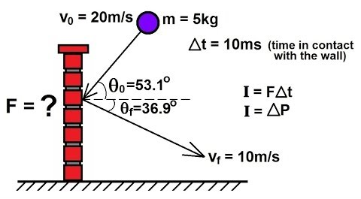
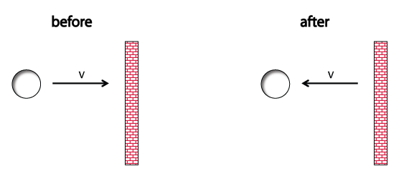
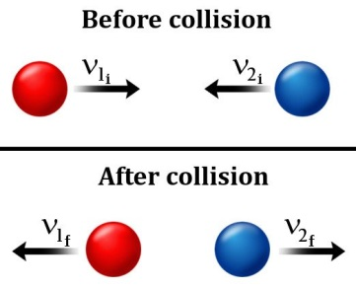
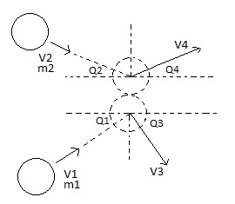
Home
Includes AS Further Maths Questions
Work-Energy Principle
Impulse and Momentum
Power
Elastic Springs, Strings & Hooke’s Law
Collisions:
One Sphere
Direct Impact
Collisions:
One Sphere
Oblique Impact
Collisions:
Two Spheres
Direct Impact
Collisions:
Two Spheres
Oblique Impact

Slide 5
New Spec Q’s
Old Spec Work-Energy Principle
June 2001
June 2005
May 2008
Jan 2012
June 2015
Jan 2002
Jan 2006
Jan 2009
May 2012
June 2016
June 2002
June 2006
May 2009
Jan 2013
June 2017
Jan 2003
Jan 2007
Jan 2010
June 2013 (a only)
June 2019
Jan 2004
June 2007 (i)
June 2010
June 2013 (R)
June 2004 (part a only)
June 2007 (ii) [C only]
Jan 2011
June 2014
Jan 2005
Jan 2008
June 2011
June 2014 (R)
see also:
Impulse and Momentum

Slide 6
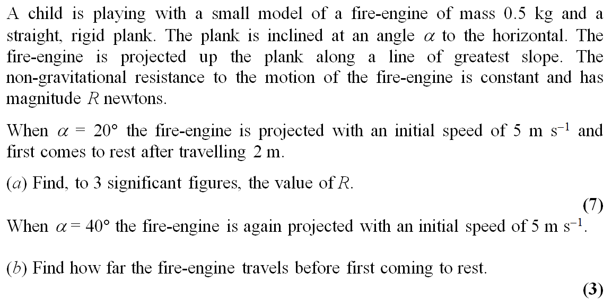
June 2001

Slide 7
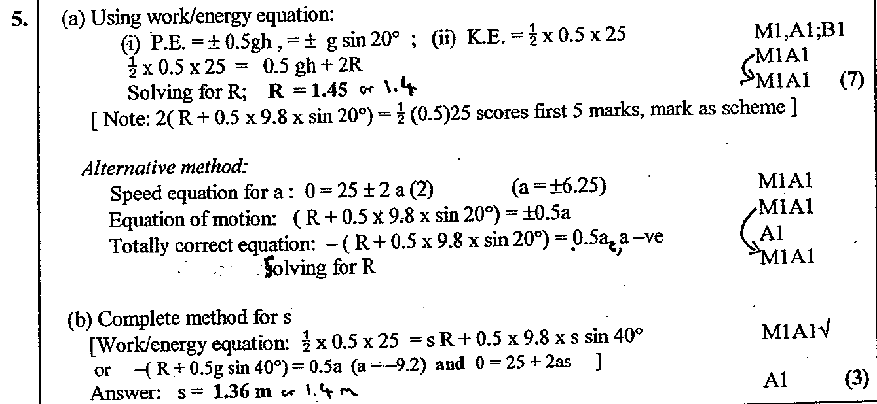
June 2001
A
B

Slide 8
Jan 2002

Slide 9
Jan 2002
A

Slide 10
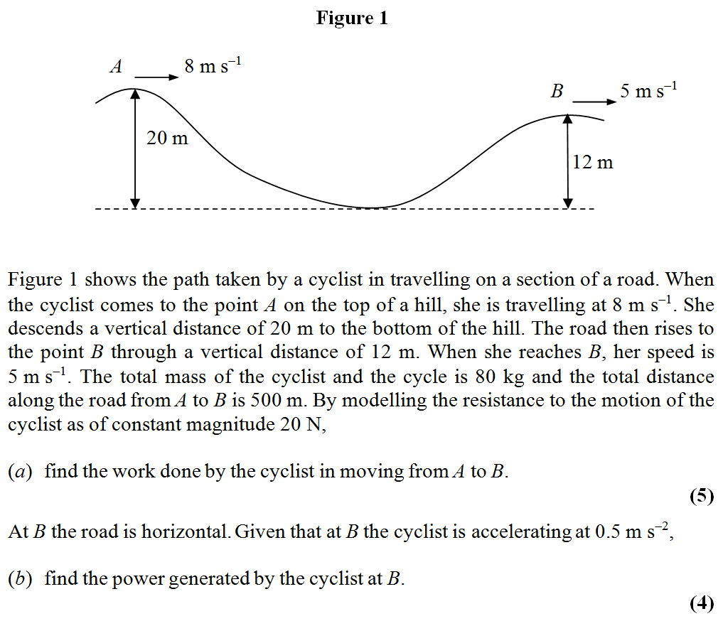
June 2002

Slide 11
June 2002
A
B

Slide 12
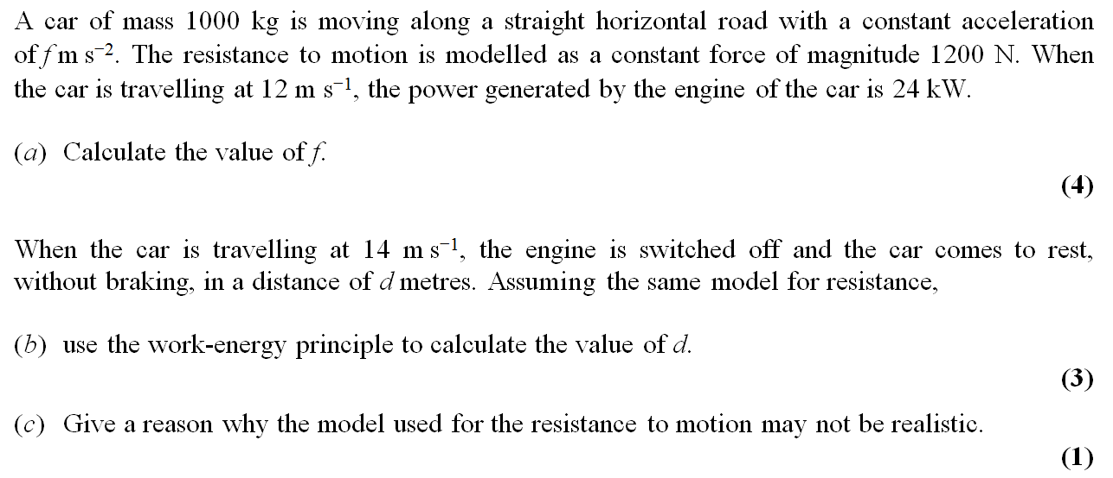
Jan 2003

Slide 13
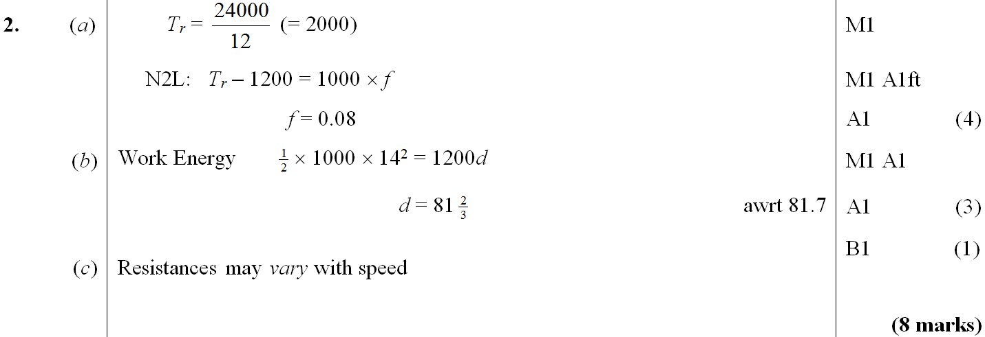
Jan 2003
A
B
C

Slide 14
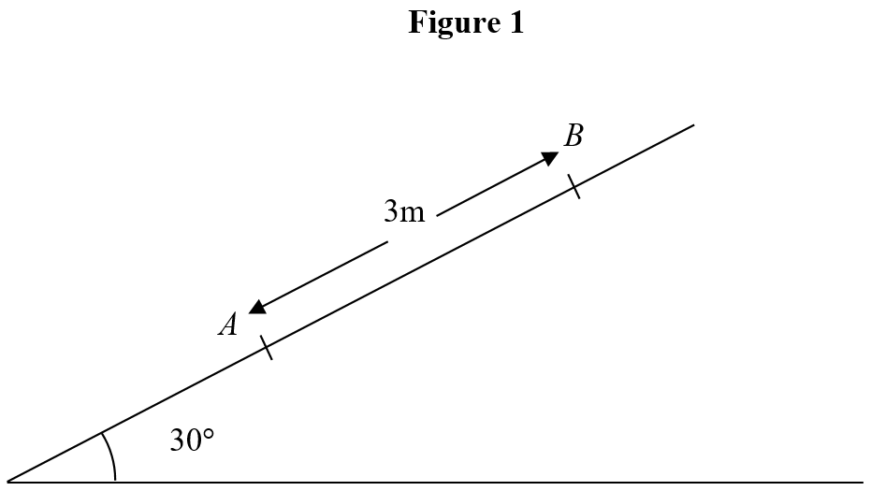
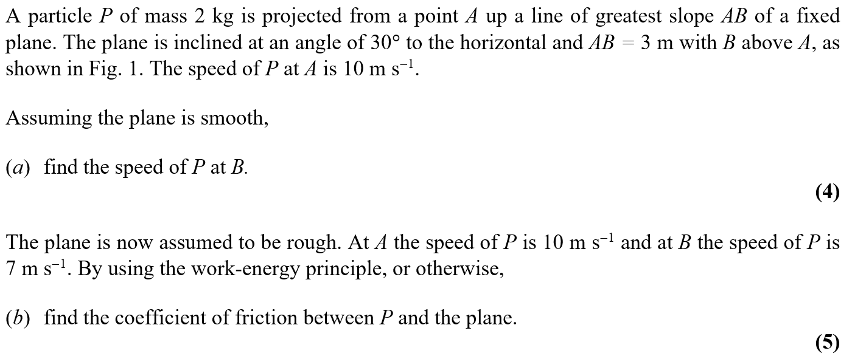
Jan 2004

Slide 15
Jan 2004
A

Slide 16
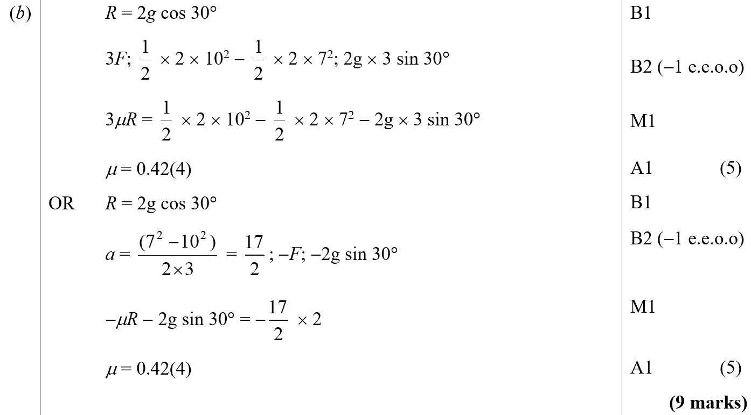
Jan 2004
B

Slide 17
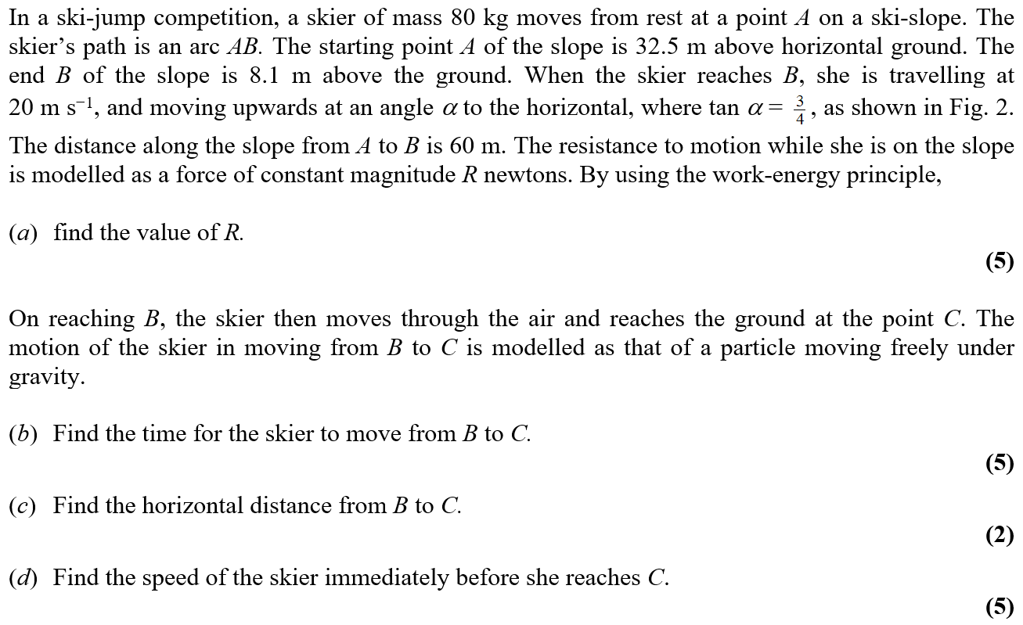
June 2004

Slide 18
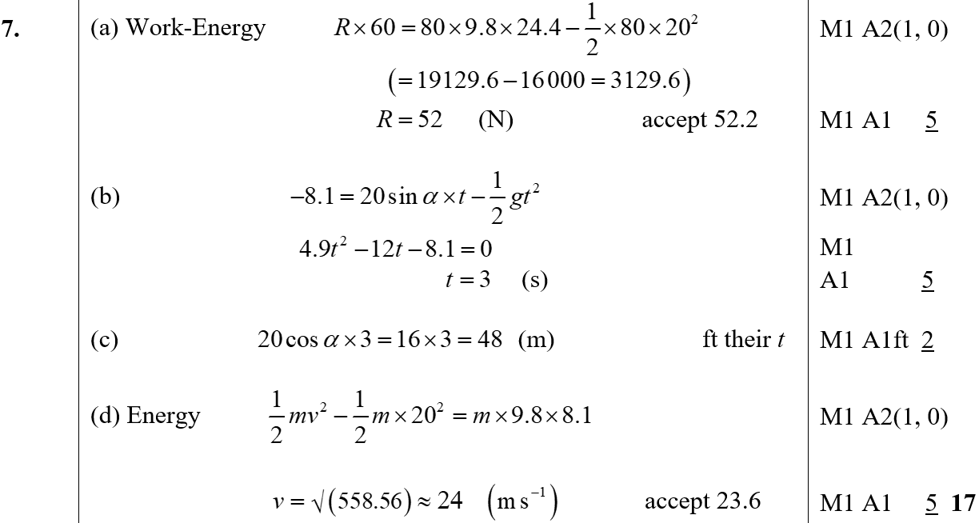
June 2004
A
B
C
D
D Alternative

Slide 19
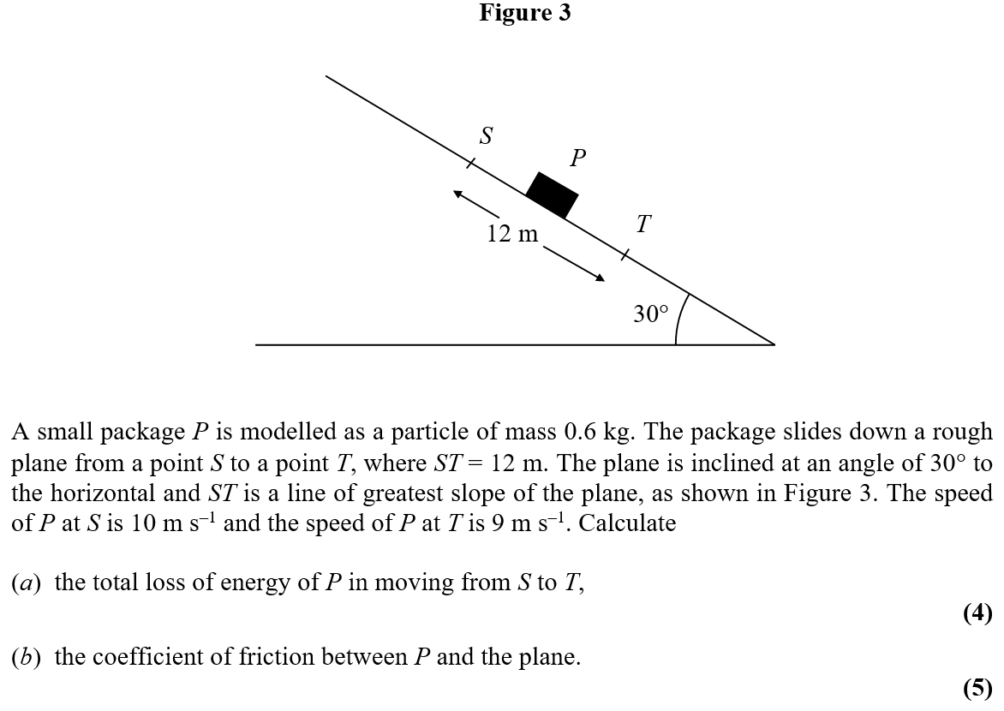
Jan 2005

Slide 20
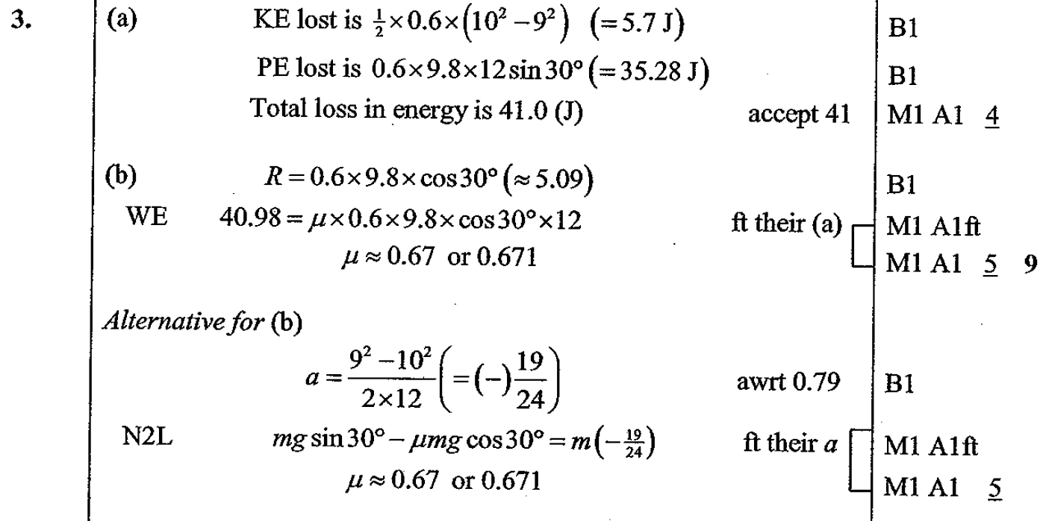
Jan 2005
A
B

Slide 21
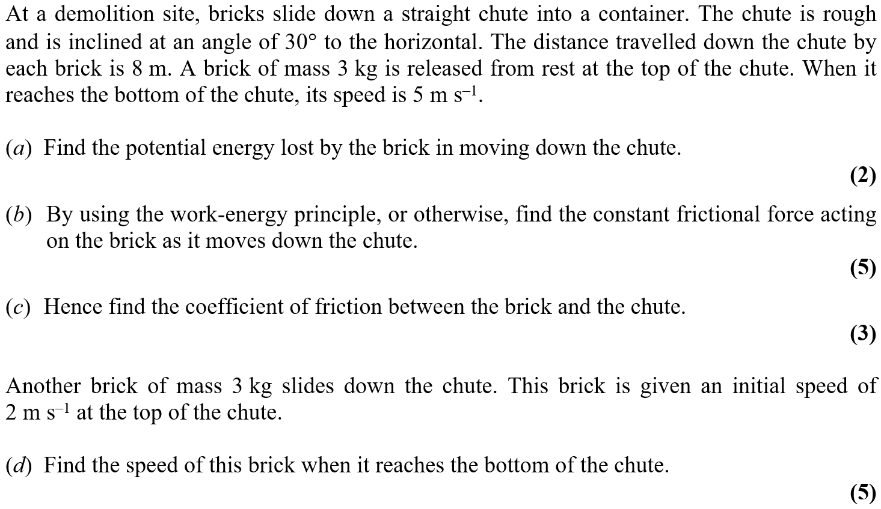
June 2005

Slide 22
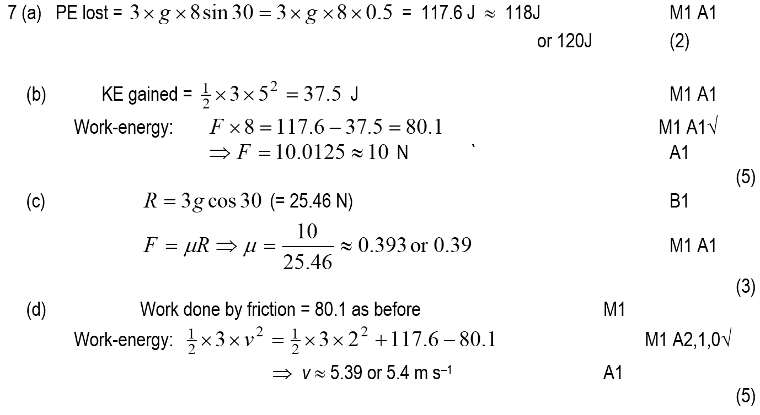
June 2005
A
B
C
D

Slide 23
Jan 2006

Slide 24
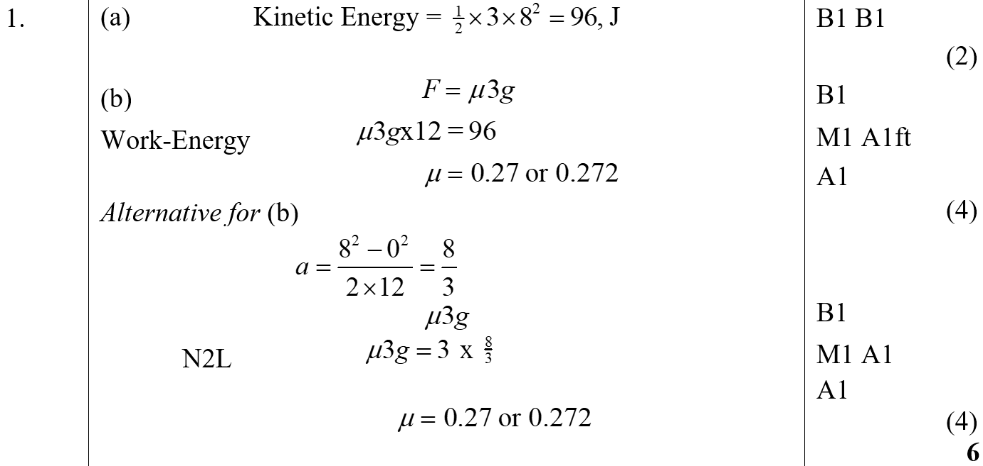
Jan 2006
A
B

Slide 25
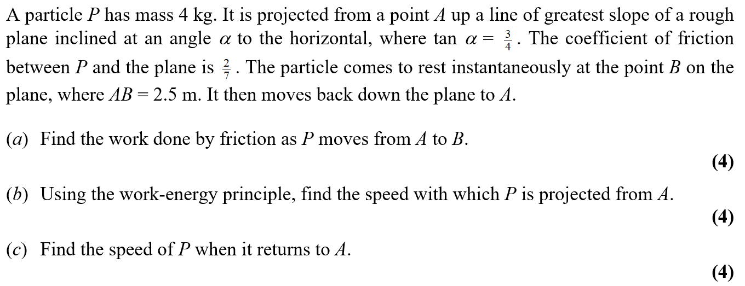
June 2006

Slide 26
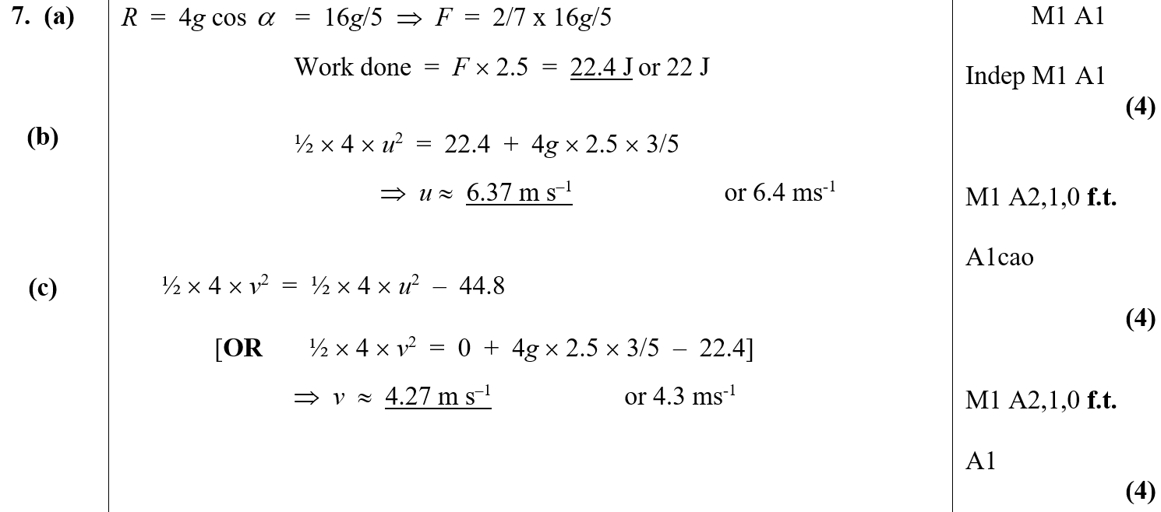
June 2006
A
B
C

Slide 27
Jan 2007

Slide 28
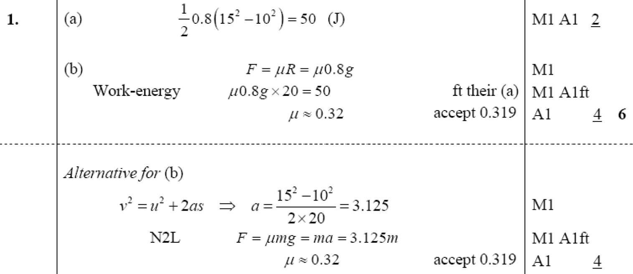
Jan 2007
A
B
B Alternative (i)

Slide 29
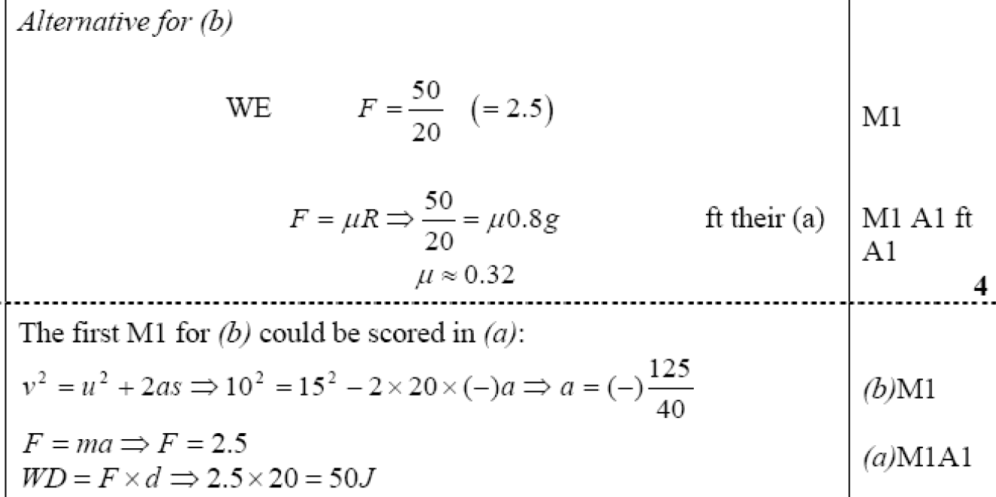
Jan 2007
B Alternative (ii)
Notes

Slide 30
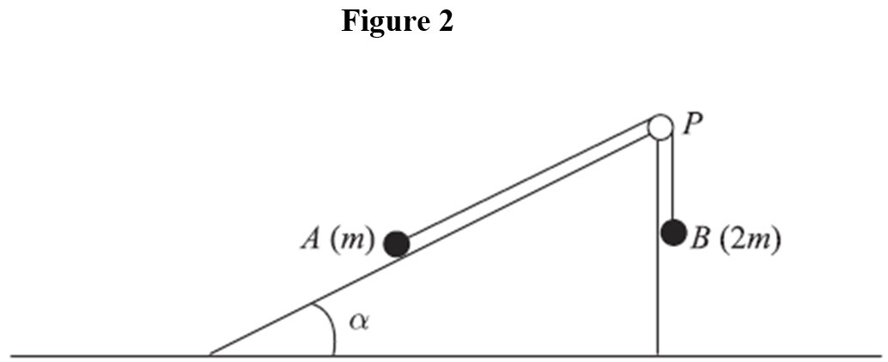
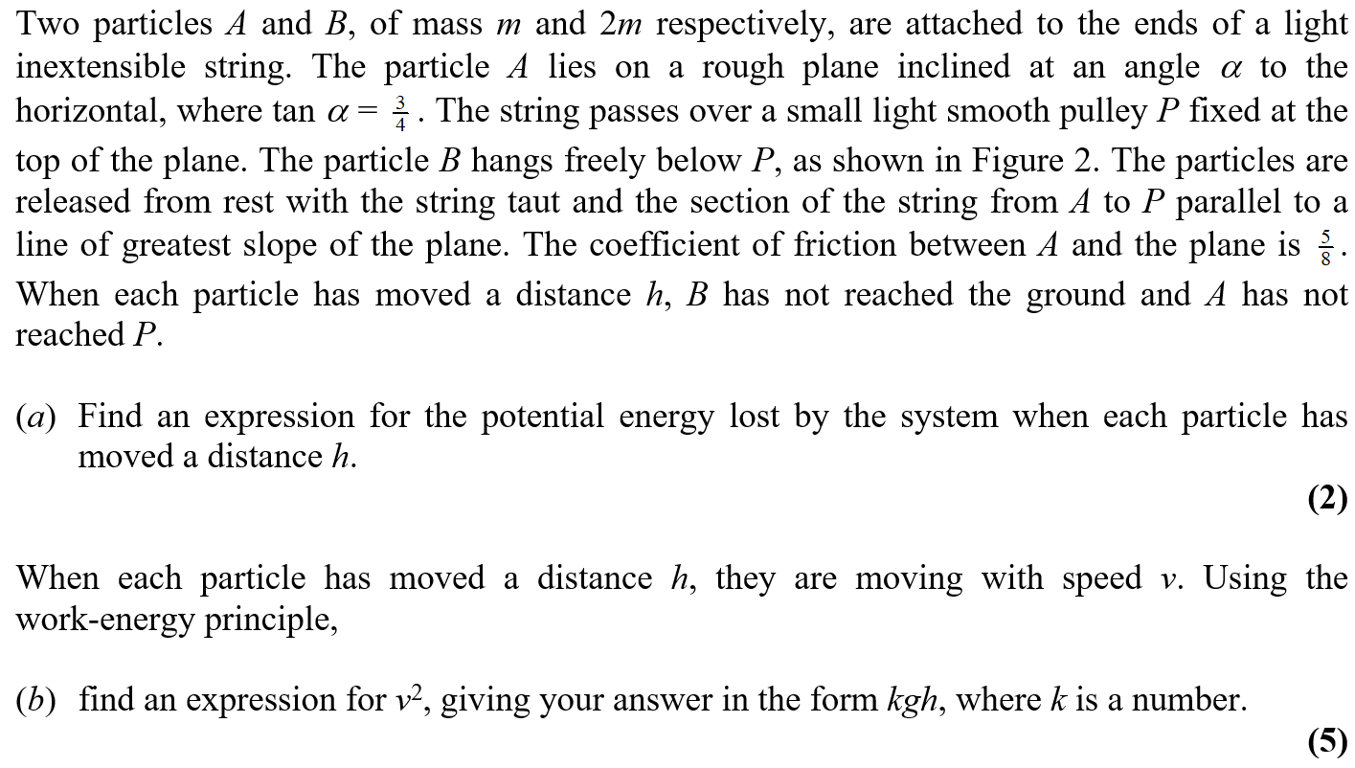
June 2007

Slide 31
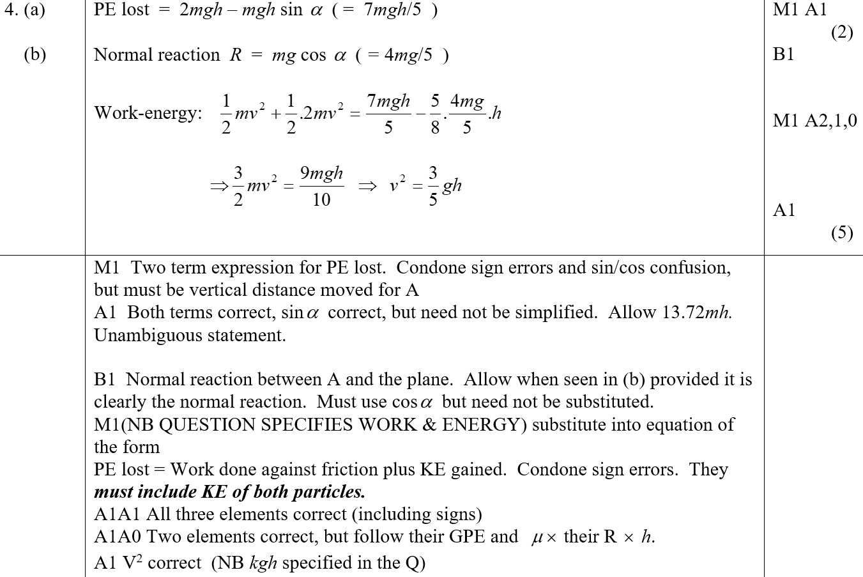
June 2007
A
B
A Notes
B Notes

Slide 32
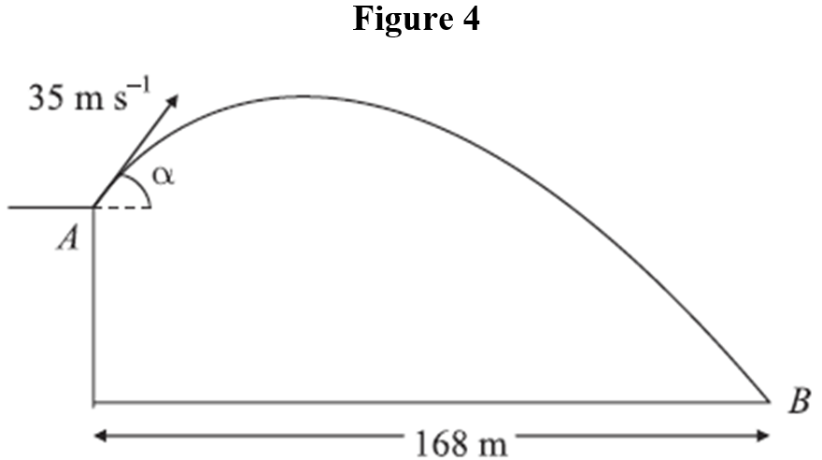
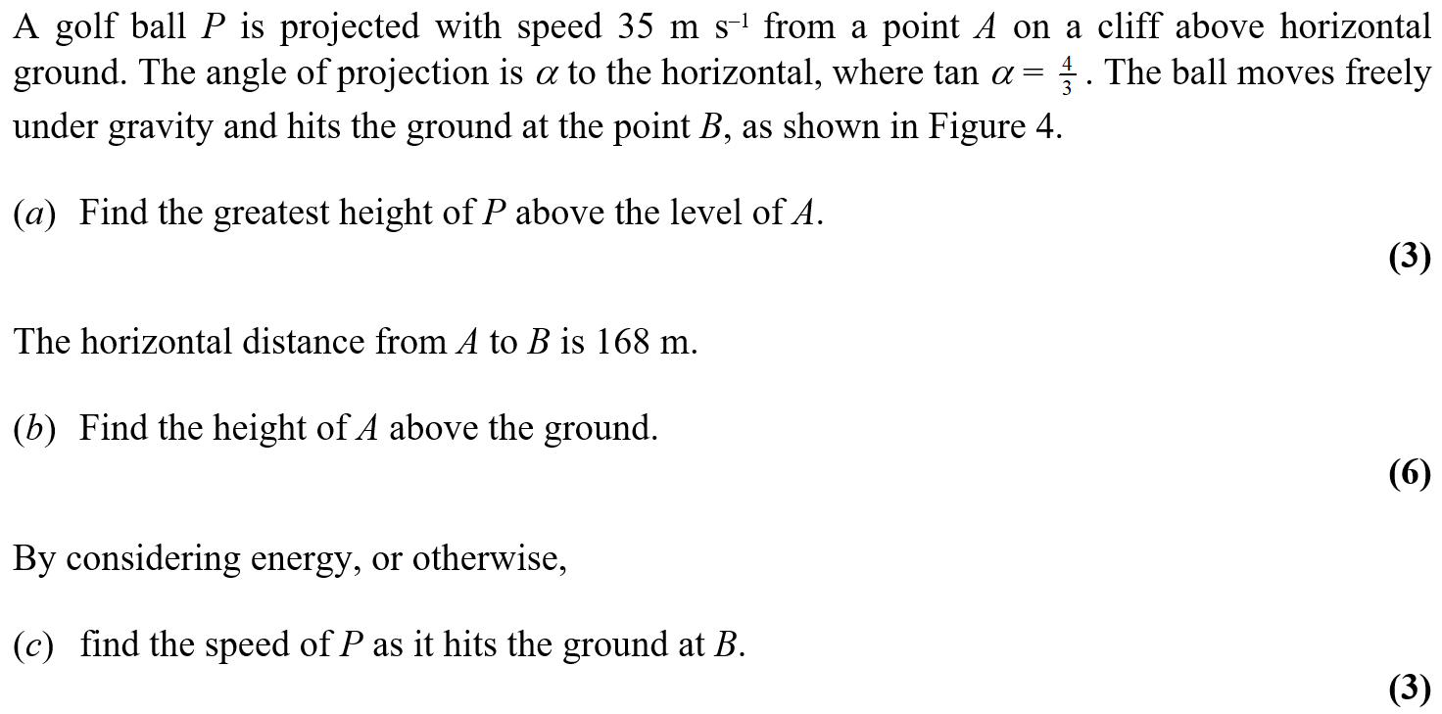
June 2007

Slide 33
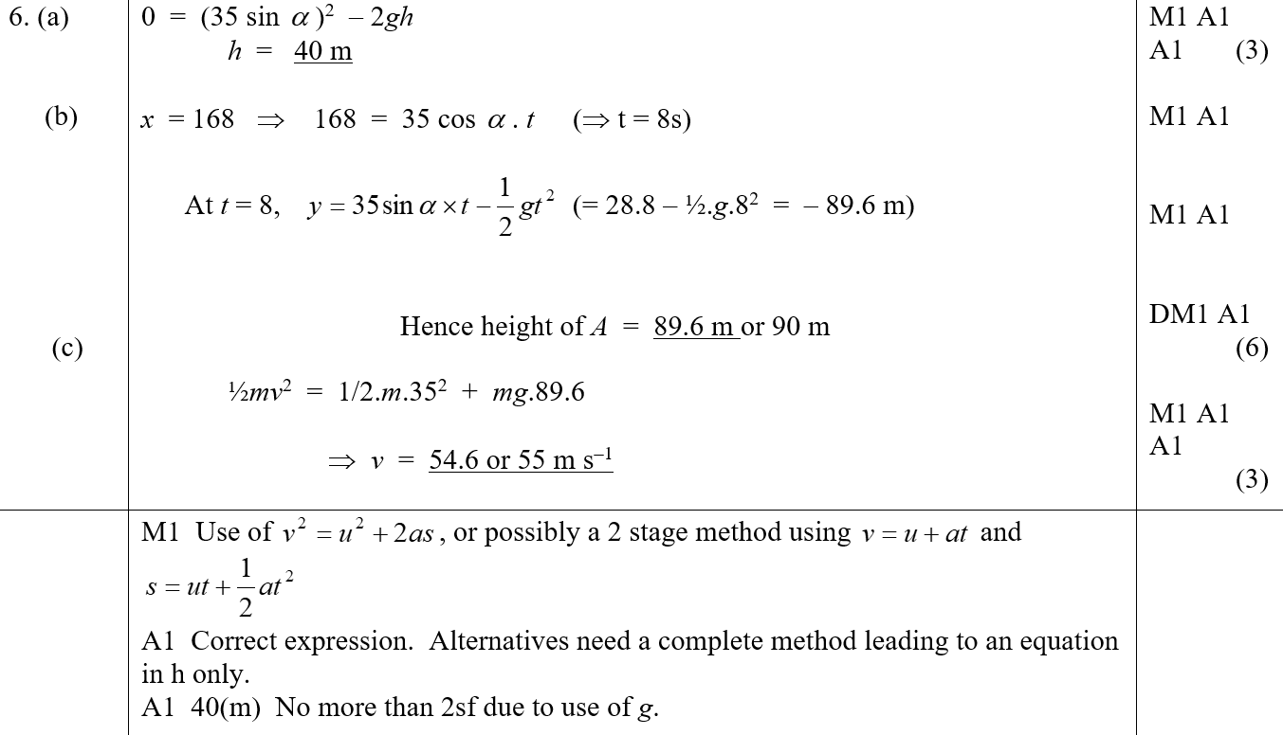
June 2007
A
B
C
A Notes

Slide 34
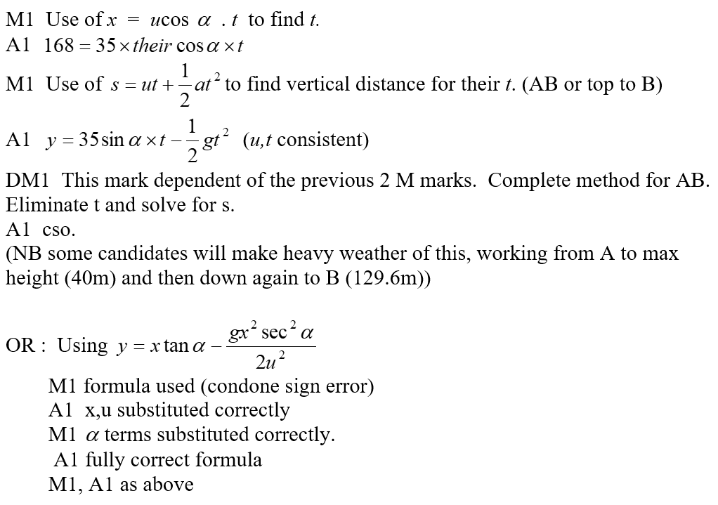
June 2007
B Notes

Slide 35
June 2007
C Notes

Slide 36
Jan 2008

Slide 37
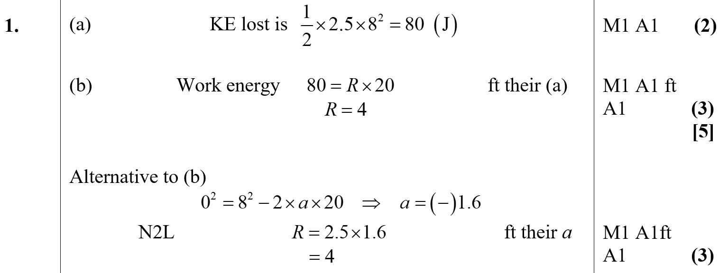
Jan 2008
A
B

Slide 38
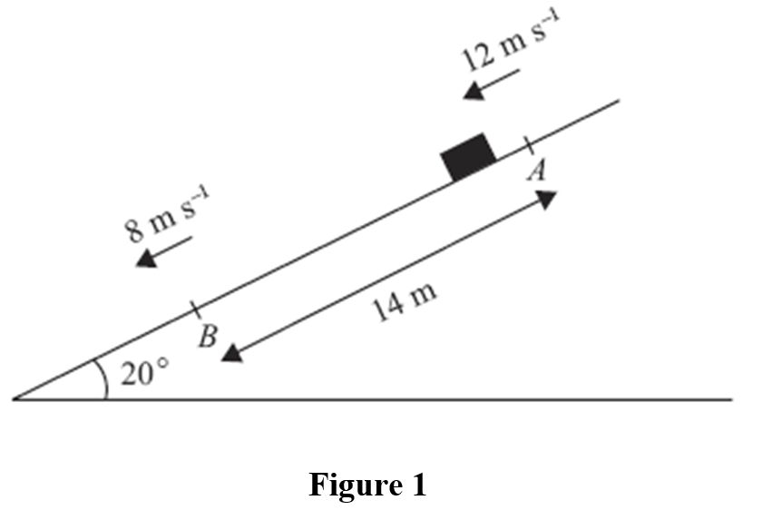
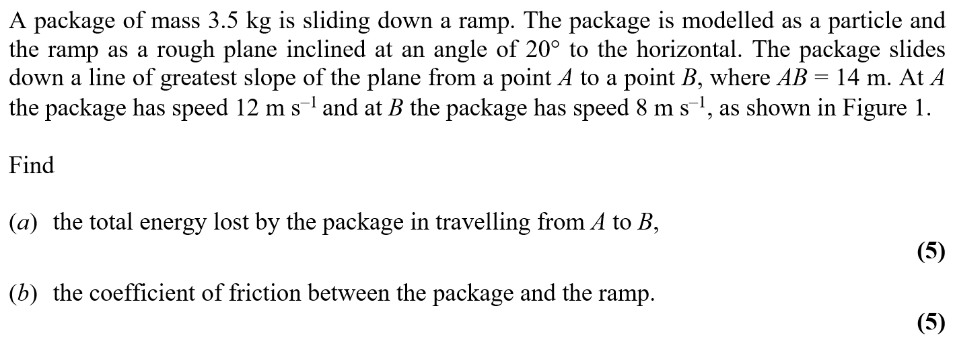
May 2008

Slide 39
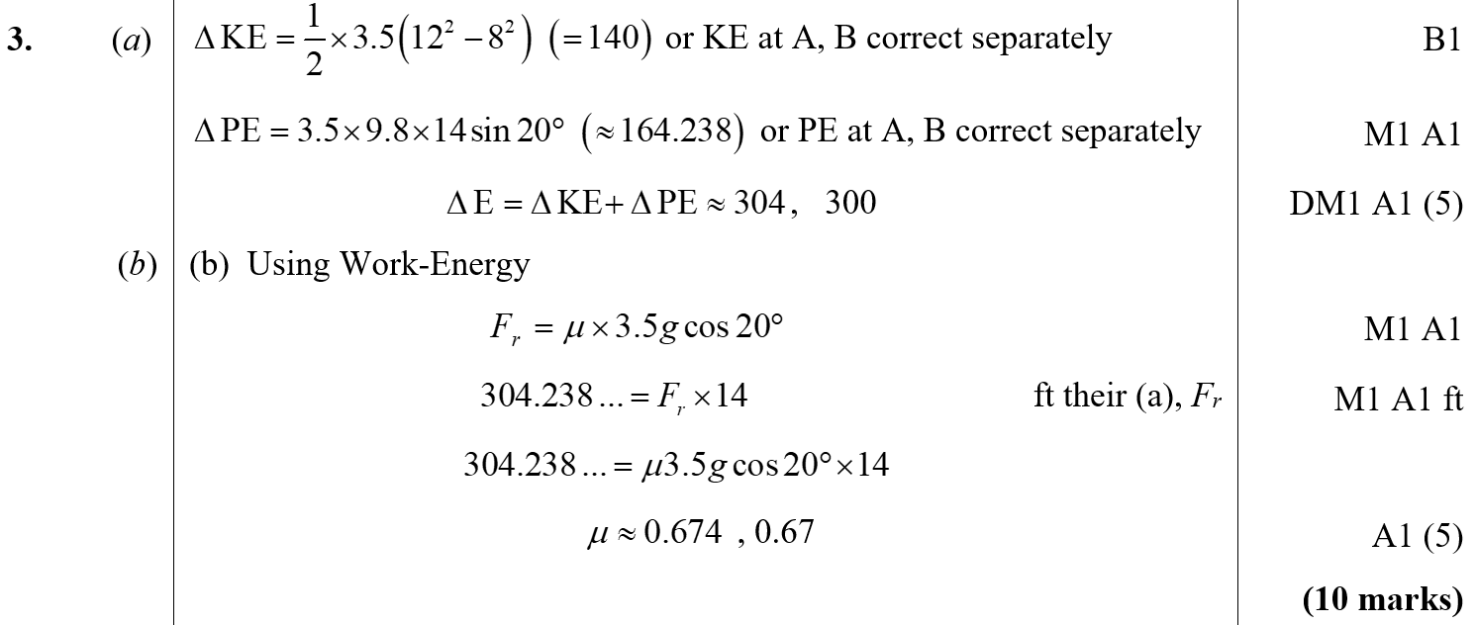
May 2008
A
B

Slide 40
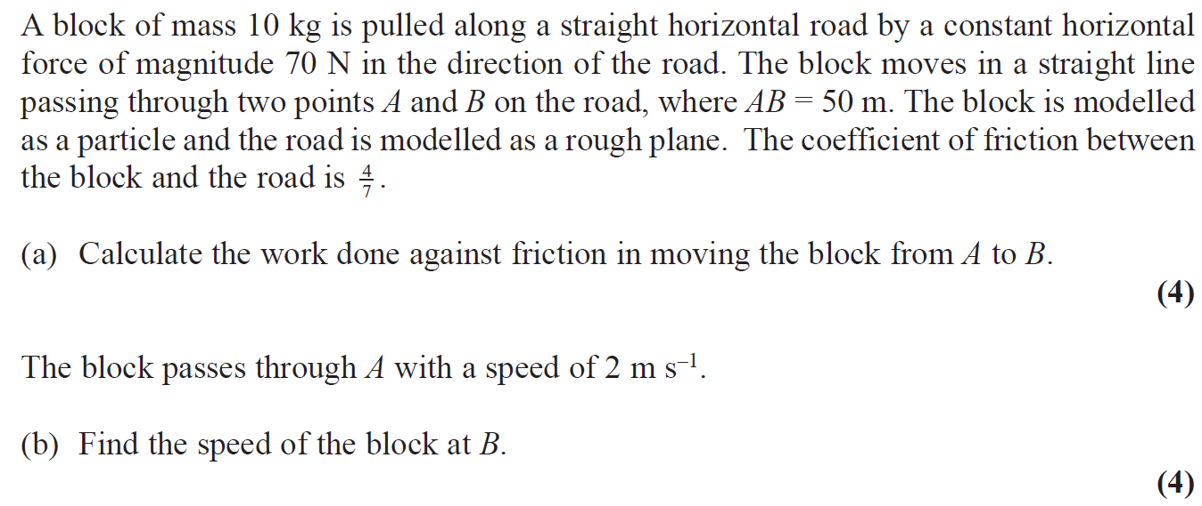
Jan 2009

Slide 41
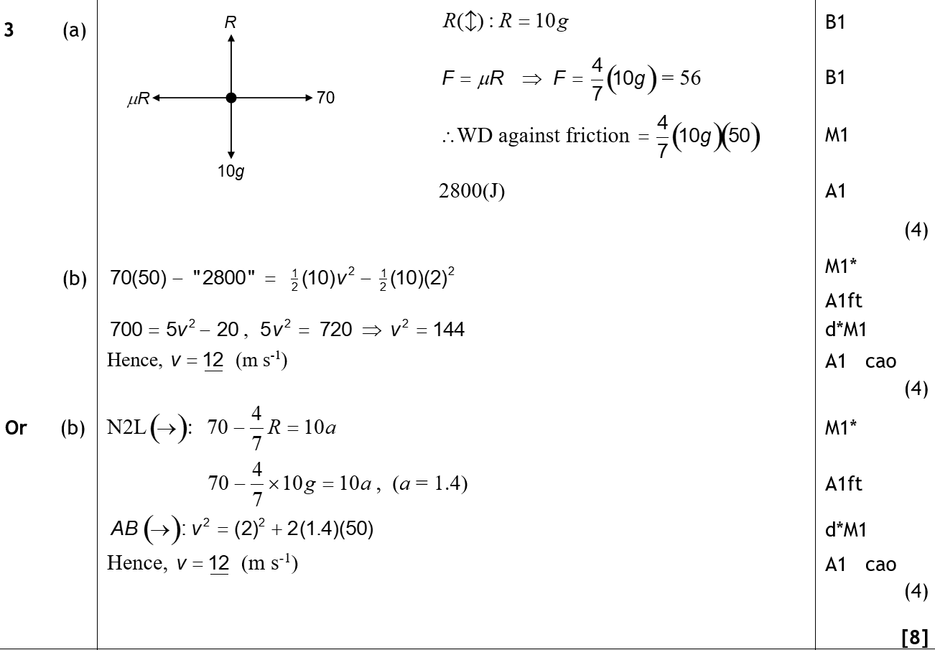
Jan 2009
A
B

Slide 42
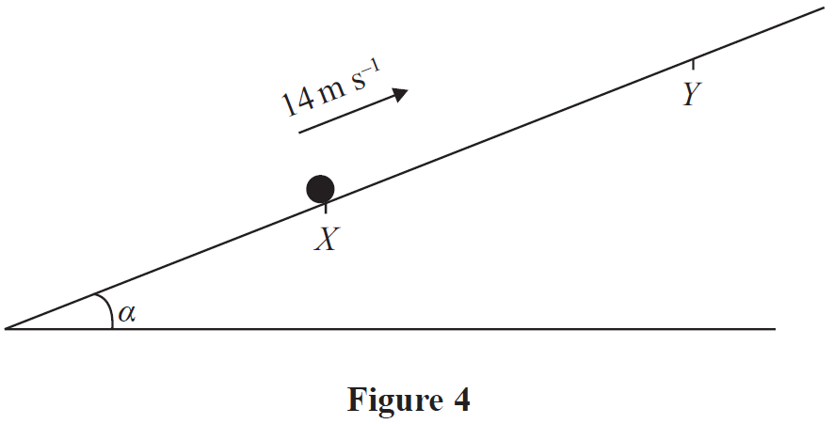
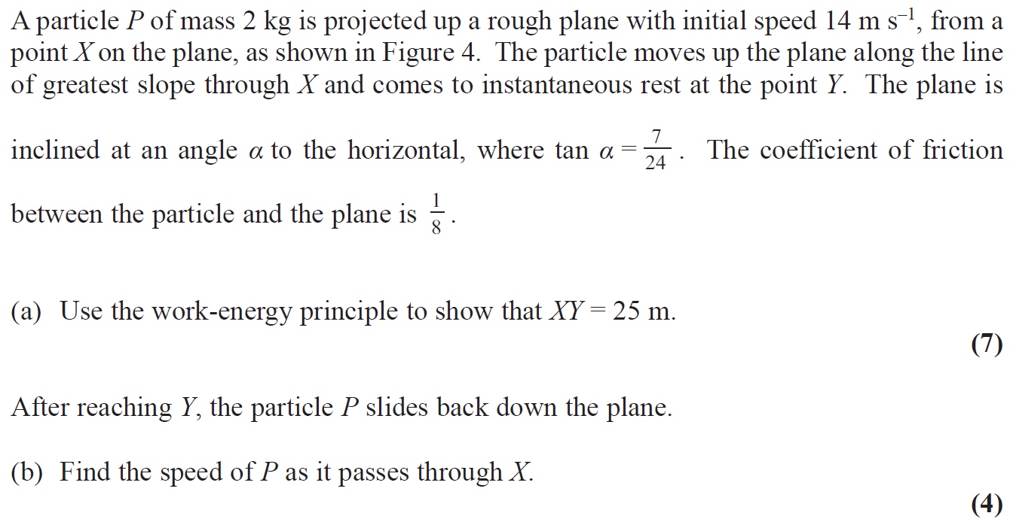
May 2009

Slide 43
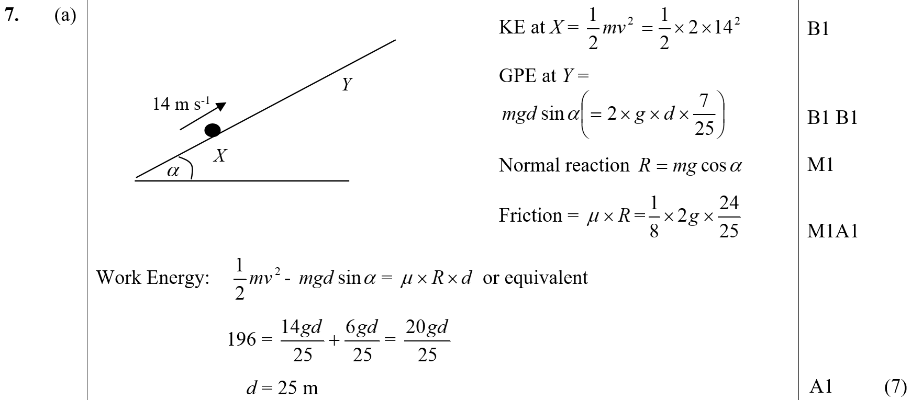
May 2009
A

Slide 44
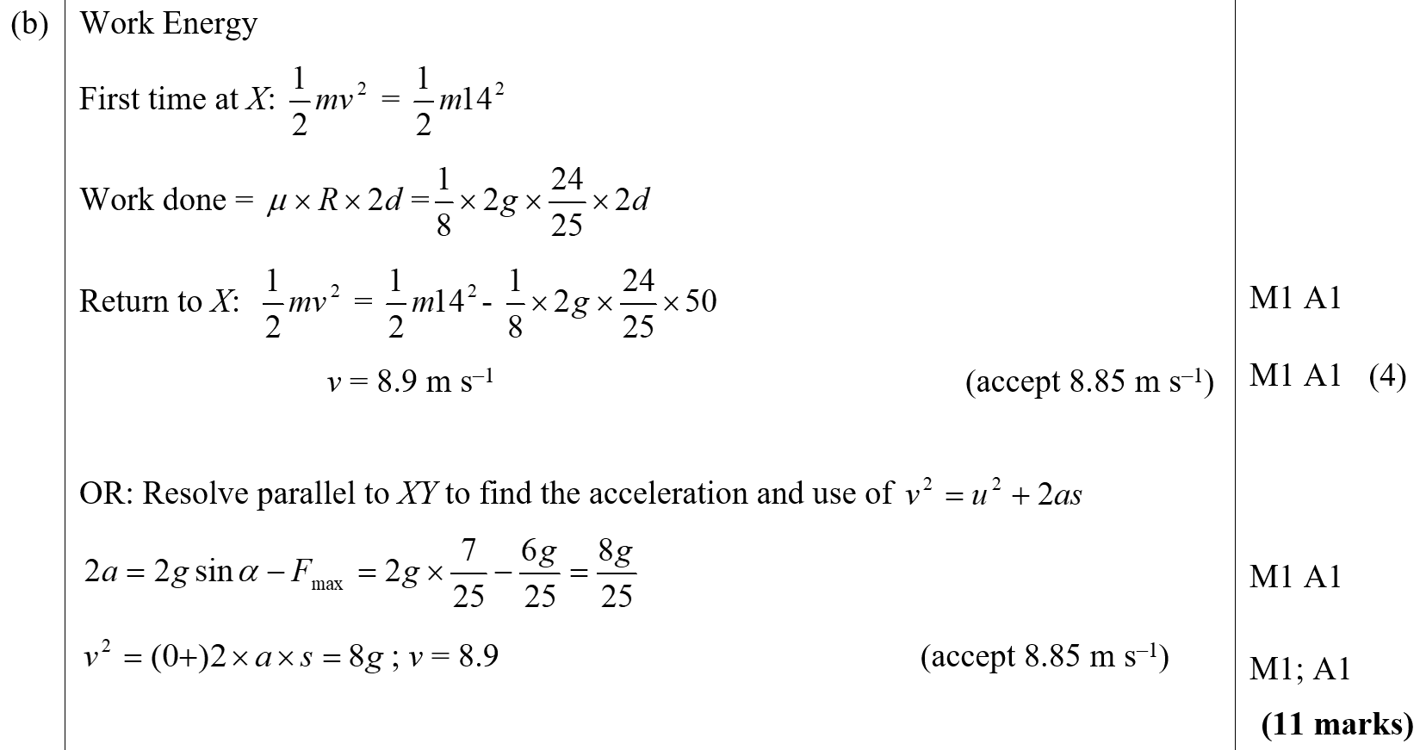
May 2009
B

Slide 45
Jan 2010

Slide 46
Jan 2010
A

Slide 47
June 2010

Slide 48
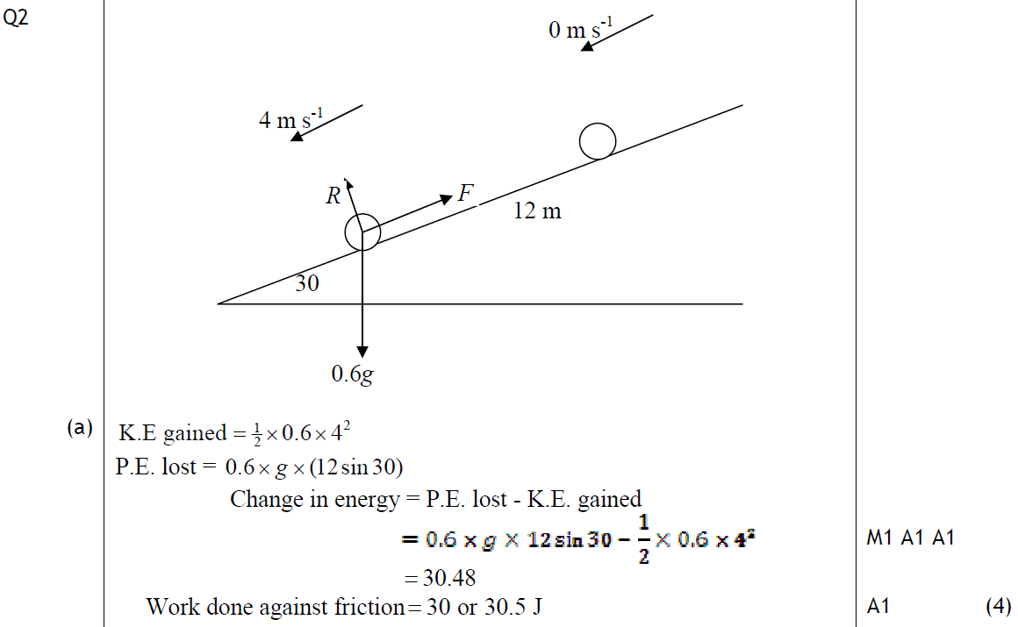
June 2010
A

Slide 49
June 2010
B

Slide 50
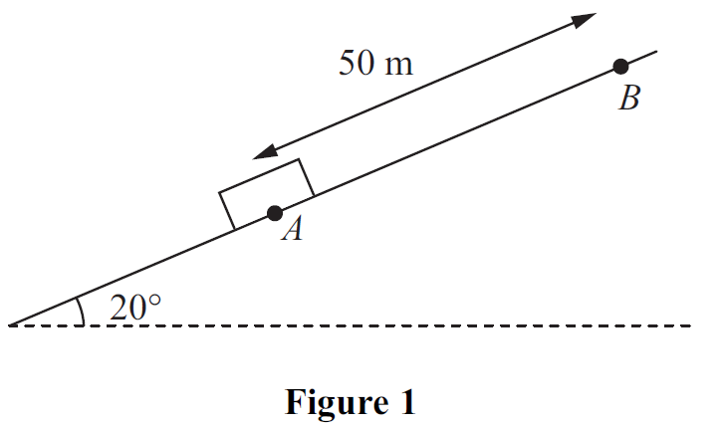
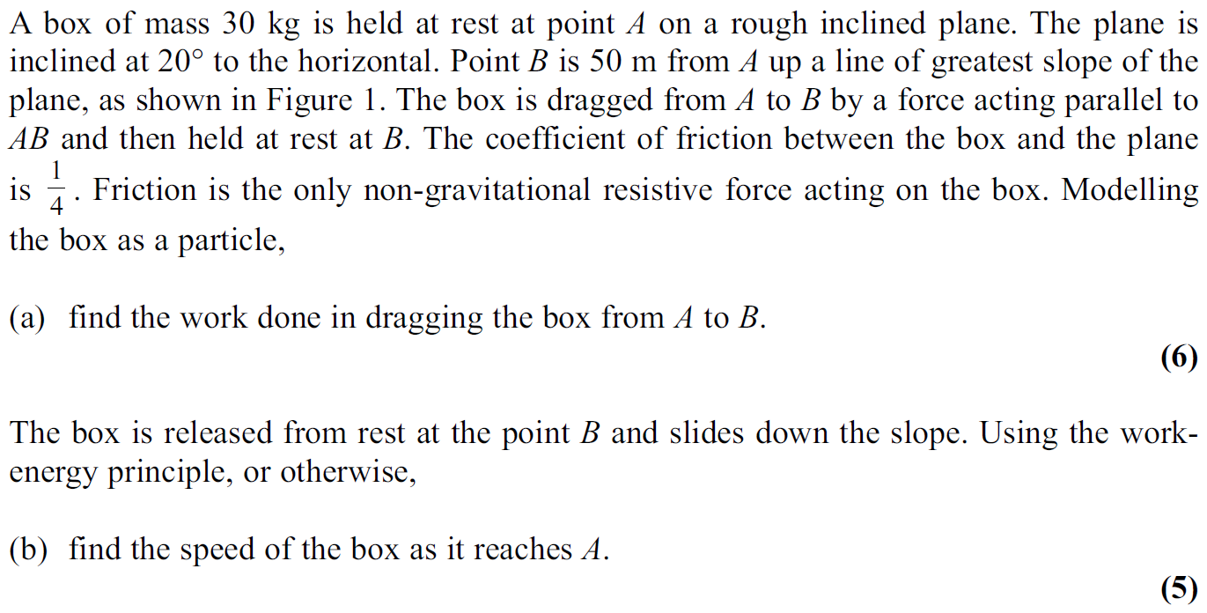
Jan 2011

Slide 51
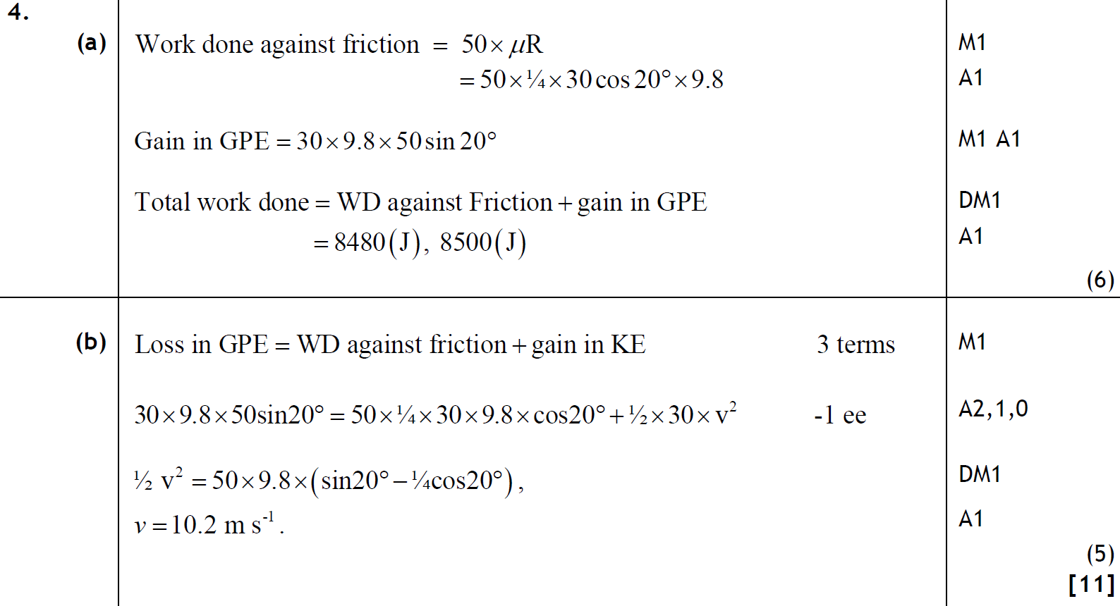
Jan 2011
A
B

Slide 52
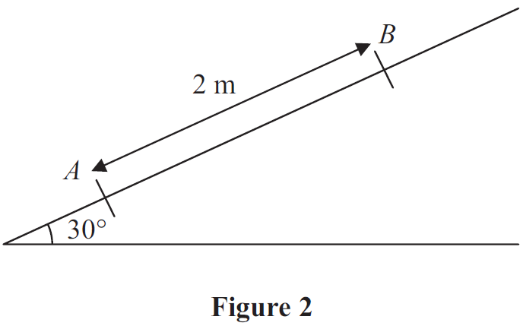
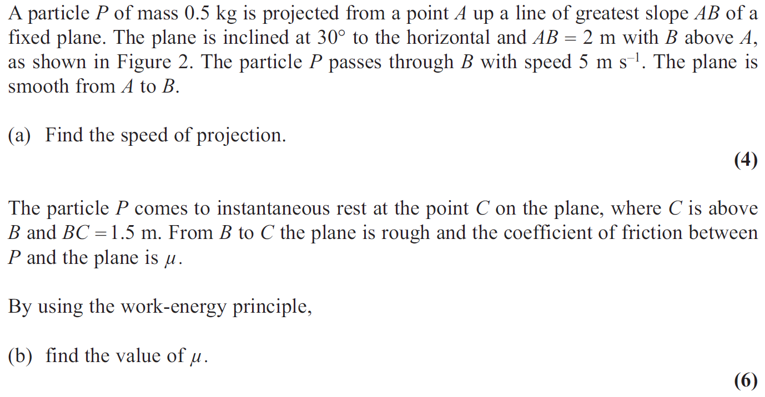
June 2011

Slide 53
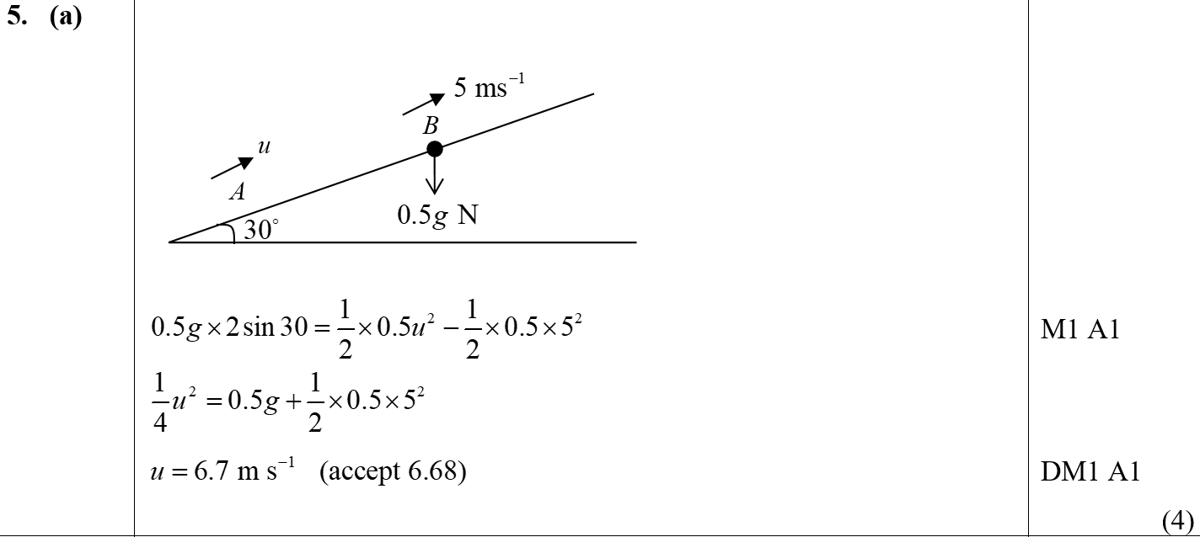
June 2011
A

Slide 54
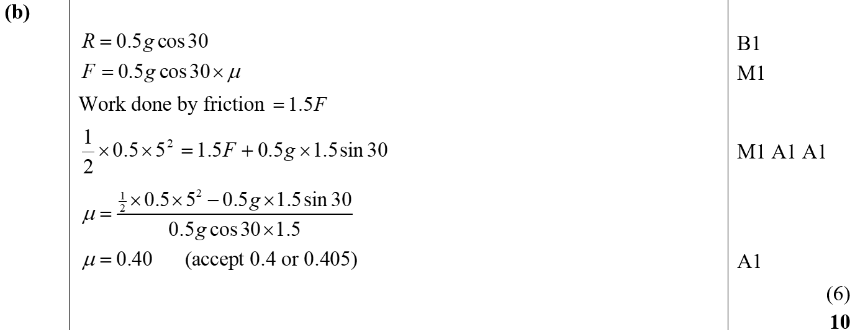
June 2011
B

Slide 55
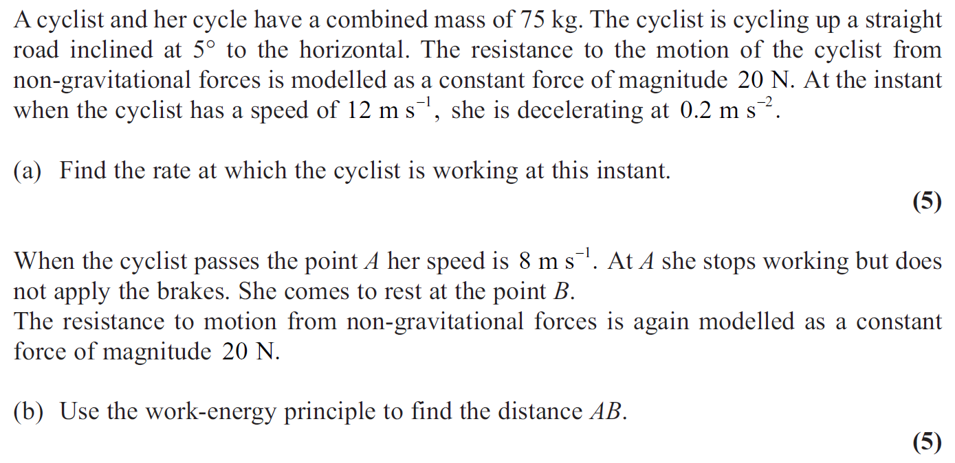
Jan 2012

Slide 56
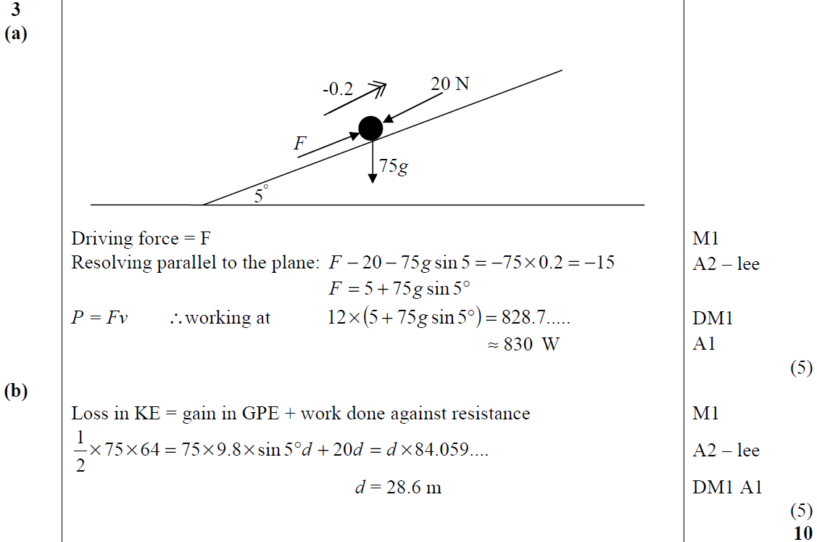
Jan 2012
A
B

Slide 57
May 2012

Slide 58
May 2012
A
B
A Alternative
B Alternative

Slide 59
May 2012
C

Slide 60
Jan 2013

Slide 61
Jan 2013
A
B

Slide 62
Jan 2013
C

Slide 63
June 2013

Slide 64
June 2013
A
B
C

Slide 65
June 2013 (R)

Slide 66
June 2013 (R)
A

Slide 67
June 2014

Slide 68
June 2014
A
B

Slide 69
June 2014 (R)

Slide 70
June 2014 (R)
A
B
C

Slide 71
June 2015

Slide 72
June 2015
A
B

Slide 73
June 2016

Slide 74
June 2016
A
B

Slide 75
June 2017

Slide 76
June 2017
A

Slide 77
June 2017
B
C

Slide 78
June 2019

Slide 79
June 2019
A
B

Slide 80
Old Spec Q’s
Work-Energy Principle
Specimen
Specimen
SAM
SAM
2018
2019
2019
see also:
Impulse and Momentum
Collisions: Two Spheres Direct Impact

Slide 81
Specimen

Slide 82
Specimen
A
A notes

Slide 83
SAM

Slide 84
SAM
A
B
c

Slide 85
SAM
A notes
B notes
C notes

Slide 86
2018

Slide 87
2018
A
B
B Alternative 1

Slide 88
2018
B Alternative 2
C

Slide 89
2018
A (SF)
B (SF)

Slide 90
2018
C (SF)

Slide 91
2019

Slide 92
2019
A

Slide 93
2019
A notes

Slide 94
2019
A (SF)

Slide 95
Specimen

Slide 96
Specimen
A

Slide 97
Specimen
A notes

Slide 98
SAM

Slide 99
SAM
A
B

Slide 100
SAM
A notes
B notes

Slide 101
2019

Slide 102
2019
A
B
C

Slide 103
New Spec Q’s
Old Spec Power
Jan 2002
June 2005
Jan 2009
Jan 2013
June 2018
June 2002
Jan 2006
May 2009
June 2013 (R)
June 2019
Jan 2003
June 2006
Jan 2010
June 2014
June 2003
Jan 2007
June 2010
June 2014 (R)
Jan 2004
June 2007
Jan 2011
June 2015
June 2004
Jan 2008
June 2011
June 2016
Jan 2005
May 2008
May 2012
June 2017

Slide 104
Jan 2002

Slide 105
Jan 2002
A
B
C

Slide 106
June 2002

Slide 107
June 2002
A
B

Slide 108
Jan 2003

Slide 109
Jan 2003
A
B
C

Slide 110
June 2003

Slide 111
June 2003
A
B
C
D

Slide 112
Jan 2004

Slide 113
Jan 2004
A

Slide 114
June 2004

Slide 115
June 2004
A
B

Slide 116
Jan 2005

Slide 117
Jan 2005
A
B
C
D
E

Slide 118
June 2005

Slide 119
June 2005
A
B

Slide 120
Jan 2006

Slide 121
Jan 2006
A
B

Slide 122
June 2006

Slide 123
June 2006
A
B

Slide 124
Jan 2007

Slide 125
Jan 2007
A
B

Slide 126
Jan 2007
General notes and Alternatives for B

Slide 127
June 2007

Slide 128
June 2007
A
notes

Slide 129
Jan 2008

Slide 130
Jan 2008
A
B

Slide 131
May 2008

Slide 132
May 2008
A

Slide 133
Jan 2009

Slide 134
Jan 2009
A

Slide 135
May 2009

Slide 136
May 2009
A
B

Slide 137
Jan 2010

Slide 138
Jan 2010
A
B

Slide 139
June 2010

Slide 140
June 2010
A

Slide 141
June 2010
B

Slide 142
Jan 2011

Slide 143
Jan 2011
A
B

Slide 144
June 2011

Slide 145
June 2011
A

Slide 146
May 2012

Slide 147
May 2012
A
B
A Alternative
B Alternative

Slide 148
May 2012
C

Slide 149
Jan 2013

Slide 150
Jan 2013
A

Slide 151
Jan 2013
B

Slide 152
June 2013 (R)

Slide 153
June 2013 (R)
A
B

Slide 154
June 2014

Slide 155
June 2014
A
B

Slide 156
June 2014 (R)

Slide 157
June 2014 (R)
A
B

Slide 158
June 2015

Slide 159
June 2015
A

Slide 160
June 2016

Slide 161
June 2016
A
B

Slide 162
June 2017

Slide 163
June 2017
A

Slide 164
June 2017
B
C

Slide 165
June 2018

Slide 166
June 2018
A

Slide 167
June 2018
B

Slide 168
June 2019

Slide 169
June 2019
A

Slide 170
Old Spec Q’s
Power
Specimen
Specimen
SAM
SAM
2018
2019
2019

Slide 171
Specimen

Slide 172
Specimen
A

Slide 173
Specimen
B

Slide 174
Specimen
A notes
B notes

Slide 175
SAM

Slide 176
SAM
A
B

Slide 177
SAM
A notes
B notes

Slide 178
2018

Slide 179
2018
A
B

Slide 180
2018
A (SF)
B (SF)

Slide 181
2019

Slide 182
2019
A
B

Slide 183
2019
A notes
B notes

Slide 184
2019
A (SF)
B (SF)

Slide 185
Specimen

Slide 186
Specimen
A
B

Slide 187
Specimen
A notes
B notes

Slide 188
SAM

Slide 189
SAM
A
B

Slide 190
SAM
A notes
B notes

Slide 191
2019

Slide 192
2019
A
B
C

Slide 193
New Spec Q’s
Old Spec Elastic Springs, Strings & Hooke’s Law
June 2001
Jan 2004
June 2007
Jan 2010 (i)
Jan 2013
May 2015 (i)
Jan 2002 (i)
May 2004
Jan 2008 (i)
Jan 2010 (ii)
June 2013 (i)
May 2015 (i) a only
Jan 2002 (ii)
June 2005 (i)
Jan 2008 (ii)
June 2010
June 2013 (ii) a only
May 2016
May 2002
June 2005 (ii)
June 2008
Jan 2011
June 2013 (withdrawn)
May 2017
Jan 2003 (i)
Jan 2006
Jan 2009 (i)
June 2011
June 2013 (R)
May 2018
Jan 2003 (ii)
June 2006
Jan 2009 (ii)
Jan 2012
May 2014
May 2019 (i)
May 2003
Jan 2007
June 2009
June 2012 (ignore c & d)
May 2014 (R)
May 2019 (ii) a only
ignore harmonic motion parts (I included a couple, but not all of these questions from old M3 papers)

Slide 194
June 2001

Slide 195
June 2001
A
B

Slide 196
Jan 2002

Slide 197
Jan 2002
A
B

Slide 198
Jan 2002

Slide 199
Jan 2002
A
B
C

Slide 200
May 2002

Slide 201
May 2002
A
B

Slide 202
Jan 2003

Slide 203
Jan 2003
A

Slide 204
Jan 2003

Slide 205
Jan 2003
A
B

Slide 206
May 2003

Slide 207
May 2003
A

Slide 208
Jan 2004

Slide 209
Jan 2004
A
B

Slide 210
Jan 2004
C

Slide 211
May 2004

Slide 212
May 2004
A

Slide 213
June 2005

Slide 214
June 2005
A

Slide 215
June 2005

Slide 216
June 2005
A
B

Slide 217
Jan 2006

Slide 218
Jan 2006
A
B
C

Slide 219
June 2006

Slide 220
June 2006
A

Slide 221
June 2006
B

Slide 222
Jan 2007

Slide 223
Jan 2007
A
B

Slide 224
June 2007

Slide 225
June 2007
A

Slide 226
June 2007
B

Slide 227
Jan 2008

Slide 228
Jan 2008
A
B

Slide 229
Jan 2008

Slide 230
Jan 2008
A
B

Slide 231
Jan 2008
notes

Slide 232
June 2008

Slide 233
June 2008
A
B

Slide 234
Jan 2009

Slide 235
Jan 2009
A

Slide 236
Jan 2009
B

Slide 237
Jan 2009

Slide 238
Jan 2009
A
B

Slide 239
June 2009

Slide 240
June 2009
A
B

Slide 241
Jan 2010

Slide 242
Jan 2010
A

Slide 243
Jan 2010

Slide 244
Jan 2010
A
B
C

Slide 245
Jan 2010
B Alternative

Slide 246
Jan 2010
B & C Alternatives

Slide 247
June 2010

Slide 248
June 2010
A

Slide 249
Jan 2011

Slide 250
Jan 2011
A

Slide 251
Jan 2011
B

Slide 252
June 2011

Slide 253
June 2011
A

Slide 254
June 2011
B
C

Slide 255
Jan 2012

Slide 256
Jan 2012
A

Slide 257
June 2012 (ignore part c & d)

Slide 258
June 2012
A
B

Slide 259
June 2012
C
D

Slide 260
Jan 2013

Slide 261
Jan 2013
A
B

Slide 262
Jan 2013
C

Slide 263
June 2013

Slide 264
June 2013
A

Slide 265
June 2013
B

Slide 266
June 2013
A notes

Slide 267
June 2013
B notes

Slide 268
June 2013 (part a only)

Slide 269
June 2013
A
B

Slide 270
June 2013
C

Slide 271
June 2013
A notes
B notes

Slide 272
June 2013
C notes

Slide 273
June 2013 (withdrawn)

Slide 274
June 2013 (withdrawn)
A

Slide 275
June 2013 (R)

Slide 276
June 2013 (R)
A
B

Slide 277
May 2014

Slide 278
May 2014
A
B

Slide 279
May 2014
A notes
B notes

Slide 280
May 2014
further notes

Slide 281
May 2014
A Alternative
B Alternative

Slide 282
May 2014 (R)

Slide 283
May 2014 (R)
A
B

Slide 284
May 2014 (R)
A notes
B notes

Slide 285
May 2015

Slide 286
May 2015
A
B

Slide 287
May 2015
A notes
B notes

Slide 288
May 2015 (part a only)

Slide 289
May 2015
A
B
C

Slide 290
May 2015
D
A notes
B notes

Slide 291
May 2015
C notes
D notes

Slide 292
May 2016

Slide 293
May 2016
A
B
A notes

Slide 294
May 2016
A Alternative (i)
A Alternative (ii)
B notes

Slide 295
May 2017

Slide 296
May 2017
A
B
C

Slide 297
May 2017
A notes
B notes
C notes

Slide 298
May 2018

Slide 299
May 2018
A

Slide 300
May 2018
A notes

Slide 301
May 2019

Slide 302
May 2019
A
B

Slide 303
May 2019
A notes
B notes
B Alternatives

Slide 304
May 2019 (part a only)

Slide 305
May 2019
A
B

Slide 306
May 2019
C

Slide 307
May 2019
A notes
B notes
C notes

Slide 308
Old Spec Q’s
Elastic Springs, Strings & Hooke’s Law
Specimen (i)
Specimen (ii)
SAM
2019

Slide 309
Specimen

Slide 310
Specimen
A

Slide 311
Specimen
A notes

Slide 312
Specimen

Slide 313
Specimen
A
B

Slide 314
Specimen
C
D
A notes

Slide 315
Specimen
B notes
C notes
D notes

Slide 316
SAM

Slide 317
SAM
A
B

Slide 318
SAM
C
D

Slide 319
SAM
A notes
B notes
C notes
D notes

Slide 320
2019

Slide 321
2019
A
B

Slide 322
2019
C

Slide 323
2019
B & C Alternative (SHM)

Slide 324
New Spec Q’s
Old Spec Impulse and Momentum
June 2001
Jan 2007
Jan 2012
June 2018
note that many of these questions were taken from the old M2 course and therefore the lead in to the impulse part of the question may come from a variable acceleration scenario
Jan 2003*
Jan 2008
May 2012
June 2019
June 2003*
May 2008
June 2013
Jan 2004
May 2009
June 2014 (mainly collisions)
June 2004*
Jan 2010
June 2014 (R)
Jan 2005 (mainly collisions)
June 2010
June 2015
Jan 2006
Jan 2011
June 2016
June 2006
June 2011*
June 2017
*with conservation of energy

Slide 325
June 2001

Slide 326
June 2001
A
B
C

Slide 327
Jan 2003

Slide 328
Jan 2003
A
B
C
D

Slide 329
Jan 2003
Alternative B
Alternative C

Slide 330
June 2003

Slide 331
June 2003
A
B
C

Slide 332
Jan 2004

Slide 333
Jan 2004
A
B

Slide 334
June 2004

Slide 335
June 2004
A
B
C

Slide 336
Jan 2005

Slide 337
Jan 2005
A
B
C

Slide 338
Jan 2006

Slide 339
Jan 2006
A
B

Slide 340
June 2006

Slide 341
June 2006
A
B

Slide 342
Jan 2007

Slide 343
Jan 2007
A
B
C
D

Slide 344
Jan 2008

Slide 345
Jan 2008
A
B
C

Slide 346
May 2008

Slide 347
May 2008
A
B

Slide 348
May 2009

Slide 349
May 2009
A

Slide 350
Jan 2010

Slide 351
Jan 2010
(i)
(ii)

Slide 352
Jan 2010
Alternatives for (i)

Slide 353
June 2010

Slide 354
June 2010
A
B

Slide 355
June 2010
C

Slide 356
Jan 2011

Slide 357
Jan 2011
A

Slide 358
June 2011

Slide 359
June 2011
A
B
C

Slide 360
Jan 2012

Slide 361
Jan 2012
A

Slide 362
May 2012

Slide 363
May 2012
A

Slide 364
June 2013

Slide 365
June 2013
A

Slide 366
June 2014

Slide 367
June 2014
A
B

Slide 368
June 2014 (R)

Slide 369
June 2014 (R)
A
B

Slide 370
June 2015

Slide 371
June 2015
A

Slide 372
June 2015
B

Slide 373
June 2016

Slide 374
June 2016
A

Slide 375
June 2016
A Alternative (i)
A Alternative (ii)

Slide 376
June 2016
A Alternative (iii)

Slide 377
June 2017

Slide 378
June 2017
A
B

Slide 379
June 2017
B Alternative

Slide 380
June 2018

Slide 381
June 2018
A

Slide 382
June 2018
B

Slide 383
June 2019

Slide 384
June 2019
A

Slide 385
June 2019
A Alternative

Slide 386
Old Spec Q’s
Impulse and Momentum
Specimen
SAM*
2019
*with conservation of energy

Slide 387
Specimen

Slide 388
Specimen
A
B

Slide 389
Specimen
B Alternative
A notes
B notes

Slide 390
SAM

Slide 391
SAM
A
A notes

Slide 392
2019

Slide 393
2019
A

Slide 394
Old Spec Collisions:
One Sphere Oblique Impact
New Spec Q’s
Jan 2002
June 2007
June 2013
June 2016
Jan 2003
June 2008
June 2013 (R)
June 2017
Jan 2005
June 2009
June 2014
June 2018
June 2005
June 2010
June 2014 (R)
June 2019
June 2006
June 2011
June 2015

Slide 395
Jan 2002

Slide 396
Jan 2002
A
B

Slide 397
Jan 2003

Slide 398
Jan 2003
A
B
C

Slide 399
Jan 2003
D
E

Slide 400
Jan 2005

Slide 401
Jan 2005
A
B
C

Slide 402
June 2005

Slide 403
June 2005
A
B

Slide 404
June 2006

Slide 405
June 2006
A

Slide 406
June 2007

Slide 407
June 2007
A
B

Slide 408
June 2007
A notes
B notes

Slide 409
June 2008

Slide 410
June 2008
A

Slide 411
June 2009

Slide 412
June 2009
A

Slide 413
June 2010

Slide 414
June 2010
A

Slide 415
June 2010
B
C

Slide 416
June 2011

Slide 417
June 2011
A

Slide 418
June 2013

Slide 419
June 2013
A
B

Slide 420
June 2013
B Alternative
C

Slide 421
June 2013 (R)

Slide 422
June 2013 (R)
A

Slide 423
June 2014

Slide 424
June 2014
A

Slide 425
June 2014
A Alternative

Slide 426
June 2014 (R)

Slide 427
June 2014 (R)
A

Slide 428
June 2015

Slide 429
June 2015
A
B

Slide 430
June 2015
B Alternative

Slide 431
June 2016

Slide 432
June 2016
A

Slide 433
June 2017

Slide 434
June 2017
A

Slide 435
June 2017
A

Slide 436
June 2017
B
B Alternative (i)

Slide 437
June 2017
More B Alternatives

Slide 438
June 2017
Another B Alternative

Slide 439
June 2018

Slide 440
June 2018
A

Slide 441
June 2018
A Alternative

Slide 442
June 2019

Slide 443
June 2019
A

Slide 444
Collisions:
One Sphere Oblique Impact
Old Spec Q’s
Specimen
SAM
2019

Slide 445
Specimen

Slide 446
Specimen
A

Slide 447
Specimen
A Alternative

Slide 448
Specimen
A notes

Slide 449
SAM

Slide 450
SAM
A

Slide 451
SAM
B
A notes
B notes

Slide 452
2019

Slide 453
2019
A
B

Slide 454
2019
C

Slide 455
Collisions:
One Sphere Direct Impact
New Spec Q’s
M1 Q’s (no e)
M2 Q’s
June 2016
June 2014
June 2018

Slide 456
June 2016

Slide 457
June 2016
A

Slide 458
June 2016
A notes

Slide 459
June 2018

Slide 460
June 2018
A
B
C

Slide 461
June 2018
B Alternative
C Alternative

Slide 462
June 2018
A Notes

Slide 463
June 2018
B Notes
C Notes

Slide 464
June 2018
B Further Notes
C Further Notes

Slide 465
June 2014

Slide 466
June 2014
A
B

Slide 467
Collisions:
One Sphere Direct Impact
Old Spec Q’s
Specimen
Specimen
SAM
SAM
2018*
2019
*no coefficient of restitution, mainly coe & impulse

Slide 468
Specimen

Slide 469
Specimen
A
B

Slide 470
Specimen
A notes
B notes

Slide 471
SAM

Slide 472
SAM
A
B

Slide 473
SAM
C
A notes
B notes
C notes

Slide 474
2018

Slide 475
2018
A
B

Slide 476
2018
A (SF)
B (SF)

Slide 477
SAM

Slide 478
SAM
A
B

Slide 479
SAM
A notes
B notes

Slide 480
2019

Slide 481
2019
A
B

Slide 482
Old Spec Collisions:
Two Spheres Direct Impact
New Spec Q’s
M1 Q’s (no e)
M2 Q’s
Jan 2006
Jan 2011
June 2001
Jan 2007
May 2012
June 2006
May 2011
Jan 2002
June 2007
Jan 2013
June 2002*
Jan 2008
June 2013
Jan 2007
Jan 2012
Jan 2003*
May 2008
June 2013 (R)
June 2007
May 2012
June 2003
Jan 2009*
June 2014 (R)
Jan 2008
Jan 2013
Jan 2004
May 2009
June 2015
May 2008
May 2013
June 2004*
Jan 2010
June 2016*
Jan 2009
June 2015
Jan 2005 (with impulse)
June 2010
June 2017*
May 2009
June 2017
June 2005
Jan 2011
June 2018
Jan 2006*
June 2011
June 2019*
Jan 2010
June 2018
includes kinetic energy
June 2006*
Jan 2012
May 2010
*also includes one sphere direct impact

Slide 483
Jan 2006

Slide 484
Jan 2006
A
B (i)
B (ii)

Slide 485
June 2006

Slide 486
June 2006
A
B
A Notes
B Notes

Slide 487
Jan 2007

Slide 488
Jan 2007
A
B
C

Slide 489
June 2007

Slide 490
June 2007
A
B
Alternative B

Slide 491
Jan 2008

Slide 492
Jan 2008
A
B

Slide 493
May 2008

Slide 494
May 2008
A
B

Slide 495
Jan 2009

Slide 496
Jan 2009
A
B
C

Slide 497
May 2009

Slide 498
May 2009
A
B

Slide 499
Jan 2010

Slide 500
Jan 2010
A
B
Alternative B

Slide 501
May 2010

Slide 502
May 2010
A
B

Slide 503
Jan 2011

Slide 504
Jan 2011
A
B

Slide 505
May 2011

Slide 506
May 2011
A
B

Slide 507
Jan 2012

Slide 508
Jan 2012
A
B

Slide 509
May 2012

Slide 510
May 2012
A
B

Slide 511
Jan 2013

Slide 512
Jan 2013
A
B

Slide 513
May 2013

Slide 514
May 2013
A
B

Slide 515
June 2015

Slide 516
June 2015
A
B
A notes
B notes

Slide 517
June 2017

Slide 518
June 2017
A
B
C

Slide 519
June 2017
A notes
B notes
C notes

Slide 520
June 2018

Slide 521
June 2018
A
B
B Alternative

Slide 522
June 2018
A notes

Slide 523
June 2018
B notes
B Alternative notes

Slide 524
June 2001

Slide 525
June 2001
A
B
C

Slide 526
Jan 2002

Slide 527
Jan 2002
A
B
C
D

Slide 528
June 2002

Slide 529
June 2002
A
B

Slide 530
Jan 2003

Slide 531
Jan 2003
A
B
C

Slide 532
June 2003

Slide 533
June 2003
A
B
C

Slide 534
Jan 2004

Slide 535
Jan 2004
A
B
C
D

Slide 536
June 2004

Slide 537
June 2004
A
B
C

Slide 538
Jan 2005

Slide 539
Jan 2005
A
B
C

Slide 540
June 2005

Slide 541
June 2005
A
B

Slide 542
Jan 2006

Slide 543
Jan 2006
A

Slide 544
Jan 2006
B
C

Slide 545
June 2006

Slide 546
June 2006
A

Slide 547
June 2006
B
C

Slide 548
Jan 2007

Slide 549
Jan 2007
A & B
C
D

Slide 550
June 2007

Slide 551
June 2007
A
B
C

Slide 552
June 2007
A notes
B notes
C notes

Slide 553
Jan 2008

Slide 554
Jan 2008
A
B

Slide 555
Jan 2008
C

Slide 556
May 2008

Slide 557
May 2008
A
B

Slide 558
Jan 2009

Slide 559
Jan 2009
A
B

Slide 560
Jan 2009
C

Slide 561
Jan 2009
D

Slide 562
May 2009

Slide 563
May 2009
A
B
C

Slide 564
Jan 2010

Slide 565
Jan 2010
A

Slide 566
June 2010

Slide 567
June 2010
A (i)
A (ii)
B

Slide 568
June 2010
C

Slide 569
Jan 2011

Slide 570
Jan 2011
A

Slide 571
Jan 2011
B

Slide 572
June 2011

Slide 573
June 2011
A

Slide 574
Jan 2012

Slide 575
Jan 2012
A

Slide 576
Jan 2012
B
C

Slide 577
May 2012

Slide 578
May 2012
A
B

Slide 579
Jan 2013

Slide 580
Jan 2013
A

Slide 581
Jan 2013
B
C

Slide 582
June 2013

Slide 583
June 2013
A
B
C

Slide 584
June 2013 (R)

Slide 585
June 2013 (R)
A
B

Slide 586
June 2014 (R)

Slide 587
June 2014 (R)
A
B

Slide 588
June 2014 (R)
C

Slide 589
June 2015

Slide 590
June 2015
A

Slide 591
June 2015
A Alterntive
B

Slide 592
June 2016

Slide 593
June 2016
A

Slide 594
June 2016
B
C

Slide 595
June 2017

Slide 596
June 2017
A
B

Slide 597
June 2017
C
C Alternative

Slide 598
June 2018

Slide 599
June 2018
A

Slide 600
June 2018
B

Slide 601
June 2018
B Alternative (i)

Slide 602
June 2018
B Alternative (ii)

Slide 603
June 2018
B Alternative (iii)

Slide 604
June 2018
B Alternative (iv)

Slide 605
June 2019

Slide 606
June 2019
A

Slide 607
Collisions:
Two Spheres Direct Impact
Old Spec Q’s
Specimen
Specimen
SAM*
SAM
2018*
2019
2019 (i)
2019 (ii)
includes kinetic energy
*also includes one sphere direct impact

Slide 608
Specimen

Slide 609
Specimen
A
B

Slide 610
Specimen
C
D

Slide 611
Specimen
A notes
B notes
C notes
D notes

Slide 612
SAM

Slide 613
SAM
A
B
C

Slide 614
SAM
D

Slide 615
SAM
A notes
B notes
C notes
D notes

Slide 616
2018

Slide 617
2018
A
B

Slide 618
2018
C

Slide 619
2018
A (SF)

Slide 620
2018
B (SF)

Slide 621
2018
C (SF)

Slide 622
2019

Slide 623
2019
A

Slide 624
2019
B
B notes

Slide 625
2019
A notes

Slide 626
2019
A Alternative

Slide 627
2019
A (SF)

Slide 628
2019
B (SF)

Slide 629
2019

Slide 630
2019
A

Slide 631
2019
B
B notes

Slide 632
2019
A notes

Slide 633
2019
A (SF)
B (SF)

Slide 634
Specimen

Slide 635
Specimen
A

Slide 636
Specimen
A Alternative
B

Slide 637
Specimen
A notes
B notes

Slide 638
SAM

Slide 639
SAM
A

Slide 640
SAM
B
C

Slide 641
SAM
A notes
B notes
C notes

Slide 642
2019

Slide 643
2019
A

Slide 644
2019
B

Slide 645
Old Spec Collisions:
Two Spheres Oblique Impact
New Spec Q’s
M2 (very basic)
M4
June 2004
Jan 2002
June 2004
June 2008
June 2013 (R)
June 2018
June 2002
Jan 2005
June 2009
June 2014
June 2019
Jan 2003
June 2005
June 2010
June 2014 (R)
June 2003
Jan 2006
June 2011
June 2015
Jan 2004 (i)
June 2006
June 2012
June 2016
Jan 2004 (ii)
June 2007
June 2013
June 2017

Slide 646
June 2004

Slide 647
June 2004
A
B
B Alternative

Slide 648
Jan 2002

Slide 649
Jan 2002
A
B

Slide 650
June 2002

Slide 651
June 2002
A

Slide 652
Jan 2003

Slide 653
Jan 2003
A
B
C

Slide 654
Jan 2003
D
E

Slide 655
June 2003

Slide 656
June 2003
A
B

Slide 657
June 2003
C

Slide 658
Jan 2004

Slide 659
Jan 2004
A

Slide 660
Jan 2004
B

Slide 661
Jan 2004

Slide 662
Jan 2004
A
B

Slide 663
June 2004

Slide 664
June 2004
A

Slide 665
Jan 2005

Slide 666
Jan 2005
A
B

Slide 667
June 2005

Slide 668
June 2005
A

Slide 669
Jan 2006

Slide 670
Jan 2006
A
B

Slide 671
Jan 2006
C

Slide 672
June 2006

Slide 673
June 2006
A

Slide 674
June 2006
B

Slide 675
June 2007

Slide 676
June 2007
A

Slide 677
June 2007
B
C

Slide 678
June 2007
A notes
B notes

Slide 679
June 2007
C notes

Slide 680
June 2008

Slide 681
June 2008
A

Slide 682
June 2009

Slide 683
June 2009
A
B
C

Slide 684
June 2010

Slide 685
June 2010
A

Slide 686
June 2010
B
C

Slide 687
June 2011

Slide 688
June 2011
A

Slide 689
June 2012

Slide 690
June 2012
A

Slide 691
June 2012
B

Slide 692
June 2013

Slide 693
June 2013
A

Slide 694
June 2013 (R)

Slide 695
June 2013 (R)
A
B

Slide 696
June 2014

Slide 697
June 2014
A

Slide 698
June 2014
B

Slide 699
June 2014 (R)

Slide 700
June 2014 (R)
A
B

Slide 701
June 2015

Slide 702
June 2015
A

Slide 703
June 2015
A Alternative

Slide 704
June 2016

Slide 705
June 2016
A

Slide 706
June 2017

Slide 707
June 2017
A

Slide 708
June 2017
B

Slide 709
June 2018

Slide 710
June 2018
A
B

Slide 711
June 2018
C

Slide 712
June 2018
C Alternative

Slide 713
June 2019

Slide 714
June 2019
A

Slide 715
June 2019
B
C

Slide 716
Collisions:
Two Spheres Oblique Impact
Old Spec Q’s
Specimen
SAM
2019

Slide 717
Specimen

Slide 718
Specimen
A

Slide 719
Specimen
B
C

Slide 720
Specimen
A notes

Slide 721
Specimen
B notes
C notes

Slide 722
SAM

Slide 723
SAM
A

Slide 724
SAM
B
A notes
B notes

Slide 725
2019

Slide 726
2019
A

Slide 727
2019
B
C

