Slide 1
Old Spec Q’s
Discrete Random Variables
Practice G
Practice J
2018 Binomial

Slide 2
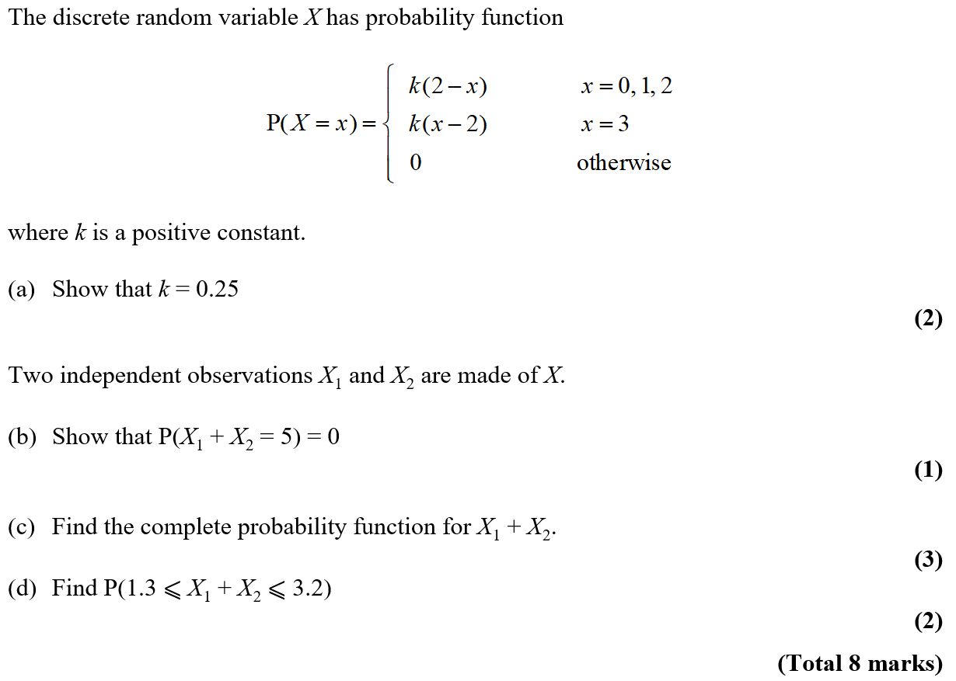
Practice G

Slide 3
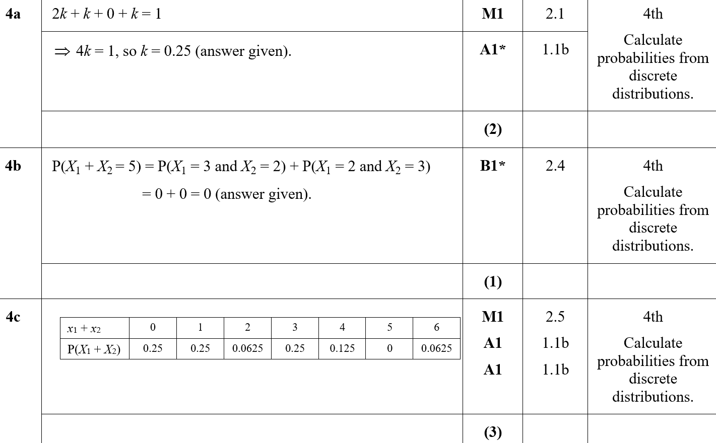
Practice G
A
B
C

Slide 4
Practice G
D
B notes
C notes

Slide 5
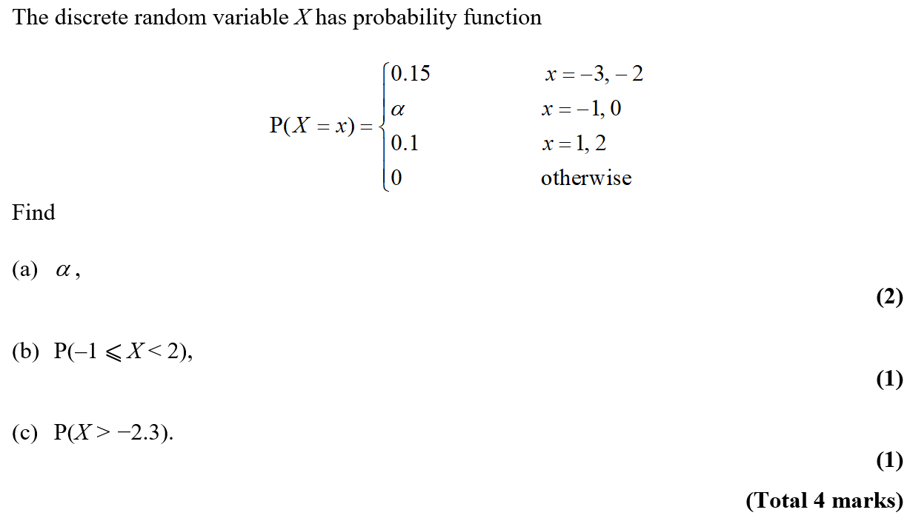
Practice J

Slide 6
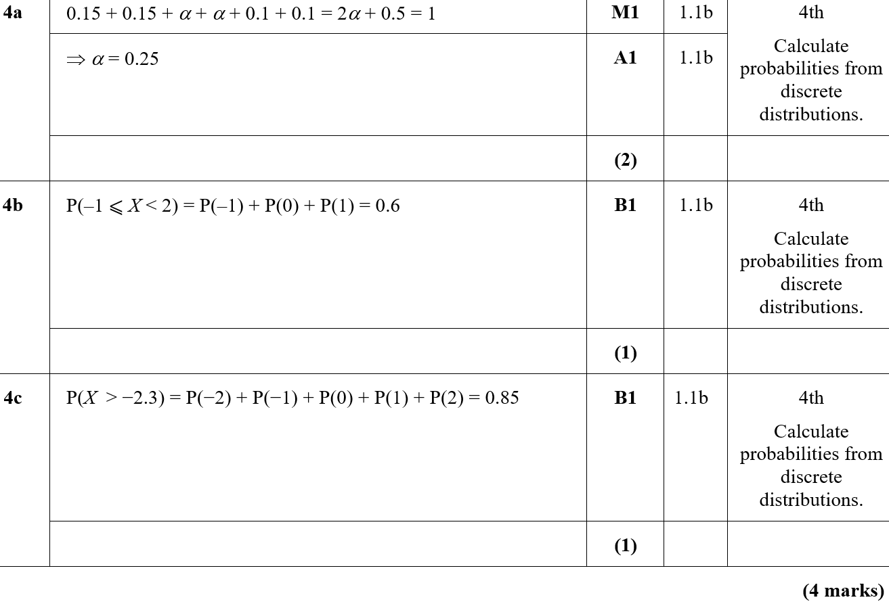
Practice Paper I
A
B
C

Slide 7
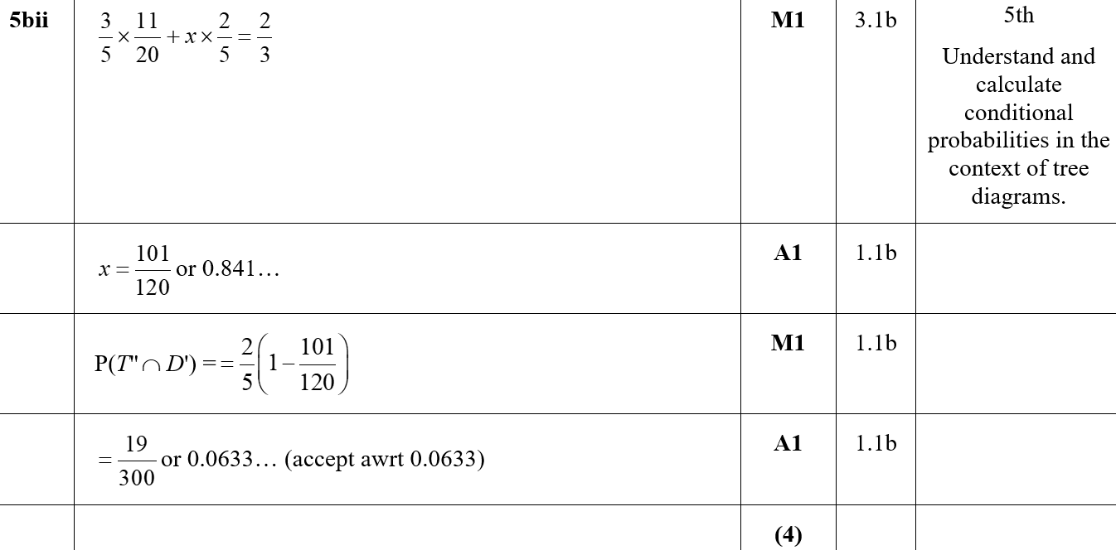
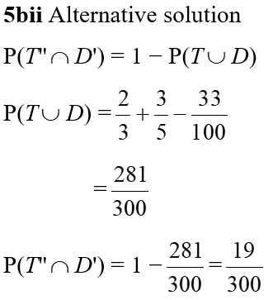
Practice Paper I
B (ii)
B (ii) (Alternative)

Slide 8
Practice Paper I
C

Slide 9
2018

Slide 10
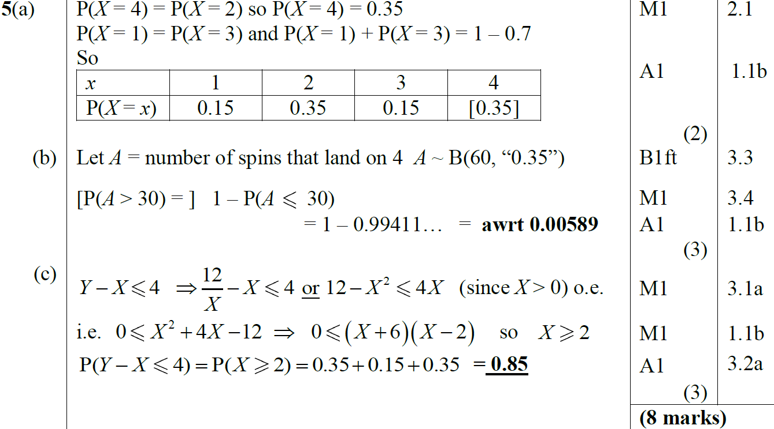
2018
A
B
C

Slide 11
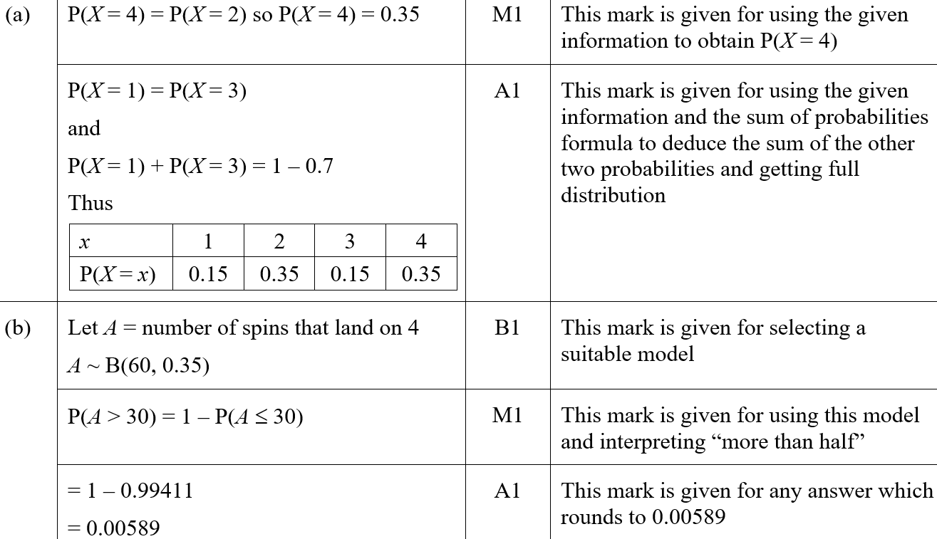
2018
A (SF)
B (SF)

Slide 12
2018
C (SF)
A notes

Slide 13
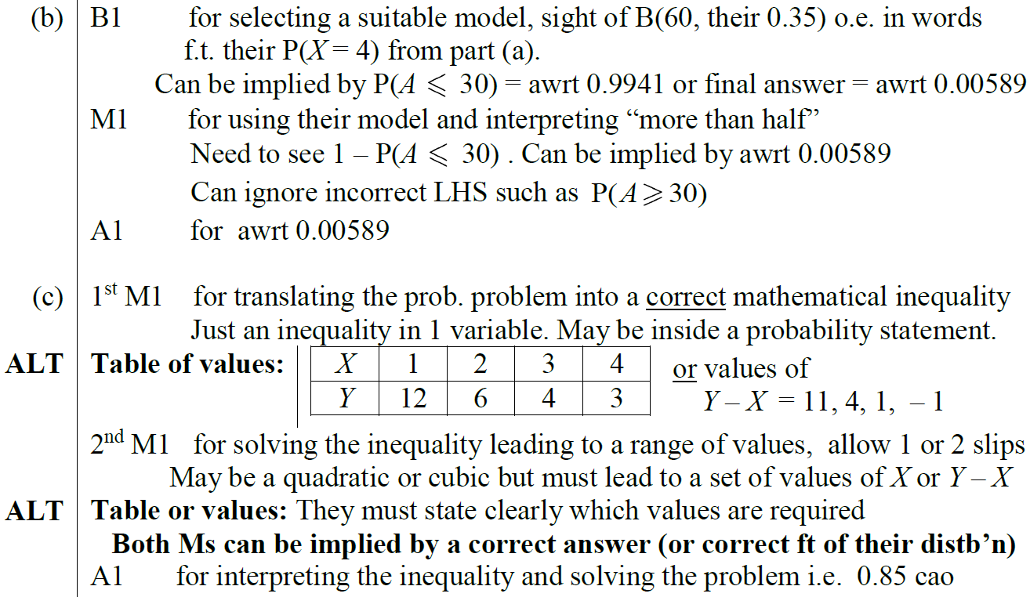
2018
B notes
C notes

Slide 14
New Spec Q’s
note. ignore all E(X) and Var(X) questions
Old Spec Probability Distributions
Jan 2007
May 2012
Jan 2008
Jan 2013
Jan 2010
May 2014
May 2011
June 2015
Jan 2012

Slide 15
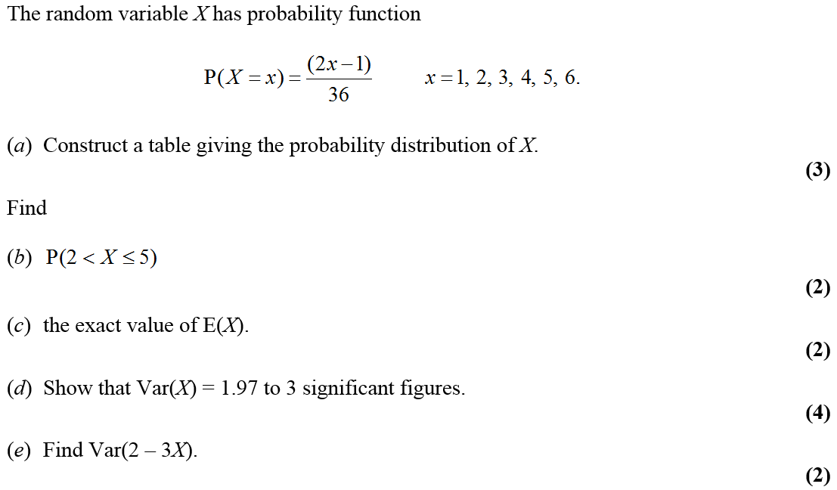
Jan 2007

Slide 16
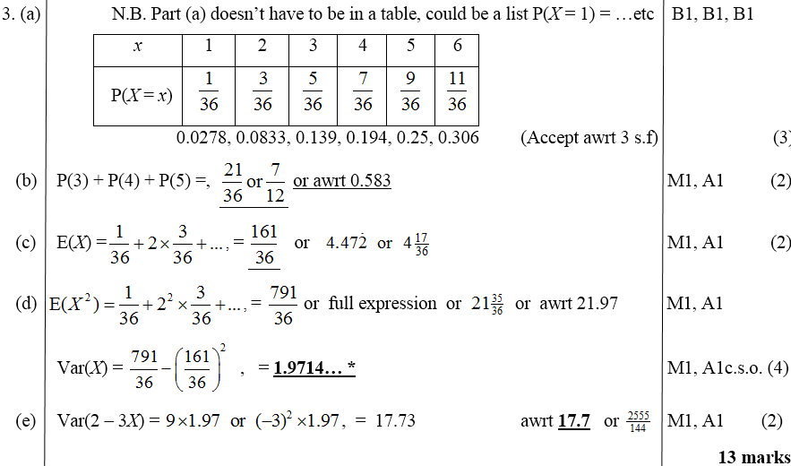
Jan 2007
A
B
C
D
E

Slide 17
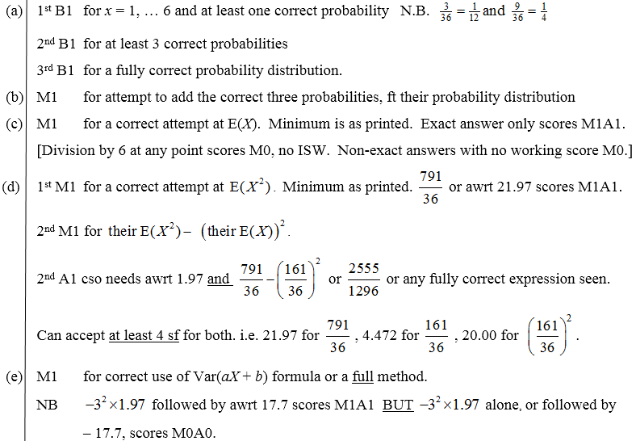
Jan 2007
A
B
C
D
E

Slide 18
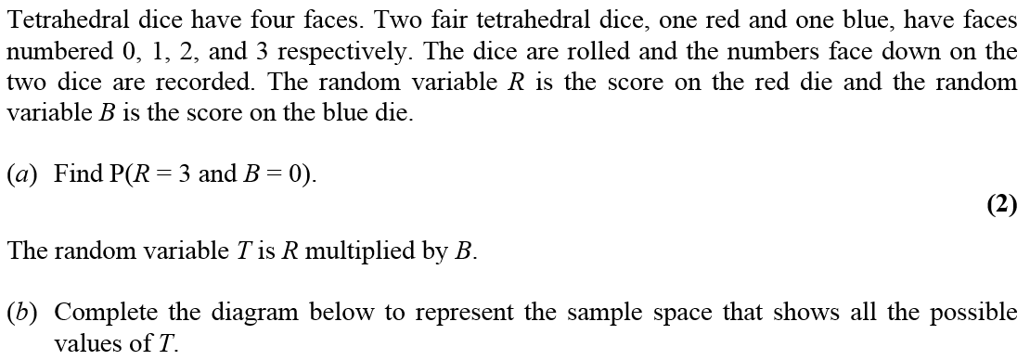
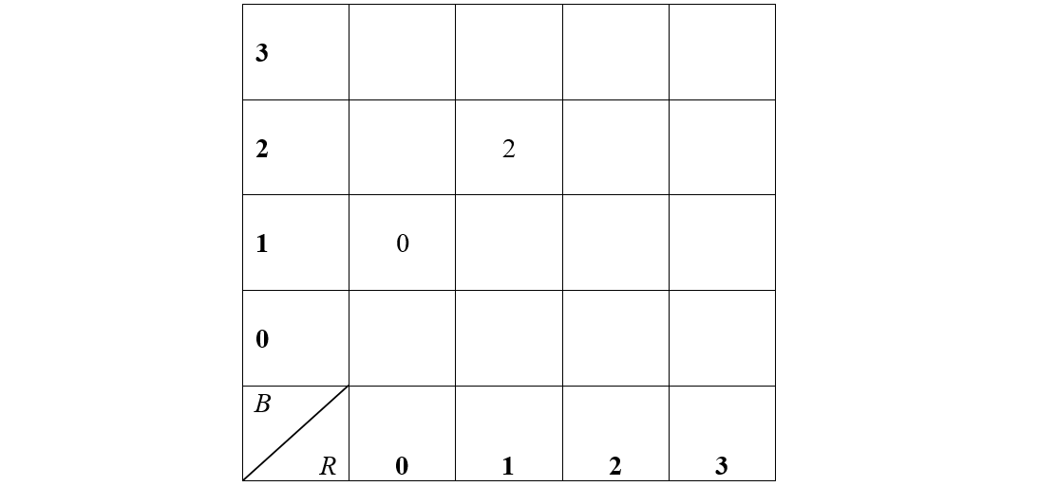
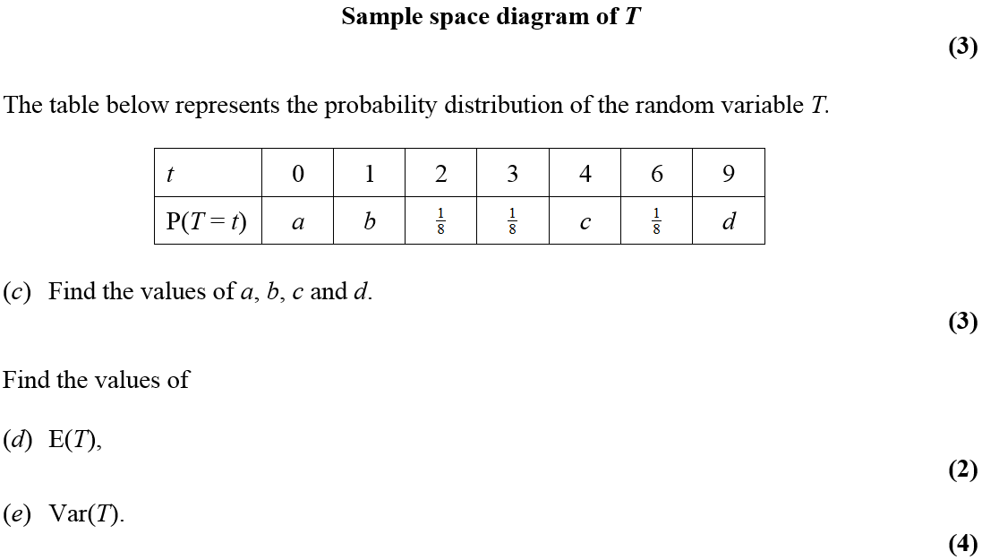
Jan 2008

Slide 19
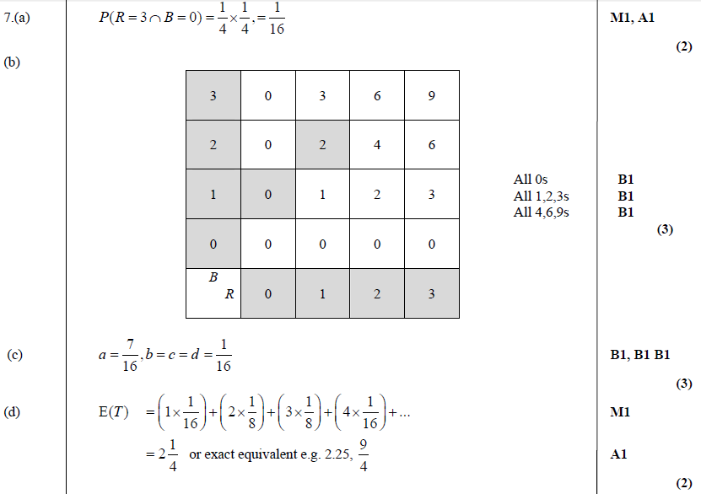
A
Jan 2008
B
C
D
E

Slide 20
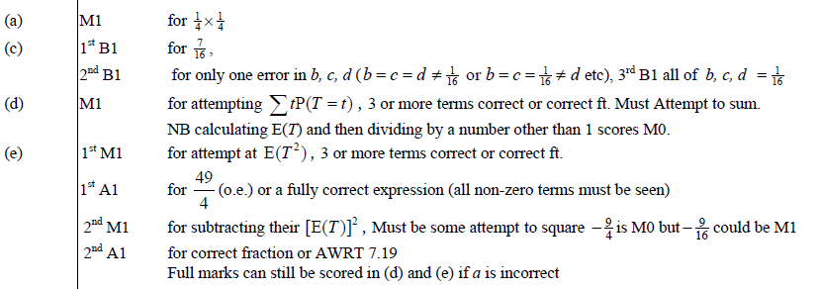
Jan 2008
A
C
D
E

Slide 21
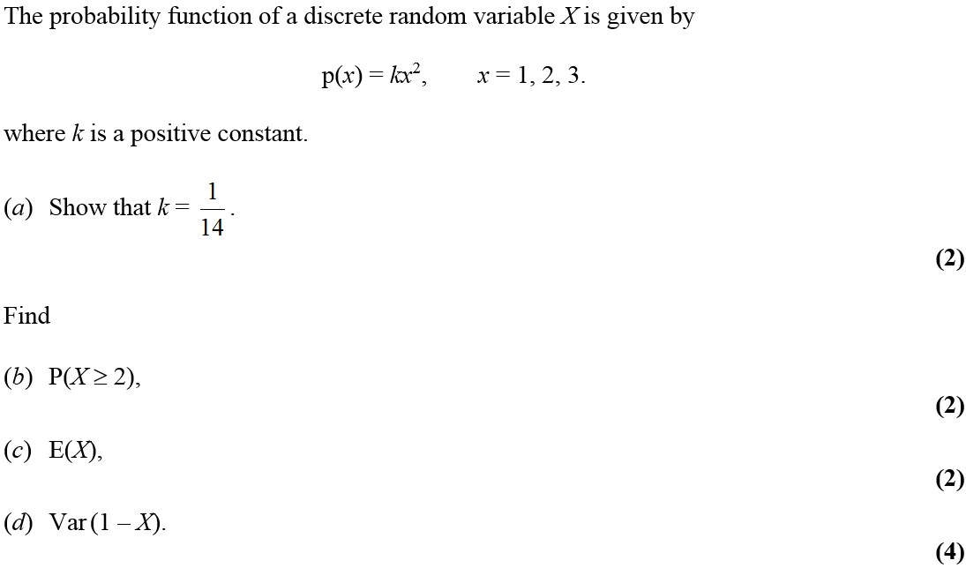
Jan 2010

Slide 22
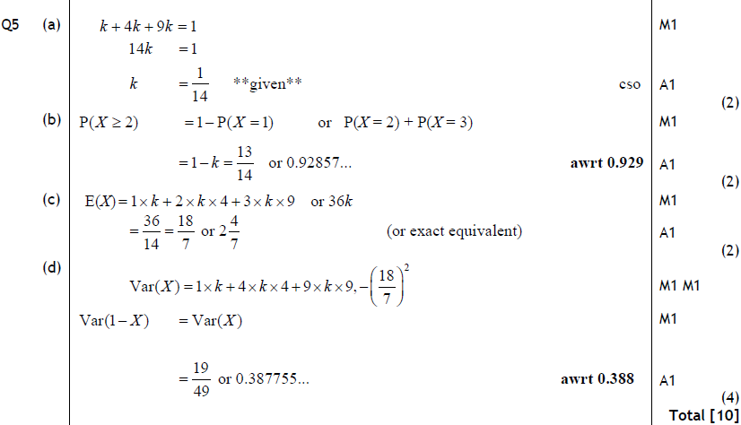
Jan 2010
A
B
C
D

Slide 23
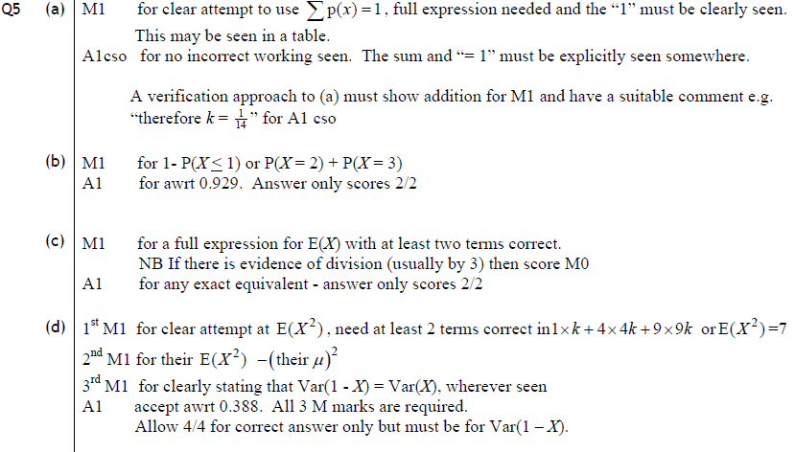
Jan 2010
A
B
C
D

Slide 24
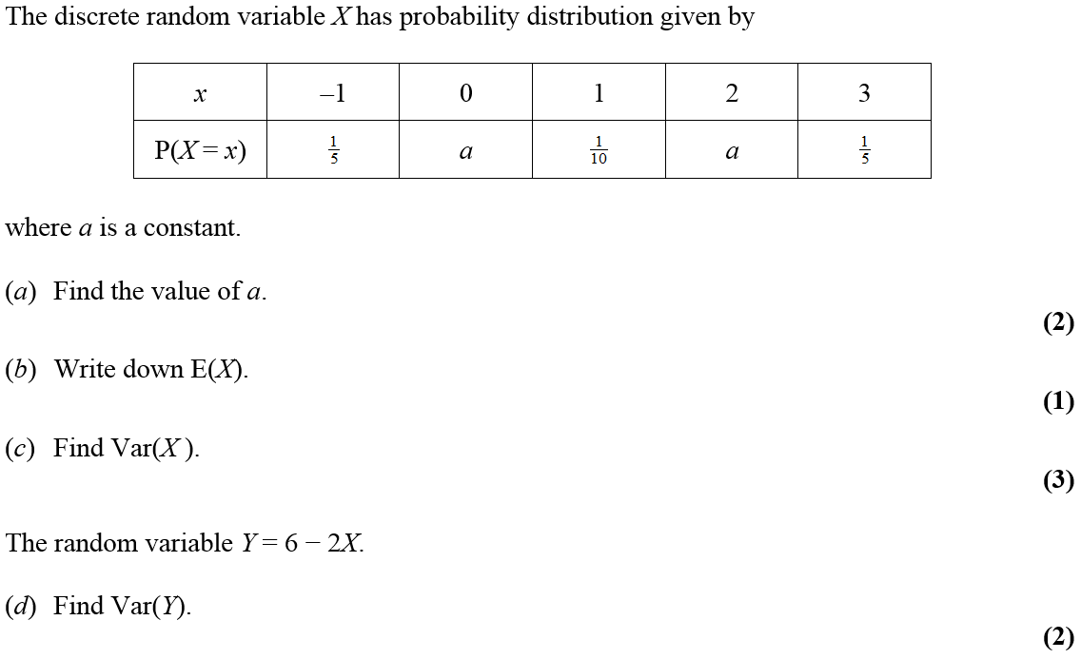
May 2010

Slide 25
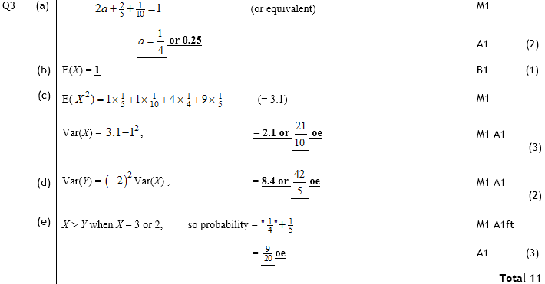
May 2010
A
B
C
D
E

Slide 26
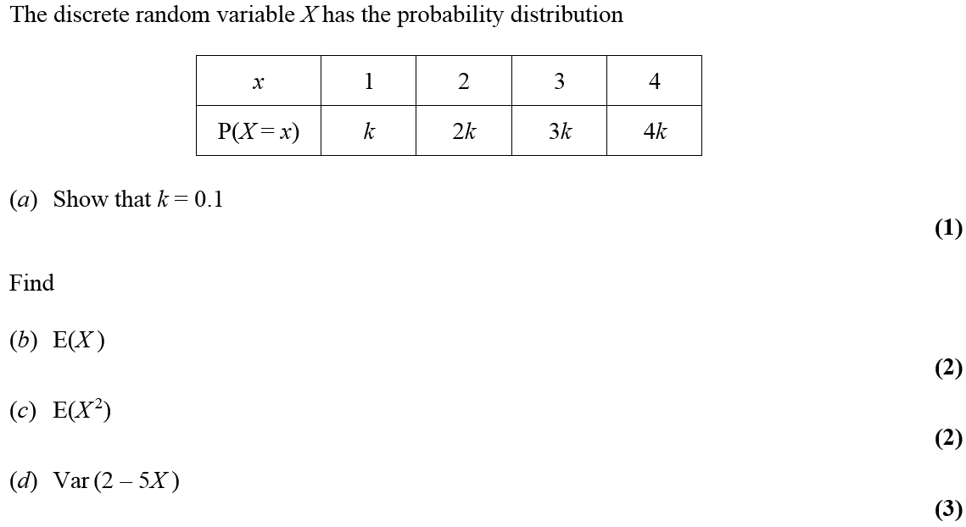
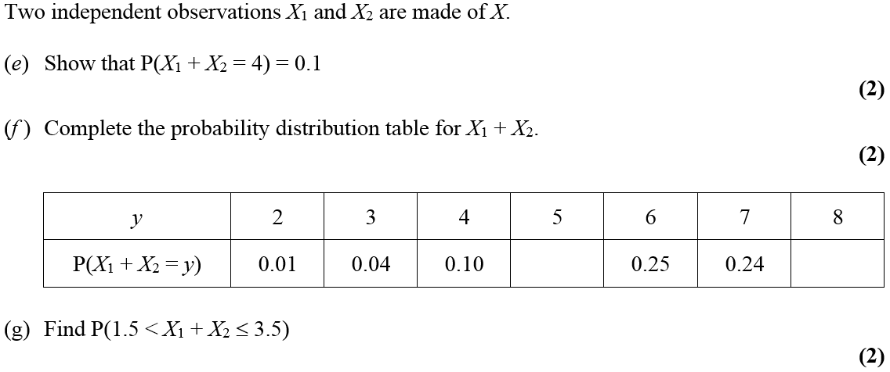
Jan 2011

Slide 27
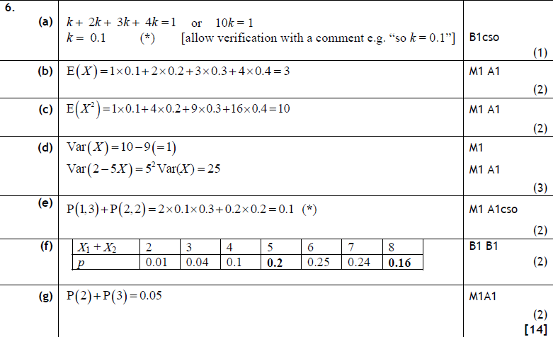
Jan 2011
A
B
C
D
E
F
G

Slide 28
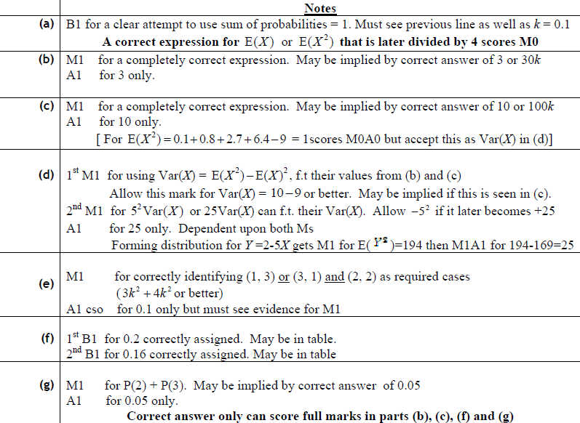
Jan 2011
A
B
C
D
E
F
G

Slide 29
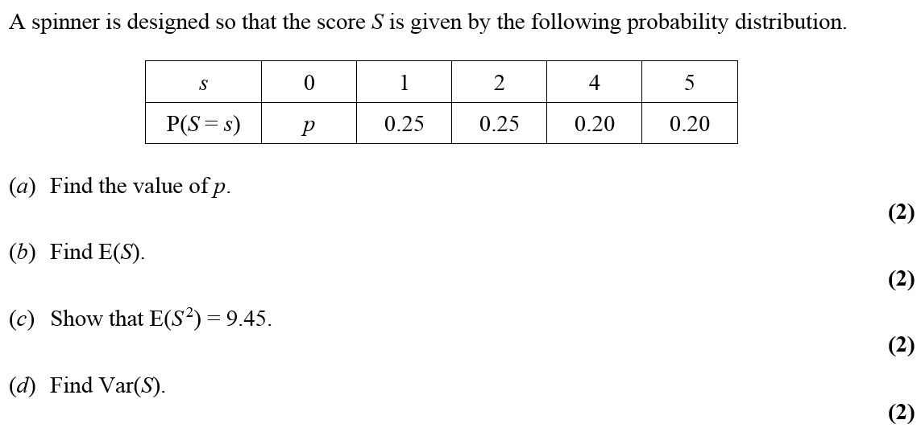
May 2011

Slide 30
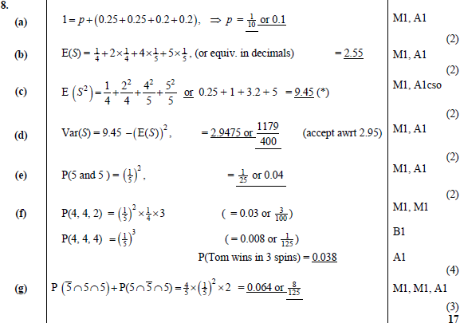
A
May 2011
B
C
D
E
F
G

Slide 31
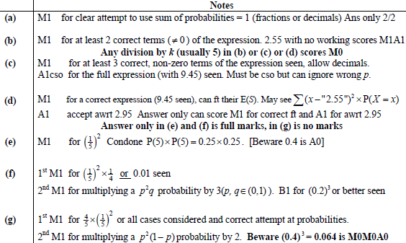
May 2011
A
B
C
D
E
F
G

Slide 32
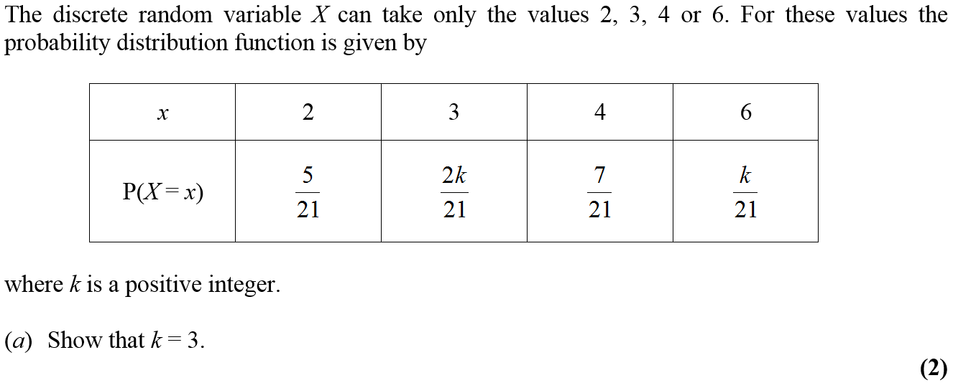
Jan 2012

Slide 33
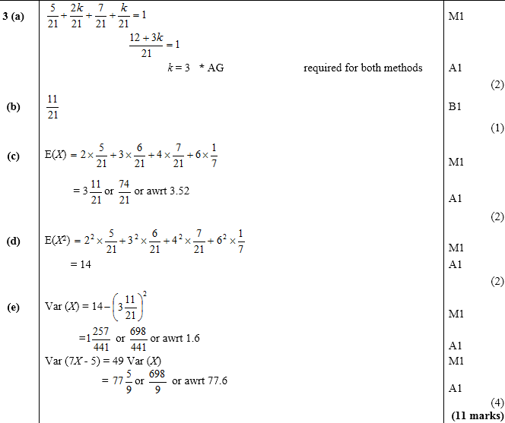
A
Jan 2012
B
C
D
E

Slide 34
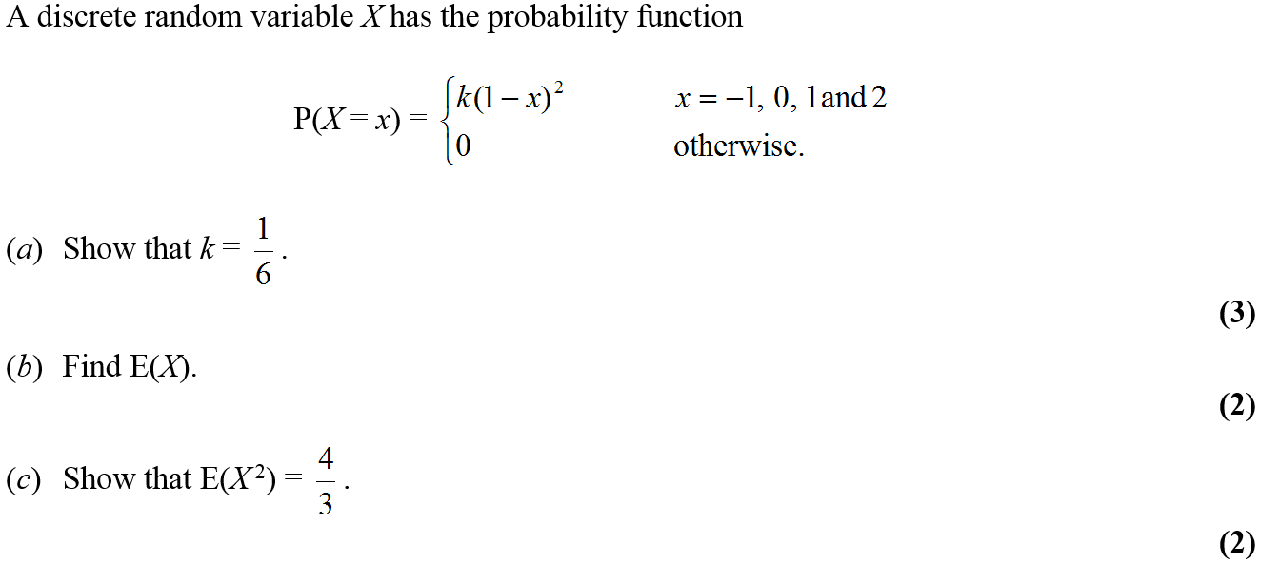
May 2012

Slide 35
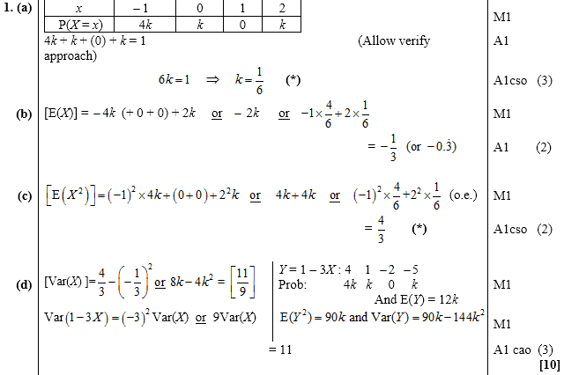
May 2012
A
B
C
D

Slide 36
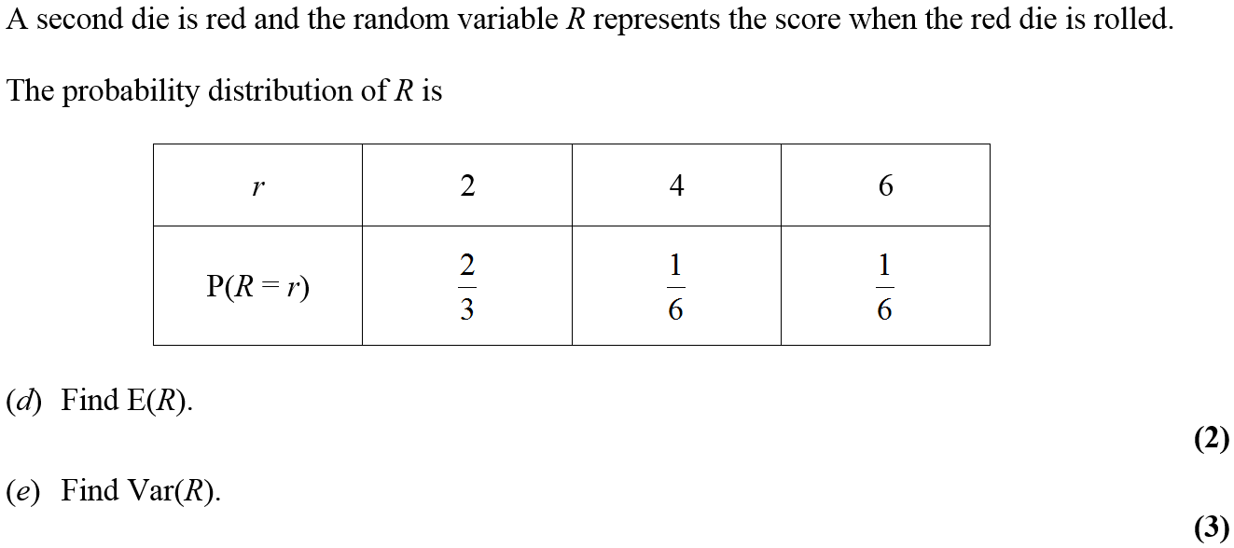
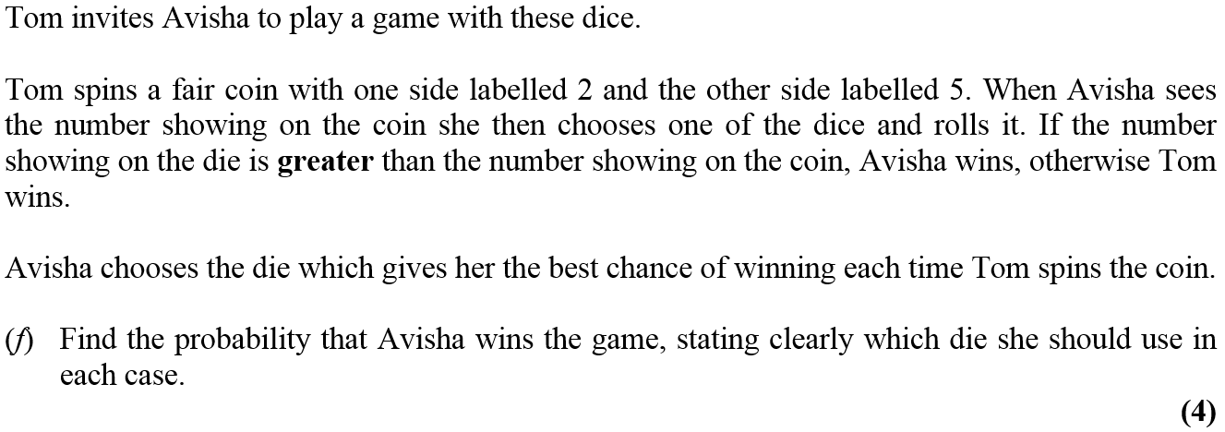
Jan 2013

Slide 37
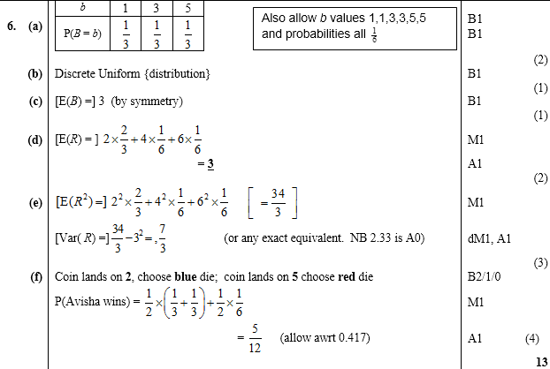
Jan 2013
A
B
C
D
E
F

Slide 38
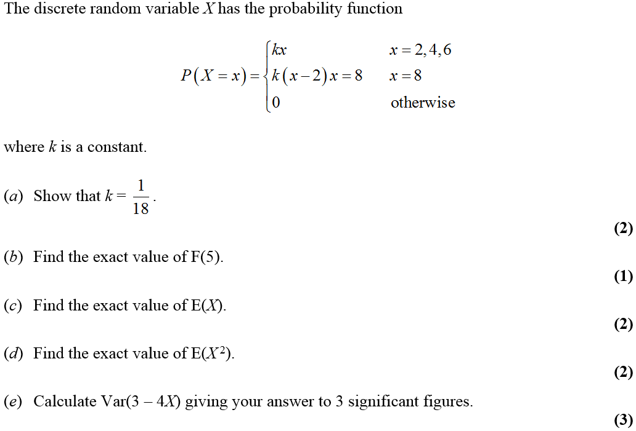
May 2014

Slide 39
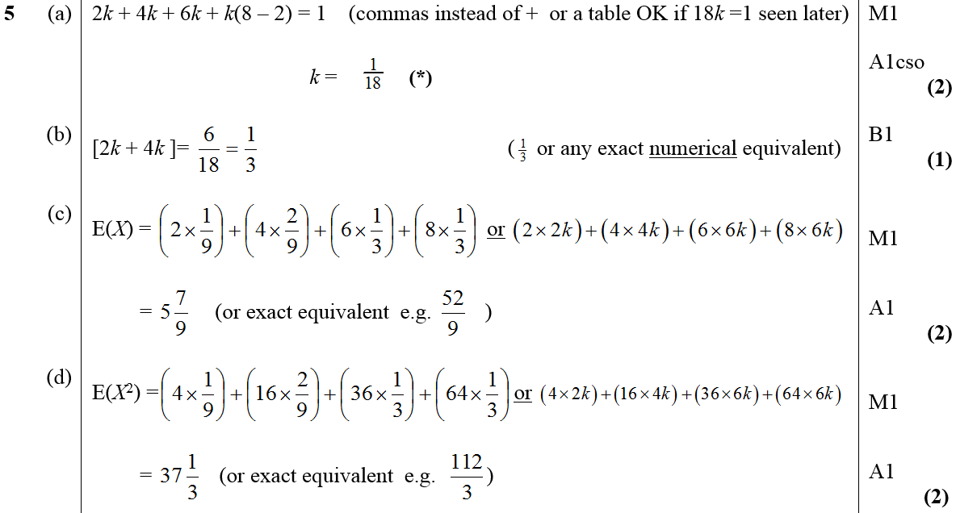
May 2014
A
B
C
D
E

Slide 40
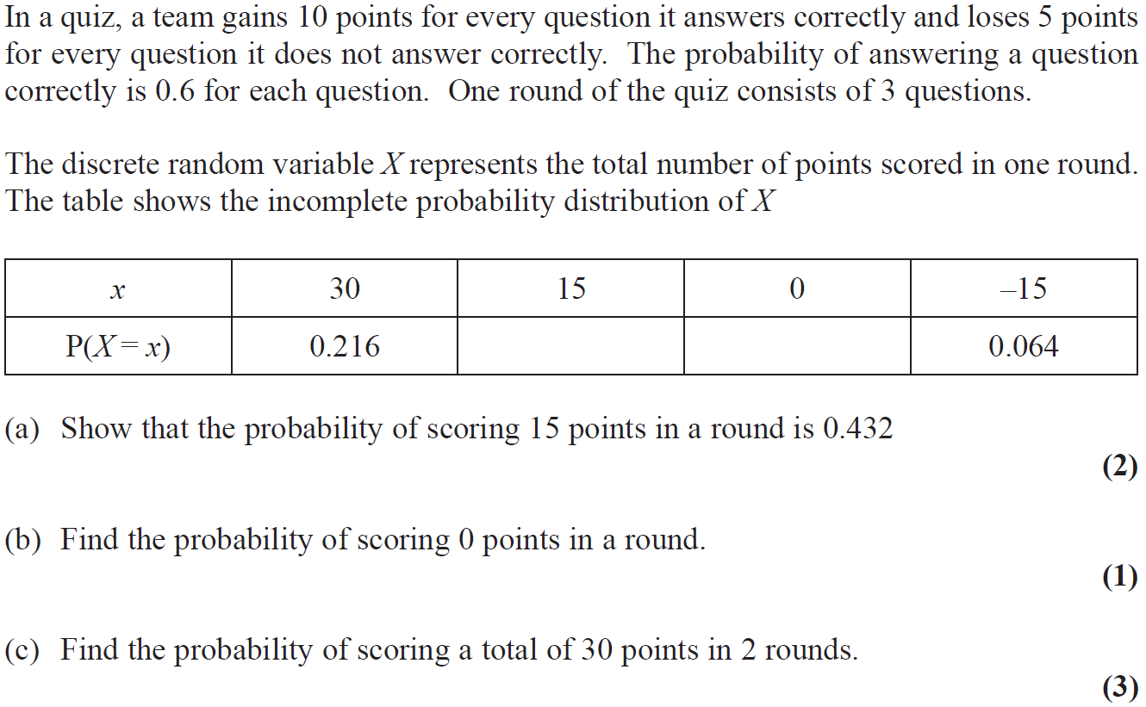
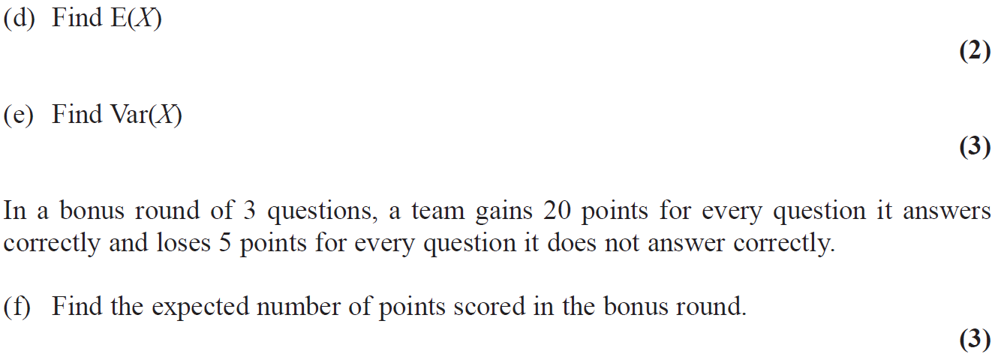
June 2015

Slide 41
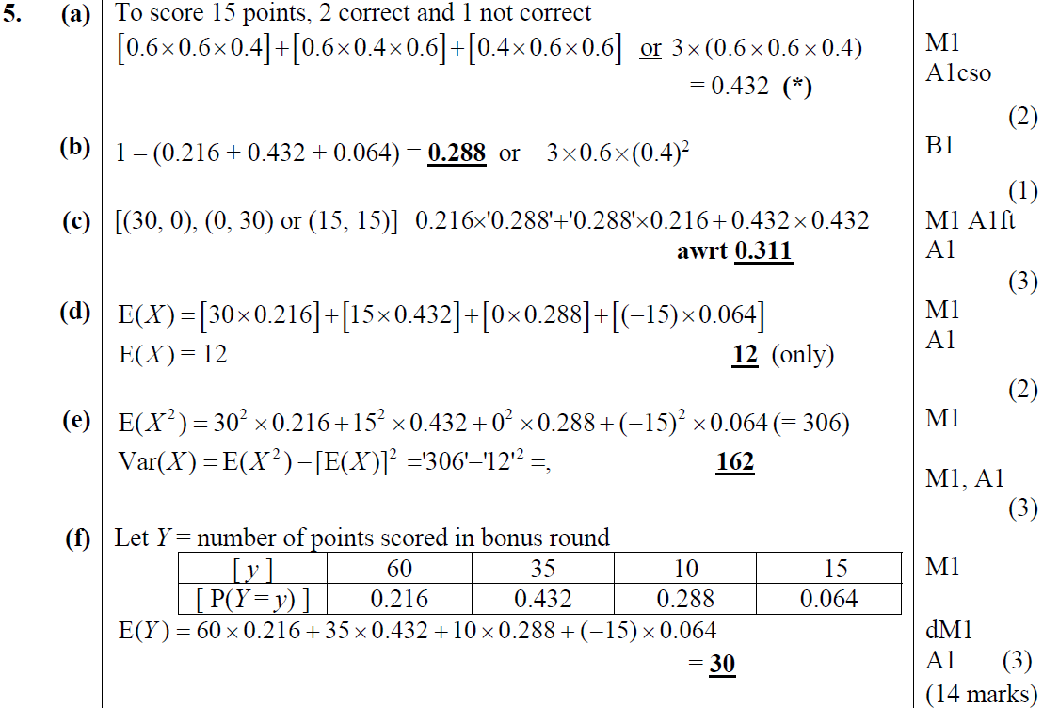
June 2015
A
B
C
D
E
F

Slide 42
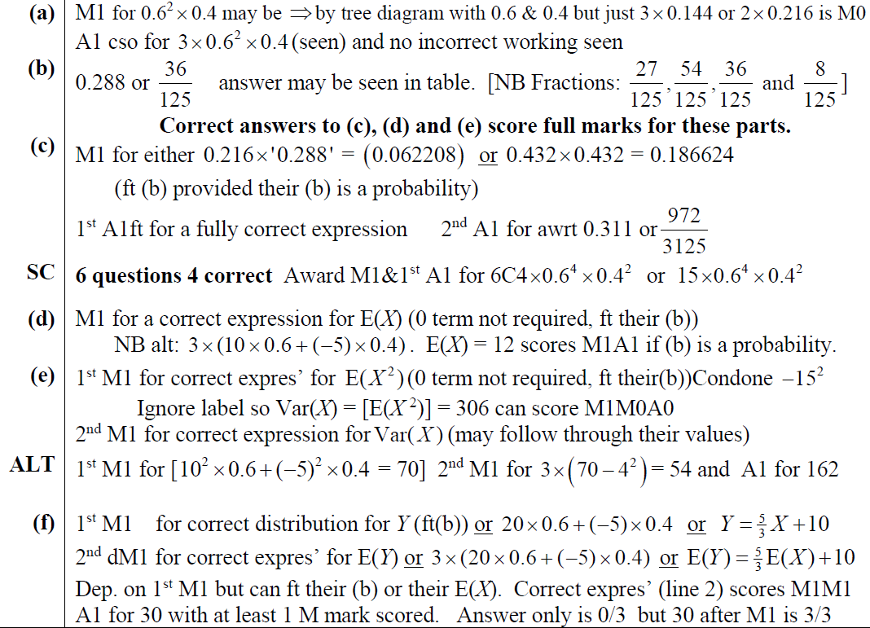
June 2015
A notes
B notes
C notes
D notes
E notes
F notes

