Slide 1
Old Spec Q’s
Binomial Distribution
Practice E
2018 (i)
Practice F (i)
2018 (ii) DRV
Practice F (ii)
Practice H
Practice I
SAM

Slide 2
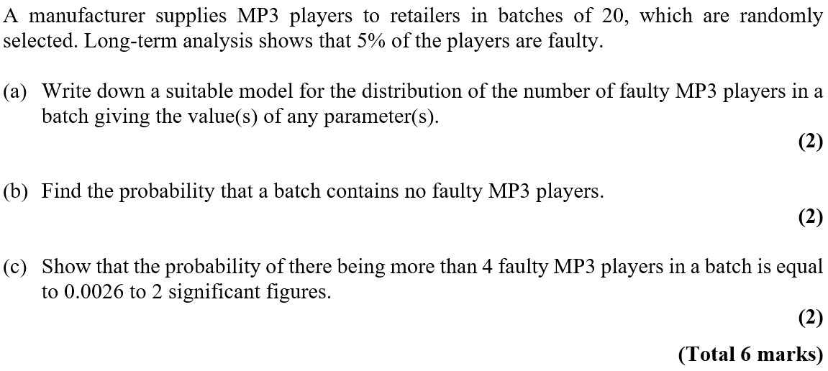
Practice E

Slide 3
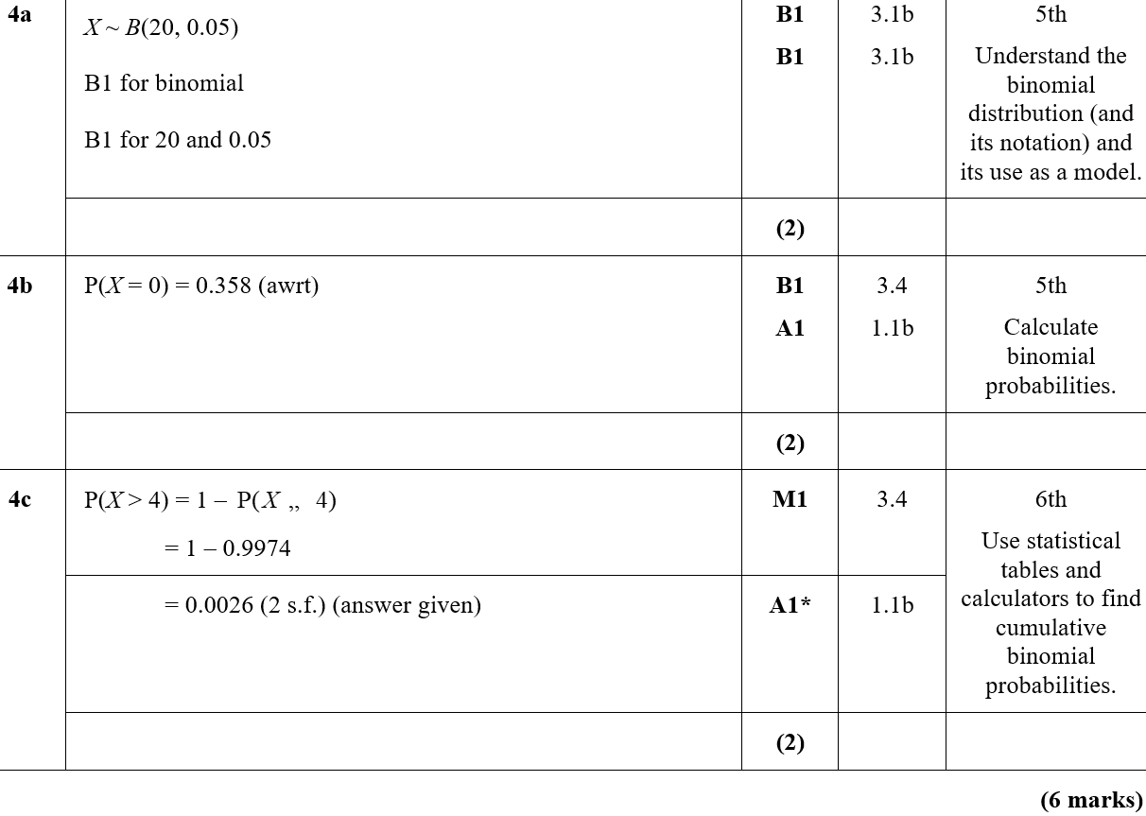
Practice E
A
B
C
B notes

Slide 4
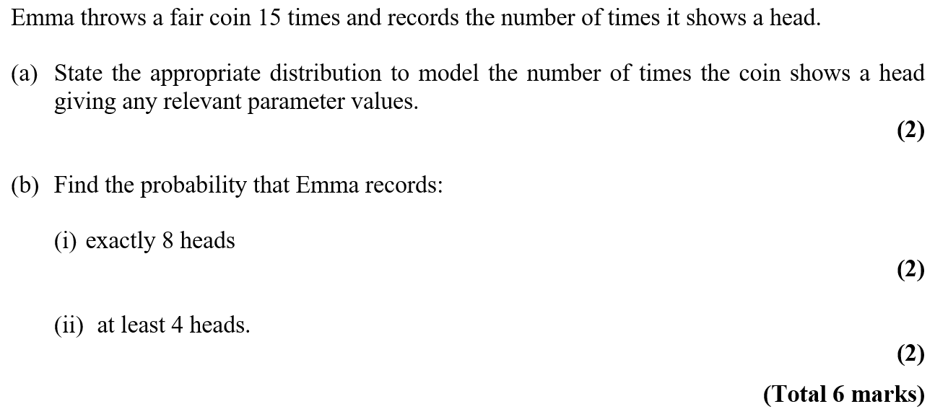
Practice F

Slide 5
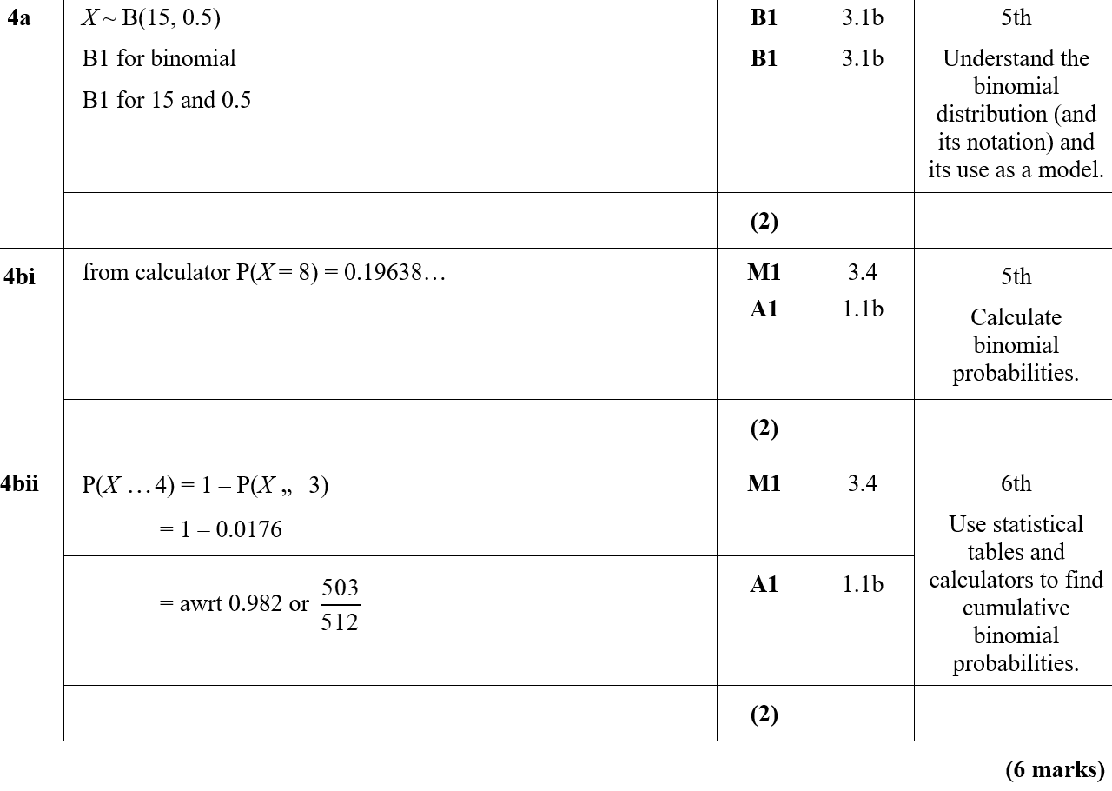
Practice F
A
B (i)
B (ii)

Slide 6
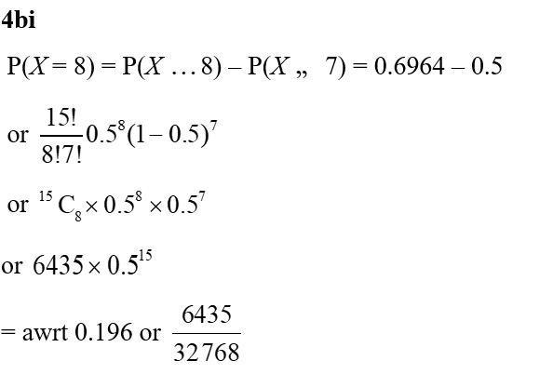
Practice F
B (i) notes

Slide 7
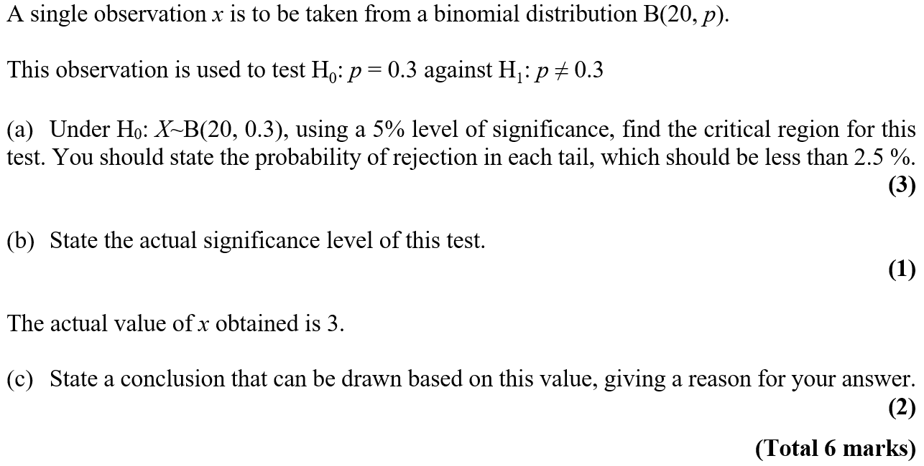
Practice F

Slide 8
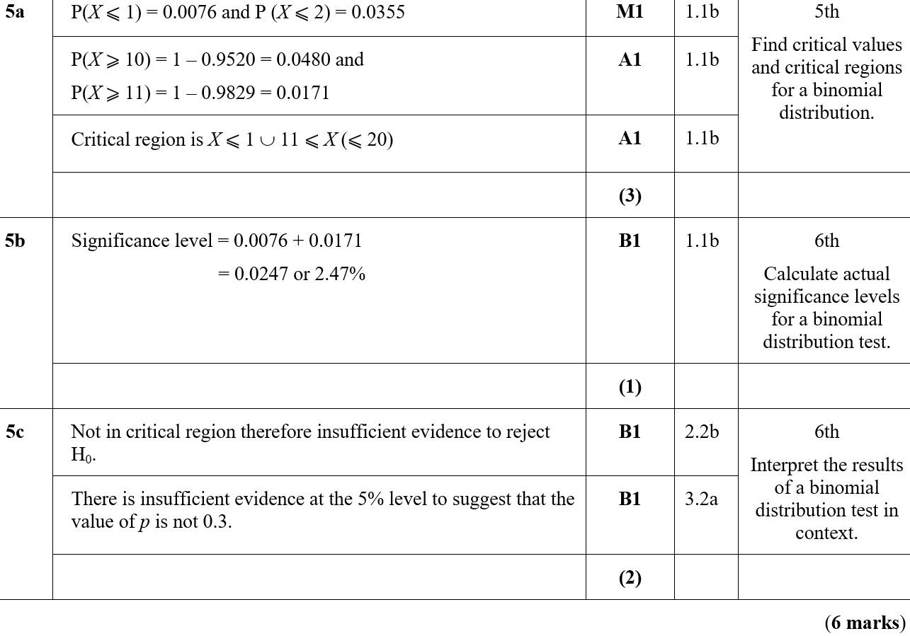
Practice F
A
B
C
C notes

Slide 9
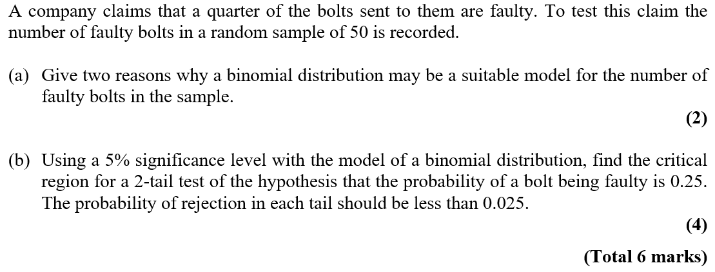
Practice H

Slide 10
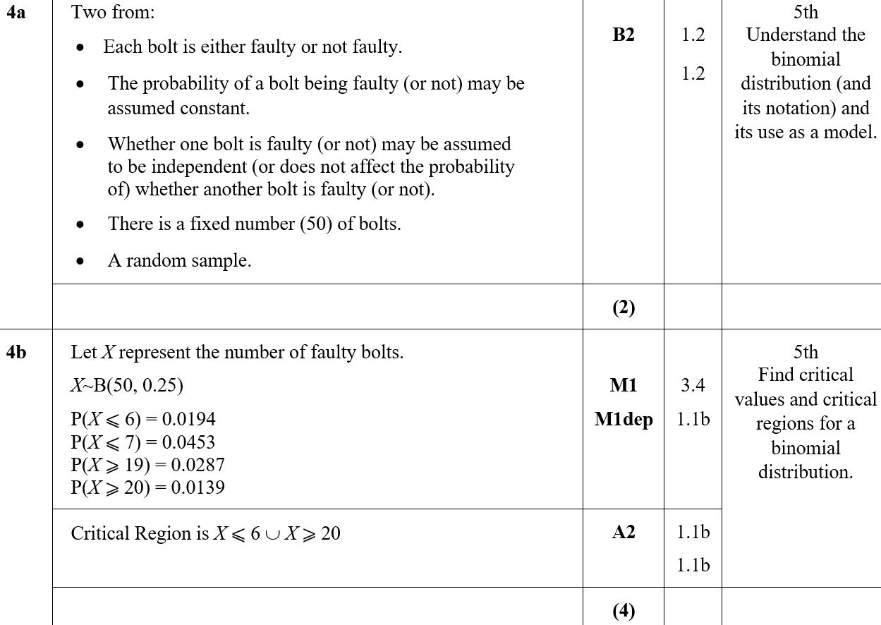
Practice H
A
B
A notes

Slide 11
Practice I

Slide 12
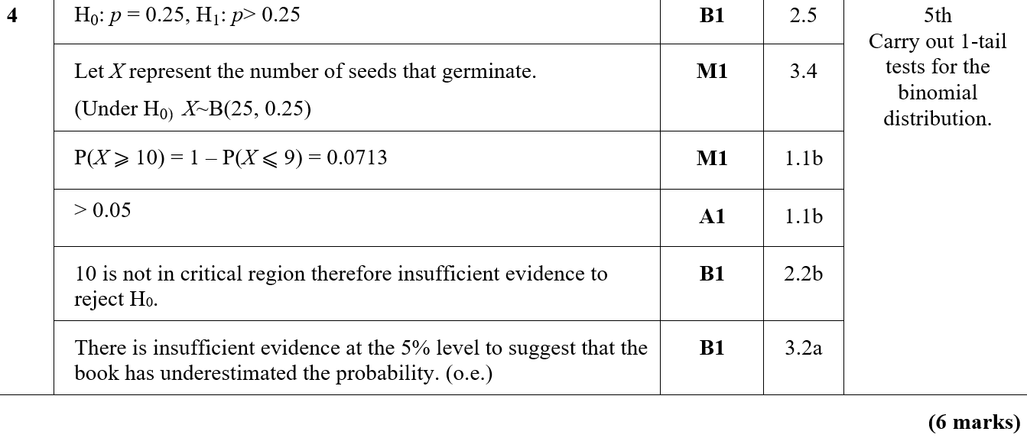
Practice I
A

Slide 13
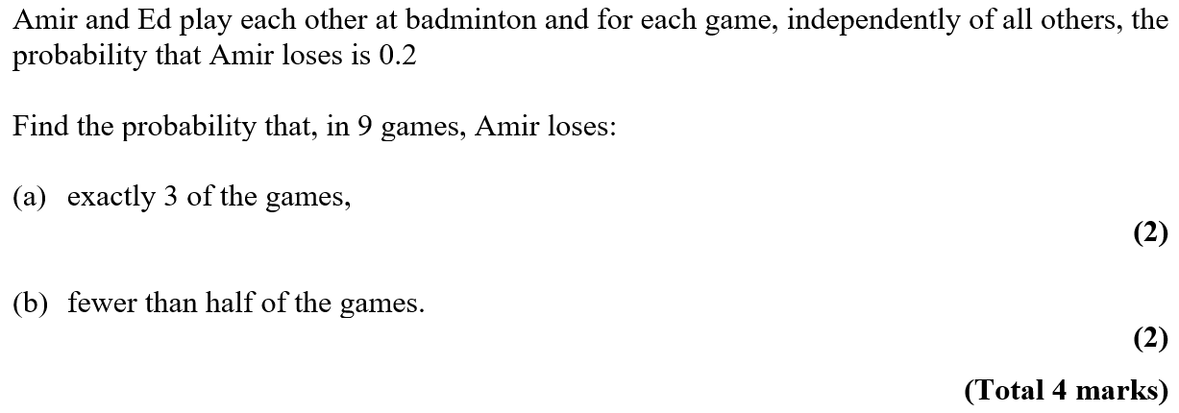
Practice J

Slide 14
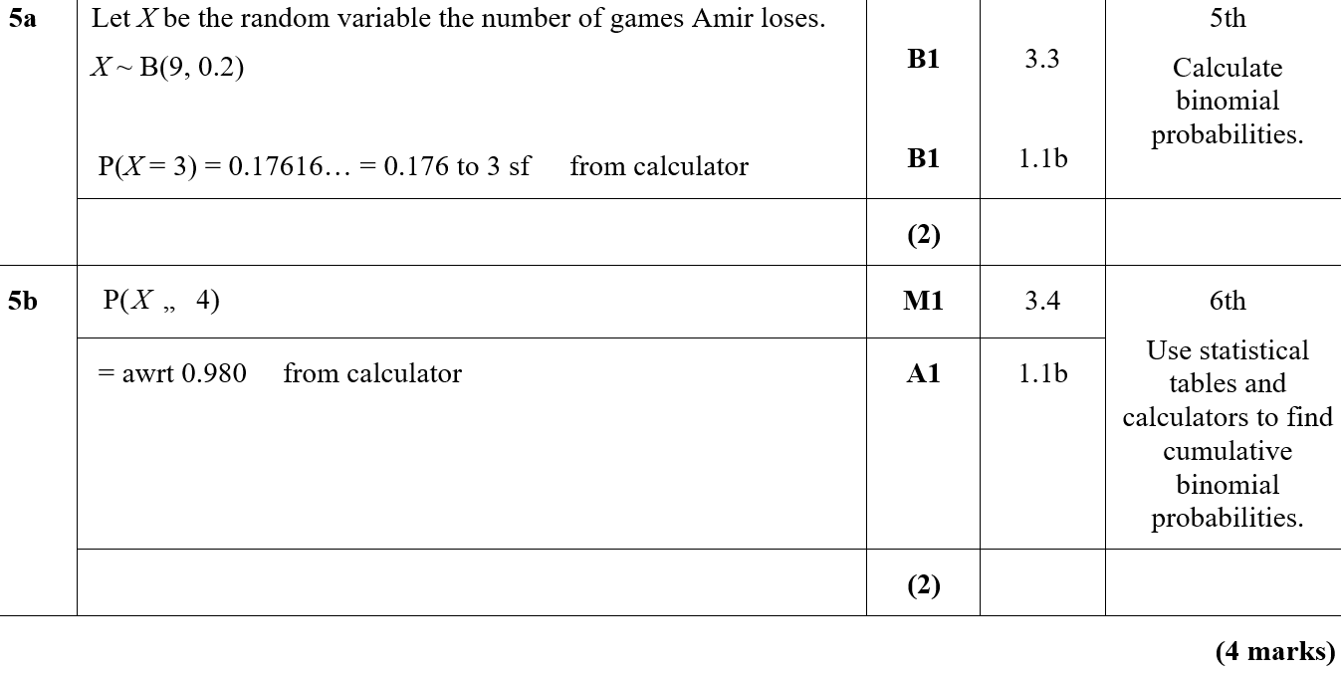
Practice J
A
B

Slide 15
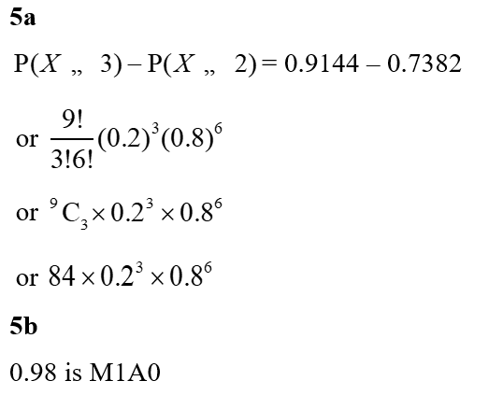
Practice J
A notes
B notes

Slide 16
SAM

Slide 17
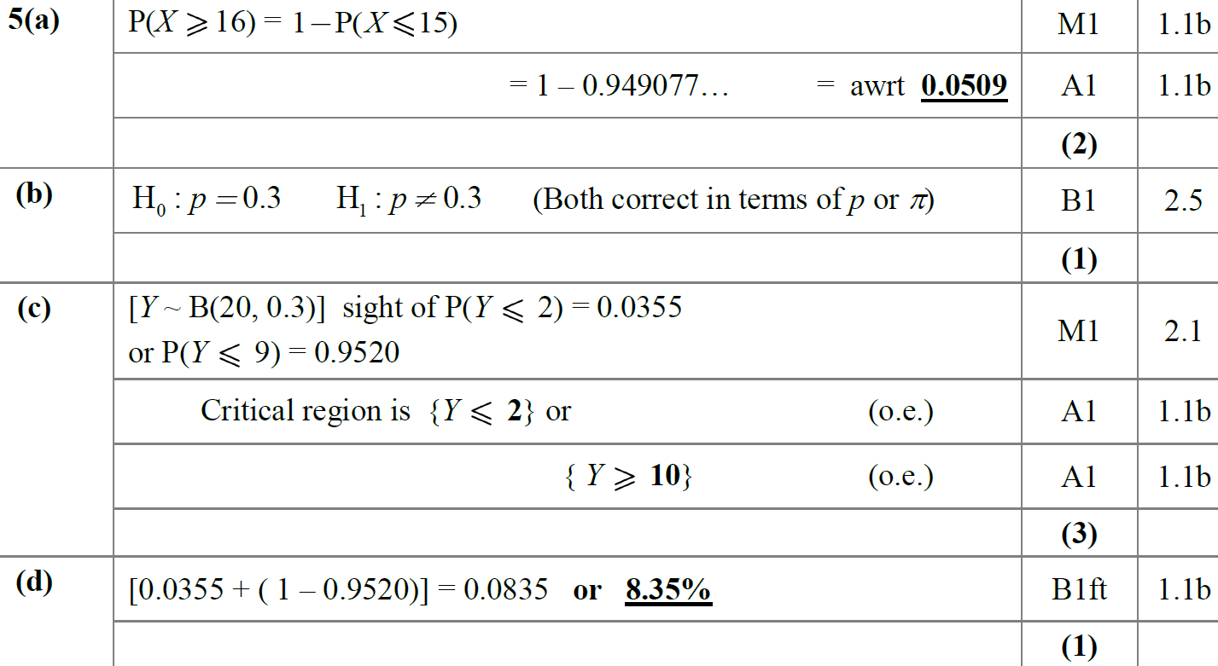
SAM
A
B
C
D

Slide 18
SAM
E
F
A notes
B notes

Slide 19
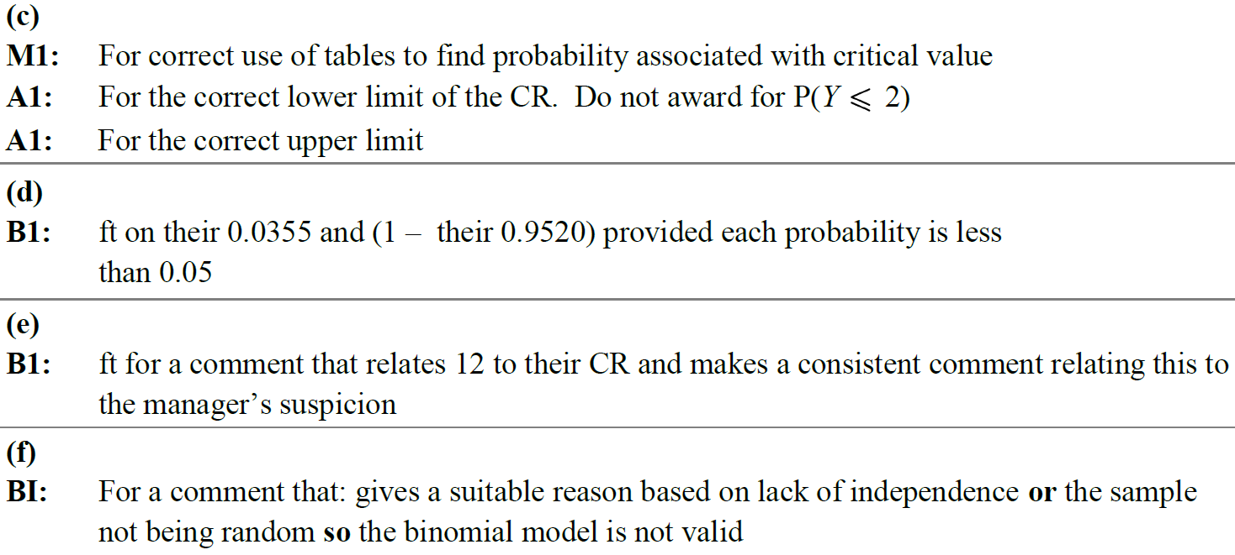
SAM
C notes
D notes
E notes
F notes

Slide 20
2018

Slide 21
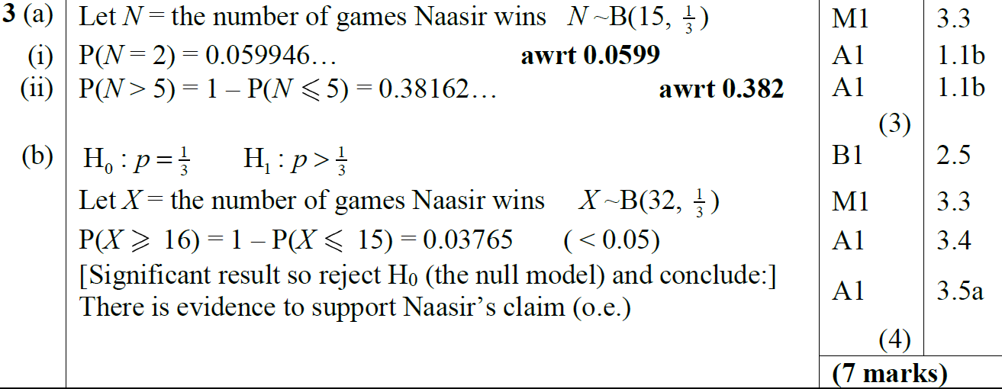
2018
A (i)
A (ii)
B

Slide 22
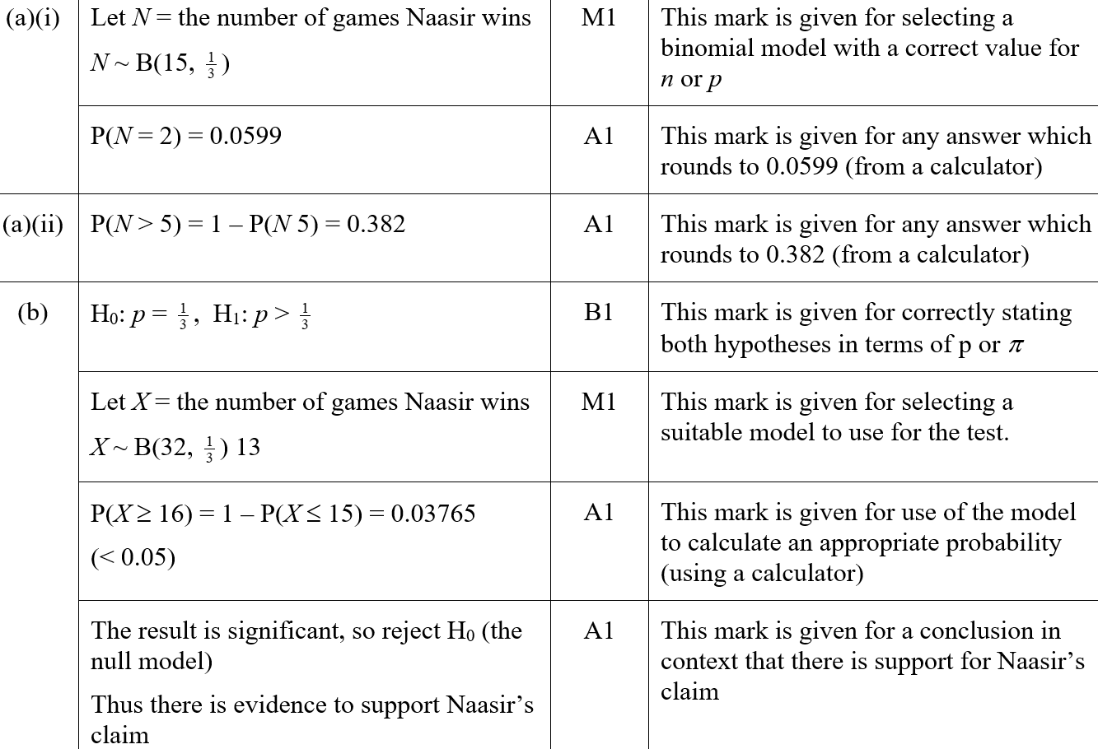
2018
A (i) (SF)
A (ii) (SF)
B (SF)

Slide 23
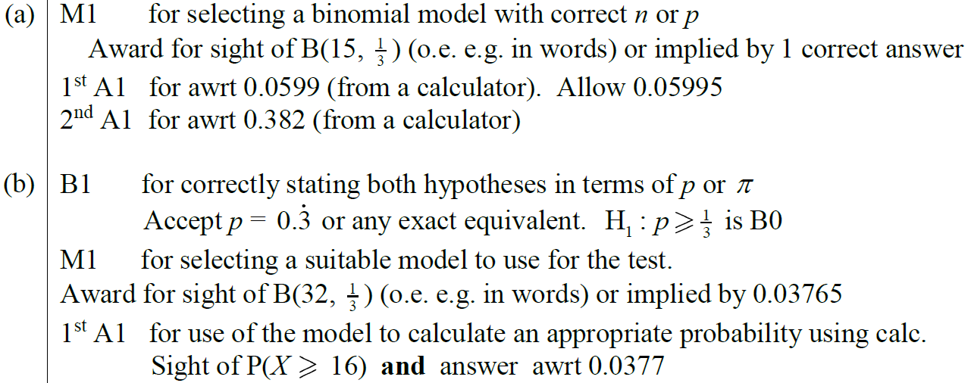
2018
A notes
B notes

Slide 24
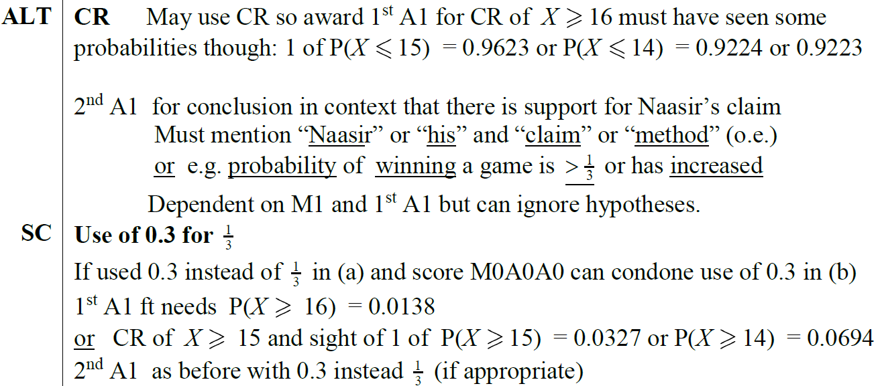
2018
B Alternative notes
general notes

Slide 25
2018

Slide 26
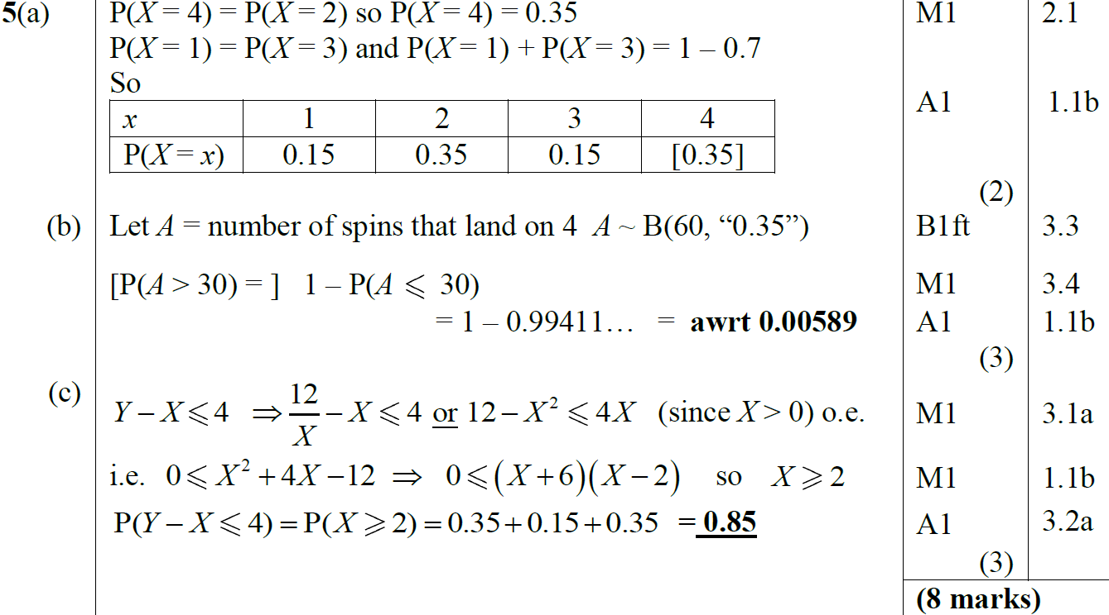
2018
A
B
C

Slide 27
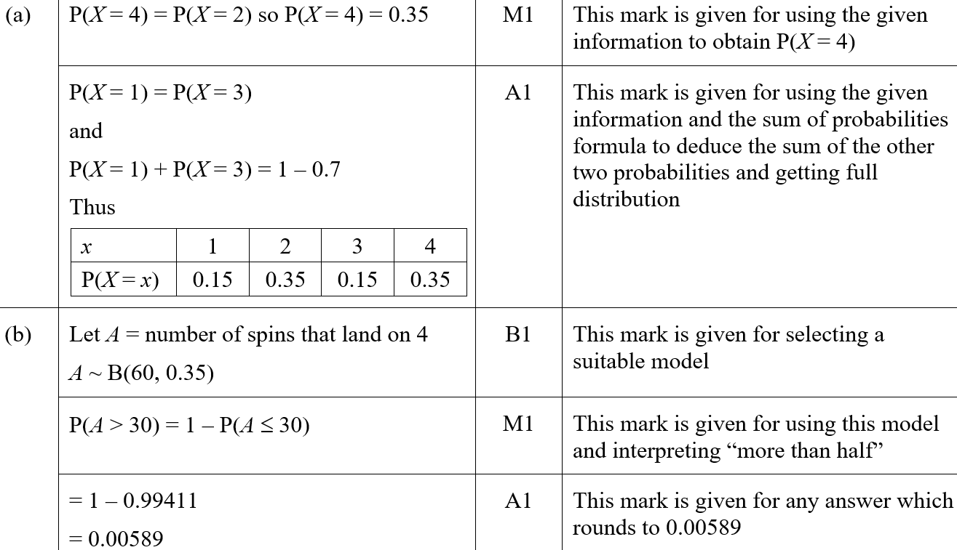
2018
A (SF)
B (SF)

Slide 28
2018
C (SF)
A notes

Slide 29
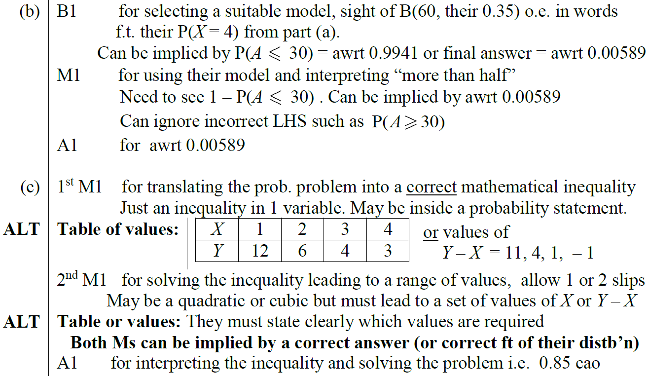
2018
B notes
C notes

Slide 30
New Spec Q’s
*Poisson Distribution not on new spec
Old Spec Binomial Distribution
Jan 2006 (i)
June 2007 (iii)
Jan 2010 (i)
Jan 2012 (i)
June 2014
Jan 2006 (ii)
Jan 2008 (i)
Jan 2010 (ii)
Jan 2012 (ii)
June 2015
May 2006 (i)*
Jan 2008 (ii)
May 2010 (i)*
May 2012 (i)
June 2016
May 2006 (ii)
May 2008 (i)*
May 2010 (ii)
May 2012 (ii)*
June 2017 (i)
Jan 2007 (i)*
May 2008 (ii)
Jan 2011 (i)*
May 2012 (iii)
June 2017 (ii)
Jan 2007 (ii)*
Jan 2009 (i)
Jan 2011 (ii)
Jan 2013 (i)
June 2018 (i)
Jan 2007 (iii)*
Jan 2009 (ii)*
May 2011 (i)
Jan 2013 (ii)
June 2018 (ii)
June 2007 (i)*
May 2009 (i)*
May 2011 (ii)
May 2013 (i)
June 2007 (ii)
May 2009 (ii)
May 2011 (iii)*
May 2013 (ii)*

Slide 31
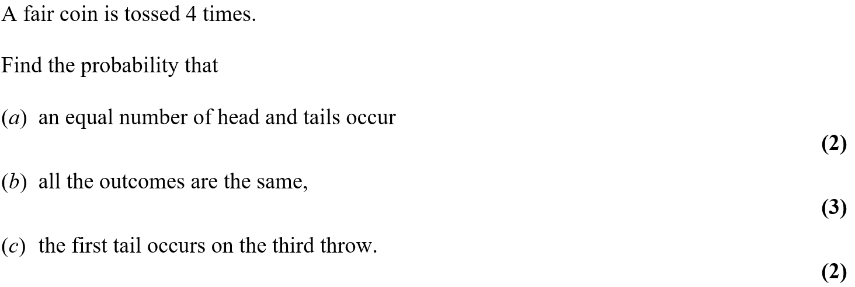
Jan 2006

Slide 32
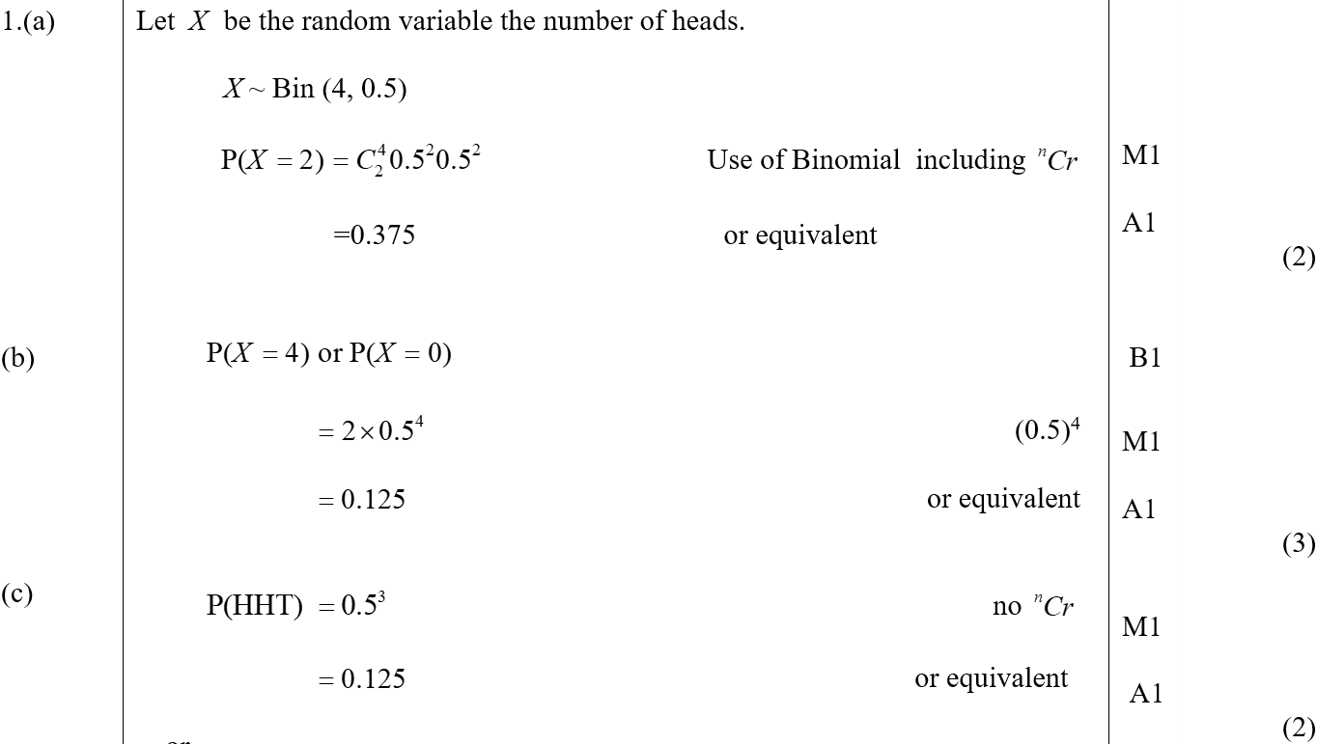
Jan 2006
A
B
C

Slide 33
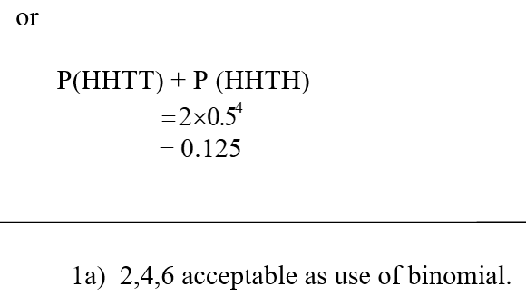
Jan 2006
C Alternative
A notes

Slide 34
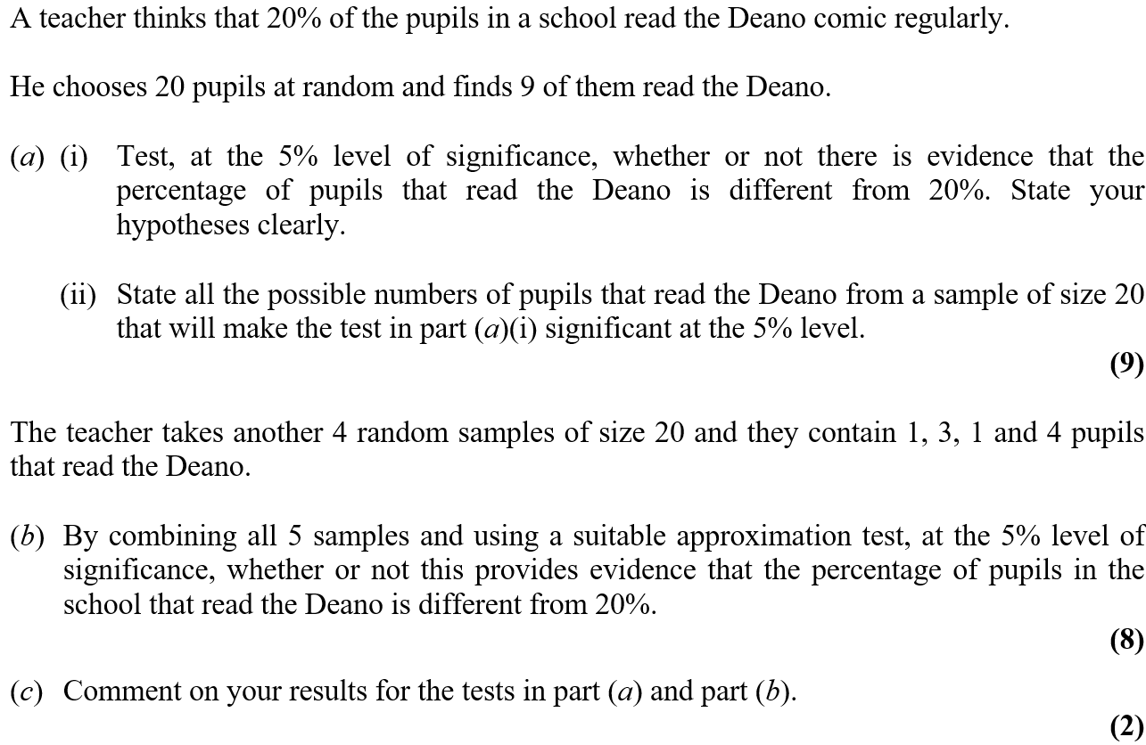
Jan 2006

Slide 35
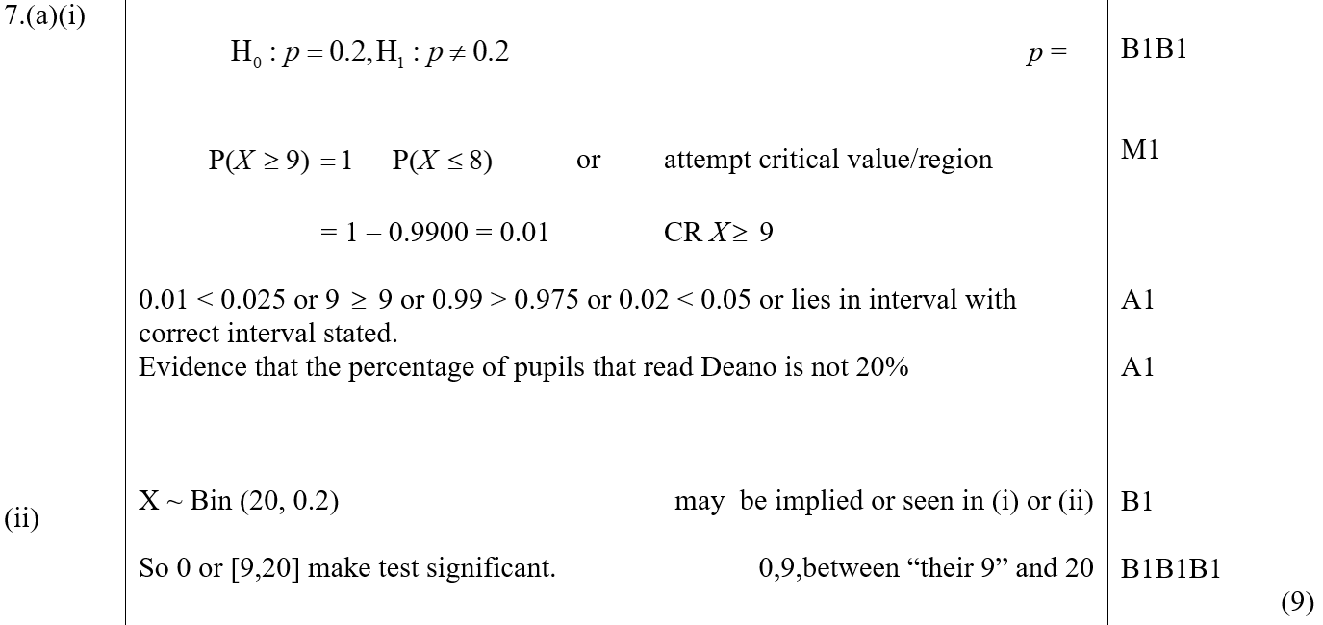
Jan 2006
A (i)
A (ii)

Slide 36
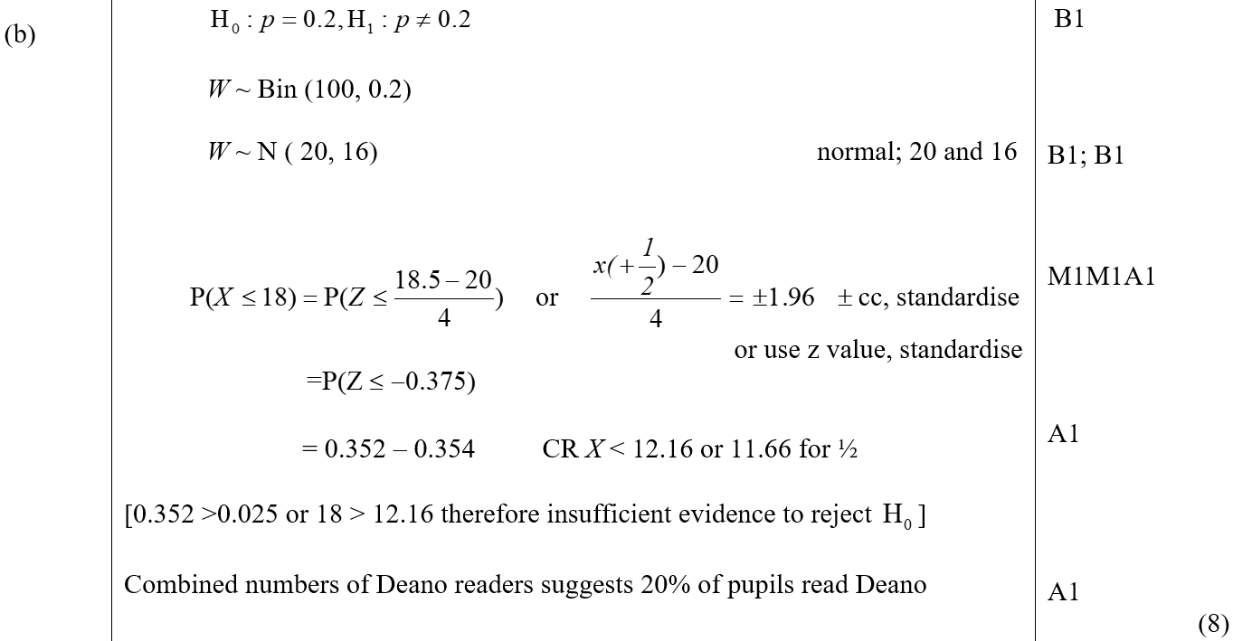
Jan 2006
B

Slide 37
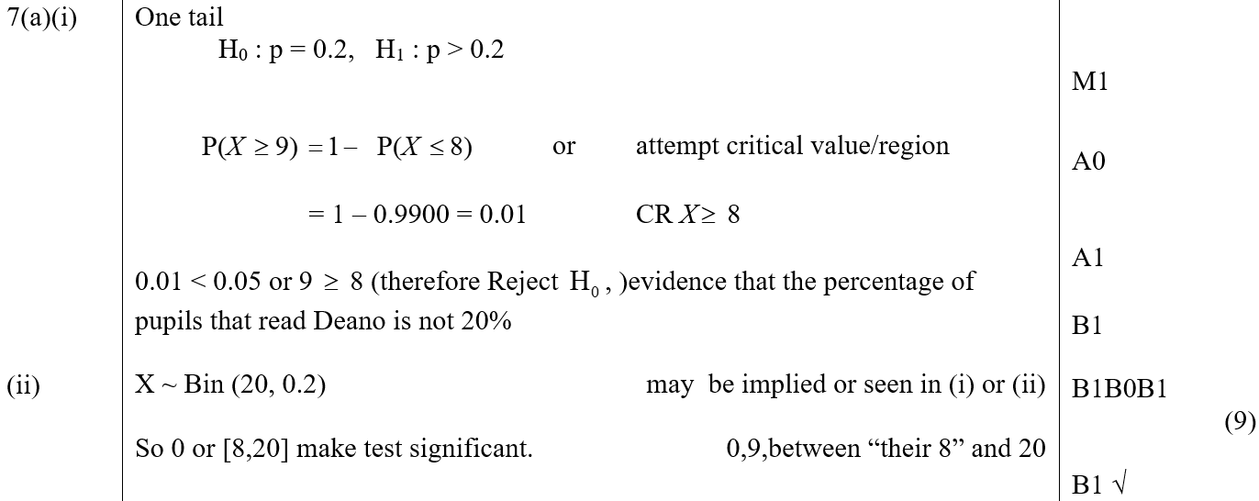
Jan 2006
C
A reduced marks for 1 tailed approach

Slide 38
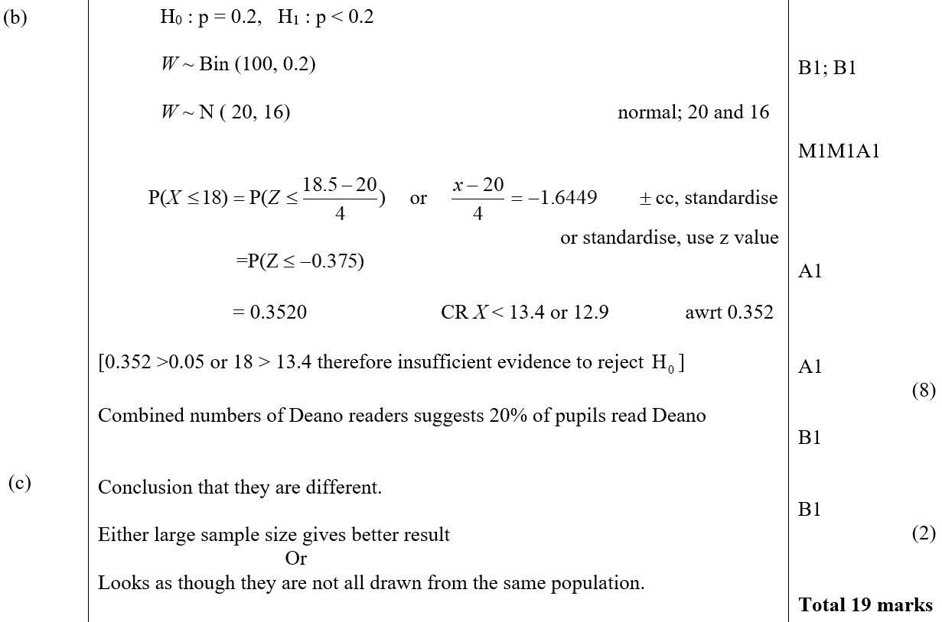
Jan 2006
B marks for 1 tailed approach
C marks for 1 tailed approach

Slide 39
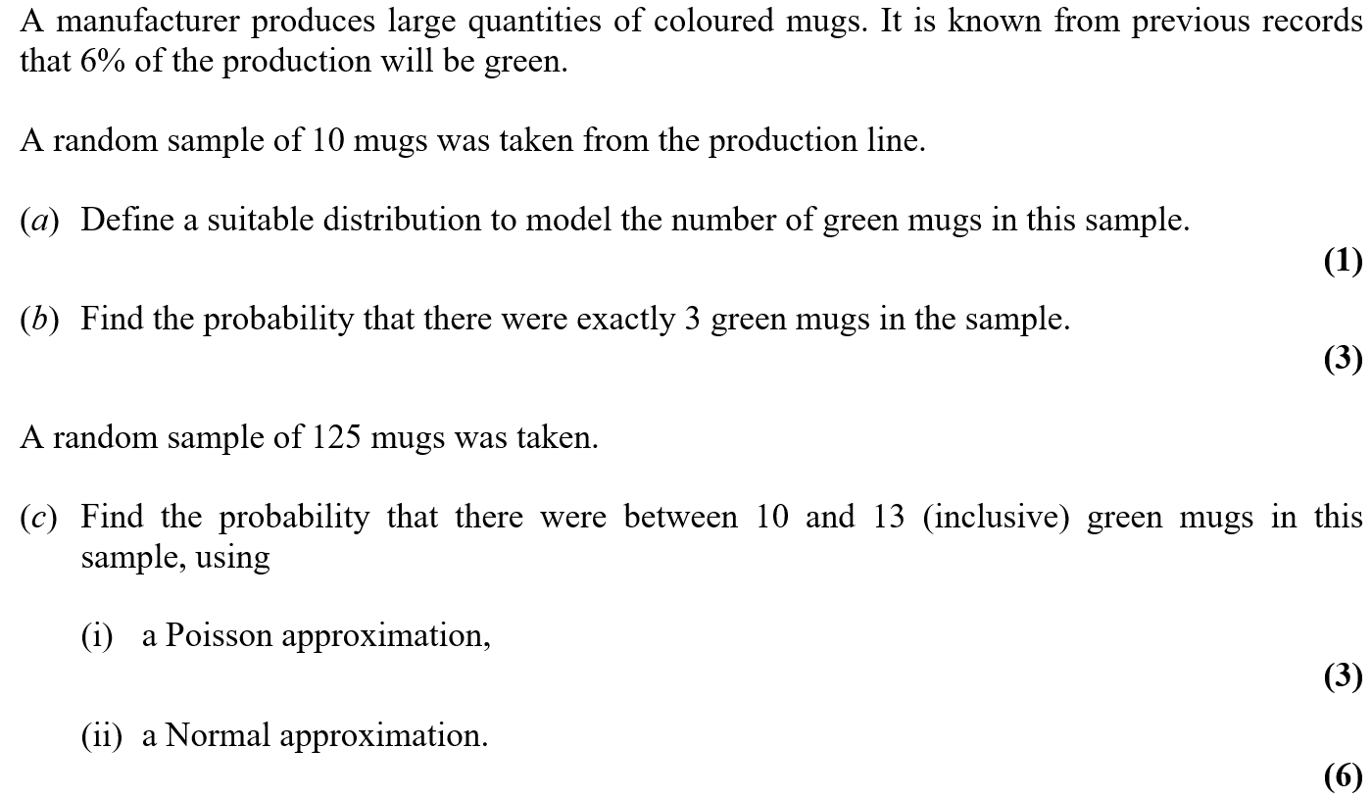
May 2006

Slide 40
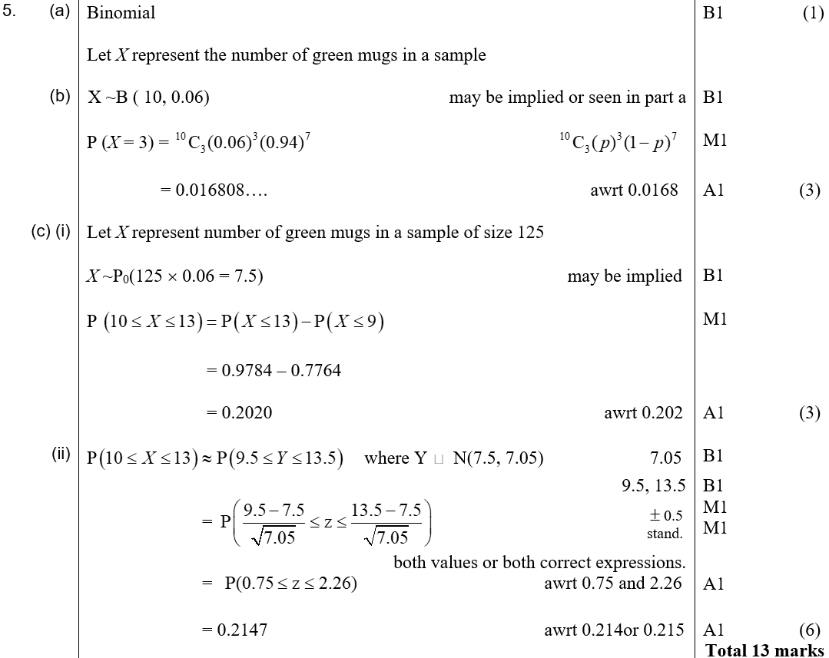
May 2006
A
B
C (i)
C (ii)

Slide 41
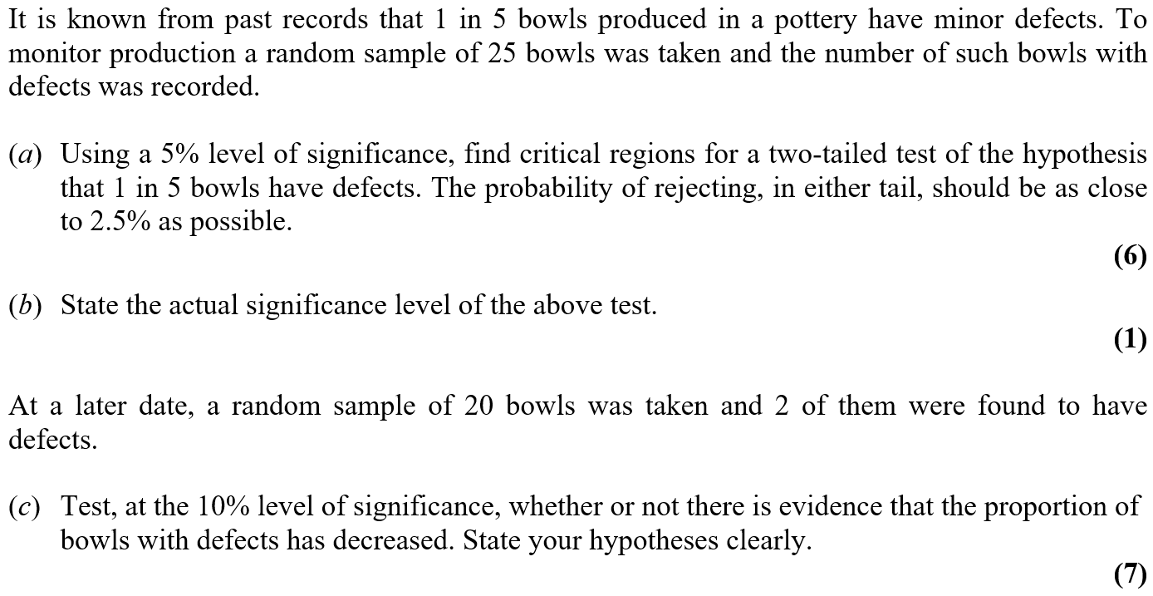
May 2006

Slide 42
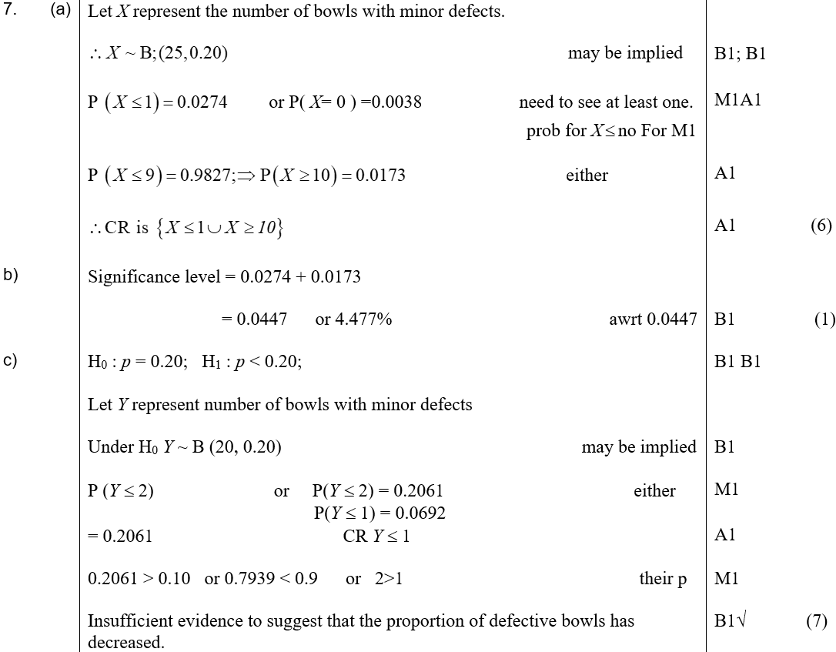
May 2006
A
B
C

Slide 43
Jan 2007

Slide 44
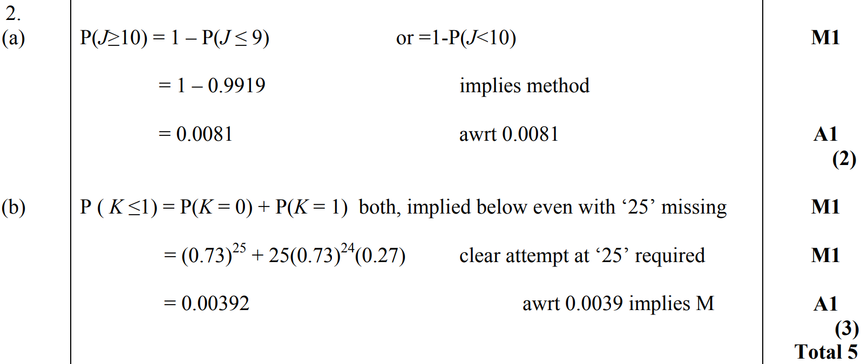
Jan 2007
A
B

Slide 45
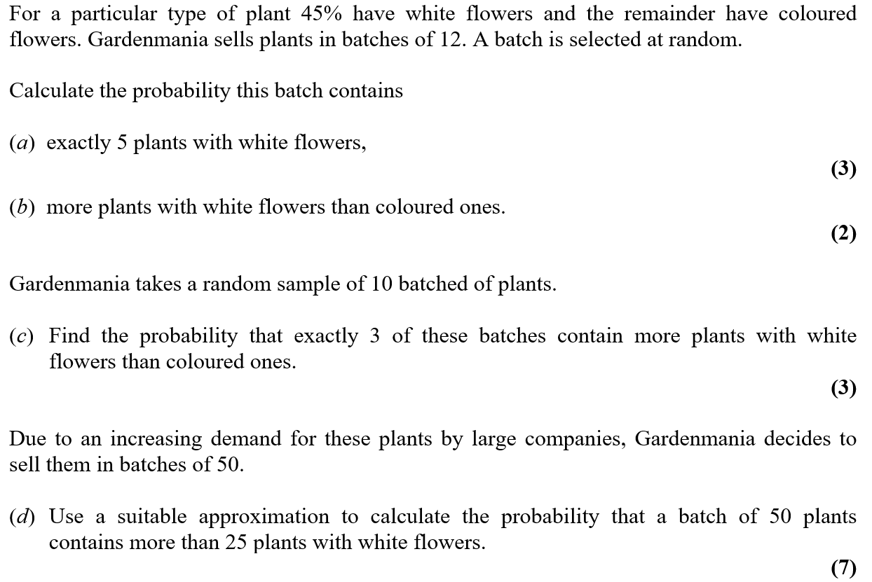
Jan 2007

Slide 46
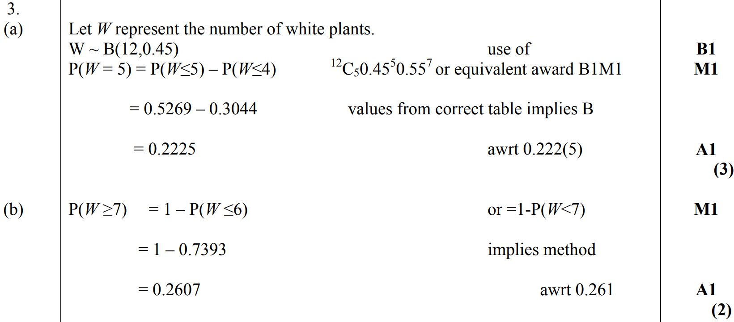
Jan 2007
A
B

Slide 47
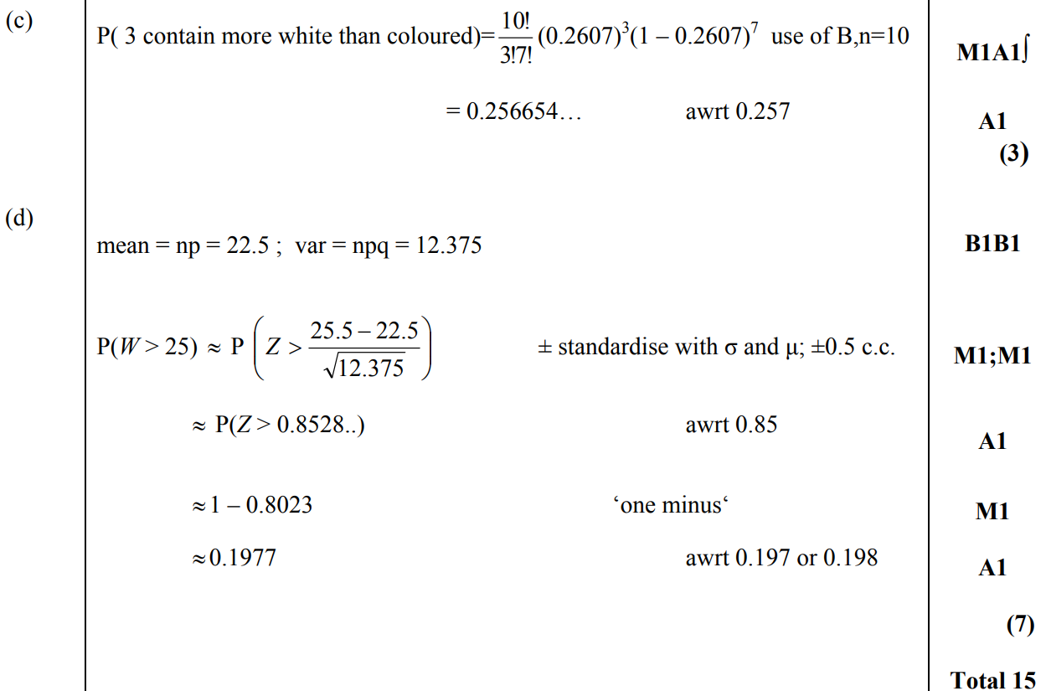
Jan 2007
C
D

Slide 48
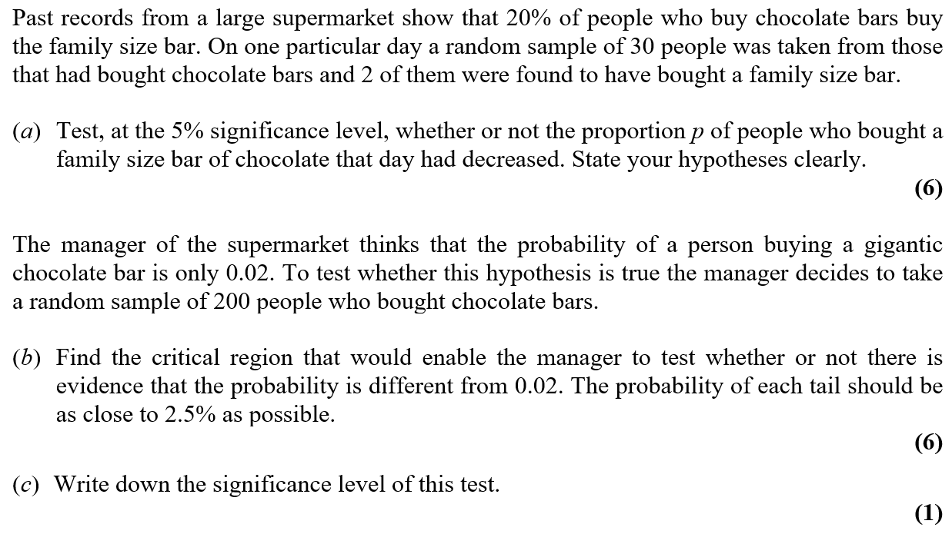
Jan 2007

Slide 49
Jan 2007
A

Slide 50
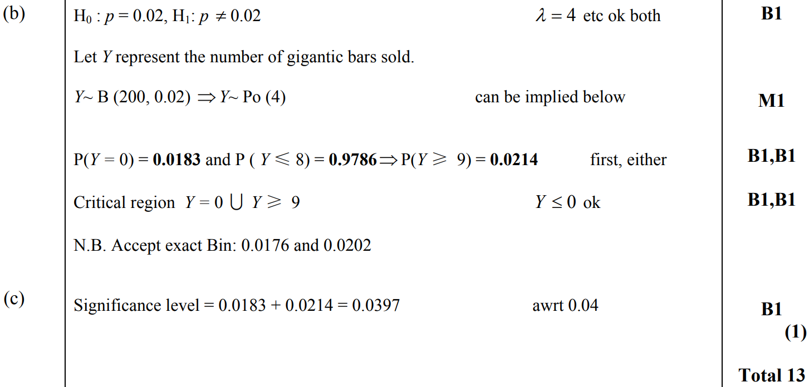
Jan 2007
B
C

Slide 51
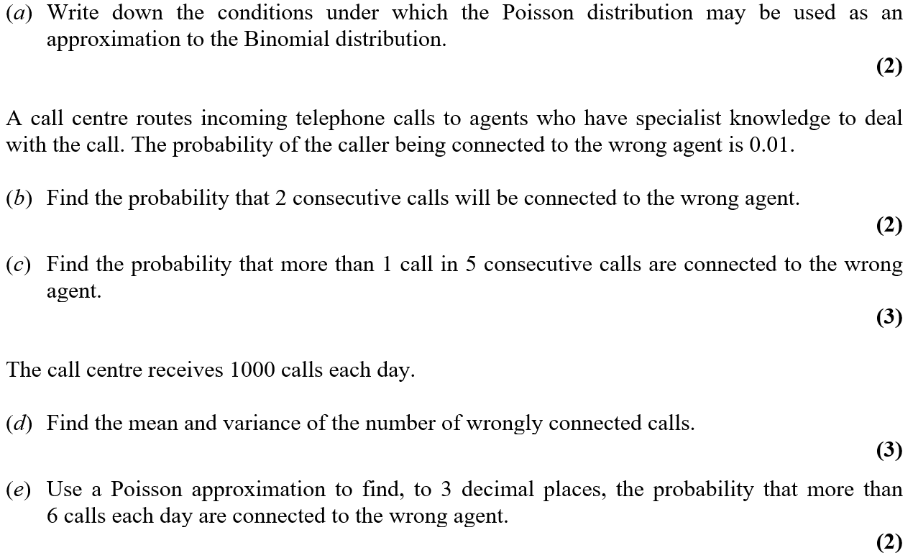
June 2007

Slide 52
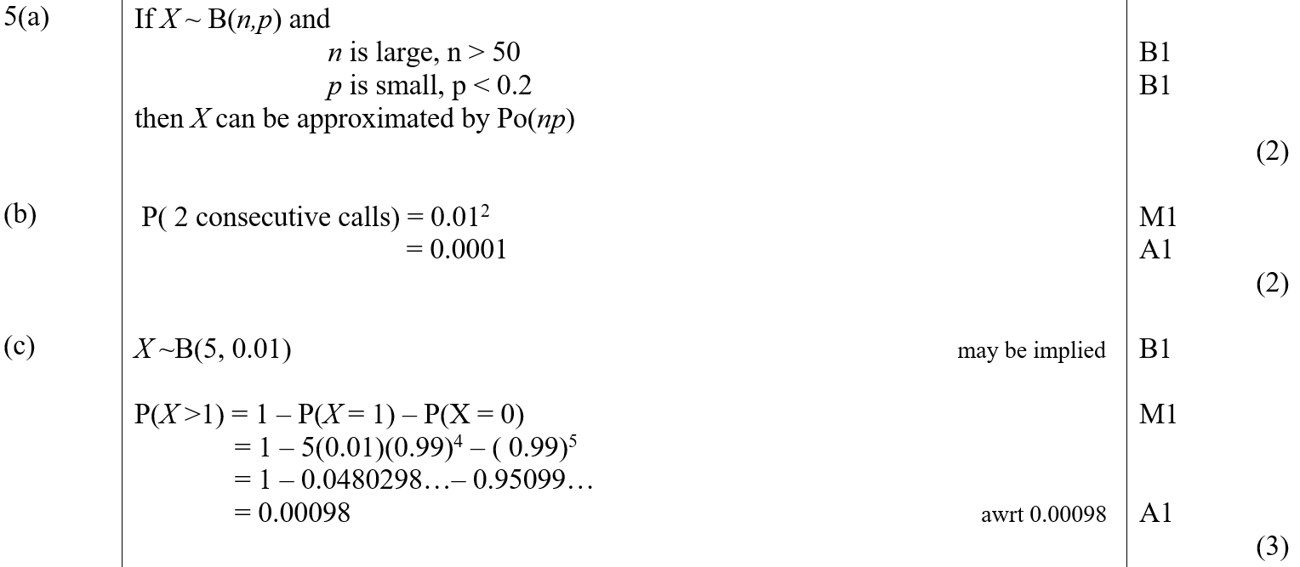
June 2007
A
B
C

Slide 53
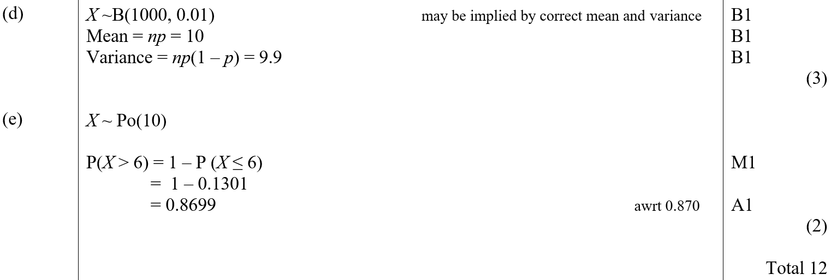
June 2007
D
E

Slide 54
June 2007

Slide 55
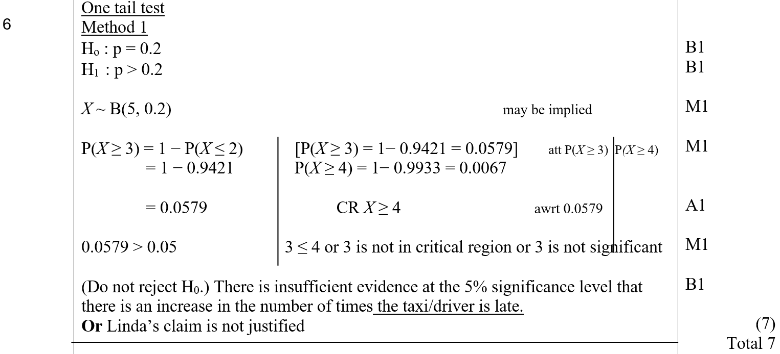
June 2007
A (One-Tailed)

Slide 56
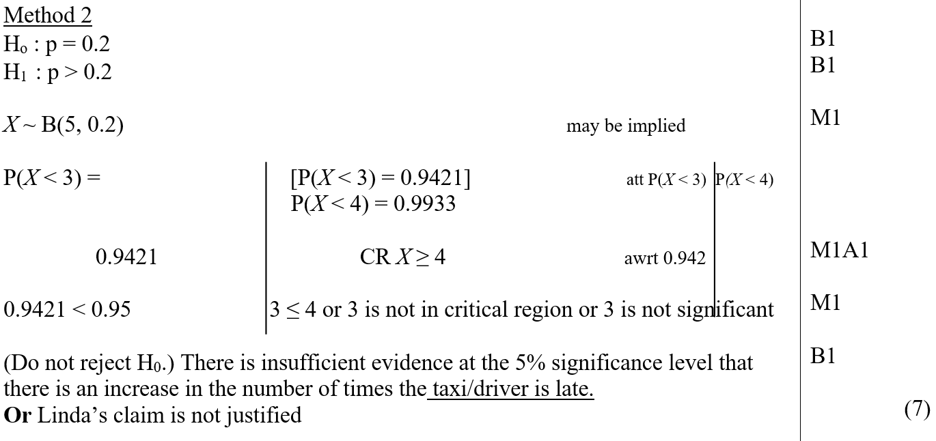
June 2007
A Alternative (One-Tailed)

Slide 57
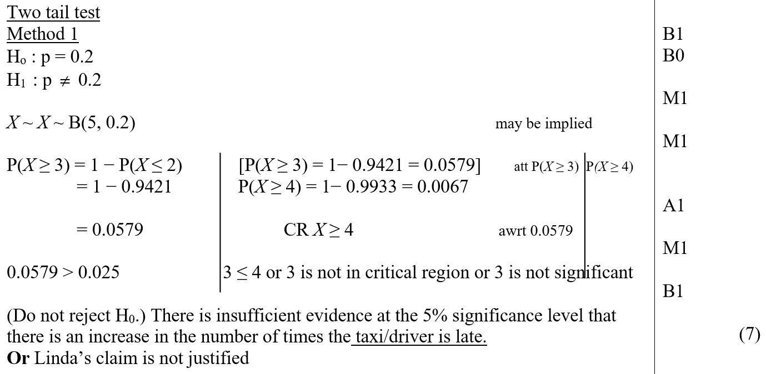
June 2007
A (Two-Tailed)

Slide 58
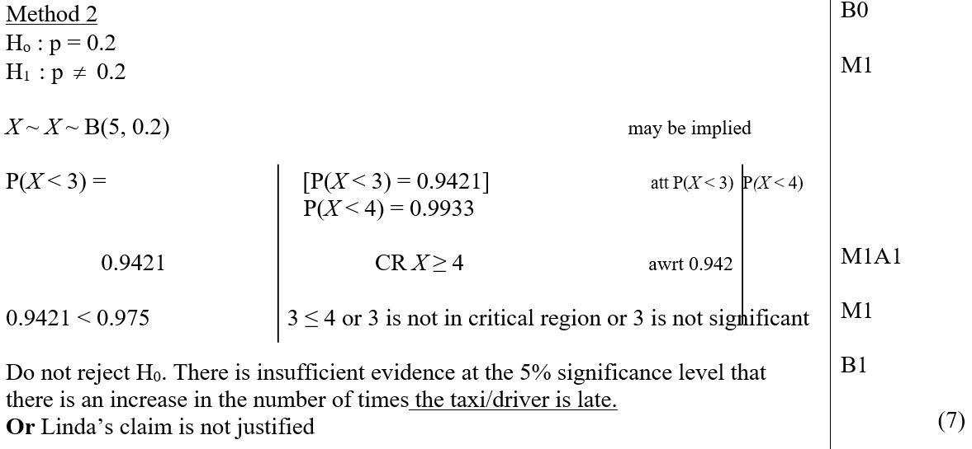
June 2007
A Alternative (Two-Tailed)
Special Case

Slide 59
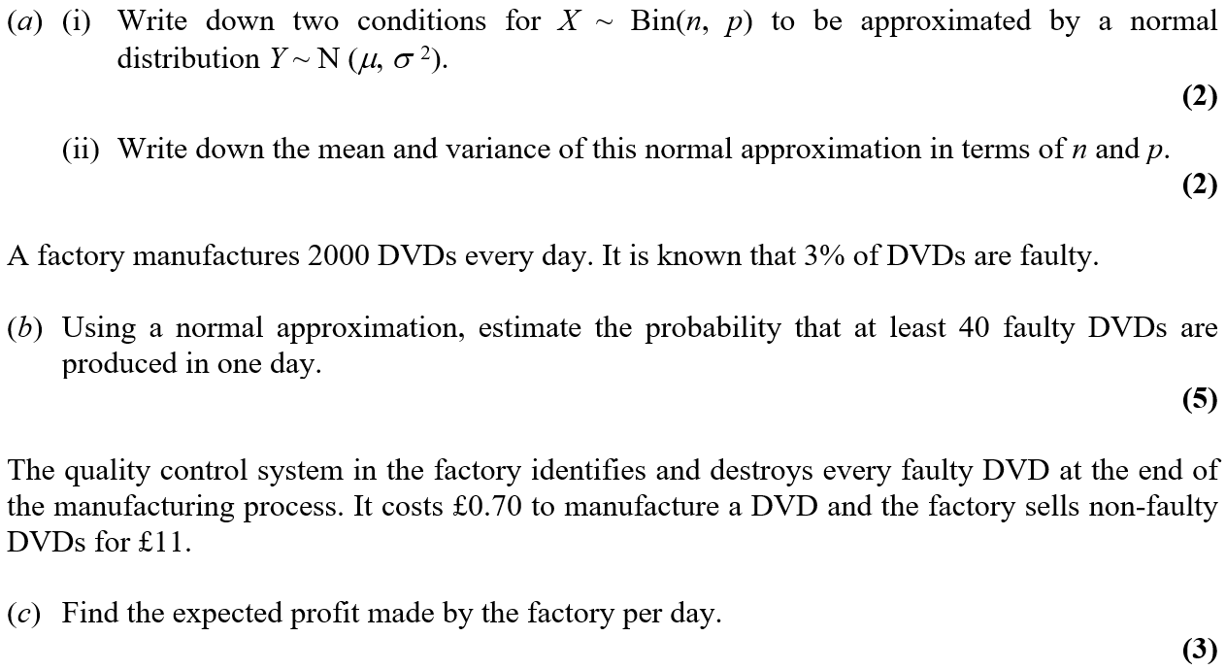
June 2007

Slide 60
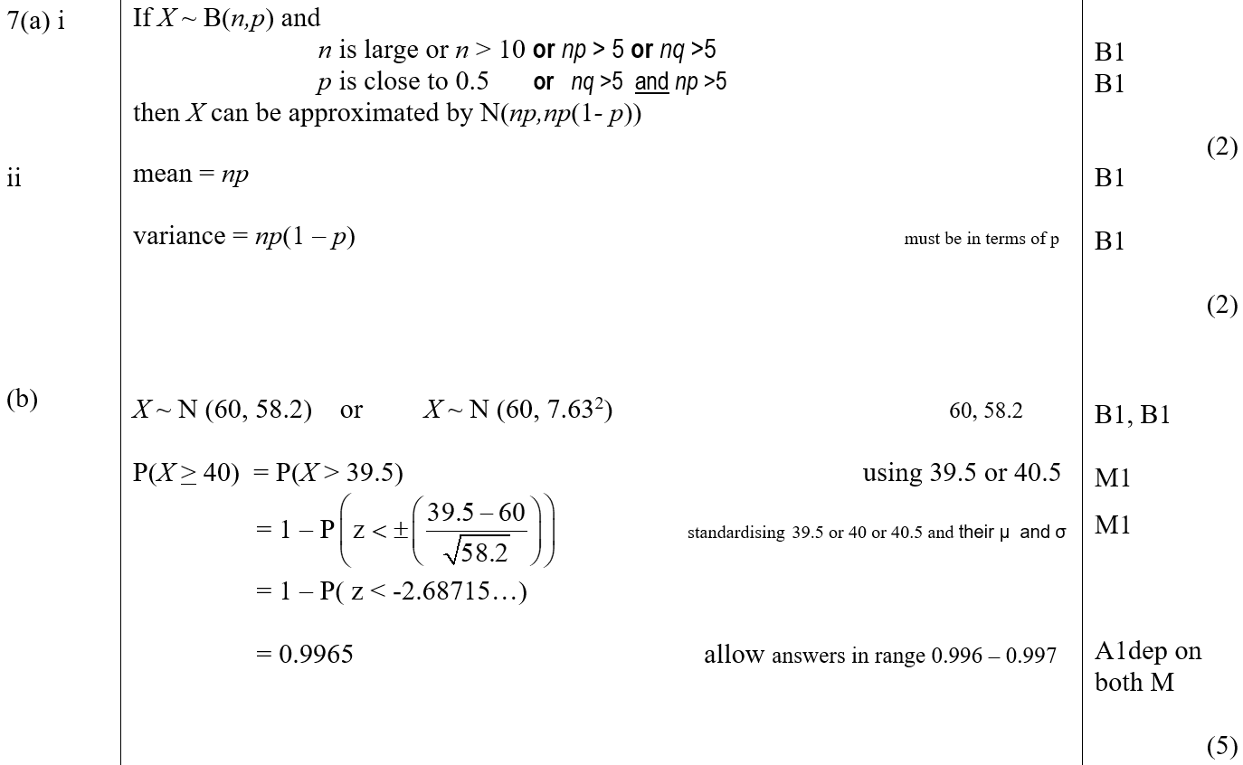
June 2007
A (i)
A (ii)
B

Slide 61
June 2007
C

Slide 62
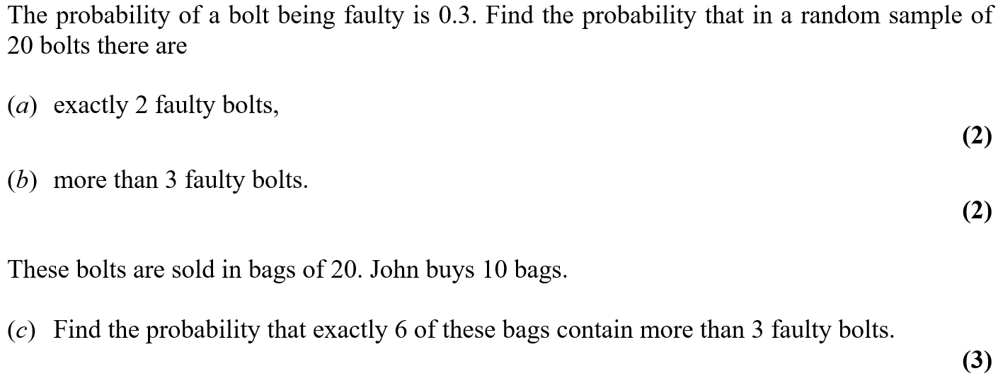
Jan 2008

Slide 63
Jan 2008
A
B
C

Slide 64
Jan 2008
A notes
B notes
C notes

Slide 65
Jan 2008

Slide 66
Jan 2008
A

Slide 67
Jan 2008
A notes

Slide 68
May 2008

Slide 69
May 2008
A
B
C

Slide 70
May 2008

Slide 71
May 2008
A
B
C

Slide 72
May 2008
D

Slide 73
Jan 2009

Slide 74
Jan 2009
A
B
C

Slide 75
Jan 2009

Slide 76
Jan 2009
A
B
C

Slide 77
Jan 2009
notes

Slide 78
May 2009

Slide 79
May 2009
A
B

Slide 80
May 2009

Slide 81
May 2009
A
B
C

Slide 82
Jan 2010

Slide 83
Jan 2010
A
B
C
D

Slide 84
Jan 2010
A notes
B notes
C notes
D notes

Slide 85
Jan 2010

Slide 86
Jan 2010
A
B
C
D

Slide 87
Jan 2010
A notes
B notes
C notes
D notes

Slide 88
May 2010

Slide 89
May 2010
A
B
C
D

Slide 90
May 2010
A notes
B notes
C notes
D notes

Slide 91
May 2010

Slide 92
May 2010
A
B
C
D
E

Slide 93
May 2010
A notes
B notes
C notes
D notes
E notes

Slide 94
Jan 2011

Slide 95
Jan 2011
A
B
C
D

Slide 96
Jan 2011
A notes
B notes
D notes

Slide 97
Jan 2011

Slide 98
Jan 2011
A

Slide 99
Jan 2011
A notes

Slide 100
May 2011

Slide 101
May 2011
A
B

Slide 102
May 2011

Slide 103
May 2011
A
B

Slide 104
May 2011

Slide 105
May 2011
A
B
C

Slide 106
Jan 2012

Slide 107
Jan 2012
A

Slide 108
Jan 2012
A notes

Slide 109
Jan 2012

Slide 110
Jan 2012
A
B
C
D

Slide 111
Jan 2012
A notes
B notes
C notes
D notes

Slide 112
May 2012

Slide 113
May 2012
A
B

Slide 114
May 2012
A notes
B notes

Slide 115
May 2012

Slide 116
May 2012
A (i)
A (ii)
B

Slide 117
May 2012
C
A notes
B notes

Slide 118
May 2012
C notes

Slide 119
May 2012

Slide 120
May 2012
A (i)
A (ii)
B

Slide 121
May 2012
A (i) notes
A (ii) notes
B notes

Slide 122
Jan 2013

Slide 123
Jan 2013
A (i)
A (ii)
B

Slide 124
Jan 2013
C

Slide 125
Jan 2013
A (ii) notes
B notes
C notes

Slide 126
Jan 2013

Slide 127
Jan 2013
A
B
C

Slide 128
Jan 2013
D
A notes

Slide 129
Jan 2013
C notes
D notes

Slide 130
May 2013

Slide 131
May 2013
A
B

Slide 132
May 2013
A notes
B notes

Slide 133
May 2013

Slide 134
May 2013
A
B
C

Slide 135
May 2013
D
A notes
B notes
C notes
D notes

Slide 136
June 2014

Slide 137
June 2014
A (i)
A (ii)
B
C

Slide 138
June 2014
A (i) notes
A (ii) notes
B notes
C notes

Slide 139
June 2015

Slide 140
June 2015
A

Slide 141
June 2015
B

Slide 142
June 2016

Slide 143
June 2016
A
B (i)
B (ii)

Slide 144
June 2016
C

Slide 145
June 2017

Slide 146
June 2017
A

Slide 147
June 2017
B

Slide 148
June 2017

Slide 149
June 2017
A
B

Slide 150
June 2017
C

Slide 151
June 2018

Slide 152
June 2018
A
B
C
D

Slide 153
June 2018
A notes
B notes
C notes
D notes

Slide 154
June 2018

Slide 155
June 2018
A
B
C
D
E

Slide 156
June 2018
A notes
B notes
C notes
E notes

