Slide 1
Mechanics
Constant
acceleration
Twitter: @Owen134866
www.mathsfreeresourcelibrary.com

Slide 2
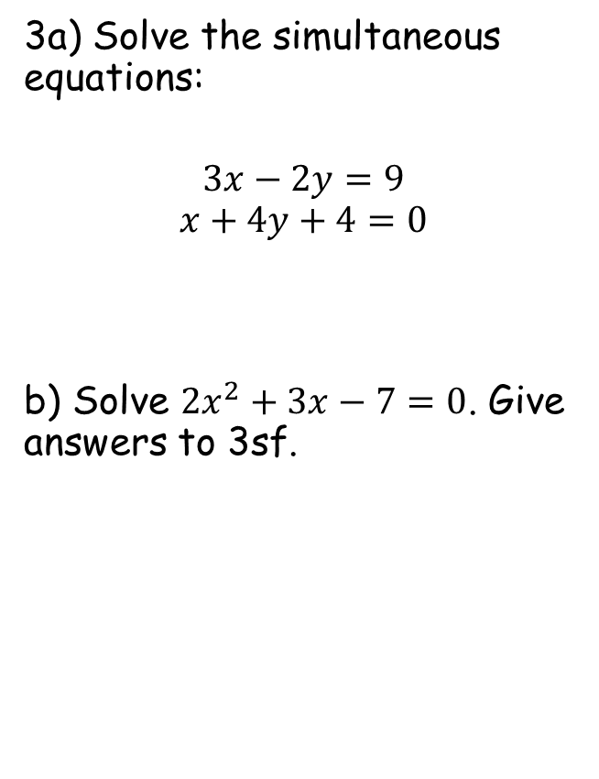
Prior Knowledge Check
For each graph, find;
The gradient
The shaded area under the graph
2) A car travels for 45 minutes at an average speed of 35mph. Find the distance travelled
3a) Solve the simultaneous equations:
$$3x−2y=9$$
$$x+4y+4=0$$
b) Solve ${2x}^{2}+3x−7=0$. Give answers to 3sf.
3
73.5
2
150
-1.5
26.25
21
25
9
x = 2, y = -1.5
5
7
10
5
6
x = 1.27 or -2.77
26.25 miles

Slide 3
Teachings for
Exercise 9A

Slide 4



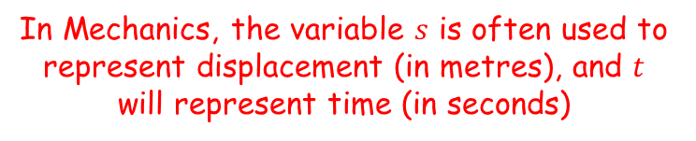






Constant acceleration
You can represent the motion of an object on a displacement-time graph
In Mechanics, the variable $s$ is often used to represent displacement (in metres), and $t$ will represent time (in seconds)
$$s$$
$$s$$
$$s$$
$$O$$
$$t$$
$$O$$
$$t$$
$$O$$
$$t$$
The displacement does not change over time – the object is stationary
The displacement increases at a constant rate over time – the object is moving at a constant velocity
The displacement increases at an increasing rate over time. The object is accelerating
On a displacement-time graph, the gradient represents the velocity
9A

Slide 5





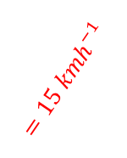




Constant acceleration
You can represent the motion of an object on a distance-time graph
A cyclist rides in a straight line for 20 minutes. She waits for half an hour, then returns in a straight line to her starting point in 15 minutes. To the right is a displacement-time graph for her journey.
Work out the average velocity for each stage of her journey, in kmh⁻¹
Write down the average velocity for the whole journey
Work out the average speed for the whole journey
$$d (km)$$
5
$$A$$
$$B$$
$$=15 {kmh}^{−1}$$
$$C$$
$$O$$
20
50
65
$$t (mins)$$
For OA, the displacement is 5km and the time is 20 minutes (¹/₃ of an hour).
$$Distance÷Time$$
$$5÷\frac{1}{3}$$
$$=15 {kmh}^{−1}$$
9A

Slide 6

Constant acceleration
You can represent the motion of an object on a distance-time graph
A cyclist rides in a straight line for 20 minutes. She waits for half an hour, then returns in a straight line to her starting point in 15 minutes. To the right is a displacement-time graph for her journey.
Work out the average velocity for each stage of her journey, in kmh⁻¹
Write down the average velocity for the whole journey
Work out the average speed for the whole journey
$$d (km)$$
5
$$A$$
$$=0 {kmh}^{−1}$$
$$B$$
$$=15 {kmh}^{−1}$$
$$C$$
$$O$$
20
50
65
$$t (mins)$$
For AB, there is no movement…
9A

Slide 7
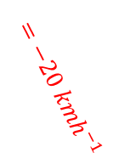



Constant acceleration
You can represent the motion of an object on a distance-time graph
A cyclist rides in a straight line for 20 minutes. She waits for half an hour, then returns in a straight line to her starting point in 15 minutes. To the right is a displacement-time graph for her journey.
Work out the average velocity for each stage of her journey, in kmh⁻¹
Write down the average velocity for the whole journey
Work out the average speed for the whole journey
$$d (km)$$
5
$$A$$
$$=0 {kmh}^{−1}$$
$$B$$
$$=15 {kmh}^{−1}$$
$$=−20 {kmh}^{−1}$$
$$C$$
$$O$$
20
50
65
$$t (mins)$$
For BC, the displacement is -5km (since the cyclist starts at 5km and moves to 0km), and the time is 15 minutes (¹/₄ of an hour)
$$Distance÷Time$$
-$5÷\frac{1}{4}$
$$=−20 {kmh}^{−1}$$
9A

Slide 8


Constant acceleration
You can represent the motion of an object on a distance-time graph
A cyclist rides in a straight line for 20 minutes. She waits for half an hour, then returns in a straight line to her starting point in 15 minutes. To the right is a displacement-time graph for her journey.
Work out the average velocity for each stage of her journey, in kmh⁻¹
Write down the average velocity for the whole journey
Work out the average speed for the whole journey
$$d (km)$$
5
$$A$$
$$=0 {kmh}^{−1}$$
$$B$$
$$=15 {kmh}^{−1}$$
$$=−20 {kmh}^{−1}$$
$$C$$
$$O$$
20
50
65
$$t (mins)$$
$$Average velocity=\frac{Displacement from starting point}{total time taken}$$
As the displacement from the start is 0, the average velocity is 0 as well
$$=0 {kmh}^{−1}$$
9A

Slide 9
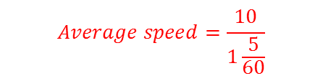


Constant acceleration
You can represent the motion of an object on a distance-time graph
A cyclist rides in a straight line for 20 minutes. She waits for half an hour, then returns in a straight line to her starting point in 15 minutes. To the right is a displacement-time graph for her journey.
Work out the average velocity for each stage of her journey, in kmh⁻¹
Write down the average velocity for the whole journey
Work out the average speed for the whole journey
$$d (km)$$
5
$$A$$
$$=0 {kmh}^{−1}$$
$$B$$
$$=15 {kmh}^{−1}$$
$$=−20 {kmh}^{−1}$$
$$C$$
$$O$$
20
50
65
$$t (mins)$$
$$Average speed=\frac{total distance travelled}{total time taken}$$
$$Average speed=\frac{10}{1\frac{5}{60}}$$
1 hour and 5 minutes
$$=0 {kmh}^{−1}$$
$$Average speed=9.23 {kmh}^{−1}$$
9A

Slide 10
Teachings for
Exercise 9B

Slide 11




Constant acceleration
You can also represent the motion of an object on a velocity-time graph
In Mechanics, the variable $v$ is used to represent velocity (in metres per second), and $t$ will represent time (in seconds)
$$v$$
$$v$$
$$v$$
$$O$$
$$t$$
$$O$$
$$t$$
$$O$$
$$t$$
The velocity does not change over time and is 0. The object is stationary.
The velocity is the same over time – the object is moving at a constant velocity
The velocity increases at a constant rate over time. The object is accelerating at a constant rate
On a velocity-time graph, the gradient represents the acceleration
9B

Slide 12




Constant acceleration
You can also represent the motion of an object on a velocity-time graph
Gradient of a velocity-time graph = Acceleration over that period
Area under a velocity-time graph = distance travelled
The diagram below shows a velocity-time graph for the motion of a cyclist moving along a straight road for 12 seconds. For the first 8 seconds, she moves at a constant speed of 6ms⁻¹. She then decelerates at a constant rate, stopping after a further 4 seconds. Find:
The distance travelled by the cyclist
The rate of deceleration of the cyclist
v(ms⁻¹)
8
6
6
0
8
12
t(s)
12
$$Area=\left(\frac{a+b}{2}\right)h$$
Sub in the appropriate values for the trapezium above
$$Area=\left(\frac{8+12}{2}\right)×6$$
Calculate
$$Area=60$$
$$The distance travelled is 60m$$
9B

Slide 13




Constant acceleration
You can also represent the motion of an object on a velocity-time graph
Gradient of a velocity-time graph = Acceleration over that period
Area under a velocity-time graph = distance travelled
The diagram below shows a velocity-time graph for the motion of a cyclist moving along a straight road for 12 seconds. For the first 8 seconds, she moves at a constant speed of 6ms⁻¹. She then decelerates at a constant rate, stopping after a further 4 seconds. Find:
The distance travelled by the cyclist – 60m
The rate of deceleration of the cyclist
v(ms⁻¹)
6
-6
0
8
12
t(s)
4
$$Gradient=\frac{change in y}{change in x}$$
Sub in the appropriate values for the trapezium above
$$Gradient=\frac{−6}{4}$$
Calculate
$$Gradient=−1.5$$
$$So the deceleration is 1.5ms^{−2}$$
9B

Slide 14






Constant acceleration
You can also represent the motion of an object on a velocity-time graph
Gradient of a velocity-time graph = Acceleration over that period
Area under a velocity-time graph = distance travelled
A particle moves along a straight line. It accelerates uniformly from rest to a speed of 8ms⁻¹ in T seconds. The particle then travels at a constant speed for 5T seconds. It then decelerates to rest uniformly over the next 40 seconds.
Sketch a velocity-time graph for this motion
Given that the particle travels 600m, find the value of T
v(ms⁻¹)
5T
8
$$Area= \left(\frac{a+b}{2}\right)h$$
Sub in values
8
$$600= \left(\frac{5T+6T+40}{2}\right)×8$$
Simplify fraction
0
$$600= \left(5.5T+20\right)×8$$
T
5T
40
t(s)
Divide by 8
6T + 40
$$75=5.5T+20$$
Subtract 20
$$55=5.5T$$
Divide by 5.5
$$10=T$$
9B

