Slide 1
Teachings for
Exercise 8D

Slide 2
Modelling in Mechanics
A vector is a quantity that has both magnitude and direction
Scalar quantities (magnitude only)
Vector quantities (magnitude and direction)
Quantity | Description | Unit
Distance | Measure of length | m
Speed | Measure of how quickly something moves | ms⁻¹
Time | Measure of ongoing events | s
Mass | Measure of the quantity of matter in an object | kg
Quantity | Description | Unit
Displacement | Distance in a specific direction | m
Velocity | Rate of change of displacement | ms⁻¹
Acceleration | Rate of change of velocity | ms⁻²
Force / weight | Described by magnitude, direction and point of application | N
Note that scalar quantities will always be positive. Vector quantities can be either positive or negative (when direction is taken into account)
8D

Slide 3
Modelling in Mechanics
A vector is a quantity that has both magnitude and direction
Fully describe the motion of the particles below:
Particle A
A
Velocity
The particle is moving to the right and its speed is increasing
Acceleration
Particle B
A
B
C
D
B
Velocity
The particle is moving to the right and its speed is decreasing
Acceleration
Velocity
+ve
+ve
-ve
-ve
Particle C
Acceleration
+ve
-ve
-ve
+ve
C
Velocity
The particle is moving to the left and its speed is increasing
Positive direction
Acceleration
Particle D
D
Velocity
The particle is moving to the left and its speed is decreasing
Acceleration
8D

Slide 4


Modelling in Mechanics
A vector is a quantity that has both magnitude and direction
You can describe motion in 2D by using vectors and the i, j notation.
The vector i represents one unit in the positive x-direction
The vector j represents one unit in the positive y-direction
You can use Pythagoras’ theorem and trigonometry when vectors are given in this way…
→ The magnitude of a displacement vector is distance, and the magnitude of the velocity vector is speed
$$y$$
(0,1)
j
0
i
(1,0)
$$x$$
8D

Slide 5


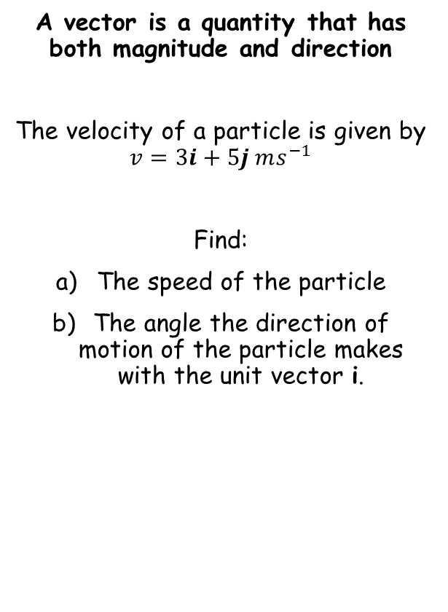



Modelling in Mechanics
A vector is a quantity that has both magnitude and direction
The velocity of a particle is given by $v=3i+5j ms^{−1}$
Find:
The speed of the particle
The angle the direction of motion of the particle makes with the unit vector i.
Draw a diagram!
$$5j$$
$$3i$$
You can use Pythagoras’ Theorem to find the magnitude of the velocity (speed)
$$\left|v\right|=\sqrt{3^{2}+5^{2}}$$
Calculate
$$\left|v\right|=\sqrt{34}$$
Round to 3sf
$$\left|v\right|=5.83 {ms}^{−1}$$
8D

Slide 6


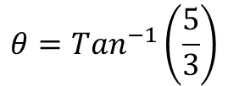

Modelling in Mechanics
A vector is a quantity that has both magnitude and direction
The velocity of a particle is given by $v=3i+5j ms^{−1}$
Find:
The speed of the particle
The angle the direction of motion of the particle makes with the unit vector i.
Draw a diagram!
Opp
$$5j$$
$$θ$$
$$3i$$
Adj
You can use Trigonometry to find the angle between the direction of motion and the unit vector i
$$Tanθ=\frac{5}{3}$$
Inverse Tan
$$θ={Tan}^{−1}\left(\frac{5}{3}\right)$$
Calculate and round to 3sf
$$θ=59.0^{°}$$
8D

Slide 7











Modelling in Mechanics
$$B$$
Draw a diagram!
A vector is a quantity that has both magnitude and direction
A man walks from A to B and then from B to C. His displacement from A to B is 6i + 4j km. His displacement from B to C is 5i – 12j km.
What is the magnitude of the displacement from A to C?
What is the total distance the man walked in getting from A to C?
$$6i+4j$$
$$A$$
$$5i−12j$$
$$13.6km$$
$$C$$
$$\vec{AC}=\vec{AB}+\vec{BC}$$
Use vector notation to add AB and BC
$$\vec{AC}=\left(\begin{matrix}6 \\ 4\end{matrix}\right)+\left(\begin{matrix}5 \\ −12\end{matrix}\right)$$
Calculate
$$\vec{AC}=\left(\begin{matrix}11 \\ −8\end{matrix}\right)$$
Use Pythagoras’ Theorem
$$\left|AC\right|=\sqrt{{(11)}^{2}+{(−8)}^{2}}$$
Calculate
$$\left|AC\right|=13.6km$$
8D

Slide 8



Modelling in Mechanics
$$B$$
Draw a diagram!
A vector is a quantity that has both magnitude and direction
A man walks from A to B and then from B to C. His displacement from A to B is 6i + 4j km. His displacement from B to C is 5i – 12j km.
What is the magnitude of the displacement from A to C?
What is the total distance the man walked in getting from A to C?
$$6i+4j$$
$$A$$
$$5i−12j$$
$$13.6km$$
$$C$$
$$Total=\left|\vec{AB}\right|+\left|\vec{BC}\right|$$
Use vector notation to add AB and BC
$$Total=\sqrt{{(6)}^{2}+{(4)}^{2}} + \sqrt{{(5)}^{2}+{(−12)}^{2}}$$
Calculate
$$Total=20.2km$$
8D

