Slide 1
Teachings for
Exercise 8C

Slide 2
Modelling in Mechanics
You need to know SI units and the types of forces that can be involved in questions
These base SI (System International d’unites) are most commonly used in Mechanics
These derived units are compounds based on the units above
A Newton is defined as:
“The force that will cause a mass of 1kg to accelerate at 1ms⁻²”
Quantity | Unit | Symbol
Mass | Kilogram | kg
Length / displacement | Metre | m
Time | Seconds | t
Quantity | Unit | Symbol
Speed / velocity | Metres per second | ms⁻¹
Acceleration | Metres per second per second | ms⁻²
Weight / force | Newton | N (= kg ms⁻²)
8C

Slide 3
Modelling in Mechanics
You need to know SI units and the types of forces that can be involved in questions
You will also encounter a variety of forces in mechanics, and you need to know how they act:
R
The Normal Reaction
The normal reaction acts perpendicular to the surface which an object is resting on
It is equal and opposite to the force exerted on the surface by the object, which is determined largely by gravity and the mass of the object
mg (mass x gravity) – ‘weight’
The table matches the force from the brick, which is why the brick remains still on the table (there of course would be a maximum possible weight the table could take, but we will not worry about this for now!)
8C

Slide 4
Modelling in Mechanics
You need to know SI units and the types of forces that can be involved in questions
You will also encounter a variety of forces in mechanics, and you need to know how they act:
Frictional Force
Direction of motion
Frictional Force
The frictional force opposes motion between two ‘rough’ surfaces
Although it is a force, friction does not cause movement in its own direction. It just reduces the effect of another force
Surfaces will have a maximum level of friction where it is unable to completely prevent movement
8C

Slide 5
Modelling in Mechanics
You need to know SI units and the types of forces that can be involved in questions
You will also encounter a variety of forces in mechanics, and you need to know how they act:
Tension in string
Tension
If an object is being pulled along (for example by a string), then the force acting on the object is called the Tension
Tension = PULLING force
8C

Slide 6
Modelling in Mechanics
You need to know SI units and the types of forces that can be involved in questions
You will also encounter a variety of forces in mechanics, and you need to know how they act:
Thrust
Thrust
If an object is being pushed along (for example by a rod), then the force acting on the object is called the Thrust (or sometimes compression)
Thrust = PUSHING force
8C

Slide 7
Modelling in Mechanics
You need to know SI units and the types of forces that can be involved in questions
You will also encounter a variety of forces in mechanics, and you need to know how they act:
Resistance
Any object moving through air, fluid or a solid will experience resistance caused by the particles in the way
Gravity
Gravity is the force between any object and the earth.
The Force caused by gravity acting on an object is its weight
Buoyancy
Buoyancy is the upward force on a body which allows it to float
It is a bit like thinking about the normal reaction between a boat and the water
8C

Slide 8
Modelling in Mechanics
You need to know SI units and the types of forces that can be involved in questions
Write the following quantities in SI units:
4km
0.32g
5.1 x 10⁶ kmh⁻¹
4000m
0.00032kg or 3.2 x 10⁻⁴kg
Multiply by 1000 → 5.1 x 10⁹ mh⁻¹
Divide by 3600 → 1.42 x 10⁶ ms⁻¹
8C

Slide 9
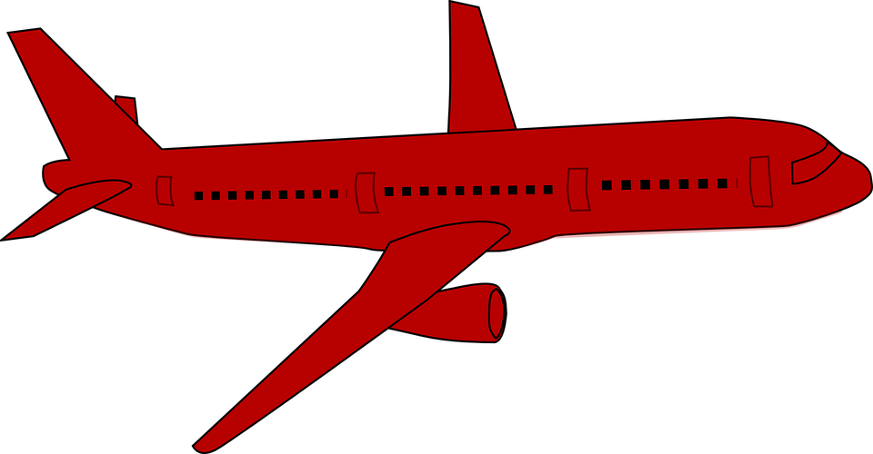
Modelling in Mechanics
You need to know SI units and the types of forces that can be involved in questions
The plane to the right is mid-flight. State the names of the labelled forces acting on it.
Upward thrust
Air resistance
Forward thrust
Weight
8C

