Slide 1
Teachings for
Exercise 8B

Slide 2
Modelling in Mechanics
You need to understand the implications of a number of key terms used to explain assumptions
Assumption can simplify a problem, helping you gain a clearer understanding of it. Please look at the definitions on page 121 and ensure you understand the implications of these assumptions.
Please be aware that these will appear in most questions, so you will get used to them!
8B

Slide 3
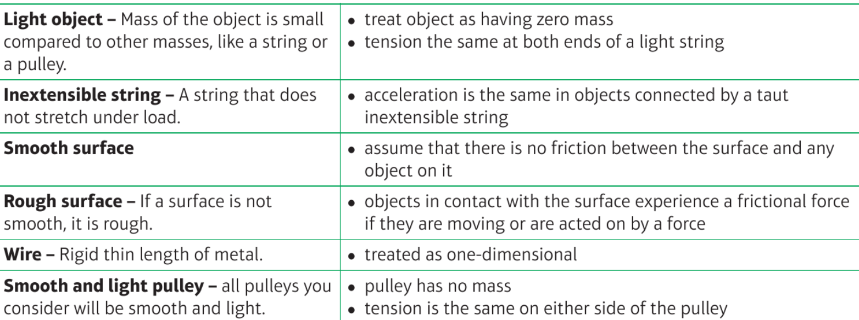
Reveal
Reveal
Reveal
Reveal
Reveal
Reveal
Reveal
Reveal
Reveal
Reveal
Reveal
Reveal
Reveal
Reveal

Slide 4
Modelling in Mechanics
You need to understand the implications of a number of key terms used to explain assumptions
A mass is attached to a length of string which is fixed to the ceiling. The mass is drawn to the side with the string taut and allowed to swing.
State the effect of the following assumptions on any calculations to be made:
The string is light and inextensible
The mass is modelled as a particle
The string is light and inextensible
The string has no mass
The string is of a fixed length (no stretching)
The mass is modelled as a particle
Ignore the effects of air resistance
No rotational effects of forces
8B

