Slide 1
Mechanics
Modelling in Mechanics
Twitter: @Owen134866
www.mathsfreeresourcelibrary.com

Slide 2


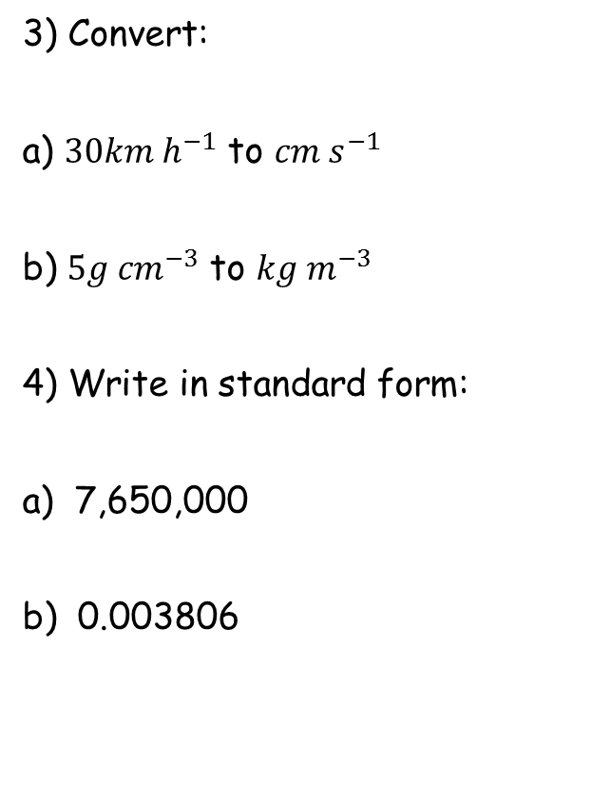


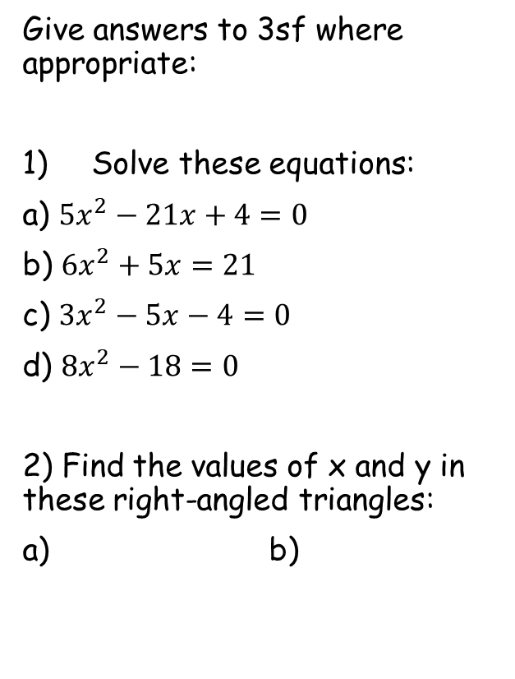








Prior Knowledge Check
Give answers to 3sf where appropriate:
Solve these equations:
a) $5x^{2}−21x+4=0$
b) $6x^{2}+5x=21$
c) $3x^{2}−5x−4=0$
d) $8x^{2}−18=0$
2) Find the values of x and y in these right-angled triangles:
a) b)
3) Convert:
a) ${30km h}^{−1}$ to ${cm s}^{−1}$
b) ${5g cm}^{−3}$ to ${kg m}^{−3}$
4) Write in standard form:
a) 7,650,000
b) 0.003806
$$833$$
$x=4$ or $x=\frac{1}{5}$
$$5000$$
$x=\frac{3}{2}$ or $x=−\frac{7}{3}$
$x=2.26$ or $x=−0.591$
$$x=±\frac{3}{2}$$
$$7.65×{10}^{6}$$
$$3.806×{10}^{−3}$$
9
x
54˚
y
x
$$14.8$$
$$8.7$$
$$10.3$$
5
y
$$61$$
12

Slide 3
Teachings for
Exercise 8A

Slide 4
Modelling in Mechanics
You need to be able to construct a model of a physical situation, sometimes by making assumptions
Mechanics deals with motion and the action of forces on objects. We can create mathematical models to simulate real-life situations, and adapt these depending on the information included.
The flow chart to the right summarizes the mathematical modelling process.
Real-world problem
Set up mathematical model, deciding on assumptions and variables
Solve and interpret
Reconsider assumptions
Is the answer reasonable?
Report solution
8A

Slide 5



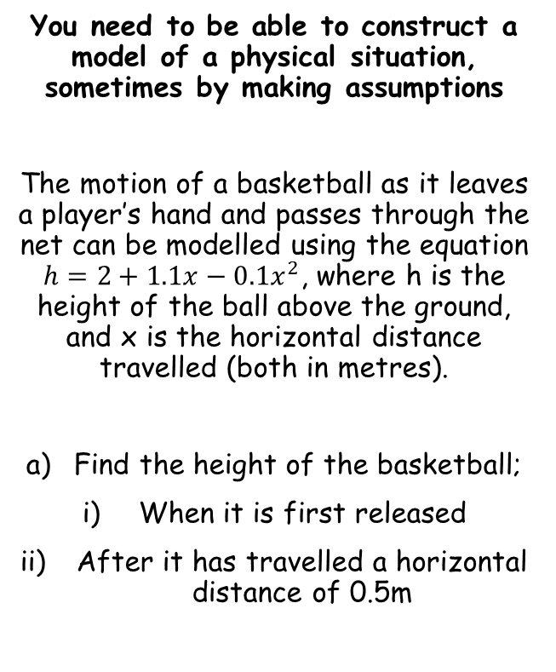



Modelling in Mechanics
You need to be able to construct a model of a physical situation, sometimes by making assumptions
The motion of a basketball as it leaves a player’s hand and passes through the net can be modelled using the equation $h=2+1.1x−0.1x^{2}$, where h is the height of the ball above the ground, and x is the horizontal distance travelled (both in metres).
Find the height of the basketball;
When it is first released
After it has travelled a horizontal distance of 0.5m
$$h=2+1.1x−0.1x^{2}$$
When first released, the horizontal distance (x) is 0
$$h=2+1.1(0)−0.1{(0)}^{2}$$
Calculate
$$h=2m$$
$$h=2+1.1x−0.1x^{2}$$
In this case, the horizontal distance (x) is 0.5
$$h=2+1.1(0.5)−0.1{(0.5)}^{2}$$
Calculate
$$h=2.525m$$
8A

Slide 6
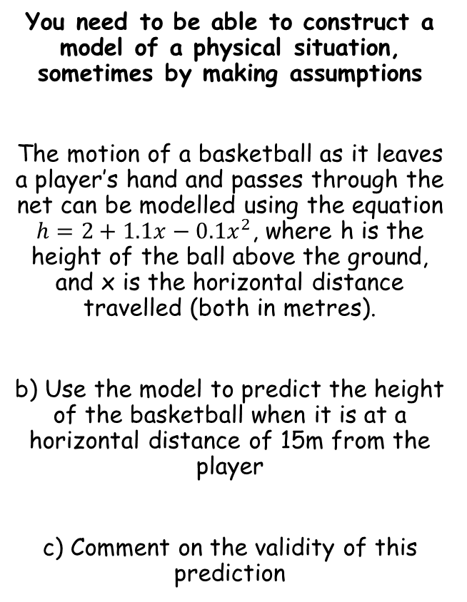


Modelling in Mechanics
You need to be able to construct a model of a physical situation, sometimes by making assumptions
The motion of a basketball as it leaves a player’s hand and passes through the net can be modelled using the equation $h=2+1.1x−0.1x^{2}$, where h is the height of the ball above the ground, and x is the horizontal distance travelled (both in metres).
b) Use the model to predict the height of the basketball when it is at a horizontal distance of 15m from the player
c) Comment on the validity of this prediction
$$h=2+1.1x−0.1x^{2}$$
In this case, the horizontal distance (x) is 15
$$h=2+1.1(15)−0.1{(15)}^{2}$$
Calculate
$$h=−4m$$
As height cannot be negative, the model is not valid if x = 15m
8A

