Slide 1
Mechanics
Modelling in Mechanics
Twitter: @Owen134866
www.mathsfreeresourcelibrary.com

Slide 2
Prior Knowledge Check
Give answers to 3sf where appropriate:
Solve these equations:
a) $5x^{2}−21x+4=0$
b) $6x^{2}+5x=21$
c) $3x^{2}−5x−4=0$
d) $8x^{2}−18=0$
2) Find the values of x and y in these right-angled triangles:
a) b)
3) Convert:
a) ${30km h}^{−1}$ to ${cm s}^{−1}$
b) ${5g cm}^{−3}$ to ${kg m}^{−3}$
4) Write in standard form:
a) 7,650,000
b) 0.003806
$$833$$
$x=4$ or $x=\frac{1}{5}$
$$5000$$
$x=\frac{3}{2}$ or $x=−\frac{7}{3}$
$x=2.26$ or $x=−0.591$
$$x=±\frac{3}{2}$$
$$7.65×{10}^{6}$$
$$3.806×{10}^{−3}$$
9
x
54˚
y
x
$$14.8$$
$$8.7$$
$$10.3$$
5
y
$$61$$
12

Slide 3
Teachings for
Exercise 8A

Slide 4
Modelling in Mechanics
You need to be able to construct a model of a physical situation, sometimes by making assumptions
Mechanics deals with motion and the action of forces on objects. We can create mathematical models to simulate real-life situations, and adapt these depending on the information included.
The flow chart to the right summarizes the mathematical modelling process.
Real-world problem
Set up mathematical model, deciding on assumptions and variables
Solve and interpret
Reconsider assumptions
Is the answer reasonable?
Report solution
8A

Slide 5
Modelling in Mechanics
You need to be able to construct a model of a physical situation, sometimes by making assumptions
The motion of a basketball as it leaves a player’s hand and passes through the net can be modelled using the equation $h=2+1.1x−0.1x^{2}$, where h is the height of the ball above the ground, and x is the horizontal distance travelled (both in metres).
Find the height of the basketball;
When it is first released
After it has travelled a horizontal distance of 0.5m
$$h=2+1.1x−0.1x^{2}$$
When first released, the horizontal distance (x) is 0
$$h=2+1.1(0)−0.1{(0)}^{2}$$
Calculate
$$h=2m$$
$$h=2+1.1x−0.1x^{2}$$
In this case, the horizontal distance (x) is 0.5
$$h=2+1.1(0.5)−0.1{(0.5)}^{2}$$
Calculate
$$h=2.525m$$
8A

Slide 6
Modelling in Mechanics
You need to be able to construct a model of a physical situation, sometimes by making assumptions
The motion of a basketball as it leaves a player’s hand and passes through the net can be modelled using the equation $h=2+1.1x−0.1x^{2}$, where h is the height of the ball above the ground, and x is the horizontal distance travelled (both in metres).
b) Use the model to predict the height of the basketball when it is at a horizontal distance of 15m from the player
c) Comment on the validity of this prediction
$$h=2+1.1x−0.1x^{2}$$
In this case, the horizontal distance (x) is 15
$$h=2+1.1(15)−0.1{(15)}^{2}$$
Calculate
$$h=−4m$$
As height cannot be negative, the model is not valid if x = 15m
8A

Slide 7
Teachings for
Exercise 8B

Slide 8
Modelling in Mechanics
You need to understand the implications of a number of key terms used to explain assumptions
Assumption can simplify a problem, helping you gain a clearer understanding of it. Please look at the definitions on page 121 and ensure you understand the implications of these assumptions.
Please be aware that these will appear in most questions, so you will get used to them!
8B

Slide 9
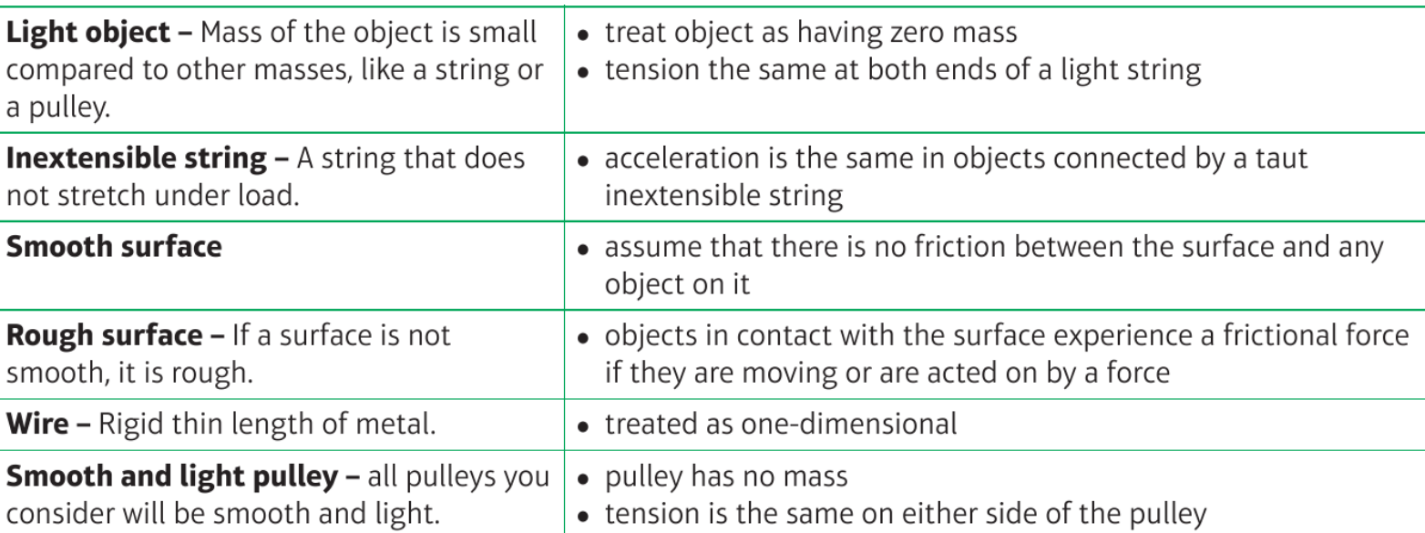
Reveal
Reveal
Reveal
Reveal
Reveal
Reveal
Reveal
Reveal
Reveal
Reveal
Reveal
Reveal
Reveal
Reveal

Slide 10
Modelling in Mechanics
You need to understand the implications of a number of key terms used to explain assumptions
A mass is attached to a length of string which is fixed to the ceiling. The mass is drawn to the side with the string taut and allowed to swing.
State the effect of the following assumptions on any calculations to be made:
The string is light and inextensible
The mass is modelled as a particle
The string is light and inextensible
The string has no mass
The string is of a fixed length (no stretching)
The mass is modelled as a particle
Ignore the effects of air resistance
No rotational effects of forces
8B

Slide 11
Teachings for
Exercise 8C

Slide 12
Modelling in Mechanics
You need to know SI units and the types of forces that can be involved in questions
These base SI (System International d’unites) are most commonly used in Mechanics
These derived units are compounds based on the units above
A Newton is defined as:
“The force that will cause a mass of 1kg to accelerate at 1ms⁻²”
Quantity | Unit | Symbol
Mass | Kilogram | kg
Length / displacement | Metre | m
Time | Seconds | t
Quantity | Unit | Symbol
Speed / velocity | Metres per second | ms⁻¹
Acceleration | Metres per second per second | ms⁻²
Weight / force | Newton | N (= kg ms⁻²)
8C

Slide 13
Modelling in Mechanics
You need to know SI units and the types of forces that can be involved in questions
You will also encounter a variety of forces in mechanics, and you need to know how they act:
R
The Normal Reaction
The normal reaction acts perpendicular to the surface which an object is resting on
It is equal and opposite to the force exerted on the surface by the object, which is determined largely by gravity and the mass of the object
mg (mass x gravity) – ‘weight’
The table matches the force from the brick, which is why the brick remains still on the table (there of course would be a maximum possible weight the table could take, but we will not worry about this for now!)
8C

Slide 14
Modelling in Mechanics
You need to know SI units and the types of forces that can be involved in questions
You will also encounter a variety of forces in mechanics, and you need to know how they act:
Frictional Force
Direction of motion
Frictional Force
The frictional force opposes motion between two ‘rough’ surfaces
Although it is a force, friction does not cause movement in its own direction. It just reduces the effect of another force
Surfaces will have a maximum level of friction where it is unable to completely prevent movement
8C

Slide 15
Modelling in Mechanics
You need to know SI units and the types of forces that can be involved in questions
You will also encounter a variety of forces in mechanics, and you need to know how they act:
Tension in string
Tension
If an object is being pulled along (for example by a string), then the force acting on the object is called the Tension
Tension = PULLING force
8C

Slide 16
Modelling in Mechanics
You need to know SI units and the types of forces that can be involved in questions
You will also encounter a variety of forces in mechanics, and you need to know how they act:
Thrust
Thrust
If an object is being pushed along (for example by a rod), then the force acting on the object is called the Thrust (or sometimes compression)
Thrust = PUSHING force
8C

Slide 17
Modelling in Mechanics
You need to know SI units and the types of forces that can be involved in questions
You will also encounter a variety of forces in mechanics, and you need to know how they act:
Resistance
Any object moving through air, fluid or a solid will experience resistance caused by the particles in the way
Gravity
Gravity is the force between any object and the earth.
The Force caused by gravity acting on an object is its weight
Buoyancy
Buoyancy is the upward force on a body which allows it to float
It is a bit like thinking about the normal reaction between a boat and the water
8C

Slide 18
Modelling in Mechanics
You need to know SI units and the types of forces that can be involved in questions
Write the following quantities in SI units:
4km
0.32g
5.1 x 10⁶ kmh⁻¹
4000m
0.00032kg or 3.2 x 10⁻⁴kg
Multiply by 1000 → 5.1 x 10⁹ mh⁻¹
Divide by 3600 → 1.42 x 10⁶ ms⁻¹
8C

Slide 19
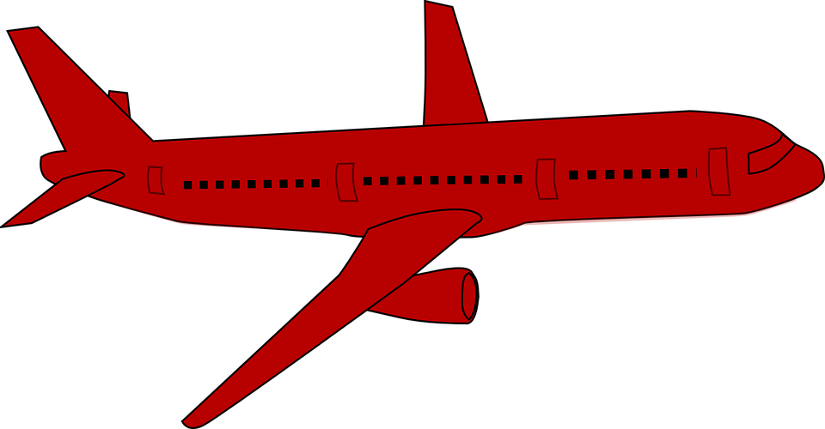
Modelling in Mechanics
You need to know SI units and the types of forces that can be involved in questions
The plane to the right is mid-flight. State the names of the labelled forces acting on it.
Upward thrust
Air resistance
Forward thrust
Weight
8C

Slide 20
Teachings for
Exercise 8D

Slide 21
Modelling in Mechanics
A vector is a quantity that has both magnitude and direction
Scalar quantities (magnitude only)
Vector quantities (magnitude and direction)
Quantity | Description | Unit
Distance | Measure of length | m
Speed | Measure of how quickly something moves | ms⁻¹
Time | Measure of ongoing events | s
Mass | Measure of the quantity of matter in an object | kg
Quantity | Description | Unit
Displacement | Distance in a specific direction | m
Velocity | Rate of change of displacement | ms⁻¹
Acceleration | Rate of change of velocity | ms⁻²
Force / weight | Described by magnitude, direction and point of application | N
Note that scalar quantities will always be positive. Vector quantities can be either positive or negative (when direction is taken into account)
8D

Slide 22
Modelling in Mechanics
A vector is a quantity that has both magnitude and direction
Fully describe the motion of the particles below:
Particle A
A
Velocity
The particle is moving to the right and its speed is increasing
Acceleration
Particle B
A
B
C
D
B
Velocity
The particle is moving to the right and its speed is decreasing
Acceleration
Velocity
+ve
+ve
-ve
-ve
Particle C
Acceleration
+ve
-ve
-ve
+ve
C
Velocity
The particle is moving to the left and its speed is increasing
Positive direction
Acceleration
Particle D
D
Velocity
The particle is moving to the left and its speed is decreasing
Acceleration
8D

Slide 23
Modelling in Mechanics
A vector is a quantity that has both magnitude and direction
You can describe motion in 2D by using vectors and the i, j notation.
The vector i represents one unit in the positive x-direction
The vector j represents one unit in the positive y-direction
You can use Pythagoras’ theorem and trigonometry when vectors are given in this way…
→ The magnitude of a displacement vector is distance, and the magnitude of the velocity vector is speed
$$y$$
(0,1)
j
0
i
(1,0)
$$x$$
8D

Slide 24
Modelling in Mechanics
A vector is a quantity that has both magnitude and direction
The velocity of a particle is given by $v=3i+5j ms^{−1}$
Find:
The speed of the particle
The angle the direction of motion of the particle makes with the unit vector i.
Draw a diagram!
$$5j$$
$$3i$$
You can use Pythagoras’ Theorem to find the magnitude of the velocity (speed)
$$\left|v\right|=\sqrt{3^{2}+5^{2}}$$
Calculate
$$\left|v\right|=\sqrt{34}$$
Round to 3sf
$$\left|v\right|=5.83 {ms}^{−1}$$
8D

Slide 25
Modelling in Mechanics
A vector is a quantity that has both magnitude and direction
The velocity of a particle is given by $v=3i+5j ms^{−1}$
Find:
The speed of the particle
The angle the direction of motion of the particle makes with the unit vector i.
Draw a diagram!
Opp
$$5j$$
$$θ$$
$$3i$$
Adj
You can use Trigonometry to find the angle between the direction of motion and the unit vector i
$$Tanθ=\frac{5}{3}$$
Inverse Tan
$$θ={Tan}^{−1}\left(\frac{5}{3}\right)$$
Calculate and round to 3sf
$$θ=59.0^{°}$$
8D

Slide 26
Modelling in Mechanics
$$B$$
Draw a diagram!
A vector is a quantity that has both magnitude and direction
A man walks from A to B and then from B to C. His displacement from A to B is 6i + 4j km. His displacement from B to C is 5i – 12j km.
What is the magnitude of the displacement from A to C?
What is the total distance the man walked in getting from A to C?
$$6i+4j$$
$$A$$
$$5i−12j$$
$$13.6km$$
$$C$$
$$\vec{AC}=\vec{AB}+\vec{BC}$$
Use vector notation to add AB and BC
$$\vec{AC}=\left(\begin{matrix}6 \\ 4\end{matrix}\right)+\left(\begin{matrix}5 \\ −12\end{matrix}\right)$$
Calculate
$$\vec{AC}=\left(\begin{matrix}11 \\ −8\end{matrix}\right)$$
Use Pythagoras’ Theorem
$$\left|AC\right|=\sqrt{{(11)}^{2}+{(−8)}^{2}}$$
Calculate
$$\left|AC\right|=13.6km$$
8D

Slide 27
Modelling in Mechanics
$$B$$
Draw a diagram!
A vector is a quantity that has both magnitude and direction
A man walks from A to B and then from B to C. His displacement from A to B is 6i + 4j km. His displacement from B to C is 5i – 12j km.
What is the magnitude of the displacement from A to C?
What is the total distance the man walked in getting from A to C?
$$6i+4j$$
$$A$$
$$5i−12j$$
$$13.6km$$
$$C$$
$$Total=\left|\vec{AB}\right|+\left|\vec{BC}\right|$$
Use vector notation to add AB and BC
$$Total=\sqrt{{(6)}^{2}+{(4)}^{2}} + \sqrt{{(5)}^{2}+{(−12)}^{2}}$$
Calculate
$$Total=20.2km$$
8D

