Slide 1
Teachings for
Exercise 7B

Slide 2
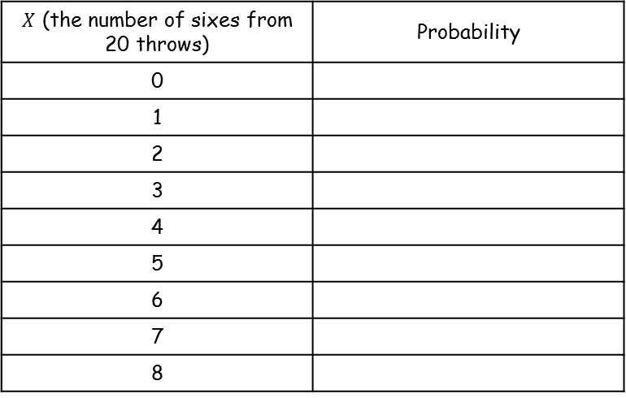
Hypothesis Testing
If: $X\sim B(n,p)$
$$P\left(X=r\right)=\left(\begin{matrix}n \\ r\end{matrix}\right)p^{r}{\left(1−p\right)}^{n−r}$$
$X$ (the number of sixes from 20 throws) | Probability
0
1
2
3
4
5
6
7
8
A critical region is one which, if the test statistic falls within it, would cause you to reject the null hypothesis
In section 7A, we considered testing the probability that a dice was biased, and calculated the following data:
$$P\left(6 sixes out of 20\right)=0.064$$
$$P\left(7 sixes out of 20\right)=0.025$$
$$P\left(8 sixes out of 20\right)=0.0084$$
Let us put this in a table, and fill in some more data (all calculated using the formula above)
0.026
0.104
0.198
0.238
0.202
0.129
0.064
0.025
0.0084
We can draw this information using a diagram…
7B

Slide 3
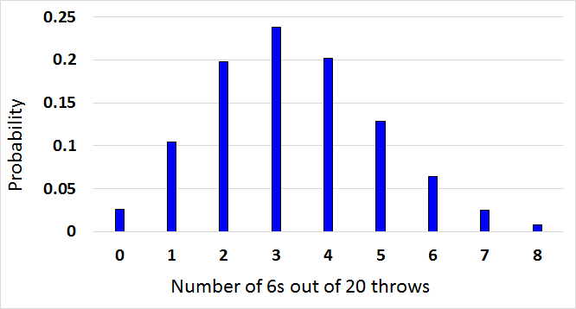
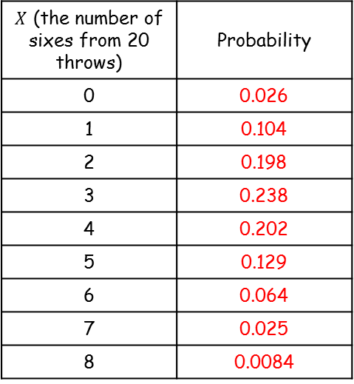
Hypothesis Testing
If: $X\sim B(n,p)$
$$P\left(X=r\right)=\left(\begin{matrix}n \\ r\end{matrix}\right)p^{r}{\left(1−p\right)}^{n−r}$$
A critical region is one which, if the test statistic falls within it, would cause you to reject the null hypothesis
Critical value
Critical Region
$X$ (the number of sixes from 20 throws) | Probability
0 | 0.026
1 | 0.104
2 | 0.198
3 | 0.238
4 | 0.202
5 | 0.129
6 | 0.064
7 | 0.025
8 | 0.0084
5%
Originally, we were considering whether the dice was biased towards 6s, at the 5% significance level. This can be represented on the diagram…
The critical value in that example was 7, in that once we get to 7 sixes out of 20, the probability is low enough to reject the idea that the dice is unbiased
→ The critical region would be the set of values that would lead to the null hypothesis being rejected, so in this example any number of sixes equal to or greater than 7
7B

Slide 4
Hypothesis Testing
If: $X\sim B(n,p)$
$$P\left(X=r\right)=\left(\begin{matrix}n \\ r\end{matrix}\right)p^{r}{\left(1−p\right)}^{n−r}$$
A critical region is one which, if the test statistic falls within it, would cause you to reject the null hypothesis
Another critical value
$X$ (the number of sixes from 20 throws) | Probability
0 | 0.026
1 | 0.104
2 | 0.198
3 | 0.238
4 | 0.202
5 | 0.129
6 | 0.064
7 | 0.025
8 | 0.0084
5%
Note that we were only considering whether the dice was biased towards sixes
If we were just considering whether the dice was biased, we could also include the value of 0 in the critical region
This is indicating that if we did not get any sixes from the 20 throws, then the dice might be biased against sixes (instead of towards)
These are called one or two-tailed tests, and we will see more about them later in the chapter…
7B

Slide 5
Hypothesis Testing
If: $X\sim B(n,p)$
$$P\left(X=r\right)=\left(\begin{matrix}n \\ r\end{matrix}\right)p^{r}{\left(1−p\right)}^{n−r}$$
A critical region is one which, if the test statistic falls within it, would cause you to reject the null hypothesis
One-tailed test
$X$ (the number of sixes from 20 throws) | Probability
0 | 0.026
1 | 0.104
2 | 0.198
3 | 0.238
4 | 0.202
5 | 0.129
6 | 0.064
7 | 0.025
8 | 0.0084
Two-tailed test
7B

Slide 6
Hypothesis Testing
If: $X\sim B(n,p)$
$$P\left(X=r\right)=\left(\begin{matrix}n \\ r\end{matrix}\right)p^{r}{\left(1−p\right)}^{n−r}$$
$$H_{0}:p=0.35$$
A critical region is one which, if the test statistic falls within it, would cause you to reject the null hypothesis
A single observation is taken from a Binomial distribution $B(6, p)$. The observation is then used to test $H_{0}:p=0.35$ against $H_{1}:p>0.35$.
Using a 5% significance level, find the critical region for this test
State the actual significance level of this test
Assuming $H_{0}$ is true, then $X\sim B(6, 0.35)$
→ You can then use your calculator or the statistical tables to find the value for which the probability would be less than 5%
As always, think about what the numbers mean
The 0.8826 means that there is an 88.26% chance of the number of successes being less than or equal to 3
It therefore also means that there is a 11.74% chance of getting 4, 5 or 6 successes
This is not unlikely enough to reject the null hypothesis that the probability is 0.35
We need to check these values
7B

Slide 7
Hypothesis Testing
If: $X\sim B(n,p)$
$$P\left(X=r\right)=\left(\begin{matrix}n \\ r\end{matrix}\right)p^{r}{\left(1−p\right)}^{n−r}$$
$$H_{0}:p=0.35$$
A critical region is one which, if the test statistic falls within it, would cause you to reject the null hypothesis
A single observation is taken from a Binomial distribution $B(6, p)$. The observation is then used to test $H_{0}:p=0.35$ against $H_{1}:p>0.35$.
Using a 5% significance level, find the critical region for this test
State the actual significance level of this test
Assuming $H_{0}$ is true, then $X\sim B(6, 0.35)$
→ You can then use your calculator or the statistical tables to find the value for which the probability would be less than 5%
The 0.9777 means that there is an 97.77% chance of the number of successes being less than or equal to 4
It therefore also means that there is a 2.23% chance of getting 5 or 6 successes
This is unlikely enough to reject the null hypothesis that the probability is 0.35
The critical region is therefore 5 or 6
7B

Slide 8
Hypothesis Testing
If: $X\sim B(n,p)$
$$P\left(X=r\right)=\left(\begin{matrix}n \\ r\end{matrix}\right)p^{r}{\left(1−p\right)}^{n−r}$$
A critical region is one which, if the test statistic falls within it, would cause you to reject the null hypothesis
A single observation is taken from a Binomial distribution $B(6, p)$. The observation is then used to test $H_{0}:p=0.35$ against $H_{1}:p>0.35$.
Using a 5% significance level, find the critical region for this test
State the actual significance level of this test
Sometimes it can help to give the problem a context (if it does not have one in the question)
→ You can think of this one as playing a game 6 times
And we assume that there is a 0.35 probability of winning each game
We just saw that the chance of winning 5 or 6 games is 2.23%
If this happens, we reject the null hypothesis, because it seems like the actual probability of winning is higher than 0.35
5 or 6
7B

Slide 9
Hypothesis Testing
If: $X\sim B(n,p)$
$$P\left(X=r\right)=\left(\begin{matrix}n \\ r\end{matrix}\right)p^{r}{\left(1−p\right)}^{n−r}$$
A critical region is one which, if the test statistic falls within it, would cause you to reject the null hypothesis
A single observation is taken from a Binomial distribution $B(6, p)$. The observation is then used to test $H_{0}:p=0.35$ against $H_{1}:p>0.35$.
Using a 5% significance level, find the critical region for this test
State the actual significance level of this test
The ‘actual significance level’ is the probability of the test statistic falling within the critical region
→ It can also be thought of as ‘the probability of incorrectly rejecting the null hypothesis’
We already found the critical region in part a
In this case, the chance of getting 5 or 6 ‘successes’ can be calculated as follows
5 or 6
$$P\left(X≥5\right)=1−P(X≤4)$$
$$2.23\%$$
$$P\left(X≥5\right)=1−0.9777$$
$$P\left(X≥5\right)=0.0223$$
7B

Slide 10
Hypothesis Testing
If: $X\sim B(n,p)$
$$P\left(X=r\right)=\left(\begin{matrix}n \\ r\end{matrix}\right)p^{r}{\left(1−p\right)}^{n−r}$$
A critical region is one which, if the test statistic falls within it, would cause you to reject the null hypothesis
A random variable $X$ has binomial distribution $B(40, p)$. A single observation in used to test $H_{0}:p=0.25$ against $H_{1}:p≠0.25$.
Using the 2% level of significance, find the critical region of this test. The probability in each ‘tail’ should be as close to possible as 0.01
Be careful – you will have to test 2 regions on this example, since we are not specifying whether we think the probability might be greater or less than the assumed value…
Again, try to give the question context to help you understand it better
This might be we are playing a game 40 times, and we think the probability of winning is 0.25
We are considering what number of wins out of 40 would cause us to reject the idea that the probability is genuinely 0.25…
7B

Slide 11
Hypothesis Testing
If: $X\sim B(n,p)$
$$P\left(X=r\right)=\left(\begin{matrix}n \\ r\end{matrix}\right)p^{r}{\left(1−p\right)}^{n−r}$$
It can help to summarise the information…
A critical region is one which, if the test statistic falls within it, would cause you to reject the null hypothesis
A random variable $X$ has binomial distribution $B(40, p)$. A single observation in used to test $H_{0}:p=0.25$ against $H_{1}:p≠0.25$.
Using the 2% level of significance, find the critical region of this test. The probability in each ‘tail’ should be as close to possible as 0.01
$$H_{0}:p=0.25$$
$$n=40$$
$$p=0.25$$
$$2\%$$
$$H_{1}:p≠0.25$$
There is a 0.0047 chance of getting 3 or fewer ‘successes’
There is a 0.016 chance of getting 4 or below ‘successes’
The question said to take the value closest to 0.01, which is 0.0047. Therefore, 3 is the critical value
If the number of ‘successes’ is less than 3, our original estimate for the probability might be too high
$$P\left(X≤3\right)=0.47\%$$
$$X≤3$$
7B

Slide 12
Hypothesis Testing
If: $X\sim B(n,p)$
$$P\left(X=r\right)=\left(\begin{matrix}n \\ r\end{matrix}\right)p^{r}{\left(1−p\right)}^{n−r}$$
It can help to summarise the information…
A critical region is one which, if the test statistic falls within it, would cause you to reject the null hypothesis
A random variable $X$ has binomial distribution $B(40, p)$. A single observation in used to test $H_{0}:p=0.25$ against $H_{1}:p≠0.25$.
Using the 2% level of significance, find the critical region of this test. The probability in each ‘tail’ should be as close to possible as 0.01
$$H_{0}:p=0.25$$
$$n=40$$
$$p=0.25$$
$$2\%$$
$$H_{1}:p≠0.25$$
There is a 0.0116 probability of getting more than 16 ‘successes’
There is a 0.0047 probability of getting more than 17 ‘successes’
The question said to take the value closest to 0.01, which is 0.0116. Therefore, 17 is the critical value (has to be more than 16)
$$P\left(X≤3\right)=0.47\%$$
$$P\left(X≥17\right)=1.16\%$$
$$X≥17$$
7B

Slide 13
Hypothesis Testing
If: $X\sim B(n,p)$
$$P\left(X=r\right)=\left(\begin{matrix}n \\ r\end{matrix}\right)p^{r}{\left(1−p\right)}^{n−r}$$
A critical region is one which, if the test statistic falls within it, would cause you to reject the null hypothesis
A random variable $X$ has binomial distribution $B(40, p)$. A single observation in used to test $H_{0}:p=0.25$ against $H_{1}:p≠0.25$.
Using the 2% level of significance, find the critical region of this test. The probability in each ‘tail’ should be as close to possible as 0.01
So the critical regions are as follows:
$$0≤X≤3$$
$$17≤X≤40$$
Think about creating a context again…
Imagine we were going to play a game 40 times, and the probability of winning the game is 0.25
Our answer suggests that if we only win 0-3 times out of the 40, then the actual probability is likely to be lower than 0.25
If we win 17-40 times out of the 40, then the actual probability is likely to be higher than 0.25
$$P\left(X≤3\right)=0.47\%$$
$$P\left(X≥17\right)=1.16\%$$
7B

Slide 14
Hypothesis Testing
If: $X\sim B(n,p)$
$$P\left(X=r\right)=\left(\begin{matrix}n \\ r\end{matrix}\right)p^{r}{\left(1−p\right)}^{n−r}$$
A critical region is one which, if the test statistic falls within it, would cause you to reject the null hypothesis
A random variable $X$ has binomial distribution $B(40, p)$. A single observation in used to test $H_{0}:p=0.25$ against $H_{1}:p≠0.25$.
b) State the actual significance level of the test
So the actual significance level is 1.63%, as this is the chance of the test statistic falling in the critical region
→ Remember it is also the chance of incorrectly rejecting the null hypothesis
$$P\left(X≤3\right)=0.47\%$$
$$P\left(X≥17\right)=1.16\%$$
$$1.16+0.47=1.63\%$$
7B

