Slide 1
Statistics
Statistical Distributions
Twitter: @Owen134866
www.mathsfreeresourcelibrary.com

Slide 2

Prior Knowledge Check
Three coins are flipped. Calculate the probability that:
All land on tails
All land on heads
Exactly one lands on tails
At least 2 land on heads
2) Two fair dice are rolled. Calculate the probability that the sum of the scores on the dice is:
5
Even
Odd
Prime
A multiple of 3
$$\frac{1}{8}$$
$$\frac{1}{9}$$
$$\frac{1}{8}$$
$$\frac{1}{2}$$
$$\frac{3}{8}$$
$$\frac{1}{2}$$
$$\frac{1}{2}$$
$$\frac{1}{3}$$
$$\frac{5}{12}$$

Slide 3
Teachings for
Exercise 6A

Slide 4
Statistical Distributions
You need to be able to understand and use probability distributions
A random variable is a variable whose value depends on the outcome of a random event
For example, when we roll 5 dice, the number of sixes rolled would be a random variable
The range of values the random variable can take is called a sample space, and is often drawn as a table
A discrete variable can only take certain countable numerical values
→ For example, the number of people has to be a whole number
This chapter focuses on Discrete Random Variables
These are values which can only take certain numerical values, each of which can be assigned a probability
For example, the number of times a 1 is rolled when rolling a dice 10 times
It can only take certain numerical values
Each can be assigned a probability
6A

Slide 5
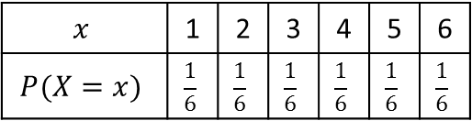
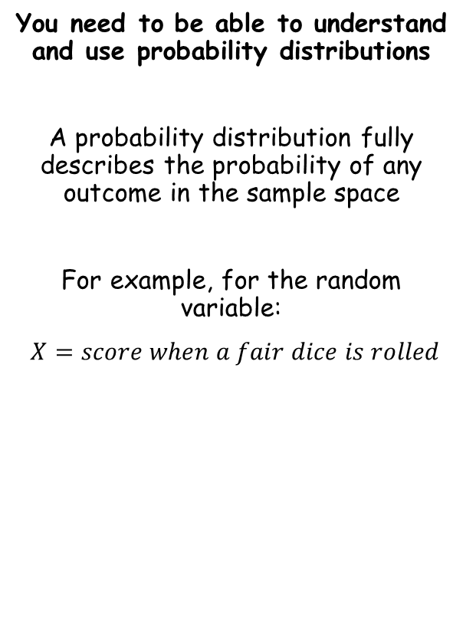
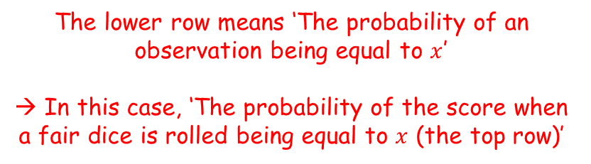
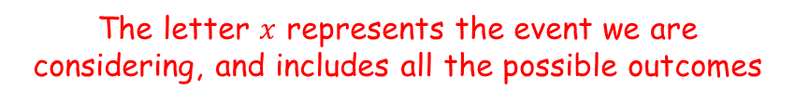
Statistical Distributions
You need to be able to understand and use probability distributions
A probability distribution fully describes the probability of any outcome in the sample space
For example, for the random variable:
$X=score when a fair dice is rolled$
The letter $x$ represents the event we are considering, and includes all the possible outcomes
$$x$$ | 1 | 2 | 3 | 4 | 5 | 6
$$P(X=x)$$ | $$\frac{1}{6}$$ | $$\frac{1}{6}$$ | $$\frac{1}{6}$$ | $$\frac{1}{6}$$ | $$\frac{1}{6}$$ | $$\frac{1}{6}$$
The lower row means ‘The probability of an observation being equal to $x$’
→ In this case, ‘The probability of the score when a fair dice is rolled being equal to $x$ (the top row)’
If all the probabilities are the same, it is known as a ‘discrete uniform distribution’
6A

Slide 6
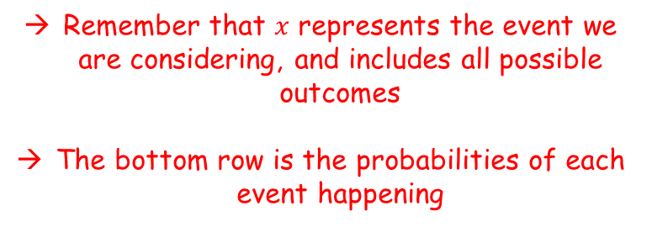
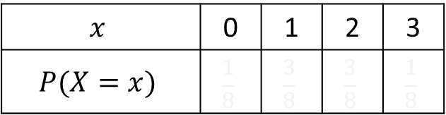

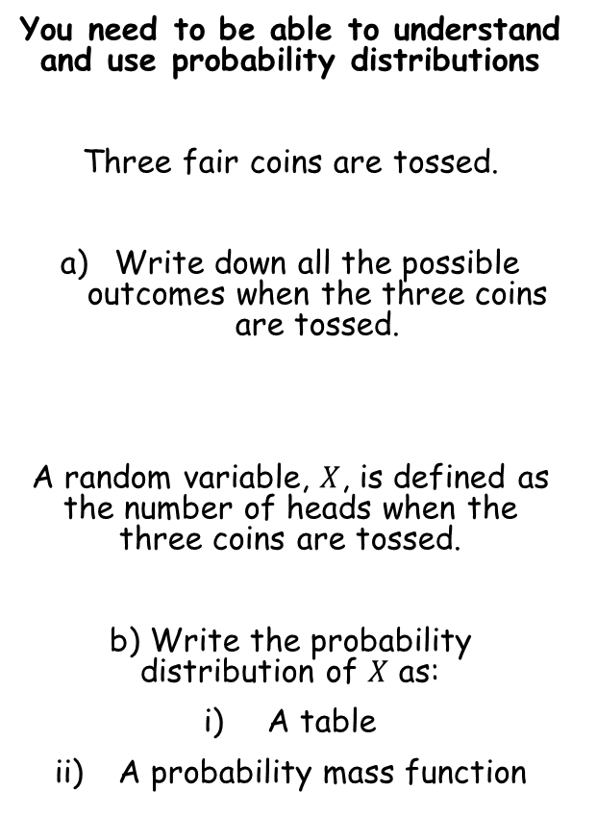



Statistical Distributions
You need to be able to understand and use probability distributions
Three fair coins are tossed.
Write down all the possible outcomes when the three coins are tossed.
A random variable, $X$, is defined as the number of heads when the three coins are tossed.
b) Write the probability distribution of $X$ as:
A table
A probability mass function
There are 4 possibilities for the number of heads:
0, 1, 2 or 3
$$x$$ | 0 | 1 | 2 | 3
$$P(X=x)$$ | $$\frac{1}{8}$$ | $$\frac{3}{8}$$ | $$\frac{3}{8}$$ | $$\frac{1}{8}$$
$$\frac{1}{8}$$
$$\frac{3}{8}$$
$$\frac{3}{8}$$
$$\frac{1}{8}$$
H H H
H T H
H H T
H T T
Remember that $x$ represents the event we are considering, and includes all possible outcomes
The bottom row is the probabilities of each event happening
T H H
T T H
T H T
T T T
6A

Slide 7


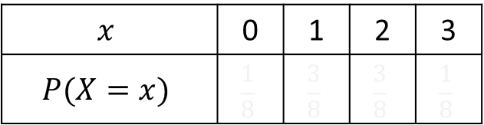










Statistical Distributions
You need to be able to understand and use probability distributions
Three fair coins are tossed.
Write down all the possible outcomes when the three coins are tossed.
A random variable, $X$, is defined as the number of heads when the three coins are tossed.
b) Write the probability distribution of $X$ as:
A table
A probability mass function
$$x$$ | 0 | 1 | 2 | 3
$$P(X=x)$$ | $$\frac{1}{8}$$ | $$\frac{3}{8}$$ | $$\frac{3}{8}$$ | $$\frac{1}{8}$$
$$\frac{1}{8}$$
$$\frac{3}{8}$$
$$\frac{3}{8}$$
$$\frac{1}{8}$$
A probability mass function summarises the probabilities and events which take those values
H H H
H T H
H H T
H T T
$$\frac{1}{8}$$
$$x=0, 3$$
T H H
T T H
T H T
T T T
$$P\left(X=x\right)=$$
$$\frac{3}{8}$$
$$x=1, 2$$
$$0$$
$$otherwise$$
Each probability is included here
The outcomes which take the corresponding probability are listed here
6A

Slide 8

Statistical Distributions
You need to be able to understand and use probability distributions
Three fair coins are tossed.
Write down all the possible outcomes when the three coins are tossed.
A random variable, $X$, is defined as the number of heads when the three coins are tossed.
b) Write the probability distribution of $X$ as:
A table
A probability mass function
$$x$$ | 0 | 1 | 2 | 3
$$P(X=x)$$ | $$\frac{1}{8}$$ | $$\frac{3}{8}$$ | $$\frac{3}{8}$$ | $$\frac{1}{8}$$
$$\frac{1}{8}$$
$$\frac{3}{8}$$
$$\frac{3}{8}$$
$$\frac{1}{8}$$
H H H
H T H
H H T
H T T
Note that since the table represents all possible outcomes, the sum of the probabilities must be equal to 1…
T H H
T T H
T H T
T T T
$$\sum{P\left(X=x\right)=1} for all x$$
6A

Slide 9
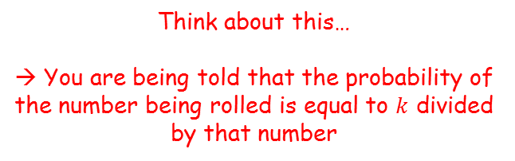
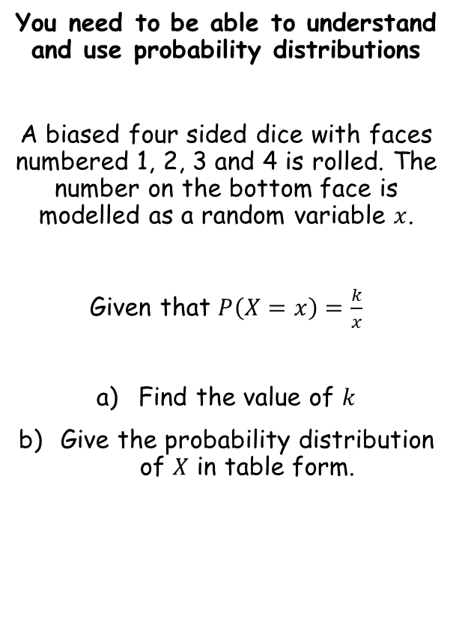
Statistical Distributions
You need to be able to understand and use probability distributions
A biased four sided dice with faces numbered 1, 2, 3 and 4 is rolled. The number on the bottom face is modelled as a random variable $x$.
Given that $P\left(X=x\right)=\frac{k}{x}$
Find the value of $k$
Give the probability distribution of $X$ in table form.
Think about this…
→ You are being told that the probability of the number being rolled is equal to $k$ divided by that number
6A

Slide 10

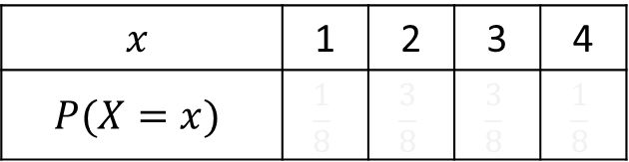







Statistical Distributions
You need to be able to understand and use probability distributions
A biased four sided dice with faces numbered 1, 2, 3 and 4 is rolled. The number on the bottom face is modelled as a random variable $x$.
Given that $P\left(X=x\right)=\frac{k}{x}$
Find the value of $k$
Give the probability distribution of $X$ in table form.
There are 4 possible outcomes for the dice:
1, 2, 3 and 4
$$x$$ | 1 | 2 | 3 | 4
$$P(X=x)$$ | $$\frac{1}{8}$$ | $$\frac{3}{8}$$ | $$\frac{3}{8}$$ | $$\frac{1}{8}$$
$$\frac{k}{1}$$
$$\frac{k}{2}$$
$$\frac{k}{3}$$
$$\frac{k}{4}$$
Remember that since all outcomes are represented, the probabilities should add up to 1…
$$\frac{k}{1}+\frac{k}{2}+\frac{k}{3}+\frac{k}{4}=1$$
Multiply by 12
$$12k+6k+4k+3k=12$$
Group like terms
$$25k=12$$
Divide by 25
$$k=\frac{12}{25}$$
6A

Slide 11
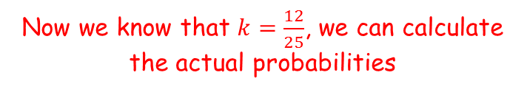










Statistical Distributions
You need to be able to understand and use probability distributions
A biased four sided dice with faces numbered 1, 2, 3 and 4 is rolled. The number on the bottom face is modelled as a random variable $x$.
Given that $P\left(X=x\right)=\frac{k}{x}$
Find the value of $k$
Give the probability distribution of $X$ in table form.
$$x$$ | 1 | 2 | 3 | 4
$$P(X=x)$$ | $$\frac{1}{8}$$ | $$\frac{3}{8}$$ | $$\frac{3}{8}$$ | $$\frac{1}{8}$$
$$\frac{k}{1}$$
$$\frac{k}{2}$$
$$\frac{k}{3}$$
$$\frac{k}{4}$$
$$\frac{12}{25}$$
$$\frac{6}{25}$$
$$\frac{4}{25}$$
$$\frac{3}{25}$$
Now we know that $k=\frac{12}{25}$, we can calculate the actual probabilities
$$k=\frac{12}{25}$$
6A

Slide 12



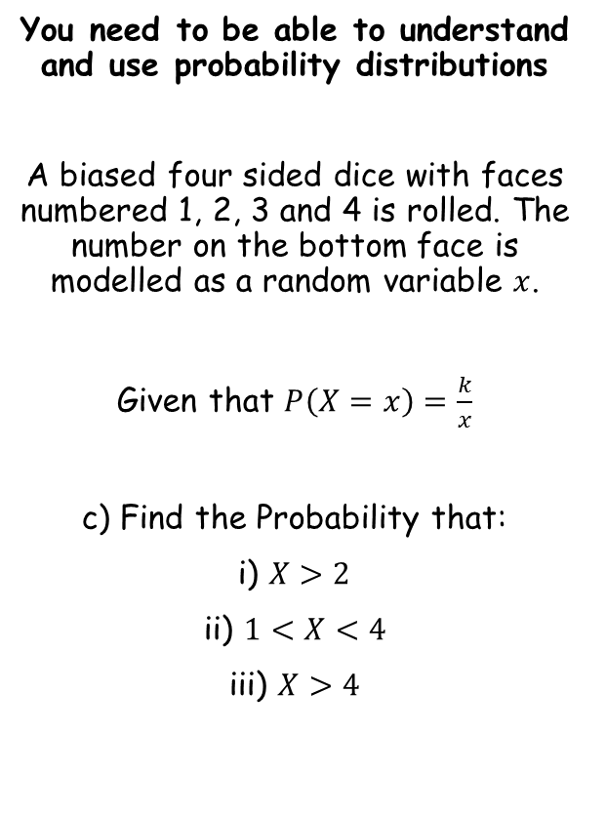




Statistical Distributions
You need to be able to understand and use probability distributions
A biased four sided dice with faces numbered 1, 2, 3 and 4 is rolled. The number on the bottom face is modelled as a random variable $x$.
Given that $P\left(X=x\right)=\frac{k}{x}$
c) Find the Probability that:
i) $X>2$
ii) $1<X<4$
iii) $X>4$
$$x$$ | 1 | 2 | 3 | 4
$$P(X=x)$$ | $$\frac{1}{8}$$ | $$\frac{3}{8}$$ | $$\frac{3}{8}$$ | $$\frac{1}{8}$$
$$\frac{12}{25}$$
$$\frac{6}{25}$$
$$\frac{4}{25}$$
$$\frac{3}{25}$$
$$=\frac{7}{25}$$
‘The probability that a random observation is greater than 2’
$$P\left(X>2\right)$$
‘The probability that a random observation is between 1 and 4, non-inclusive’
$$=\frac{10}{25}$$
$$P\left(1<X<4\right)$$
$$=\frac{2}{5}$$
$$P\left(X>4\right)$$
$$=0$$
‘The probability that a random observation is greater than 4’
6A

Slide 13

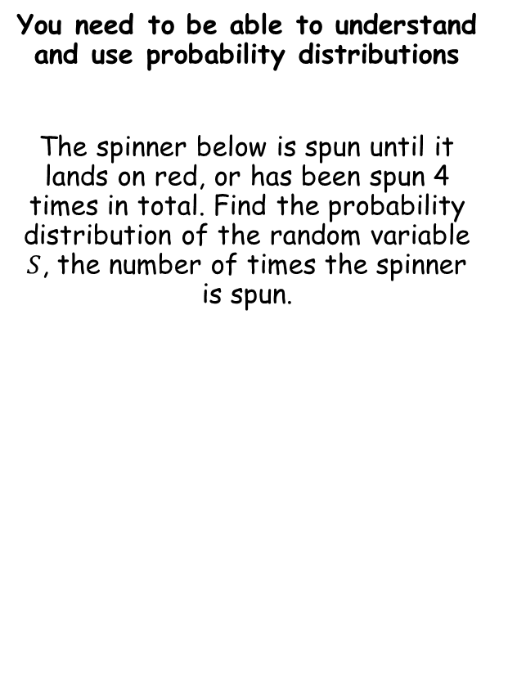



Statistical Distributions
You need to be able to understand and use probability distributions
The spinner below is spun until it lands on red, or has been spun 4 times in total. Find the probability distribution of the random variable $S$, the number of times the spinner is spun.
$$s$$ | 1 | 2 | 3 | 4
$$P(S=s)$$ | $$\frac{1}{8}$$ | $$\frac{3}{8}$$ | $$\frac{3}{8}$$ | $$\frac{1}{8}$$
$$\frac{2}{5}$$
$$P\left(S=1\right)=$$
$$\frac{2}{5}$$
The probability that the number of spins is 1
(ie – we get a red on the first spin)
6A

Slide 14





Statistical Distributions
You need to be able to understand and use probability distributions
The spinner below is spun until it lands on red, or has been spun 4 times in total. Find the probability distribution of the random variable $S$, the number of times the spinner is spun.
$$s$$ | 1 | 2 | 3 | 4
$$P(S=s)$$ | $$\frac{1}{8}$$ | $$\frac{3}{8}$$ | $$\frac{3}{8}$$ | $$\frac{1}{8}$$
$$\frac{2}{5}$$
$$\frac{6}{25}$$
$$P\left(S=2\right)=$$
$$\frac{3}{5}×\frac{2}{5}$$
$$\frac{6}{25}$$
$$=$$
The probability that the number of spins is 2
(ie – we get a red on the second spin)
→ This means we need to get blue and then red…
6A

Slide 15




Statistical Distributions
You need to be able to understand and use probability distributions
The spinner below is spun until it lands on red, or has been spun 4 times in total. Find the probability distribution of the random variable $S$, the number of times the spinner is spun.
$$s$$ | 1 | 2 | 3 | 4
$$P(S=s)$$ | $$\frac{1}{8}$$ | $$\frac{3}{8}$$ | $$\frac{3}{8}$$ | $$\frac{1}{8}$$
$$\frac{2}{5}$$
$$\frac{6}{25}$$
$$\frac{18}{125}$$
$$P\left(S=3\right)=$$
$$\frac{3}{5}×\frac{3}{5}×\frac{2}{5}$$
$$\frac{18}{125}$$
$$=$$
The probability that the number of spins is 3
(ie – we get a red on the third spin)
→ This means we need to get blue and then blue and then red…
6A

Slide 16




Statistical Distributions
You need to be able to understand and use probability distributions
The spinner below is spun until it lands on red, or has been spun 4 times in total. Find the probability distribution of the random variable $S$, the number of times the spinner is spun.
$$s$$ | 1 | 2 | 3 | 4
$$P(S=s)$$ | $$\frac{1}{8}$$ | $$\frac{3}{8}$$ | $$\frac{3}{8}$$ | $$\frac{1}{8}$$
$$\frac{2}{5}$$
$$\frac{6}{25}$$
$$\frac{18}{125}$$
$$\frac{27}{125}$$
$$P\left(S=4\right)=$$
$$1−\left(\frac{2}{5}+\frac{6}{25}+\frac{18}{125}\right)$$
$$=$$
$$\frac{27}{125}$$
The probability that the number of spins is 4
In this case it does not matter whether we get red or blue
Spinning 4 times is equivalent to not stopping after 1, 2 or 3 spins (since we will not go above 4)
6A

