Slide 1
THE HEI$T
Suspect interactive resource

Slide 2
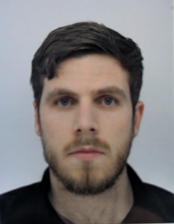
Arthur Much
Will Stutely
Bob Locke
Amy Thomas
Innocent?
Innocent?
Guilty?
Guilty?
Innocent?
Innocent?
Guilty?
Guilty?
Sarah Champion
Jess Robinson
Zoe Nottingham
James Rosenberg
Innocent?
Guilty?
Innocent?
Innocent?
Guilty?
Innocent?
Guilty?
Guilty?
Dwayne Neighbour
Will Scarlett
Marien Taylor
Robin Locke
Innocent?
Innocent?
Guilty?
Innocent?
Guilty?
Innocent?
Guilty?
Guilty?
Alan Dale
Danielle Clark
Clark Tuck
John Small
Innocent?
Innocent?
Guilty?
Guilty?
Innocent?
Innocent?
Guilty?
Guilty?

