Slide 1
Area of segments (5.3)

Slide 2
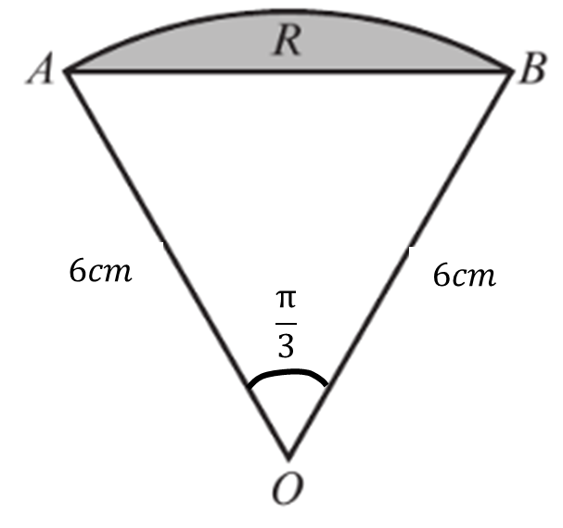
1
What is the area of the region R?
Give your answer in to 1dp.
a) $3.3cm^{2}$
b) $6.5cm^{2}$
c) $18.5cm^{2}$
d) $37.0cm^{2}$

Slide 3
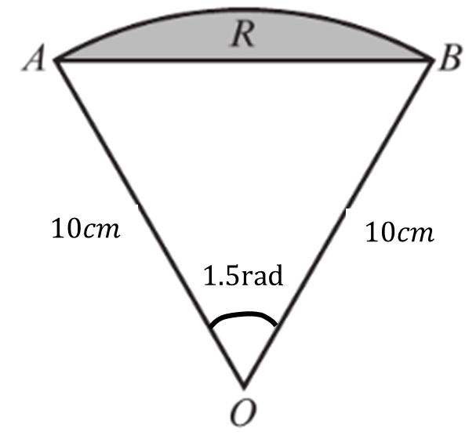
2
What is the area of the region R?
Give your answer in to 1dp.
a) $73.7cm^{2}$
b) $75.0cm^{2}$
c) $147.4cm^{2}$
d) $25.1cm^{2}$

