Slide 1
Arc length and area of sectors (5.2 and part of 5.3)

Slide 2
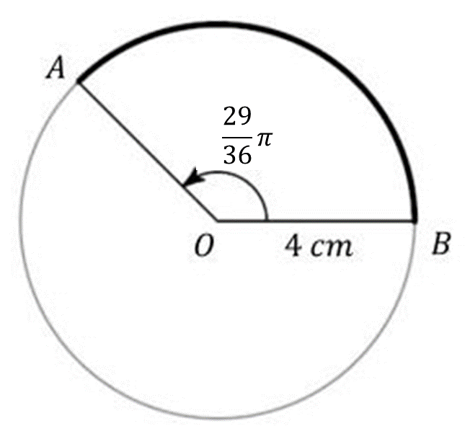
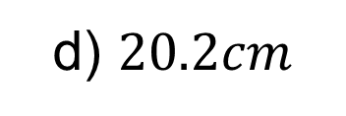
1
What is the arc length of the minor
sector AOB? Give your answer to 1dp.
a) $40.5cm$
b) $15.0cm$
c) $10.1cm$
d) $20.2cm$

Slide 3
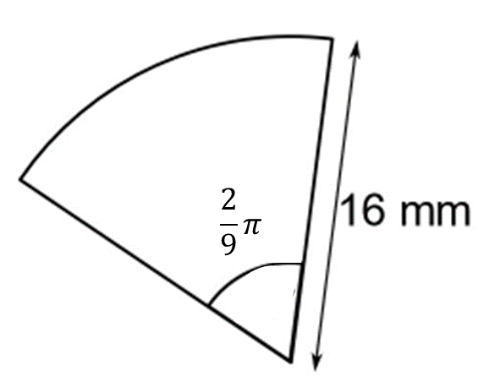
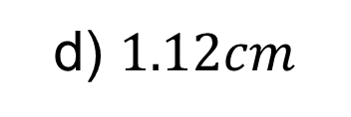
2
What is the arc length of this sector?
Give your answer to 2dp.
a) $17.8cm$
b) $89.36cm$
c) $2.23cm$
d) $1.12cm$

Slide 4
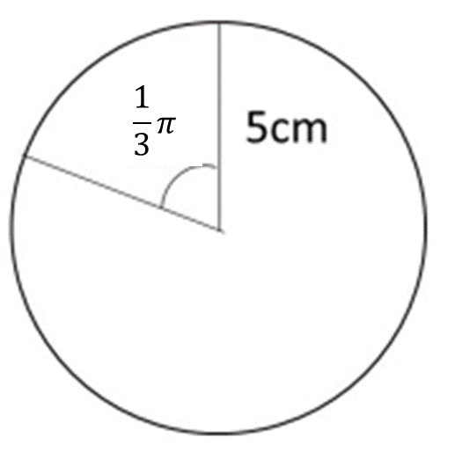
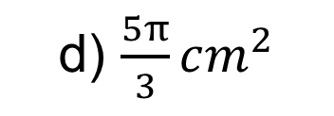
3
What is the area of the minor sector?
Give your answer in terms of $π$.
a) $\frac{25π}{6}cm^{2}$
b) $\frac{25π}{60}cm^{2}$
c) $\frac{25π}{3}cm^{2}$
d) $\frac{5π}{3}cm^{2}$

Slide 5
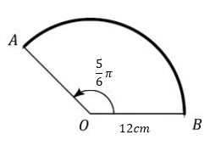
4
What is the area of the sector AOB?
Give your answer to 1dp.
a) $188.5cm^{2}$
b) $452.4cm^{2}$
c) $377.0cm^{2}$
d) $493.5cm^{2}$

