Slide 1
Teachings for
Section 5B

Slide 2





























Radians
$$2π radians={360}^{°}$$
$$π radians={180}^{°}$$
You should also try to learn some of the exact values of trig ratios (similar to when using degrees). These can help in proofs.
Radians
Degrees
$$0$$
$$\frac{π}{6}$$
$$\frac{π}{4}$$
$$\frac{π}{3}$$
$$\frac{π}{2}$$
$$0$$
$$30$$
$$45$$
$$60$$
$$90$$
$$sin$$
$$0$$
$$\frac{1}{2}$$
$$\frac{\sqrt{2}}{2}$$
$$\frac{\sqrt{3}}{2}$$
$$1$$
$$cos$$
$$1$$
$$\frac{\sqrt{3}}{2}$$
$$\frac{\sqrt{2}}{2}$$
$$\frac{1}{2}$$
$$0$$
$$tan$$
$$0$$
$$\frac{\sqrt{3}}{3}$$
$$1$$
$$\sqrt{3}$$
$$−$$
5B

Slide 3

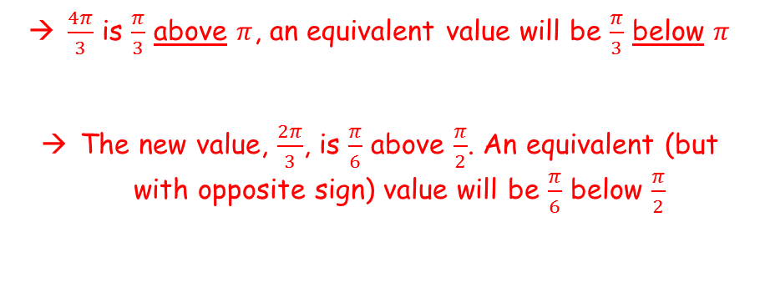












Radians
$$2π radians={360}^{°}$$
$$π radians={180}^{°}$$
y
$$\frac{π}{3}$$
You should also try to learn some of the exact values of trig ratios (similar to when using degrees). These can help in proofs.
Find the exact value of:
$$cos\frac{4π}{3}$$
$$\frac{2π}{3}$$
$$\frac{4π}{3}$$
$$y=cosx$$
1
$$\frac{π}{6}$$
0
x
$$\frac{π}{2}$$
$$π$$
$$\frac{3π}{2}$$
$$2π$$
$$\frac{π}{6}$$
-1
$$\frac{π}{3}$$
$$\frac{π}{3}$$
You can use a CAST diagram or the symmetry of the cosine graph to find an equivalent value
$\frac{4π}{3}$ is $\frac{π}{3}$ above $π$, an equivalent value will be $\frac{π}{3}$ below $π$
The new value, $\frac{2π}{3}$, is $\frac{π}{6}$ above $\frac{π}{2}$. An equivalent (but with opposite sign) value will be $\frac{π}{6}$ below $\frac{π}{2}$
$$cos\frac{4π}{3}$$
$$= cos\frac{2π}{3}$$
$$=−cos\frac{π}{3}$$
$$=−\frac{1}{2}$$
5B

Slide 4














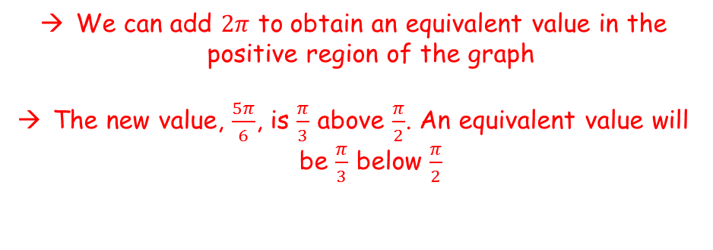






Radians
$$2π radians={360}^{°}$$
$$π radians={180}^{°}$$
We can add $2π$ to obtain an equivalent value in the positive region of the graph
The new value, $\frac{5π}{6}$, is $\frac{π}{3}$ above $\frac{π}{2}$. An equivalent value will be $\frac{π}{3}$ below $\frac{π}{2}$
You should also try to learn some of the exact values of trig ratios (similar to when using degrees). These can help in proofs.
Find the exact value of:
$$sin\left(−\frac{7π}{6}\right)$$
$$sin\left(−\frac{7π}{6}\right)$$
$$=sin\left(\frac{5π}{6}\right)$$
$$=sin\left(\frac{π}{6}\right)$$
$$=\frac{1}{2}$$
$$−\frac{7π}{6}$$
$$\frac{π}{6}$$
$$\frac{5π}{6}$$
$$y$$
$$1$$
$$\frac{π}{3}$$
$$\frac{π}{3}$$
$$x$$
$$−2π$$
$$−\frac{3π}{2}$$
$$−π$$
$$−\frac{π}{2}$$
$$\frac{π}{2}$$
$$π$$
$$\frac{3π}{2}$$
$$2π$$
$$y=sinx$$
$$−1$$
5B

