Slide 1
Radians
Twitter: @Owen134866
www.mathsfreeresourcelibrary.com

Slide 2

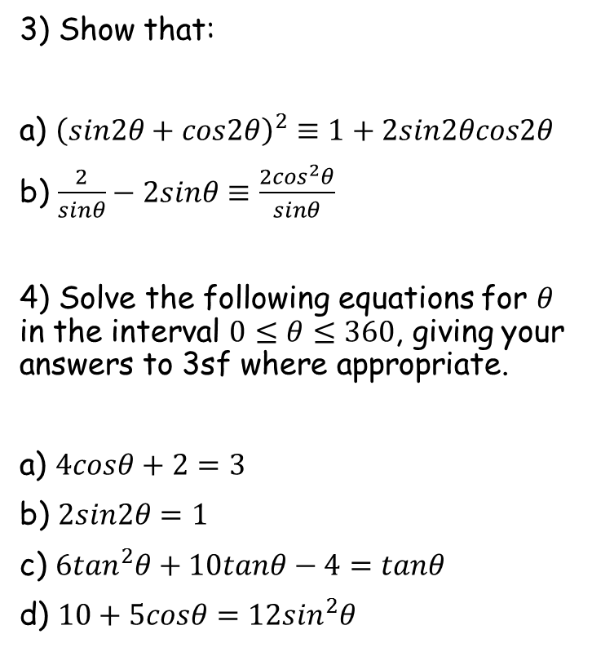

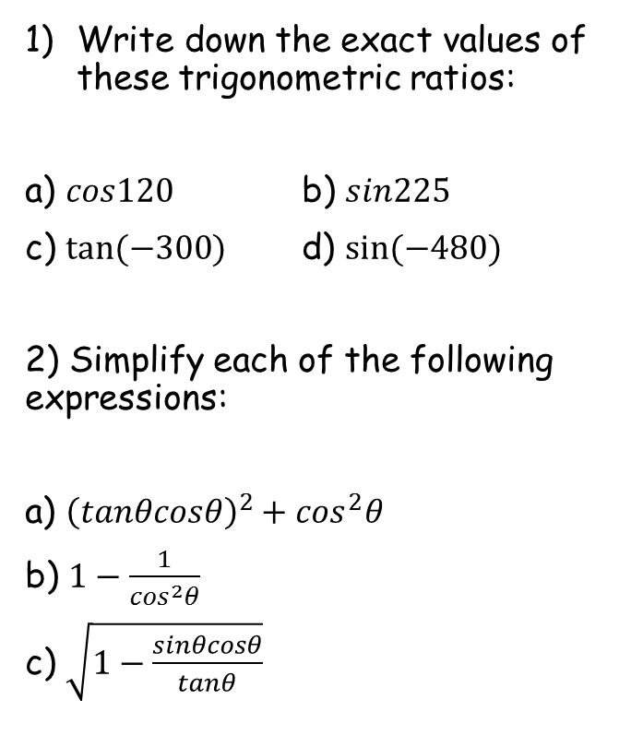





Prior Knowledge Check
Write down the exact values of these trigonometric ratios:
a) $cos120$ b) $sin225$
c) $tan⁡(−300)$ d) $sin⁡(−480)$
2) Simplify each of the following expressions:
a) ${\left(tanθcosθ\right)}^{2}+\cos^{2}θ$
b) $1−\frac{1}{\cos^{2}θ}$
c) $\sqrt{1−\frac{sinθcosθ}{tanθ}}$
3) Show that:
a) ${\left(sin2θ+cos2θ\right)}^{2}≡1+2sin2θcos2θ$
b) $\frac{2}{sinθ}−2sinθ≡\frac{2\cos^{2}θ}{sinθ}$
4) Solve the following equations for $θ$ in the interval $0≤θ≤360$, giving your answers to 3sf where appropriate.
a) $4cosθ+2=3$
b) $2sin2θ=1$
c) $6\tan^{2}θ+10tanθ−4=tanθ$
d) $10+5cosθ=12\sin^{2}θ$
$$−\frac{1}{2}$$
$$−\frac{\sqrt{2}}{2}$$
$$−\frac{\sqrt{3}}{2}$$
$$\sqrt{3}$$
$$1$$
75.5, 284
$$−\tan^{2}θ$$
15, 75, 195, 255
19.7, 118, 200, 298
$$\left|sinθ\right|$$
75.5, 132, 228, 284

Slide 3
Teachings for
Section 5A

Slide 4


Radians
$$2π radians={360}^{°}$$
$$π radians={180}^{°}$$
You can measure angles in Radians
Radians are an alternative to degrees. Some calculations involving circles are easier when Radians are used, as opposed to degrees.
‘If arc AB has length r, then angle AOB is 1 radian (1^{c} or 1 rad)’
A
r
O
1^{c}
r
r
B
Arc Length
Multiply by 2π
Arc Length
As 2πr is a complete circle, this means that 2π radians is the same as 360 degrees
÷ 2
÷ π
5A

Slide 5
Radians
$$2π radians={360}^{°}$$
$$π radians={180}^{°}$$
You can measure angles in Radians
You need to be able to convert between degrees and radians.
Convert the following angle to degrees
Multiply by ¹⁸⁰/_{π}
Radians → Degrees
Top x Top, Bottom x Bottom
Multiply by ¹⁸⁰/_{π}
Cancel out π
Work out the sum
5A

Slide 6
Radians
$$2π radians={360}^{°}$$
$$π radians={180}^{°}$$
You can measure angles in Radians
You need to be able to convert between degrees and radians.
Convert the following angle to degrees
Multiply by ¹⁸⁰/_{π}
Radians → Degrees
Top x Top, Bottom x Bottom
Multiply by ¹⁸⁰/_{π}
Cancel out π
Work out the sum
5A

Slide 7
Radians
$$2π radians={360}^{°}$$
$$π radians={180}^{°}$$
You can measure angles in Radians
You need to be able to convert between degrees and radians.
Convert the following angle to radians
Multiply by ^{π}/₁₈₀
Degrees → Radians
Only multiply the top here
Divide by ¹⁸⁰/_{π}
Simplify
Multiply by ^{π}/₁₈₀
5A

Slide 8
Radians
$$2π radians={360}^{°}$$
$$π radians={180}^{°}$$
You can measure angles in Radians
You need to be able to convert between degrees and radians.
Convert the following angle to radians
Multiply by ^{π}/₁₈₀
Degrees → Radians
Only multiply the top here
Divide by ¹⁸⁰/_{π}
Simplify
Multiply by ^{π}/₁₈₀
5A

Slide 9









Radians
$$2π radians={360}^{°}$$
$$π radians={180}^{°}$$
You can measure angles in Radians
→ You should learn to recognize some equivalences, using the relationships above…
$$π radians={180}^{°}$$
$$\frac{π}{2} radians=$$
$${90}^{°}$$
$$\frac{π}{3} radians=$$
$${60}^{°}$$
$$\frac{π}{4} radians=$$
$${45}^{°}$$
$$\frac{π}{6} radians=$$
$${30}^{°}$$
5A

Slide 10
Radians
$$2π radians={360}^{°}$$
$$π radians={180}^{°}$$
You can measure angles in Radians
When you have angles in degrees, you can calculate sine/cos/tan of them
You can also do this in radians, but you must set your calculator to radians first (a common mistake is that students forget to do this, but actually do the question correctly!)
You only need to change the mode if sine/cos/tan is involved. Regular calculations are not affected
5A

Slide 11
Radians
$$2π radians={360}^{°}$$
$$π radians={180}^{°}$$
y
y = sinθ
You can measure angles in Radians
→ You also need to be able to sketch and use graphs where radians are the units…
1
-π 2
0
π 2
θ
-2π
-3π 2
-π
-90º
π
3π 2
-360º
-270º
-180º
90º
180º
270º
360º
2π
-1
y
y = cosθ
1
0
θ
-π
-π 2
π 2
π
3π 2
-2π
-3π 2
-90º
-360º
-270º
-180º
90º
180º
270º
360º
2π
-1
y = tanθ
1
0
θ
-π
-π 2
π 2
π
3π 2
-2π
-3π 2
-90º
-360º
-270º
-180º
90º
180º
270º
360º
2π
-1
5A

Slide 12

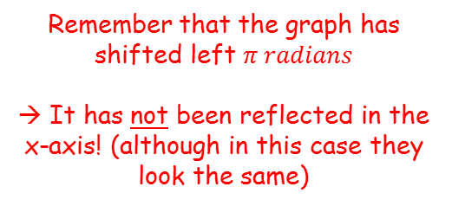








Radians
$$2π radians={360}^{°}$$
$$π radians={180}^{°}$$
You can measure angles in Radians
→ Sketch the graph of $y=cos\left(x+π\right)$ for $0≤x≤2π$.
Horizontal shift, $π$ units left
y
1
$$y=cosx$$
0
$$π$$
x
$$\frac{π}{2}$$
$$\frac{3π}{2}$$
$$2π$$
-1
y
Remember that the graph has shifted left $π radians$
→ It has not been reflected in the x-axis! (although in this case they look the same)
1
0
$$π$$
x
$$\frac{π}{2}$$
$$\frac{3π}{2}$$
$$2π$$
-1
$$y=cos⁡(x+π)$$
5A

