Slide 1
Radian Measure (5.1)

Slide 2




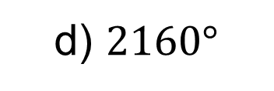

1
Convert $\frac{π}{12}$ radians into degrees.
a) $30°$
b) $15°$
c) $0.262°$
d) $2160°$

Slide 3





2
Convert $\frac{2π}{9}$ radians into degrees.
a) $0.0122°$
b) $20°$
c) $40°$
d) $30°$

Slide 4





3
Convert $45°$ into radians.
a) $\frac{π}{4}$
b) $\frac{4π}{5}$
c) $\frac{π}{2}$
d) $\frac{π}{8}$

Slide 5





4
Convert $78°$ into radians.
a) $\frac{7π}{4}$
b) $\frac{26π}{25}$
c) $\frac{13π}{30}$
d) $\frac{13π}{15}$

