Slide 1
Teachings for
Exercise 3G

Slide 2
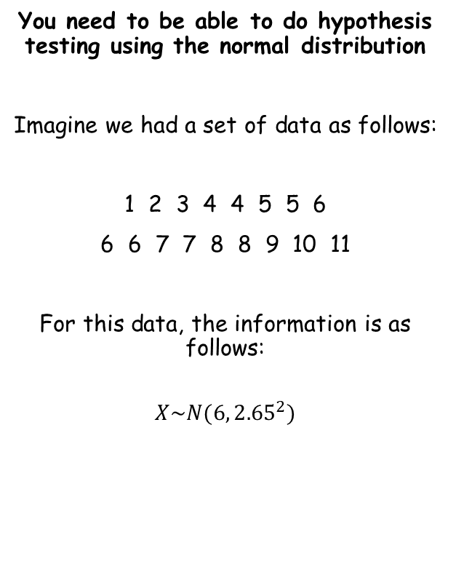
The normal distribution
You need to be able to do hypothesis testing using the normal distribution
Imagine we had a set of data as follows:
1 2 3 4 4 5 5 6
6 6 7 7 8 8 9 10 11
For this data, the information is as follows:
$$X\sim N(6, {2.65}^{2})$$
In this case, the data set is so small that we can include all the data
In more practical situations, we would most likely take a sample of the population
We need to consider how this would affect our use of the mean and variance
3G

Slide 3


The normal distribution
You need to be able to do hypothesis testing using the normal distribution
Imagine we had a set of data as follows:
1 2 3 4 4 5 5 6
6 6 7 7 8 8 9 10 11
Imagine we took samples from this data, all of size 2 (ie – choosing 2 values at random)
For example:
Value 1 | Value 2 | Mean
4
5
4.5
3
9
6
6
5
5.5
$$X\sim N(6, {2.65}^{2})$$
2
8
5
7
10
8.5
Notation for the population
6
8
7
Notation for this sample
Let’s now calculate the mean and variance of this data set…
Sample mean = 6.08
$$\overline{X}\sim N(6.08, {1.33}^{2})$$
Variance (of the sample means) = 1.78
Standard Deviation (of the sample means) = 1.33
3G

Slide 4
The normal distribution
You need to be able to do hypothesis testing using the normal distribution
Imagine we had a set of data as follows:
1 2 3 4 4 5 5 6
6 6 7 7 8 8 9 10 11
Imagine we took samples from this data, all of size 2 (ie – choosing 2 values at random)
For example:
Value 1 | Value 2 | Mean
4
5
4.5
3
9
6
6
5
5.5
$$X\sim N(6, {2.65}^{2})$$
2
8
5
7
10
8.5
Notation for the population
6
8
7
Notation for this sample
If we take enough samples, then because the data is normally distributed, the sample mean will average out to be the same as the population mean
How is the variance affected though?
$$\overline{X}\sim N(6.08, {1.33}^{2})$$
3G

Slide 5

The normal distribution
Value 1 | Value 2 | Mean
You need to be able to do hypothesis testing using the normal distribution
Imagine we had a set of data as follows:
1 2 3 4 4 5 5 6
6 6 7 7 8 8 9 10 11
4
5
4.5
3
9
6
6
5
5.5
2
8
5
7
10
8.5
6
8
7
$$X\sim N(6, {2.65}^{2})$$
When choosing only 2 values for our sample, consider the range of possible means
The smallest possible mean would be 1.5 (if 1 and 2 were selected), and the highest would be 10.5, if 10 and 11 were selected)
If we took a sample size 10, the smallest possible mean would be 4.2, and the largest would be 7.8
$$\overline{X}\sim N(6.08, {1.33}^{2})$$
Population range: 1-11
Sample size 2 range: 1.5-10.5
Sample size 10 range: 4.2-7.8
3G

Slide 6
The normal distribution
Value 1 | Value 2 | Mean
You need to be able to do hypothesis testing using the normal distribution
Imagine we had a set of data as follows:
1 2 3 4 4 5 5 6
6 6 7 7 8 8 9 10 11
4
5
4.5
3
9
6
6
5
5.5
2
8
5
7
10
8.5
6
8
7
$$X\sim N(6, {2.65}^{2})$$
The key idea to take from this is that with a larger sample size, the range of possible values is lower
Hence, the variance is also going to be lower as there is a smaller range for the values to exist in
When dealing with a sample, the variance is estimated by dividing the population variance by the size of the sample
That way, a larger sample will have a smaller estimated value for the variance…
$$\overline{X}\sim N(6.08, {1.33}^{2})$$
Population range: 1-11
Sample size 2 range: 1.5-10.5
Sample size 10 range: 4.2-7.8
3G

Slide 7
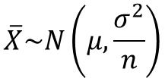

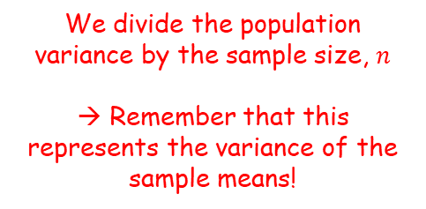
The normal distribution
You need to be able to do hypothesis testing using the normal distribution
When hypothesis testing with a population, you use values as follows:
With a sample, we use the following relationship instead:
$$X\sim N(μ,σ^{2})$$
$$\overline{X}\sim N\left(μ,\frac{σ^{2}}{n}\right)$$
We divide the population variance by the sample size, $n$
→ Remember that this represents the variance of the sample means!
We use the population mean
3G

Slide 8



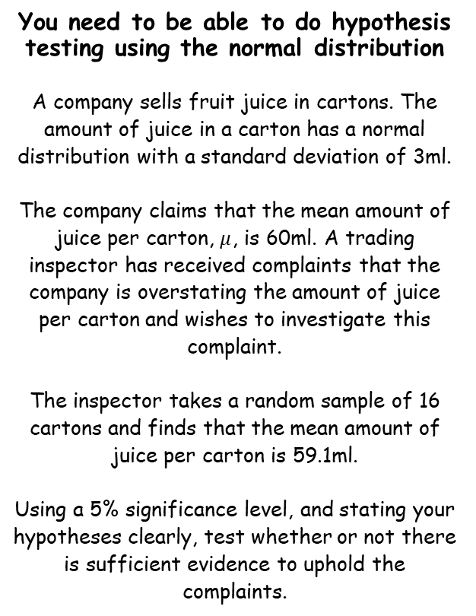



The normal distribution
$$X\sim N(μ,σ^{2})$$
$$\overline{X}\sim N\left(μ,\frac{σ^{2}}{n}\right)$$
You need to be able to do hypothesis testing using the normal distribution
A company sells fruit juice in cartons. The amount of juice in a carton has a normal distribution with a standard deviation of 3ml.
The company claims that the mean amount of juice per carton, $μ$, is 60ml. A trading inspector has received complaints that the company is overstating the amount of juice per carton and wishes to investigate this complaint.
The inspector takes a random sample of 16 cartons and finds that the mean amount of juice per carton is 59.1ml.
Using a 5% significance level, and stating your hypotheses clearly, test whether or not there is sufficient evidence to uphold the complaints.
1) Write your Hypotheses
$$H_{0}: μ=60$$
$$H_{1}: μ<60$$
→ Remember that the null hypothesis is the default position ie) Nothing has changed
→ The alternative hypothesis is where we consider the statement in the question. In this case, the claim is that the mean is lower than the company is saying
2) Convert the population distribution to the sample distribution
Population distribution
Sample distribution
$$\overline{X}\sim N\left(60,\frac{3^{2}}{16}\right)$$
$$X\sim N(60,3^{2})$$
3) Now, using the sample distribution, we need to find the probability that a random sample of 16 gives a mean equal to or lower than 59.1…
3G

Slide 9









The normal distribution
$$X\sim N(μ,σ^{2})$$
$$\overline{X}\sim N\left(μ,\frac{σ^{2}}{n}\right)$$
You need to be able to do hypothesis testing using the normal distribution
A company sells fruit juice in cartons. The amount of juice in a carton has a normal distribution with a standard deviation of 3ml.
The company claims that the mean amount of juice per carton, $μ$, is 60ml. A trading inspector has received complaints that the company is overstating the amount of juice per carton and wishes to investigate this complaint.
The inspector takes a random sample of 16 cartons and finds that the mean amount of juice per carton is 59.1ml.
Using a 5% significance level, and stating your hypotheses clearly, test whether or not there is sufficient evidence to uphold the complaints.
$$H_{0}: μ=60$$
$$\overline{X}\sim N\left(60,\frac{3^{2}}{16}\right)$$
$$H_{1}: μ<60$$
3) Now, using the sample distribution, we need to find the probability that a random sample of 16 gives a mean equal to or lower than 59.1…
$$\overline{X}\sim N\left(60,\frac{3^{2}}{16}\right)$$
$$μ=60$$
$$σ=\sqrt{\frac{3^{2}}{16}}$$
Area = ?
$$59.1$$
$$60$$
Use your calculator as you have seen in prior sections to calculate the probability of being below 59.1
$$P\left(\overline{X}<59.1\right)=0.1151$$
$$=11.51\%$$
3G

Slide 10


The normal distribution
$$X\sim N(μ,σ^{2})$$
$$\overline{X}\sim N\left(μ,\frac{σ^{2}}{n}\right)$$
You need to be able to do hypothesis testing using the normal distribution
A company sells fruit juice in cartons. The amount of juice in a carton has a normal distribution with a standard deviation of 3ml.
The company claims that the mean amount of juice per carton, $μ$, is 60ml. A trading inspector has received complaints that the company is overstating the amount of juice per carton and wishes to investigate this complaint.
The inspector takes a random sample of 16 cartons and finds that the mean amount of juice per carton is 59.1ml.
Using a 5% significance level, and stating your hypotheses clearly, test whether or not there is sufficient evidence to uphold the complaints.
$$H_{0}: μ=60$$
$$\overline{X}\sim N\left(60,\frac{3^{2}}{16}\right)$$
$$H_{1}: μ<60$$
$$P\left(\overline{X}<59.1\right)=0.1151$$
$$=11.51\%$$
Although getting in this range is unlikely , it is not below 5%
Therefore, it is not unlikely enough for us to reject the null hypothesis that the mean is actually 60ml
So we accept the null hypothesis
3G

Slide 11
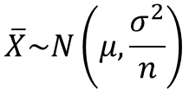



The normal distribution
$$X\sim N(μ,σ^{2})$$
$$\overline{X}\sim N\left(μ,\frac{σ^{2}}{n}\right)$$
You need to be able to do hypothesis testing using the normal distribution
It is also possible to use the standardised normal distribution when using a sample
Population
Sample
Variance
Variance
$$\overline{X}\sim N\left(μ,\frac{σ^{2}}{n}\right)$$
$$X\sim N(μ,σ^{2})$$
Converting values to the standard normal distribution
Converting values to the standard normal distribution
Square root the variance
Square root the variance
$$Z=\frac{X−μ}{σ}$$
$$Z=\frac{X−μ}{\frac{σ}{\sqrt{n}}}$$
Standard deviation
Standard deviation
3G

Slide 12


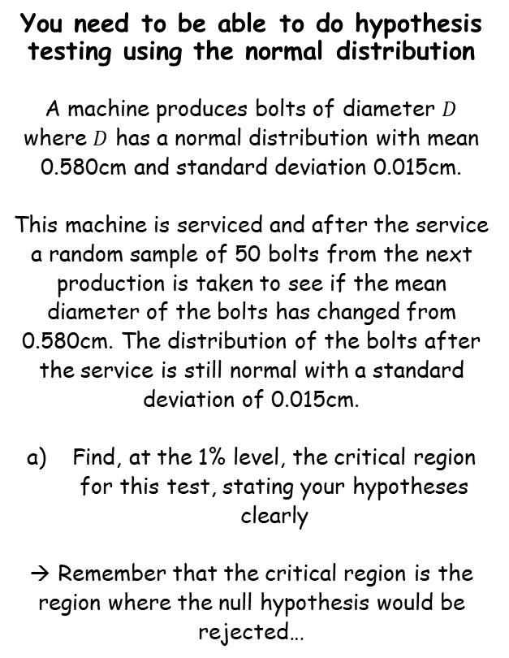

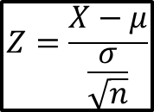


The normal distribution
$$X\sim N(μ,σ^{2})$$
$$Z=\frac{X−μ}{\frac{σ}{\sqrt{n}}}$$
$$\overline{X}\sim N\left(μ,\frac{σ^{2}}{n}\right)$$
You need to be able to do hypothesis testing using the normal distribution
A machine produces bolts of diameter $D$ where $D$ has a normal distribution with mean 0.580cm and standard deviation 0.015cm.
This machine is serviced and after the service a random sample of 50 bolts from the next production is taken to see if the mean diameter of the bolts has changed from 0.580cm. The distribution of the bolts after the service is still normal with a standard deviation of 0.015cm.
Find, at the 1% level, the critical region for this test, stating your hypotheses clearly
→ Remember that the critical region is the region where the null hypothesis would be rejected…
1) Write your Hypotheses
$$H_{0}: μ=0.580$$
$$H_{1}: μ≠0.580$$
→ Remember that the null hypothesis is the default position ie) Nothing has changed
→ The alternative hypothesis is where we consider the statement in the question. In this case, the claim is that the mean has changed (could be higher or lower)
2) Convert the population distribution to the sample distribution (using $D$ for diameter)
Population distribution
Sample distribution
$$\overline{D}\sim N\left(0.580,\frac{{0.015}^{2}}{50}\right)$$
$$D\sim N(0.580,{0.015}^{2})$$
3) Now, using the sample distribution, we need to find the regions that have a probability of 1% or less (ie have an total area of 0.01)
3G

Slide 13










The normal distribution
$$X\sim N(μ,σ^{2})$$
$$Z=\frac{X−μ}{\frac{σ}{\sqrt{n}}}$$
$$\overline{X}\sim N\left(μ,\frac{σ^{2}}{n}\right)$$
$$\overline{D}\sim N\left(0.580,\frac{{0.015}^{2}}{50}\right)$$
$$H_{0}: μ=0.580$$
$$H_{1}: μ≠0.580$$
You need to be able to do hypothesis testing using the normal distribution
A machine produces bolts of diameter $D$ where $D$ has a normal distribution with mean 0.580cm and standard deviation 0.015cm.
This machine is serviced and after the service a random sample of 50 bolts from the next production is taken to see if the mean diameter of the bolts has changed from 0.580cm. The distribution of the bolts after the service is still normal with a standard deviation of 0.015cm.
Find, at the 1% level, the critical region for this test, stating your hypotheses clearly
→ Remember that the critical region is the region where the null hypothesis would be rejected…
3) Now, using the sample distribution, we need to find the regions that have a probability of 1% or less (ie have an total area of 0.01)
Specific distribution
Area = 0.005
Area = 0.005
$$?$$
$$0.580$$
$$?$$
Standard distribution
Using the standard table of results given in the booklet, we can find that the value with an area 0.005 above it is 2.5758
→ Due to symmetry, the lower value will be the negative of this…
Area = 0.005
Area = 0.005
$$?$$
$$0$$
$$2.5758$$
$$−2.5758$$
$$?$$
3G

Slide 14


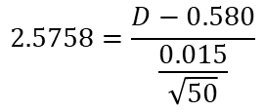
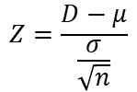
The normal distribution
$$X\sim N(μ,σ^{2})$$
$$Z=\frac{X−μ}{\frac{σ}{\sqrt{n}}}$$
$$\overline{X}\sim N\left(μ,\frac{σ^{2}}{n}\right)$$
$$\overline{D}\sim N\left(0.580,\frac{{0.015}^{2}}{50}\right)$$
$$H_{0}: μ=0.580$$
$$H_{1}: μ≠0.580$$
You need to be able to do hypothesis testing using the normal distribution
A machine produces bolts of diameter $D$ where $D$ has a normal distribution with mean 0.580cm and standard deviation 0.015cm.
This machine is serviced and after the service a random sample of 50 bolts from the next production is taken to see if the mean diameter of the bolts has changed from 0.580cm. The distribution of the bolts after the service is still normal with a standard deviation of 0.015cm.
Find, at the 1% level, the critical region for this test, stating your hypotheses clearly
→ Remember that the critical region is the region where the null hypothesis would be rejected…
3) Now, using the sample distribution, we need to find the regions that have a probability of 1% or less (ie have an total area of 0.01)
Specific distribution
Now use the formula above…
$$Z=\frac{D−μ}{\frac{σ}{\sqrt{n}}}$$
Sub in values
Area = 0.005
Area = 0.005
$$2.5758=\frac{D−0.580}{\frac{0.015}{\sqrt{50}}}$$
$$?$$
$$0.580$$
$$0.5854$$
$$?$$
Work out
Standard distribution
$$D=0.5854$$
Area = 0.005
Area = 0.005
$$−2.5758$$
$$0$$
$$2.5758$$
3G

Slide 15


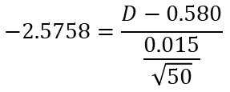
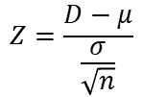
The normal distribution
$$X\sim N(μ,σ^{2})$$
$$Z=\frac{X−μ}{\frac{σ}{\sqrt{n}}}$$
$$\overline{X}\sim N\left(μ,\frac{σ^{2}}{n}\right)$$
$$\overline{D}\sim N\left(0.580,\frac{{0.015}^{2}}{50}\right)$$
$$H_{0}: μ=0.580$$
$$H_{1}: μ≠0.580$$
You need to be able to do hypothesis testing using the normal distribution
A machine produces bolts of diameter $D$ where $D$ has a normal distribution with mean 0.580cm and standard deviation 0.015cm.
This machine is serviced and after the service a random sample of 50 bolts from the next production is taken to see if the mean diameter of the bolts has changed from 0.580cm. The distribution of the bolts after the service is still normal with a standard deviation of 0.015cm.
Find, at the 1% level, the critical region for this test, stating your hypotheses clearly
→ Remember that the critical region is the region where the null hypothesis would be rejected…
3) Now, using the sample distribution, we need to find the regions that have a probability of 1% or less (ie have an total area of 0.01)
Specific distribution
Now use the formula above for the lower value…
$$Z=\frac{D−μ}{\frac{σ}{\sqrt{n}}}$$
Sub in values
Area = 0.005
Area = 0.005
$$−2.5758=\frac{D−0.580}{\frac{0.015}{\sqrt{50}}}$$
$$?$$
$$0.580$$
$$0.5854$$
$$0.5745$$
Standard distribution
Work out
$$D=0.5745$$
Area = 0.005
Area = 0.005
$$−2.5758$$
$$0$$
$$2.5758$$
3G

Slide 16

The normal distribution
$$X\sim N(μ,σ^{2})$$
$$Z=\frac{X−μ}{\frac{σ}{\sqrt{n}}}$$
$$\overline{X}\sim N\left(μ,\frac{σ^{2}}{n}\right)$$
$$\overline{D}\sim N\left(0.580,\frac{{0.015}^{2}}{50}\right)$$
$$H_{0}: μ=0.580$$
$$H_{1}: μ≠0.580$$
You need to be able to do hypothesis testing using the normal distribution
A machine produces bolts of diameter $D$ where $D$ has a normal distribution with mean 0.580cm and standard deviation 0.015cm.
This machine is serviced and after the service a random sample of 50 bolts from the next production is taken to see if the mean diameter of the bolts has changed from 0.580cm. The distribution of the bolts after the service is still normal with a standard deviation of 0.015cm.
Find, at the 1% level, the critical region for this test, stating your hypotheses clearly
→ Remember that the critical region is the region where the null hypothesis would be rejected…
3) Now, using the sample distribution, we need to find the regions that have a probability of 1% or less (ie have an total area of 0.01)
Specific distribution
So the critical region (to 3sf) will be where:
$\overline{D}≤0.575$ or $\overline{D}≥0.585$
Area = 0.005
Area = 0.005
$$0.5745$$
$$0.580$$
$$0.5854$$
Standard distribution
Area = 0.005
Area = 0.005
$$−2.5758$$
$$0$$
$$2.5758$$
3G

Slide 17
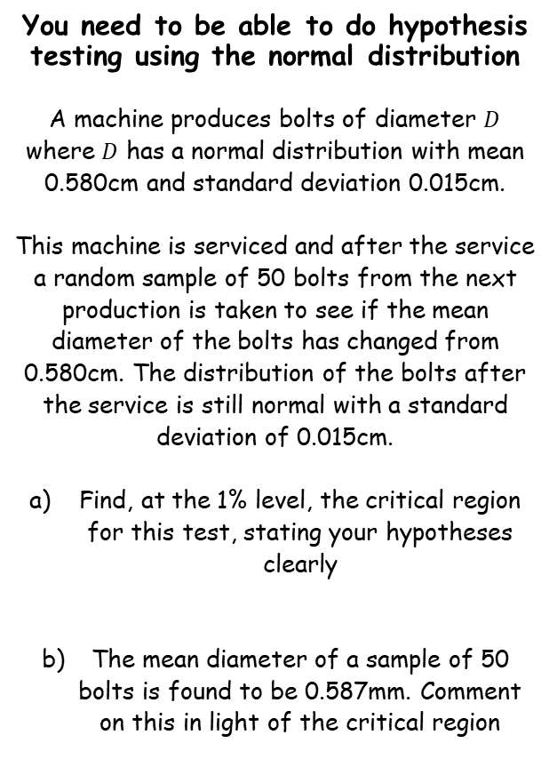

The normal distribution
$$X\sim N(μ,σ^{2})$$
$$Z=\frac{X−μ}{\frac{σ}{\sqrt{n}}}$$
$$\overline{X}\sim N\left(μ,\frac{σ^{2}}{n}\right)$$
$$H_{0}: μ=0.580$$
$$H_{1}: μ≠0.580$$
You need to be able to do hypothesis testing using the normal distribution
A machine produces bolts of diameter $D$ where $D$ has a normal distribution with mean 0.580cm and standard deviation 0.015cm.
This machine is serviced and after the service a random sample of 50 bolts from the next production is taken to see if the mean diameter of the bolts has changed from 0.580cm. The distribution of the bolts after the service is still normal with a standard deviation of 0.015cm.
Find, at the 1% level, the critical region for this test, stating your hypotheses clearly
The mean diameter of a sample of 50 bolts is found to be 0.587mm. Comment on this in light of the critical region
Since this mean is inside the critical region, there is sufficient evidence to reject the null hypothesis
→ It seems that the mean diameter has changed…
$\overline{D}≤0.575$ or $\overline{D}≥0.585$
3G

