Slide 1
Teachings for
Exercise 3F

Slide 2

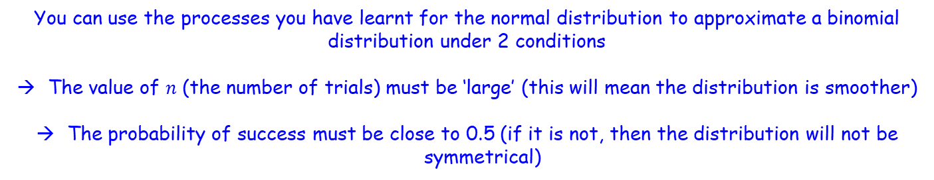
The normal distribution
$$Z=\frac{X−μ}{σ}$$
You need to be able to approximate a binomial distribution
Let’s compare the two quickly…
Binomial distribution
→ Discrete data
Normal distribution
→ Continuous data
No. heads when flipping a coin 7 times
Height of the flipped coin
You can use the processes you have learnt for the normal distribution to approximate a binomial distribution under 2 conditions
The value of $n$ (the number of trials) must be ‘large’ (this will mean the distribution is smoother)
The probability of success must be close to 0.5 (if it is not, then the distribution will not be symmetrical)
3F

Slide 3

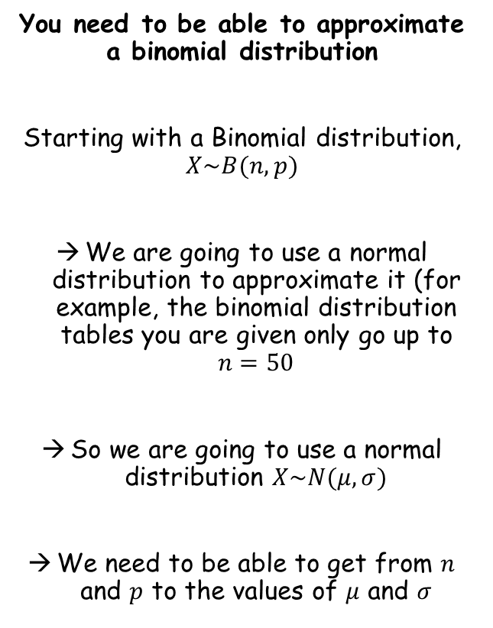
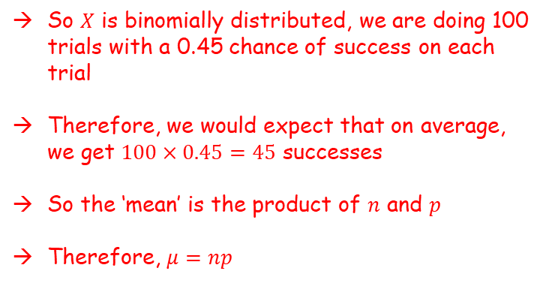


The normal distribution
$$Z=\frac{X−μ}{σ}$$
Using normal distribution to approximate a binomial distribution
$n$ must be large
$p$ must be close to 0.5
$$μ=np$$
You need to be able to approximate a binomial distribution
Starting with a Binomial distribution, $X\sim B(n,p)$
We are going to use a normal distribution to approximate it (for example, the binomial distribution tables you are given only go up to $n=50$
So we are going to use a normal distribution $X\sim N(μ,σ)$
We need to be able to get from $n$ and $p$ to the values of $μ$ and $σ$
Let $X\sim B(100,0.45)$
So $X$ is binomially distributed, we are doing 100 trials with a 0.45 chance of success on each trial
Therefore, we would expect that on average, we get $100×0.45=45$ successes
So the ‘mean’ is the product of $n$ and $p$
Therefore, $μ=np$
Finding a relationship for the standard deviation is much more difficult to understand…
We will need to clarify some statements first…
3F

Slide 4

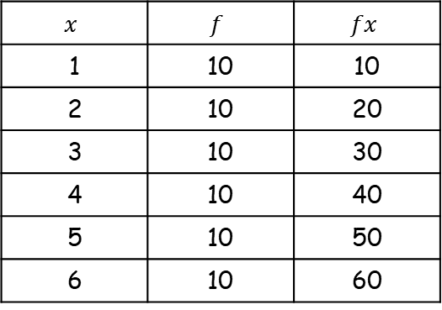

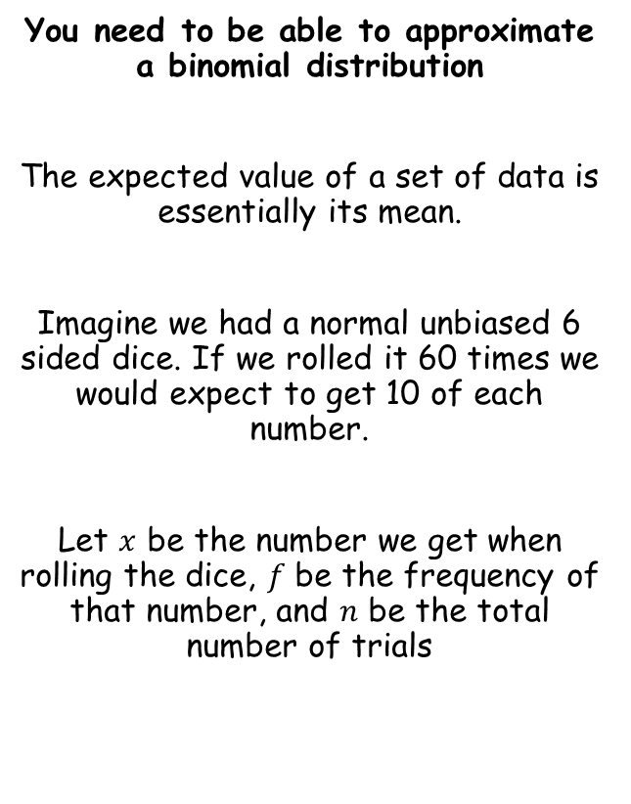
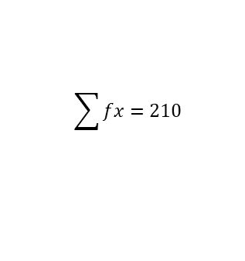
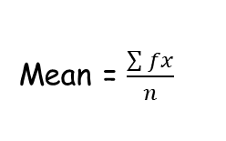



The normal distribution
$$X\sim B(n,p)$$
$$X\sim N(μ,σ)$$
$$μ=np$$
You need to be able to approximate a binomial distribution
The expected value of a set of data is essentially its mean.
Imagine we had a normal unbiased 6 sided dice. If we rolled it 60 times we would expect to get 10 of each number.
Let $x$ be the number we get when rolling the dice, $f$ be the frequency of that number, and $n$ be the total number of trials
$$x$$ | $$f$$ | $$fx$$
1 | 10 | 10
2 | 10 | 20
3 | 10 | 30
4 | 10 | 40
5 | 10 | 50
6 | 10 | 60
$$n=60$$
$$\sum{fx=210}$$
Mean = $\frac{\sum{fx}}{n}$
Sub in values
Mean = $\frac{210}{60}$
Calculate
Mean = $3.5$
3F

Slide 5
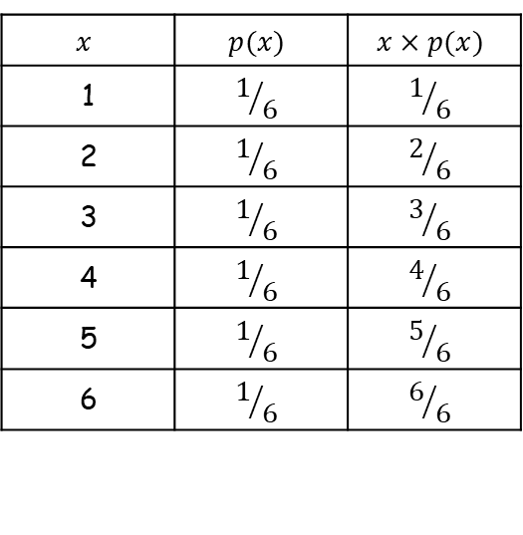
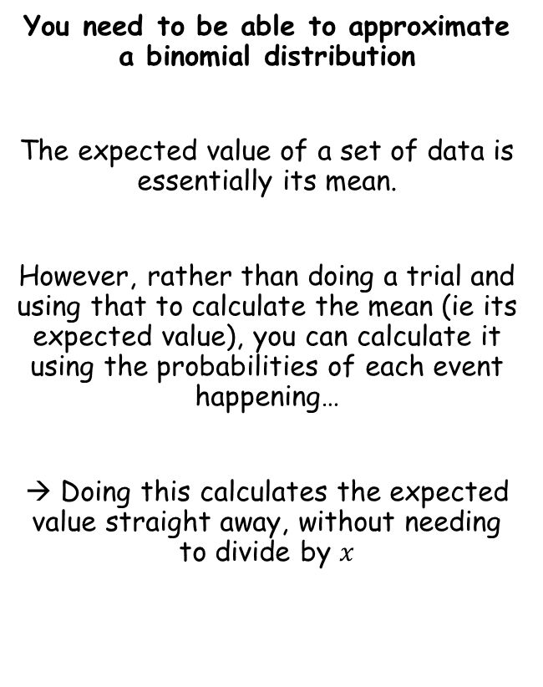
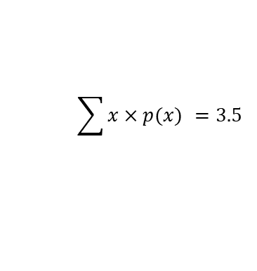
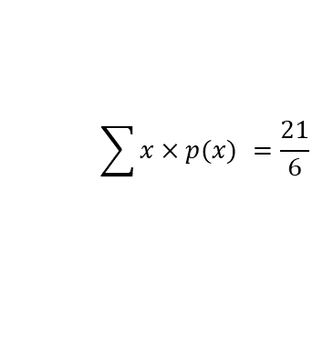
The normal distribution
$$X\sim B(n,p)$$
$$X\sim N(μ,σ)$$
$$μ=np$$
You need to be able to approximate a binomial distribution
The expected value of a set of data is essentially its mean.
However, rather than doing a trial and using that to calculate the mean (ie its expected value), you can calculate it using the probabilities of each event happening…
→ Doing this calculates the expected value straight away, without needing to divide by $x$
$$x$$ | $$p(x)$$ | $$x×p(x)$$
1 | $$1/6$$ | $$1/6$$
2 | $$1/6$$ | $$2/6$$
3 | $$1/6$$ | $$3/6$$
4 | $$1/6$$ | $$4/6$$
5 | $$1/6$$ | $$5/6$$
6 | $$1/6$$ | $$6/6$$
$$\sum{x×p(x) =\frac{21}{6}}$$
$$\sum{x×p(x) =3.5}$$
3F

Slide 6


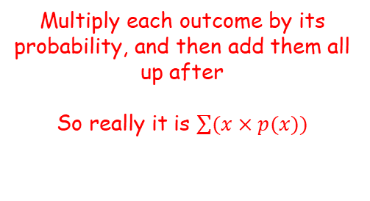


The normal distribution
$$X\sim B(n,p)$$
$$X\sim N(μ,σ)$$
$$μ=np$$
You need to be able to approximate a binomial distribution
What you have just seen is showing that the following two calculations are equivalent…
$$\frac{\sum{x}}{n}$$
$$=$$
$$\frac{\sum{x×p(x)}}{}$$
Add all the outcomes up, and divide by how many there are in total
(note that in the example we used $fx$, but the idea is the same – add up all the values! The fx just sped things up a bit)
Multiply each outcome by its probability, and then add them all up after
So really it is $\sum{(x×p(x)})$
3F

Slide 7
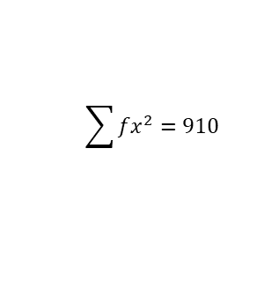




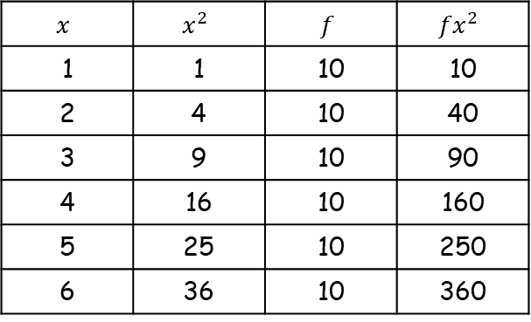




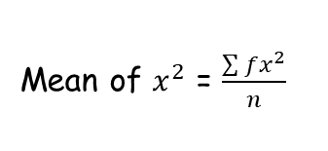
The normal distribution
$$\frac{\sum{x}}{n}$$
$$X\sim B(n,p)$$
$$=$$
$$\frac{\sum{x×p(x)}}{}$$
$$X\sim N(μ,σ)$$
$$μ=np$$
You need to be able to approximate a binomial distribution
It does not matter what set of values we start with.
For example, if the starting values were all $x^{2}$ instead of $x$…
$$x$$ | $$x^{2}$$ | $$f$$ | $${fx}^{2}$$
1 | 1 | 10 | 10
2 | 4 | 10 | 40
3 | 9 | 10 | 90
4 | 16 | 10 | 160
5 | 25 | 10 | 250
6 | 36 | 10 | 360
$$n=60$$
$$\sum{fx^{2}=910}$$
Mean of $x^{2}$ = $\frac{\sum{fx^{2}}}{n}$
Sub in values
Mean of $x^{2}$ = $\frac{910}{60}$
Calculate
Mean of $x^{2}$ = $15.16…$
So the ‘expected value’ of $x^{2}$ is 15.16…
3F

Slide 8
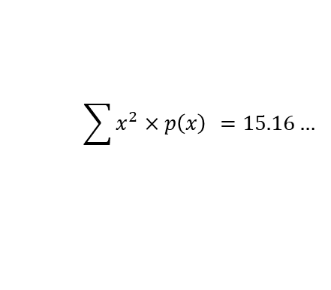
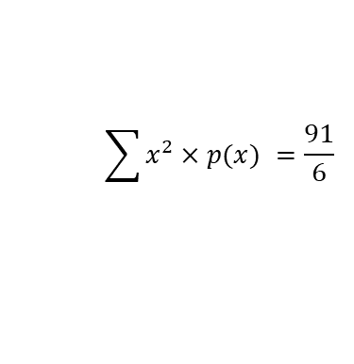
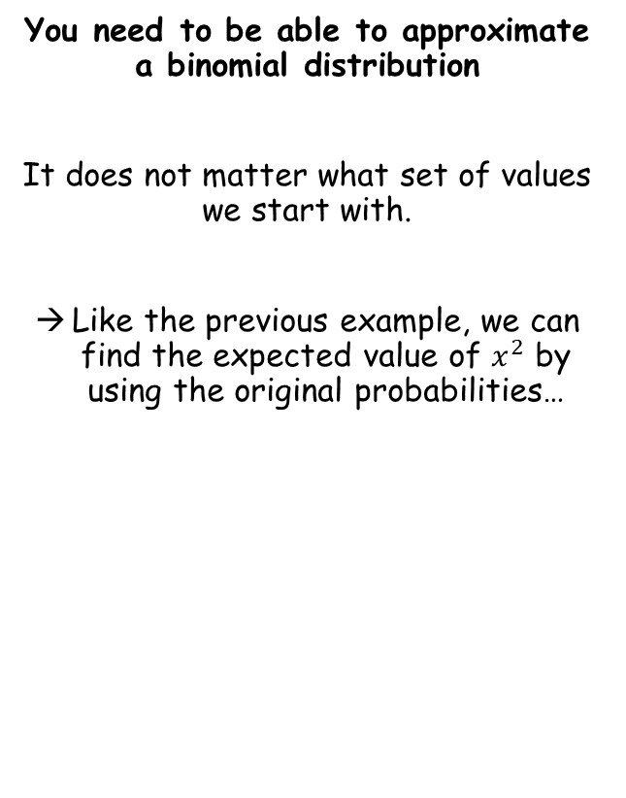
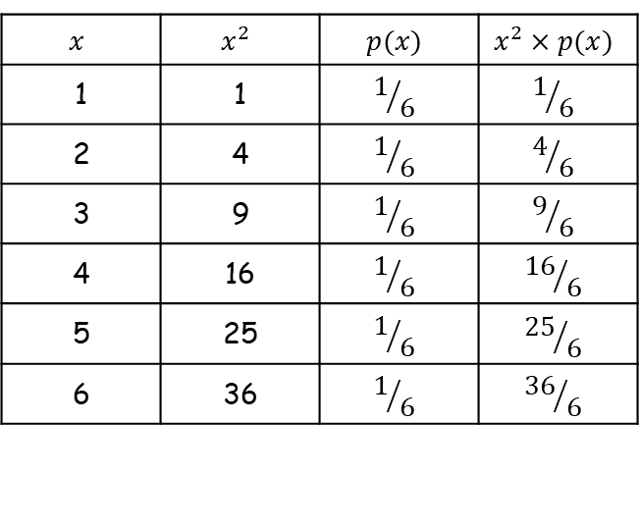
The normal distribution
$$\frac{\sum{x}}{n}$$
$$X\sim B(n,p)$$
$$=$$
$$\frac{\sum{x×p(x)}}{}$$
$$X\sim N(μ,σ)$$
$$μ=np$$
You need to be able to approximate a binomial distribution
It does not matter what set of values we start with.
Like the previous example, we can find the expected value of $x^{2}$ by using the original probabilities…
$$x$$ | $$x^{2}$$ | $$p(x)$$ | $$x^{2}×p(x)$$
1 | 1 | $$1/6$$ | $$1/6$$
2 | 4 | $$1/6$$ | $$4/6$$
3 | 9 | $$1/6$$ | $$9/6$$
4 | 16 | $$1/6$$ | $${16}/6$$
5 | 25 | $$1/6$$ | $${25}/6$$
6 | 36 | $$1/6$$ | $${36}/6$$
$$\sum{x^{2}×p(x) =\frac{91}{6}}$$
$$\sum{x^{2}×p\left(x\right) =15.16…}$$
3F

Slide 9



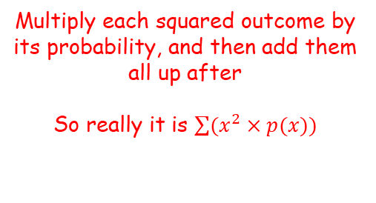


The normal distribution
$$\frac{\sum{x}}{n}$$
$$\frac{\sum{x^{2}}}{n}$$
$$X\sim B(n,p)$$
$$=$$
$$\frac{\sum{x×p(x)}}{}$$
$$=$$
$$\frac{\sum{x^{2}×p(x)}}{}$$
$$X\sim N(μ,σ)$$
$$μ=np$$
You need to be able to approximate a binomial distribution
What you have just seen is showing that the following two calculations are equivalent…
$$\frac{\sum{x^{2}}}{n}$$
$$=$$
$$\frac{\sum{x^{2}×p(x)}}{}$$
Add all the squared outcomes up, and divide by how many there are in total
Multiply each squared outcome by its probability, and then add them all up after
So really it is $\sum{(x^{2}×p(x)})$
3F

Slide 10
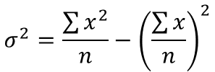





The normal distribution
$$\frac{\sum{x}}{n}$$
$$\frac{\sum{x^{2}}}{n}$$
$$X\sim B(n,p)$$
$$=$$
$$\frac{\sum{x×p(x)}}{}$$
$$=$$
$$\frac{\sum{x^{2}×p(x)}}{}$$
$$X\sim N(μ,σ)$$
$$μ=np$$
You need to be able to approximate a binomial distribution
Can you remember the formula for the variance of a data set from year 12?
So we need to focus on rewriting this part…
$$σ^{2}=\frac{\sum{x^{2}}}{n}−{\left(\frac{\sum{x}}{n}\right)}^{2}$$
The second part of this is the mean squared
→ Remember that we already have an expression for the mean from before!
$$σ^{2}=\frac{\sum{x^{2}}}{n}−{\left(np\right)}^{2}$$
What we need to do now is to find a way to replace the first part in terms of $n$ and $p$, the number of trials and the probability of success in the binomial distribution
$$\sum{(x^{2}×p(x))}$$
→ We can replace the first part using the equivalent calculation that we saw before…
$$σ^{2}=\frac{\sum{x^{2}}}{n}−{\left(np\right)}^{2}$$
Replace first term using the above
$$σ^{2}=\sum{(x^{2}×p(x))}−{\left(np\right)}^{2}$$
3F

Slide 11















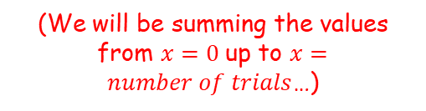





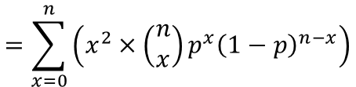




The normal distribution
$$X\sim B(n,p)$$
$$X\sim N(μ,σ)$$
$$μ=np$$
You need to be able to approximate a binomial distribution
Can you remember the formula for the variance of a data set from year 12?
So we need to focus on rewriting this part…
Remember how to find the calculation for a an event that is binomially distributed?
Imagine we are considering the number of heads when tossing a biased coin 5 times. Let $x=number of heads$, and $P\left(Head\right)=0.4$
→ Lets put together a table…
$$x$$
$$p(x)$$
$$x^{2}×p(x)$$
$$0$$
$$\left(\begin{matrix}5 \\ 0\end{matrix}\right){0.4}^{0}{\left(0.6\right)}^{5}$$
$$0^{2}×\left(\begin{matrix}5 \\ 0\end{matrix}\right){0.4}^{0}{\left(0.6\right)}^{5}$$
$$1$$
$$\left(\begin{matrix}5 \\ 1\end{matrix}\right){0.4}^{1}{\left(0.6\right)}^{4}$$
$$1^{2}×\left(\begin{matrix}5 \\ 1\end{matrix}\right){0.4}^{1}{\left(0.6\right)}^{4}$$
$$\sum{(x^{2}×p(x))}$$
$$2$$
$$\left(\begin{matrix}5 \\ 2\end{matrix}\right){0.4}^{2}{\left(0.6\right)}^{3}$$
$$2^{2}×\left(\begin{matrix}5 \\ 2\end{matrix}\right){0.4}^{2}{\left(0.6\right)}^{3}$$
$$=\sum_{x=0}^{n}{\left(x^{2}×\left(\begin{matrix}n \\ x\end{matrix}\right)p^{x}{\left(1−p\right)}^{n−x}\right)}$$
$$3$$
$$\left(\begin{matrix}5 \\ 3\end{matrix}\right){0.4}^{3}{\left(0.6\right)}^{2}$$
$$3^{2}×\left(\begin{matrix}5 \\ 3\end{matrix}\right){0.4}^{3}{\left(0.6\right)}^{2}$$
$$4$$
$$\left(\begin{matrix}5 \\ 4\end{matrix}\right){0.4}^{4}{\left(0.6\right)}^{1}$$
$$4^{2}×\left(\begin{matrix}5 \\ 4\end{matrix}\right){0.4}^{4}{\left(0.6\right)}^{1}$$
$$5$$
$$\left(\begin{matrix}5 \\ 5\end{matrix}\right){0.4}^{5}{\left(0.6\right)}^{0}$$
$$5^{2}×\left(\begin{matrix}5 \\ 5\end{matrix}\right){0.4}^{5}{\left(0.6\right)}^{0}$$
$$P\left(X=r\right)=\left(\begin{matrix}n \\ r\end{matrix}\right)p^{r}{\left(1−p\right)}^{n−r}$$
(We will be summing the values from $x=0$up to $x=number of trials$…)
$$x^{2}×\left(\begin{matrix}n \\ x\end{matrix}\right)p^{x}{\left(1−p\right)}^{n−x}$$
So we are doing this calculation for each value of $x$, and then adding them up…
3F

Slide 12
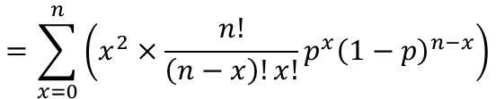


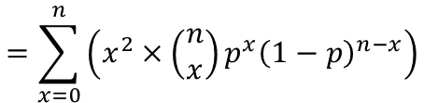
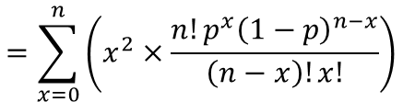
The normal distribution
$$P\left(X=r\right)=\left(\begin{matrix}n \\ r\end{matrix}\right)p^{r}{\left(1−p\right)}^{n−r}$$
$$X\sim B(n,p)$$
$$X\sim N(μ,σ)$$
$$μ=np$$
You need to be able to approximate a binomial distribution
Can you remember the formula for the variance of a data set from year 12?
So now we need to rewrite this…
You hopefully also remember the following from year 12 (Binomial expansion powerpoint)
$$\left(\begin{matrix}n \\ r\end{matrix}\right)=\frac{n!}{\left(n−r\right)!r!}$$
$$=\sum_{x=0}^{n}{\left(x^{2}×\left(\begin{matrix}n \\ x\end{matrix}\right)p^{x}{\left(1−p\right)}^{n−x}\right)}$$
Replace the first bracket using the relationship shown…
$$=\sum_{x=0}^{n}{\left(x^{2}×\frac{n!}{\left(n−x\right)!x!}p^{x}{\left(1−p\right)}^{n−x}\right)}$$
Group together
$$=\sum_{x=0}^{n}{\left(x^{2}×\frac{n!p^{x}{\left(1−p\right)}^{n−x}}{\left(n−x\right)!x!}\right)}$$
3F

Slide 13

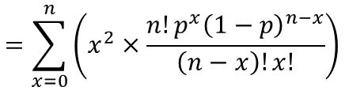

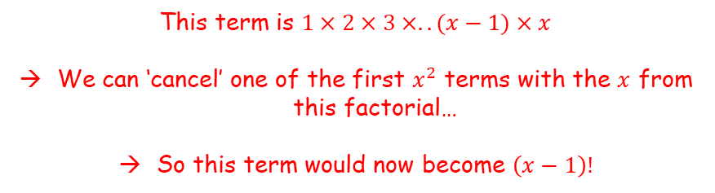

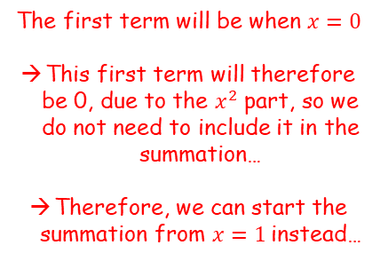
The normal distribution
$$P\left(X=r\right)=\left(\begin{matrix}n \\ r\end{matrix}\right)p^{r}{\left(1−p\right)}^{n−r}$$
$$X\sim B(n,p)$$
$$X\sim N(μ,σ)$$
$$μ=np$$
You need to be able to approximate a binomial distribution
Can you remember the formula for the variance of a data set from year 12?
So now we need to rewrite this…
$$\sum_{x=0}^{n}{\left(x^{2}×\frac{n!p^{x}{\left(1−p\right)}^{n−x}}{\left(n−x\right)!x!}\right)}$$
The first term will be when $x=0$
This first term will therefore be 0, due to the $x^{2}$ part, so we do not need to include it in the summation…
Therefore, we can start the summation from $x=1$instead…
$$\sum_{x=1}^{n}{\left(x^{2}×\frac{n!p^{x}{\left(1−p\right)}^{n−x}}{\left(n−x\right)!x!}\right)}$$
$$=\sum_{x=0}^{n}{\left(x^{2}×\frac{n!p^{x}{\left(1−p\right)}^{n−x}}{\left(n−x\right)!x!}\right)}$$
This term is $1×2×3×..(x−1)×x$
We can ‘cancel’ one of the first $x^{2}$ terms with the $x$ from this factorial…
So this term would now become $\left(x−1\right)!$
$$=\sum_{x=1}^{n}{\left(x×\frac{n!p^{x}{\left(1−p\right)}^{n−x}}{\left(n−x\right)!(x−1)!}\right)}$$
3F

Slide 14

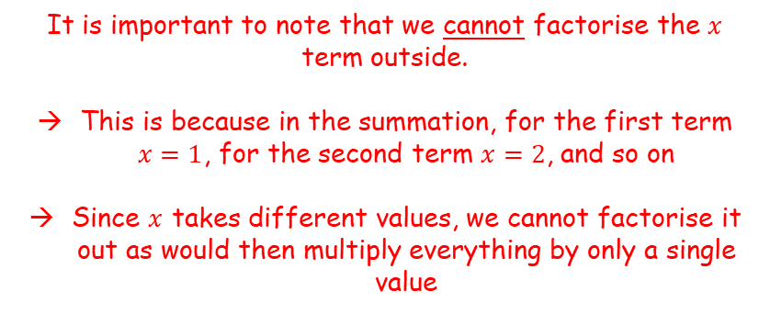


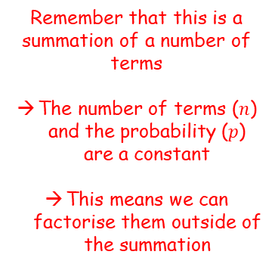
The normal distribution
$$P\left(X=r\right)=\left(\begin{matrix}n \\ r\end{matrix}\right)p^{r}{\left(1−p\right)}^{n−r}$$
$$X\sim B(n,p)$$
$$X\sim N(μ,σ)$$
$$μ=np$$
$$=\sum_{x=1}^{n}{\left(x×\frac{n!p^{x}{\left(1−p\right)}^{n−x}}{\left(n−x\right)!(x−1)!}\right)}$$
Remember that this is a summation of a number of terms
The number of terms ($n$) and the probability ($p$) are a constant
This means we can factorise them outside of the summation
You need to be able to approximate a binomial distribution
Can you remember the formula for the variance of a data set from year 12?
So now we need to rewrite this…
$$=np\sum_{x=1}^{n}{\left(x×\frac{(n−1)!p^{x−1}{\left(1−p\right)}^{n−x}}{\left(n−x\right)!(x−1)!}\right)}$$
$$=\sum_{x=0}^{n}{\left(x^{2}×\frac{n!p^{x}{\left(1−p\right)}^{n−x}}{\left(n−x\right)!x!}\right)}$$
The $n!$term has been changed as in the previous example
The $p$ term has been adjusted as well…
It is important to note that we cannot factorise the $x$ term outside.
This is because in the summation, for the first term $x=1$, for the second term $x=2$, and so on
Since $x$ takes different values, we cannot factorise it out as would then multiply everything by only a single value
3F

Slide 15

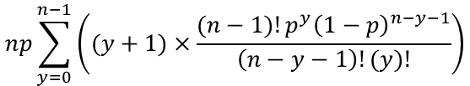
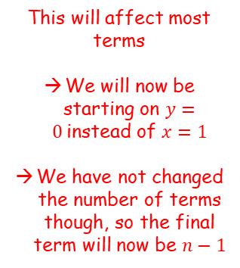

The normal distribution
$$P\left(X=r\right)=\left(\begin{matrix}n \\ r\end{matrix}\right)p^{r}{\left(1−p\right)}^{n−r}$$
$$X\sim B(n,p)$$
$$X\sim N(μ,σ)$$
$$μ=np$$
Let $y=x−1$
So $x=y+1$
$$np\sum_{x=1}^{n}{\left(x×\frac{(n−1)!p^{x−1}{\left(1−p\right)}^{n−x}}{\left(n−x\right)!(x−1)!}\right)}$$
You need to be able to approximate a binomial distribution
Can you remember the formula for the variance of a data set from year 12?
So now we need to rewrite this…
This will affect most terms
We will now be starting on $y=0$instead of $x=1$
We have not changed the number of terms though, so the final term will now be $n−1$
$$np\sum_{y=0}^{n−1}{\left((y+1)×\frac{(n−1)!p^{y}{\left(1−p\right)}^{n−y−1}}{\left(n−y−1\right)!(y)!}\right)}$$
$$=\sum_{x=0}^{n}{\left(x^{2}×\frac{n!p^{x}{\left(1−p\right)}^{n−x}}{\left(n−x\right)!x!}\right)}$$
3F

Slide 16
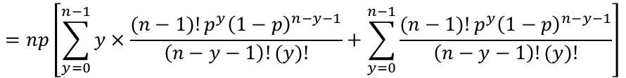

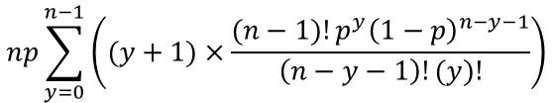


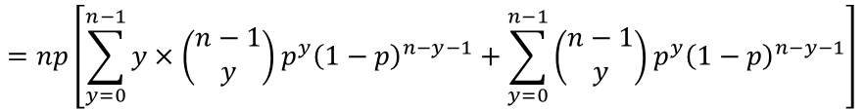
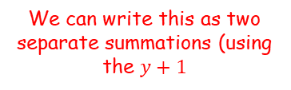

The normal distribution
$$P\left(X=r\right)=\left(\begin{matrix}n \\ r\end{matrix}\right)p^{r}{\left(1−p\right)}^{n−r}$$
$$X\sim B(n,p)$$
$$X\sim N(μ,σ)$$
$$μ=np$$
You need to be able to approximate a binomial distribution
$$np\sum_{y=0}^{n−1}{\left((y+1)×\frac{(n−1)!p^{y}{\left(1−p\right)}^{n−y−1}}{\left(n−y−1\right)!(y)!}\right)}$$
We can write this as two separate summations (using the $y+1$
$$=np\left[\sum_{y=0}^{n−1}{y×\frac{(n−1)!p^{y}{\left(1−p\right)}^{n−y−1}}{\left(n−y−1\right)!(y)!}}+\sum_{y=0}^{n−1}{\frac{(n−1)!p^{y}{\left(1−p\right)}^{n−y−1}}{\left(n−y−1\right)!(y)!}}\right]$$
$$\left(\begin{matrix}n \\ r\end{matrix}\right)=\frac{n!}{\left(n−r\right)!r!}$$
$$\left(\begin{matrix}n−1 \\ y\end{matrix}\right)=$$
$$\frac{(n−1)!}{\left(n−y−1\right)!y!}$$
What if we let $n=n−1$ and $r=y$?
$$=np\left[\sum_{y=0}^{n−1}{y×\left(\begin{matrix}n−1 \\ y\end{matrix}\right)p^{y}{\left(1−p\right)}^{n−y−1}}+\sum_{y=0}^{n−1}{\left(\begin{matrix}n−1 \\ y\end{matrix}\right)}p^{y}{\left(1−p\right)}^{n−y−1}\right]$$
3F

Slide 17



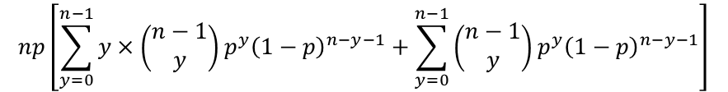









The normal distribution
$$P\left(X=r\right)=\left(\begin{matrix}n \\ r\end{matrix}\right)p^{r}{\left(1−p\right)}^{n−r}$$
$$X\sim B(n,p)$$
$$X\sim N(μ,σ)$$
$$μ=np$$
This term represents all possible outcomes in a trial, so it will always equal 1 regardless of the values chosen for $n$, $y$ and $p$…
You need to be able to approximate a binomial distribution
$$np\left[\sum_{y=0}^{n−1}{y×\left(\begin{matrix}n−1 \\ y\end{matrix}\right)p^{y}{\left(1−p\right)}^{n−y−1}}+\sum_{y=0}^{n−1}{\left(\begin{matrix}n−1 \\ y\end{matrix}\right)}p^{y}{\left(1−p\right)}^{n−y−1}\right]$$
Lets think about the second summation, using heads on the biased coin from before as an example
Let the number of trials, $n$, equal 3
Let $P(Heads)=0.4$
Remember this is going to be the sum of the terms from $y=0$to $y=2$
$$\sum_{y=0}^{2}{\left(\begin{matrix}2 \\ y\end{matrix}\right)}{0.4}^{y}{0.6}^{2−y}$$
When $y=0$
When $y=1$
When $y=2$
$$\left(\begin{matrix}2 \\ 0\end{matrix}\right){0.4}^{0}{0.6}^{2}$$
$$+$$
$$\left(\begin{matrix}2 \\ 1\end{matrix}\right){0.4}^{1}{0.6}^{1}$$
$$+$$
$$\left(\begin{matrix}2 \\ 2\end{matrix}\right){0.4}^{2}{0.6}^{0}$$
What will these add up to?
→ They will add up to 1 as they represent all possible outcomes (from 2 choose 0 + from 2 choose 1 + from 2 choose 2)
3F

Slide 18
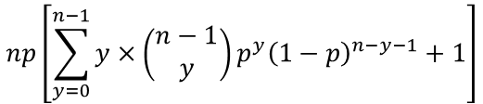


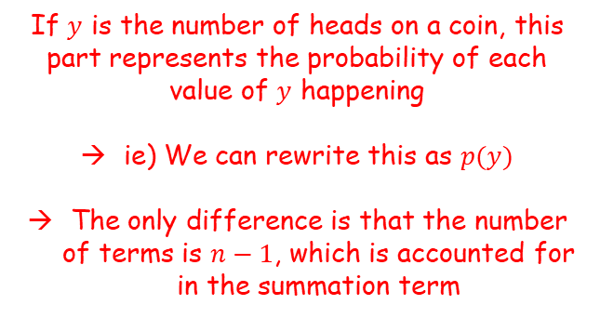
The normal distribution
$$P\left(X=r\right)=\left(\begin{matrix}n \\ r\end{matrix}\right)p^{r}{\left(1−p\right)}^{n−r}$$
$$X\sim B(n,p)$$
$$X\sim N(μ,σ)$$
$$μ=np$$
You need to be able to approximate a binomial distribution
$$np\left[\sum_{y=0}^{n−1}{y×\left(\begin{matrix}n−1 \\ y\end{matrix}\right)p^{y}{\left(1−p\right)}^{n−y−1}}+\sum_{y=0}^{n−1}{\left(\begin{matrix}n−1 \\ y\end{matrix}\right)}p^{y}{\left(1−p\right)}^{n−y−1}\right]$$
If $y$ is the number of heads on a coin, this part represents the probability of each value of $y$ happening
ie) We can rewrite this as $p(y)$
The only difference is that the number of terms is $n−1$, which is accounted for in the summation term
$$np\left[\sum_{y=0}^{n−1}{y×\left(\begin{matrix}n−1 \\ y\end{matrix}\right)p^{y}{\left(1−p\right)}^{n−y−1}}+1\right]$$
$$np\left[\sum_{y=0}^{n−1}{y×p\left(y\right)+1}\right]$$
$$P\left(X=r\right)=\left(\begin{matrix}n \\ r\end{matrix}\right)p^{r}{\left(1−p\right)}^{n−r}$$
3F

Slide 19


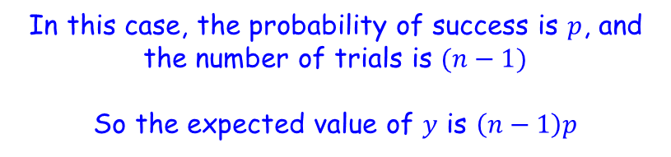
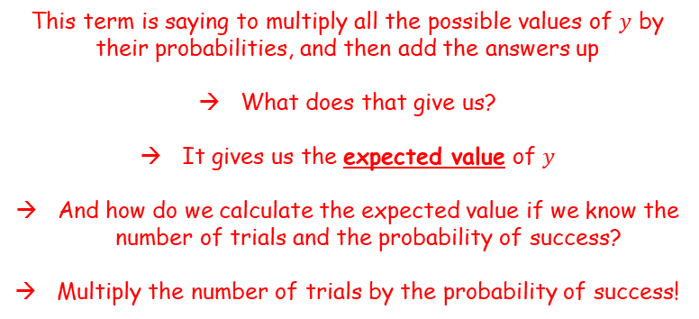
The normal distribution
$$P\left(X=r\right)=\left(\begin{matrix}n \\ r\end{matrix}\right)p^{r}{\left(1−p\right)}^{n−r}$$
$$X\sim B(n,p)$$
$$X\sim N(μ,σ)$$
$$μ=np$$
You need to be able to approximate a binomial distribution
$$np\left[\sum_{y=0}^{n−1}{y×p\left(y\right)+1}\right]$$
This term is saying to multiply all the possible values of $y$ by their probabilities, and then add the answers up
What does that give us?
It gives us the expected value of $y$
And how do we calculate the expected value if we know the number of trials and the probability of success?
Multiply the number of trials by the probability of success!
$$=np\left[\left(n−1\right)p+1\right]$$
In this case, the probability of success is $p$, and the number of trials is $(n−1)$
So the expected value of $y$ is $\left(n−1\right)p$
3F

Slide 20
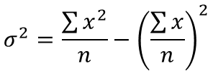












The normal distribution
$$P\left(X=r\right)=\left(\begin{matrix}n \\ r\end{matrix}\right)p^{r}{\left(1−p\right)}^{n−r}$$
$$X\sim B(n,p)$$
$$X\sim N(μ,σ)$$
$$μ=np$$
$$σ=\sqrt{np(1−p)}$$
You need to be able to approximate a binomial distribution
If you remember (quite a while back), we were finding an expression for the variance
The expression we just found is that:
→ A reminder that we were finding this so we could use it to replace the expected value of $x^{2}$, which we can now do!
$$σ^{2}=\frac{\sum{x^{2}}}{n}−{\left(\frac{\sum{x}}{n}\right)}^{2}$$
Earlier, we replaced the mean with $np$
$$σ^{2}=\frac{\sum{x^{2}}}{n}−{\left(np\right)}^{2}$$
Now we can replace the expected value of $x^{2}$ with the expression we found…
$$σ^{2}=np\left[\left(n−1\right)p+1\right]−{\left(np\right)}^{2}$$
Multiply the inner bracket
$$σ^{2}=np\left[np−p+1\right]−{\left(np\right)}^{2}$$
Multiply the square bracket
$$np\left[\left(n−1\right)p+1\right]$$
$$σ^{2}={\left(np\right)}^{2}−np^{2}+np−{\left(np\right)}^{2}$$
Simplify
$$σ^{2}=np−{np}^{2}$$
Factorise
$$σ^{2}=np(1−p)$$
Square root
$$σ=\sqrt{np(1−p)}$$
3F

Slide 21


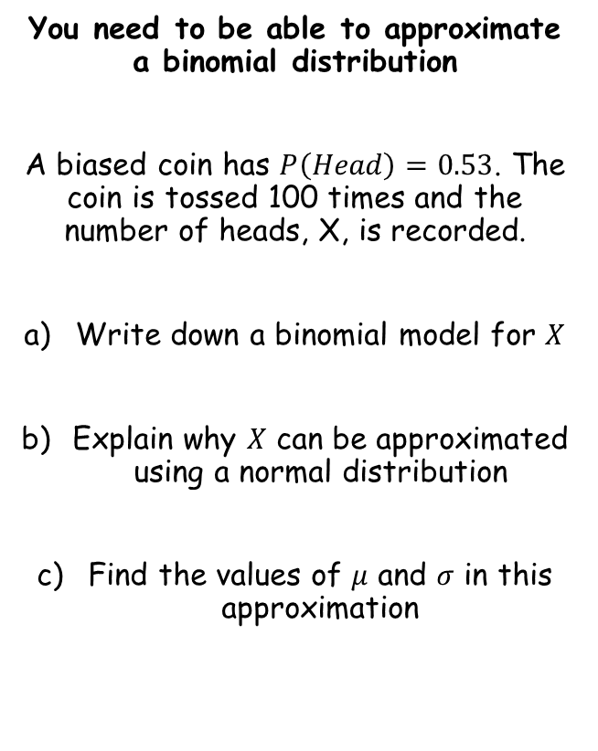






The normal distribution
$$X\sim B(n,p)$$
$$X\sim N(μ,σ)$$
$$μ=np$$
$$σ=\sqrt{np(1−p)}$$
You need to be able to approximate a binomial distribution
A biased coin has $P\left(Head\right)=0.53$. The coin is tossed 100 times and the number of heads, X, is recorded.
Write down a binomial model for $X$
Explain why $X$ can be approximated using a normal distribution
Find the values of $μ$ and $σ$ in this approximation
$$μ=np$$
Sub in values
$$μ=(100)(0.53)$$
Calculate
$$μ=53$$
$$σ=\sqrt{np(1−p)}$$
Sub in values
$$X\sim B(100,0.53)$$
$$σ=\sqrt{(100)(0.53)(1−0.53)}$$
Calculate
$$σ=4.99$$
Since $n$ is large and $p$ is close to 0.5
3F

Slide 22







The normal distribution
$$X\sim B(n,p)$$
$$X\sim N(μ,σ)$$
$$μ=np$$
$$σ=\sqrt{np(1−p)}$$
You need to be able to approximate a binomial distribution
The binomial random variable $X\sim B(150,0.48)$ is approximated by the normal random variable $Y\sim N(72,{6.12}^{2})$.
Use this approximation to find $P(X≤70)$
Something to be careful is that the normal distribution is continuous and the binomial distribution is discrete
You need to apply a ‘continuity correction’
$$P(X≤70)$$
Since $Y$ is the continuous distribution, any values up to 70.5 would round to 70 when converted to the binomial distribution
So you need to go up to 70.5 when calculating…
$$=P(Y<70.5)$$
$$=0.4032$$
Use your calculator with $μ=72$, $σ=6.12$, lower limit of -100 and upper limit of 70.5
$$=0.4032$$
3F

Slide 23





The normal distribution
$$X\sim B(n,p)$$
$$X\sim N(μ,σ)$$
$$μ=np$$
$$σ=\sqrt{np(1−p)}$$
You need to be able to approximate a binomial distribution
The binomial random variable $X\sim B(150,0.48)$ is approximated by the normal random variable $Y\sim N(72,{6.12}^{2})$.
Use this approximation to find $P(X≤70)$
b) Also use the approximation to find $P(80≤X<90)$
$$P(80≤X<90)$$
Apply the continuity correction
→ Be careful! The upper limit should not include 90. As such, in the continuous distribution we should not go higher than 89.5
$$=P(79.5≤Y<89.5)$$
Use your calculator with a lower limit of 79.5, upper limit of 89.5, $μ=72$ and $σ=6.12$
$$=0.1081$$
$$=0.4032$$
3F

Slide 24




The normal distribution
$$X\sim B(n,p)$$
$$X\sim N(μ,σ)$$
$$μ=np$$
$$σ=\sqrt{np(1−p)}$$
You need to be able to approximate a binomial distribution
For a particular type of flower bulb, 55% will produce yellow flowers. A random sample of 80 bulbs is planted.
Calculate the percentage error incurred when using a normal approximation to estimate the probability that there are exactly 50 yellow flowers.
First, calculate the actual probability using the binomial distribution
$$P\left(Y=r\right)=\left(\begin{matrix}n \\ r\end{matrix}\right)p^{r}{\left(1−p\right)}^{n−r}$$
Sub in values, with the number of yellow bulbs being 30
$$P\left(Y=50\right)=\left(\begin{matrix}80 \\ 50\end{matrix}\right){0.55}^{50}{\left(0.45\right)}^{30}$$
Calculate
$$P\left(Y=50\right)=0.0365$$
$$P\left(Y=50\right)=0.0365$$
3F

Slide 25






The normal distribution
$$X\sim B(n,p)$$
$$X\sim N(μ,σ)$$
$$μ=np$$
$$σ=\sqrt{np(1−p)}$$
You need to be able to approximate a binomial distribution
For a particular type of flower bulb, 55% will produce yellow flowers. A random sample of 80 bulbs is planted.
Calculate the percentage error incurred when using a normal approximation to estimate the probability that there are exactly 50 yellow flowers.
Now convert the problem to a normal distribution…
$$μ=np$$
Sub in values
$$μ=(80)(0.55)$$
Calculate
$$μ=44$$
$$σ=\sqrt{np(1−p)}$$
Sub in values
$$σ=\sqrt{(80)(0.55)(1−0.55)}$$
Calculate
$$σ=4.45…$$
$$P\left(Y=50\right)=0.0365$$
$$μ=44$$
$$σ=4.45…$$
3F

Slide 26






The normal distribution
$$X\sim B(n,p)$$
$$X\sim N(μ,σ)$$
$$μ=np$$
$$σ=\sqrt{np(1−p)}$$
You need to be able to approximate a binomial distribution
For a particular type of flower bulb, 55% will produce yellow flowers. A random sample of 80 bulbs is planted.
Calculate the percentage error incurred when using a normal approximation to estimate the probability that there are exactly 50 yellow flowers.
Now convert the problem to a normal distribution…
$$Y\sim B(80,0.55)$$
Convert using the values we calculated
$$X\sim N(44,{4.45}^{2})$$
$$P(Y=50)$$
Apply continuity corrections and change to a normal distribution calculation
$$=P(49.5<X<50.5)$$
Use your calculator with a lower limit of 49.5, upper limit of 50.5, $μ=44$ and $σ=4.45$
$$=0.0362$$
$$P\left(Y=50\right)=0.0365$$
$$μ=44$$
$$σ=4.45…$$
3F

Slide 27




The normal distribution
$$X\sim B(n,p)$$
$$X\sim N(μ,σ)$$
$$μ=np$$
$$σ=\sqrt{np(1−p)}$$
You need to be able to approximate a binomial distribution
For a particular type of flower bulb, 55% will produce yellow flowers. A random sample of 80 bulbs is planted.
Calculate the percentage error incurred when using a normal approximation to estimate the probability that there are exactly 50 yellow flowers.
Now convert the problem to a normal distribution…
$$P\left(Y=50\right)=0.0365$$
$$P\left(49.5<X<50.5\right)=0.0362$$
Divide the difference by the correct value…
$$\% error=\frac{0.0003}{0.0365}×100$$
$$=0.82\%$$
$$P\left(Y=50\right)=0.0365$$
$$μ=44$$
$$σ=4.45…$$
3F

