Slide 1
Statistics
The normal distribution
Twitter: @Owen134866
www.mathsfreeresourcelibrary.com

Slide 2
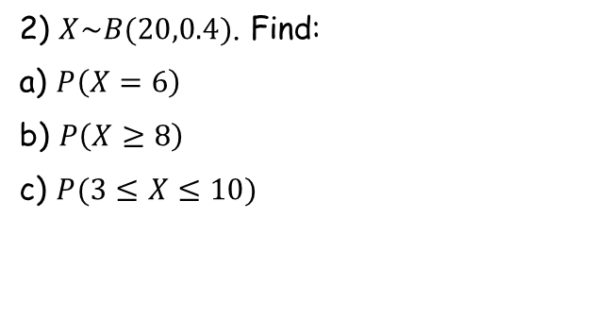
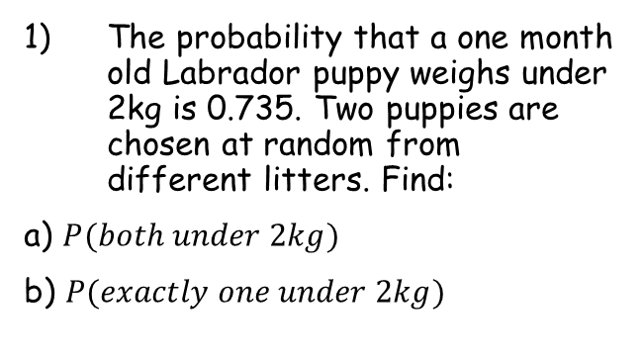
Prior knowledge check
The probability that a one month old Labrador puppy weighs under 2kg is 0.735. Two puppies are chosen at random from different litters. Find:
a) $P(both under 2kg)$
b) $P(exactly one under 2kg)$
3) The probability that a plate made using a particular production process is faulty is given as 0.16. A sample of 20 plates is taken. Find:
The probability that exactly two plates are faulty
The probability that no more than three plates are faulty
0.540
0.211
0.390
0.599
2) $X\sim B(20,0.4)$. Find:
a) $P\left(X=6\right)$
b) $P\left(X≥8\right)$
c) $P(3≤X≤10)$
0.124
0.584
0.869

Slide 3
Teachings for
Exercise 3A

Slide 4




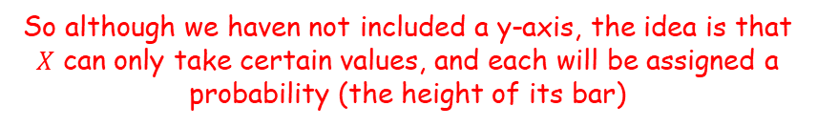
The normal distribution
Let $X=number of heads when 8 coins are thrown$
You need to understand the shape and basic ideas behind the normal distribution
In year 12 you will have encountered discrete random variables
The key numerical point was that these can only take certain values, determined by the context
$$P(x=X)$$
0
1
2
3
4
5
6
7
8
So although we haven not included a y-axis, the idea is that $X$ can only take certain values, and each will be assigned a probability (the height of its bar)
$$P(x≤3)$$
$$P(x=X)$$
$$P(x=4)$$
The probability of getting 4 heads will be equal to the height of this bar
The probability of getting 3 heads or less will be equal to the sum of the heights of these bars
0
1
2
3
4
5
6
7
8
3A

Slide 5
The normal distribution
The distribution of heights as a Histogram
You need to understand the shape and basic ideas behind the normal distribution
The normal distribution focuses on continuous random variables
These can take any numerical value (eg Height), and are modelled using a curve instead
For a quantity such as height, the majority of people will be close to the average
As we move further away from the average height, there are fewer people (ie – there would be a lower probability of randomly selecting one at that height)
130
140
150
160
170
180
If we reduce the classwidths used…
130
140
150
160
170
180
The shape of the Histogram becomes smoother. If we continue indefinitely, we get what is known as the normal distribution curve…
3A

Slide 6


The normal distribution
$$y$$
175cm
You need to understand the shape and basic ideas behind the normal distribution
For example, if we decided to model the heights of adult males in a city…
Imagine that the mean height was 175cm, and the standard deviation was 12cm…
The curve will be split into equal halves either side of 175cm
The area under the curve is used to represent probabilities, with the total area underneath being equal to 1
Area = 0.5
Area = 0.5
$$x$$
140
150
160
170
180
190
200
210
So the probability of a randomly selected person being under 175cm tall is 0.5, based on this data
3A

Slide 7

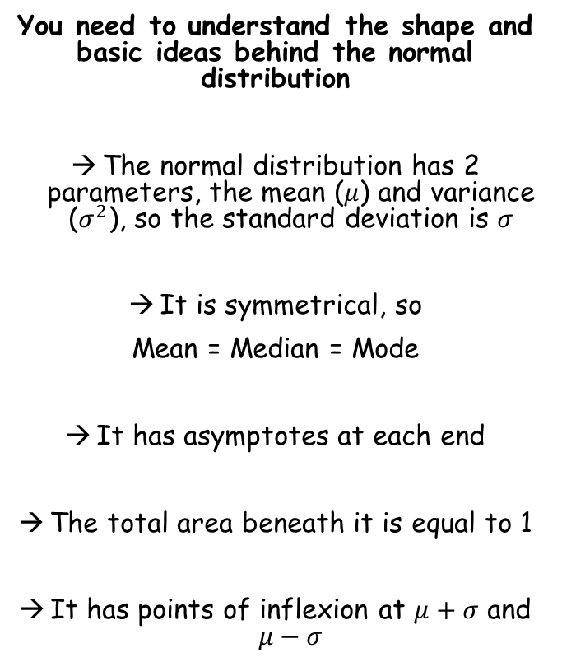


The normal distribution
$$y$$
You need to understand the shape and basic ideas behind the normal distribution
The normal distribution has 2 parameters, the mean ($μ$) and variance ($σ^{2}$), so the standard deviation is $σ$
It is symmetrical, so
Mean = Median = Mode
It has asymptotes at each end
The total area beneath it is equal to 1
It has points of inflexion at $μ+σ$ and $μ−σ$
$$μ−σ$$
$$μ$$
$$μ+σ$$
$$x$$
3A

Slide 8





The normal distribution
$$y$$
$$1−0.68=0.32$$
You need to understand the shape and basic ideas behind the normal distribution
Approximately 68% of the data is within one standard deviation of the mean
Approximately 95% of the data is within 2 standard deviations of the mean
Almost all (99.7%) of the data is within 3 standard deviations of the mean
$$0.32÷2=0.16$$
So what would this area be?
So 16% of the males would have a height less than 163cm
Area = 0.68
Area = 0.16
$$163cm$$
$$175cm$$
$$187cm$$
$$x$$
For example, using the data from before, the height of adult males is being investigated, and we find the mean is 175cm and the standard deviation is 12cm
→ This means the area on the diagram above would be 0.68 (ie – the probability of a randomly chosen male falling into this region would be 68%)
3A

Slide 9


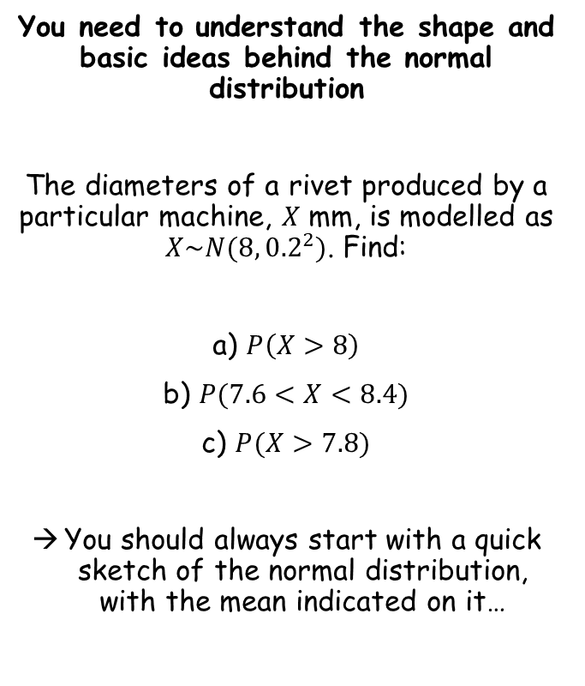
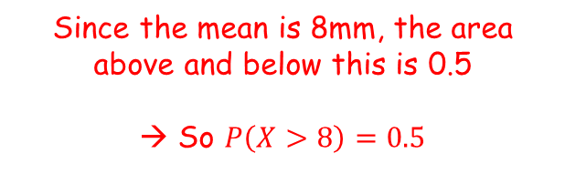


The normal distribution
$$y$$
You need to understand the shape and basic ideas behind the normal distribution
The diameters of a rivet produced by a particular machine, $X$ mm, is modelled as $X\sim N(8,{0.2}^{2})$. Find:
a) $P\left(X>8\right)$
b) $P(7.6<X<8.4)$
c) $P(X>7.8)$
You should always start with a quick sketch of the normal distribution, with the mean indicated on it…
Area = 0.5
Area = 0.5
(normally distributed with a mean of 8mm and a standard deviation of 0.2)
$$8mm$$
$$x$$
$$=0.5$$
Since the mean is 8mm, the area above and below this is 0.5
→ So $P\left(X>8\right)=0.5$
3A

Slide 10





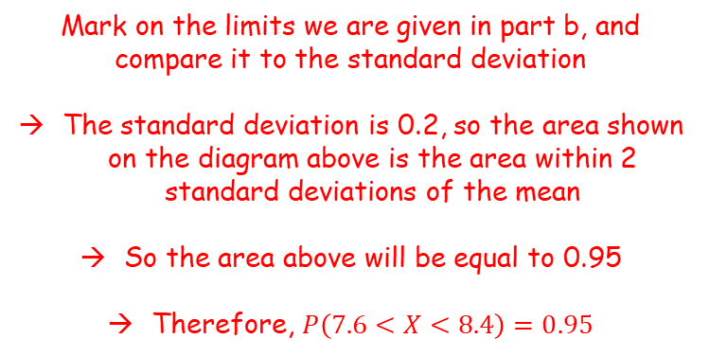
The normal distribution
$$y$$
You need to understand the shape and basic ideas behind the normal distribution
The diameters of a rivet produced by a particular machine, $X$ mm, is modelled as $X\sim N(8,{0.2}^{2})$. Find:
a) $P\left(X>8\right)$
b) $P(7.6<X<8.4)$
c) $P(X>7.8)$
You should always start with a quick sketch of the normal distribution, with the mean indicated on it…
Area = 0.95
$$7.6mm$$
$$8mm$$
$$8.4mm$$
$$x$$
$$=0.5$$
$$0.4$$
$$0.4$$
$$=0.95$$
Mark on the limits we are given in part b, and compare it to the standard deviation
The standard deviation is 0.2, so the area shown on the diagram above is the area within 2 standard deviations of the mean
So the area above will be equal to 0.95
Therefore, $P\left(7.6<X<8.4\right)=0.95$
3A

Slide 11



The normal distribution
$$y$$
You need to understand the shape and basic ideas behind the normal distribution
The diameters of a rivet produced by a particular machine, $X$ mm, is modelled as $X\sim N(8,{0.2}^{2})$. Find:
a) $P\left(X>8\right)$
b) $P(7.6<X<8.4)$
c) $P(X>7.8)$
You should always start with a quick sketch of the normal distribution, with the mean indicated on it…
Area = 0.34
Area = 0.5
$$7.8mm$$
$$8mm$$
$$x$$
$$=0.5$$
$$0.2$$
$$=0.95$$
Mark on the value we are given in part c)
The standard deviation is 0.2, so the area shown on the diagram above is the area within 1 standard deviation of the mean
So the area between 7.8mm and 8mm will be equal to 0.68 ÷ 2 (0.34)
The area above 7.8mm will therefore be equal to 0.34 + 0.5 (0.84)
$$=0.84$$
3A

