Slide 1
Logarithms with non-linear data (14.8)

Slide 2
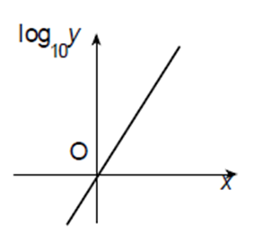
1
The diagram shows the graph of $\log_{10}{(y)}$
plotted against $x$. The graph is a straight
line through the origin with gradient 2.
a) $y=2x$
b) $y={10}^{2x}$
c) $y={10}^{x^{2}}$
d) $y=x^{2}$

Slide 3
2
Given that $y=kn^{x}$ where $k$and $n$ are
constants, what would you plot in order
to get a straight line graph?
a) $x$ against $y$
b) $x$ against $log(y)$
c) $log(x)$ against $y$
d) $log⁡(x)$ against $log⁡(y)$

Slide 4
3
Given that $y=ka^{x}$ where $k$and $a$ are
constants, which of these is the correct
rearrangement to form a straight line?
a) $\log\left(y\right)=klog\left(a\right)x$
b) $\log\left(y\right)=xlog\left(a\right)+log⁡(k)$
c) $\log\left(y\right)=xlog(ka)$
d) $\log\left(y\right)=x+log⁡(k)$

Slide 5
4
A coin increases in value by 20% each year.
If the original cost was £75, write an
expression for in $x$ years time.
a) $0.2×{\left(75\right)}^{x}$
b) $75x^{20}$
c) $75×{\left(0.2\right)}^{x}$
d) $75×{\left(1.2\right)}^{x}$

Slide 6
5
The cost of a car is £25,000. The car
Depreciates by 15% each year.
Write an expression for in $x$ years time.
a) $25,000×{\left(0.15\right)}^{x}$
b) $25,000×{\left(1.85\right)}^{x}$
c) $25,000×{\left(0.85\right)}^{x}$
d) $25,000×{\left(1.15\right)}^{x}$

