Slide 1
Working with natural logarithms (14.7)

Slide 2
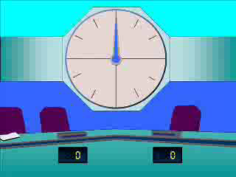
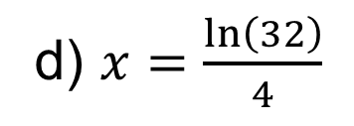
1
Solve the following:
$2e^{2x}=32$
(give your answer in its simplest form).
a) $x=ln⁡(8)$
b) $x=ln⁡(2)$
c) $x=ln⁡(4)$
d) $x=\frac{\ln\left(32\right)}{4}$

Slide 3
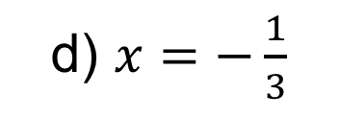
2
Solve the following:
$e^{3x+2}=1$
a) $x=−\frac{2}{3}$
b) $x=−\frac{3}{2}$
c) $x=ln⁡\left(\frac{1}{3}\right)$
d) $x=−\frac{1}{3}$

Slide 4
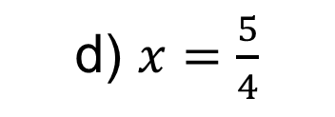
3
Solve the following:
$e^{4−5x}=1$
a) $x=−\frac{4}{5}$
b) $x=\frac{4}{5}$
c) $x=−\frac{5}{4}$
d) $x=\frac{5}{4}$

Slide 5
4
Solve the following:
$\ln\left(2x−5\right)=7$
a) $x=550.8$
b) $x=1099$
c) $x=553.3$
d) $x=545.8$

Slide 6
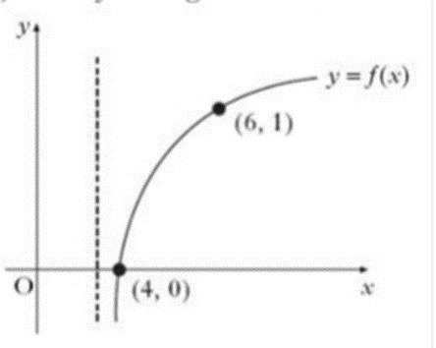
5
The diagram shows the graph of $y=f(x)$,
Where $f$ is a logarithmic function.
What is $f(x)$?
a) $f\left(x\right)=\log_{6}{(x−3)}$
b) $f\left(x\right)=\log_{3}{(x+3)}$
c) $f\left(x\right)=\log_{3}{(x−3)}$
d) $f\left(x\right)=\log_{6}{(x+3)}$

