Slide 1
Solving equations using logarithms (14.6)

Slide 2
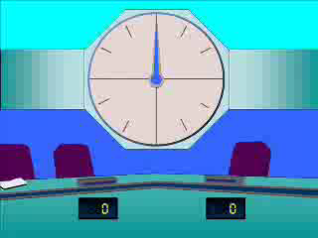
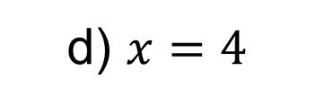
1
Solve the following:
$\log\left(x\right)=3log⁡(2)$.
a) $x=2$
b) $x=6$
c) $x=8$
d) $x=4$

Slide 3
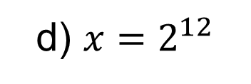
2
Solve the following:
$\log_{2}\left(x\right)−\log_{2}\left(8\right)=9$.
a) $x=2^{−3}$
b) $x=2^{6}$
c) $x=2^{−27}$
d) $x=2^{12}$

Slide 4
3
Solve the following:
$\log_{2}\left(x\right)+\log_{2}\left(4\right)=10$.
a) $x=2^{8}$
b) $x=2^{2}$
c) $x=2^{12}$
d) $x=2^{15}$

Slide 5
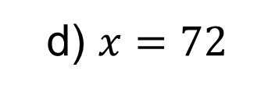
4
Solve the following:
$\log_{4}\left(12\right)−\log_{4}\left(x\right)=\log_{4}{(6)}$.
a) $x=2$
b) $x=6$
c) $x=18$
d) $x=72$

Slide 6
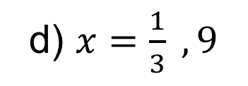
5
Solve the following:
$1+2\log_{3}\left(x\right)=\log_{3}\left(28x−9\right)$.
a) $x=\frac{2}{5}, 5$
b) $x=\frac{1}{3} , 4$
c) $x=\frac{2}{3} , 7$
d) $x=\frac{1}{3} , 9$

Slide 7
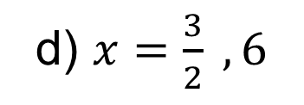
6
Solve the following:
$\log_{2}\left(11−6x\right)=2\log_{2}\left(x−1\right)+3$.
a) $x=−\frac{1}{4} ,\frac{3}{2}$
b) $x=\frac{3}{2}$
c) $x=\frac{1}{4} ,\frac{3}{2}$
d) $x=\frac{3}{2} , 6$

