Slide 1
Laws of logarithms (14.5)

Slide 2
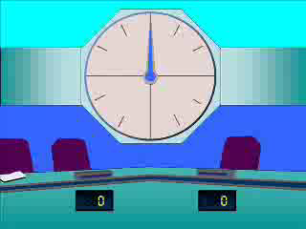
1
Simplify the following:
$3\log\left(2\right)−log⁡(4).$
a) $log⁡(2)$
b) $log⁡(4)$
c) $1$
d) $3$

Slide 3
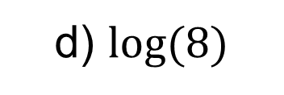
2
Simplify the following:
$\frac{1}{2}\log\left(16\right)+log⁡(2).$
a) $log⁡(16)$
b) $log⁡(6)$
c) $\frac{1}{2}log⁡(32)$
d) $log⁡(8)$

Slide 4
3
Which expression is equivalent to
$\log_{a}\left(12x\right)$?
a) $2\log_{a}{(3x)}$
b) $\log_{a}\left(4x\right)×\log_{a}{(3)}$
c) $\log_{a}\left(3x\right)+\log_{a}{(4)}$
d) No equivalent expression

Slide 5
4
Which expression is equivalent to
$\log_{2}\left(\frac{\sqrt{x}}{y^{5}}\right)$?
a) $\sqrt{\log_{2}{(x)}}−5\log_{2}{(y)}$
b) $2\log_{2}\left(x\right)+5\log_{2}{(y)}$
c) $\frac{1}{2}\log_{2}\left(x\right)−5\log_{2}{(y)}$
d) $2\log_{2}\left(x\right)−5\log_{2}{(y)}$

Slide 6
5
If $\log\left(x\right)=2\log\left(y\right)−3log⁡(z)$, find an
expression for $x$ in terms of $y$ and $z$.
a) $x=2y−3z$
b) $x=\frac{2y}{3z}$
c) $x=\frac{y^{2}}{z^{3}}$
d) $x=2y+\frac{z}{3}$

Slide 7
6
If $\log\left(y\right)=2\log\left(x\right)+log⁡(3)$, find an
expression for $y$ in terms $x$.
a) $y=2x+3$
b) $y=6x$
c) $y=3x^{2}$
d) $y=3×2^{x}$

Slide 8
7
If $\log{(x)}=y\log\left(3\right)+1$, find an
expression for $x$ in terms $y$.
a) $x=10×3^{y}$
b) $x={30}^{10y}$
c) $x=3y+10$
d) $x=y^{3}+10$

