Slide 1
Logarithms (14.4)

Slide 2
1
Calculate $\log_{4}\left(\frac{1}{64}\right).$
a) $3$
b) $\frac{1}{3}$
c) $−\frac{1}{3}$
d) $−3$

Slide 3
2
Calculate $2−\log_{5}\left(\frac{1}{25}\right).$
a) $−3$
b) $4$
c) $\frac{3}{2}$
d) $0$

Slide 4
3
If $\log_{9}\left(x\right)=\frac{1}{4}$ , what is the value of $x$?
a) $\sqrt{3}$
b) $\frac{9}{4}$
c) ${\left(\frac{1}{4}\right)}^{9}$
d) $\frac{3}{2}$

Slide 5
4
If $\log_{x}\left(64\right)=\frac{3}{2}$ , what is the value of $x$?
a) $16$
b) ${42}^{\frac{2}{3}}$
c) $96$
d) $512$

Slide 6
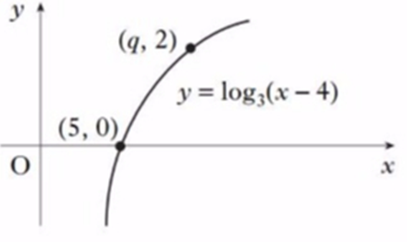
5
The diagram shows part of the graph of
$y=\log_{3}\left(x−4\right)$. The point $(q,2)$ lies on
the graph. What is the value of $q$?
a) $7$
b) $8$
c) $6$
d) $13$

