Slide 1
Teachings for
Exercise 14C

Slide 2





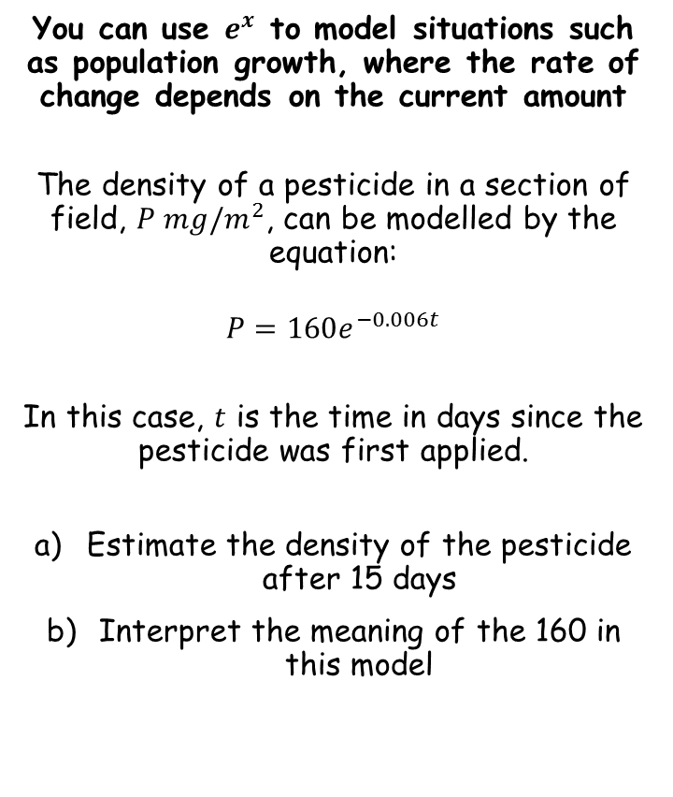


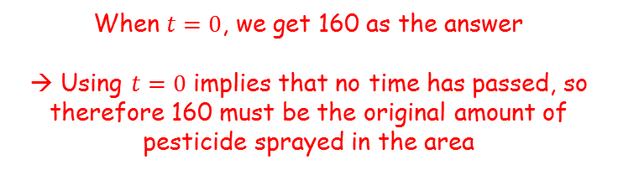






Exponentials and Logarithms
If: $f\left(x\right)=e^{x}$
Then: $f^{′}\left(x\right)=e^{x}$
If: $f\left(x\right)=e^{kx}$
Then: $f^{′}\left(x\right)={ke}^{kx}$
You can use $e^{x}$ to model situations such as population growth, where the rate of change depends on the current amount
The density of a pesticide in a section of field, $P mg/m^{2}$, can be modelled by the equation:
$$P=160e^{−0.006t}$$
In this case, $t$ is the time in days since the pesticide was first applied.
Estimate the density of the pesticide after 15 days
Interpret the meaning of the 160 in this model
$$P=160e^{−0.006t}$$
Sub in $t=15$
$$P=160e^{−0.006(15)}$$
Calculate
$$P=146.2$$
$$P=160e^{−0.006t}$$
Sub in $t=0$
$$P=160e^{−0.006(0)}$$
Calculate
$$P=160$$
$$146.2mg$$
When $t=0$, we get 160 as the answer
→ Using $t=0$ implies that no time has passed, so therefore 160 must be the original amount of pesticide sprayed in the area
14C

Slide 3


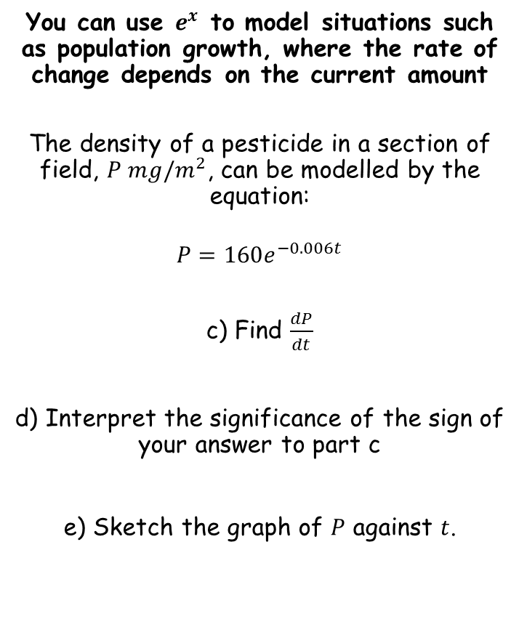
Exponentials and Logarithms
If: $f\left(x\right)=e^{x}$
Then: $f^{′}\left(x\right)=e^{x}$
If: $f\left(x\right)=e^{kx}$
Then: $f^{′}\left(x\right)={ke}^{kx}$
You can use $e^{x}$ to model situations such as population growth, where the rate of change depends on the current amount
The density of a pesticide in a section of field, $P mg/m^{2}$, can be modelled by the equation:
$$P=160e^{−0.006t}$$
c) Find $\frac{dP}{dt}$
d) Interpret the significance of the sign of your answer to part c
e) Sketch the graph of $P$ against $t$.
$$P=160e^{−0.006t}$$
$$\frac{dP}{dt}=−0.96e^{−0.006t}$$
The sign is negative
This means that the gradient function (in this case) is downward sloping
In context, this means that the level of decay of the pesticide is decreasing
160
The original graph is a negative exponential shape!
14C

