Slide 1
$y=e^{x}$ (14.2)

Slide 2
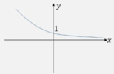
1
Which of these is the correct sketch
for $y=3e^{x}$?
a)
b)
c)
d)

Slide 3
2
Which of these is the correct sketch
for $y=3e^{−x}$?
a)
b)
c)
d)

Slide 4
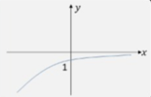
3
Which of these is the correct sketch
for $y=−e^{x}$?
a)
b)
c)
d)

Slide 5
4
$$\frac{d}{dx}(27e^{\frac{1}{3}x})$$
a) $9e^{\frac{1}{3}}$
b) $9e^{\frac{1}{3}x}$
c) $27e^{\frac{1}{3}x}$
d) $9e^{x}$

Slide 6
5
$$\frac{d}{dx}(π^{2}e^{3x})$$
a) $π^{2}e^{3x}$
b) $3xπ^{2}e^{3x}$
c) $3π^{2}e^{3x}+3πe^{3x}$
d) $3π^{2}e^{3x}$

