Slide 1
Exponential functions (14.1)

Slide 2
1
Which of these is the correct sketch
for $y=3^{x}$?
a)
b)
c)
d)

Slide 3
2
Which of these is the correct sketch
for $y=4^{3x}$?
a)
b)
c)
d)

Slide 4
3
Which of these is the correct sketch
for $y={0.2}^{x}$?
a)
b)
c)
d)

Slide 5
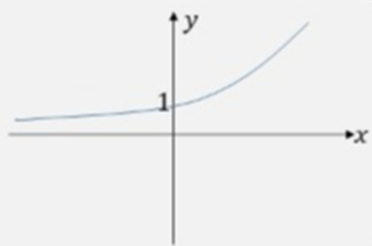
4
Which of these is the correct sketch
for $y=4^{−x}$?
a)
b)
c)
d)

Slide 6
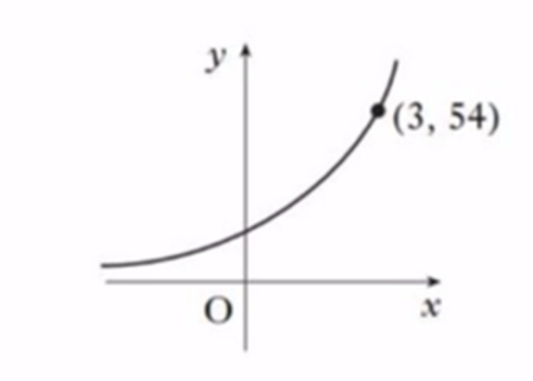
5
The diagrams shows part of the graph
whose equation is of the form $y=2m^{x}$.
What is the value of $m$?
a) $2$
b) $3$
c) $8$
d) $18$

