Slide 1
Areas between curves and lines (13.7)

Slide 2
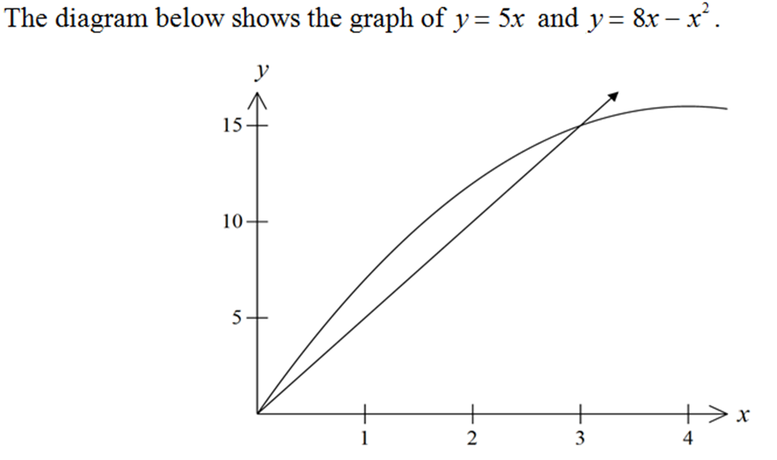
1
Find the area between the two curves.
a) $9.0$
b) $5.5$
c) $4.5$
d) $13.5$

