Slide 1
Areas under the $x$-axis (13.6)

Slide 2
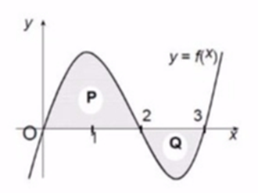
1
In the diagram area $P=5 units^{2}$ and
area $Q=3 units^{2}$. Which of the
following is true about the statements
below?
(1) $\int_{0}^{3}{f\left(x\right) dx=8}$
(2) $\int_{2}^{3}{f\left(x\right) dx=3}$
a) Neither statement is correct
b) Only statement 1 is correct
c) Only statement 2 is correct
d) Both statements are correct

Slide 3
2
Two statements about the numerical
value of the shaded area in
the diagram are shown below. Which of
the following is true?
(1) Shaded area$=\int_{0}^{1}{x dx}$
(2) Shaded area$=\int_{−1}^{1}{x dx}$
a) Neither statement is correct
b) Only statement 1 is correct
c) Only statement 2 is correct
d) Both statements are correct

Slide 4
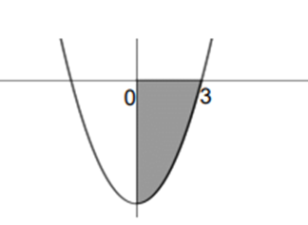
3
The equation of the curve below
is $y=x^{2}−9$. Determine the
area of the shaded region.
a) $−18$
b) $−6$
c) $6$
d) $18$

Slide 5
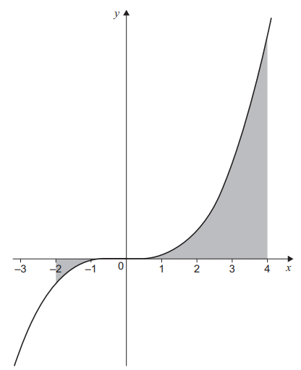
4
The equation of the curve below
is $y=x^{3}$. Determine the
total area of the shaded region.
a) $−68$
b) $60$
c) $68$
d) $128$

Slide 6
5
Calculate the area of the region bounded
by the curve with equation
$y=2x^{2}−6x$ and the $x$-axis.
a) $9$
b) $18$
c) $3$
d) $0$

