Slide 1
Areas under curves (13.5)

Slide 2
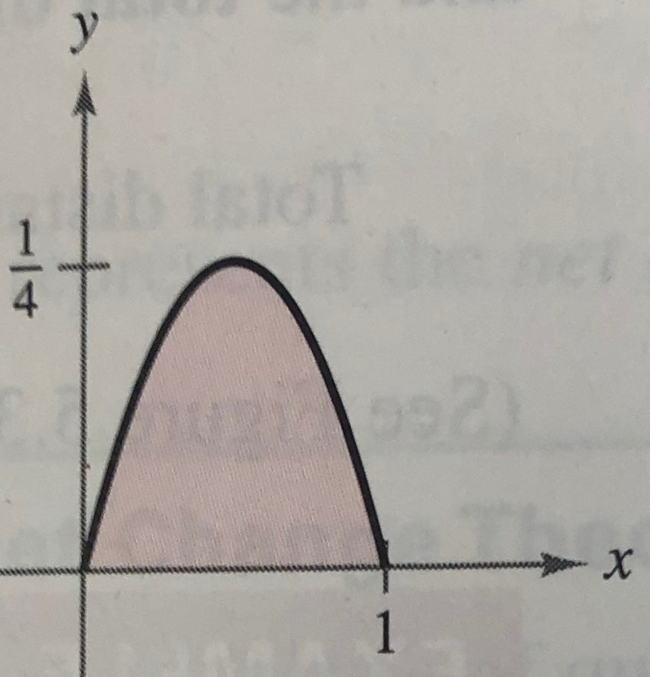
1
The equation of the curve below
is $y=x^{2}−x$. Determine the
area of the given region.
a) $\frac{1}{6}$
b) $\frac{1}{2}$
c) $\frac{1}{7}$
d) $\frac{1}{3}$

Slide 3
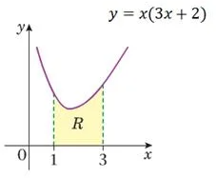
2
The equation of the curve below
is $y=x(3x+2)$. Determine the
area of the given region R.
a) $31$
b) $32$
c) $33$
d) $34$

Slide 4
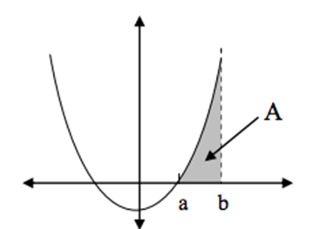
3
The equation of the curve below
is $y=x^{2}−4$. Determine the
area bounded by the curves $y=x^{2}−4$,
$y=0$ and $x=4$.
a) $\frac{56}{3}$
b) $\frac{36}{8}$
c) $\frac{32}{3}$
d) $8$

