Slide 1
Definite integrals (13.4)

Slide 2
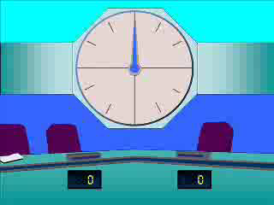
1
$$\int_{−1}^{1}{x^{4} dx}$$
a) $0$
b) $\frac{1}{4}$
c) $\frac{2}{5}$
d) $8$

Slide 3
2
$$\int_{2}^{8}{\frac{1}{\sqrt{x}} dx}$$
a) $\frac{\sqrt{2}}{2}$
b) $2\sqrt{2}$
c) $\frac{7\sqrt{2}}{48}$
d) $−2\sqrt{2}$

Slide 4
3
$$\int_{1}^{2}{(x^{2}−1) dx}$$
a) $−\frac{2}{3}$
b) $0$
c) $\frac{4}{3}$
d) $3$

Slide 5
4
$$\int_{0}^{3}{(3x^{2}+4x) dx}$$
a) $22$
b) $31$
c) $39$
d) $45$

Slide 6
5
$$\int_{0}^{2}{(x^{3}+12) dx}$$
a) $8$
b) $12$
c) $16$
d) $28$

