Slide 1
Finding functions (13.3)

Slide 2
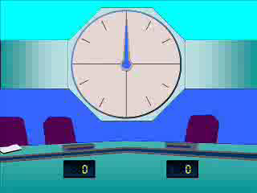
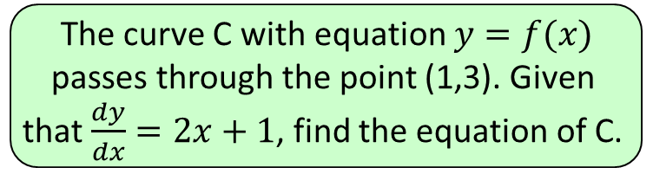




1
The curve C with equation $y=f(x)$
passes through the point (1,3). Given
that $\frac{dy}{dx}=2x+1$, find the equation of C.
a) $y=x^{2}$
b) $y=x^{2}+x+1$
c) $y=2$
d) $y=x^{2}+2$

Slide 3
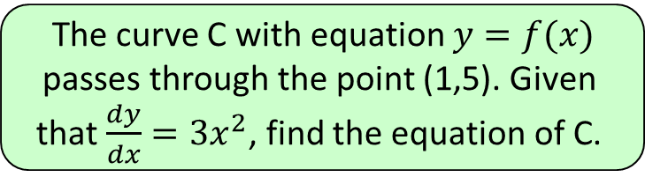
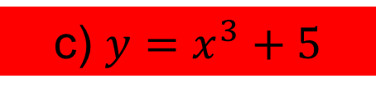
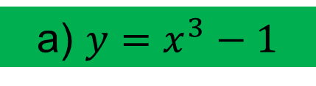
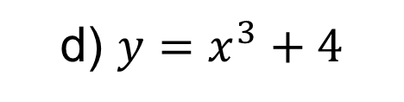
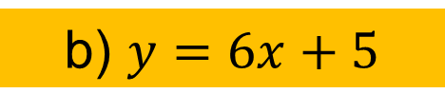
2
The curve C with equation $y=f(x)$
passes through the point (1,5). Given
that $\frac{dy}{dx}=3x^{2}$, find the equation of C.
a) $y=x^{3}−1$
b) $y=6x+5$
c) $y=x^{3}+5$
d) $y=x^{3}+4$

Slide 4





3
The curve C with equation $y=f(x)$
passes through the point (2,3). Given
that $\frac{dy}{dx}=6x^{2}$, find the equation of C.
a) $y=18x^{3}−141$
b) $y=2x^{3}−13$
c) $y=2x^{3}$
d) $y=12x−21$

Slide 5
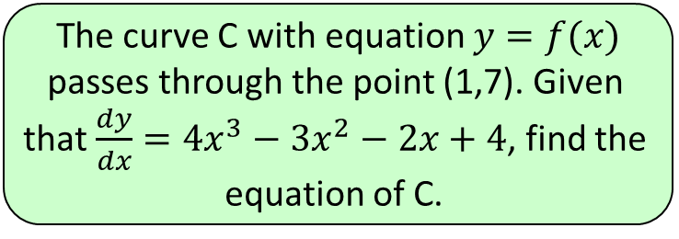

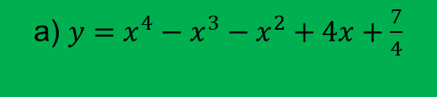


4
The curve C with equation $y=f(x)$
passes through the point (1,7). Given
that $\frac{dy}{dx}=4x^{3}−3x^{2}−2x+4$, find the
equation of C.
a) $y=x^{4}−x^{3}−x^{2}+4x+\frac{7}{4}$
b) $y=x^{4}−x^{3}−x^{2}+4x+2$
c) $y=12x^{4}−6x^{3}−4x^{2}+4x+7$
d) $y=x^{4}−x^{3}−x^{2}+4x+4$

