Slide 1
Indefinite integrals (13.2)

Slide 2
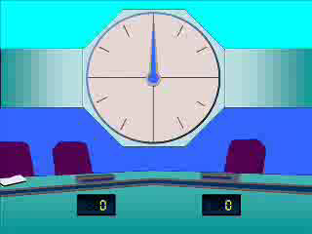
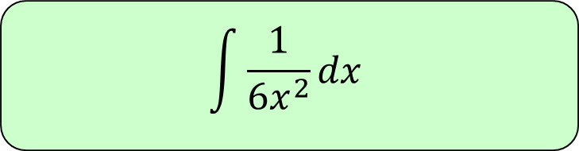
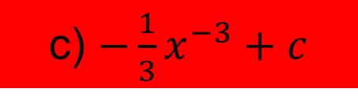
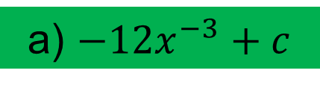
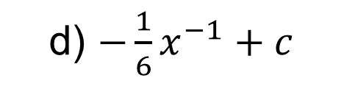
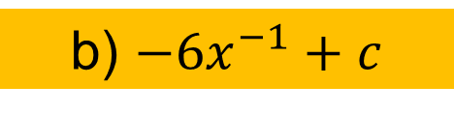
1
$$\int{\frac{1}{6x^{2}}dx}$$
a) $−12x^{−3}+c$
b) $−6x^{−1}+c$
c) $−\frac{1}{3}x^{−3}+c$
d) $−\frac{1}{6}x^{−1}+c$

Slide 3
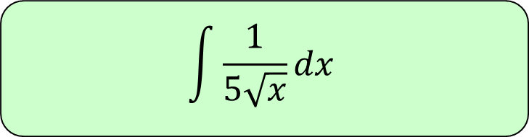
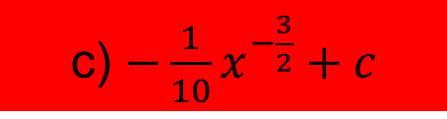



2
$$\int{\frac{1}{5\sqrt{x}}dx}$$
a) $\frac{2}{5}x^{\frac{1}{2}}+c$
b) $\frac{5}{2}x^{\frac{1}{2}}+c$
c) $−\frac{1}{10}x^{−\frac{3}{2}}+c$
d) $\frac{1}{10}x^{−\frac{3}{2}}+c$

Slide 4
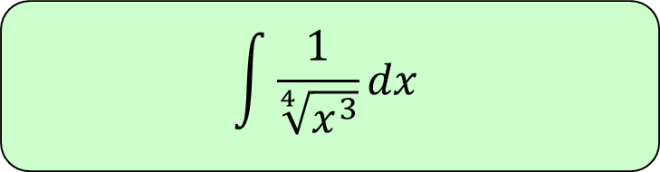
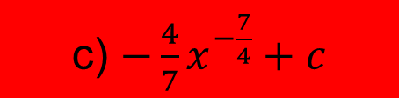



3
$$\int{\frac{1}{\sqrt[4]{x^{3}}}dx}$$
a) $\frac{1}{4}x^{\frac{1}{4}}+c$
b) $4x^{\frac{1}{4}}+c$
c) $−\frac{4}{7}x^{−\frac{7}{4}}+c$
d) $\frac{3}{4}x^{−\frac{7}{4}}+c$

Slide 5
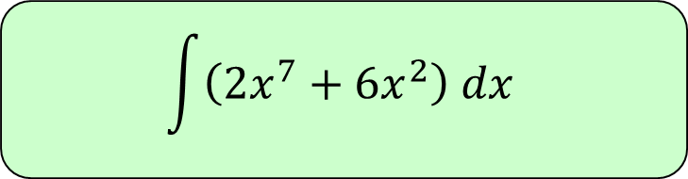
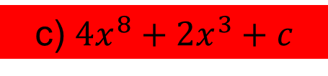
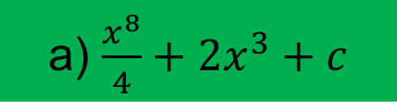
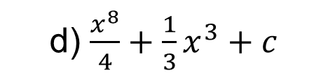
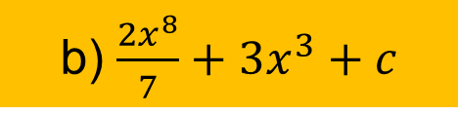
4
$$\int{\left(2x^{7}+6x^{2}\right) dx}$$
a) $\frac{x^{8}}{4}+2x^{3}+c$
b) $\frac{2x^{8}}{7}+3x^{3}+c$
c) $4x^{8}+2x^{3}+c$
d) $\frac{x^{8}}{4}+\frac{1}{3}x^{3}+c$

Slide 6
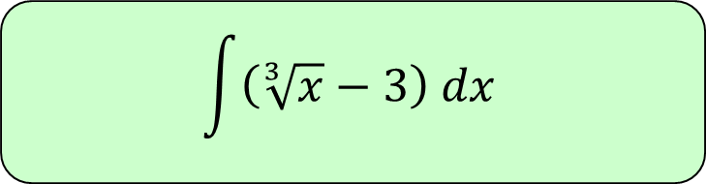
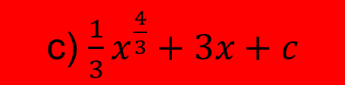
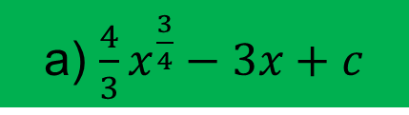
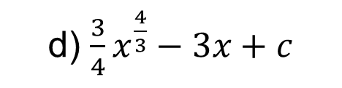
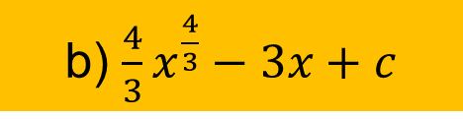
5
$$\int{\left(\sqrt[3]{x}−3\right) dx}$$
a) $\frac{4}{3}x^{\frac{3}{4}}−3x+c$
b) $\frac{4}{3}x^{\frac{4}{3}}−3x+c$
c) $\frac{1}{3}x^{\frac{4}{3}}+3x+c$
d) $\frac{3}{4}x^{\frac{4}{3}}−3x+c$

Slide 7
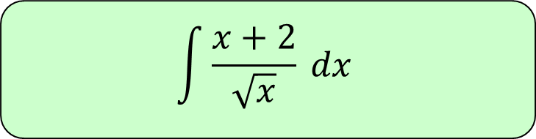
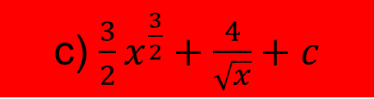
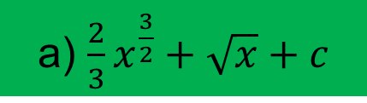
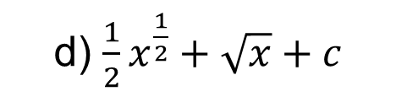
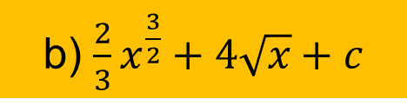
6
$$\int{\frac{x+2}{\sqrt{x}} dx}$$
a) $\frac{2}{3}x^{\frac{3}{2}}+\sqrt{x}+c$
b) $\frac{2}{3}x^{\frac{3}{2}}+4\sqrt{x}+c$
c) $\frac{3}{2}x^{\frac{3}{2}}+\frac{4}{\sqrt{x}}+c$
d) $\frac{1}{2}x^{\frac{1}{2}}+\sqrt{x}+c$

Slide 8
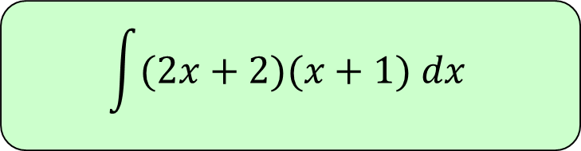




7
$$\int{(2x+2)(x+1) dx}$$
a) $\frac{3}{2}x^{3}−2x^{2}−2x+c$
b) $\frac{2}{3}x^{3}−x^{2}−2x+c$
c) $2x^{2}+4x−2+c$
d) $\frac{2}{3}x^{3}+2x^{2}+2x+c$

