Slide 1
Integrating $x^{n}$ (13.1)

Slide 2
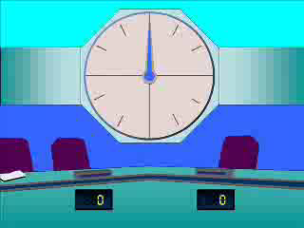
1
$$\int{5x^{2} dx}$$
a) $10x+c$
b) $\frac{5}{2}x^{2}+c$
c) $5x^{3}+c$
d) $\frac{5}{3}x^{3}+c$

Slide 3
2
$$\int{\frac{1}{2}x^{2} dx}$$
a) $\frac{1}{5}x^{3}+c$
b) $2x+c$
c) $\frac{3}{2}x^{3}+c$
d) $\frac{1}{6}x^{3}+c$

Slide 4
3
$$\int{(x^{2}−2x) dx}$$
a) $\frac{x^{3}}{3}−2+c$
b) $\frac{x^{3}}{3}−x^{2}+c$
c) $2x−2+c$
d) $3x^{3}−x^{2}+c$

Slide 5
4
$$\int{(6x^{2}−x^{−2}) dx}$$
a) $18x^{3}−x^{−1}+c$
b) $12x−2x^{−3}+c$
c) $2x^{3}−x^{−1}+c$
d) $2x^{3}−\frac{1}{3}x^{−3}+c$

Slide 6
5
$$\int{(4x^{\frac{1}{2}}+x^{−3}) dx}$$
a) $2x^{−\frac{1}{2}}−3x^{−4}+c$
b) $2x^{−\frac{1}{2}}−\frac{1}{2}x^{−2}+c$
c) $\frac{8}{3}x^{\frac{3}{2}}−\frac{1}{2}x^{−2}+c$
d) $\frac{8}{3}x^{\frac{3}{2}}−\frac{1}{2}x^{−2}+c$

