Slide 1
Teachings for
Exercise 11E

Slide 2

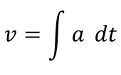

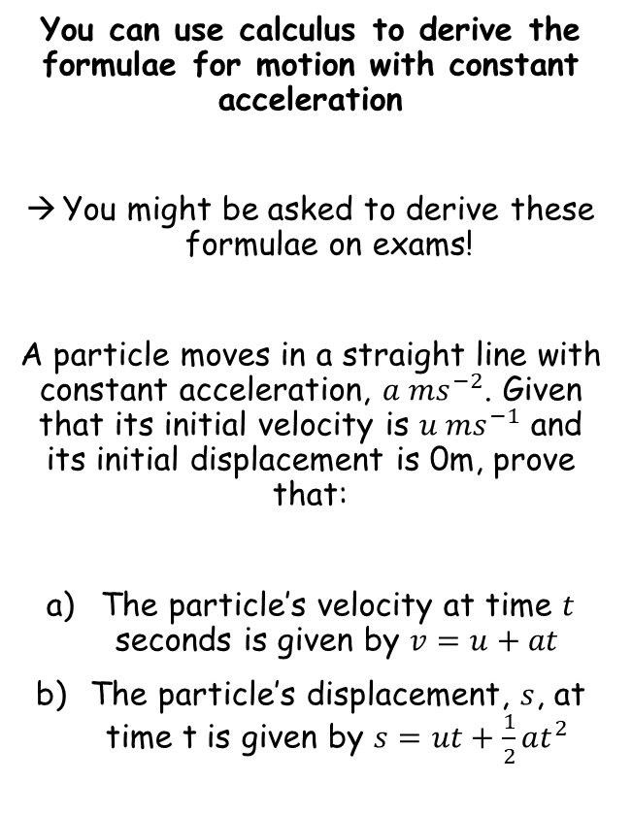



Variable acceleration
You can use calculus to derive the formulae for motion with constant acceleration
You might be asked to derive these formulae on exams!
A particle moves in a straight line with constant acceleration, $a {ms}^{−2}$. Given that its initial velocity is $u {ms}^{−1}$ and its initial displacement is 0m, prove that:
The particle’s velocity at time $t$ seconds is given by $v=u+at$
The particle’s displacement, $s$, at time t is given by $s=ut+\frac{1}{2}at^{2}$
$$v=\int{a} dt$$
Integrate with respect to t
$$v=at+c$$
The velocity at $t=0$is u
$$(u)=a(0)+c$$
Calculate
$$u=c$$
Sub into original relationship
$$v=u+at$$
11E

Slide 3

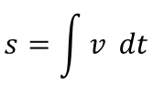



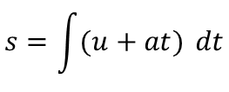

Variable acceleration
You can use calculus to derive the formulae for motion with constant acceleration
You might be asked to derive these formulae on exams!
A particle moves in a straight line with constant acceleration, $a {ms}^{−2}$. Given that its initial velocity is $u {ms}^{−1}$ and its initial displacement is 0m, prove that:
The particle’s velocity at time $t$ seconds is given by $v=u+at$
The particle’s displacement, $s$, at time t is given by $s=ut+\frac{1}{2}at^{2}$
$$s=\int{v} dt$$
We have a relationship for v from a)
$$s=\int{(u+at)} dt$$
Integrate with respect to t
$$s=ut+\frac{{at}^{2}}{2}+c$$
When $t=0$, $s=0$
$$(0)=u(0)+\frac{{a(0)}^{2}}{2}+c$$
Calculate c
$$0=c$$
We can therefore remove c from the formula above!
$$s=ut+\frac{1}{2}{at}^{2}$$
11E

