Slide 1
Teachings for
Exercise 11C

Slide 2



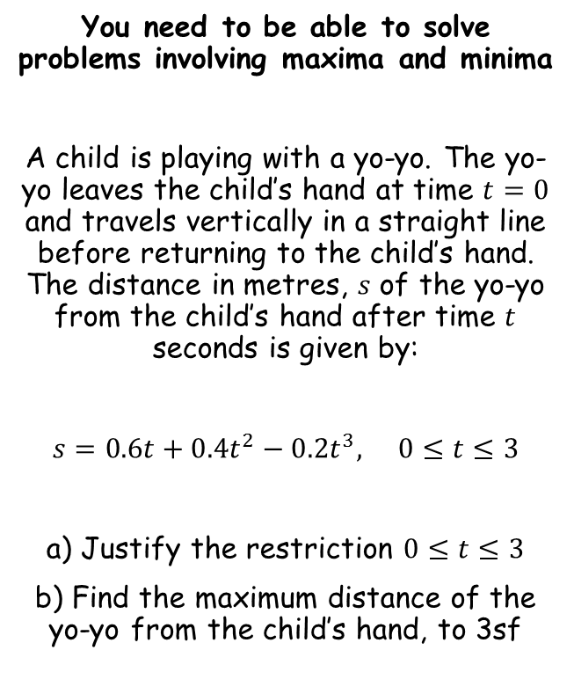



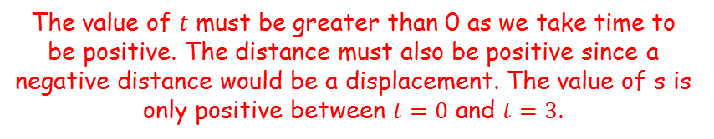
Variable acceleration
$$s=0.6t+0.4t^{2}−0.2t^{3}$$
You need to be able to solve problems involving maxima and minima
A child is playing with a yo-yo. The yo-yo leaves the child’s hand at time $t=0$ and travels vertically in a straight line before returning to the child’s hand. The distance in metres, $s$ of the yo-yo from the child’s hand after time $t$ seconds is given by:
$s=0.6t+0.4t^{2}−0.2t^{3},$ $0≤t≤3$
a) Justify the restriction $0≤t≤3$
b) Find the maximum distance of the yo-yo from the child’s hand, to 3sf
The roots will be where $s=0$
$$0=0.6t+0.4t^{2}−0.2t^{3}$$
Multiply by 5
$$0=3t+2t^{2}−t^{3}$$
Factorise
$$0=t(3+2t−t^{2})$$
Factorise again
$$0=t(3−t)(1+t)$$
s
So the graph will be a negative cubic shape, with roots at -1, 0 and 3
-1
0
3
t
The value of $t$ must be greater than 0 as we take time to be positive. The distance must also be positive since a negative distance would be a displacement. The value of s is only positive between $t=0$ and $t=3$.
Sketch the graph by finding the roots and the y-intercept
11C

Slide 3







Variable acceleration
s
You need to be able to solve problems involving maxima and minima
A child is playing with a yo-yo. The yo-yo leaves the child’s hand at time $t=0$ and travels vertically in a straight line before returning to the child’s hand. The distance in metres, $s$ of the yo-yo from the child’s hand after time $t$ seconds is given by:
$s=0.6t+0.4t^{2}−0.2t^{3},$ $0≤t≤3$
a) Justify the restriction $0≤t≤3$
b) Find the maximum distance of the yo-yo from the child’s hand, to 3sf
-1
0
3
t
The maximum distance will be at the turning point
→ Differentiate and set equal to 0
$$s=0.6t+0.4t^{2}−0.2t^{3}$$
$$\frac{ds}{dt}=0.6+0.8t−0.6t^{2}$$
Differentiate
Set equal to 0
$$0=0.6+0.8t−0.6t^{2}$$
Multiply by 5
$$0=3+4t−3t^{2}$$
Rearrange
$$3t^{2}−4t−3=0$$
Solve using the quadratic formula
$$t=1.868 or −0.5351…$$
Answer is between 0 and 3
$$t=1.868$$
11C

Slide 4



Variable acceleration
s
You need to be able to solve problems involving maxima and minima
A child is playing with a yo-yo. The yo-yo leaves the child’s hand at time $t=0$ and travels vertically in a straight line before returning to the child’s hand. The distance in metres, $s$ of the yo-yo from the child’s hand after time $t$ seconds is given by:
$s=0.6t+0.4t^{2}−0.2t^{3},$ $0≤t≤3$
a) Justify the restriction $0≤t≤3$
b) Find the maximum distance of the yo-yo from the child’s hand, to 3sf
-1
0
3
t
$$t=1.868$$
We can sub this into the original equation to find the maximum distance
→ Use the exact value by pressing the ‘ANS’ button on your calculator
$$s=0.6t+0.4t^{2}−0.2t^{3}$$
Sub in the exact value of t
$$s=0.6(Ans)+0.4{(Ans)}^{2}−0.2{(Ans)}^{3}$$
Calculate
$s=1.21m$ (3sf)
11C

