Slide 1
Mechanics
Variable acceleration
Twitter: @Owen134866
www.mathsfreeresourcelibrary.com

Slide 2
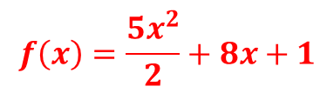
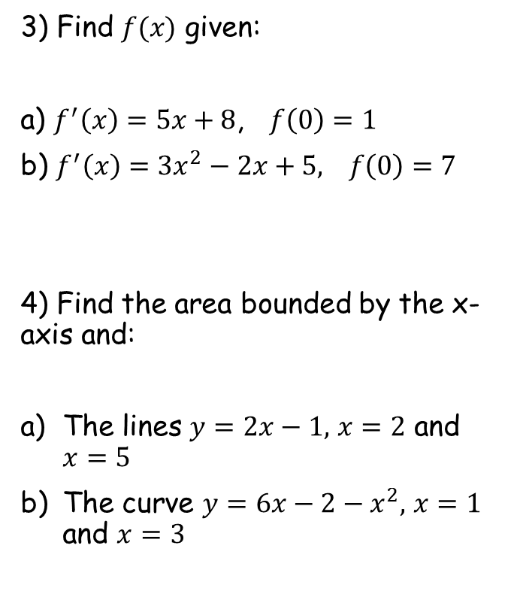

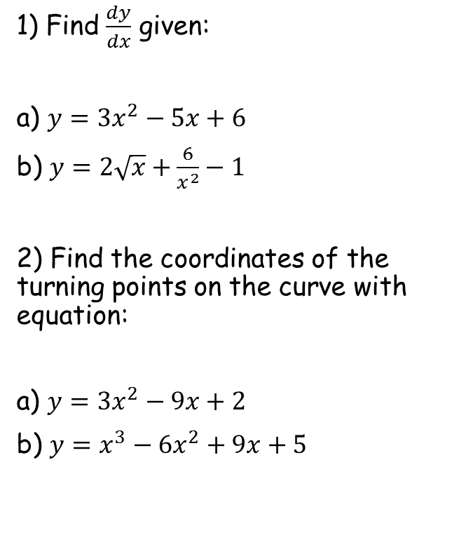






Prior Knowledge Check
1) Find $\frac{dy}{dx}$ given:
a) $y={3x}^{2}−5x+6$
b) $y=2\sqrt{x}+\frac{6}{x^{2}}−1$
2) Find the coordinates of the turning points on the curve with equation:
a) $y={3x}^{2}−9x+2$
b) $y=x^{3}−{6x}^{2}+9x+5$
3) Find $f(x)$ given:
a) $f^{′}\left(x\right)=5x+8$, $f\left(0\right)=1$
b) $f^{′}\left(x\right)={3x}^{2}−2x+5,$ $f\left(0\right)=7$
4) Find the area bounded by the x-axis and:
The lines $y=2x−1,$ $x=2$ and $x=5$
The curve $y=6x−2−x^{2},$ $x=1$ and $x=3$
$$f\left(x\right)=\frac{5x^{2}}{2}+8x+1$$
$$6x−5$$
$$\frac{1}{\sqrt{x}}−\frac{12}{x^{3}}$$
$$f\left(x\right)=x^{3}−x^{2}+5x+7$$
$$(1.5, −4.75)$$
$$18$$
$$\left(1, 9\right) and (3,5)$$
$$11\frac{1}{3}$$

Slide 3
Teachings for
Exercise 11A

Slide 4
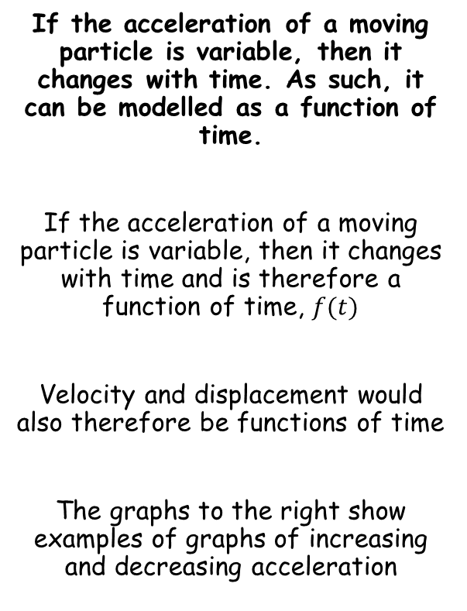
Variable acceleration
If the acceleration of a moving particle is variable, then it changes with time. As such, it can be modelled as a function of time.
If the acceleration of a moving particle is variable, then it changes with time and is therefore a function of time, $f(t)$
Velocity and displacement would also therefore be functions of time
The graphs to the right show examples of graphs of increasing and decreasing acceleration
Velocity
Increasing acceleration
Time
Velocity
Decreasing acceleration
Time
11A

Slide 5

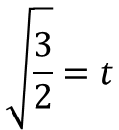



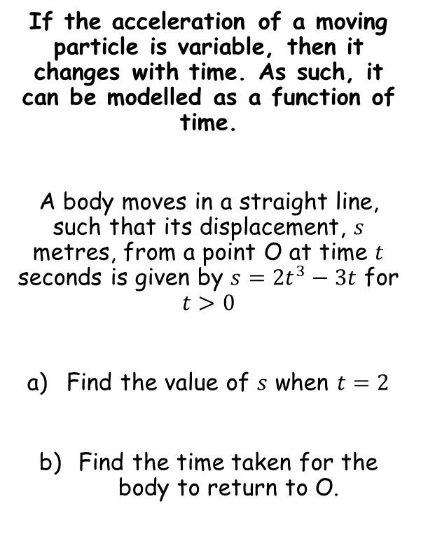



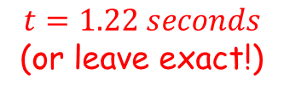




Variable acceleration
If the acceleration of a moving particle is variable, then it changes with time. As such, it can be modelled as a function of time.
A body moves in a straight line, such that its displacement, $s$ metres, from a point O at time $t$ seconds is given by $s={2t}^{3}−3t$ for $t>0$
Find the value of $s$ when $t=2$
Find the time taken for the body to return to O.
$$s={2t}^{3}−3t$$
Sub in $t=2$
$$s={2(2)}^{3}−3(2)$$
Calculate
$$s=10$$
$$s={2t}^{3}−3t$$
At its starting point, s = 0
$$0={2t}^{3}−3t$$
Factorise
$$0=t({2t}^{2}−3)$$
One solution is t = 0
The other will be if the bracket equals 0
$$0={2t}^{2}−3$$
Add 3
$$10 metres$$
$$3={2t}^{2}$$
Divide by 2
$$\frac{3}{2}=t^{2}$$
Square root
→ Note that only the positive answer is valid
$$t=1.22 seconds$$
(or leave exact!)
$$\sqrt{\frac{3}{2}}=t$$
11A

Slide 6



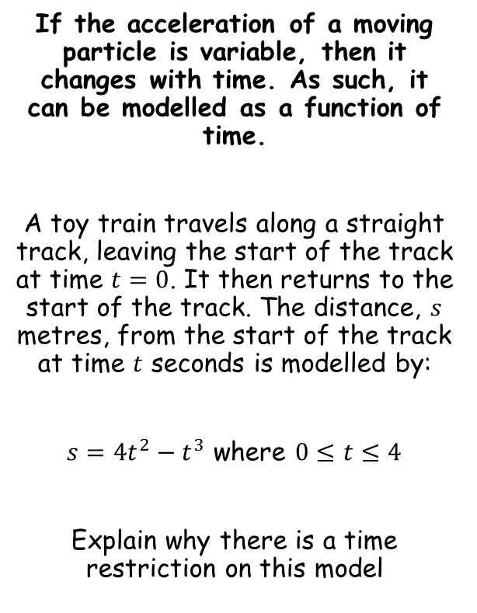



Variable acceleration
If the acceleration of a moving particle is variable, then it changes with time. As such, it can be modelled as a function of time.
A toy train travels along a straight track, leaving the start of the track at time $t=0$. It then returns to the start of the track. The distance, $s$ metres, from the start of the track at time $t$ seconds is modelled by:
$s={4t}^{2}−t^{3}$ where $0≤t≤4$
Explain why there is a time restriction on this model
Since the track is straight, and the train starts from one end, $s≥0$
$$s≥0$$
The function must therefore give an answer greater than 0
$${4t}^{2}−t^{3}≥0$$
Factorise
$$t^{2}\left(4−t\right)≥0$$
As t² is 0 or greater, the bracket must be as well
$$4−t≥0$$
Add t
$$4≥t$$
So t must be less than or equal to 4
The value of t must also start at 0 (negative time does not make sense in this context)
11A

Slide 7



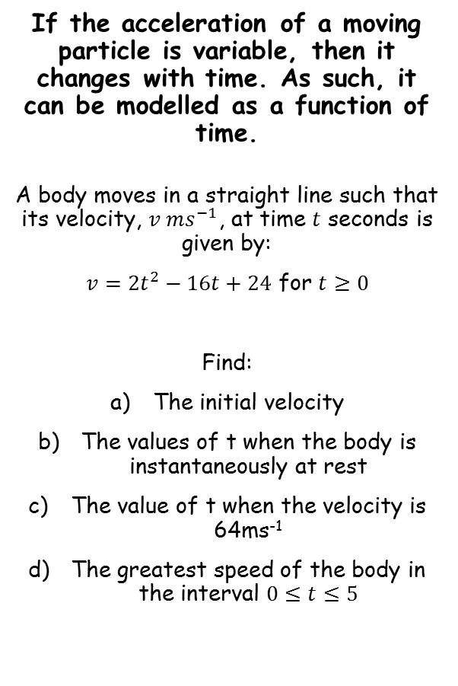






Variable acceleration
If the acceleration of a moving particle is variable, then it changes with time. As such, it can be modelled as a function of time.
A body moves in a straight line such that its velocity, $v ms^{−1}$, at time $t$ seconds is given by:
$v={2t}^{2}−16t+24$ for $t≥0$
Find:
The initial velocity
The values of t when the body is instantaneously at rest
The value of t when the velocity is 64ms⁻¹
The greatest speed of the body in the interval $0≤t≤5$
$$v={2t}^{2}−16t+24$$
Sub in t = 0
$$v={2(0)}^{2}−16(0)+24$$
Calculate
$$v=24$$
$$v={2t}^{2}−16t+24$$
‘At rest’ indicates that v = 0
$$0={2t}^{2}−16t+24$$
Divide by 2
$$0=t^{2}−8t+12$$
$$24{ms}^{−1}$$
Factorise
$$0=(t−6)(t−2)$$
2 or 6 seconds
Calculate values
$t=2$ or $t=6$
11A

Slide 8






Variable acceleration
If the acceleration of a moving particle is variable, then it changes with time. As such, it can be modelled as a function of time.
A body moves in a straight line such that its velocity, $v ms^{−1}$, at time $t$ seconds is given by:
$v={2t}^{2}−16t+24$ for $t≥0$
Find:
The initial velocity
The values of t when the body is instantaneously at rest
The value of t when the velocity is 64ms⁻¹
The greatest speed of the body in the interval $0≤t≤5$
$$v={2t}^{2}−16t+24$$
Velocity = 64
$$64={2t}^{2}−16t+24$$
Subtract 64
$$0={2t}^{2}−16t−40$$
Divide by 2
$$0=t^{2}−8t−20$$
Factorise
$$0=\left(t−10\right)(t+2)$$
-2 cannot be a value of t…
$$t=10 seconds$$
$$24{ms}^{−1}$$
2 or 6 seconds
10 seconds
11A

Slide 9
Variable acceleration
You can use the information calculated already to sketch a graph…
If the acceleration of a moving particle is variable, then it changes with time. As such, it can be modelled as a function of time.
A body moves in a straight line such that its velocity, $v ms^{−1}$, at time $t$ seconds is given by:
$v={2t}^{2}−16t+24$ for $t≥0$
Find:
The initial velocity
The values of t when the body is instantaneously at rest
The value of t when the velocity is 64ms⁻¹
The greatest speed of the body in the interval $0≤t≤5$
v
24
5
2
6
t
$$24{ms}^{−1}$$
2 or 6 seconds
10 seconds
As we are only considering up to t = 5, you can see that the greatest speed will be 24ms⁻¹
11A

