Slide 1
Mechanics
Variable acceleration
Twitter: @Owen134866
www.mathsfreeresourcelibrary.com

Slide 2
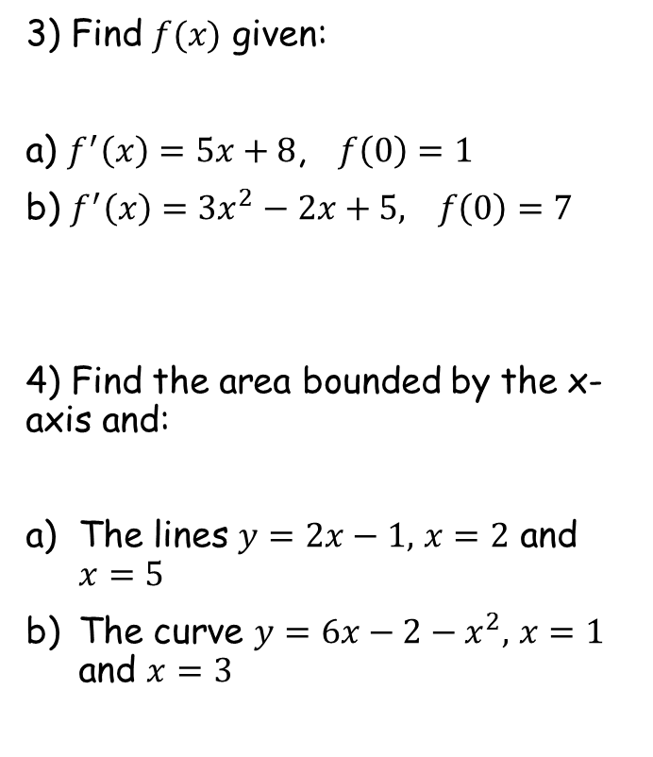

Prior Knowledge Check
1) Find $\frac{dy}{dx}$ given:
a) $y={3x}^{2}−5x+6$
b) $y=2\sqrt{x}+\frac{6}{x^{2}}−1$
2) Find the coordinates of the turning points on the curve with equation:
a) $y={3x}^{2}−9x+2$
b) $y=x^{3}−{6x}^{2}+9x+5$
3) Find $f(x)$ given:
a) $f^{′}\left(x\right)=5x+8$, $f\left(0\right)=1$
b) $f^{′}\left(x\right)={3x}^{2}−2x+5,$ $f\left(0\right)=7$
4) Find the area bounded by the x-axis and:
The lines $y=2x−1,$ $x=2$ and $x=5$
The curve $y=6x−2−x^{2},$ $x=1$ and $x=3$
$$f\left(x\right)=\frac{5x^{2}}{2}+8x+1$$
$$6x−5$$
$$\frac{1}{\sqrt{x}}−\frac{12}{x^{3}}$$
$$f\left(x\right)=x^{3}−x^{2}+5x+7$$
$$(1.5, −4.75)$$
$$18$$
$$\left(1, 9\right) and (3,5)$$
$$11\frac{1}{3}$$

Slide 3
Teachings for
Exercise 11A

Slide 4
Variable acceleration
If the acceleration of a moving particle is variable, then it changes with time. As such, it can be modelled as a function of time.
If the acceleration of a moving particle is variable, then it changes with time and is therefore a function of time, $f(t)$
Velocity and displacement would also therefore be functions of time
The graphs to the right show examples of graphs of increasing and decreasing acceleration
Velocity
Increasing acceleration
Time
Velocity
Decreasing acceleration
Time
11A

Slide 5
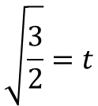
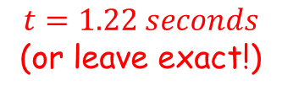
Variable acceleration
If the acceleration of a moving particle is variable, then it changes with time. As such, it can be modelled as a function of time.
A body moves in a straight line, such that its displacement, $s$ metres, from a point O at time $t$ seconds is given by $s={2t}^{3}−3t$ for $t>0$
Find the value of $s$ when $t=2$
Find the time taken for the body to return to O.
$$s={2t}^{3}−3t$$
Sub in $t=2$
$$s={2(2)}^{3}−3(2)$$
Calculate
$$s=10$$
$$s={2t}^{3}−3t$$
At its starting point, s = 0
$$0={2t}^{3}−3t$$
Factorise
$$0=t({2t}^{2}−3)$$
One solution is t = 0
The other will be if the bracket equals 0
$$0={2t}^{2}−3$$
Add 3
$$10 metres$$
$$3={2t}^{2}$$
Divide by 2
$$\frac{3}{2}=t^{2}$$
Square root
→ Note that only the positive answer is valid
$$t=1.22 seconds$$
(or leave exact!)
$$\sqrt{\frac{3}{2}}=t$$
11A

Slide 6
Variable acceleration
If the acceleration of a moving particle is variable, then it changes with time. As such, it can be modelled as a function of time.
A toy train travels along a straight track, leaving the start of the track at time $t=0$. It then returns to the start of the track. The distance, $s$ metres, from the start of the track at time $t$ seconds is modelled by:
$s={4t}^{2}−t^{3}$ where $0≤t≤4$
Explain why there is a time restriction on this model
Since the track is straight, and the train starts from one end, $s≥0$
$$s≥0$$
The function must therefore give an answer greater than 0
$${4t}^{2}−t^{3}≥0$$
Factorise
$$t^{2}\left(4−t\right)≥0$$
As t² is 0 or greater, the bracket must be as well
$$4−t≥0$$
Add t
$$4≥t$$
So t must be less than or equal to 4
The value of t must also start at 0 (negative time does not make sense in this context)
11A

Slide 7
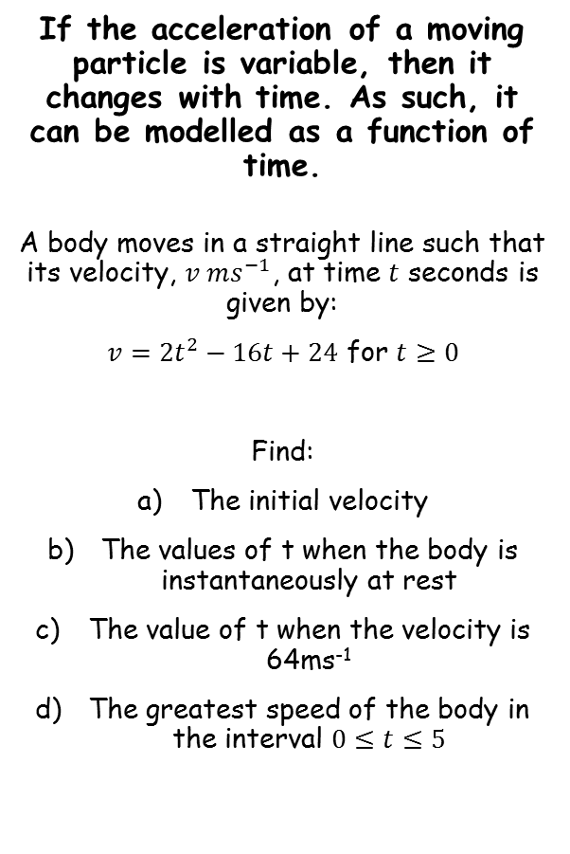
Variable acceleration
If the acceleration of a moving particle is variable, then it changes with time. As such, it can be modelled as a function of time.
A body moves in a straight line such that its velocity, $v ms^{−1}$, at time $t$ seconds is given by:
$v={2t}^{2}−16t+24$ for $t≥0$
Find:
The initial velocity
The values of t when the body is instantaneously at rest
The value of t when the velocity is 64ms⁻¹
The greatest speed of the body in the interval $0≤t≤5$
$$v={2t}^{2}−16t+24$$
Sub in t = 0
$$v={2(0)}^{2}−16(0)+24$$
Calculate
$$v=24$$
$$v={2t}^{2}−16t+24$$
‘At rest’ indicates that v = 0
$$0={2t}^{2}−16t+24$$
Divide by 2
$$0=t^{2}−8t+12$$
$$24{ms}^{−1}$$
Factorise
$$0=(t−6)(t−2)$$
2 or 6 seconds
Calculate values
$t=2$ or $t=6$
11A

Slide 8
Variable acceleration
If the acceleration of a moving particle is variable, then it changes with time. As such, it can be modelled as a function of time.
A body moves in a straight line such that its velocity, $v ms^{−1}$, at time $t$ seconds is given by:
$v={2t}^{2}−16t+24$ for $t≥0$
Find:
The initial velocity
The values of t when the body is instantaneously at rest
The value of t when the velocity is 64ms⁻¹
The greatest speed of the body in the interval $0≤t≤5$
$$v={2t}^{2}−16t+24$$
Velocity = 64
$$64={2t}^{2}−16t+24$$
Subtract 64
$$0={2t}^{2}−16t−40$$
Divide by 2
$$0=t^{2}−8t−20$$
Factorise
$$0=\left(t−10\right)(t+2)$$
-2 cannot be a value of t…
$$t=10 seconds$$
$$24{ms}^{−1}$$
2 or 6 seconds
10 seconds
11A

Slide 9
Variable acceleration
You can use the information calculated already to sketch a graph…
If the acceleration of a moving particle is variable, then it changes with time. As such, it can be modelled as a function of time.
A body moves in a straight line such that its velocity, $v ms^{−1}$, at time $t$ seconds is given by:
$v={2t}^{2}−16t+24$ for $t≥0$
Find:
The initial velocity
The values of t when the body is instantaneously at rest
The value of t when the velocity is 64ms⁻¹
The greatest speed of the body in the interval $0≤t≤5$
v
24
5
2
6
t
$$24{ms}^{−1}$$
2 or 6 seconds
10 seconds
As we are only considering up to t = 5, you can see that the greatest speed will be 24ms⁻¹
11A

Slide 10
Teachings for
Exercise 11B

Slide 11
Variable acceleration
You can use differentiation to solve problems involving variable acceleration
Displacement (x)
The SUVAT equations can be used when acceleration is constant and a particle is moving in a straight line.
If the acceleration of a particle varies, you need to use Calculus
Differentiate
Integrate
Velocity (v)
Differentiate
Integrate
Acceleration (a)
Velocity is the rate of change of displacement with respect to time
→ Therefore, differentiating displacement gives velocity
Acceleration is the rate of change of velocity with respect to time
→ Therefore, differentiating velocity gives acceleration
In reverse, use integration!
11B

Slide 12
Variable acceleration
You can use differentiation to solve problems involving variable acceleration
$$x=t^{4}−32t+12$$
Differentiate x with respect to t
$$\frac{dx}{dt}={4t}^{3}−32$$
Displacement (x)
^{dx}/_{dt} is the velocity
Differentiate
Integrate
Velocity (v)
$$v={4t}^{3}−32$$
Differentiate
Integrate
Acceleration (a)
A particle P is moving along the x-axis. At time t seconds, the displacement x metres from O is given by:
Find:
The speed of P when t = 3
The value of t for which P is instantaneously at rest
The magnitude of acceleration when t = 1.5
$$v={4t}^{3}−32$$
Sub in t = 3
$$v={4(3)}^{3}−32$$
$$x=t^{4}−32t+12$$
Calculate
$$v=76ms^{−1}$$
11B

Slide 13
Variable acceleration
You can use differentiation to solve problems involving variable acceleration
You can use differentiation to solve problems involving variable acceleration
$$x=t^{4}−32t+12$$
$$v={4t}^{3}−32$$
Displacement (x)
If P is instantaneously at rest, it is the time when the velocity is 0
Differentiate
Integrate
Velocity (v)
Differentiate
Integrate
$$v={4t}^{3}−32$$
Acceleration (a)
v = 0
$$0={4t}^{3}−32$$
A particle P is moving along the x-axis. At time t seconds, the displacement x metres from O is given by:
Find:
The speed of P when t = 3 – 76ms⁻¹
The value of t for which P is instantaneously at rest
The magnitude of acceleration when t = 1.5
Add 32
$$32={4t}^{3}$$
Divide by 4
$$x=t^{4}−32t+12$$
$$8=t^{3}$$
Cube root
$$2=t$$
11B

Slide 14
Variable acceleration
You can use differentiation to solve problems involving variable acceleration
You can use differentiation to solve problems involving variable acceleration
$$x=t^{4}−32t+12$$
$$v={4t}^{3}−32$$
Displacement (x)
Differentiate the velocity again to get the acceleration, in terms of t
Differentiate
Integrate
Velocity (v)
Differentiate
Integrate
$$v={4t}^{3}−32$$
Differentiate v with respect to t
Acceleration (a)
$$\frac{dv}{dt}={12t}^{2}$$
A particle P is moving along the x-axis. At time t seconds, the displacement x metres from O is given by:
Find:
The speed of P when t = 3 – 76ms⁻¹
The value of t for which P is instantaneously at rest – 2 seconds
The magnitude of acceleration when t = 1.5
^{dv}/_{dt} is just acceleration
$$a={12t}^{2}$$
$$x=t^{4}−32t+12$$
$$a={12t}^{2}$$
Sub in t = 1.5
$$a={12(1.5)}^{2}$$
Calculate
$$a=27ms^{−2}$$
11B

Slide 15
Teachings for
Exercise 11C

Slide 16
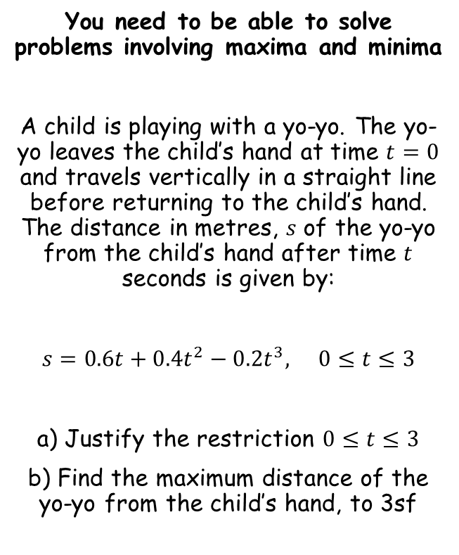
Variable acceleration
$$s=0.6t+0.4t^{2}−0.2t^{3}$$
You need to be able to solve problems involving maxima and minima
A child is playing with a yo-yo. The yo-yo leaves the child’s hand at time $t=0$ and travels vertically in a straight line before returning to the child’s hand. The distance in metres, $s$ of the yo-yo from the child’s hand after time $t$ seconds is given by:
$s=0.6t+0.4t^{2}−0.2t^{3},$ $0≤t≤3$
a) Justify the restriction $0≤t≤3$
b) Find the maximum distance of the yo-yo from the child’s hand, to 3sf
The roots will be where $s=0$
$$0=0.6t+0.4t^{2}−0.2t^{3}$$
Multiply by 5
$$0=3t+2t^{2}−t^{3}$$
Factorise
$$0=t(3+2t−t^{2})$$
Factorise again
$$0=t(3−t)(1+t)$$
s
So the graph will be a negative cubic shape, with roots at -1, 0 and 3
-1
0
3
t
The value of $t$ must be greater than 0 as we take time to be positive. The distance must also be positive since a negative distance would be a displacement. The value of s is only positive between $t=0$ and $t=3$.
Sketch the graph by finding the roots and the y-intercept
11C

Slide 17
Variable acceleration
s
You need to be able to solve problems involving maxima and minima
A child is playing with a yo-yo. The yo-yo leaves the child’s hand at time $t=0$ and travels vertically in a straight line before returning to the child’s hand. The distance in metres, $s$ of the yo-yo from the child’s hand after time $t$ seconds is given by:
$s=0.6t+0.4t^{2}−0.2t^{3},$ $0≤t≤3$
a) Justify the restriction $0≤t≤3$
b) Find the maximum distance of the yo-yo from the child’s hand, to 3sf
-1
0
3
t
The maximum distance will be at the turning point
→ Differentiate and set equal to 0
$$s=0.6t+0.4t^{2}−0.2t^{3}$$
$$\frac{ds}{dt}=0.6+0.8t−0.6t^{2}$$
Differentiate
Set equal to 0
$$0=0.6+0.8t−0.6t^{2}$$
Multiply by 5
$$0=3+4t−3t^{2}$$
Rearrange
$$3t^{2}−4t−3=0$$
Solve using the quadratic formula
$$t=1.868 or −0.5351…$$
Answer is between 0 and 3
$$t=1.868$$
11C

Slide 18
Variable acceleration
s
You need to be able to solve problems involving maxima and minima
A child is playing with a yo-yo. The yo-yo leaves the child’s hand at time $t=0$ and travels vertically in a straight line before returning to the child’s hand. The distance in metres, $s$ of the yo-yo from the child’s hand after time $t$ seconds is given by:
$s=0.6t+0.4t^{2}−0.2t^{3},$ $0≤t≤3$
a) Justify the restriction $0≤t≤3$
b) Find the maximum distance of the yo-yo from the child’s hand, to 3sf
-1
0
3
t
$$t=1.868$$
We can sub this into the original equation to find the maximum distance
→ Use the exact value by pressing the ‘ANS’ button on your calculator
$$s=0.6t+0.4t^{2}−0.2t^{3}$$
Sub in the exact value of t
$$s=0.6(Ans)+0.4{(Ans)}^{2}−0.2{(Ans)}^{3}$$
Calculate
$s=1.21m$ (3sf)
11C

Slide 19
Teachings for
Exercise 11D

Slide 20
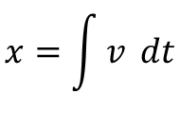
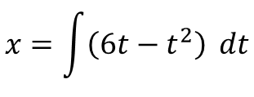
Variable acceleration
$$x=\int{v} dt$$
Integration can also be used in these types of problem, since it is just the reverse of differentiation
A particle is moving on the x-axis. At time $t=0$, the particle is at the point where $x=5$. The velocity of the particle at time t seconds ($t≥0$) is $\left(6t−t^{2}\right) ms^{−1}$. Find:
An expression for the displacement of the particle from O at time t seconds
The distance of the particle from its starting point when $t=6$
We have an expression for v in terms of t
$$x=\int{\left(6t−t^{2}\right)} dt$$
Displacement (x)
Integrate – remember +c!
Differentiate
Integrate
$$x={3t}^{2}−\frac{t^{3}}{3}+c$$
Velocity (v)
Use the information in the question to calculate c
Differentiate
Integrate
Acceleration (a)
$$5={3(0)}^{2}−\frac{{(0)}^{3}}{3}+c$$
Calculate
$$5=c$$
Put this into the formula we have
$$x={3t}^{2}−\frac{t^{3}}{3}+5$$
11D

Slide 21
Variable acceleration
Integration can also be used in these types of problem, since it is just the reverse of differentiation
A particle is moving on the x-axis. At time $t=0$, the particle is at the point where $x=5$. The velocity of the particle at time t seconds ($t≥0$) is $\left(6t−t^{2}\right) ms^{−1}$. Find:
An expression for the displacement of the particle from O at time t seconds
The distance of the particle from its starting point when $t=6$
$$x={3t}^{2}−\frac{t^{3}}{3}+5$$
Sub in t = 6
$$x={3(6)}^{2}−\frac{{(6)}^{3}}{3}+5$$
Displacement (x)
Differentiate
Integrate
Calculate
Velocity (v)
$$x=41$$
Differentiate
Integrate
Acceleration (a)
This means that after 6 seconds, the particle is 41 metres from O
Note that it started 5 metres from O, so it is therefore 36m from its starting point
Read questions carefully!
11D

Slide 22
Variable acceleration
v
Integration can also be used in these types of problem, since it is just the reverse of differentiation
A particle travels in a straight line. After $t$ seconds its velocity, ${v ms}^{−1}$, is given by $v=5−3t^{2}, t≥0$. Find the distance travelled by the particle in the third second of its motion.
→ A sketch of the graph can help make the process clear!
5
1.29
t
Displacement (x)
Differentiate
Integrate
Velocity (v)
Differentiate
Integrate
Acceleration (a)
$$v=5−{3t}^{2}$$
It is a negative quadratic, with a v-intercept of 5
→ The roots will be when v = 0
$$0=5−{3t}^{2}$$
Add 3t²
$${3t}^{2}=5$$
$$t^{2}=\frac{5}{3}$$
Divide by 3
Square root
$$t=±1.29…$$
11D

Slide 23
Variable acceleration
v
2
3
Integration can also be used in these types of problem, since it is just the reverse of differentiation
A particle travels in a straight line. After $t$ seconds its velocity, ${v ms}^{−1}$, is given by $v=5−3t^{2}, t≥0$. Find the distance travelled by the particle in the third second of its motion.
First second = 0-1
Second second = 1-2
Third second = 2-3
5
1.29
t
Displacement (x)
Differentiate
Integrate
Velocity (v)
Differentiate
Integrate
Acceleration (a)
Remember that the area ‘under’ a velocity-time curve is equal to the distance travelled
→ So we need to integrate the function between the limits of 2 and 3…
11D

Slide 24
Variable acceleration
v
2
3
Integration can also be used in these types of problem, since it is just the reverse of differentiation
A particle travels in a straight line. After $t$ seconds its velocity, ${v ms}^{−1}$, is given by $v=5−3t^{2}, t≥0$. Find the distance travelled by the particle in the third second of its motion.
First second = 0-1
Second second = 1-2
Third second = 2-3
5
1.29
t
Displacement (x)
Differentiate
Integrate
Velocity (v)
Differentiate
Integrate
Acceleration (a)
$$s=\int_{2}^{3}{\left(5−{3t}^{2}\right) dt}$$
Integrate and use a square bracket
$$={\left[5t−t^{3}\right]}_{2}^{3}$$
Sub in limits and subtract
$$=\left(5\left(3\right)−{\left(3\right)}^{3}\right)−\left(5\left(2\right)−{\left(2\right)}^{3}\right)$$
Calculate
$$=−14$$
We want the positive value
$$=14$$
11D

Slide 25
Variable acceleration
v
2
3
Integration can also be used in these types of problem, since it is just the reverse of differentiation
A particle travels in a straight line. After $t$ seconds its velocity, ${v ms}^{−1}$, is given by $v=5−3t^{2}, t≥0$. Find the distance travelled by the particle in the third second of its motion.
First second = 0-1
Second second = 1-2
Third second = 2-3
5
1.29
t
Displacement (x)
Differentiate
Integrate
Velocity (v)
Differentiate
Integrate
Acceleration (a)
Be very careful on this type of question – if part of the area is above and part is below the x-axis, you will need to integrate each part separately!
11D

Slide 26
Teachings for
Exercise 11E

Slide 27
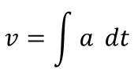
Variable acceleration
You can use calculus to derive the formulae for motion with constant acceleration
You might be asked to derive these formulae on exams!
A particle moves in a straight line with constant acceleration, $a {ms}^{−2}$. Given that its initial velocity is $u {ms}^{−1}$ and its initial displacement is 0m, prove that:
The particle’s velocity at time $t$ seconds is given by $v=u+at$
The particle’s displacement, $s$, at time t is given by $s=ut+\frac{1}{2}at^{2}$
$$v=\int{a} dt$$
Integrate with respect to t
$$v=at+c$$
The velocity at $t=0$is u
$$(u)=a(0)+c$$
Calculate
$$u=c$$
Sub into original relationship
$$v=u+at$$
11E

Slide 28
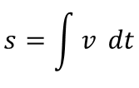
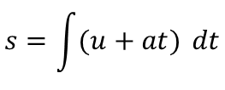
Variable acceleration
You can use calculus to derive the formulae for motion with constant acceleration
You might be asked to derive these formulae on exams!
A particle moves in a straight line with constant acceleration, $a {ms}^{−2}$. Given that its initial velocity is $u {ms}^{−1}$ and its initial displacement is 0m, prove that:
The particle’s velocity at time $t$ seconds is given by $v=u+at$
The particle’s displacement, $s$, at time t is given by $s=ut+\frac{1}{2}at^{2}$
$$s=\int{v} dt$$
We have a relationship for v from a)
$$s=\int{(u+at)} dt$$
Integrate with respect to t
$$s=ut+\frac{{at}^{2}}{2}+c$$
When $t=0$, $s=0$
$$(0)=u(0)+\frac{{a(0)}^{2}}{2}+c$$
Calculate c
$$0=c$$
We can therefore remove c from the formula above!
$$s=ut+\frac{1}{2}{at}^{2}$$
11E

