Slide 1
Teachings For
Exercise 10D

Slide 2








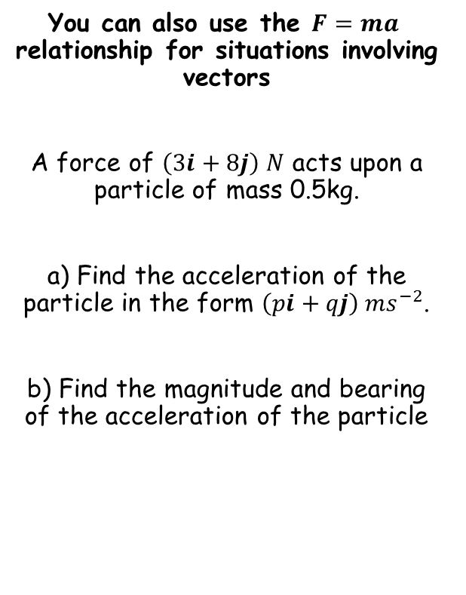











Forces and motion
$$F=ma$$
You can also use the $F=ma$ relationship for situations involving vectors
A force of $\left(3i+8j\right) N$ acts upon a particle of mass 0.5kg.
a) Find the acceleration of the particle in the form $\left(pi+qj\right) {ms}^{−2}$.
b) Find the magnitude and bearing of the acceleration of the particle
$$F=ma$$
Sub in values
$$\left(3i+8j\right)=0.5a$$
Multiply by 2
$$\left(6i+16j\right)=a$$
Draw a diagram
$$N$$
$$\left|a\right|=\sqrt{{\left(6\right)}^{2}+{\left(16\right)}^{2}}$$
$$\left(6i+16j\right) {ms}^{−2}$$
$$\left|a\right|=17.1 ms^{−2}$$
$$a$$
$$16j$$
$$Tanθ=\frac{16}{6}$$
$$\left|a\right|=17.1 ms^{−2}$$
$$Bearing=020.6^{°}$$
$$θ=69.4^{°}$$
$$69.4^{°}$$
$$θ$$
$$6i$$
$$Bearing=90^{°}−69.4^{°}$$
$$=020.6^{°}$$
10D

Slide 3


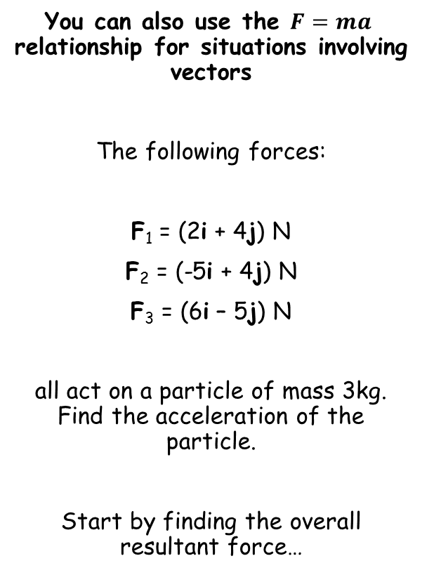





Forces and motion
$$F=ma$$
$$Resultant Force$$
You can also use the $F=ma$ relationship for situations involving vectors
The following forces:
F₁ = (2i + 4j) N
F₂ = (-5i + 4j) N
F₃ = (6i – 5j) N
all act on a particle of mass 3kg. Find the acceleration of the particle.
Start by finding the overall resultant force…
$$=F_{1}+F_{2}+F_{3}$$
Sub in values
$$=\left(2i+4j\right)+\left(−5i+4j\right)+(6i−5j)$$
Group up
$$=\left(3i+3j\right)$$
$$F=ma$$
Sub in the resultant force, and the mass
$$(3i+3j)=3a$$
Divide by 3
$$i+j=a$$
The acceleration is (i + j) ms⁻²
10D

Slide 4
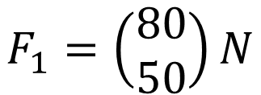
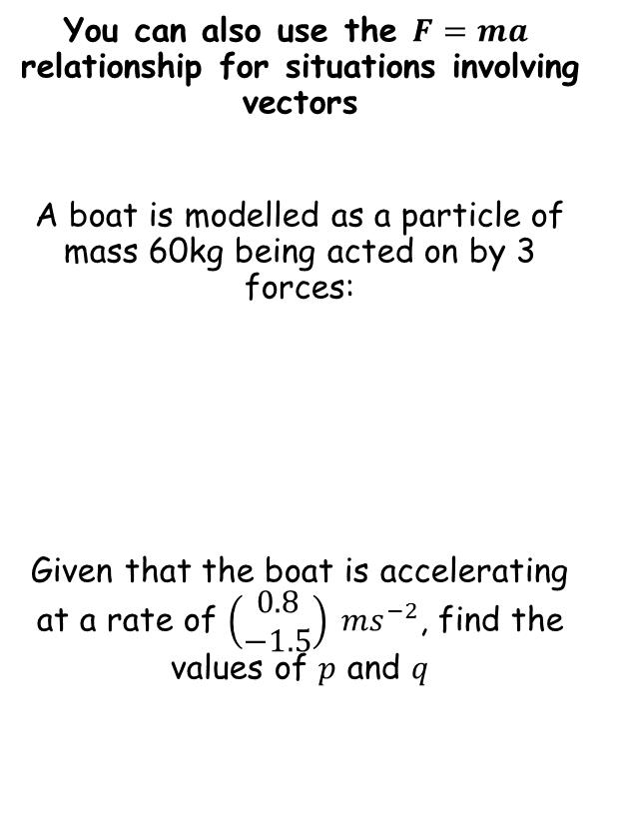



Forces and motion
$$F=ma$$
You can also use the $F=ma$ relationship for situations involving vectors
A boat is modelled as a particle of mass 60kg being acted on by 3 forces:
Given that the boat is accelerating at a rate of $\left(\begin{matrix}0.8 \\ −1.5\end{matrix}\right) {ms}^{−2}$, find the values of $p$ and $q$
In vector form, the top number represents movement/forces in the i direction
$$F_{1}=\left(\begin{matrix}80 \\ 50\end{matrix}\right)N$$
$$F_{1}=\left(\begin{matrix}80 \\ 50\end{matrix}\right)N$$
$$F_{2}=\left(\begin{matrix}10p \\ 20q\end{matrix}\right)N$$
$$F_{3}=\left(\begin{matrix}−75 \\ 100\end{matrix}\right)N$$
In vector form, the bottom number represents movement/forces in the j direction
10D

Slide 5


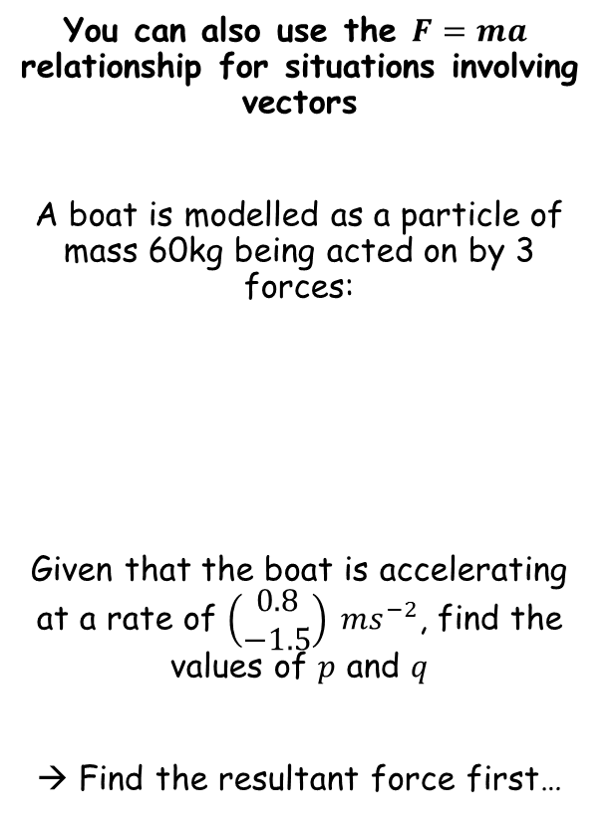


Forces and motion
$$F=ma$$
You can also use the $F=ma$ relationship for situations involving vectors
A boat is modelled as a particle of mass 60kg being acted on by 3 forces:
Given that the boat is accelerating at a rate of $\left(\begin{matrix}0.8 \\ −1.5\end{matrix}\right) {ms}^{−2}$, find the values of $p$ and $q$
→ Find the resultant force first…
$$Resultant Force$$
$$=F_{1}+F_{2}+F_{3}$$
Sub in values
$$=\left(\begin{matrix}80 \\ 50\end{matrix}\right)+\left(\begin{matrix}10p \\ 20q\end{matrix}\right)+\left(\begin{matrix}−75 \\ 100\end{matrix}\right)$$
Group up
$$=\left(\begin{matrix}10p+5 \\ 20q+150\end{matrix}\right)N$$
$$F_{1}=\left(\begin{matrix}80 \\ 50\end{matrix}\right)N$$
$$F_{2}=\left(\begin{matrix}10p \\ 20q\end{matrix}\right)N$$
$$F_{3}=\left(\begin{matrix}−75 \\ 100\end{matrix}\right)N$$
10D

Slide 6
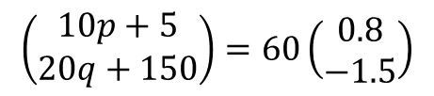







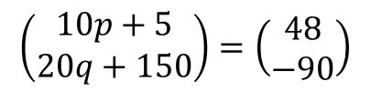

Forces and motion
$$F=ma$$
You can also use the $F=ma$ relationship for situations involving vectors
A boat is modelled as a particle of mass 60kg being acted on by 3 forces:
Given that the boat is accelerating at a rate of $\left(\begin{matrix}0.8 \\ −1.5\end{matrix}\right) {ms}^{−2}$, find the values of $p$ and $q$
→ Find the resultant force first…
$$F=ma$$
$$\left(\begin{matrix}10p+5 \\ 20q+150\end{matrix}\right)=60\left(\begin{matrix}0.8 \\ −1.5\end{matrix}\right)$$
Sub in values
Multiply the second vector
$$\left(\begin{matrix}10p+5 \\ 20q+150\end{matrix}\right)=\left(\begin{matrix}48 \\ −90\end{matrix}\right)$$
$$F_{1}=\left(\begin{matrix}80 \\ 50\end{matrix}\right)N$$
$$F_{2}=\left(\begin{matrix}10p \\ 20q\end{matrix}\right)N$$
Solve the top for p
Solve the bottom for q
$$F_{3}=\left(\begin{matrix}−75 \\ 100\end{matrix}\right)N$$
$$10p+5=48$$
$$20q+150=−90$$
$$10p=43$$
$$20q=−240$$
$$p=4.3$$
$$q=−12$$
$$\left(\begin{matrix}10p+5 \\ 20q+150\end{matrix}\right)N$$
10D

Slide 7






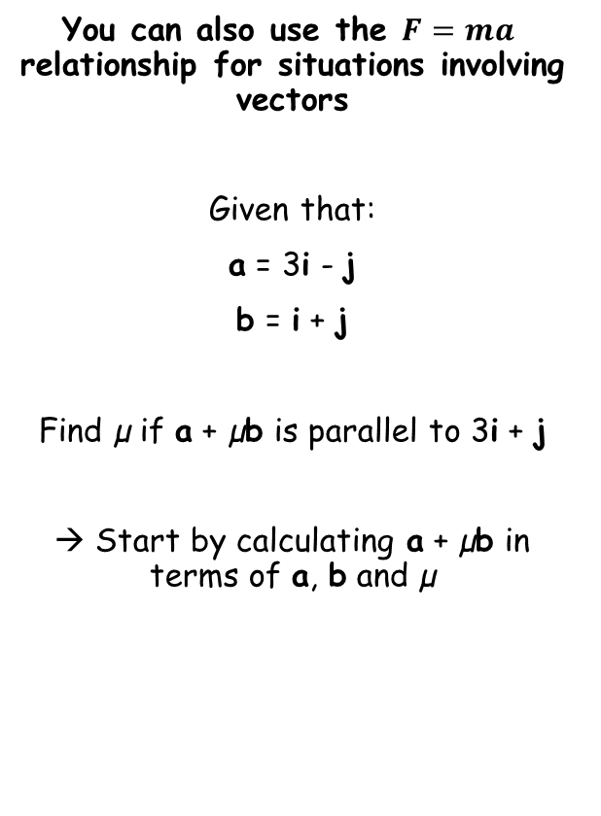









Forces and motion
$$F=ma$$
You can also use the $F=ma$ relationship for situations involving vectors
Given that:
a = 3i - j
b = i + j
Find µ if a + µb is parallel to 3i + j
→ Start by calculating a + µb in terms of a, b and µ
$$a+μb =$$
$$(3i−j)+μ(i+j)$$
Multiply out the brackets
$$= 3i−j+μi+μj$$
Move the i and j terms together
$$= 3i+μi−j+μj$$
Factorise the terms in i and j
$$= \left(3+μ\right)i$$
$$+ \left(−1+μ\right)j$$
As the vector must be parallel to 3i + j, the i term must be 3 times the j term!
$$3+μ =$$
$$3(−1+μ)$$
Multiply out the bracket
$$3+μ =$$
$$−3+3μ$$
Subtract µ, and add 3
$$6=$$
$$2μ$$
$$μ=3$$
$$3=$$
$$μ$$
Divide by 2
10D

