Slide 1
Mechanics
Forces and motion
Twitter: @Owen134866
www.mathsfreeresourcelibrary.com

Slide 2



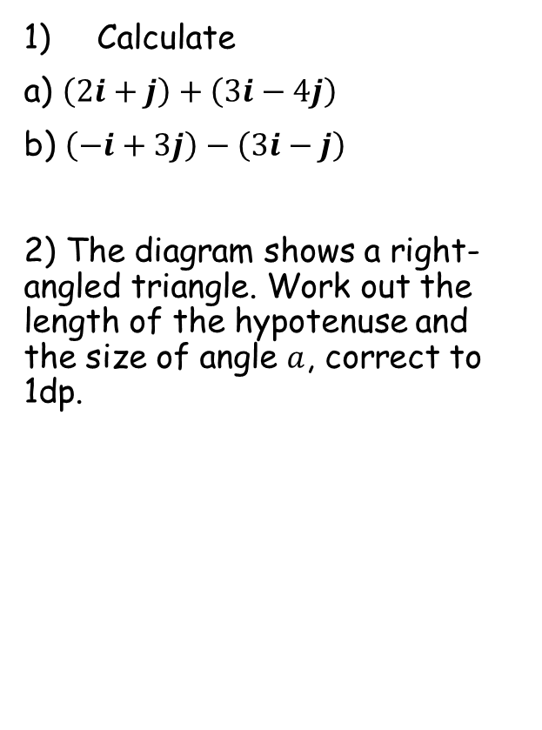




Prior Knowledge Check
Calculate
a) $\left(2i+j\right)+\left(3i−4j\right)$
b) $\left(−i+3j\right)−\left(3i−j\right)$
2) The diagram shows a right-angled triangle. Work out the length of the hypotenuse and the size of angle $a$, correct to 1dp.
3) A car starts from rest and accelerates constantly at 1.5ms⁻².
Work out the velocity of the car after 12 seconds
After the 12 seconds, the driver brakes, causing the car to decelerate at a constant rate of 1ms⁻²
b) Calculate the distance the car travels from the instant the driver brakes until the car comes to rest.
$$5i−3j$$
$$−4i+4j$$
$$18ms^{−1}$$
$$19.2cm$$
12cm
$$38.7$$
$$a$$
$$162m$$
15cm

Slide 3
Teachings For
Exercise 10A

Slide 4



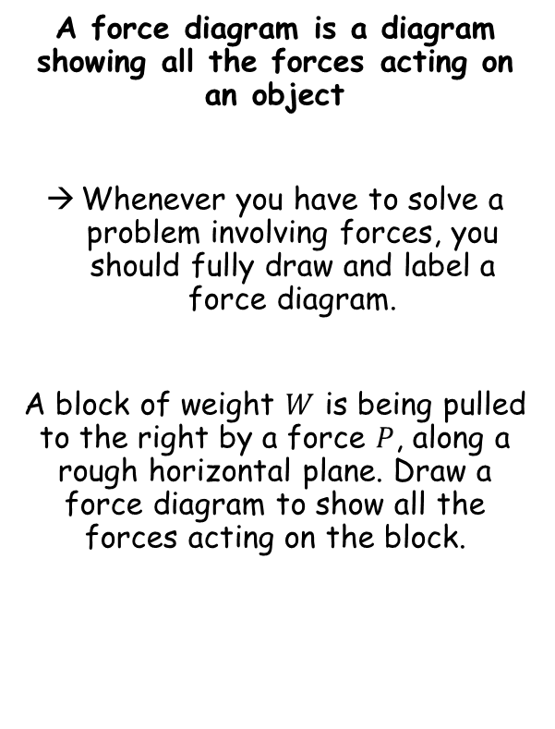




Forces and motion
$$R$$
A force diagram is a diagram showing all the forces acting on an object
Whenever you have to solve a problem involving forces, you should fully draw and label a force diagram.
A block of weight $W$ is being pulled to the right by a force $P$, along a rough horizontal plane. Draw a force diagram to show all the forces acting on the block.
$$F$$
$$P$$
$$W$$
If the horizontal plane was smooth…
$$R$$
$$P$$
$$W$$
10A

Slide 5




Forces and motion
$$30N$$
A force diagram is a diagram showing all the forces acting on an object
Whenever you have to solve a problem involving forces, you should fully draw and label a force diagram.
The diagram shows the forces acting on a particle.
Calculate the resultant force
Describe the motion of the particle
$$20N$$
$$20N$$
$$10N$$
The left and right forces are equal so there is no movement in either direction
The upwards force is 20N higher, so the resultant force is 20N upwards.
→ The particle is therefore accelerating vertically upwards
10A

Slide 6
Forces and motion
$$30N$$
A force diagram is a diagram showing all the forces acting on an object
Whenever you have to solve a problem involving forces, you should fully draw and label a force diagram.
The diagram shows the forces acting on a particle.
Calculate the resultant force
Describe the motion of the particle
$$20N$$
$$20N$$
$$10N$$
It is really important to note that a resultant force in a particular direction will cause acceleration in that direction
If there is no resultant force (such as left/right in the diagram above), then the particle could be stationary or moving at a constant velocity
10A

