Slide 1
Mechanics
Forces and motion
Twitter: @Owen134866
www.mathsfreeresourcelibrary.com

Slide 2



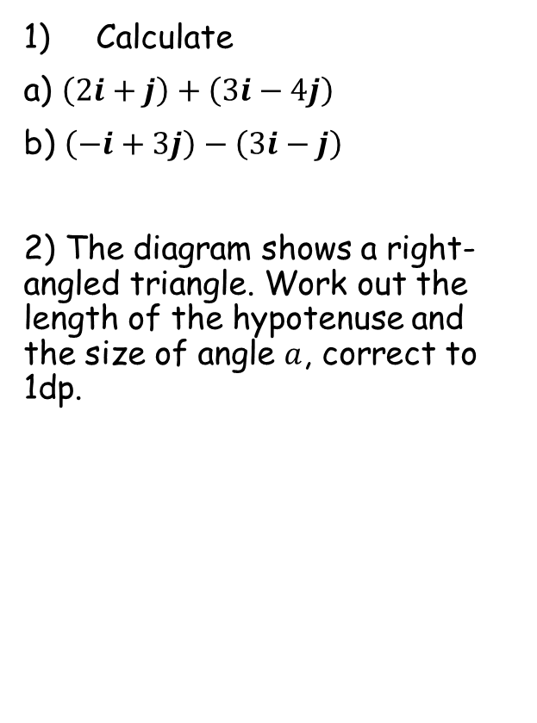




Prior Knowledge Check
Calculate
a) $\left(2i+j\right)+\left(3i−4j\right)$
b) $\left(−i+3j\right)−\left(3i−j\right)$
2) The diagram shows a right-angled triangle. Work out the length of the hypotenuse and the size of angle $a$, correct to 1dp.
3) A car starts from rest and accelerates constantly at 1.5ms⁻².
Work out the velocity of the car after 12 seconds
After the 12 seconds, the driver brakes, causing the car to decelerate at a constant rate of 1ms⁻²
b) Calculate the distance the car travels from the instant the driver brakes until the car comes to rest.
$$5i−3j$$
$$−4i+4j$$
$$18ms^{−1}$$
$$19.2cm$$
12cm
$$38.7$$
$$a$$
$$162m$$
15cm

Slide 3
Teachings For
Exercise 10A

Slide 4



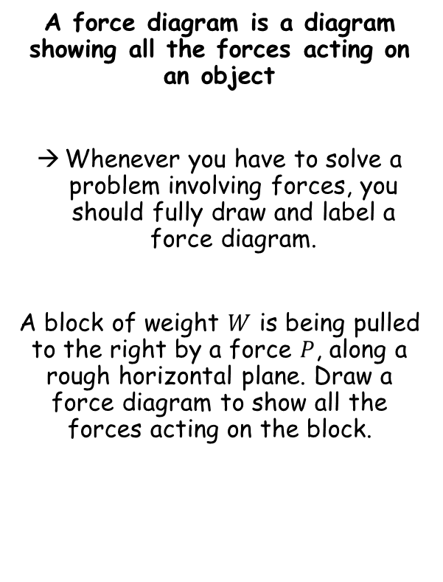




Forces and motion
$$R$$
A force diagram is a diagram showing all the forces acting on an object
Whenever you have to solve a problem involving forces, you should fully draw and label a force diagram.
A block of weight $W$ is being pulled to the right by a force $P$, along a rough horizontal plane. Draw a force diagram to show all the forces acting on the block.
$$F$$
$$P$$
$$W$$
If the horizontal plane was smooth…
$$R$$
$$P$$
$$W$$
10A

Slide 5




Forces and motion
$$30N$$
A force diagram is a diagram showing all the forces acting on an object
Whenever you have to solve a problem involving forces, you should fully draw and label a force diagram.
The diagram shows the forces acting on a particle.
Calculate the resultant force
Describe the motion of the particle
$$20N$$
$$20N$$
$$10N$$
The left and right forces are equal so there is no movement in either direction
The upwards force is 20N higher, so the resultant force is 20N upwards.
→ The particle is therefore accelerating vertically upwards
10A

Slide 6
Forces and motion
$$30N$$
A force diagram is a diagram showing all the forces acting on an object
Whenever you have to solve a problem involving forces, you should fully draw and label a force diagram.
The diagram shows the forces acting on a particle.
Calculate the resultant force
Describe the motion of the particle
$$20N$$
$$20N$$
$$10N$$
It is really important to note that a resultant force in a particular direction will cause acceleration in that direction
If there is no resultant force (such as left/right in the diagram above), then the particle could be stationary or moving at a constant velocity
10A

Slide 7
Teachings For
Exercise 10B

Slide 8


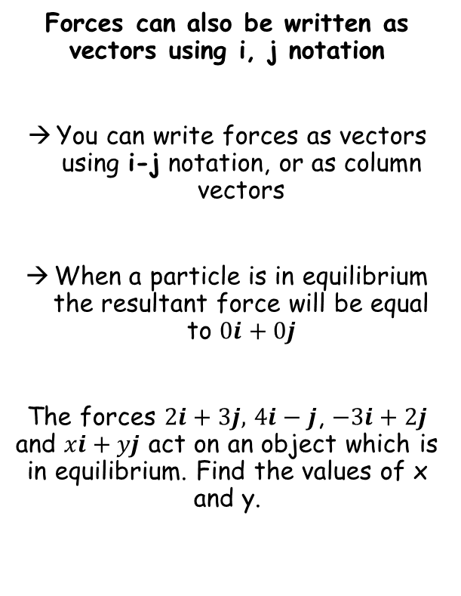


Forces and motion
Forces can also be written as vectors using i, j notation
You can write forces as vectors using i-j notation, or as column vectors
When a particle is in equilibrium the resultant force will be equal to $0i+0j$
The forces $2i+3j,$ $4i−j$, $−3i+2j$ and $xi+yj$ act on an object which is in equilibrium. Find the values of x and y.
Set up an equation equal to 0
$$\left(2i+3j\right)+\left(4i−j\right)+\left(−3i+2j\right)+\left(xi+yj\right)=0$$
Group i and j terms
$$\left(2+4−3+x\right)i+\left(3−1+2+y\right)j=0$$
$$3+x=0$$
$$4+y=0$$
$$x=−3$$
$$y=−4$$
10B

Slide 9

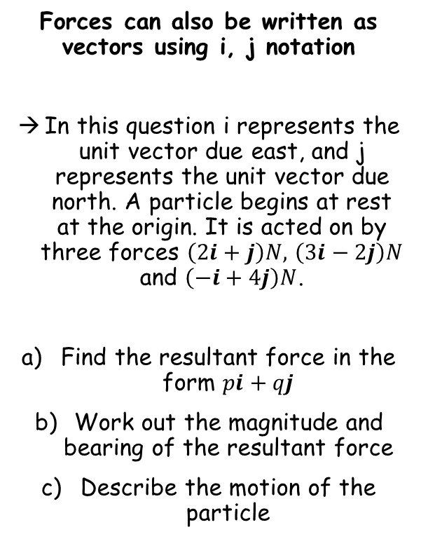


Forces and motion
Forces can also be written as vectors using i, j notation
In this question i represents the unit vector due east, and j represents the unit vector due north. A particle begins at rest at the origin. It is acted on by three forces $\left(2i+j\right)N,$ $\left(3i−2j\right)N$ and $\left(−i+4j\right)N$.
Find the resultant force in the form $pi+qj$
Work out the magnitude and bearing of the resultant force
Describe the motion of the particle
Add the forces together to find the resultant
$$\left(2i+j\right)+\left(3i−2j\right)+\left(−i+4j\right)$$
$$=4i+3j$$
$$4i+3j$$
10B

Slide 10






Forces and motion
Draw a diagram
Forces can also be written as vectors using i, j notation
In this question i represents the unit vector due east, and j represents the unit vector due north. A particle begins at rest at the origin. It is acted on by three forces $\left(2i+j\right)N,$ $\left(3i−2j\right)N$ and $\left(−i+4j\right)N$.
Find the resultant force in the form $pi+qj$
Work out the magnitude and bearing of the resultant force
Describe the motion of the particle
$$R$$
$$3j$$
$$θ$$
$$4i$$
You can find the magnitude of the force using Pythagoras’ Theorem
$$\left|R\right|=\sqrt{{\left(3\right)}^{2}+{\left(4\right)}^{2}}$$
$$4i+3j$$
$$\left|R\right|=5N$$
10B

Slide 11







Forces and motion
Draw a diagram
$$N$$
Forces can also be written as vectors using i, j notation
In this question i represents the unit vector due east, and j represents the unit vector due north. A particle begins at rest at the origin. It is acted on by three forces $\left(2i+j\right)N,$ $\left(3i−2j\right)N$ and $\left(−i+4j\right)N$.
Find the resultant force in the form $pi+qj$
Work out the magnitude and bearing of the resultant force
Describe the motion of the particle
$$\left|R\right|=5N$$
$$R$$
$$3j$$
$$36.9^{°}$$
$$θ$$
$$4i$$
You can find the direction of the force using Trigonometry
$$Tanθ=\frac{3}{4}$$
$$4i+3j$$
$θ=36.9^{°}$ (1dp)
Remember that bearings are measured clockwise from due North
$90^{°}−36.9^{°}=53.1^{°}$
$=053.1^{°}$
10B

Slide 12


Forces and motion
Forces can also be written as vectors using i, j notation
In this question i represents the unit vector due east, and j represents the unit vector due north. A particle begins at rest at the origin. It is acted on by three forces $\left(2i+j\right)N,$ $\left(3i−2j\right)N$ and $\left(−i+4j\right)N$.
Find the resultant force in the form $pi+qj$
Work out the magnitude and bearing of the resultant force
Describe the motion of the particle
The particle is accelerating in the direction of the resultant force
$$4i+3j$$
$$\left|R\right|=5N$$
$Bearing=053.1^{°}$
10B

Slide 13
Teachings For
Exercise 10C

Slide 14
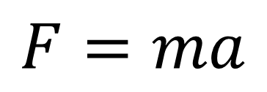
Forces and motion
A non-zero resultant set of forces acting on an object will cause it to accelerate in the resultant force’s direction
$$F=ma$$
The force acting on an object
Equals the object’s mass, multiplied by its acceleration
No acceleration (constant velocity) means there will be no force
→ Think about being in a car. You only feel a force on you when it accelerates or decelerates…
10C

Slide 15
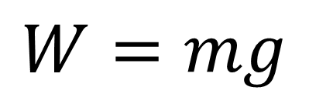
Forces and motion
A non-zero resultant set of forces acting on an object will cause it to accelerate in the resultant force’s direction
$$F=ma$$
$$W=mg$$
The weight is the force caused by gravity
The value g is the acceleration due to gravity…
10C

Slide 16






Forces and motion
$$F=ma$$
$$W=mg$$
A non-zero resultant set of forces acting on an object will cause it to accelerate in the resultant force’s direction
Find the weight in Newtons, of a particle of mass 12kg.
$$F=ma$$
The mass is already in kg, and use acceleration due to gravity
$$F=12×9.8$$
Calculate
$$F=117.6N$$
As the acceleration was given to 2sf, you should give you answer to the same accuracy
→ Ensure you use the exact amount in any subsequent calculations though!
$$F=120N$$
10C

Slide 17




Forces and motion
$$F=ma$$
$$W=mg$$
A non-zero resultant set of forces acting on an object will cause it to accelerate in the resultant force’s direction
Find the acceleration when a particle of mass 1.5kg is acted on by a force of 6N
$$F=ma$$
Sub in F and m
$$6=1.5a$$
Divide by 1.5
$$4=a$$
$$a=4ms^{−2}$$
10C

Slide 18










Forces and motion
$$F=ma$$
$$W=mg$$
A non-zero resultant set of forces acting on an object will cause it to accelerate in the resultant force’s direction
Find the values of the missing forces acting on the object in the diagram below
In this example you need to consider the horizontal forces and vertical forces separately (This is called resolving)
Resolving Horizontally $R\left(→\right)$
Take the direction of acceleration as the positive one
$$F=ma$$
Sub in values. You must subtract any forces acting in the opposite direction!
$$X−4=(2×2)$$
2ms⁻²
Calculate
$$X−4=4$$
Y
Add 4
$$X=8N$$
Resolving Vertically $R\left(↑\right)$
4N
2kg
X
Take the direction of the force Y as positive
$$F=ma$$
Sub in values. Acceleration is 0 as there is none in the vertical direction
$$Y−2g=(2×0)$$
Calculate
2g N
$$Y−2g=0$$
Add 2g
$$Y=2g (19.6N)$$
10C

Slide 19










Forces and motion
$$F=ma$$
$$W=mg$$
In this example you need to consider the horizontal forces and vertical forces separately (This is called resolving)
A non-zero resultant set of forces acting on an object will cause it to accelerate in the resultant force’s direction
Find the values of the missing forces acting on the object in the diagram below
Resolving Horizontally $R\left(→\right)$
Take the direction of acceleration as the positive one
$$F=ma$$
Sub in values. You must subtract any forces acting in the opposite direction!
$$80−X=(4×2)$$
Calculate
2ms⁻²
$$80−X=8$$
Add X and Subtract 8
$$72N=X$$
Y
20N
Resolving Vertically $R\left(↑\right)$
Take the direction of the force Y as positive
80N
4kg
X
$$F=ma$$
Sub in values. Acceleration is 0 as there is none in the vertical direction
$$Y−20−4g=(4×0)$$
Calculate
$$Y−20−4g=0$$
4g N
Add 20, add 4g
$$Y=20+4g (59.2N)$$
10C

Slide 20



Forces and motion
$$F=ma$$
$$W=mg$$
A non-zero resultant set of forces acting on an object will cause it to accelerate in the resultant force’s direction
A particle of mass 5kg is pulled along a rough horizontal table by a force of 20N, with a frictional force of 4N acting against it. Given that the particle is initially at rest, find:
The acceleration of the particle
The distance travelled by the particle in the first 4 seconds
The magnitude of the normal reaction between the particle and the table
a ms⁻²
Start by drawing a diagram
R
4N
5kg
20N
5g N
a)
$$F=ma$$
Resolve horizontally and sub in values. Take the direction of acceleration as positive
$$20−4=(5×a)$$
$$a=3.2ms^{−2}$$
Calculate a
10C

Slide 21








Forces and motion
$$F=ma$$
$$W=mg$$
A non-zero resultant set of forces acting on an object will cause it to accelerate in the resultant force’s direction
A particle of mass 5kg is pulled along a rough horizontal table by a force of 20N, with a frictional force of 4N acting against it. Given that the particle is initially at rest, find:
The acceleration of the particle – 3.2ms⁻²
The distance travelled by the particle in the first 4 seconds
The magnitude of the normal reaction between the particle and the table
3.2ms⁻²
Start by drawing a diagram
R
4N
5kg
20N
5g N
Use SUVAT
b)
$$s= ?$$
$$u=0$$
$$v= ?$$
$$a=3.2$$
$$t=4$$
$$s=ut+\frac{1}{2}at^{2}$$
Sub in values
$$s=(0×4)+\frac{1}{2}(3.2)(4^{2})$$
Calculate
$$s=25.6m$$
10C

Slide 22


Forces and motion
$$F=ma$$
$$W=mg$$
A non-zero resultant set of forces acting on an object will cause it to accelerate in the resultant force’s direction
A particle of mass 5kg is pulled along a rough horizontal table by a force of 20N, with a frictional force of 4N acting against it. Given that the particle is initially at rest, find:
The acceleration of the particle – 3.2ms⁻²
The distance travelled by the particle in the first 4 seconds – 25.6m
The magnitude of the normal reaction between the particle and the table
3.2ms⁻²
Start by drawing a diagram
R
4N
5kg
20N
5g N
c)
$$F=ma$$
Resolve vertically, taking R as the positive direction
$$R−5g=(5×0)$$
Calculate
$$R=5g (49N)$$
10C

Slide 23
Teachings For
Exercise 10D

Slide 24







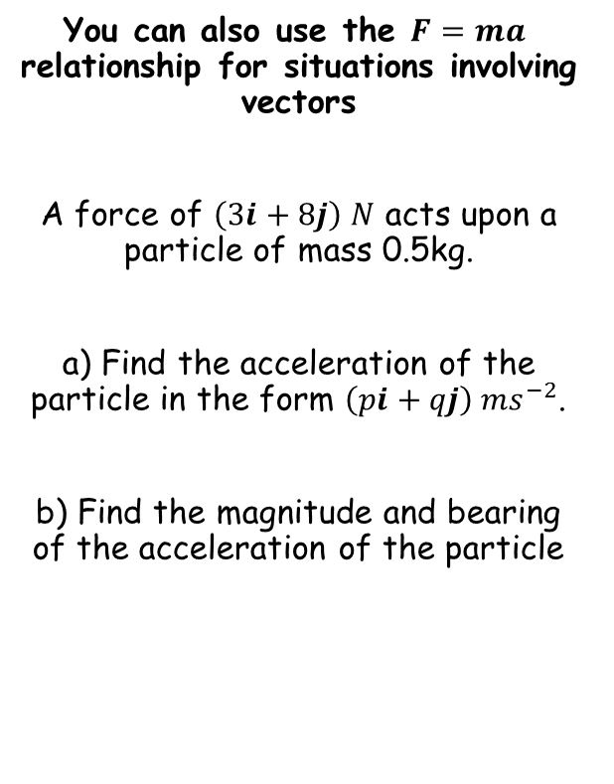











Forces and motion
$$F=ma$$
You can also use the $F=ma$ relationship for situations involving vectors
A force of $\left(3i+8j\right) N$ acts upon a particle of mass 0.5kg.
a) Find the acceleration of the particle in the form $\left(pi+qj\right) {ms}^{−2}$.
b) Find the magnitude and bearing of the acceleration of the particle
$$F=ma$$
Sub in values
$$\left(3i+8j\right)=0.5a$$
Multiply by 2
$$\left(6i+16j\right)=a$$
Draw a diagram
$$N$$
$$\left|a\right|=\sqrt{{\left(6\right)}^{2}+{\left(16\right)}^{2}}$$
$$\left(6i+16j\right) {ms}^{−2}$$
$$\left|a\right|=17.1 ms^{−2}$$
$$a$$
$$16j$$
$$Tanθ=\frac{16}{6}$$
$$\left|a\right|=17.1 ms^{−2}$$
$$Bearing=020.6^{°}$$
$$θ=69.4^{°}$$
$$69.4^{°}$$
$$θ$$
$$6i$$
$$Bearing=90^{°}−69.4^{°}$$
$$=020.6^{°}$$
10D

Slide 25


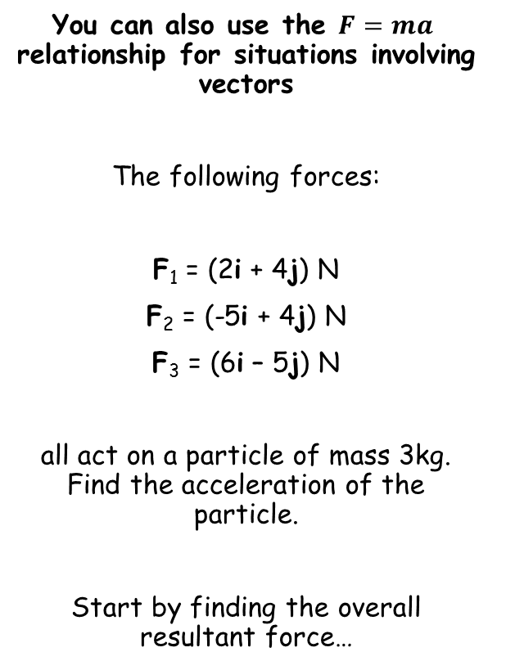





Forces and motion
$$F=ma$$
$$Resultant Force$$
You can also use the $F=ma$ relationship for situations involving vectors
The following forces:
F₁ = (2i + 4j) N
F₂ = (-5i + 4j) N
F₃ = (6i – 5j) N
all act on a particle of mass 3kg. Find the acceleration of the particle.
Start by finding the overall resultant force…
$$=F_{1}+F_{2}+F_{3}$$
Sub in values
$$=\left(2i+4j\right)+\left(−5i+4j\right)+(6i−5j)$$
Group up
$$=\left(3i+3j\right)$$
$$F=ma$$
Sub in the resultant force, and the mass
$$(3i+3j)=3a$$
Divide by 3
$$i+j=a$$
The acceleration is (i + j) ms⁻²
10D

Slide 26
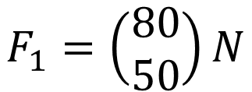
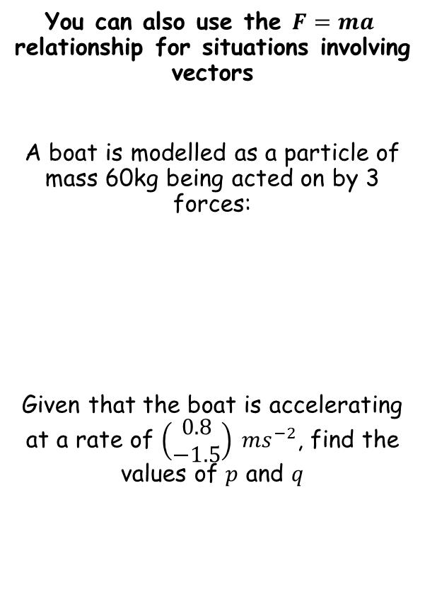



Forces and motion
$$F=ma$$
You can also use the $F=ma$ relationship for situations involving vectors
A boat is modelled as a particle of mass 60kg being acted on by 3 forces:
Given that the boat is accelerating at a rate of $\left(\begin{matrix}0.8 \\ −1.5\end{matrix}\right) {ms}^{−2}$, find the values of $p$ and $q$
In vector form, the top number represents movement/forces in the i direction
$$F_{1}=\left(\begin{matrix}80 \\ 50\end{matrix}\right)N$$
$$F_{1}=\left(\begin{matrix}80 \\ 50\end{matrix}\right)N$$
$$F_{2}=\left(\begin{matrix}10p \\ 20q\end{matrix}\right)N$$
$$F_{3}=\left(\begin{matrix}−75 \\ 100\end{matrix}\right)N$$
In vector form, the bottom number represents movement/forces in the j direction
10D

Slide 27


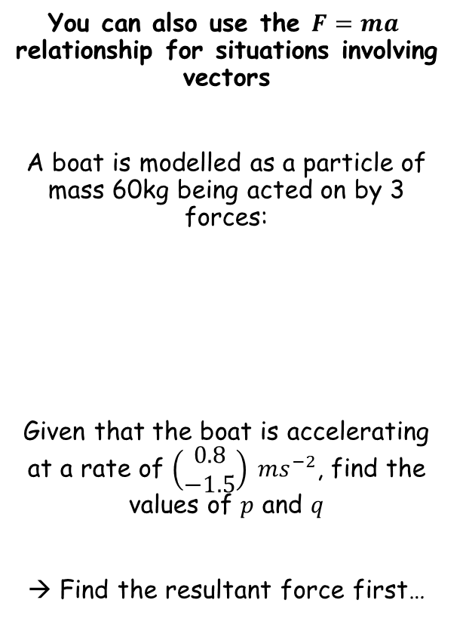


Forces and motion
$$F=ma$$
You can also use the $F=ma$ relationship for situations involving vectors
A boat is modelled as a particle of mass 60kg being acted on by 3 forces:
Given that the boat is accelerating at a rate of $\left(\begin{matrix}0.8 \\ −1.5\end{matrix}\right) {ms}^{−2}$, find the values of $p$ and $q$
→ Find the resultant force first…
$$Resultant Force$$
$$=F_{1}+F_{2}+F_{3}$$
Sub in values
$$=\left(\begin{matrix}80 \\ 50\end{matrix}\right)+\left(\begin{matrix}10p \\ 20q\end{matrix}\right)+\left(\begin{matrix}−75 \\ 100\end{matrix}\right)$$
Group up
$$=\left(\begin{matrix}10p+5 \\ 20q+150\end{matrix}\right)N$$
$$F_{1}=\left(\begin{matrix}80 \\ 50\end{matrix}\right)N$$
$$F_{2}=\left(\begin{matrix}10p \\ 20q\end{matrix}\right)N$$
$$F_{3}=\left(\begin{matrix}−75 \\ 100\end{matrix}\right)N$$
10D

Slide 28
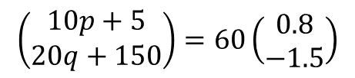







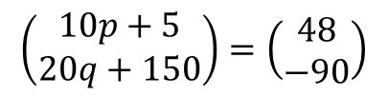

Forces and motion
$$F=ma$$
You can also use the $F=ma$ relationship for situations involving vectors
A boat is modelled as a particle of mass 60kg being acted on by 3 forces:
Given that the boat is accelerating at a rate of $\left(\begin{matrix}0.8 \\ −1.5\end{matrix}\right) {ms}^{−2}$, find the values of $p$ and $q$
→ Find the resultant force first…
$$F=ma$$
$$\left(\begin{matrix}10p+5 \\ 20q+150\end{matrix}\right)=60\left(\begin{matrix}0.8 \\ −1.5\end{matrix}\right)$$
Sub in values
Multiply the second vector
$$\left(\begin{matrix}10p+5 \\ 20q+150\end{matrix}\right)=\left(\begin{matrix}48 \\ −90\end{matrix}\right)$$
$$F_{1}=\left(\begin{matrix}80 \\ 50\end{matrix}\right)N$$
$$F_{2}=\left(\begin{matrix}10p \\ 20q\end{matrix}\right)N$$
Solve the top for p
Solve the bottom for q
$$F_{3}=\left(\begin{matrix}−75 \\ 100\end{matrix}\right)N$$
$$10p+5=48$$
$$20q+150=−90$$
$$10p=43$$
$$20q=−240$$
$$p=4.3$$
$$q=−12$$
$$\left(\begin{matrix}10p+5 \\ 20q+150\end{matrix}\right)N$$
10D

Slide 29






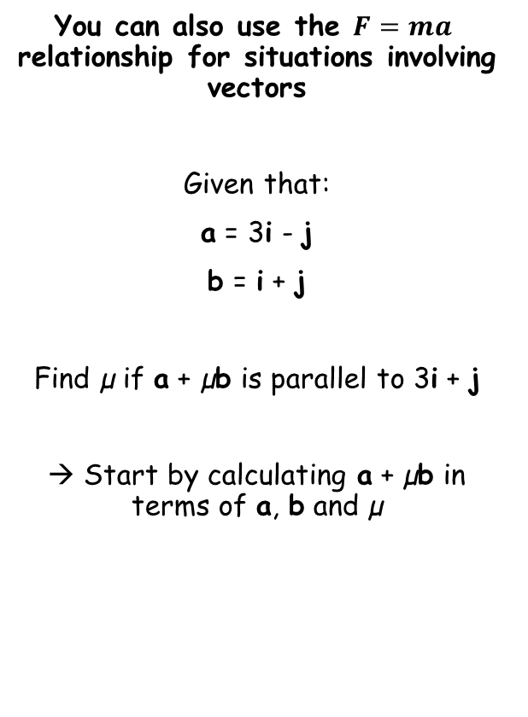









Forces and motion
$$F=ma$$
You can also use the $F=ma$ relationship for situations involving vectors
Given that:
a = 3i - j
b = i + j
Find µ if a + µb is parallel to 3i + j
→ Start by calculating a + µb in terms of a, b and µ
$$a+μb =$$
$$(3i−j)+μ(i+j)$$
Multiply out the brackets
$$= 3i−j+μi+μj$$
Move the i and j terms together
$$= 3i+μi−j+μj$$
Factorise the terms in i and j
$$= \left(3+μ\right)i$$
$$+ \left(−1+μ\right)j$$
As the vector must be parallel to 3i + j, the i term must be 3 times the j term!
$$3+μ =$$
$$3(−1+μ)$$
Multiply out the bracket
$$3+μ =$$
$$−3+3μ$$
Subtract µ, and add 3
$$6=$$
$$2μ$$
$$μ=3$$
$$3=$$
$$μ$$
Divide by 2
10D

Slide 30
Teachings For
Exercise 10E

Slide 31
Forces and motion
Sometimes a system will involve the motion of more than one particle, which are connected together
If a system involves the motion of more than one particle, the particles may be considered separately. However, if all parts of the system are moving in the same straight line, then you can also treat the whole system as a single particle…
10E

Slide 32




Forces and motion
Draw a diagram
3ms⁻²
a
Sometimes a system will involve the motion of more than one particle, which are connected together
Two particles, P and Q, of masses 5kg and 3kg respectively, are connected by a light inextensible string. Particle P is pulled by a horizontal force of magnitude 40N along a rough horizontal plane. Particle P experiences a frictional force of 10N and particle Q experiences a frictional force of 6N.
Find the acceleration of the particles
Find the tension in the string
Explain how the modelling assumptions that the string is light and inextensible have been used
R_{Q}
R_{P}
T
T
6N
Q
10N
P
40N
3g
5g
As they are moving in the same straight line, you can treat the system as a whole…
→ Note that the Tensions will cancel each other out so can be ignored here…
$$R(→)$$
$$F=ma$$
$$40−10−6=8a$$
Sub in values
Calculate a
$$3=a$$
10E

Slide 33






Forces and motion
Draw a diagram
3ms⁻²
Sometimes a system will involve the motion of more than one particle, which are connected together
Two particles, P and Q, of masses 5kg and 3kg respectively, are connected by a light inextensible string. Particle P is pulled by a horizontal force of magnitude 40N along a rough horizontal plane. Particle P experiences a frictional force of 10N and particle Q experiences a frictional force of 6N.
Find the acceleration of the particles
Find the tension in the string
Explain how the modelling assumptions that the string is light and inextensible have been used
R_{Q}
R_{P}
T
T
6N
Q
10N
P
40N
3g
5g
To find the tension in the string, you can choose to resolve forces on either P or Q only
$R(→)$ on P
$$a=3{ms}^{−2}$$
$$F=ma$$
$$40−10−T=5(3)$$
Sub in values
Simplify
$$30−T=15$$
$$T=15N$$
Calculate T
10E

Slide 34

Forces and motion
Draw a diagram
3ms⁻²
Sometimes a system will involve the motion of more than one particle, which are connected together
Two particles, P and Q, of masses 5kg and 3kg respectively, are connected by a light inextensible string. Particle P is pulled by a horizontal force of magnitude 40N along a rough horizontal plane. Particle P experiences a frictional force of 10N and particle Q experiences a frictional force of 6N.
Find the acceleration of the particles
Find the tension in the string
Explain how the modelling assumptions that the string is light and inextensible have been used
R_{Q}
R_{P}
T
T
6N
Q
10N
P
40N
3g
5g
Light – the string has no mass/tension is constant
Inextensible – the particle will share the same acceleration
$$a=3{ms}^{−2}$$
$$T=35N$$
10E

Slide 35




Forces and motion
Sometimes a system will involve the motion of more than one particle, which are connected together
A light scale-pan is attached to a vertical light inextensible string. The scale pan carries two masses, A and B. The mass of A is 400g and the mass of B is 600g. A rests on top of B.
The scale pan is raised vertically with an acceleration of 0.5ms⁻².
Find the Tension in the string
Find the force exerted on mass B by mass A
Find the force exerted on mass B by the scale pan
T
10.3N
To find the tension in the string you should consider the system as a whole, as all the forces will affect it!
0.5ms⁻²
A
0.4g
B
0.6g
Resolving vertically
$$F=ma$$
Resolve vertically. There is no normal reaction as the pan is not on a surface
$$T−0.4g−0.6g=(1×0.5)$$
Rearrange to find T
$$T=\left(1×0.5\right)+1g$$
Calculate
$$T=10.3N$$
10E

Slide 36


Forces and motion
Sometimes a system will involve the motion of more than one particle, which are connected together
A light scale-pan is attached to a vertical light inextensible string. The scale pan carries two masses, A and B. The mass of A is 400g and the mass of B is 600g. A rests on top of B.
The scale pan is raised vertically with an acceleration of 0.5ms⁻².
Find the Tension in the string
Find the force exerted on mass B by mass A
Find the force exerted on mass B by the scale pan
10.3N
We cannot consider mass B on its own at this point.
The reason is that the scale pan is also acting on mass B, and we do not know the magnitude of this force
However, the force exerted on mass B by mass A, will be the same as the force exerted on mass A by mass B
→ So we can consider mass A instead (the scale pan is not acting on it)
0.5ms⁻²
A
0.4g
B
0.6g
R
Resolving forces on A
→ R is the normal reaction, the force of B acting on A
10.3N
0.4kg
A
0.5ms⁻²
$$F=ma$$
Sub in forces
0.4g
B
$$R−0.4g=(0.4×0.5)$$
Calculate
$$R=4.1N (2sf)$$
The magnitude of the force from B acting on A is 4.1N. Therefore, the force from A acting on B must be equal to this!
(since the two masses are staying together)
10E

Slide 37


Forces and motion
Sometimes a system will involve the motion of more than one particle, which are connected together
A light scale-pan is attached to a vertical light inextensible string. The scale pan carries two masses, A and B. The mass of A is 400g and the mass of B is 600g. A rests on top of B.
The scale pan is raised vertically with an acceleration of 0.5ms⁻².
Find the Tension in the string
Find the force exerted on mass B by mass A
Find the force exerted on mass B by the scale pan
10.3N
Now as we have to involve the scale pan, we will consider the forces acting on Mass B
0.5ms⁻²
A
Draw a diagram for B, remember to include the force exerted by A which pushes down, and the force from the scale pan which pushes up, from beneath…
0.4g
B
0.6g
4.1N
Resolving forces on B
→ S is the force exerted by the scale pan on mass B
10.3N
0.5ms⁻²
0.6kg
B
$$F=ma$$
Sub in forces
0.6g
$$S−4.1−0.6g=(0.6×0.5)$$
4.1N
S
Calculate
$$S=10.3N$$
This type of question can be very tricky to get the hang of – make sure you get lots of practice!
10E

Slide 38
Teachings For
Exercise 10F

Slide 39
Forces and motion
You need to be able to model situations where particles are connected across a pulley
→ When modelling a situation where particles are connected across a pulley, you may need to use Simultaneous Equations…
10F

Slide 40






Forces and motion
You need to be able to model situations where particles are connected across a pulley
Particles P and Q, of masses 2m and 3m, are attached to the ends of a light inextensible string. The string passes over a small, smooth, fixed pulley and the masses hang with the string taut. The system is released from rest.
Find the acceleration of each mass
Find the tension in the string, in terms of m
Find the force exerted on the pulley by the string, in terms of m
Find the distance travelled by Q in the first 4 seconds, assuming that P does not reach the pulley
Comment on any modelling assumptions used
Draw a diagram with all the forces on…
The heavier particle will move downwards, pulling the lighter one upwards
T
T
T
Sometimes you have to set up two equations with the information given, and combine them…
T
a
2m
3m
a
P
Q
2mg
3mg
Equation using P
Equation using Q
$$F=ma$$
$$F=ma$$
Sub in values
Sub in values
$$T−2mg=2ma$$
$$3mg−T=3ma$$
$$T−2mg=2ma$$
$$3mg−T=3ma$$
Add the equations together
$$mg=5ma$$
Cancel m’s and divide g by 5
$$1.96=a$$
10F

Slide 41



Forces and motion
You need to be able to model situations where particles are connected across a pulley
Particles P and Q, of masses 2m and 3m, are attached to the ends of a light inextensible string. The string passes over a small, smooth, fixed pulley and the masses hang with the string taut. The system is released from rest.
Find the acceleration of each mass
Find the tension in the string, in terms of m
Find the force exerted on the pulley by the string, in terms of m
Find the distance travelled by Q in the first 4 seconds, assuming that P does not reach the pulley
Comment on any modelling assumptions used
Draw a diagram with all the forces on…
The heavier particle will move downwards, pulling the lighter one upwards
T
T
T
Sometimes you have to set up two equations with the information given, and combine them…
T
a
2m
3m
a
P
Q
1.96ms⁻²
2mg
3mg
Equation using P
Equation using Q
$$F=ma$$
$$F=ma$$
Sub in values
Sub in values
$$T−2mg=2ma$$
$$3mg−T=3ma$$
$$T−2mg=2ma$$
Rearrange to find T
$$T=2ma+2mg$$
Sub in g and a
$$T=\left(2×1.96\right)m+\left(2×9.8\right)m$$
Group up for m
$$T=23.52m$$
10F

Slide 42
Forces and motion
You need to be able to model situations where particles are connected across a pulley
Particles P and Q, of masses 2m and 3m, are attached to the ends of a light inextensible string. The string passes over a small, smooth, fixed pulley and the masses hang with the string taut. The system is released from rest.
Find the acceleration of each mass
Find the tension in the string, in terms of m
Find the force exerted on the pulley by the string, in terms of m
Find the distance travelled by Q in the first 4 seconds, assuming that P does not reach the pulley
Comment on any modelling assumptions used
The force on the pulley is the tension on both sides – these must be added together
T
23.52m
23.52m
T
23.52m + 23.52m
T
T
= 47.04m
a
2m
3m
a
P
Q
1.96ms⁻²
2mg
3mg
23.52m
10F

Slide 43








Forces and motion
You need to be able to model situations where particles are connected across a pulley
Particles P and Q, of masses 2m and 3m, are attached to the ends of a light inextensible string. The string passes over a small, smooth, fixed pulley and the masses hang with the string taut. The system is released from rest.
Find the acceleration of each mass
Find the tension in the string, in terms of m
Find the force exerted on the pulley by the string, in terms of m
Find the distance travelled by Q in the first 4 seconds, assuming that P does not reach the pulley
Comment on any modelling assumptions used
As P does not meet the pulley, we assume Q moves consistently
23.52m
23.52m
T
T
a
2m
3m
a
P
Q
1.96ms⁻²
2mg
3mg
23.52m
$$s=?$$
$$u=0$$
$$v=?$$
$$a=1.96$$
$$t=4$$
47.04m
$$s=ut+\frac{1}{2}at^{2}$$
Sub in values
$$s=\left(0\right)(4)+\frac{1}{2}(1.96){(4)}^{2}$$
Calculate
$$s=15.7m$$
10F

Slide 44
Forces and motion
You need to be able to model situations where particles are connected across a pulley
Particles P and Q, of masses 2m and 3m, are attached to the ends of a light inextensible string. The string passes over a small, smooth, fixed pulley and the masses hang with the string taut. The system is released from rest.
Find the acceleration of each mass
Find the tension in the string, in terms of m
Find the force exerted on the pulley by the string, in terms of m
Find the distance travelled by Q in the first 4 seconds, assuming that P does not reach the pulley
Comment on any modelling assumptions used
23.52m
23.52m
T
T
a
2m
3m
a
P
Q
1.96ms⁻²
2mg
3mg
23.52m
Comment on the modelling assumptions used:
Light string → The string has no mass
Inextensible string → The particles move with the same acceleration
Smooth pulley – No Frictional force, tension equal on both sides
47.04m
15.7m
10F

Slide 45




Forces and motion
Draw a diagram and label all the forces
R
You need to be able to model situations where particles are connected across a pulley
Two particles A and B of masses 0.4kg and 0.8kg respectively are connected by a light inextensible string. Particle A lies on a rough horizontal table 4.5m from a small smooth fixed pulley which is attached to the end of the table. The string passes over the pulley and B hangs freely, with the string taut, 0.5m above the ground. The frictional force has a magnitude 0.08g.The system is released from rest. Find:
The acceleration of the system
The velocity at which B hits the ground
The total distance travelled by A before it comes to rest
T
T
0.08g
A
T
0.4g
T
a
We can set up separate equations of motion for A and B
B
a
0.5m
0.8g
Resolving horizontally for A
Resolving vertically for B
$$F=ma$$
Resolve horizontally
$$F=ma$$
Resolve vertically
$$T−0.08g=0.4a$$
$$0.8g−T=0.8a$$
Add the two equations together
→ The T’s cancel out
$$T−0.08g=0.4a$$
$$0.8g−T=0.8a$$
$$0.72g=1.2a$$
Divide by 1.2
$$0.6g=a$$
10F

Slide 46










Forces and motion
Draw a diagram and label all the forces
R
You need to be able to model situations where particles are connected across a pulley
Two particles A and B of masses 0.4kg and 0.8kg respectively are connected by a light inextensible string. Particle A lies on a rough horizontal table 4.5m from a small smooth fixed pulley which is attached to the end of the table. The string passes over the pulley and B hangs freely, with the string taut, 0.5m above the ground. The frictional force has a magnitude 0.08g.The system is released from rest. Find:
The acceleration of the system
The velocity at which B hits the ground
The total distance travelled by A before it comes to rest
T
T
0.08g
A
T
0.4g
T
0.6g
B
0.6g
We can use SUVAT to calculate the velocity of B as it hits the ground
0.5m
0.8g
$$s=0.5$$
$$u=0$$
$$v=?$$
$$a=0.6g$$
$$t=?$$
$$a=0.6g$$
$$v^{2}=u^{2}+2as$$
Sub in values
$$v^{2}={(0)}^{2}+2(0.6g)(0.5)$$
Calculate
$$v^{2}=0.6g$$
Square root
$$v=2.42ms^{−1}$$
10F

Slide 47





Forces and motion
Draw a diagram and label all the forces
R
You need to be able to model situations where particles are connected across a pulley
Two particles A and B of masses 0.4kg and 0.8kg respectively are connected by a light inextensible string. Particle A lies on a rough horizontal table 4.5m from a small smooth fixed pulley which is attached to the end of the table. The string passes over the pulley and B hangs freely, with the string taut, 0.5m above the ground. The frictional force has a magnitude 0.08g.The system is released from rest. Find:
The acceleration of the system
The velocity at which B hits the ground
The total distance travelled by A before it comes to rest
T
T
0.08g
A
T
0.4g
T
0.6g
B
0.6g
Particle A will travel 0.5m by the time B hits the floor
When B hits the floor, A will be moving at speed (the same as B as it hit the floor…) and will decelerate due to the frictional force…
→ We need to know the deceleration of a…
0.5m
0.8g
$$a=0.6g$$
$$F=ma$$
Resolve horizontally for A
$$v=2.42ms^{−1}$$
$$T−0.08g=(0.4×a)$$
T = 0 now as the string will be slack
$$0−0.08g=0.4a$$
Divide by 0.4
$$−0.2g=a$$
10F

Slide 48










Forces and motion
Draw a diagram and label all the forces
R
You need to be able to model situations where particles are connected across a pulley
Two particles A and B of masses 0.4kg and 0.8kg respectively are connected by a light inextensible string. Particle A lies on a rough horizontal table 4.5m from a small smooth fixed pulley which is attached to the end of the table. The string passes over the pulley and B hangs freely, with the string taut, 0.5m above the ground. The frictional force has a magnitude 0.08g.The system is released from rest. Find:
The acceleration of the system
The velocity at which B hits the ground
The total distance travelled by A before it comes to rest
T
T
0.08g
A
T
0.4g
T
0.6g
0.2g
Now we can use SUVAT again to find the distance A travels before coming to rest…
B
0.6g
$$s=?$$
$$u=2.42$$
$$v=0$$
$$a=−0.2g$$
$$t=?$$
0.5m
0.8g
$$a=0.6g$$
$$v^{2}=u^{2}+2as$$
Sub in values (remember the initial velocity of A)
$$0^{2}={2.42}^{2}+2(−0.2g)(s)$$
Calculate
$$v=2.42ms^{−1}$$
$$0=5.88−3.92s$$
Rearrange to find s
$$s=1.5m$$
Remember to add on the 0.5m A has already travelled!
$$s=2m$$
10F

