Slide 1
Due to the large change in spec, I have not included any old spec questions on vectors
Vectors
Practice A
Specimen 1
Practice B
SAM 1
Practice C
2018 2
Practice D
Practice E
Practice F (i)
Practice F (ii)

Slide 2
Practice A

Slide 3
Practice A
A

Slide 4
Practice B

Slide 5
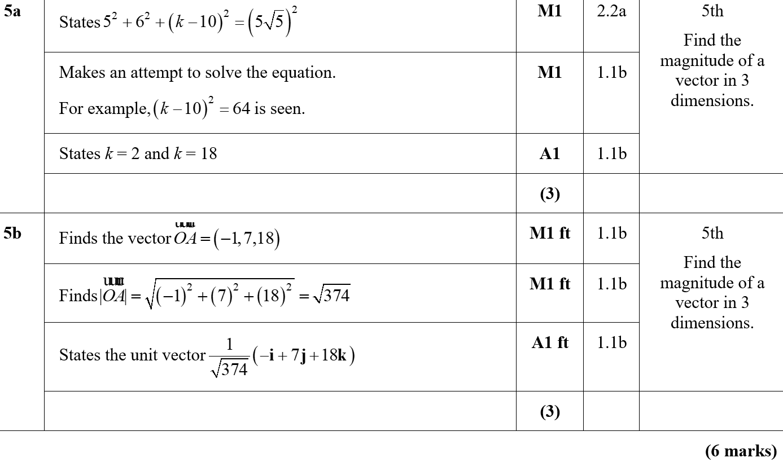
Practice B
A
B
B notes

Slide 6
Practice C

Slide 7
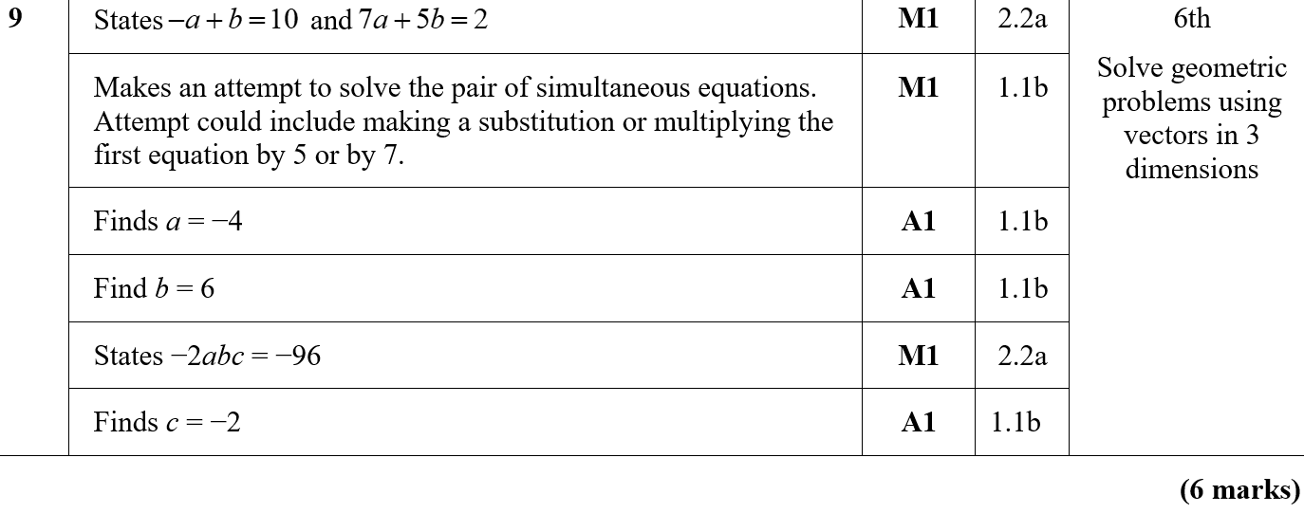
Practice C
A

Slide 8
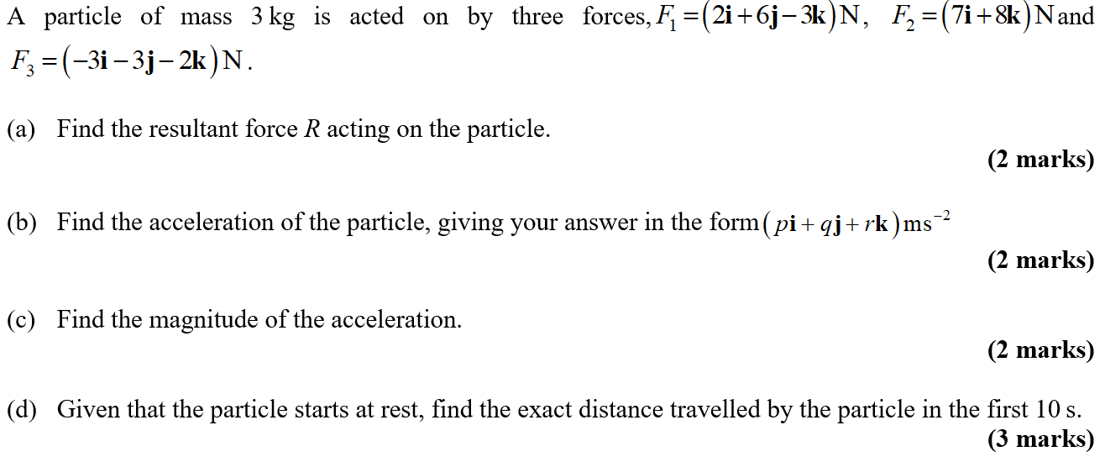
Practice D

Slide 9
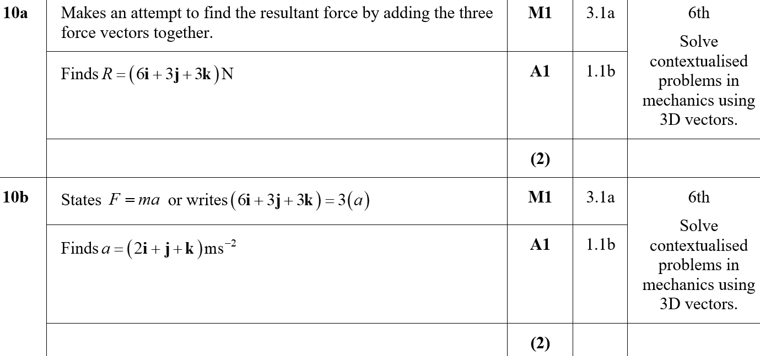
Practice D
A
B

Slide 10
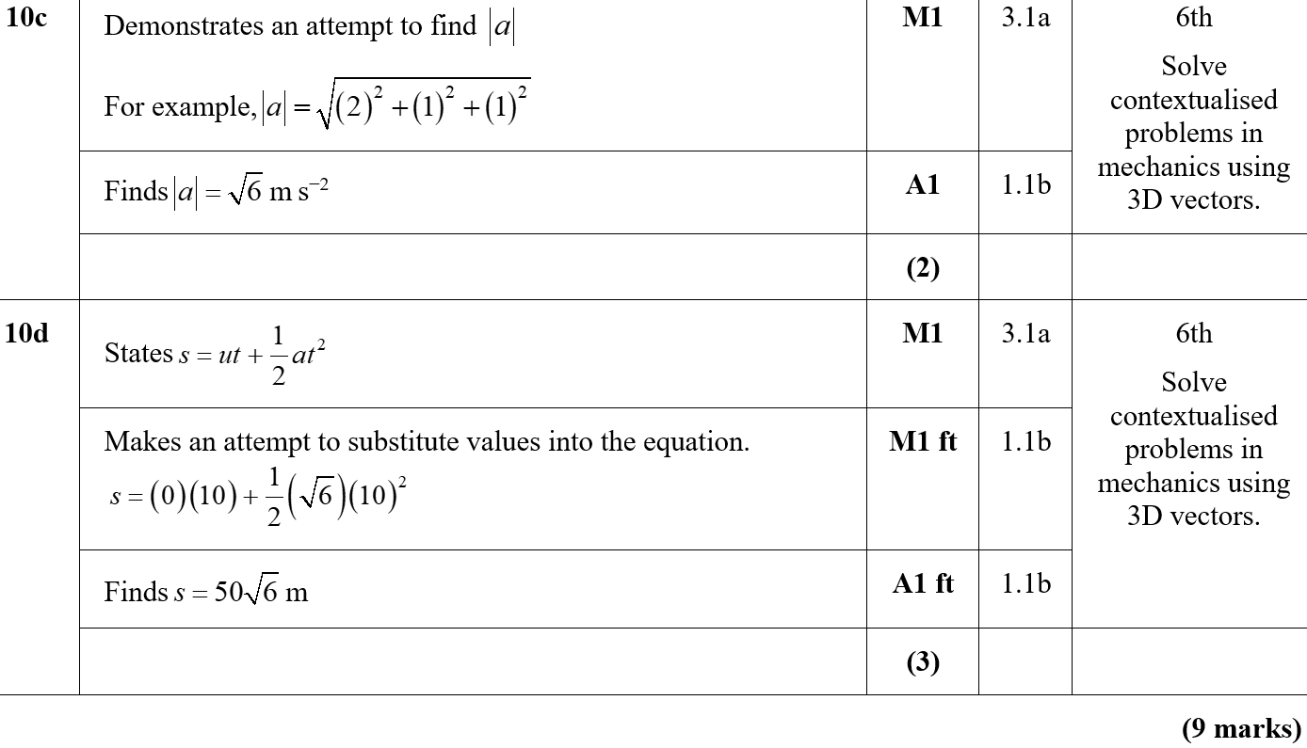
Practice D
C
D
D notes

Slide 11
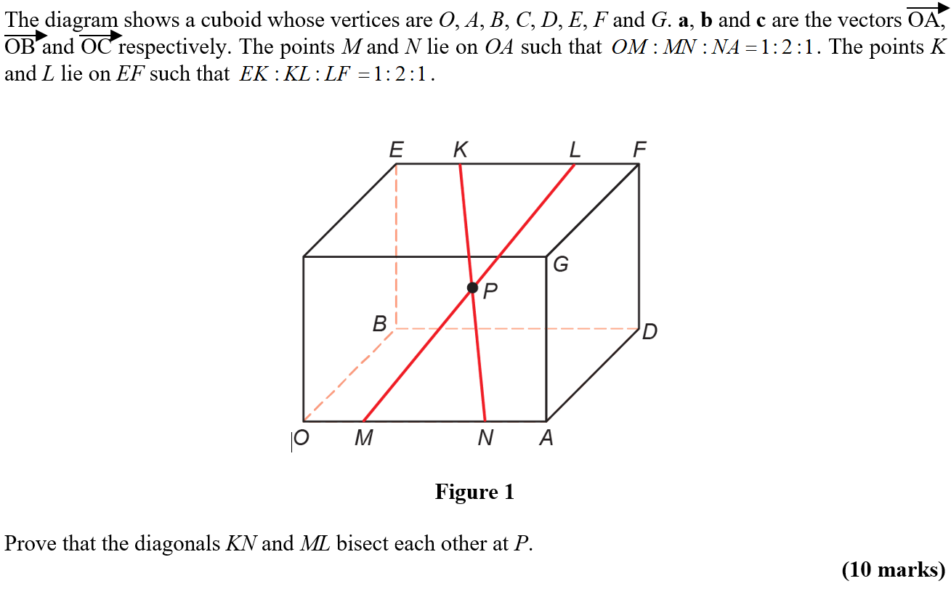
Practice E

Slide 12
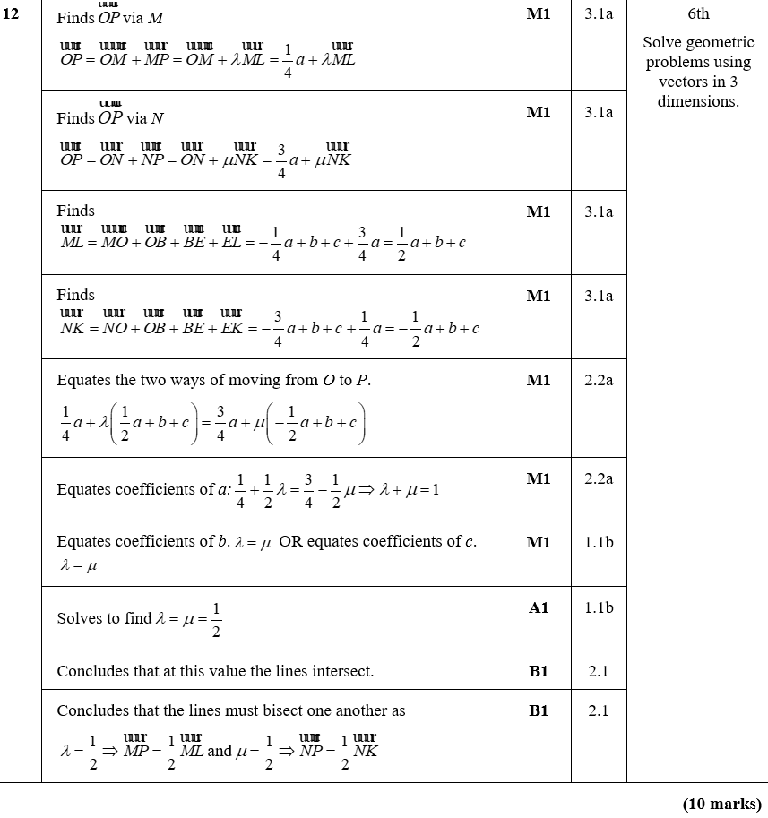
Practice E
A

Slide 13
Practice F

Slide 14
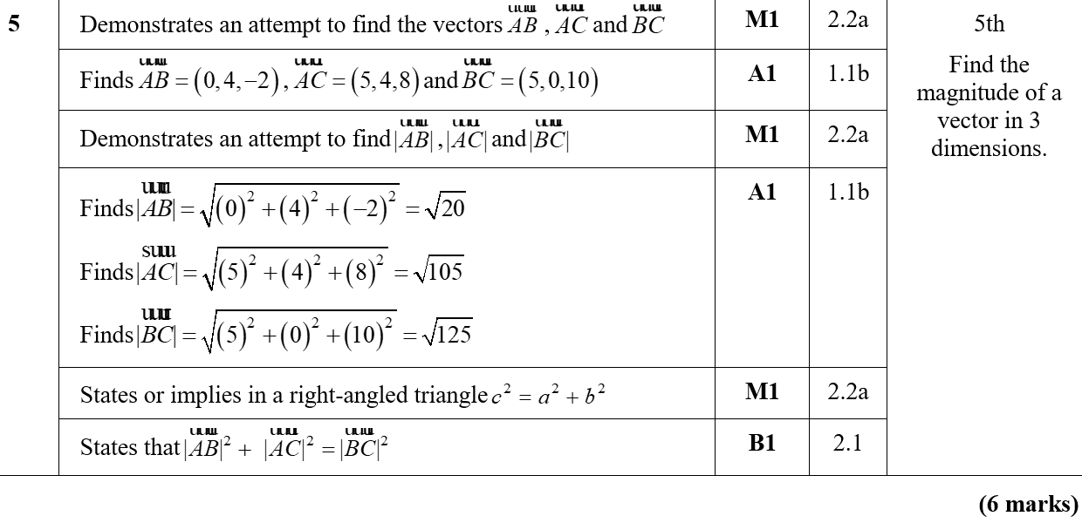
Practice F
A

Slide 15
Practice F

Slide 16
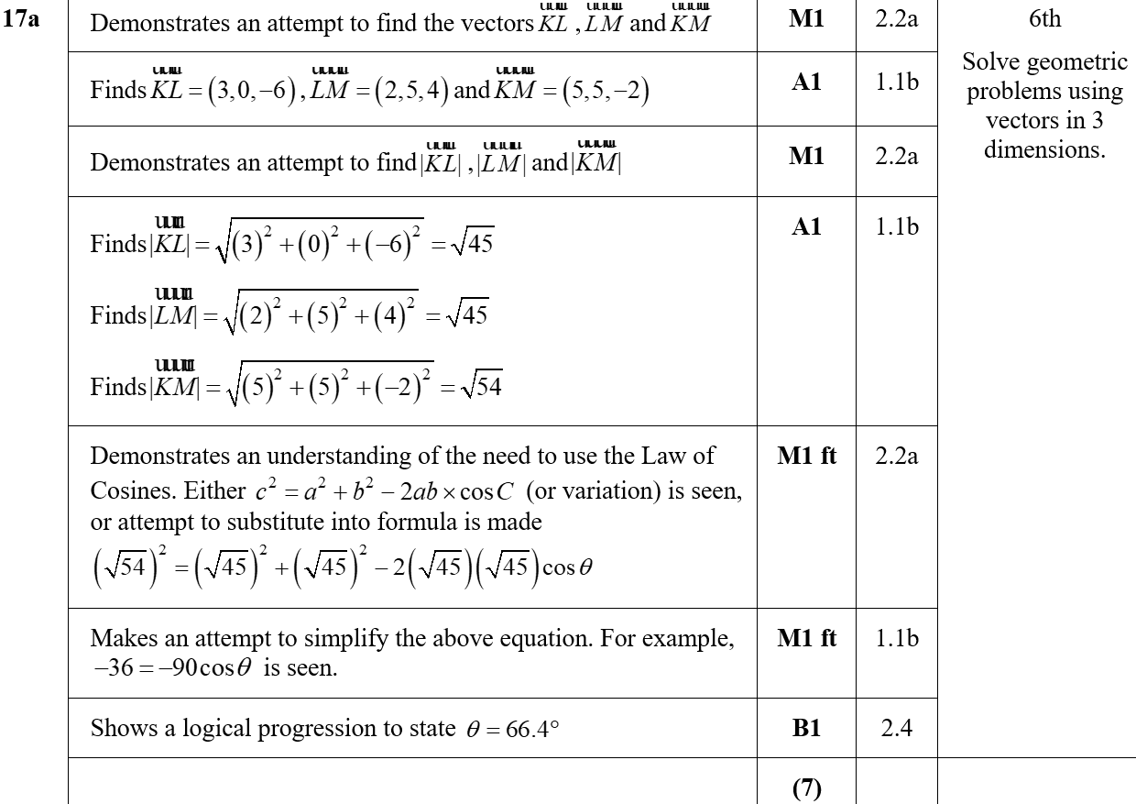
Practice F
A

Slide 17
Practice F
B
B notes

Slide 18
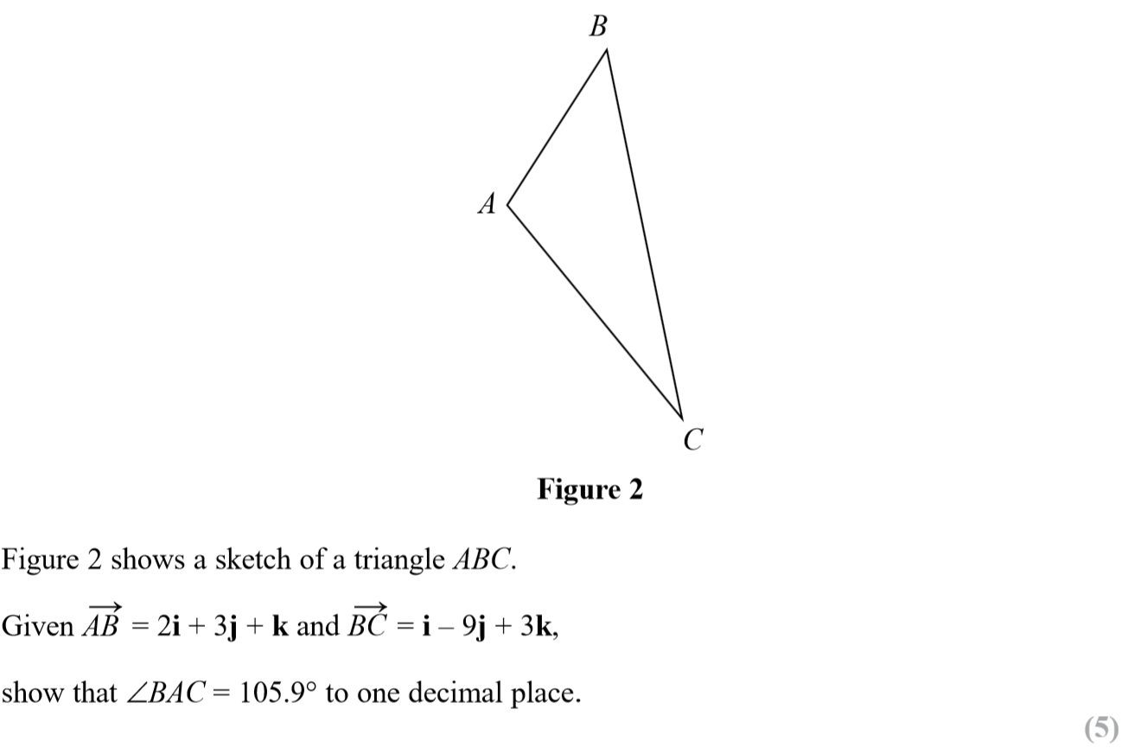
SAM Paper 1

Slide 19
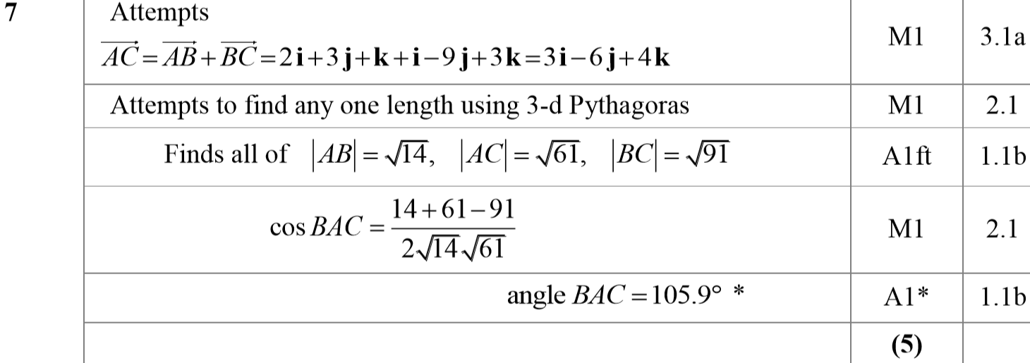
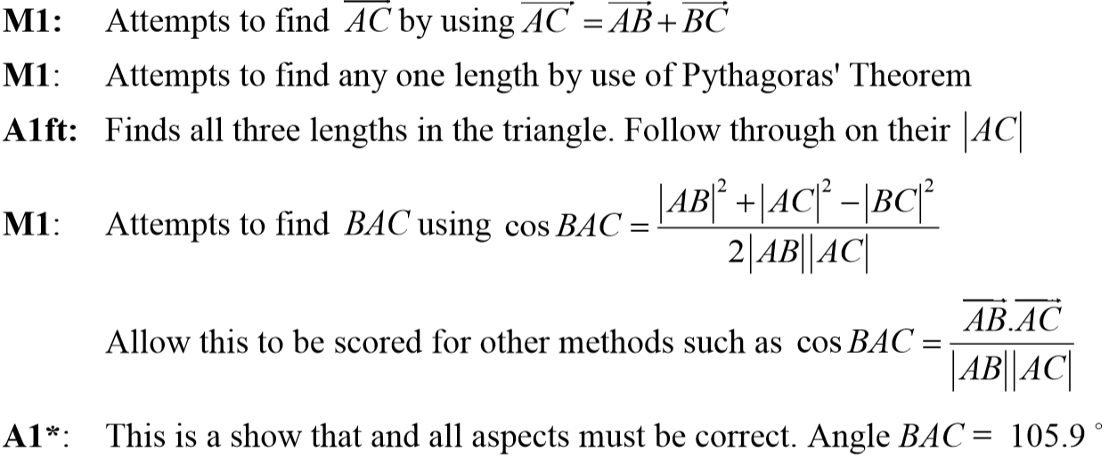
SAM Paper 1
A
A notes

Slide 20
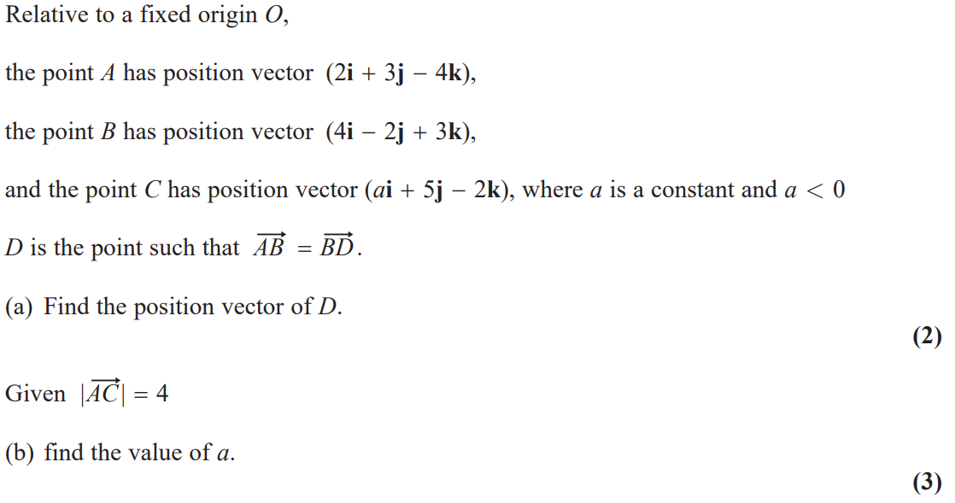
2018 Paper 2

Slide 21
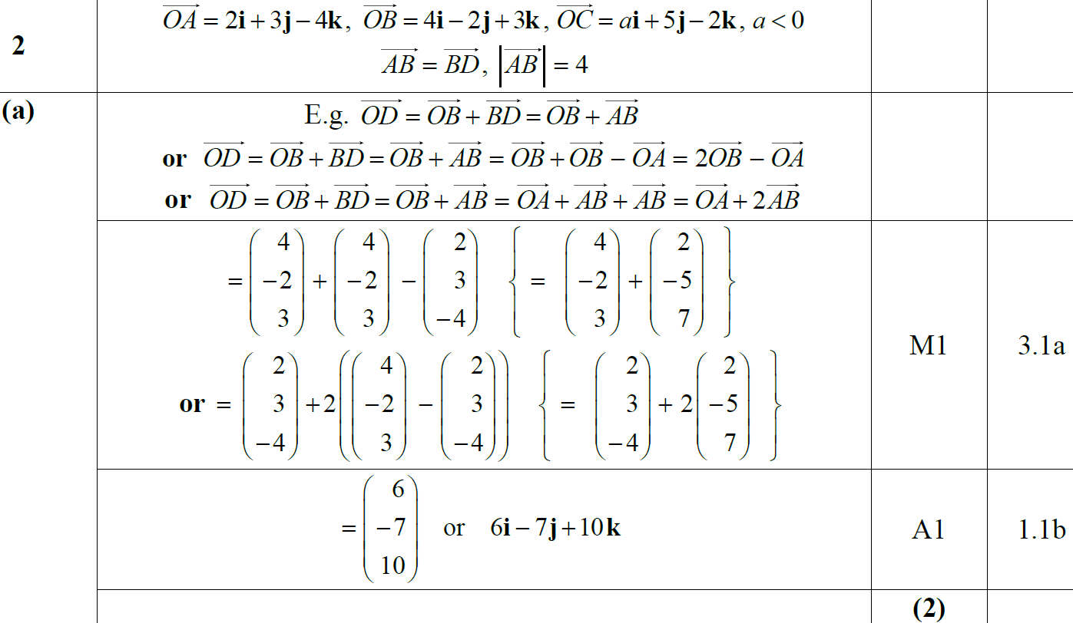
2018 Paper 2
A

Slide 22
2018 Paper 2
B

Slide 23
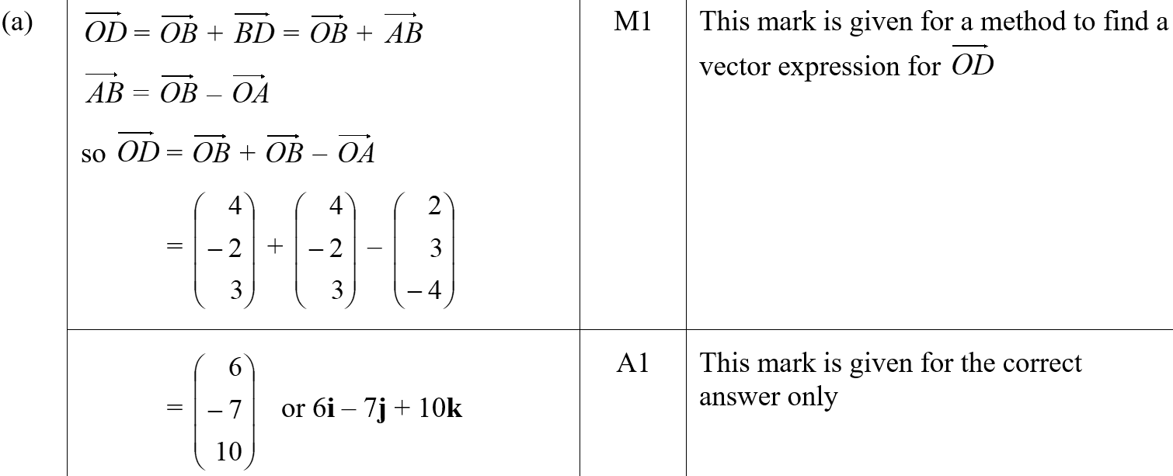
2018 Paper 2
A (SF)
B (SF)
A notes

Slide 24
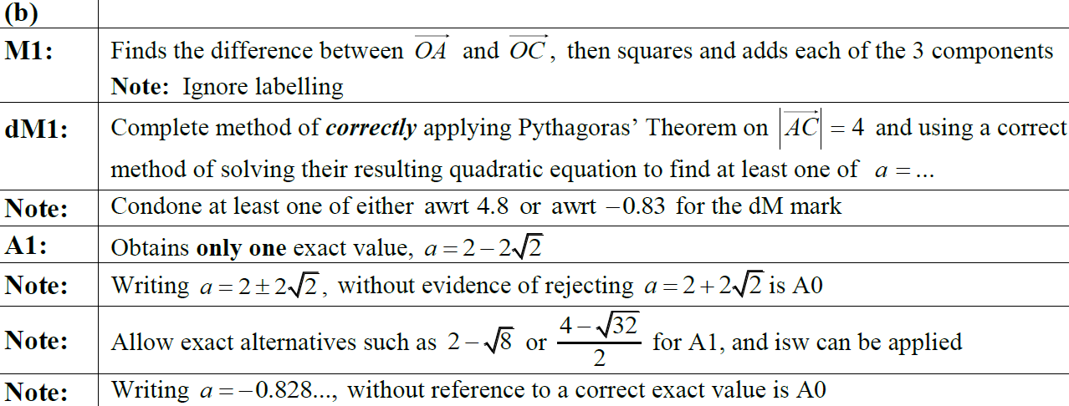
2018 Paper 2
A notes
B notes

