Slide 1
Old Spec Q’s
Vectors
Practice G
Practice H
Practice I
SAM
2018

Slide 2
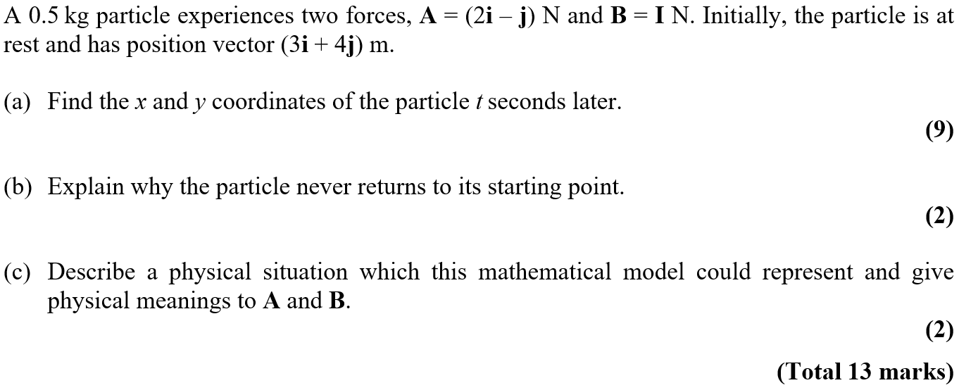
Practice Paper G

Slide 3
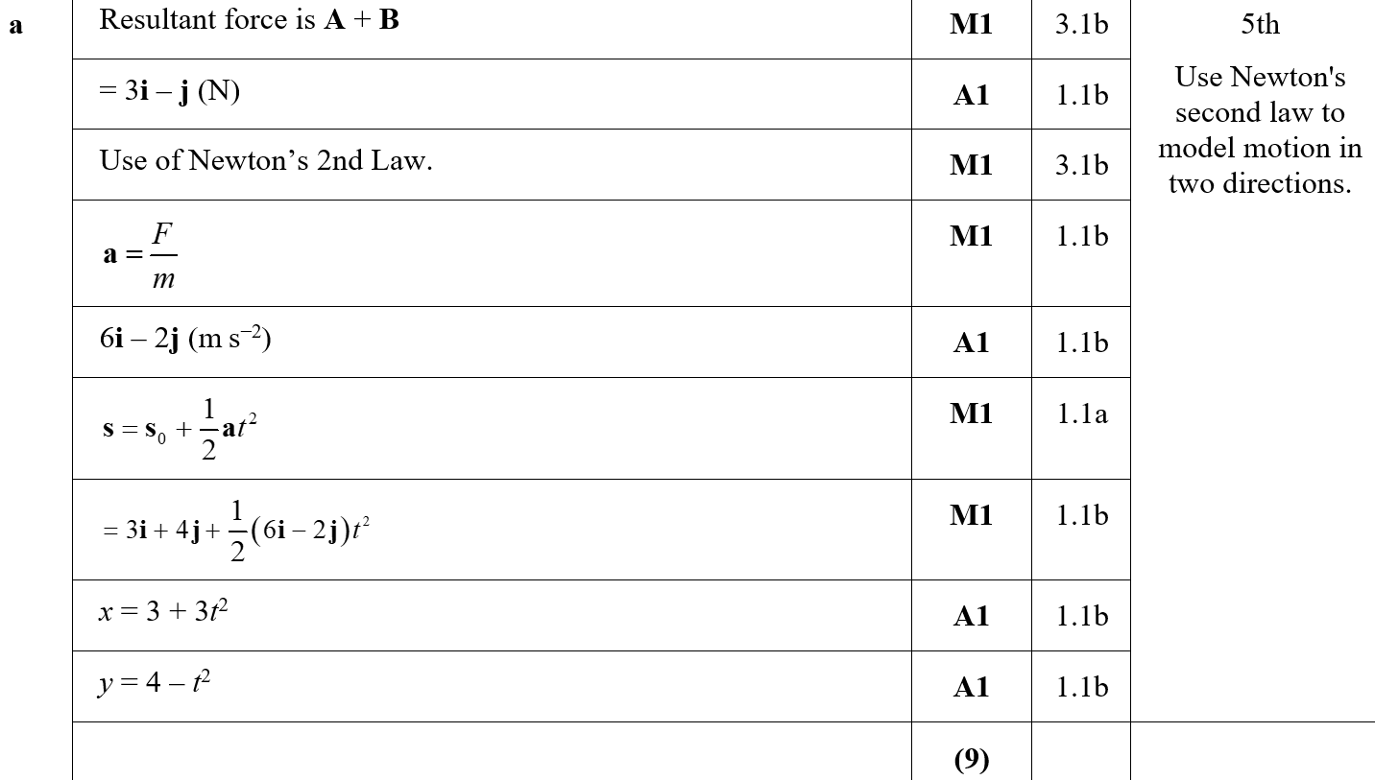
Practice Paper G
A

Slide 4
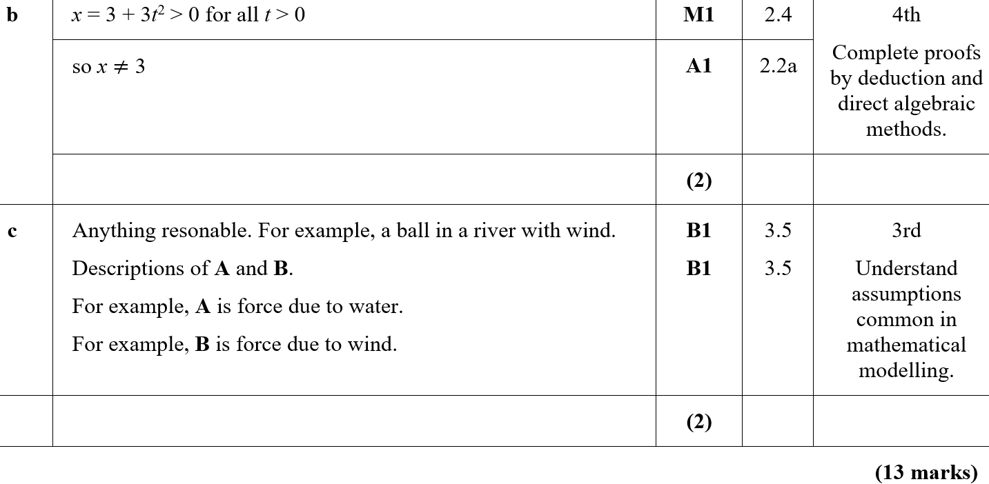
Practice Paper G
B
C
B notes

Slide 5
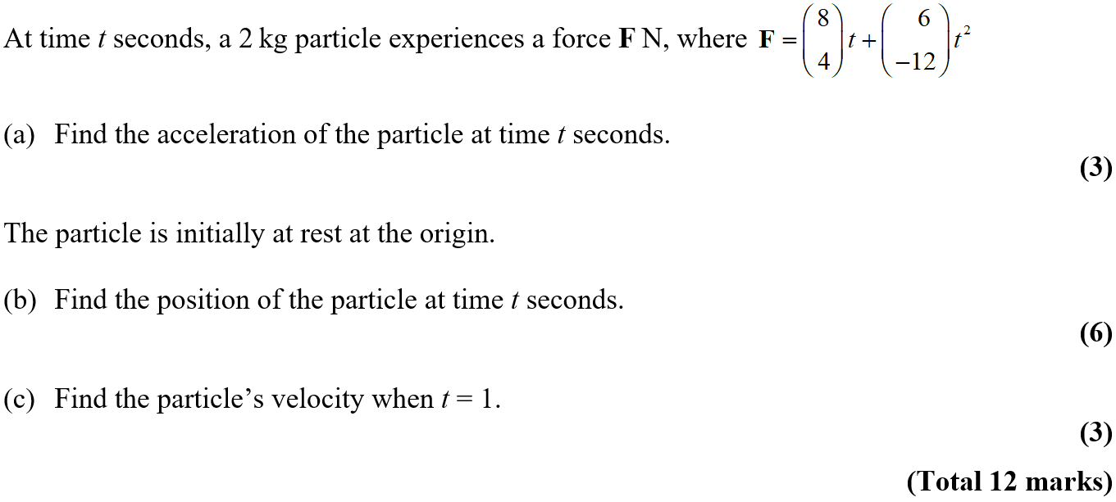
Practice Paper H

Slide 6
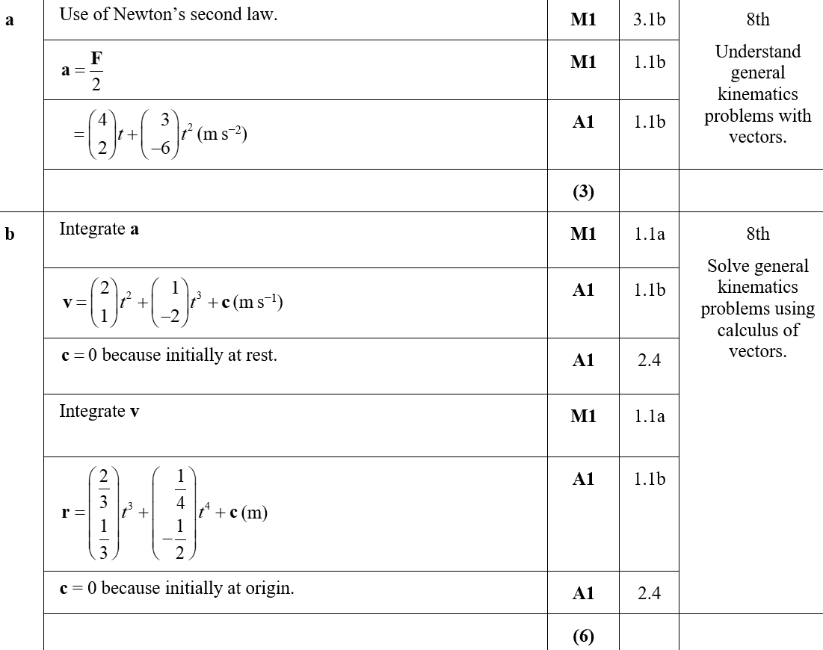
Practice Paper H
A
B

Slide 7
Practice Paper H
C

Slide 8
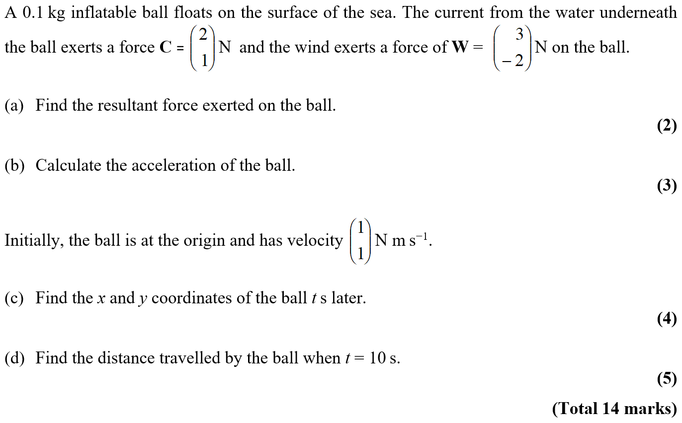
Practice Paper I

Slide 9
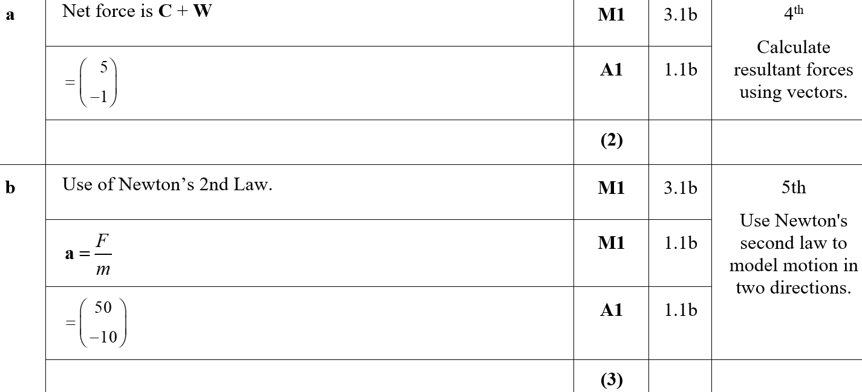
Practice Paper I
A
B

Slide 10
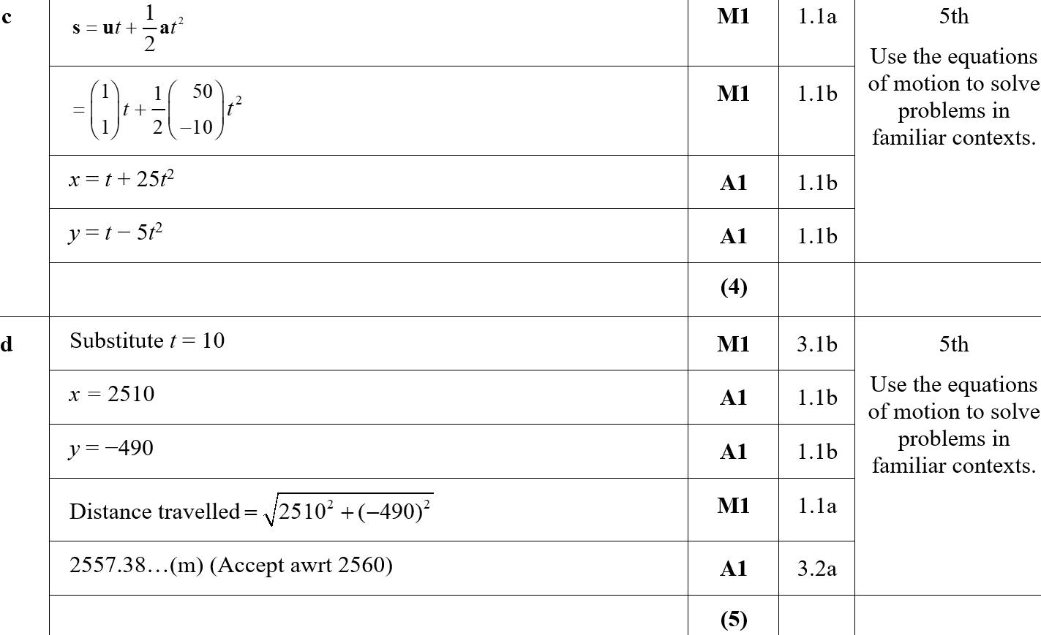
Practice Paper I
C
D

Slide 11
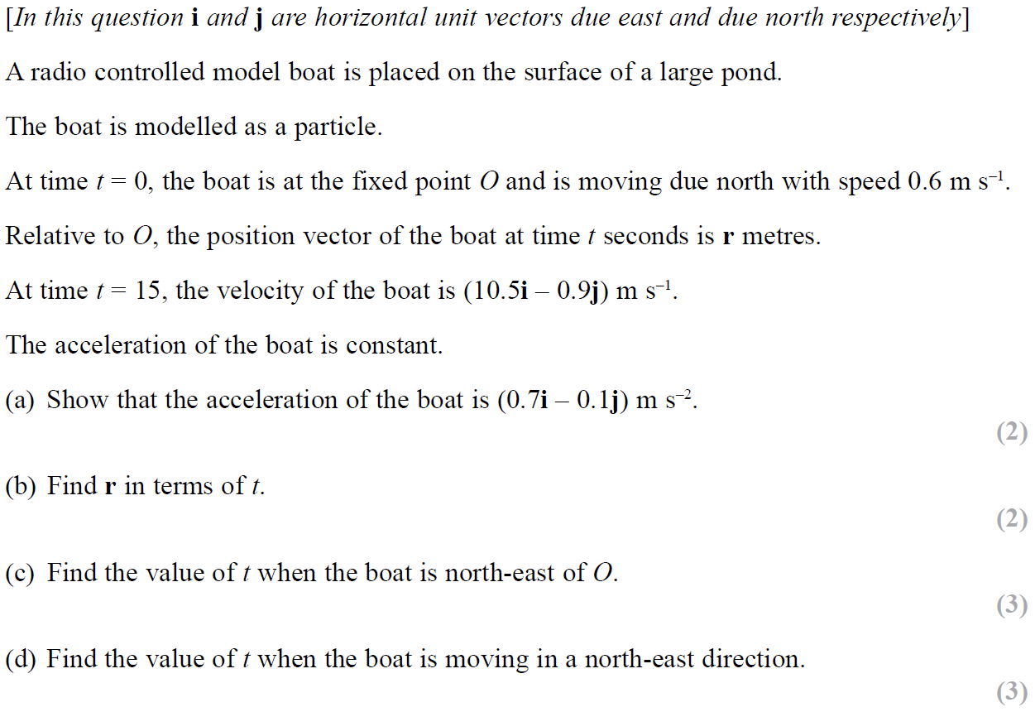
SAM

Slide 12
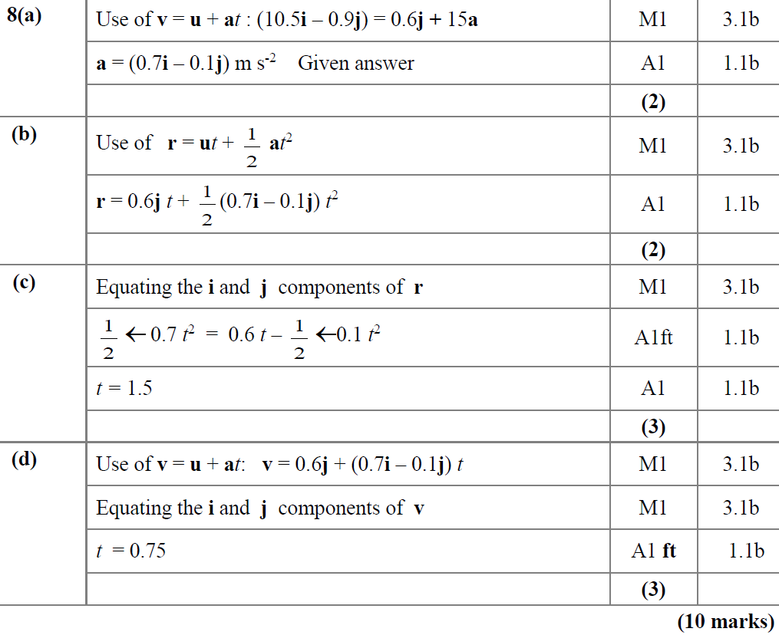
SAM
A
B
C
D

Slide 13
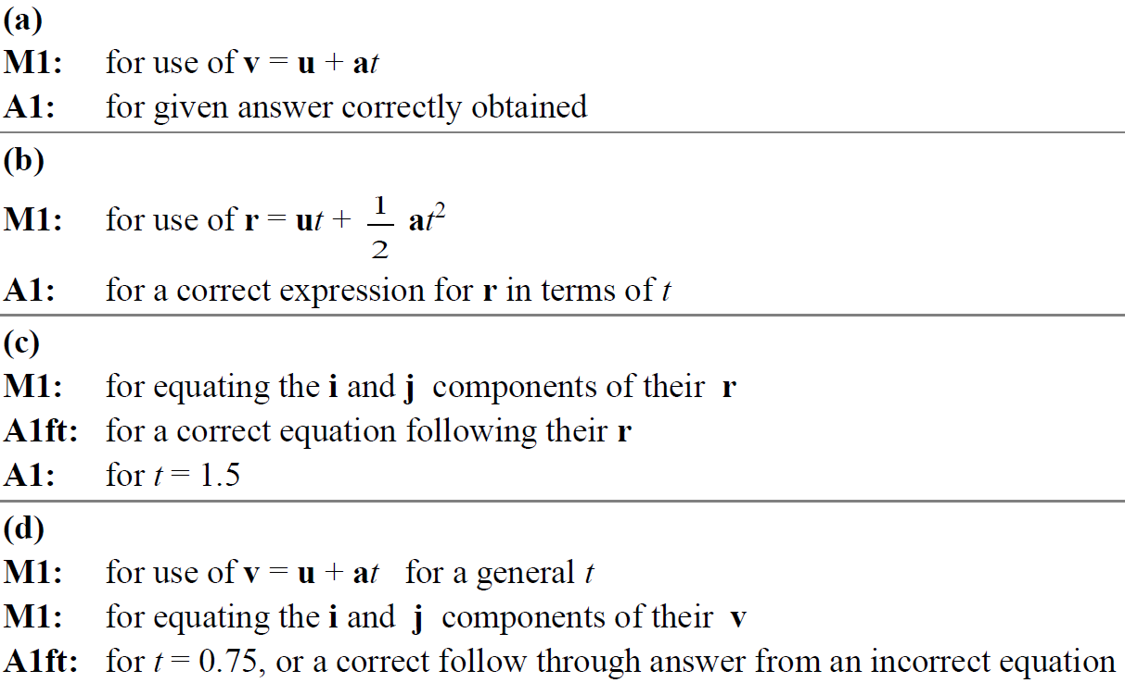
SAM
A notes
B notes
C notes
D notes

Slide 14
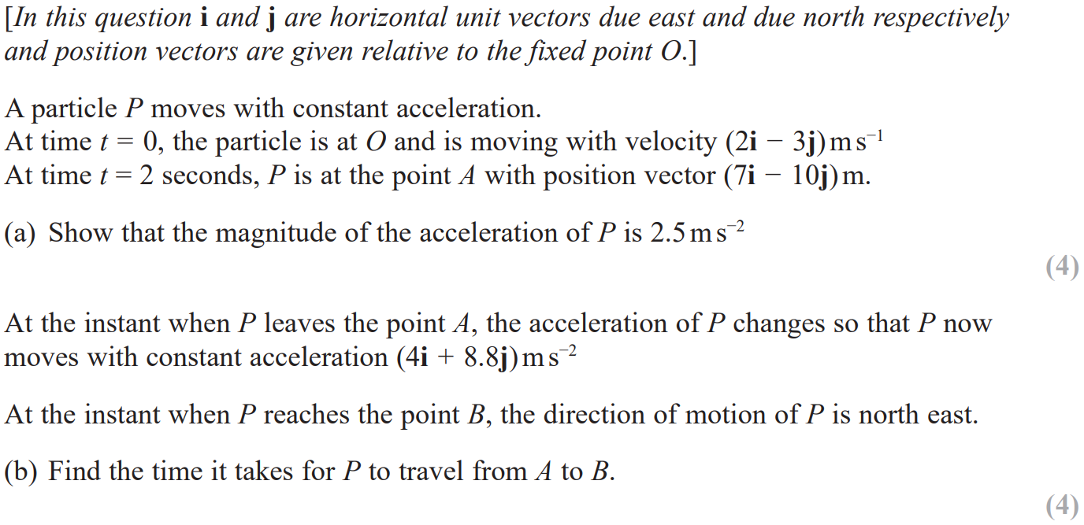
2018

Slide 15
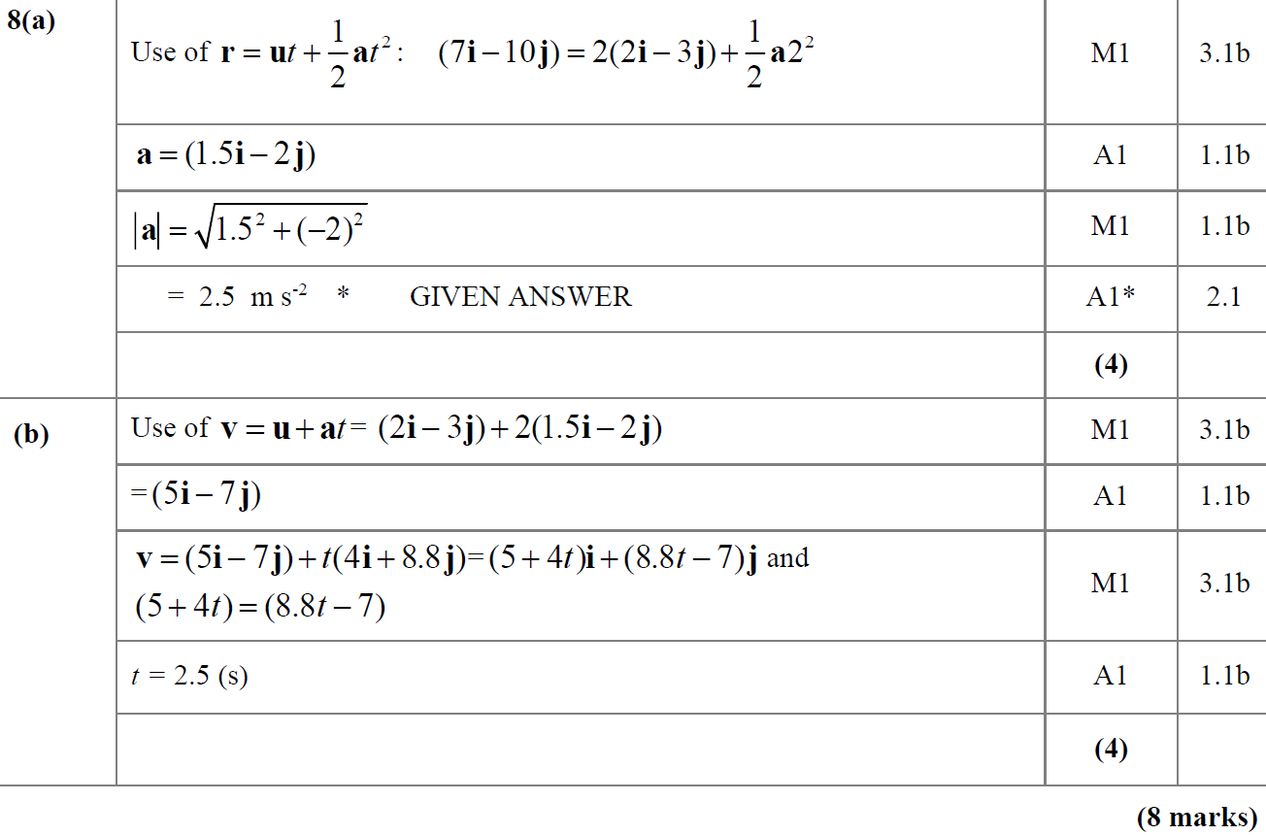
2018
A
B

Slide 16
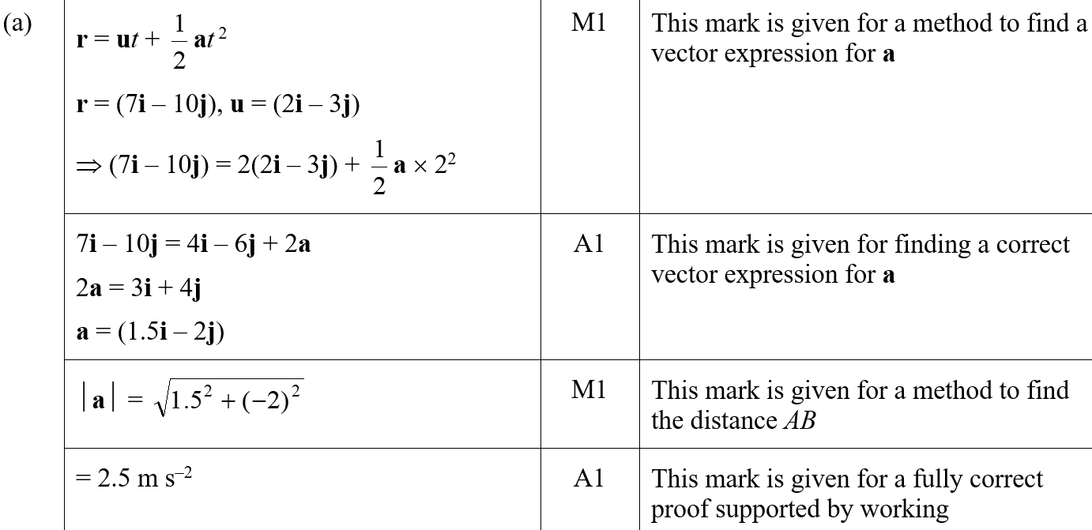
2018
A (SF)

Slide 17
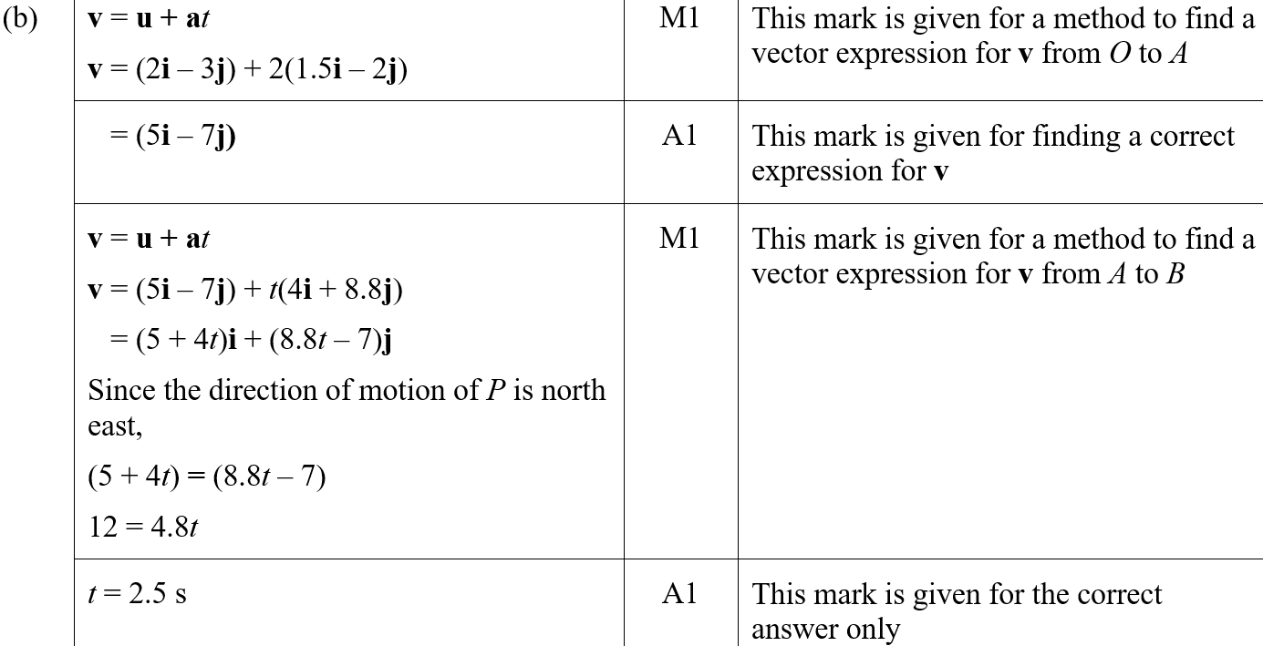
2018
B (SF)

Slide 18
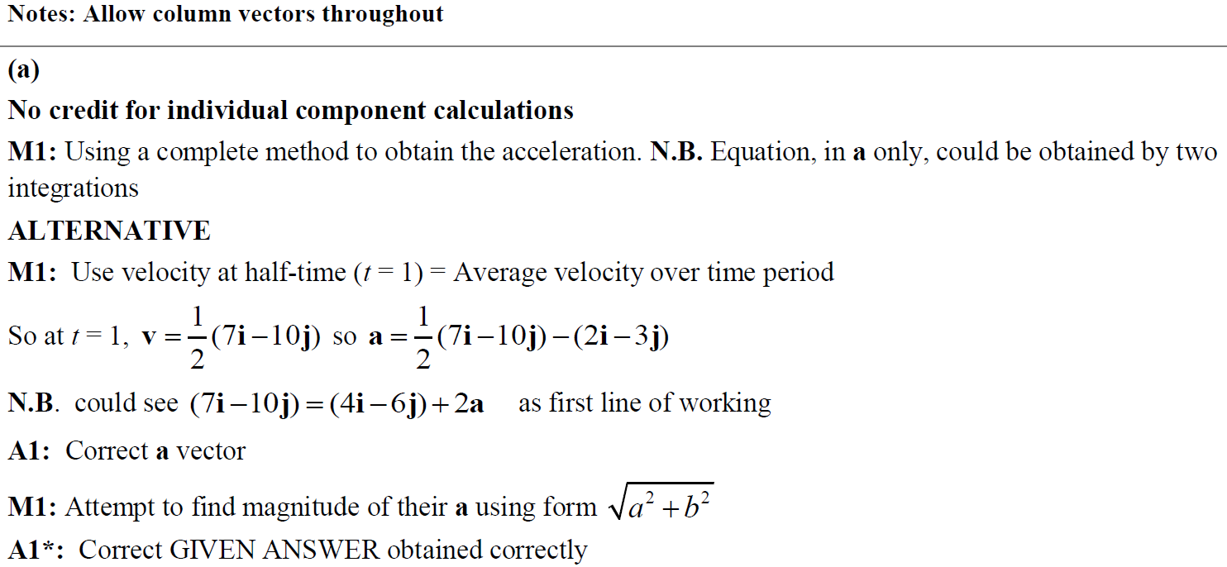
2018
A notes

Slide 19
2018
B notes

Slide 20
New Spec Q’s
Old Spec Vectors
Jan 2006 (i)
May 2012
Jan 2006 (ii)
Jan 2013
June 2006
May 2013
Jan 2007
June 2014
June 2007
June 2015
Jan 2008
June 2016 (i)
May 2008
June 2016 (ii)
Jan 2009 (i)
June 2017 (i)
Jan 2009 (ii)
Jan 2010
May 2011
June 2017 (ii)
May 2009 (i)
May 2010
Jan 2012 (i)
June 2018
May 2009 (ii)
Jan 2011
Jan 2012 (ii)

Slide 21
Jan 2006

Slide 22
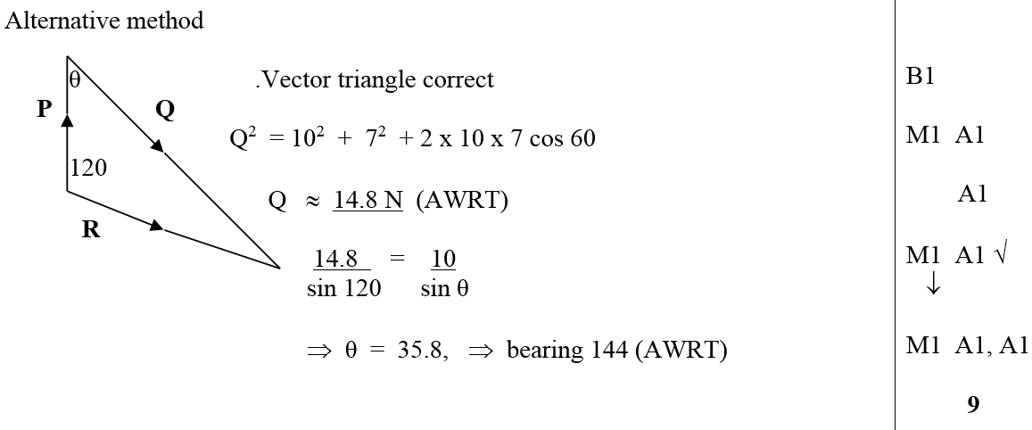
Jan 2006
i
ii
Alternative Method

Slide 23
Jan 2006

Slide 24
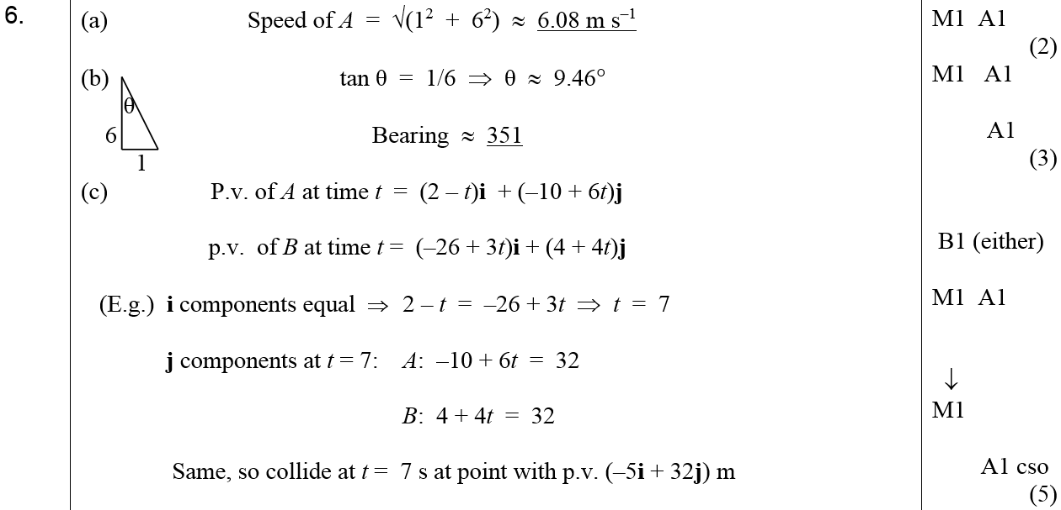
Jan 2006
A
B
C
D

Slide 25
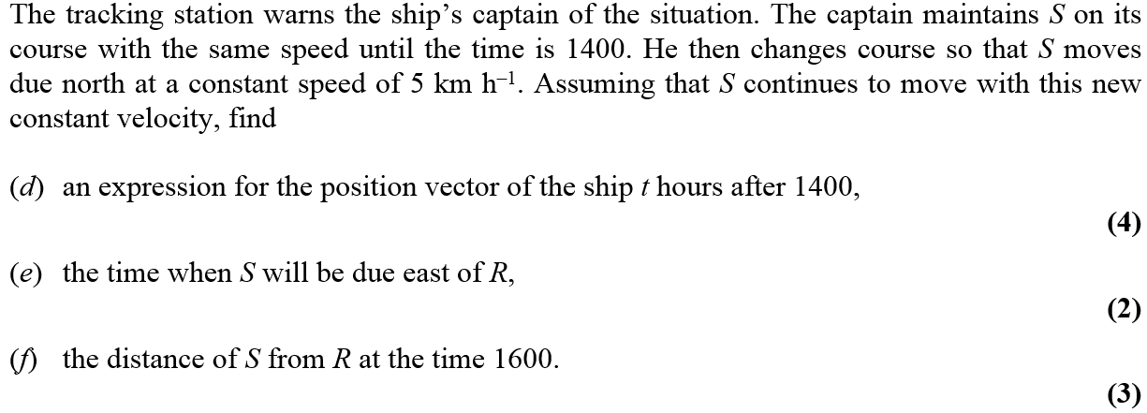
June 2006

Slide 26
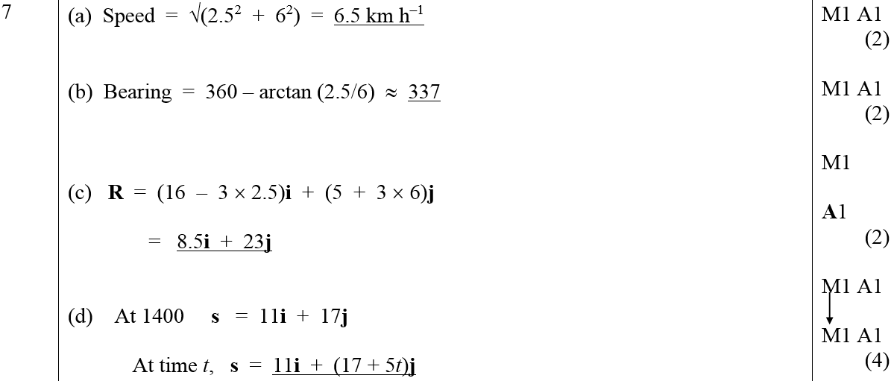
June 2006
A
B
C
D
E
F

Slide 27
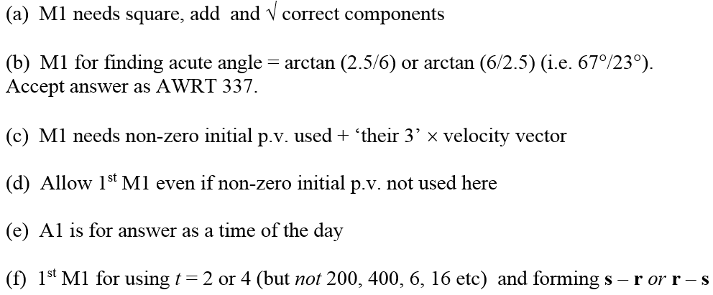
June 2006
A Notes
B Notes
C Notes
D Notes
E Notes
F Notes

Slide 28
Jan 2007

Slide 29
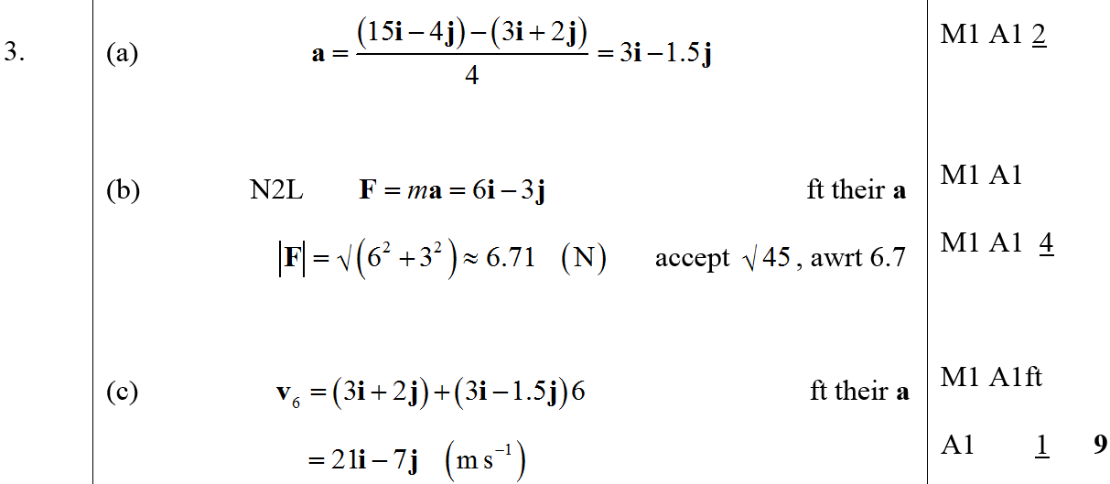
Jan 2007
A
B
C

Slide 30
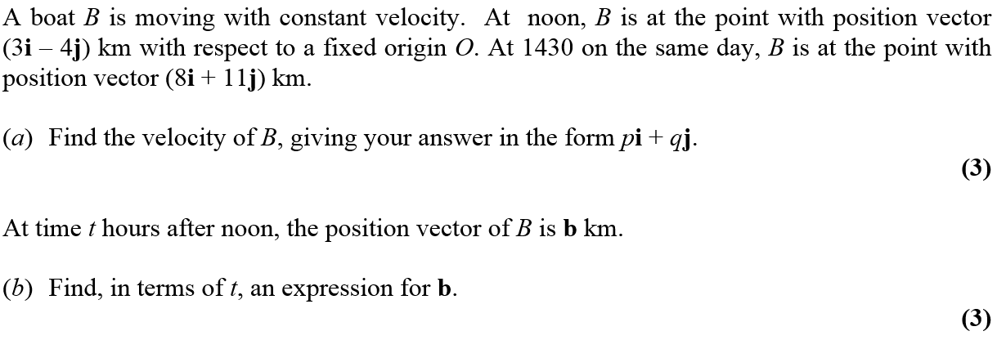
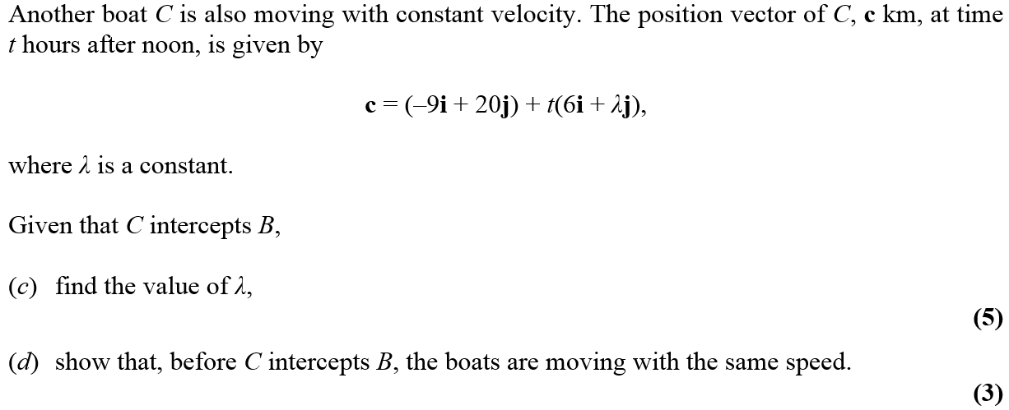
June 2007

Slide 31
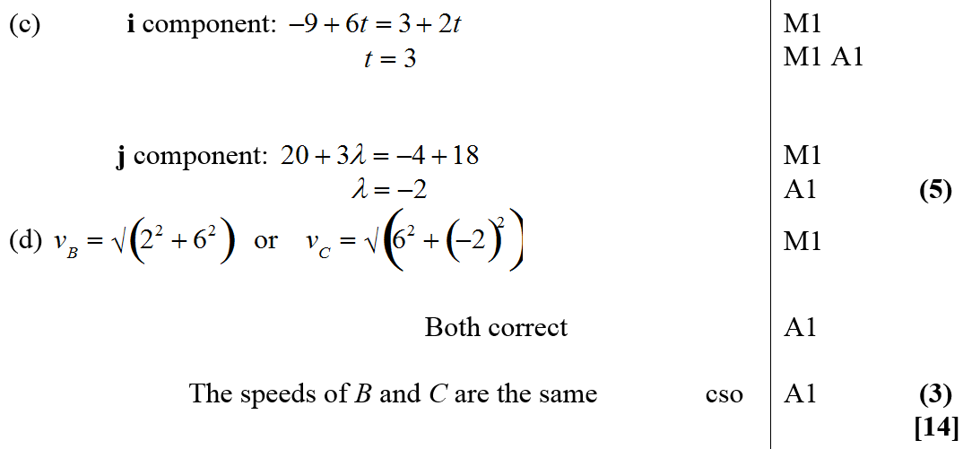
June 2007
A
B
C
D

Slide 32
Jan 2008

Slide 33
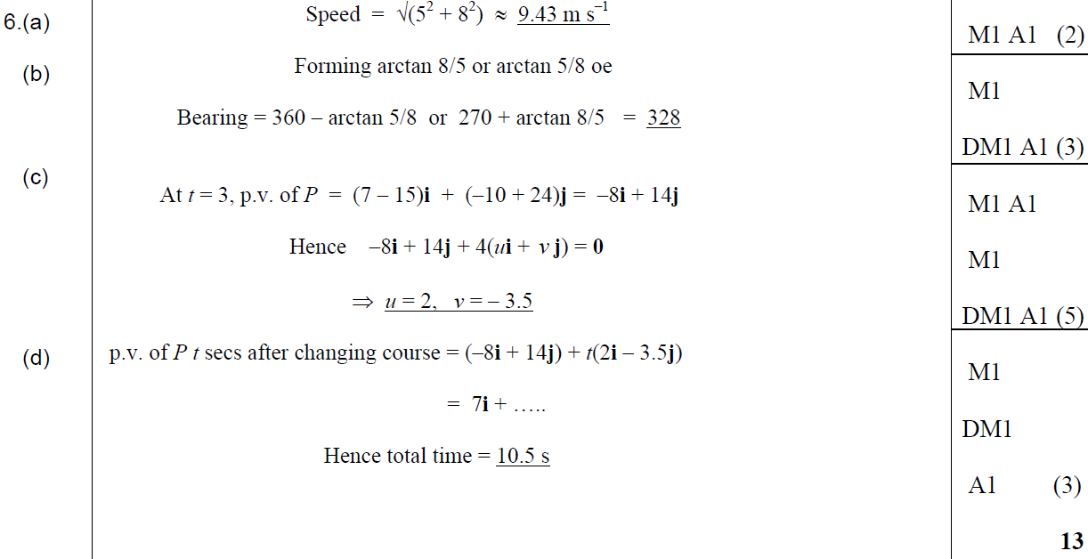
Jan 2008
A
B
C
D

Slide 34
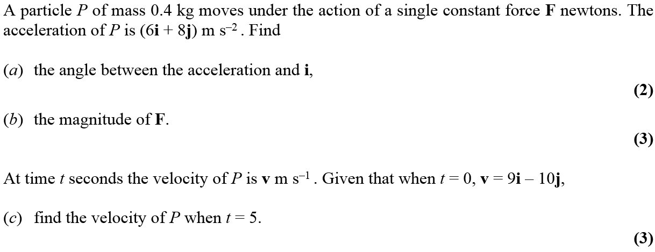
May 2008

Slide 35
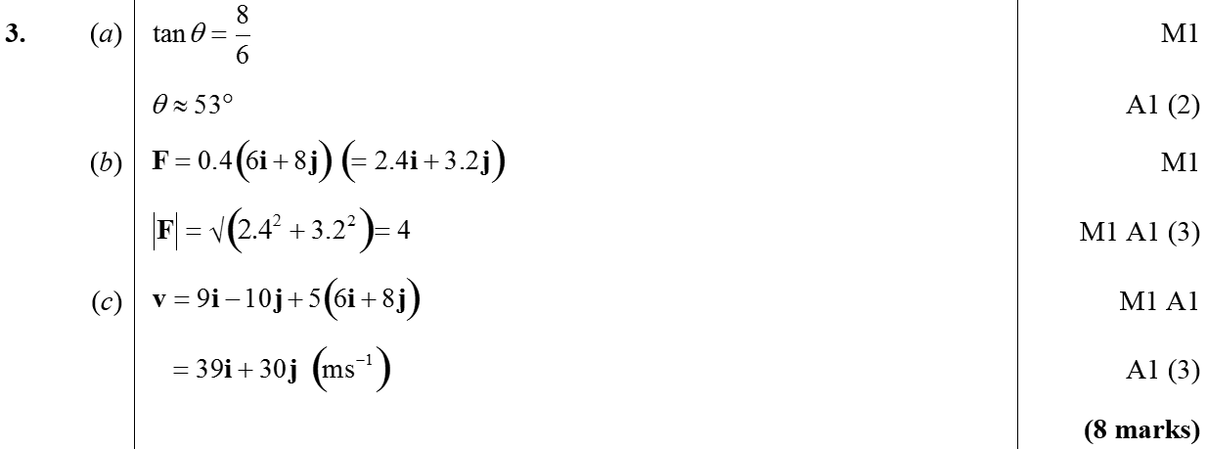
May 2008
A
B
C

Slide 36
Jan 2009

Slide 37
Jan 2009
A

Slide 38
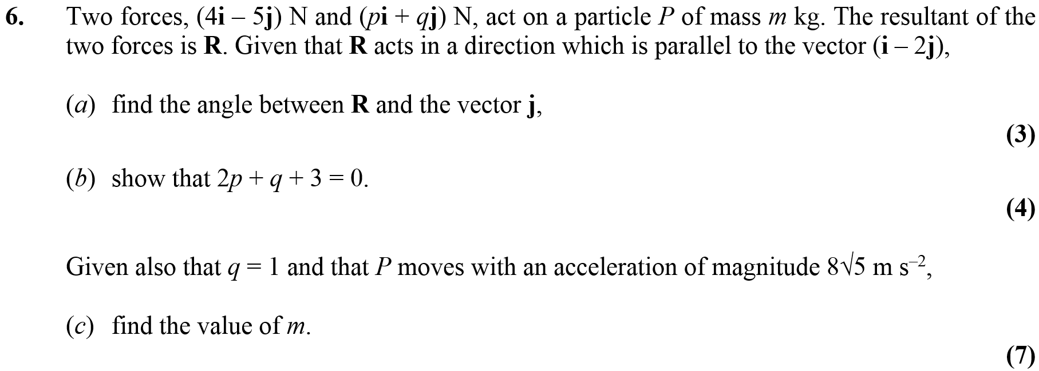
Jan 2009

Slide 39
Jan 2009
A
B
C

Slide 40
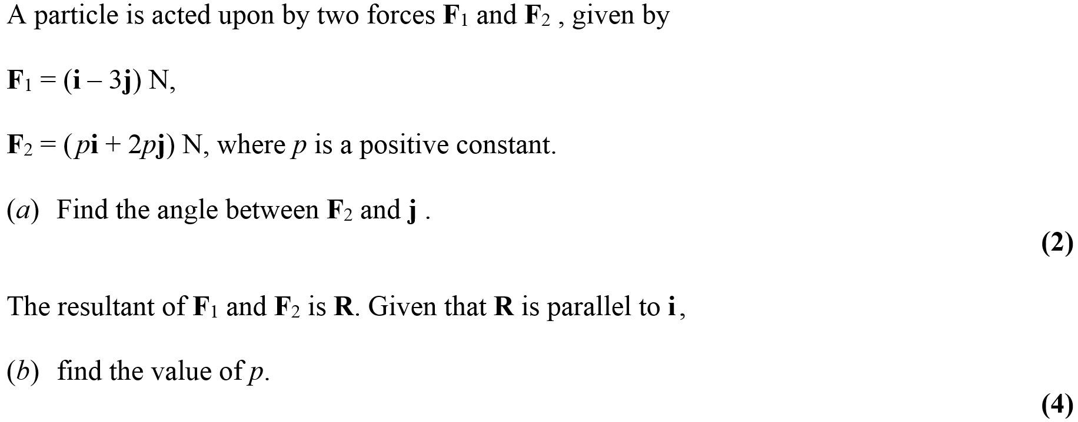
May 2009

Slide 41
May 2009
A
B

Slide 42
May 2009

Slide 43
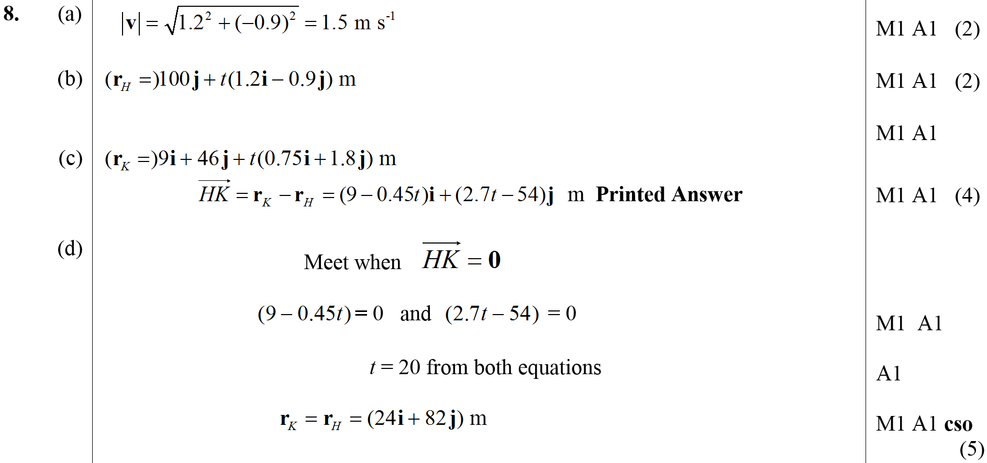
May 2009
A
B
C
D

Slide 44
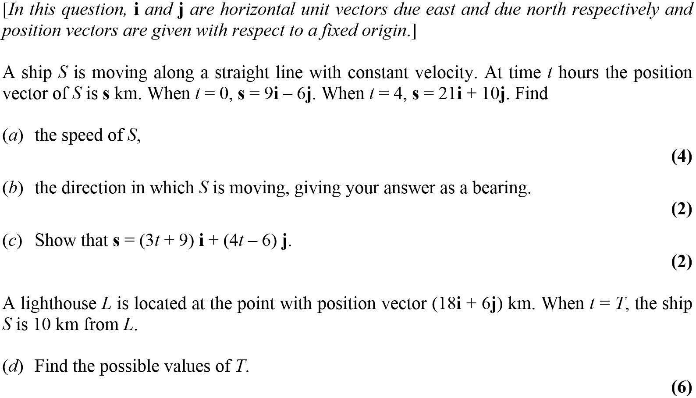
Jan 2010

Slide 45
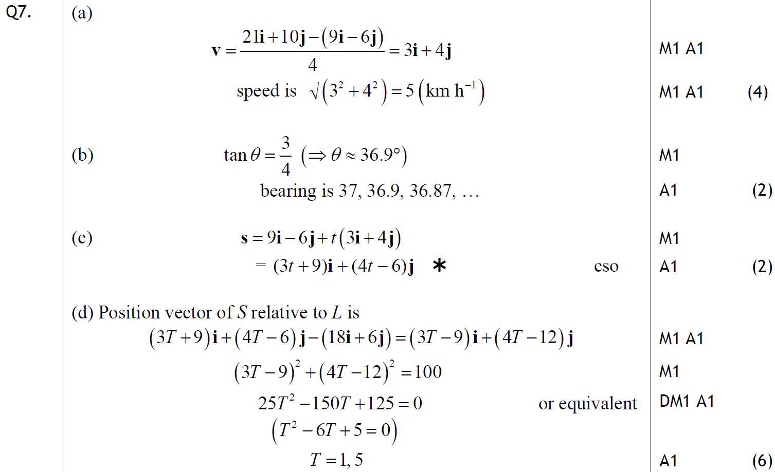
Jan 2010
A
B
C
D

Slide 46
May 2010

Slide 47
May 2010
A

Slide 48
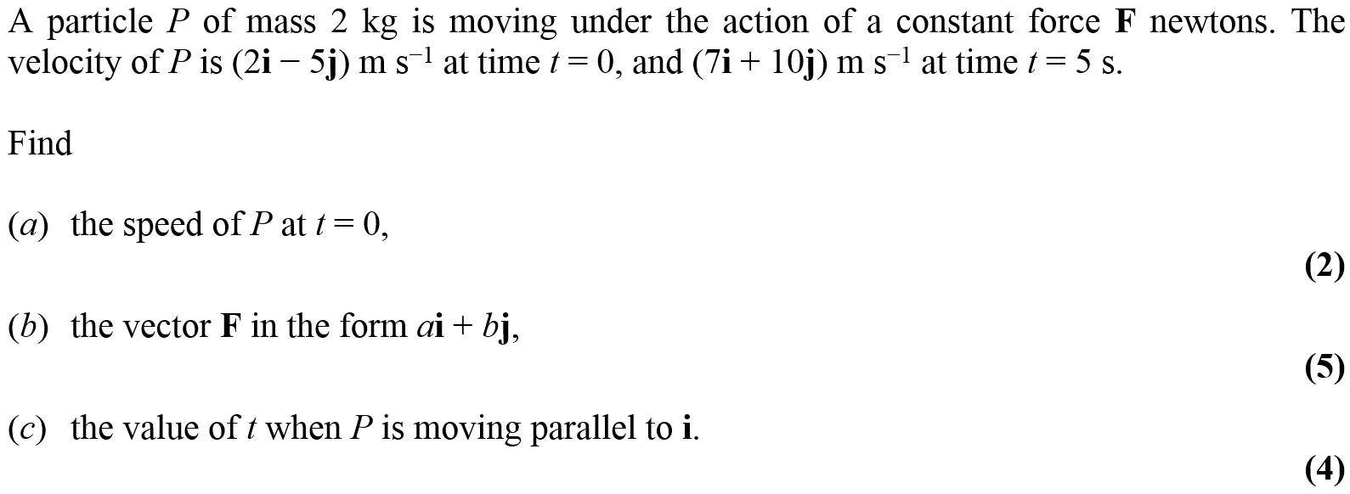
Jan 2011

Slide 49
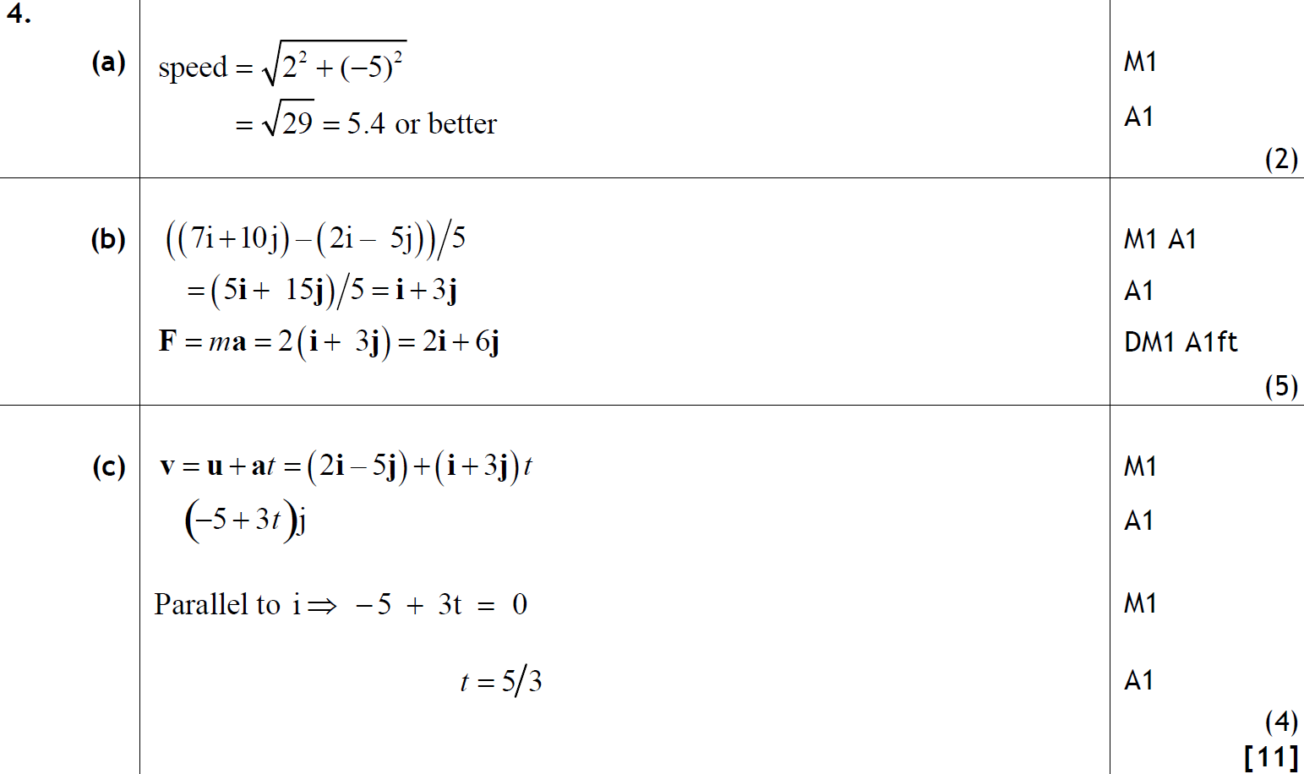
Jan 2011
A
B
C

Slide 50
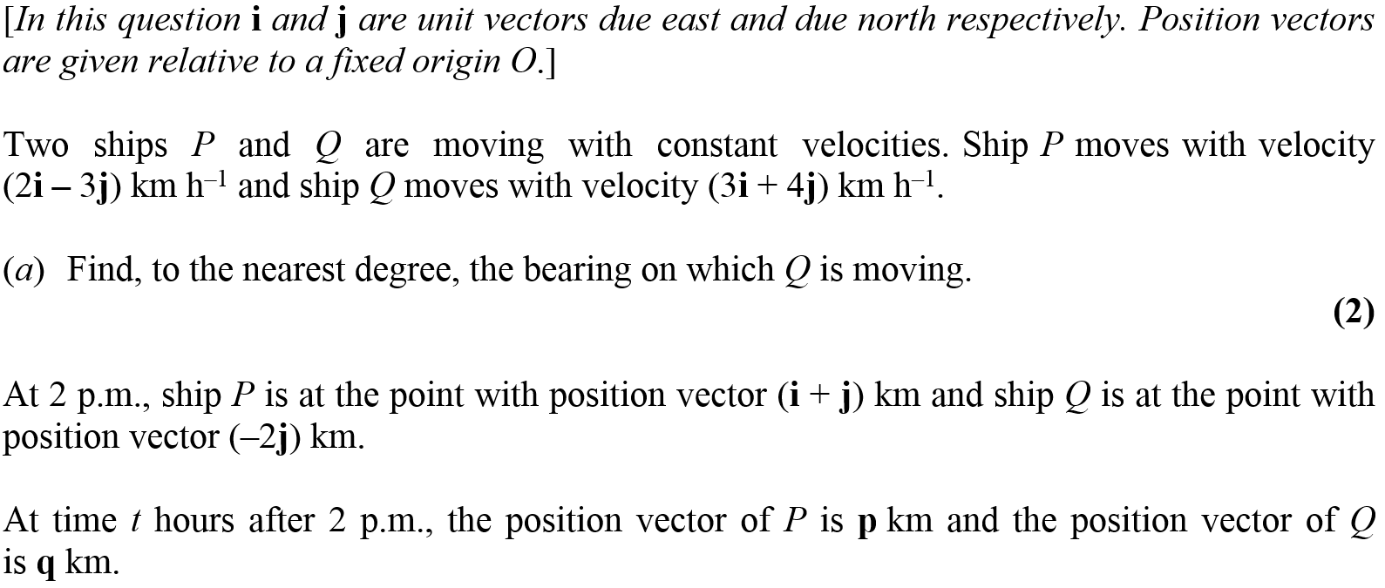
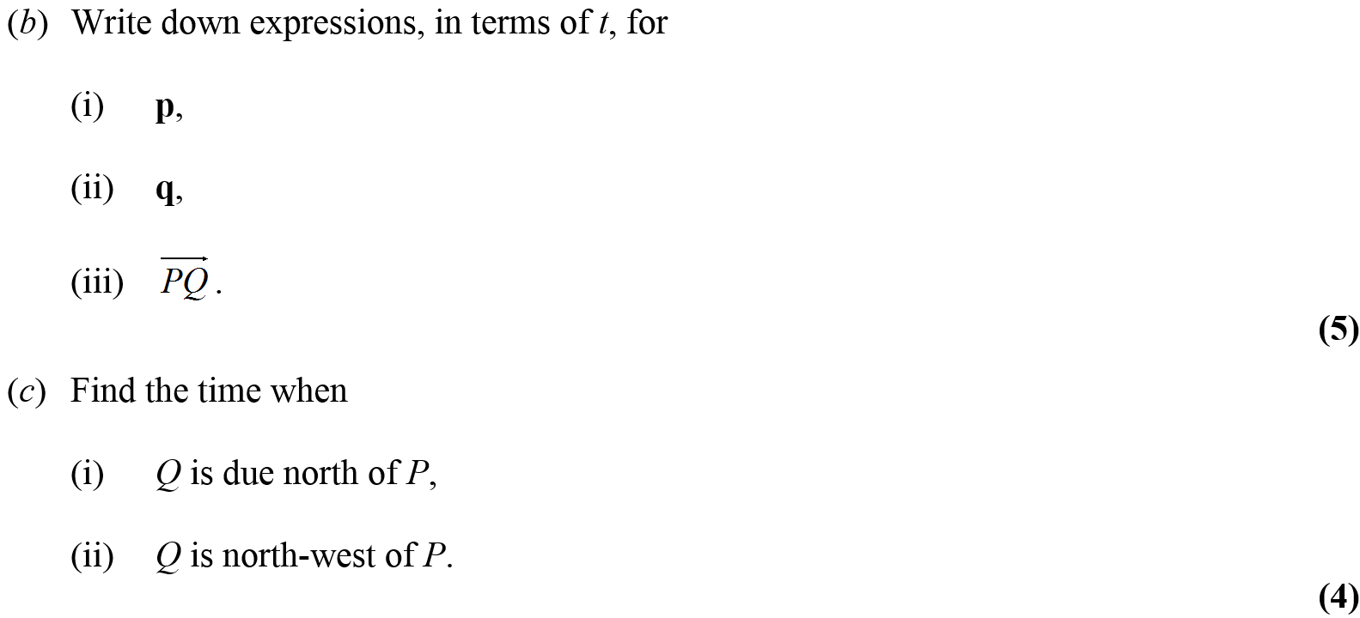
May 2011

Slide 51
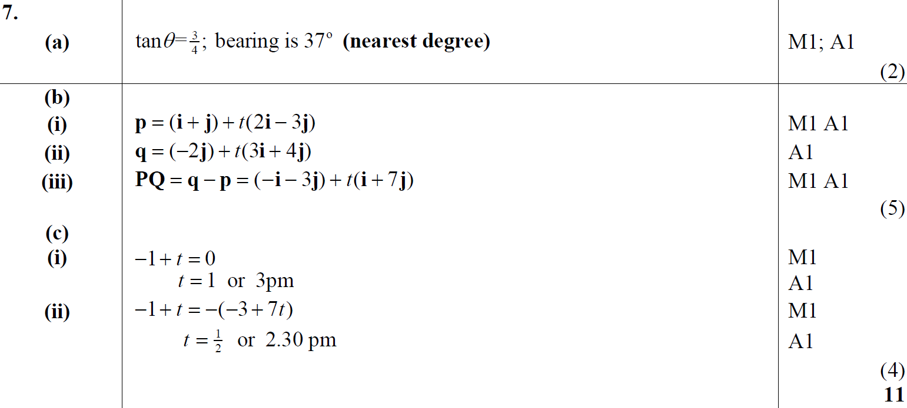
May 2011
A
B (i)
B (ii)
B (iii)
C (i)
C (ii)

Slide 52
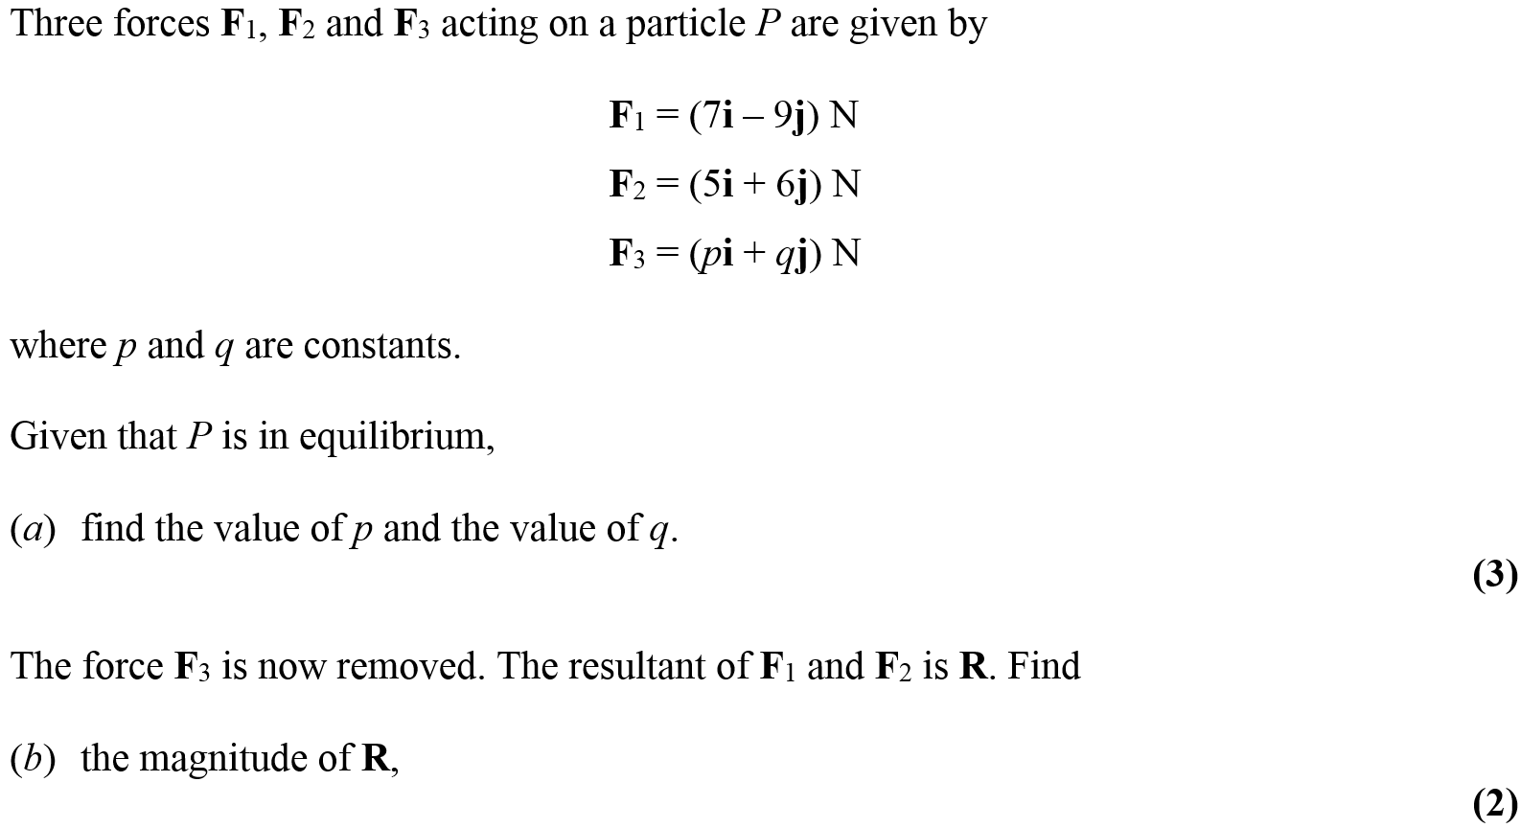
Jan 2012

Slide 53
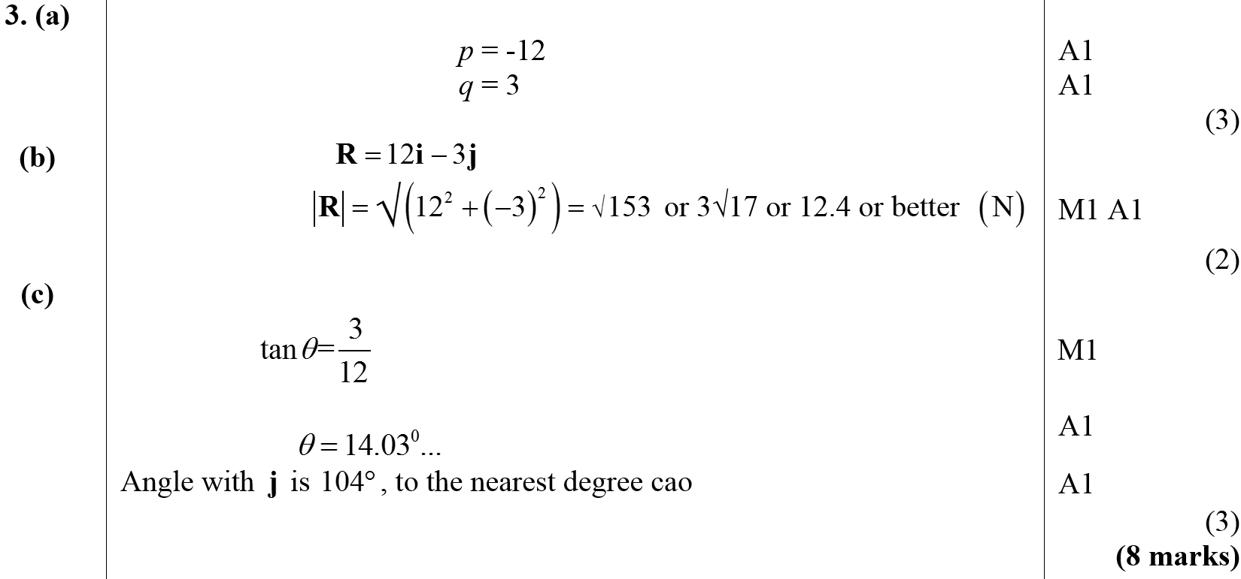
Jan 2012
A
B
C

Slide 54
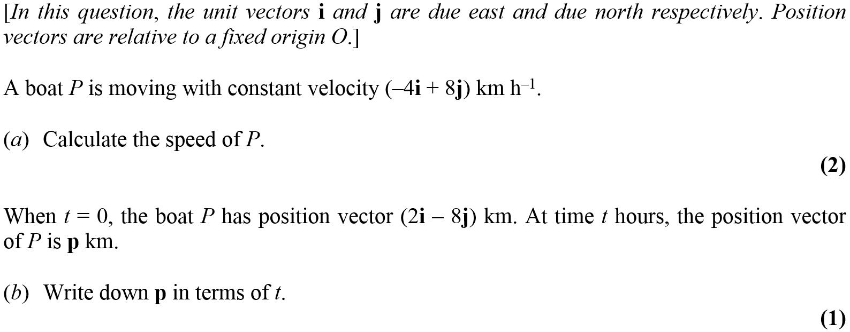
Jan 2012

Slide 55
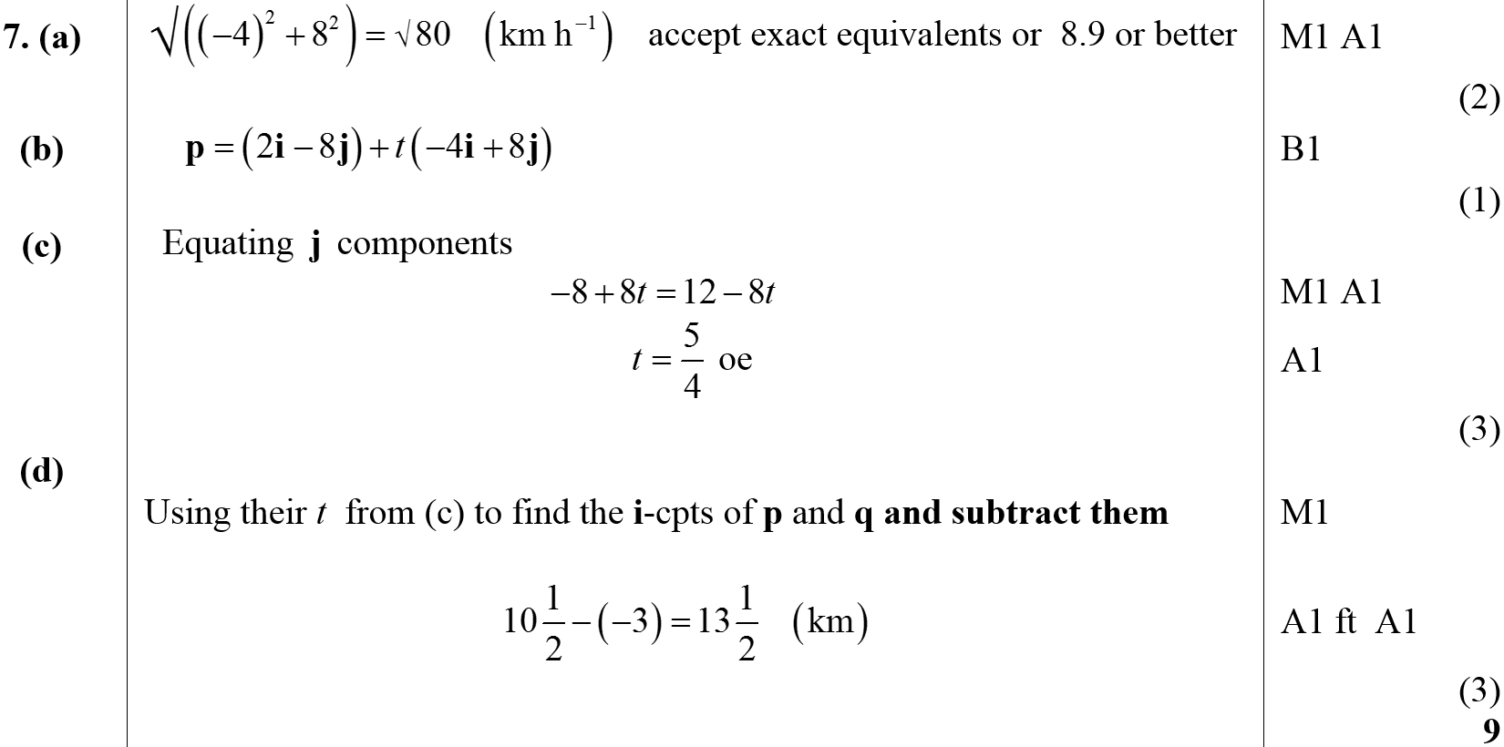
Jan 2012
A
B
C
D

Slide 56
May 2012

Slide 57
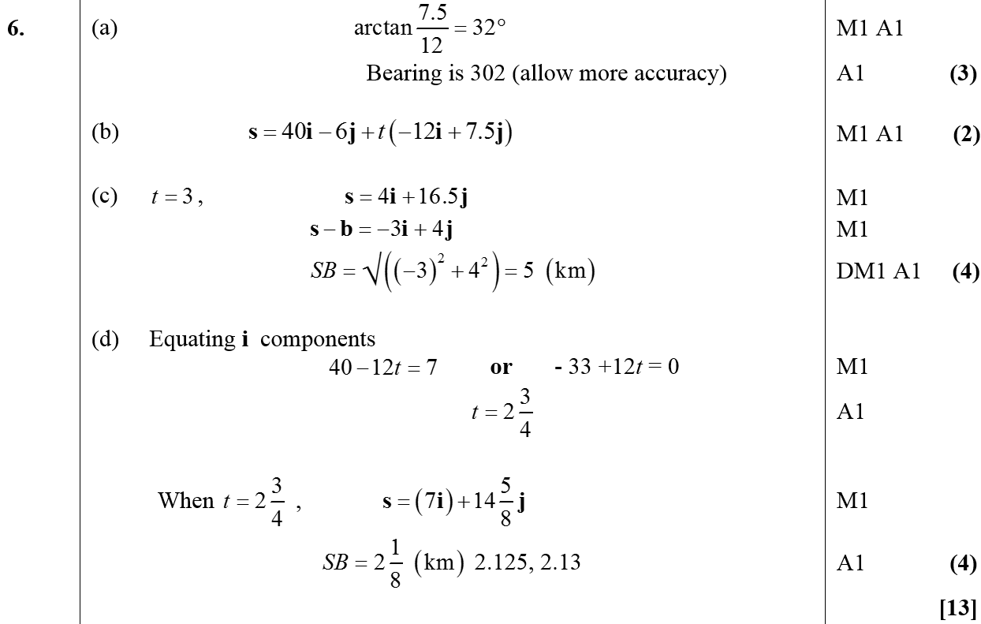
May 2012
A
B
C
D

Slide 58
Jan 2013

Slide 59
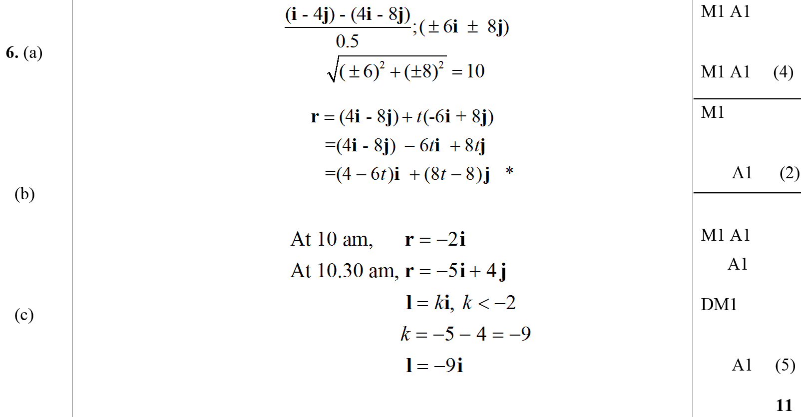
Jan 2013
A
B
C

Slide 60
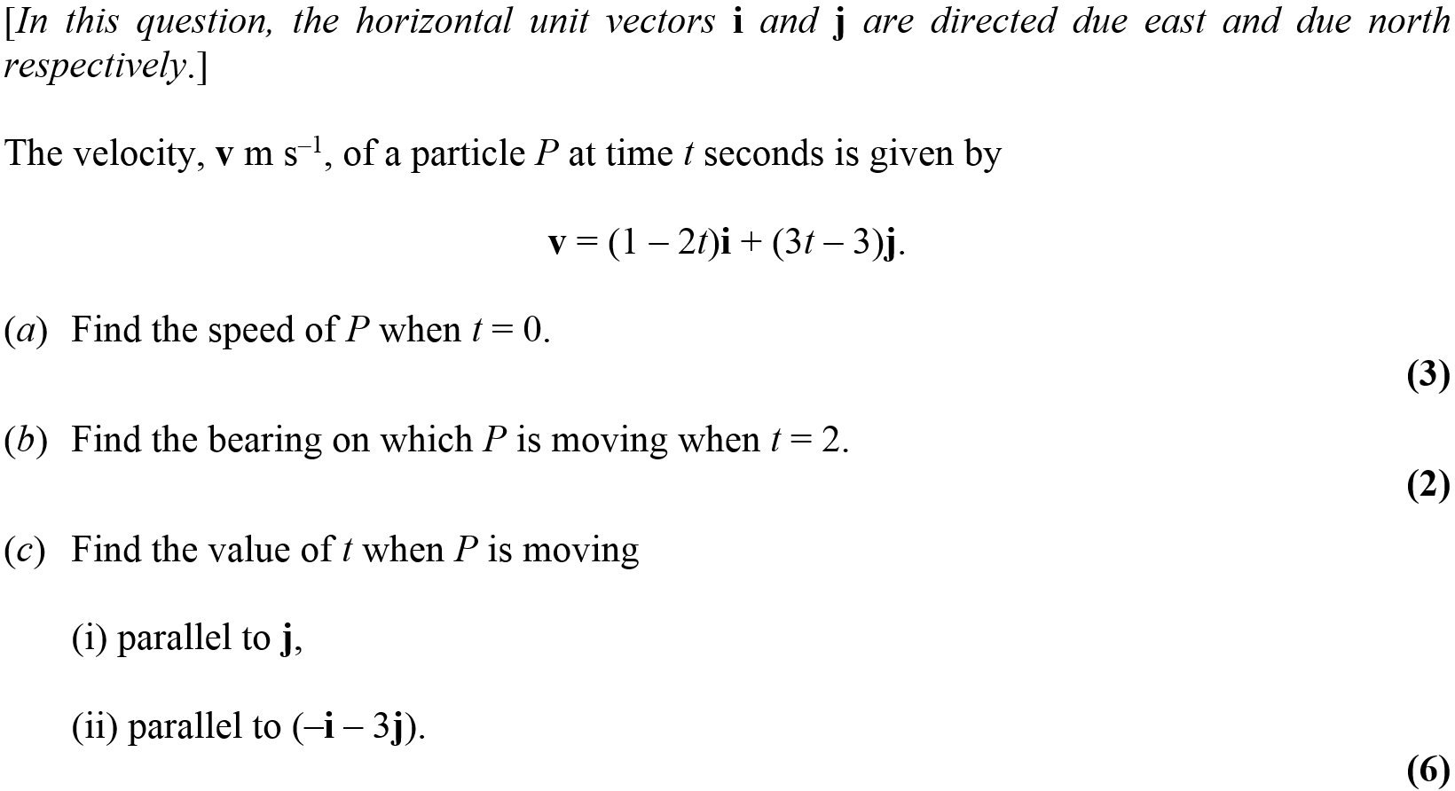
May 2013

Slide 61
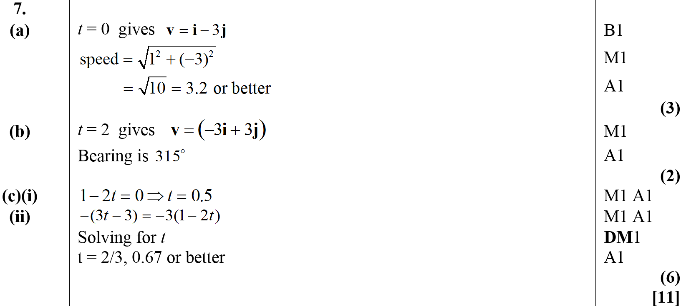
May 2013
A
B
C (i)
C (ii)

Slide 62
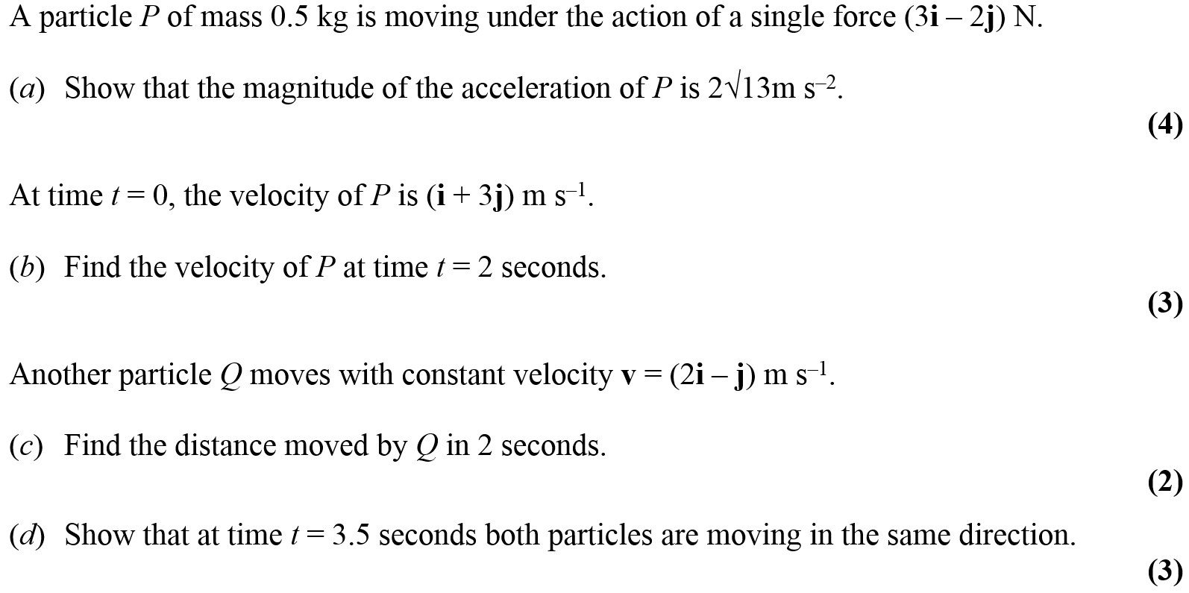
June 2014

Slide 63
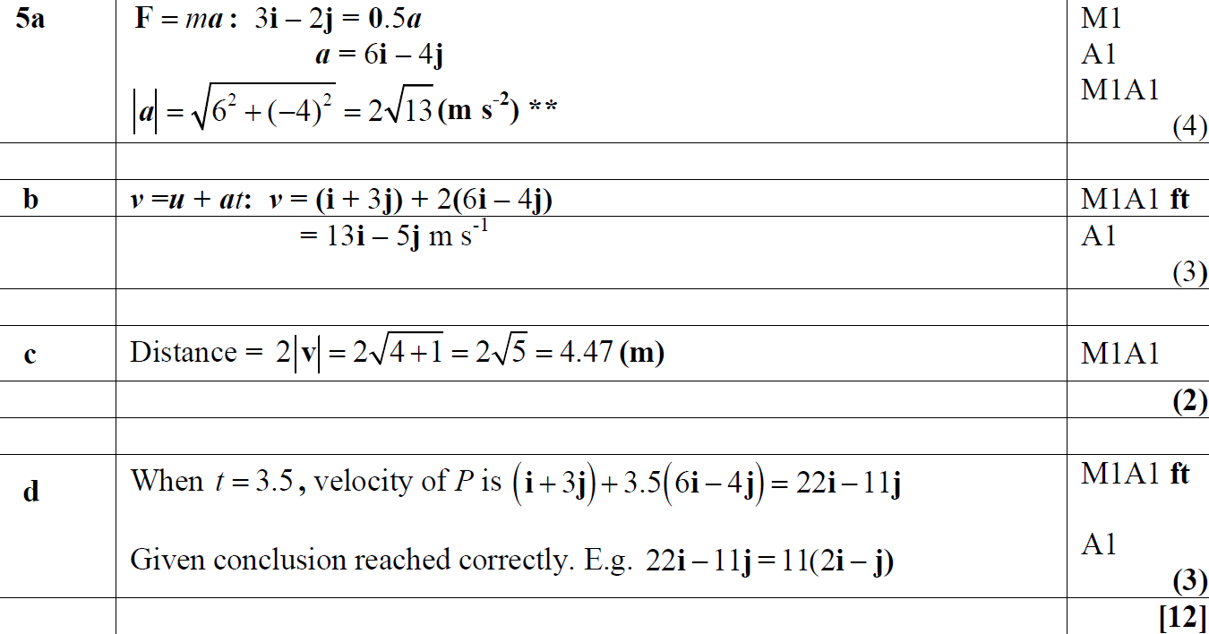
June 2014
A
B
C
D

Slide 64
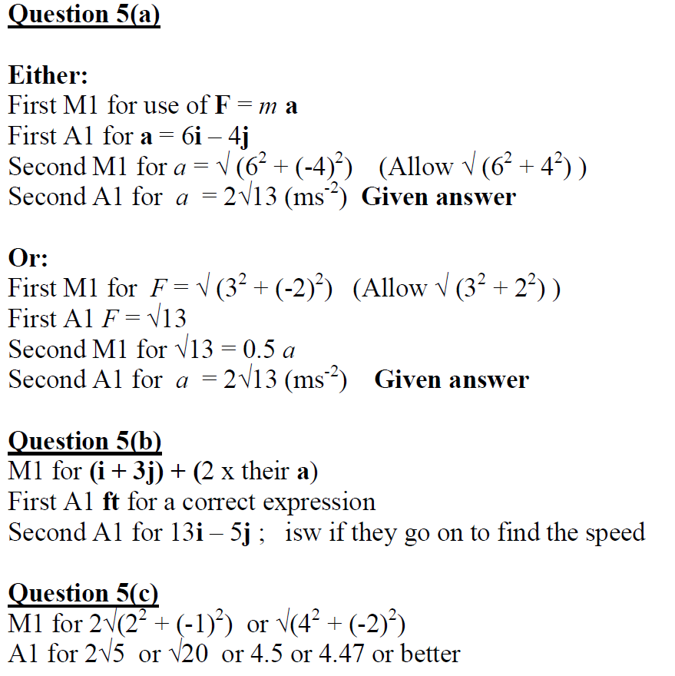
June 2014
A Notes
B Notes
C Notes
D Notes

Slide 65
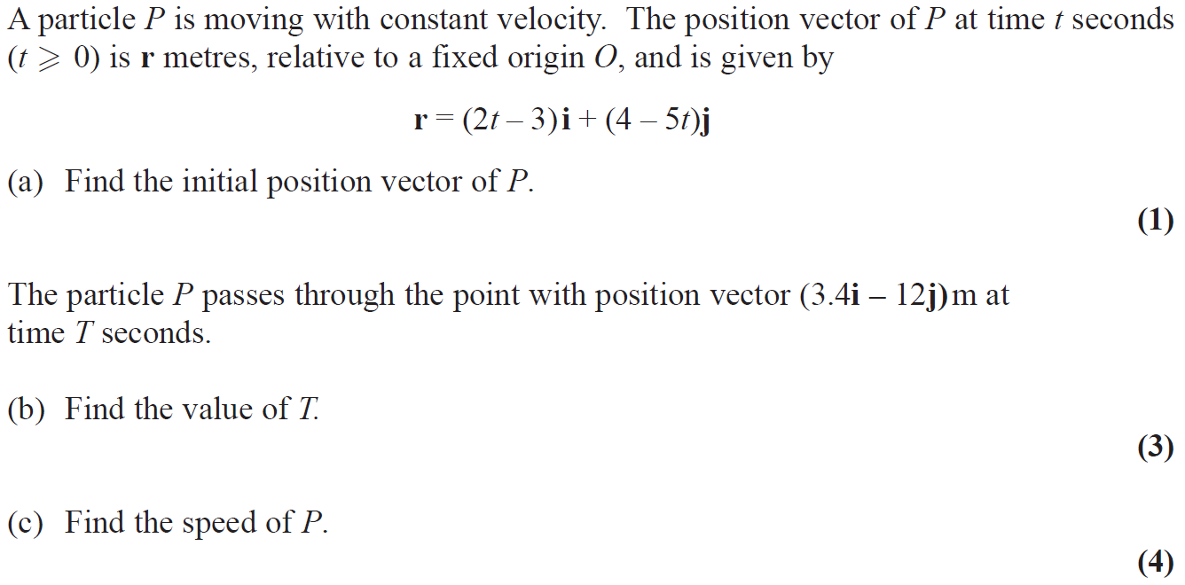
June 2015

Slide 66
June 2015
A
B
C
C Alternative

Slide 67
June 2015
A Notes
B Notes

Slide 68
June 2015
C Notes

Slide 69
June 2016

Slide 70
June 2016
A
B
C

Slide 71
June 2016
A Notes
B Notes
C Notes

Slide 72
June 2016

Slide 73
June 2016
A
A Alternative
B

Slide 74
June 2016
A notes

Slide 75
June 2016
A Alternative with simultaneous equations notes

Slide 76
June 2016
A Alternative 1 with magnitudes and directions notes

Slide 77
June 2016
A Alternative 2 with magnitudes and directions notes
B Notes

Slide 78
June 2017

Slide 79
June 2017
A
A notes

Slide 80
June 2017

Slide 81
June 2017
A
B
C
D

Slide 82
June 2017
A notes
B notes
C notes
D notes

Slide 83
June 2018

Slide 84
June 2018
A
B
C

Slide 85
June 2018
A notes
B notes

Slide 86
June 2018
B Alternative notes
C notes

