Slide 1
Old Spec Q’s
Variable Acceleration
Practice G
Practice H
(i)
Practice H
(ii)
SAM
2018

Slide 2
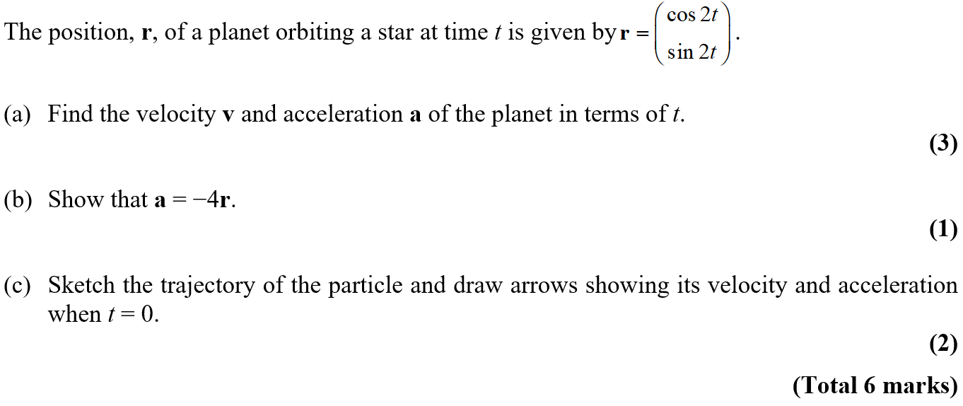
Practice Paper G

Slide 3
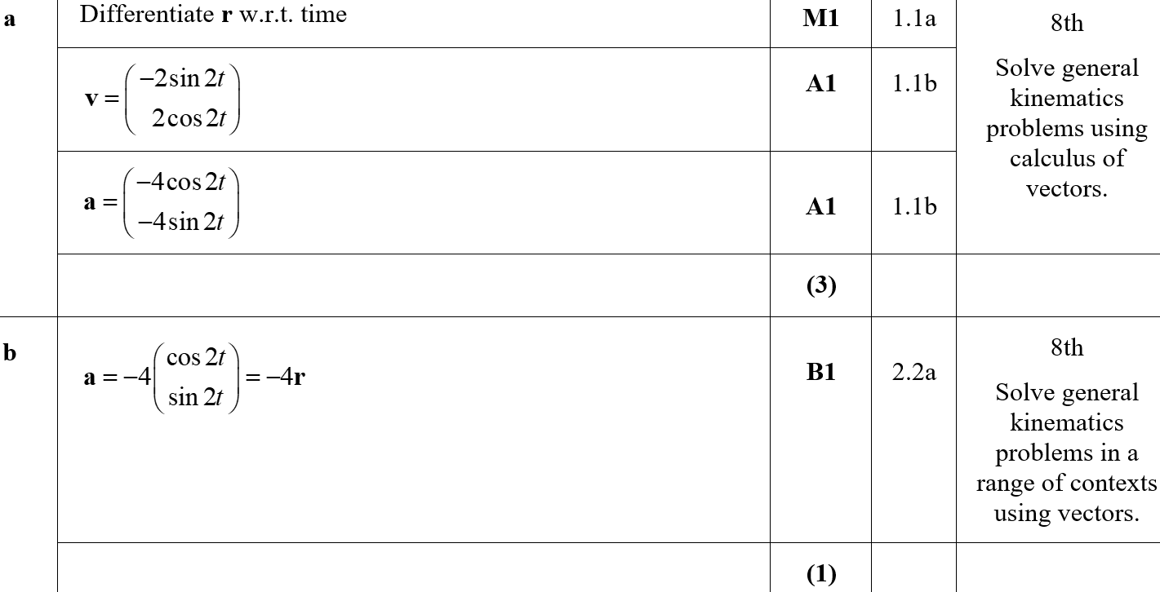
Practice Paper G
A
B

Slide 4
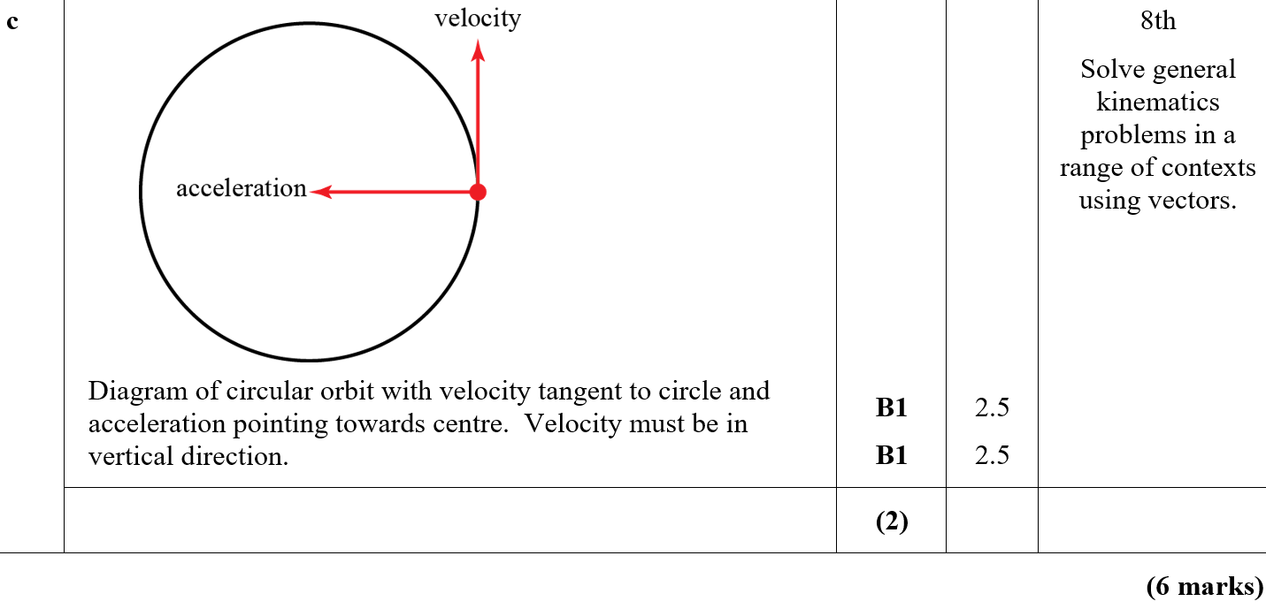
Practice Paper G
C
C notes

Slide 5
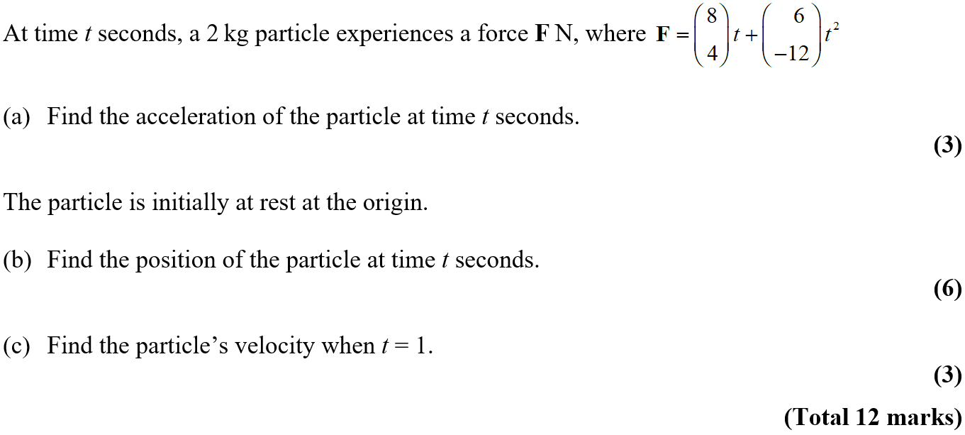
Practice Paper H

Slide 6
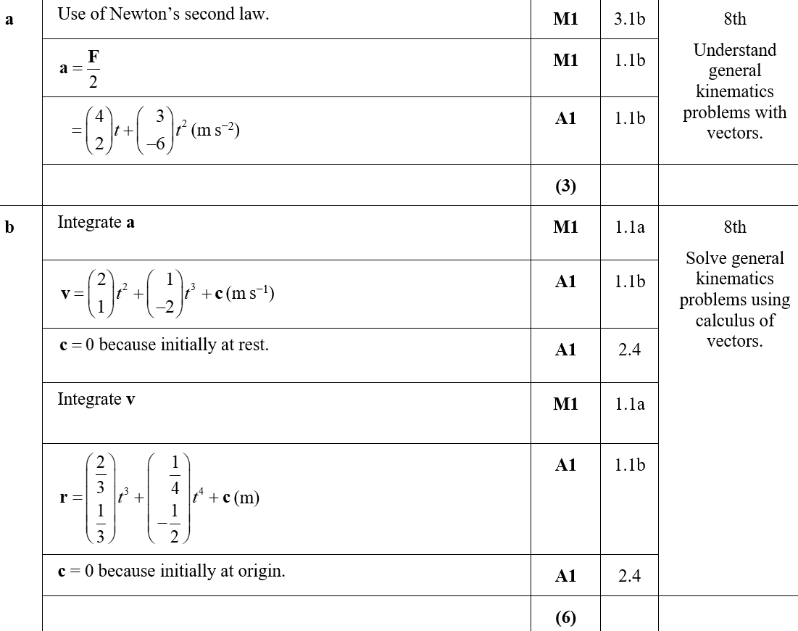
Practice Paper H
A
B

Slide 7
Practice Paper H
C

Slide 8
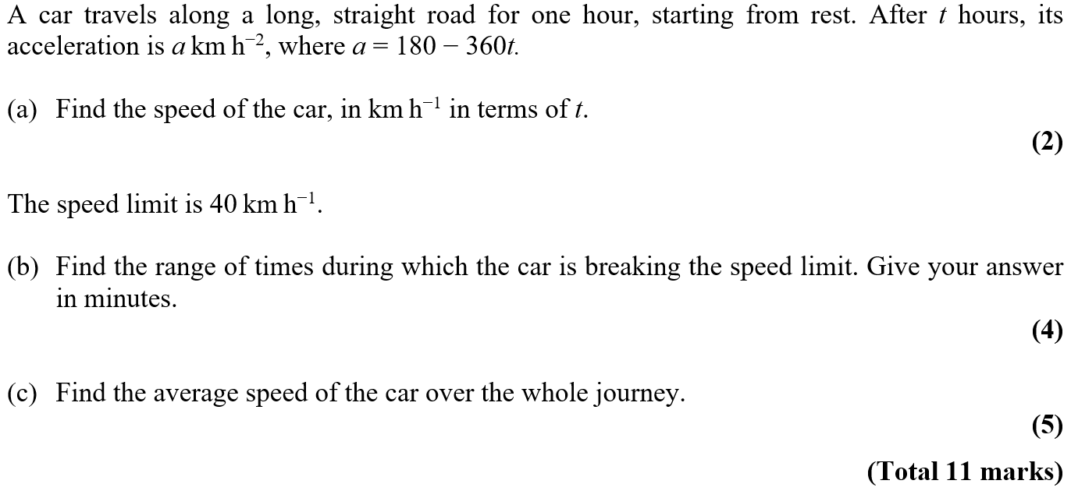
Practice Paper H

Slide 9
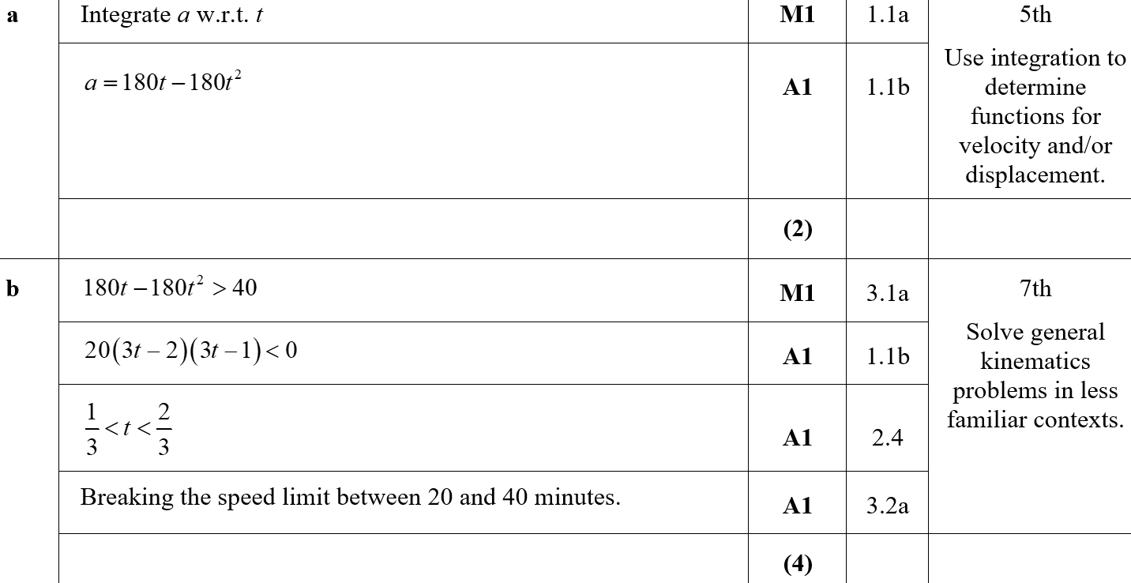
Practice Paper H
A
B

Slide 10
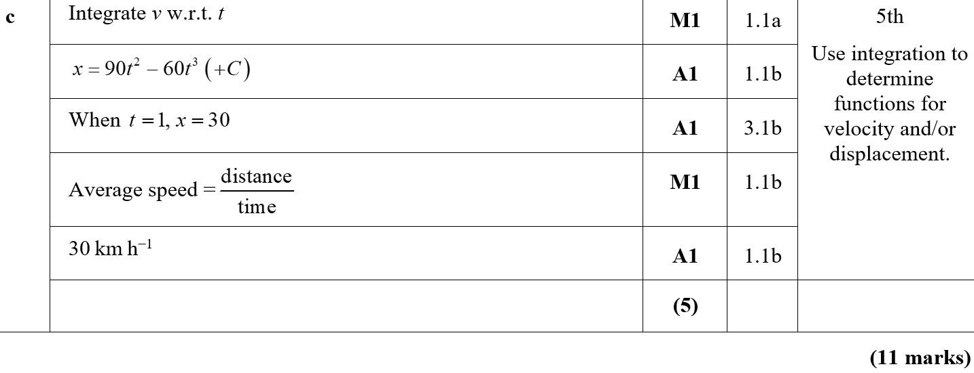
Practice Paper H
C

Slide 11
SAM

Slide 12
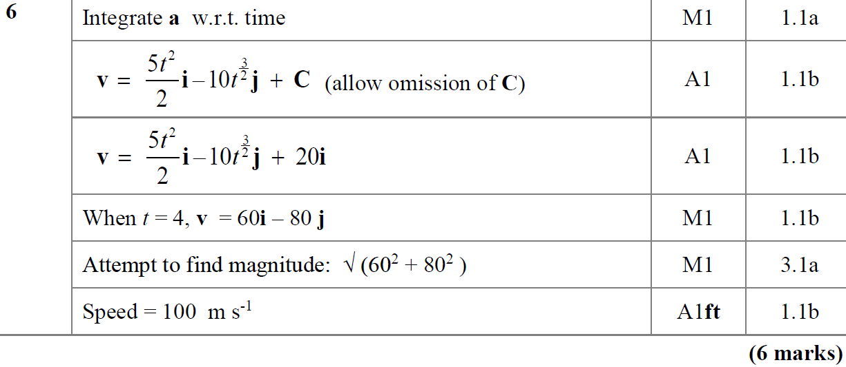
SAM
A
A notes

Slide 13
2018

Slide 14
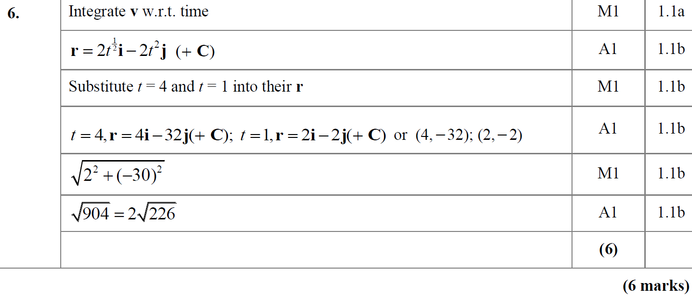
2018
A

Slide 15
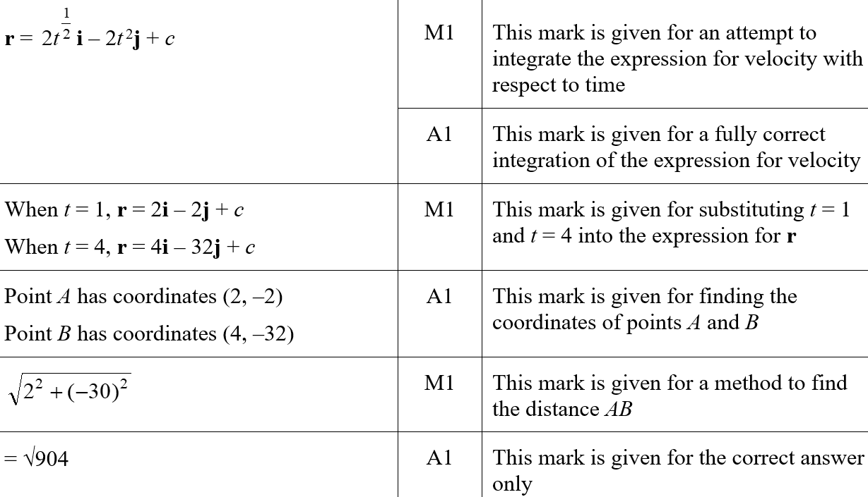
2018
A (SF)

Slide 16
2018
A notes

Slide 17
New Spec Q’s
note* ignore parts of questions involving impulse
Old Spec Variable Acceleration
Jan 2006*
Jan 2013
June 2006 (i)
June 2013
June 2006 (ii)*
June 2014
Jan 2007*
Jan 2009
June 2015
June 2007 (i)
May 2009
June 2016
June 2007 (ii)
Jan 2010
June 2011
June 2017
Jan 2008
June 2010
Jan 2012
June 2018
May 2008*
Jan 2011
May 2012

Slide 18
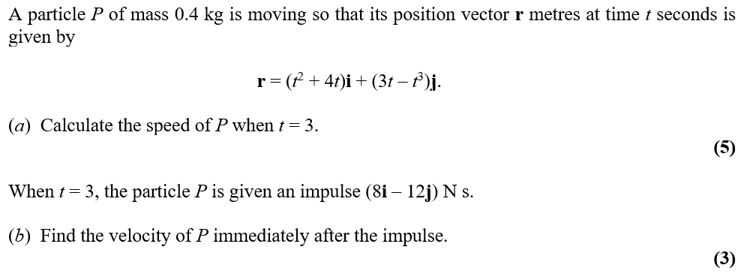
Jan 2006

Slide 19
Jan 2006
A
B

Slide 20
June 2006

Slide 21
June 2006
A

Slide 22
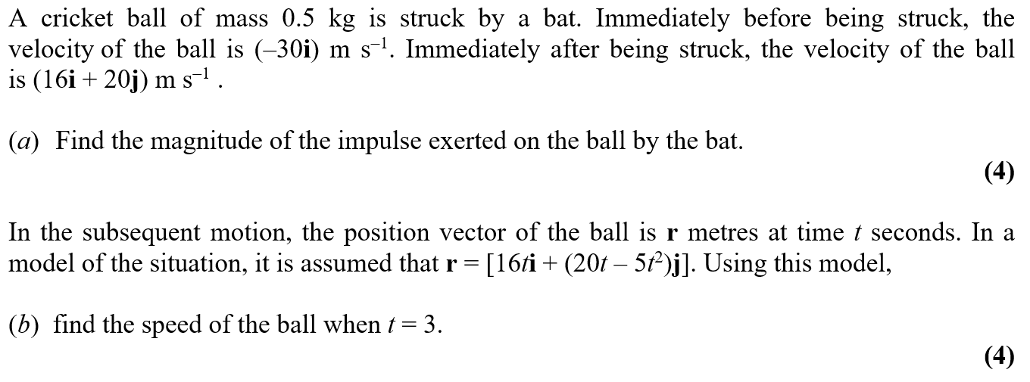
June 2006

Slide 23
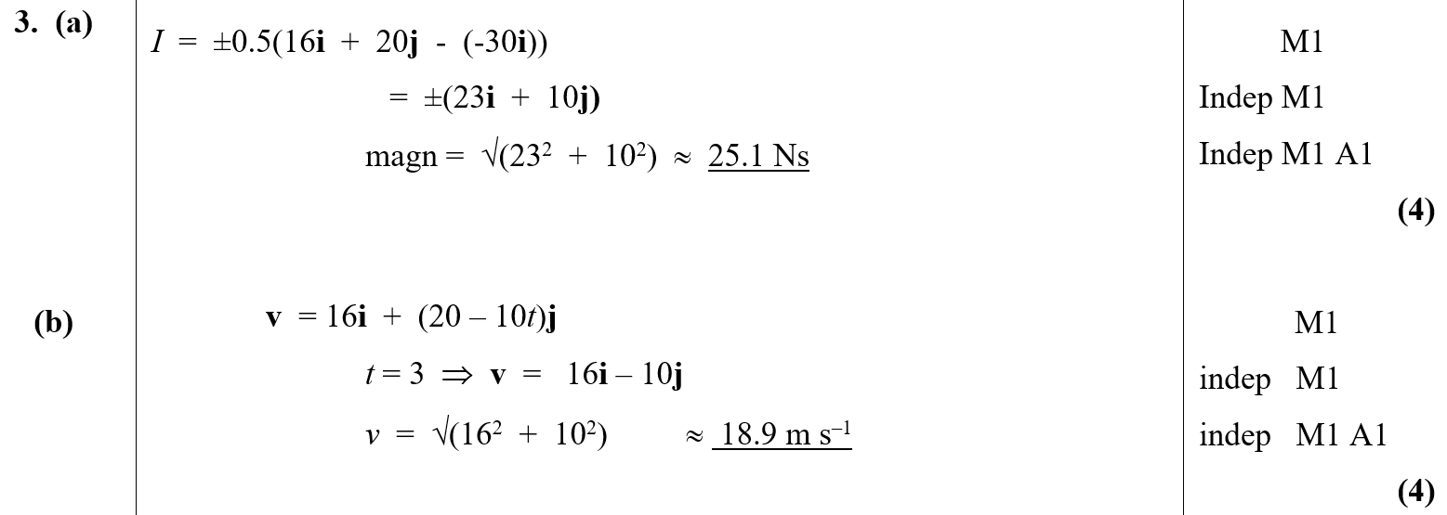
June 2006
A
B

Slide 24
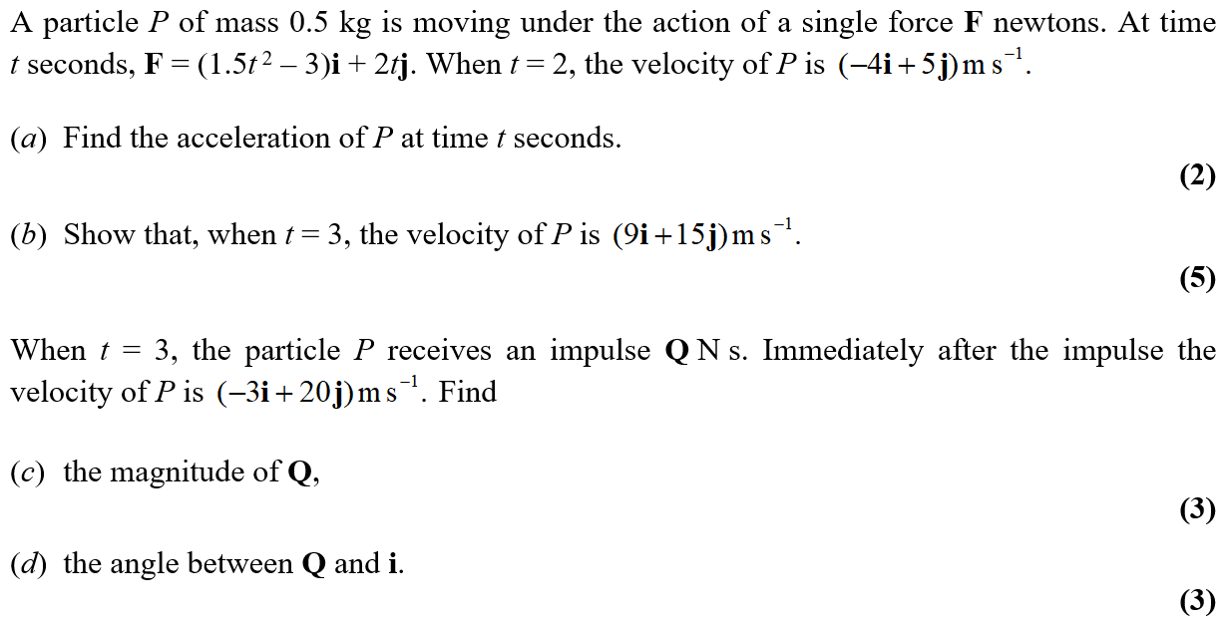
Jan 2007

Slide 25
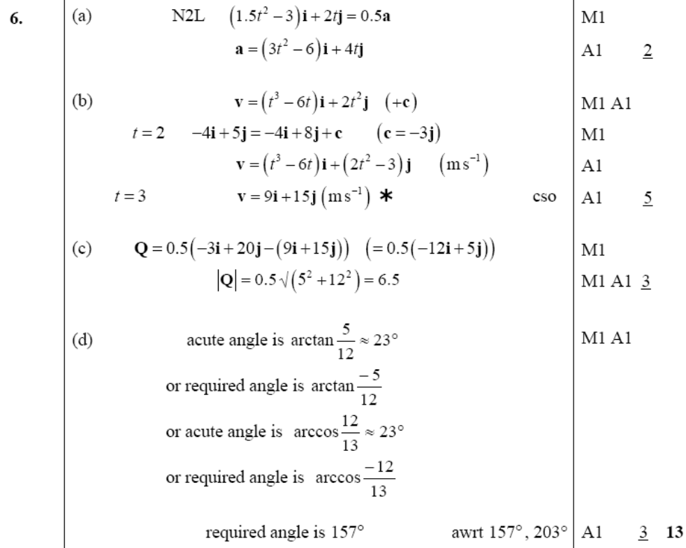
Jan 2007
A
B
C
D

Slide 26
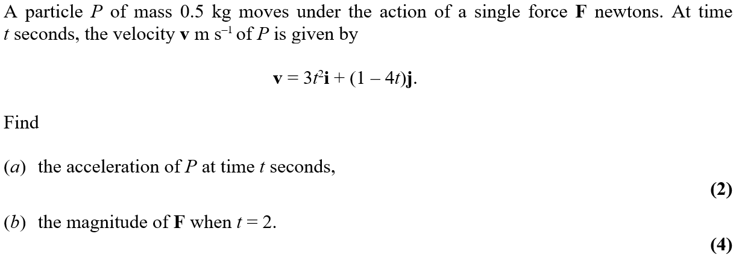
June 2007

Slide 27
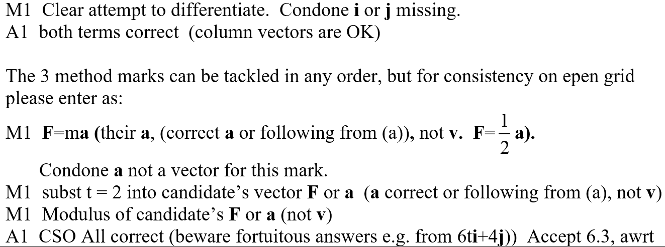
June 2007
A
B
A notes
B notes

Slide 28
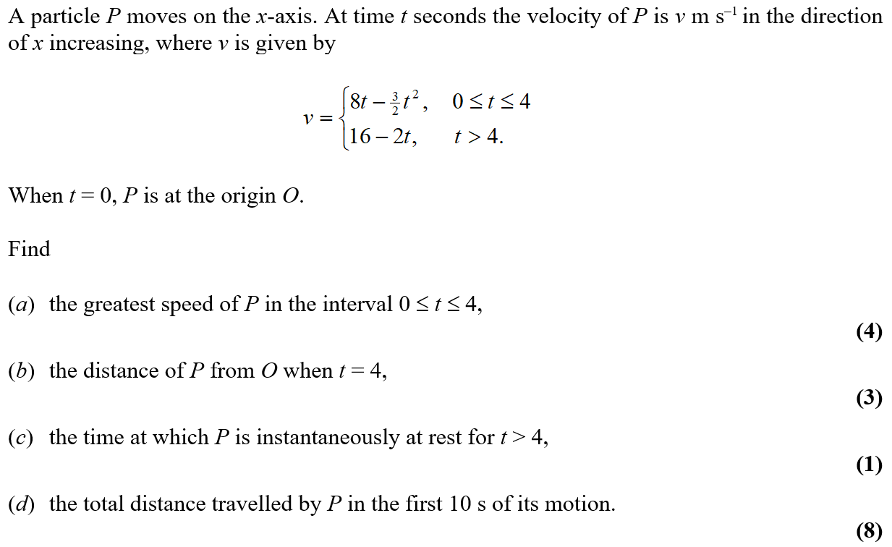
June 2007

Slide 29
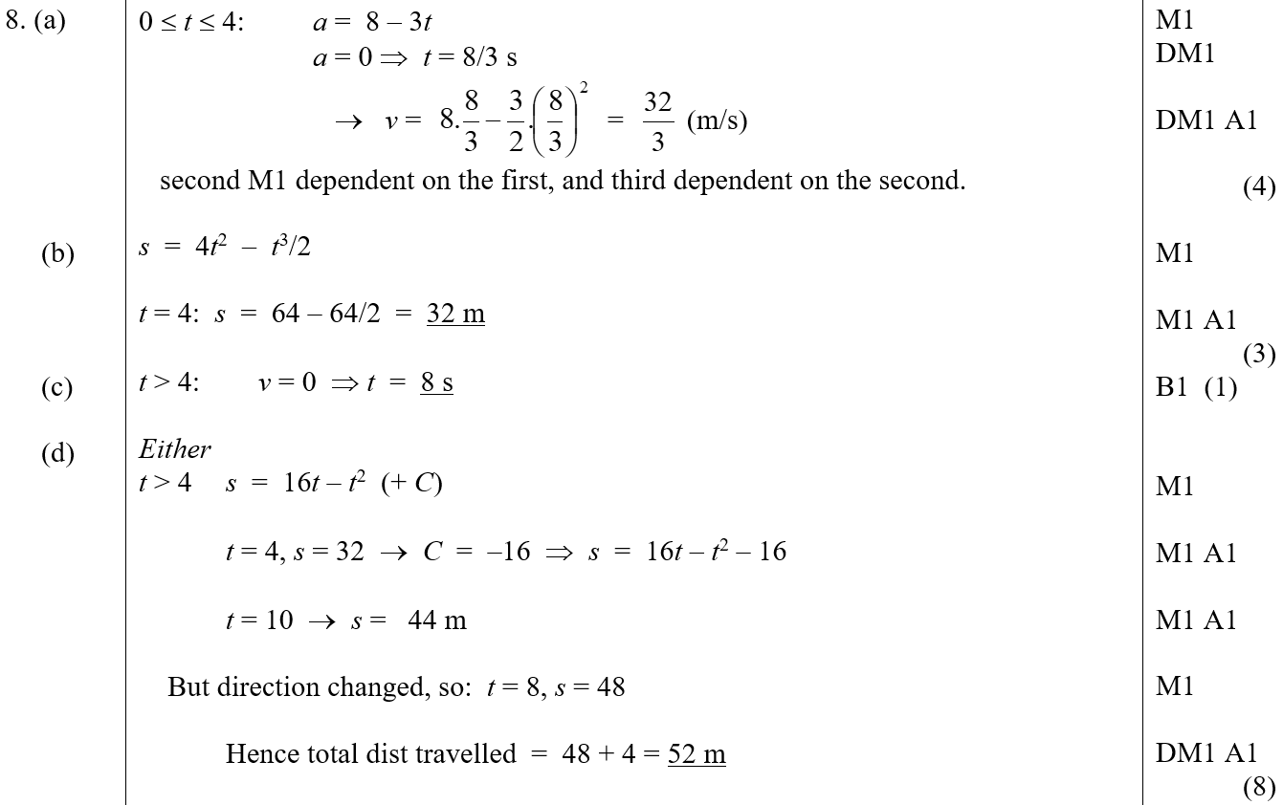
June 2007
A
B
C
D

Slide 30
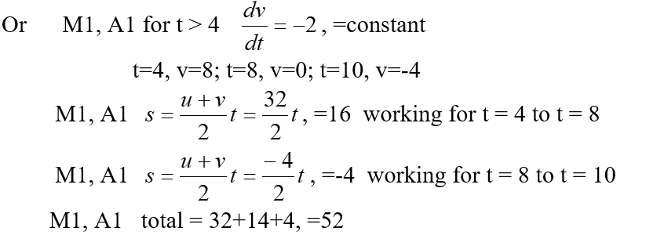
June 2007
D Alternative 1
D Alternative 2

Slide 31
June 2007
A notes
A Alternative 1 notes
A Alternative 2 notes
A Alternative 3 notes

Slide 32
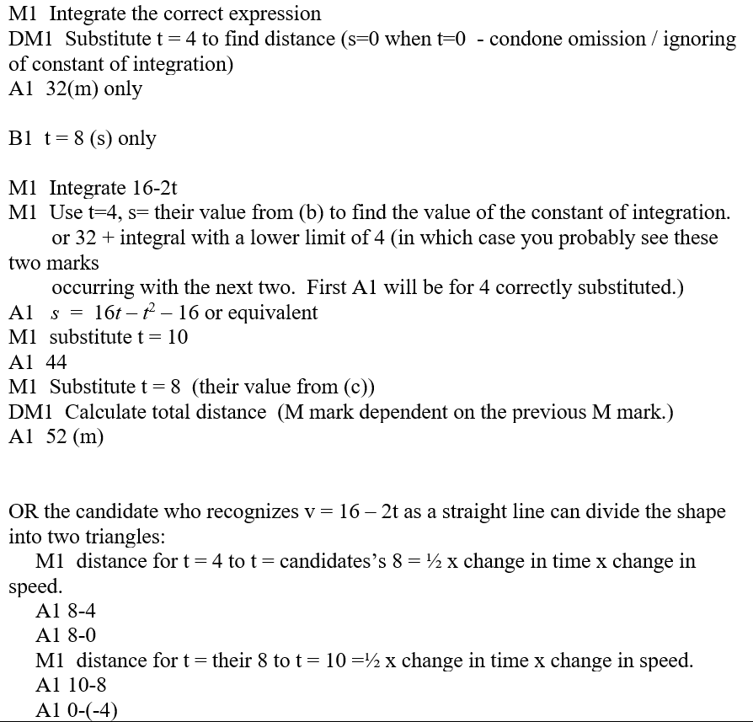
June 2007
B notes
C notes
D notes

Slide 33
June 2007
D Alternative notes

Slide 34
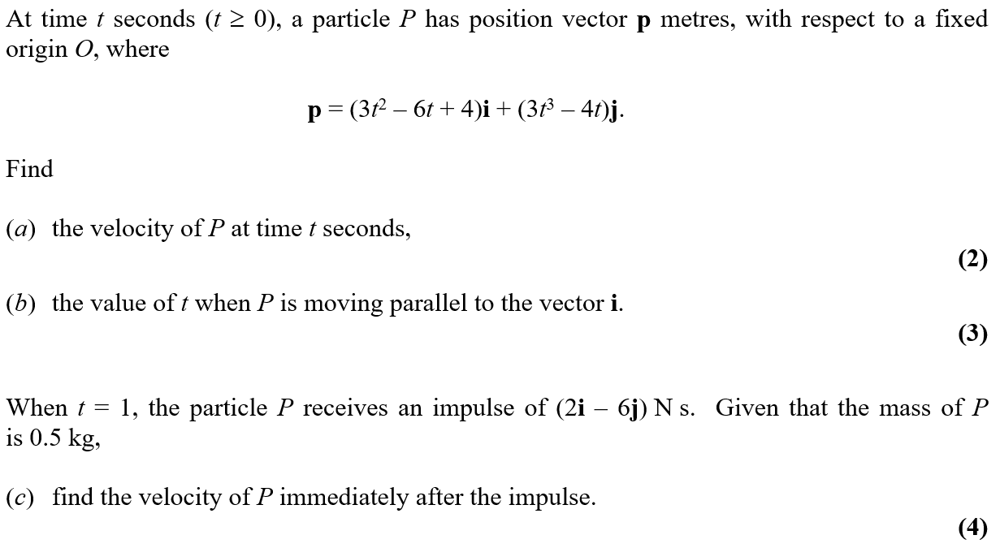
Jan 2008

Slide 35
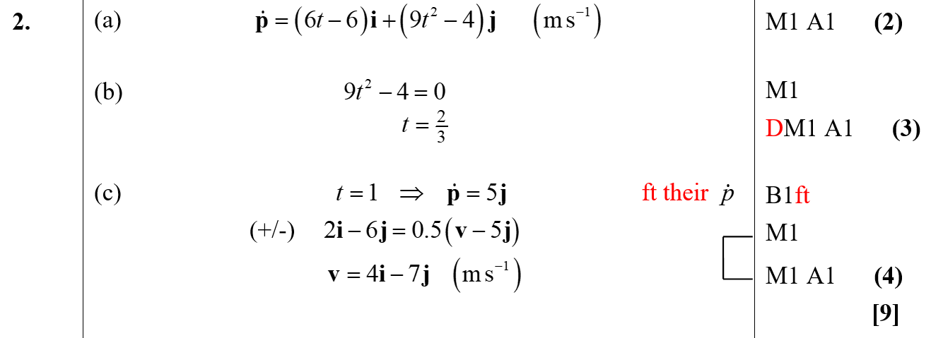
Jan 2008
A
B
C

Slide 36
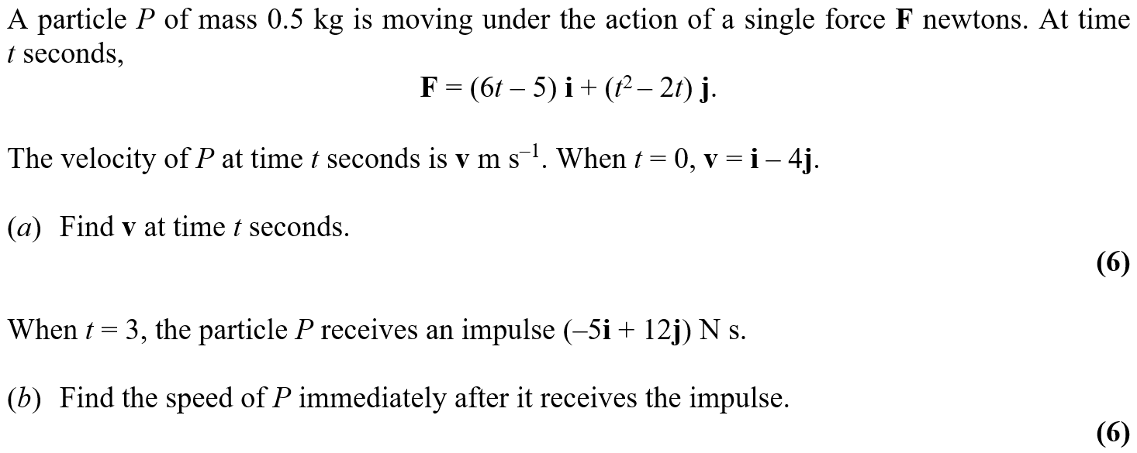
May 2008

Slide 37
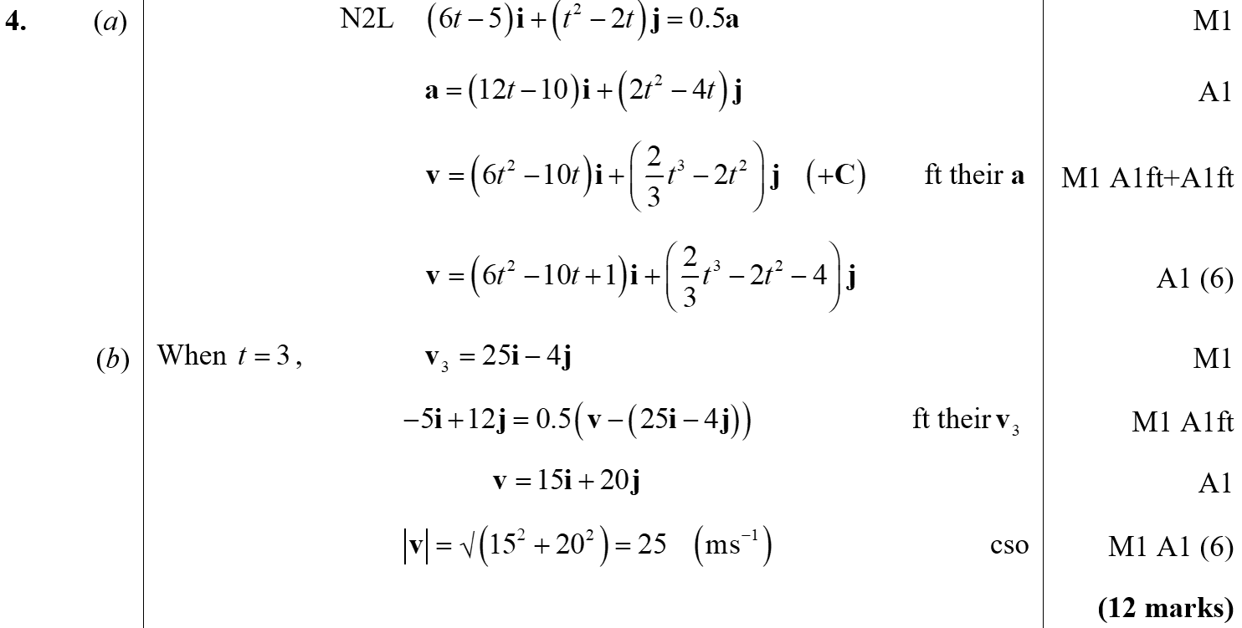
May 2008
A
B

Slide 38
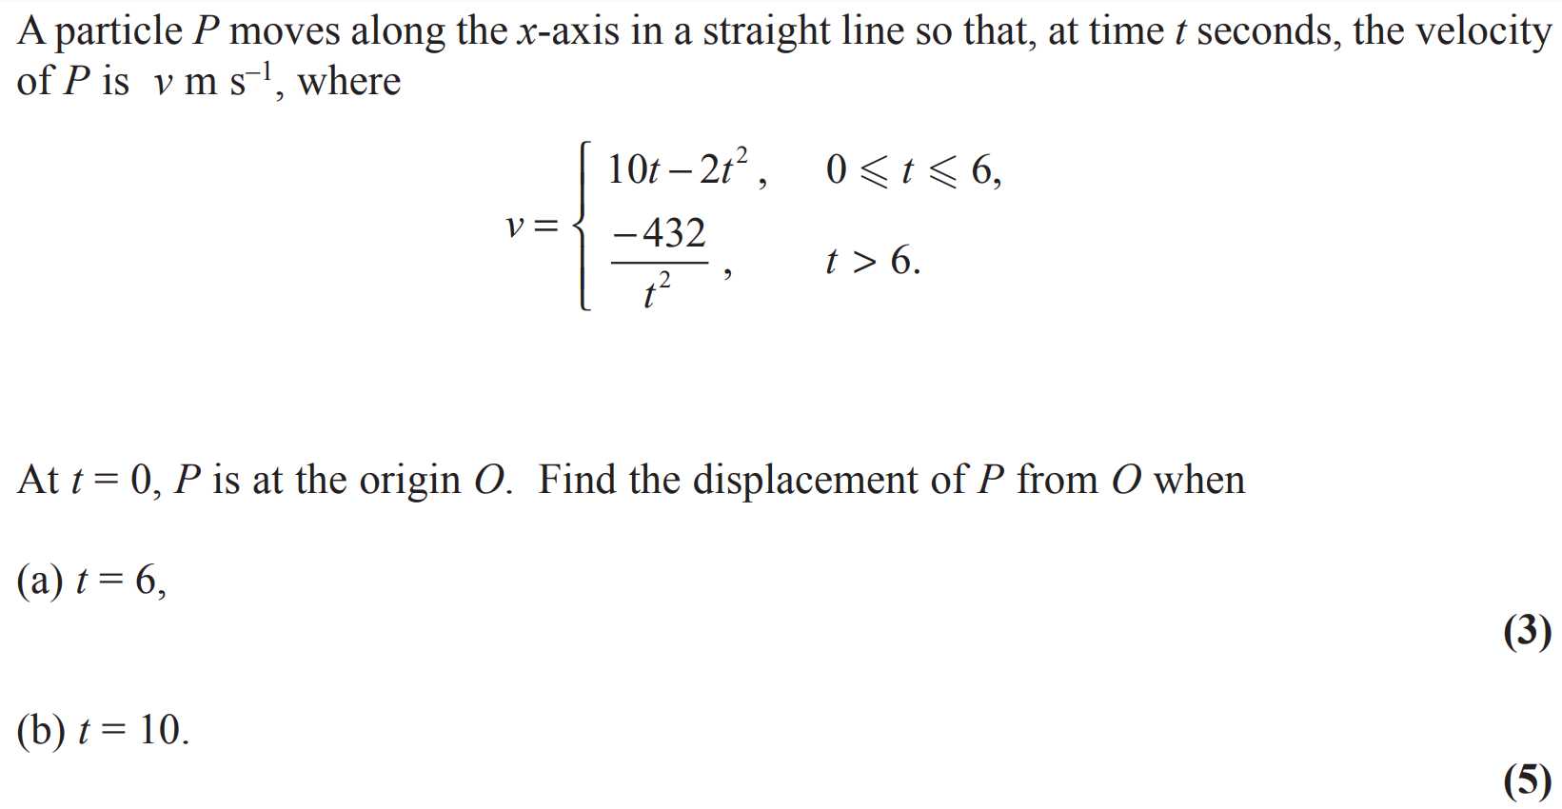
Jan 2009

Slide 39
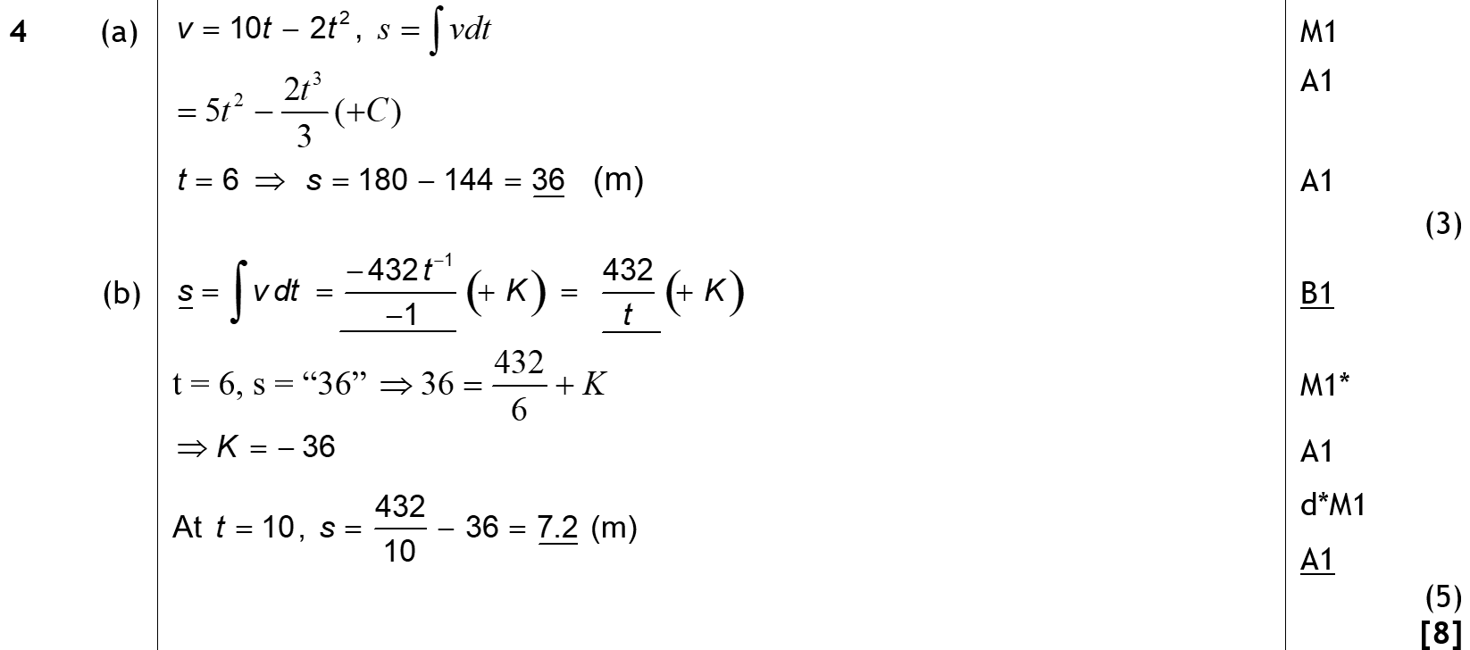
Jan 2009
A
B

Slide 40
May 2009

Slide 41
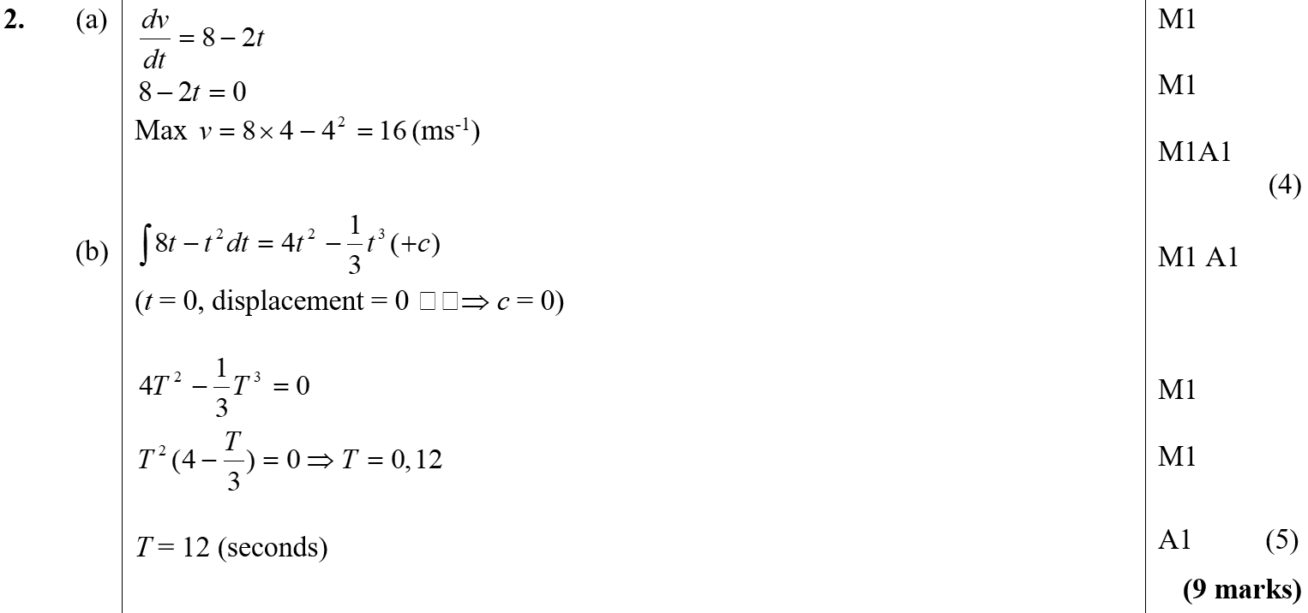
May 2009
A
B

Slide 42
Jan 2010

Slide 43
Jan 2010
A

Slide 44
June 2010

Slide 45
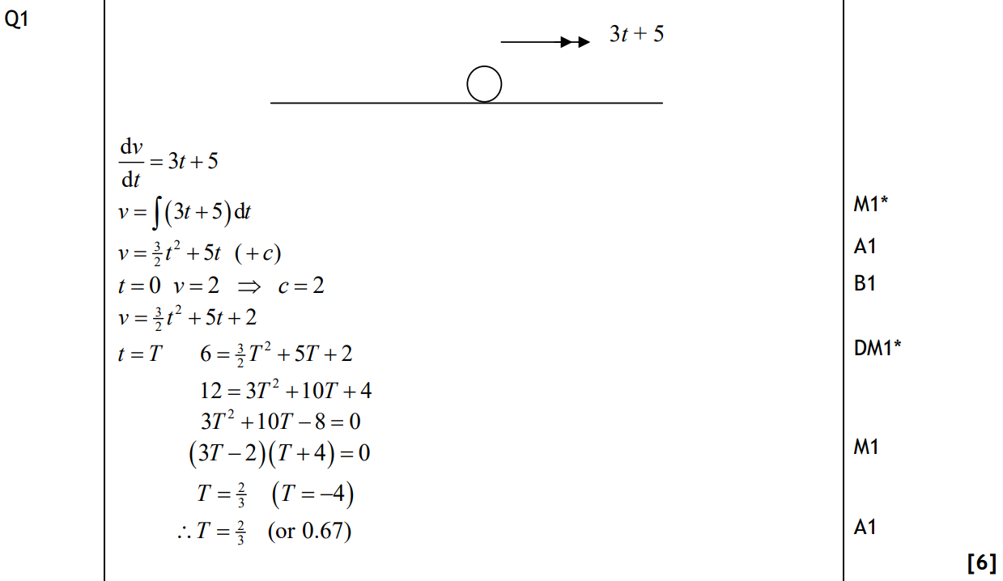
June 2010
A

Slide 46
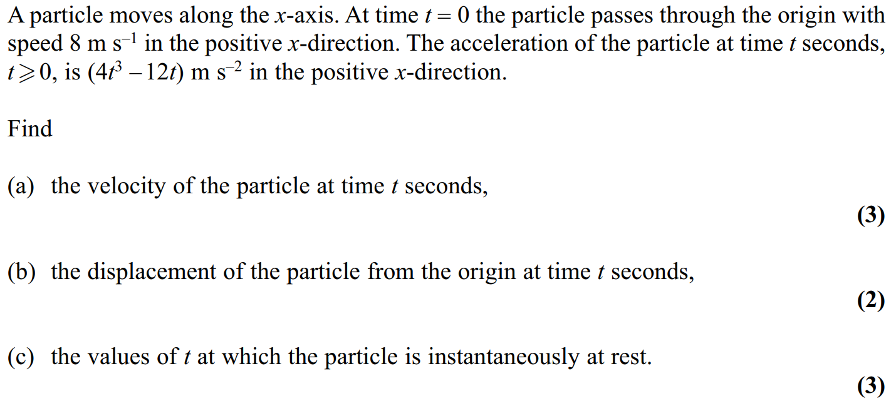
Jan 2011

Slide 47
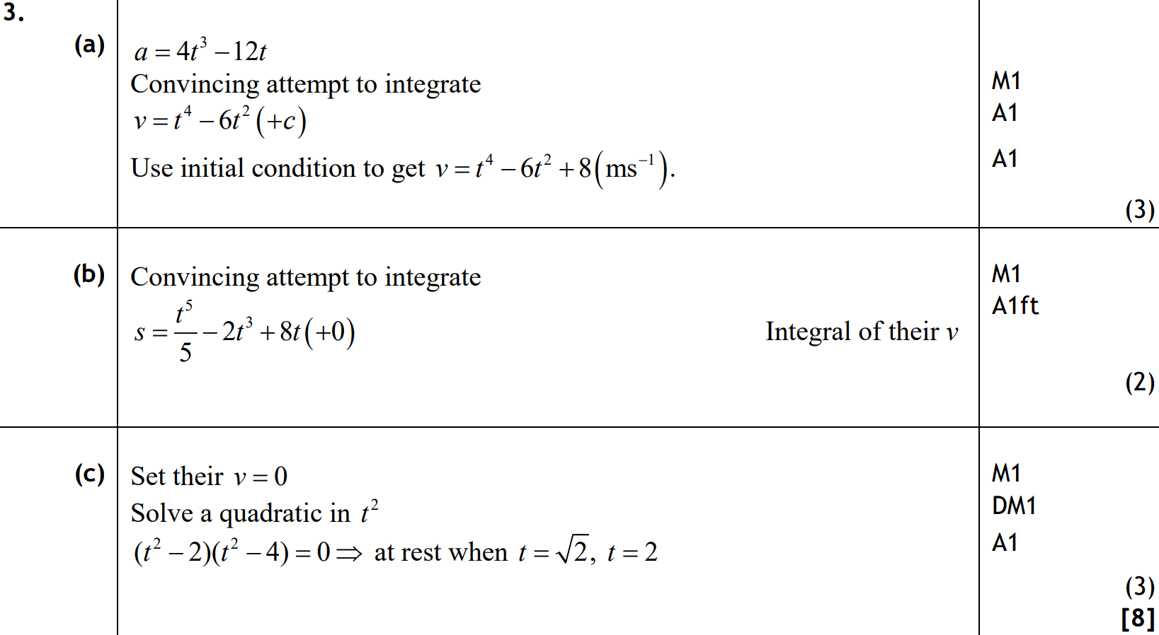
Jan 2011
A
B
C

Slide 48
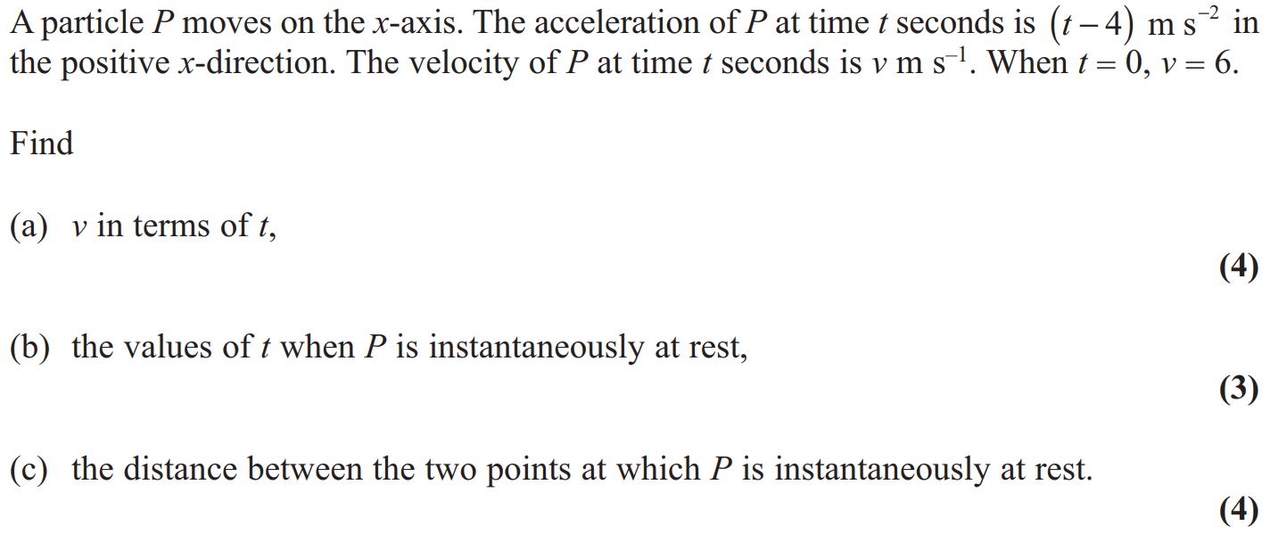
June 2011

Slide 49
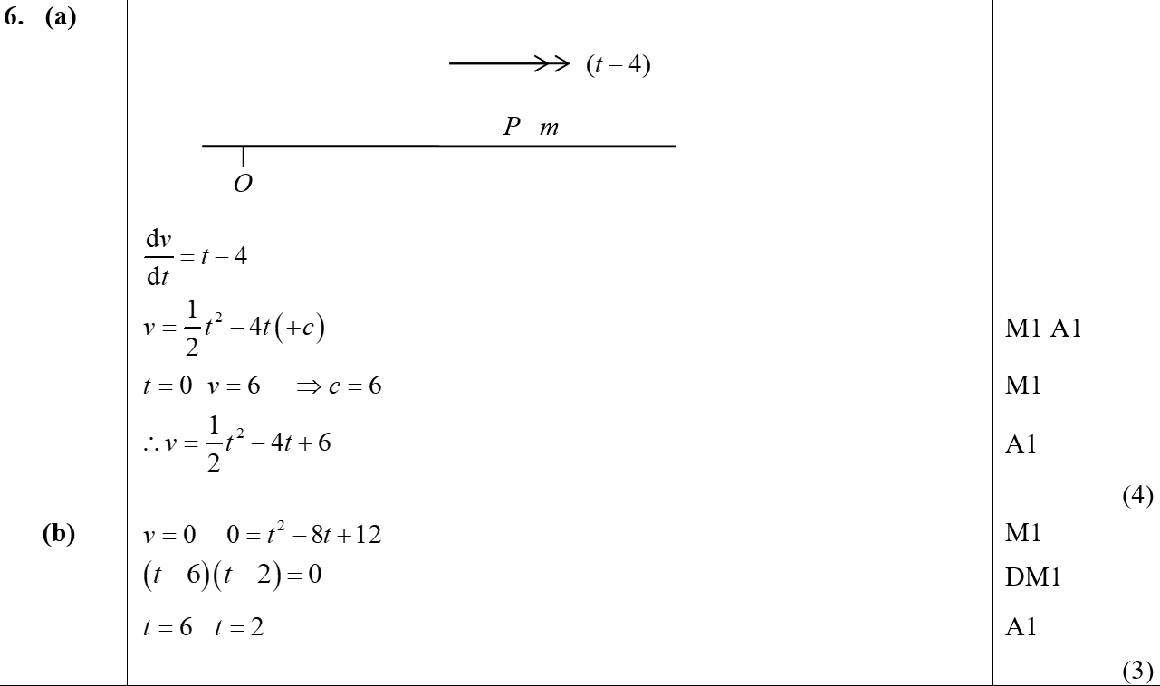
June 2011
A
B

Slide 50
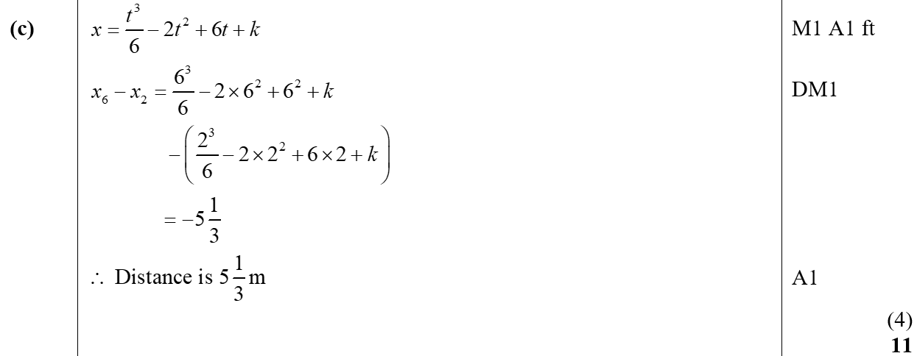
June 2011
C

Slide 51
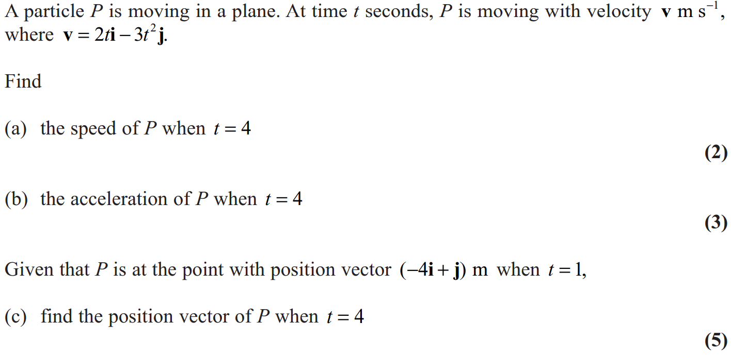
Jan 2012

Slide 52
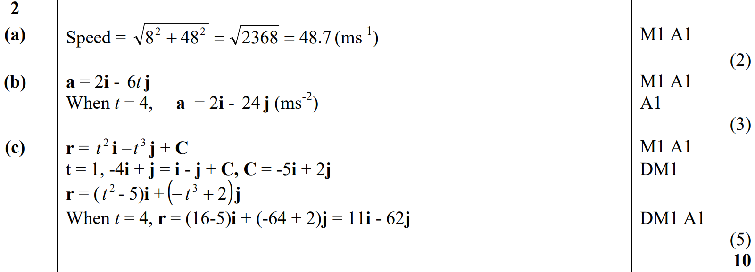
Jan 2012
A
B
C

Slide 53
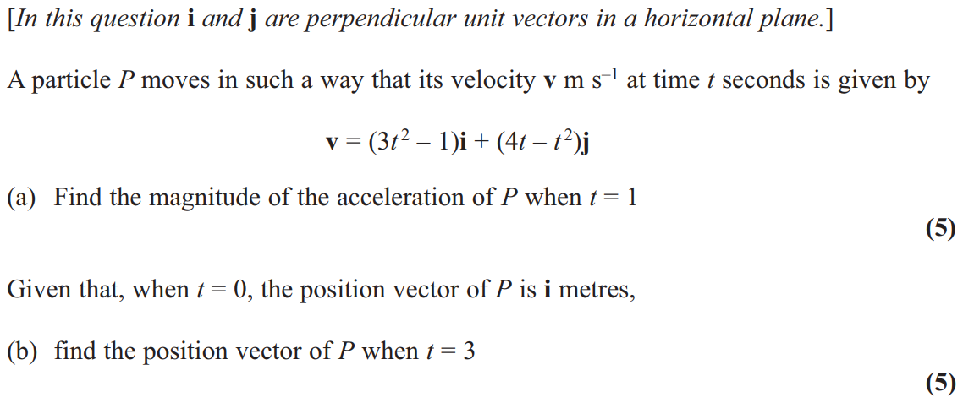
May 2012

Slide 54
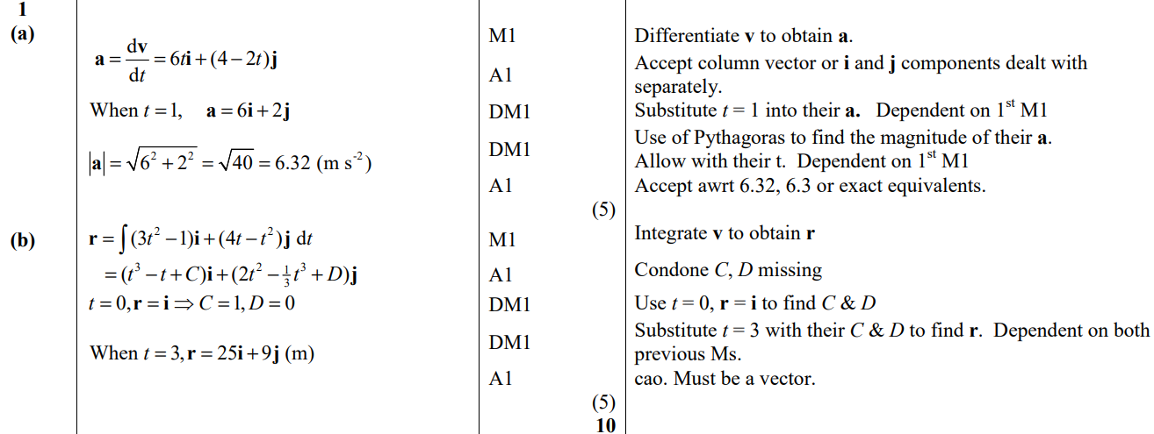
May 2012
A
B

Slide 55
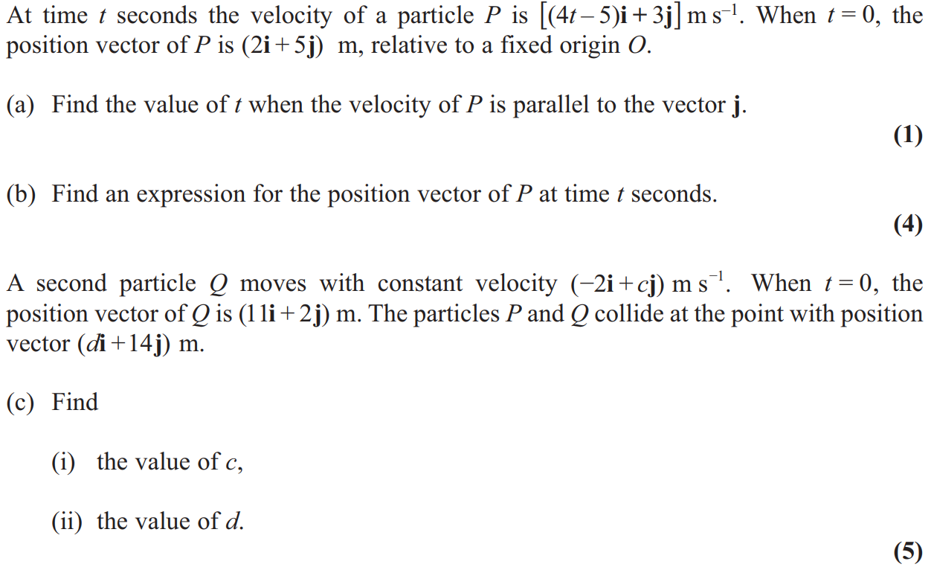
Jan 2013

Slide 56
Jan 2013
A
B

Slide 57
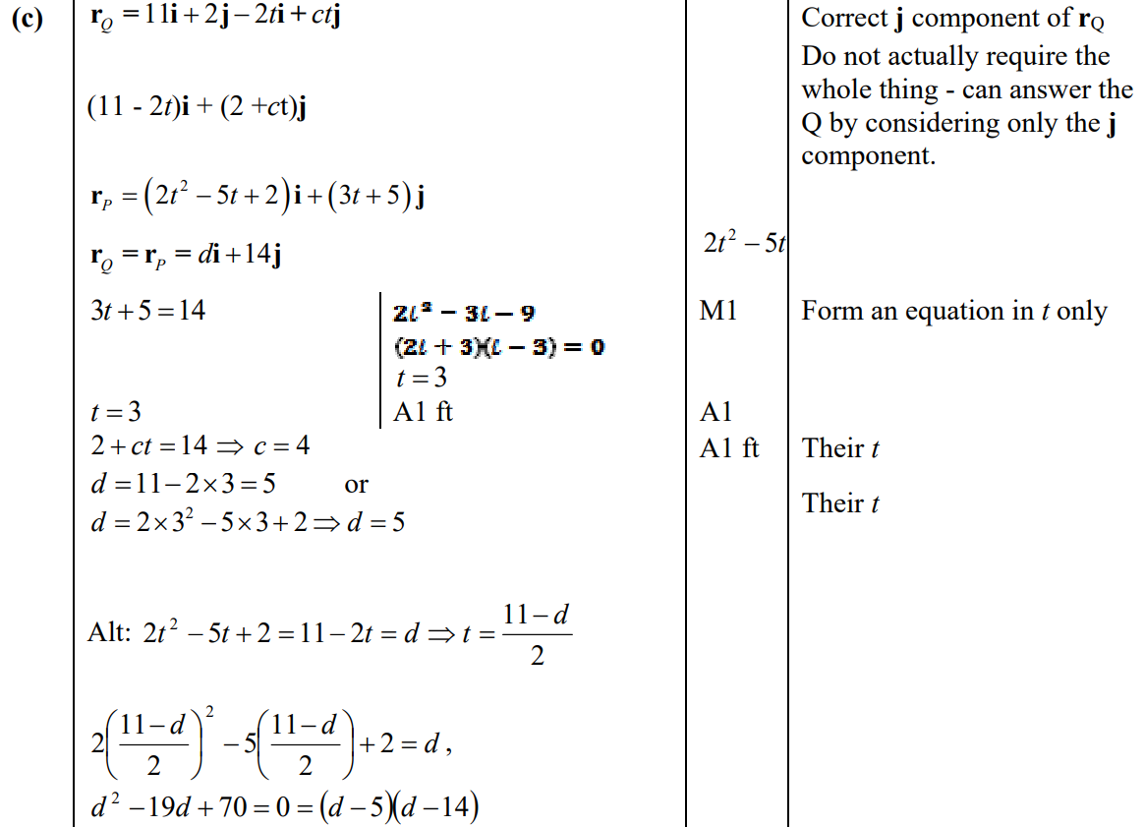
Jan 2013
C

Slide 58
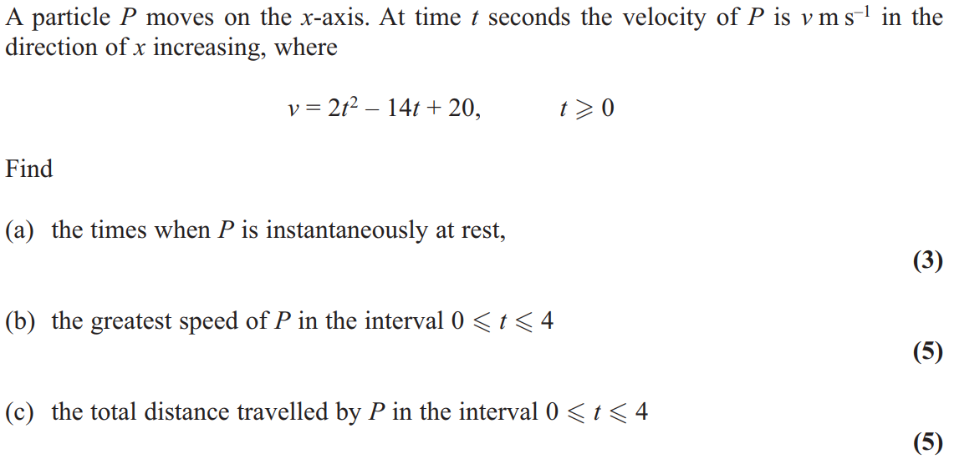
June 2013

Slide 59
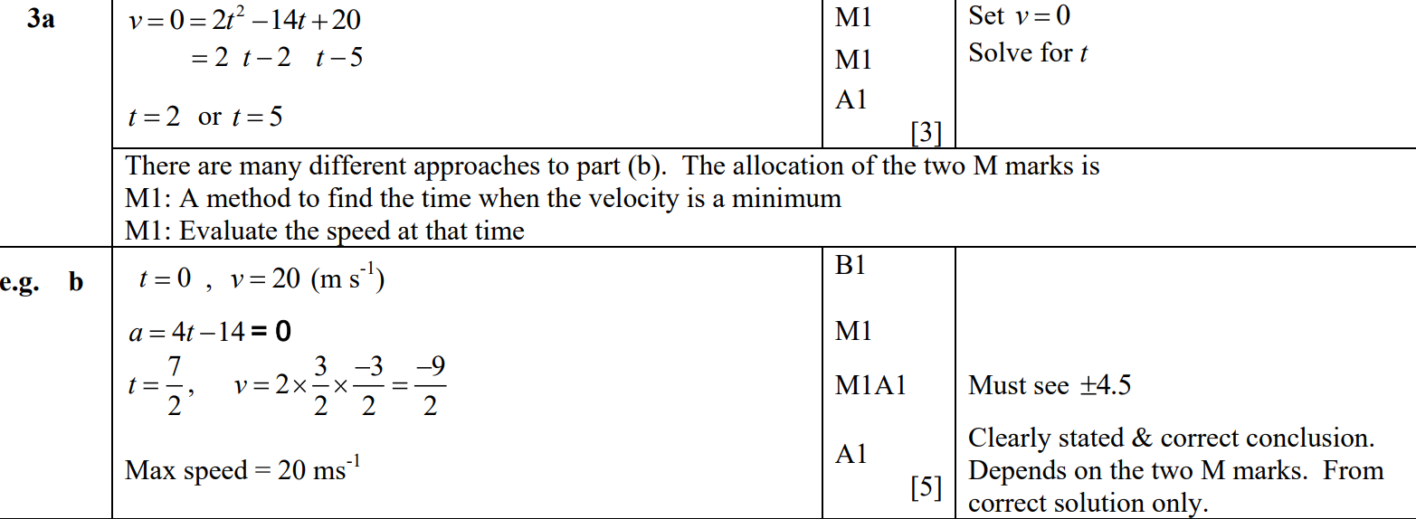
June 2013
A
B
B alternative 1

Slide 60
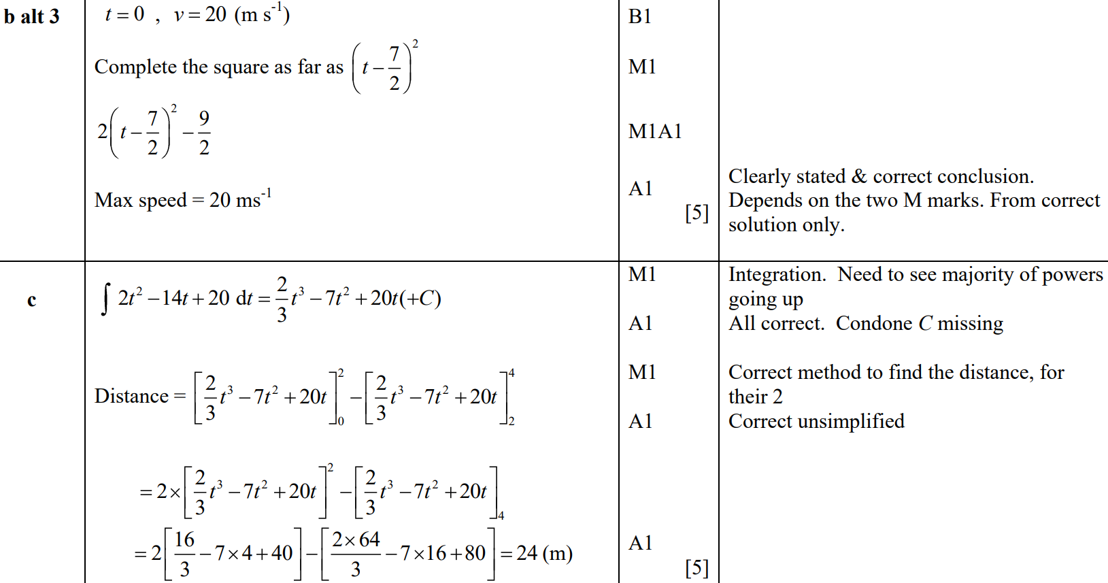
June 2013
B Alternative 2
B Alternative 3
C

Slide 61
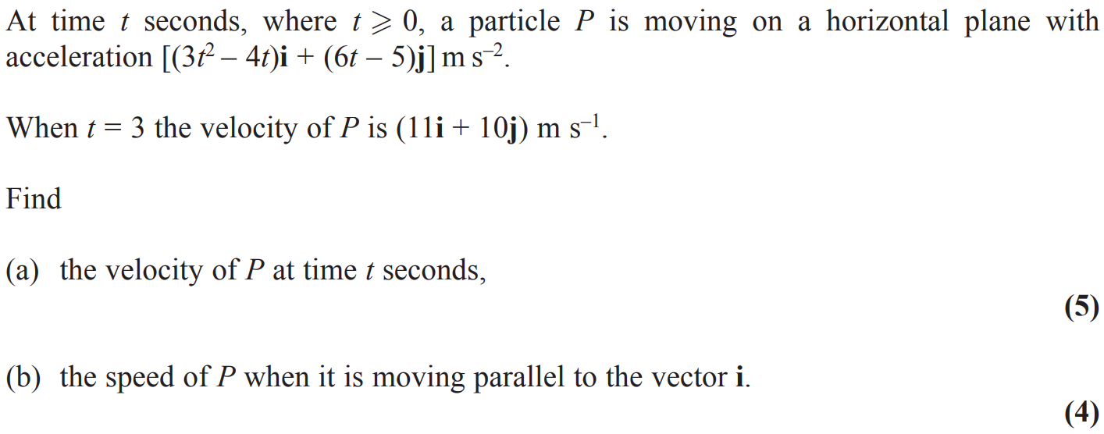
June 2014

Slide 62
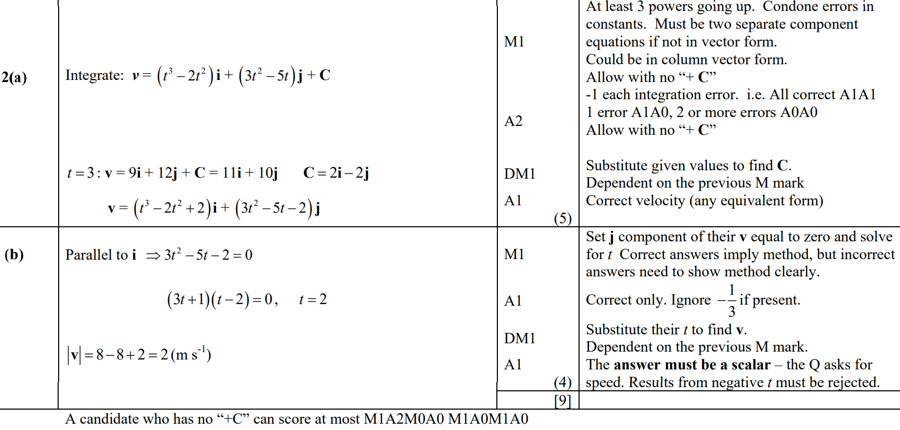
June 2014
A
B

Slide 63
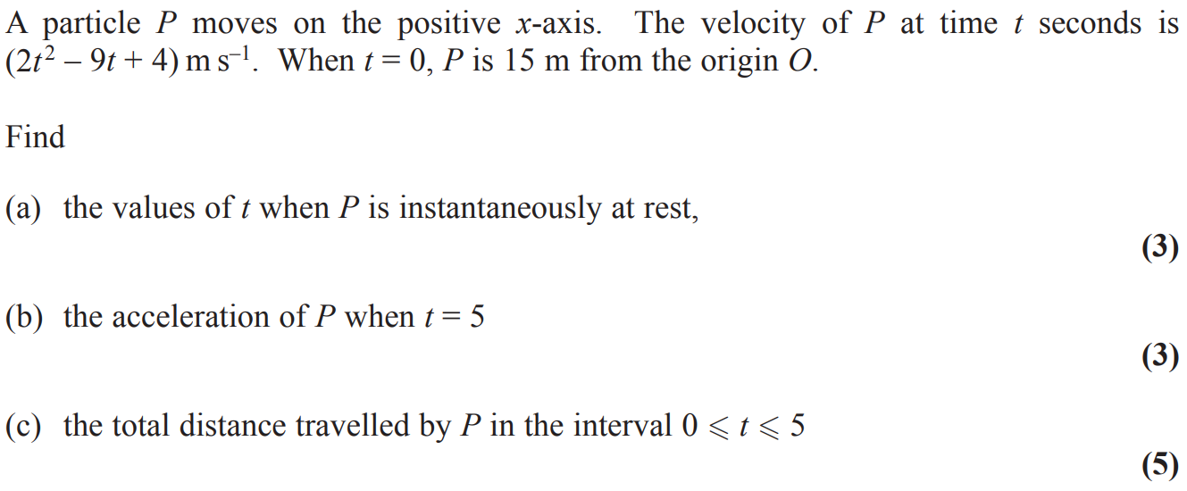
June 2015

Slide 64
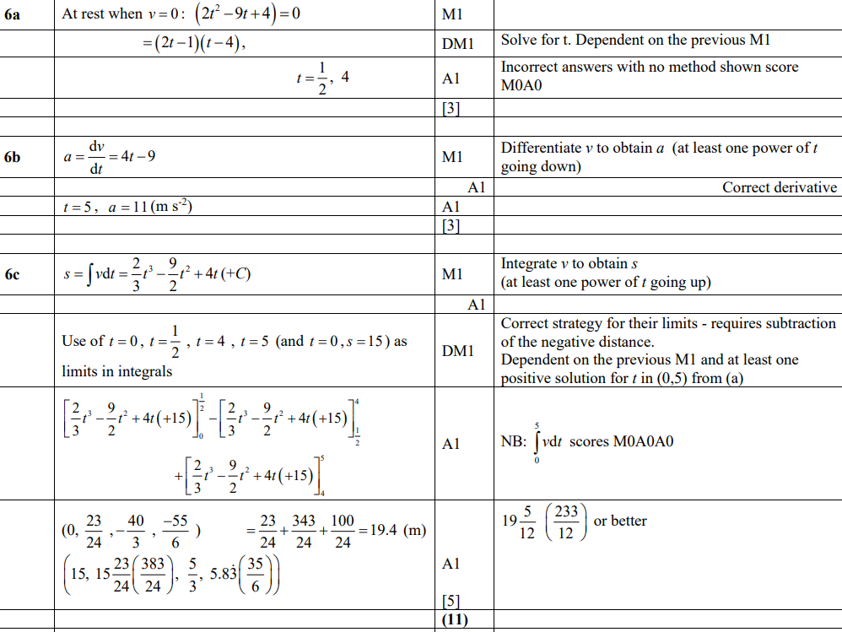
June 2015
A
B
C

Slide 65
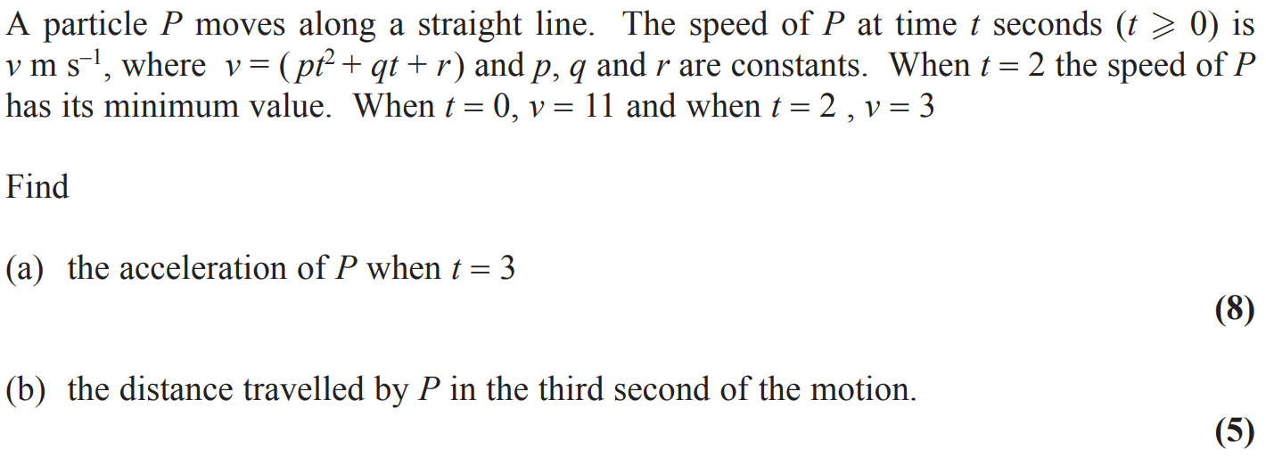
June 2016

Slide 66
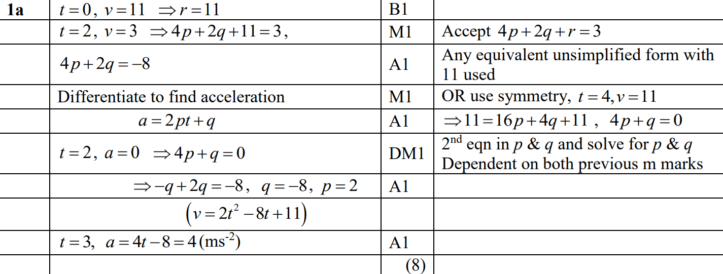
June 2016
A

Slide 67
June 2016
A Alternative

Slide 68
June 2016
B

Slide 69
June 2017

Slide 70
June 2017
A
B
C

Slide 71
June 2017
D
D Alternative 1
D Alternative 2

Slide 72
June 2018

Slide 73
June 2018
A

Slide 74
June 2018
B

