Slide 1
Old Spec Q’s
Sequences and Series
Practice A
(i)
SAM 2
Practice A
(ii)
2018 2
Practice B
(i)
Practice B (ii)
Practice C
Practice D
Practice E
Practice F

Slide 2
Practice A

Slide 3
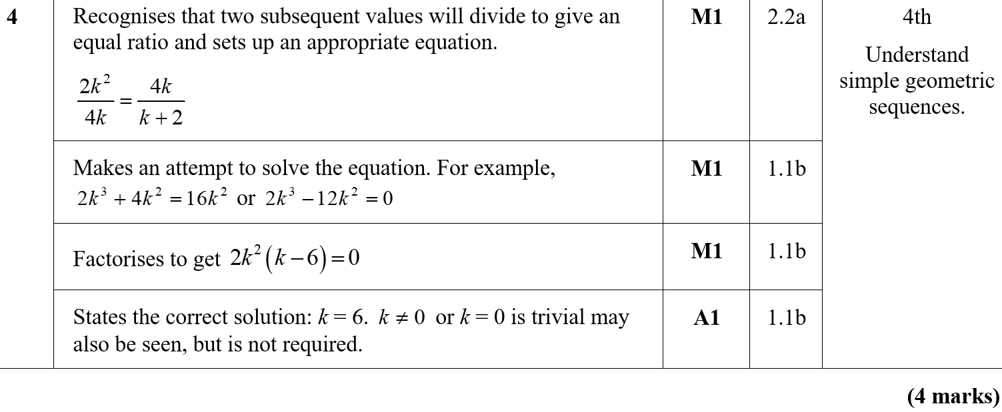
Practice A
A

Slide 4
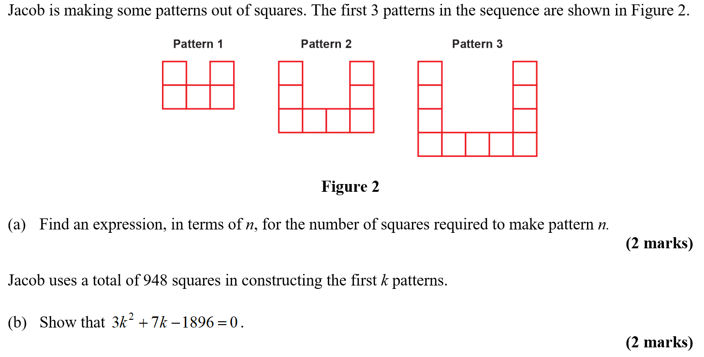
Practice A

Slide 5
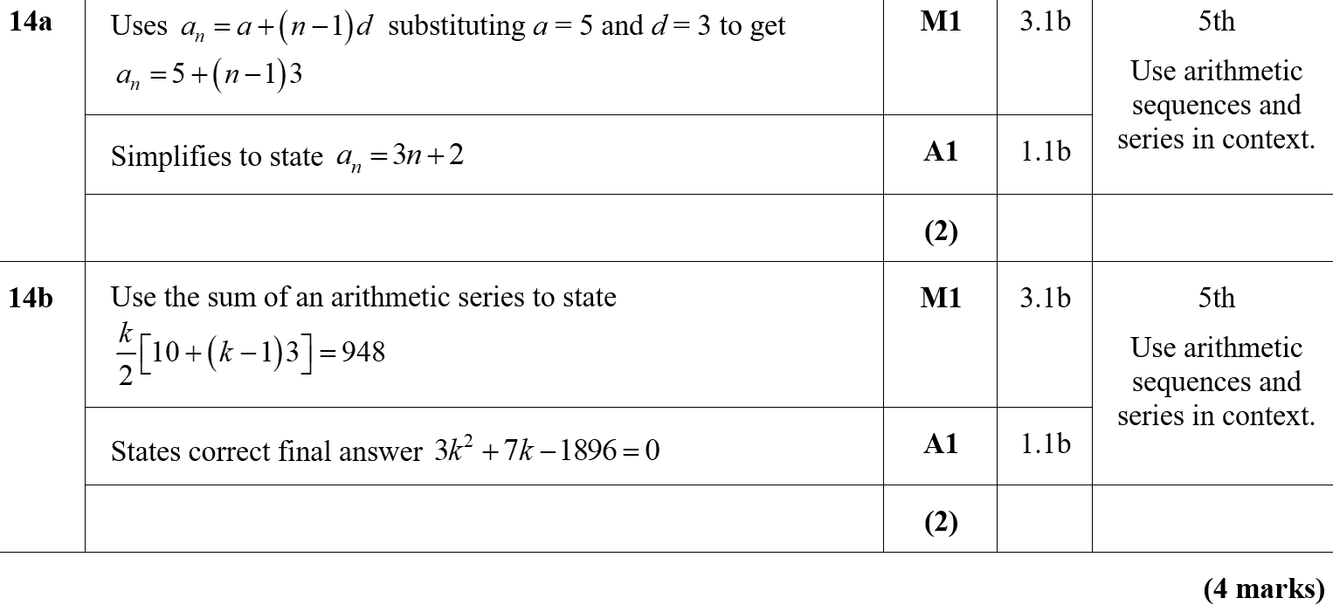
Practice A
A
B

Slide 6
Practice B

Slide 7
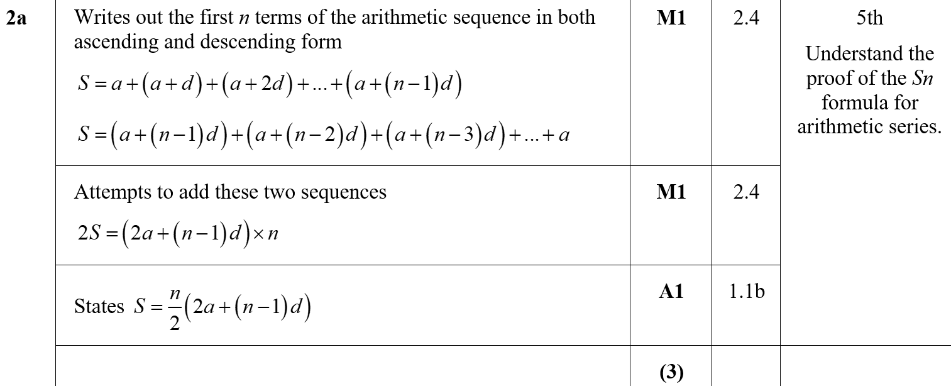
Practice B
A
A notes

Slide 8
Practice B
B

Slide 9
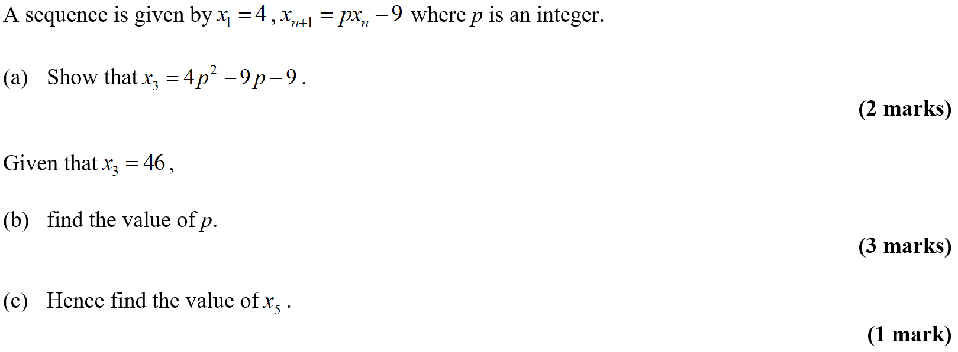
Practice B

Slide 10
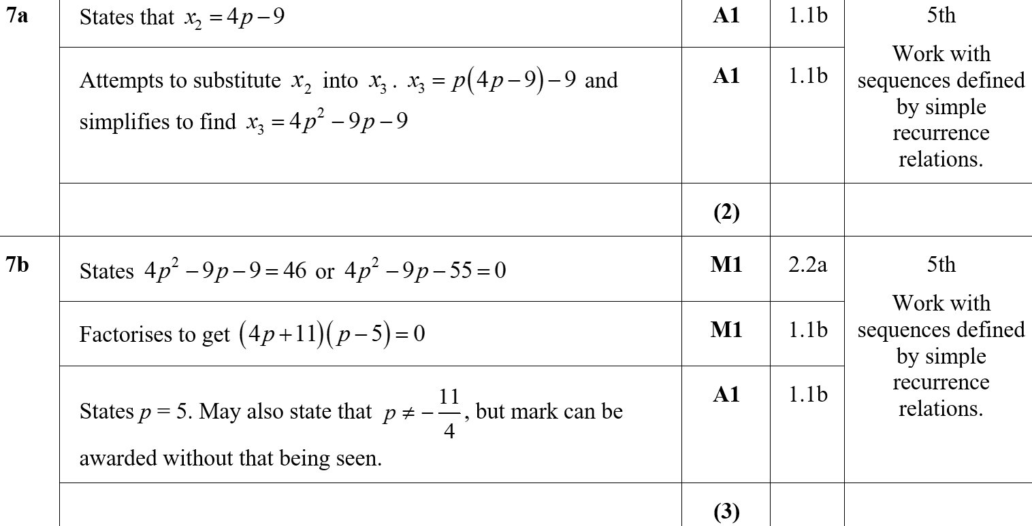
Practice B
A
B

Slide 11
Practice B
C
C Notes

Slide 12
Practice C

Slide 13
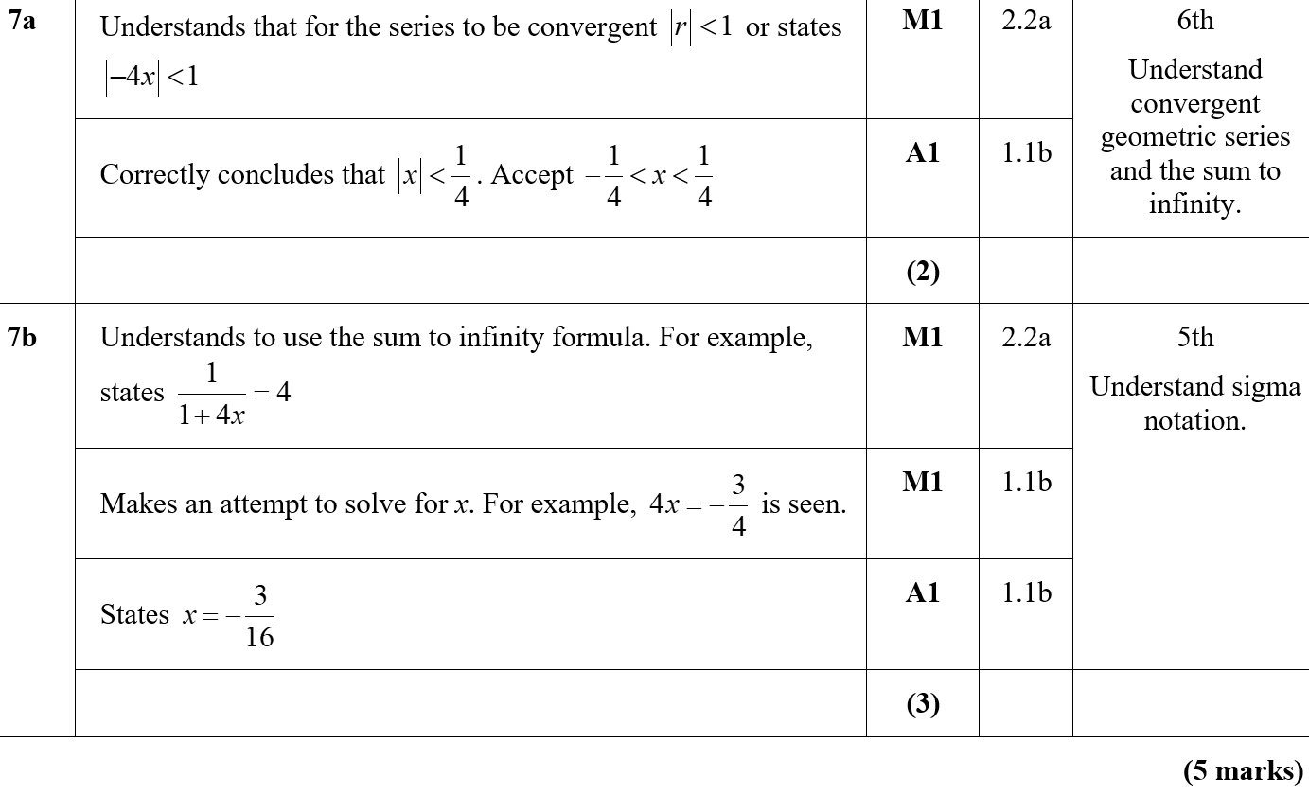
Practice C
A
B

Slide 14
Practice D

Slide 15
Practice D
A
A notes

Slide 16
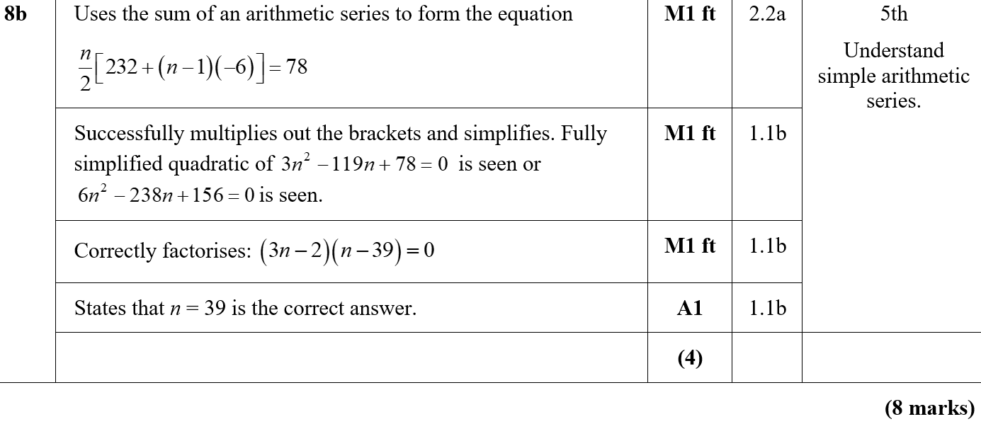
Practice D
B
B notes

Slide 17
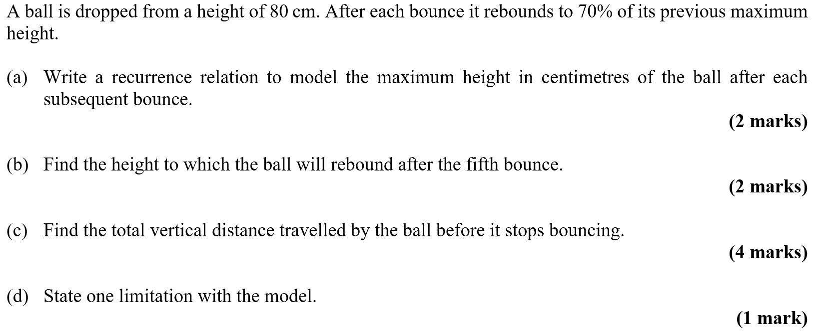
Practice E

Slide 18
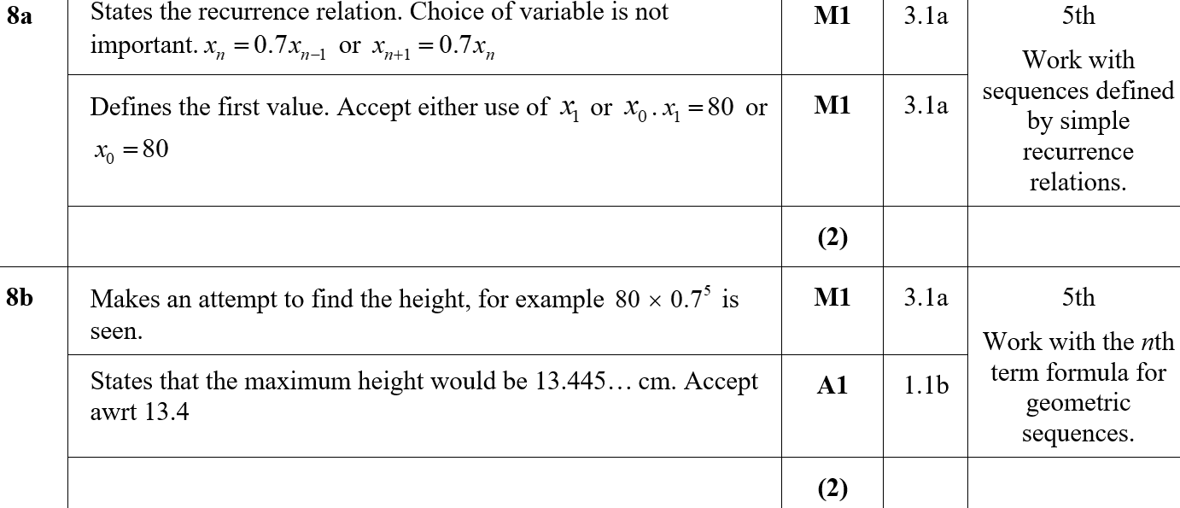
Practice E
A
B

Slide 19
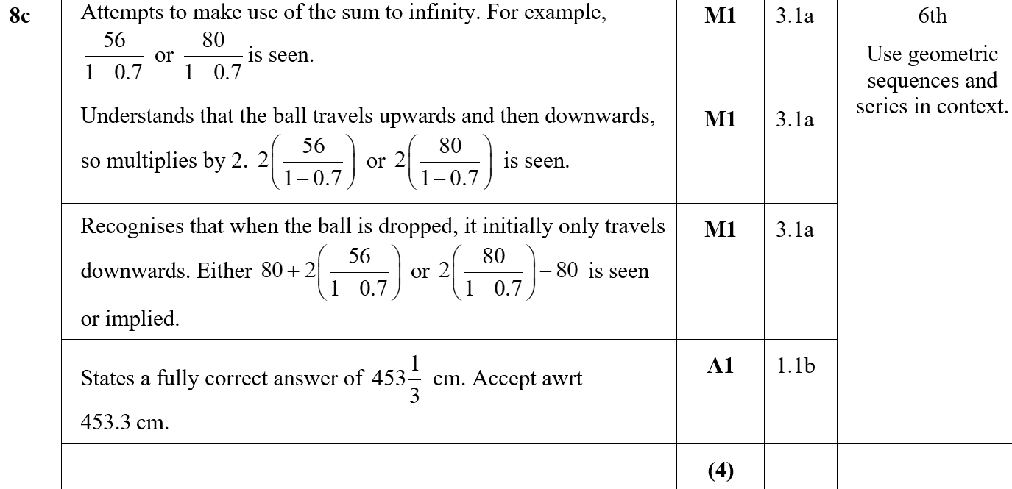
Practice E
C
C Notes

Slide 20
Practice E
D

Slide 21
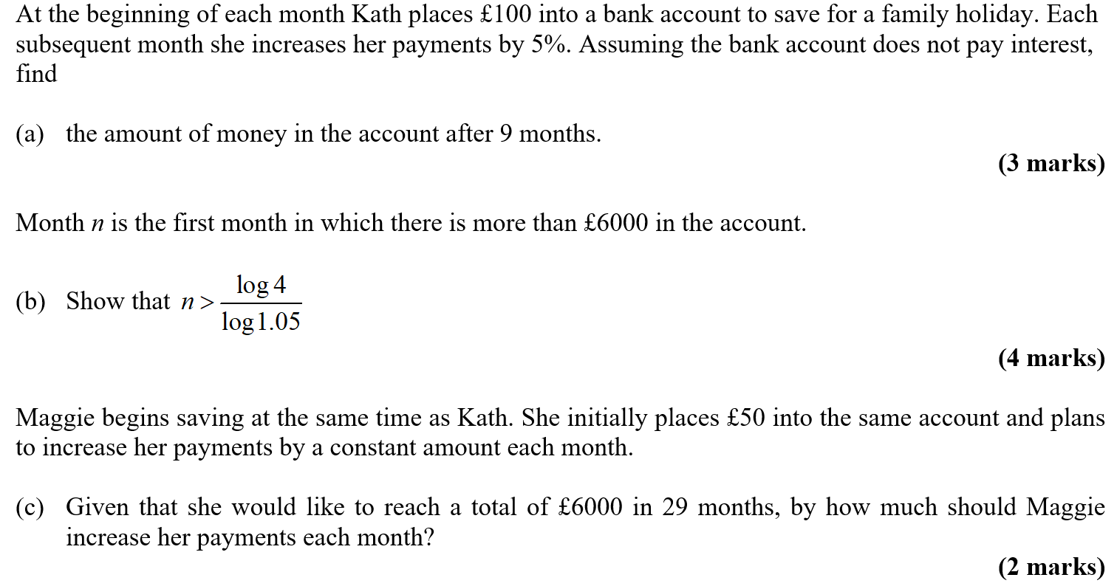
Practice F

Slide 22
Practice F
A
A notes

Slide 23
Practice F
B
C

Slide 24
SAM Paper 2

Slide 25
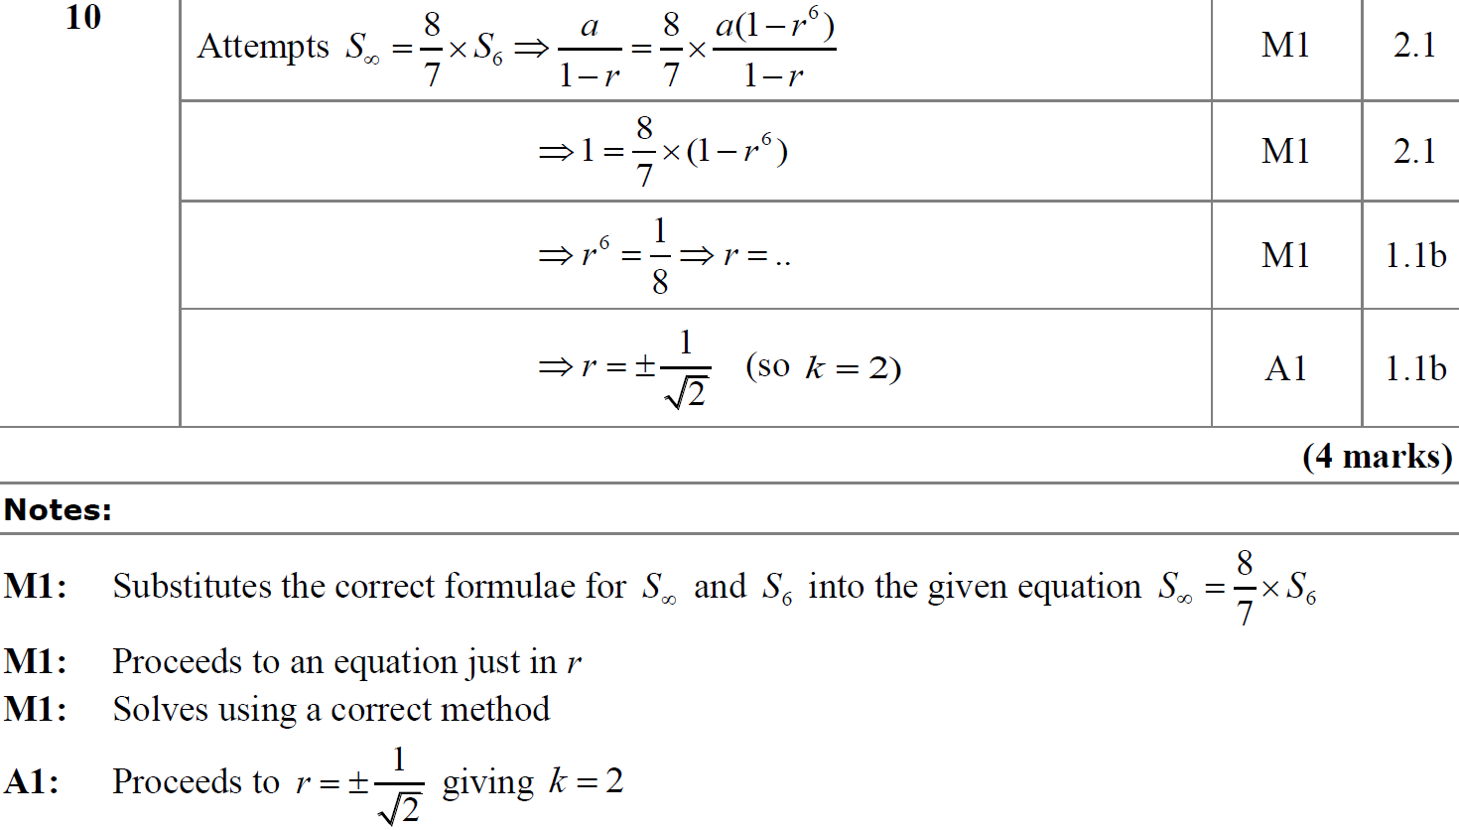
SAM Paper 2
A
A notes

Slide 26
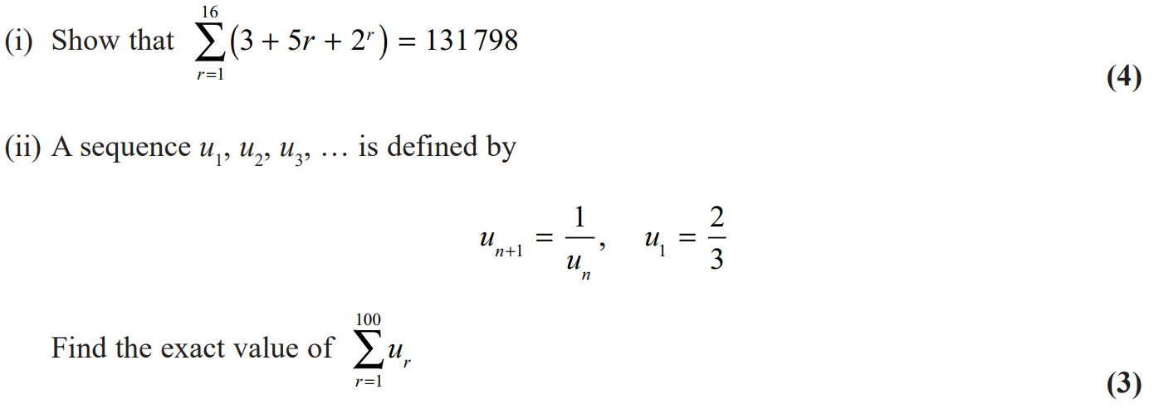
2018 Paper 2

Slide 27
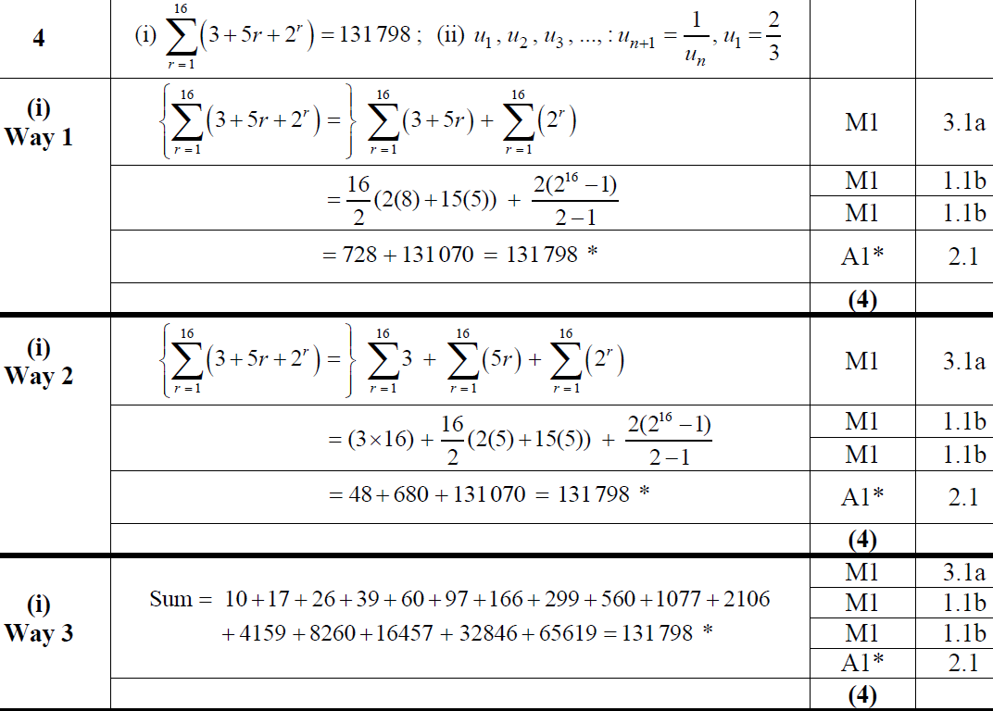
2018 Paper 2
(i)
(i) Alternative 1

Slide 28
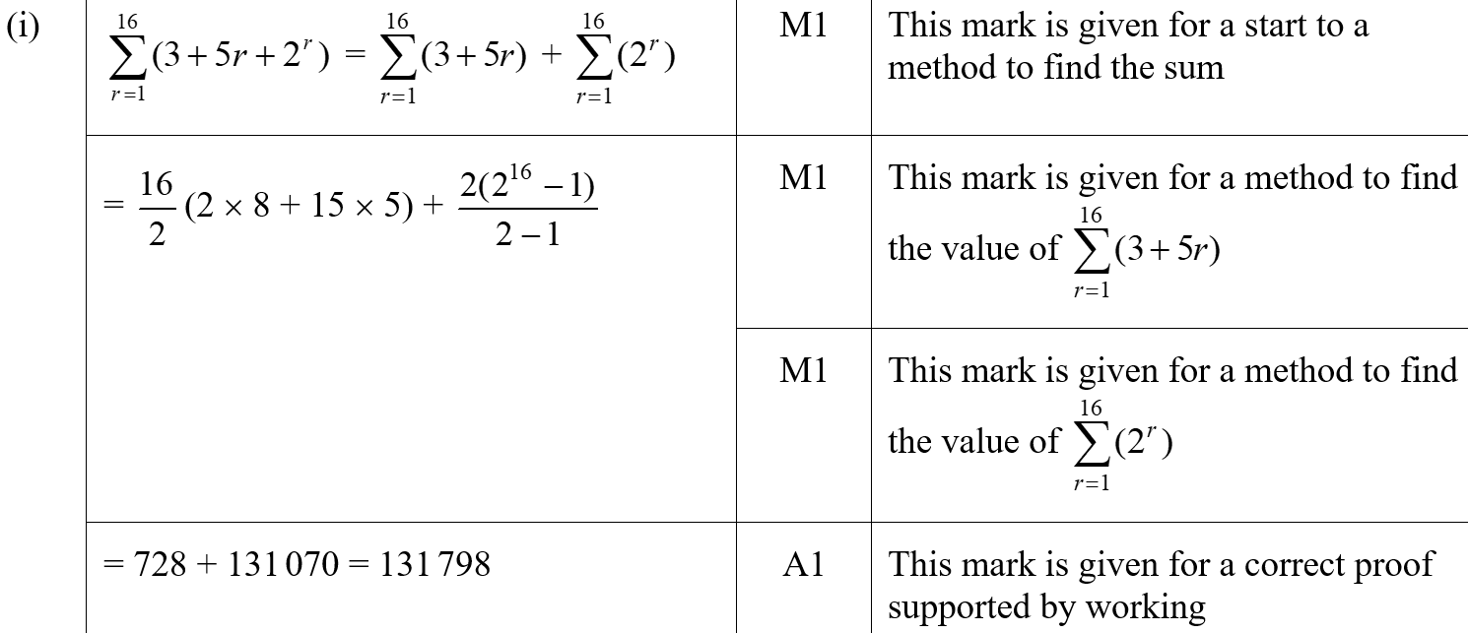
2018 Paper 2
(i) Alternative 2
(i) (SF)

Slide 29
2018 Paper 2
(ii)
(ii) (SF)

Slide 30
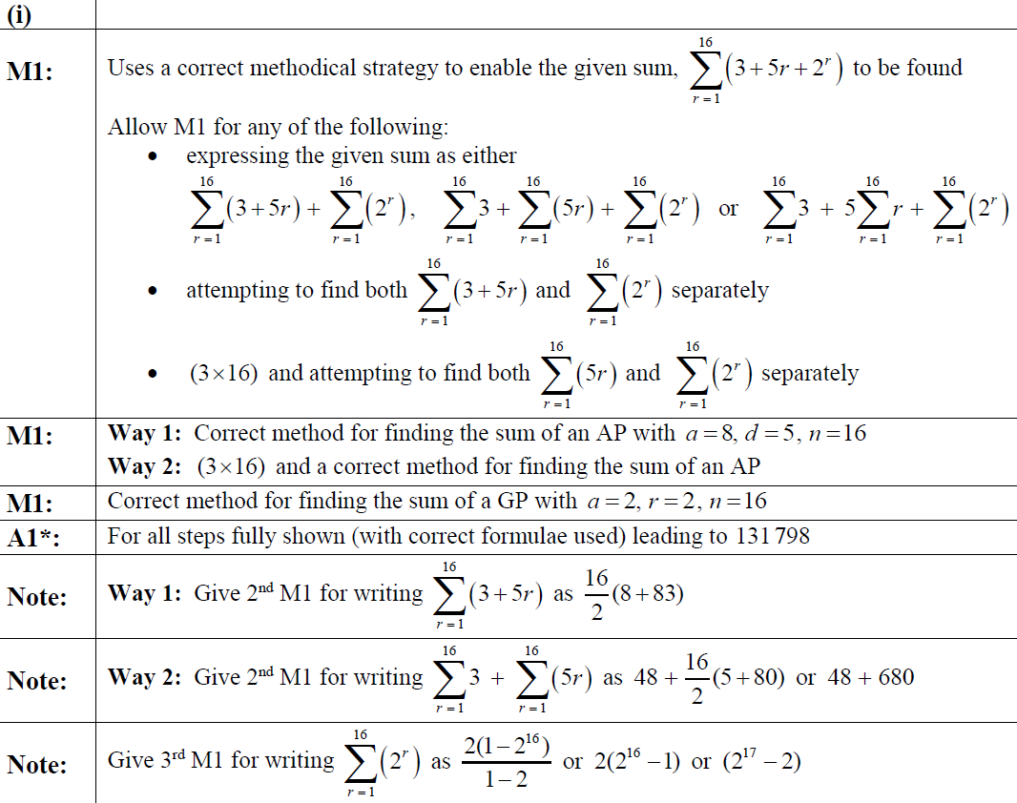
2018 Paper 2
(i) (with Alternative 1) notes

Slide 31
2018 Paper 2
(i) Alternative 2 notes

Slide 32
2018 Paper 2
(ii) notes

Slide 33
New Spec Q’s
Old Spec Sequences and Series
C1
C2 (geometric)
Jan 2006 (r)
June 2008 (a)
May 2011 (a)
May 2014 (a)
Jan 2006
June 2009
Jan 2013
Jan 2006 (a)
Jan 2009 (a)
Jan 2012 (r)
May 2015 (r)
May 2006
Jan 2010
May 2013
May 2006 (r)
June 2009 (a)
Jan 2012 (a)
May 2015 (a)
Jan 2007
June 2010
May 2014
May 2006 (a)
June 2009 (r)
May 2012 (r)
May 2016 (r)
May 2007
Jan 2011
May 2015
Jan 2007 (a)
Jan 2010 (a)
May 2012 (a)
May 2016 (a)
Jan 2008
May 2011
May 2016
May 2007 (a)
June 2010 (r)
Jan 2013 (r)
May 2017 (r)
June 2008
Jan 2012
May 2017
May 2007 (r)
June 2010 (a)
Jan 2013 (a)
May 2017 (a)
Jan 2008 (r)
Jan 2011 (r)
May 2013 (r)
May 2018 (a)
Jan 2009
May 2012
May 2018
Jan 2008 (a)
Jan 2011 (a)
May 2013 (a)
May 2018 (r)
June 2008 (r)
May 2011 (r)
May 2014 (r)
a = arithmetic sequence
r =recurrence relationship

Slide 34
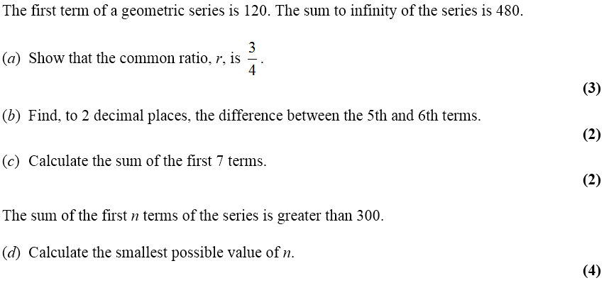
Jan 2006

Slide 35
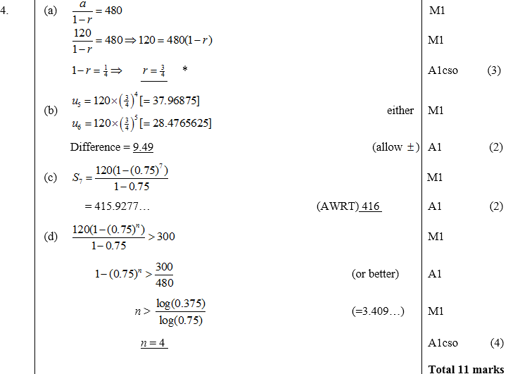
A
Jan 2006
B
C
D

Slide 36
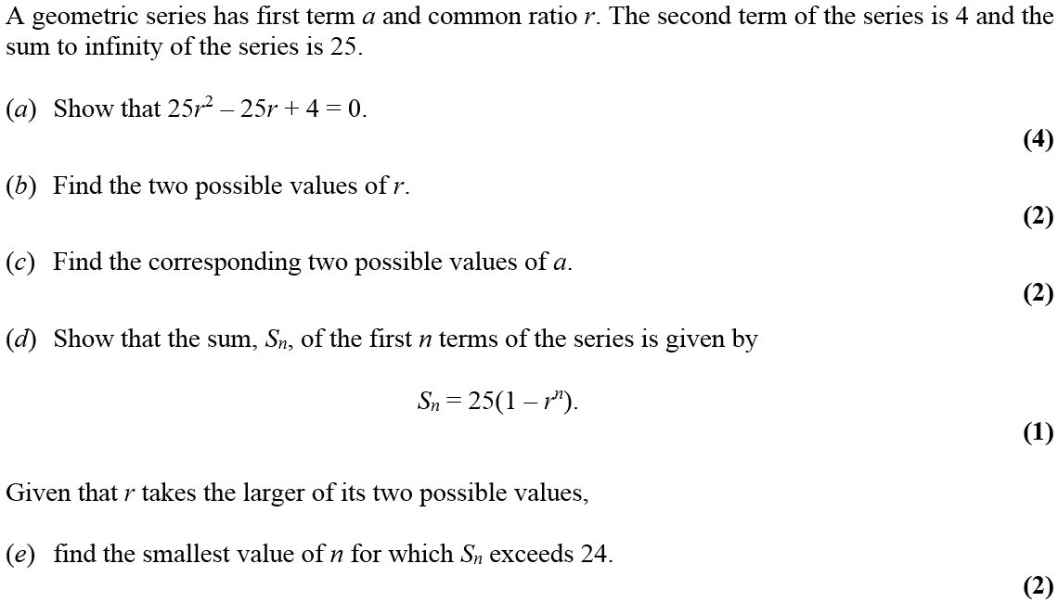
May 2006

Slide 37
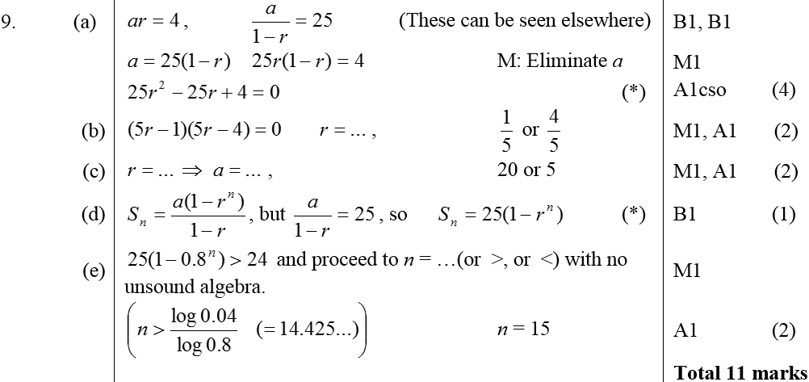
May 2006
A
B
C
D
E

Slide 38
Jan 2007

Slide 39
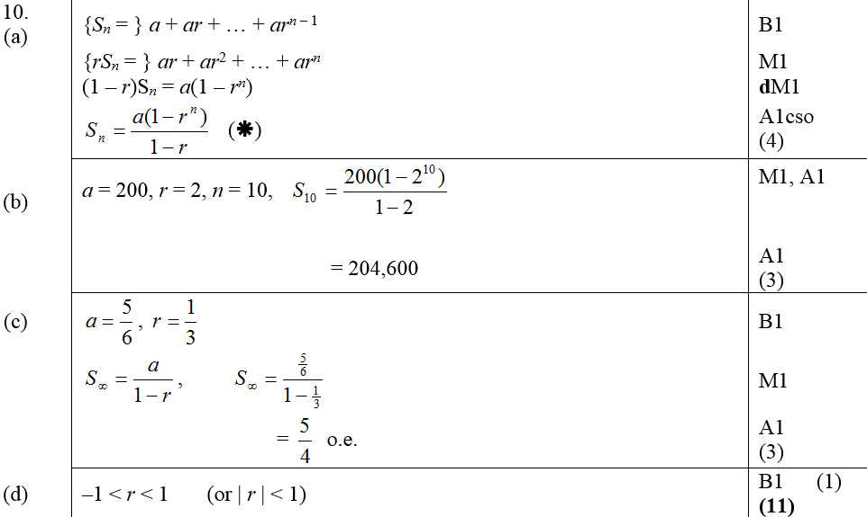
Jan 2007
A
B
C
D

Slide 40
Jan 2007
A
A slight alternate

Slide 41
Jan 2007
B
Alternative B (adding 10 terms)

Slide 42
Jan 2007
C
D

Slide 43
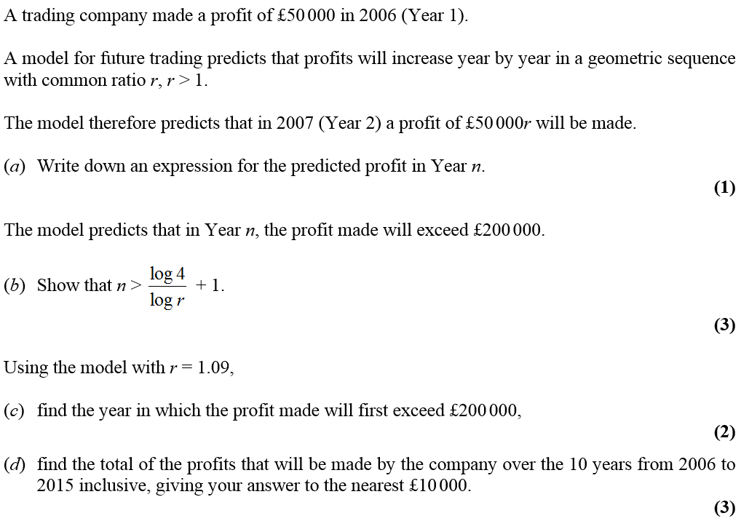
May 2007

Slide 44
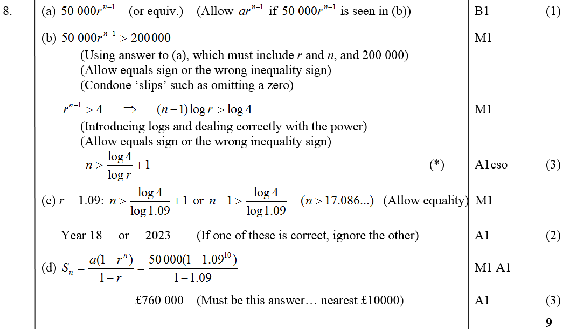
May 2007
A
B
C
D

Slide 45
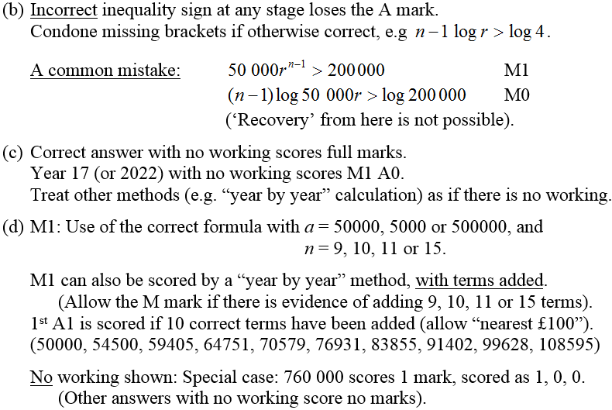
May 2007
B notes
C notes
D notes

Slide 46
Jan 2008

Slide 47
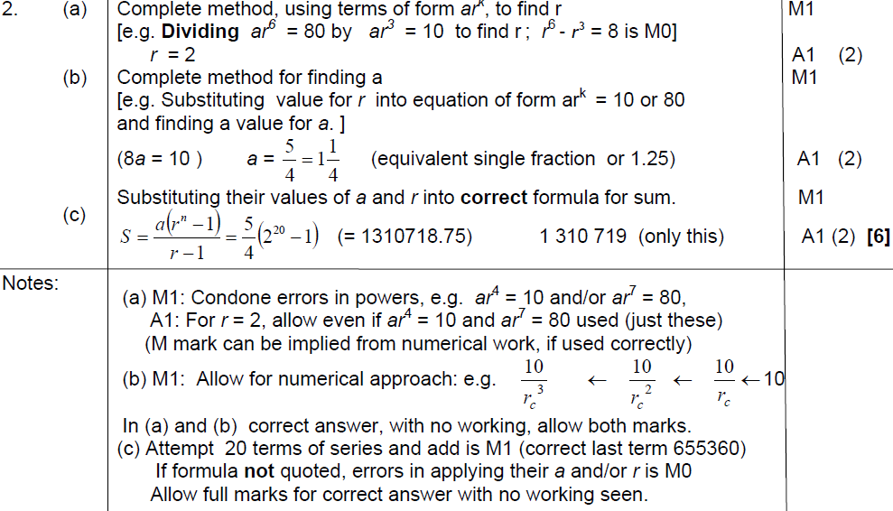
Jan 2008
A
B
C
A notes
B notes
C notes

Slide 48
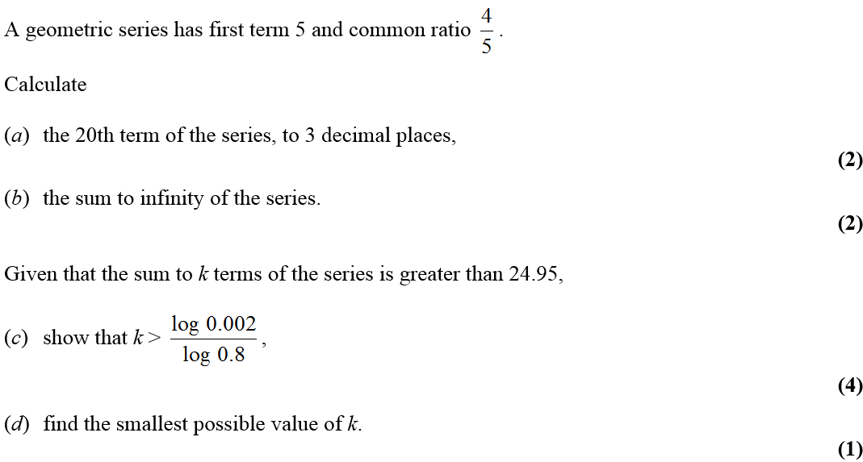
June 2008

Slide 49
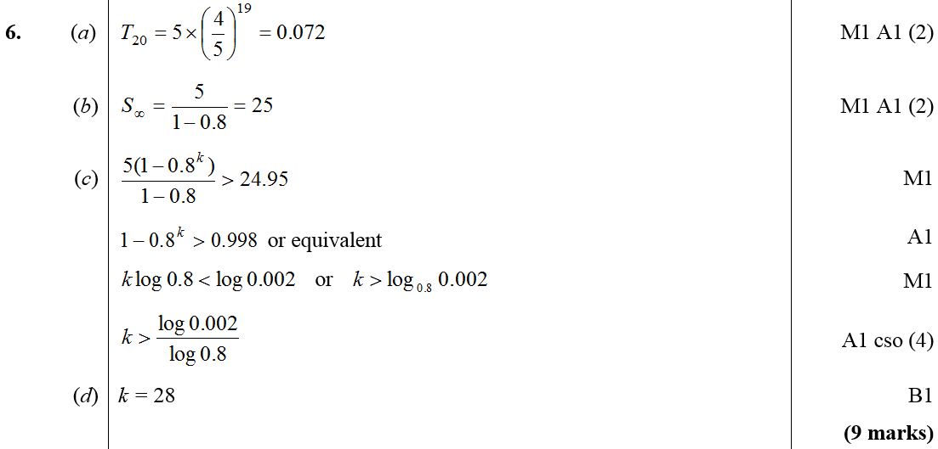
June 2008
A
B
C
D

Slide 50
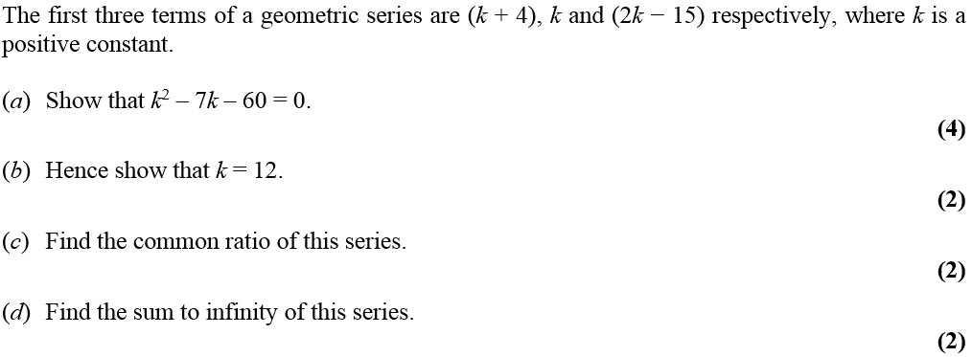
Jan 2009

Slide 51
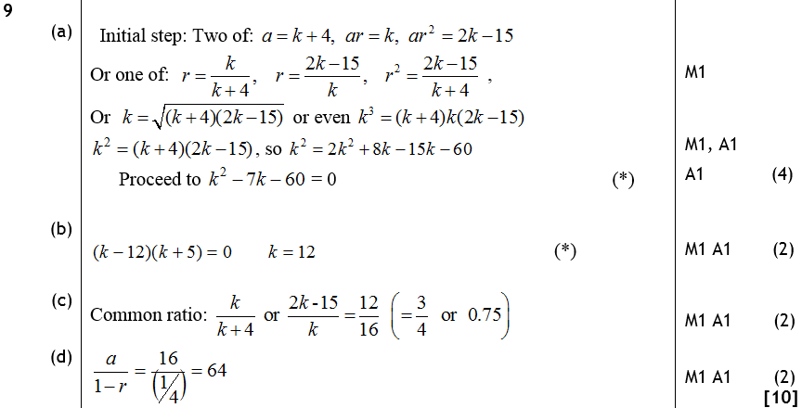
Jan 2009
A
B
C
D

Slide 52
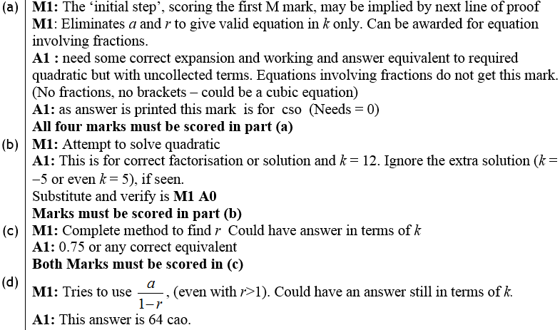
Jan 2009
A notes
B notes
C notes
D notes

Slide 53
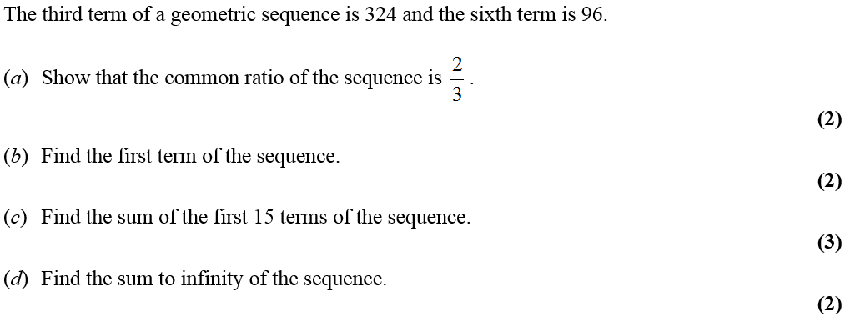
June 2009

Slide 54
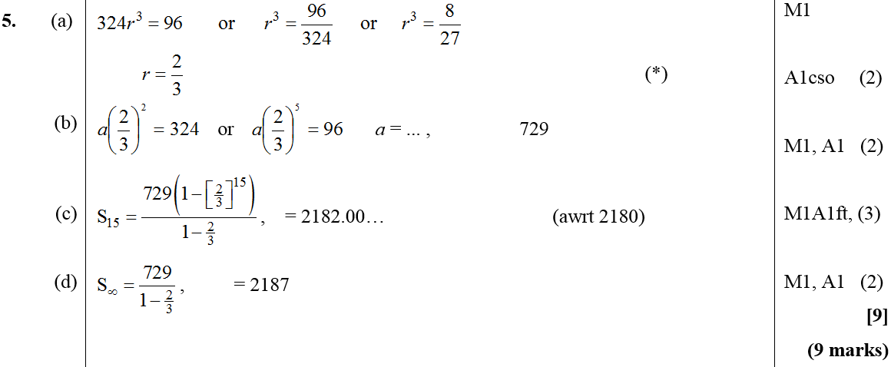
June 2009
A
B
C
D

Slide 55
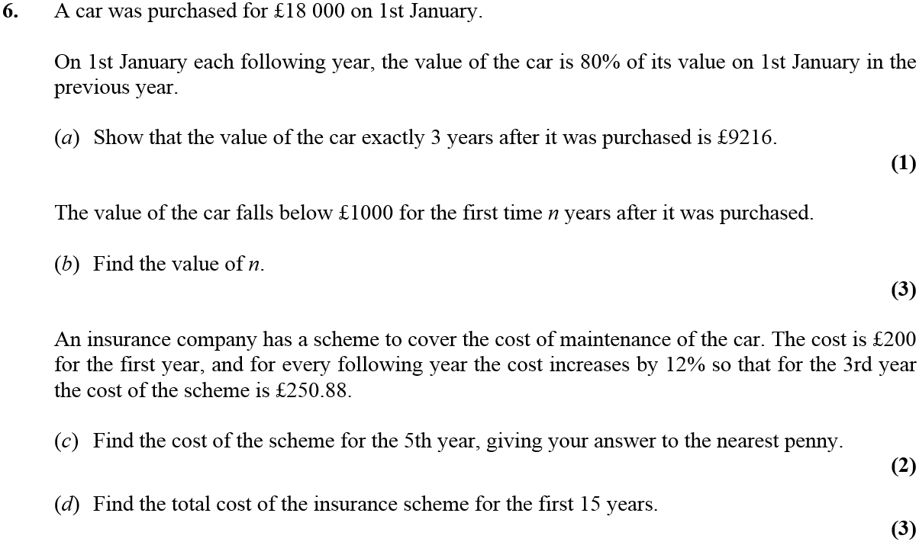
Jan 2010

Slide 56
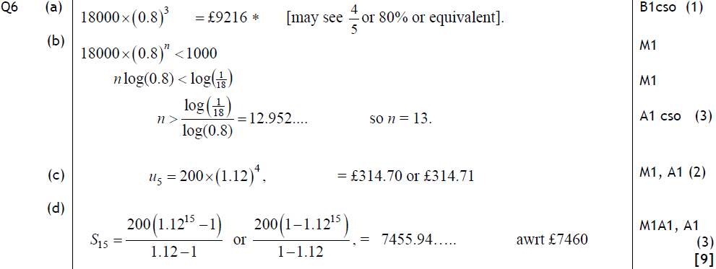
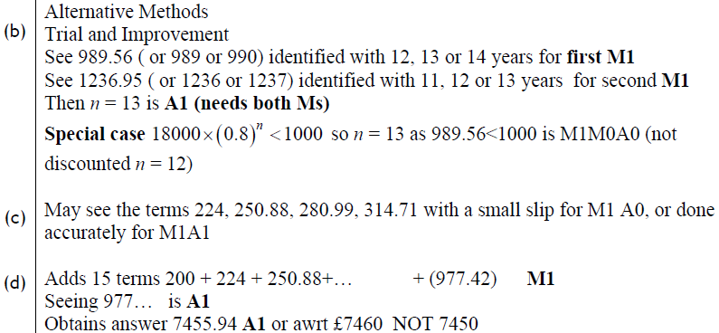
Jan 2010
A
B
C
D
Alternative B
Alternative C
Alternative D

Slide 57
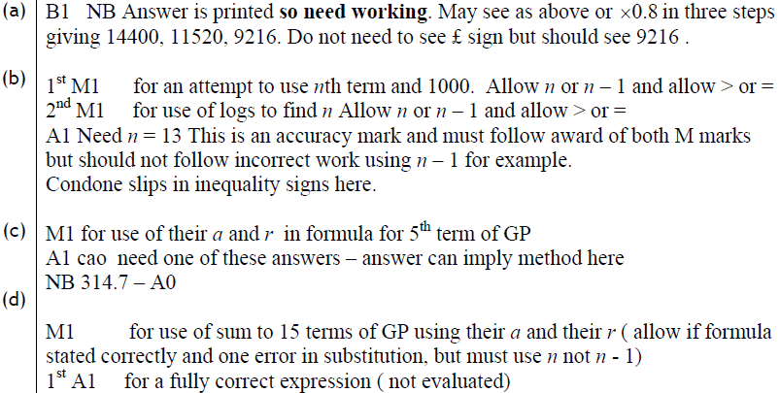
Jan 2010
A
B
C
D

Slide 58
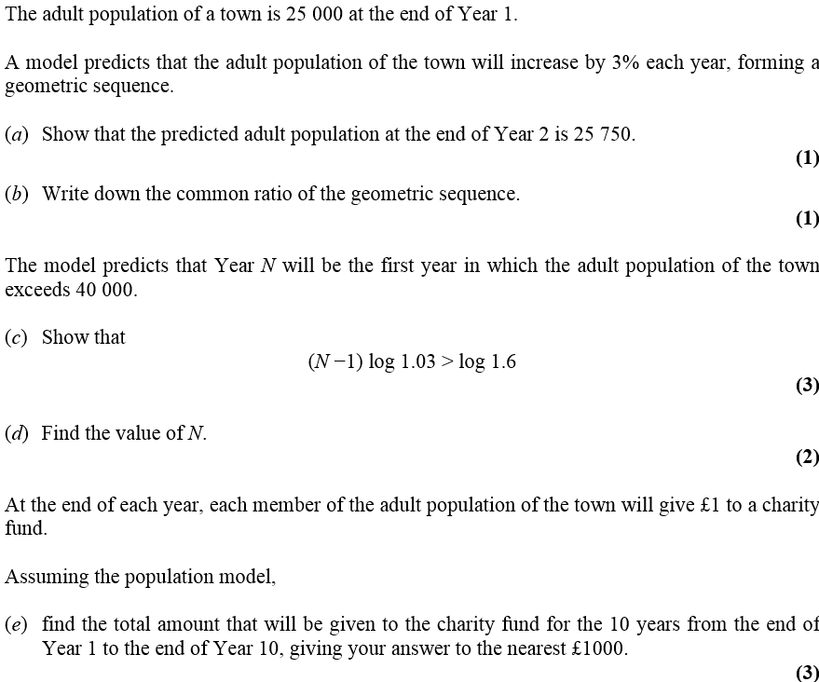
June 2010

Slide 59
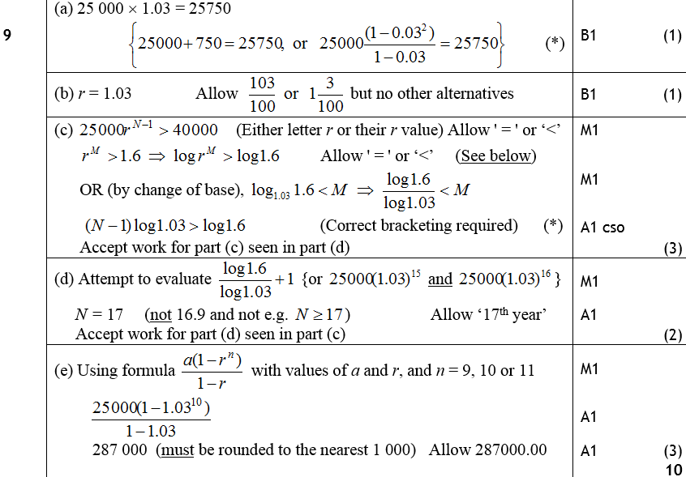
June 2010
A
B
C
D
E

Slide 60
Jan 2011

Slide 61
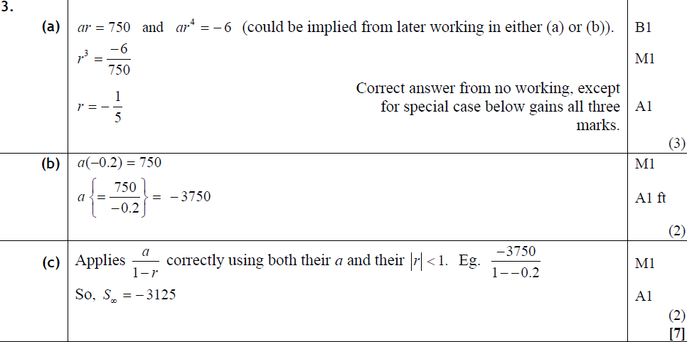
Jan 2011
A
B
C

Slide 62
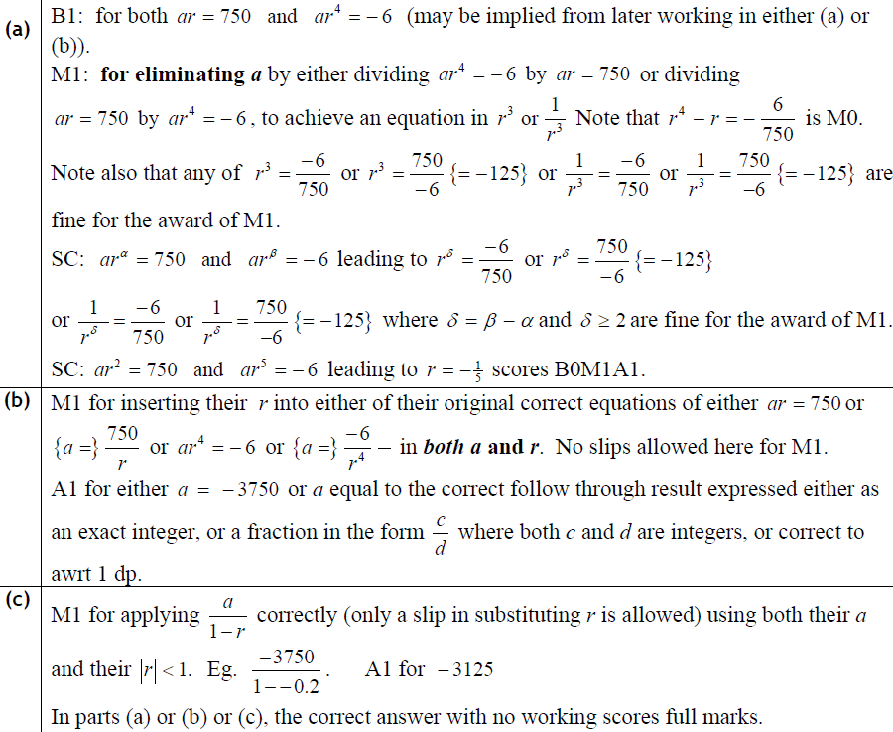
Jan 2011
A
B
C

Slide 63
May 2011

Slide 64
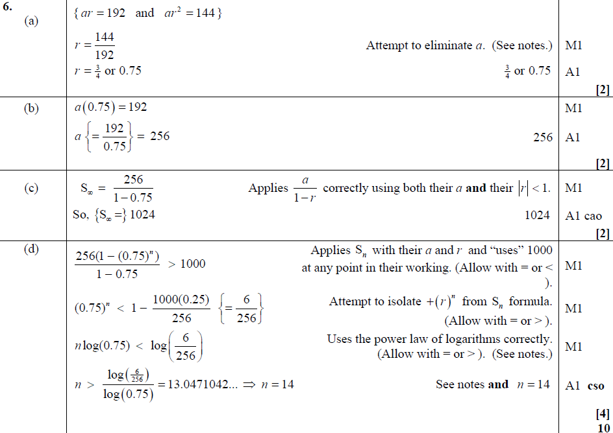
A
May 2011
B
C
D

Slide 65
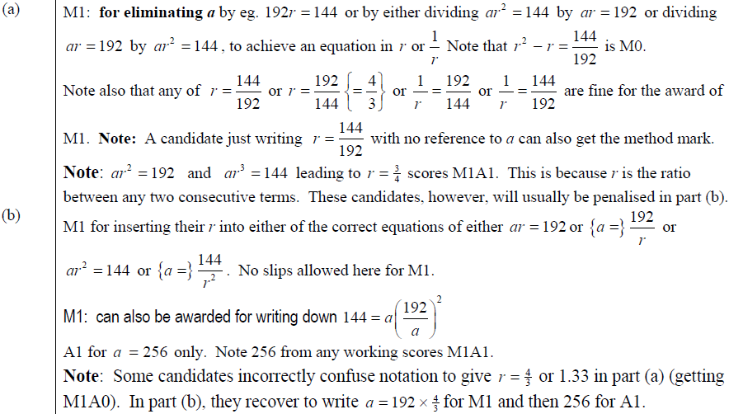
May 2011
A
B

Slide 66
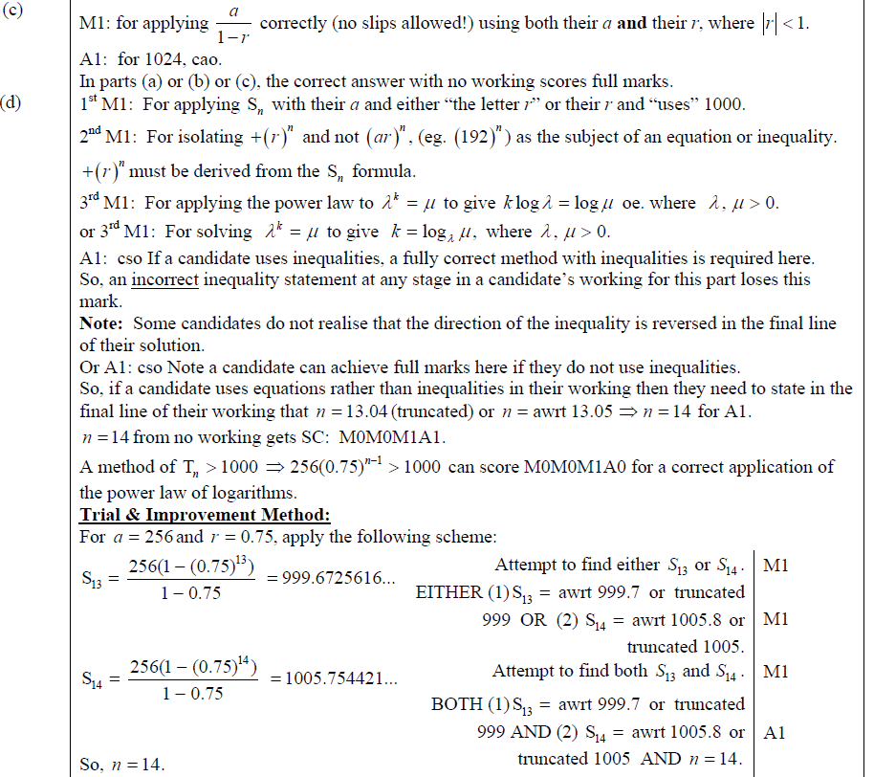
C
May 2011
D

Slide 67
May 2011
D…

Slide 68
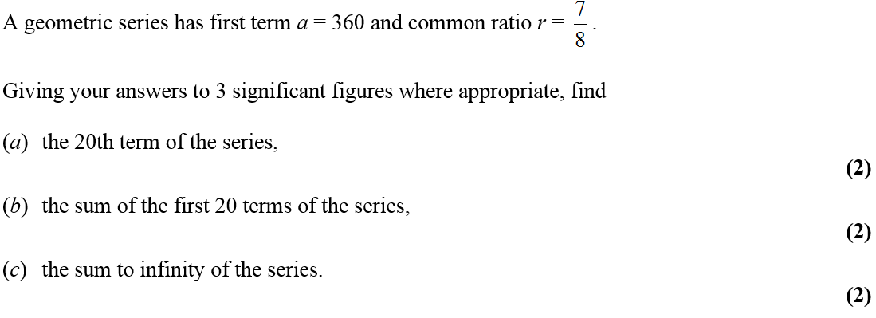
Jan 2012

Slide 69
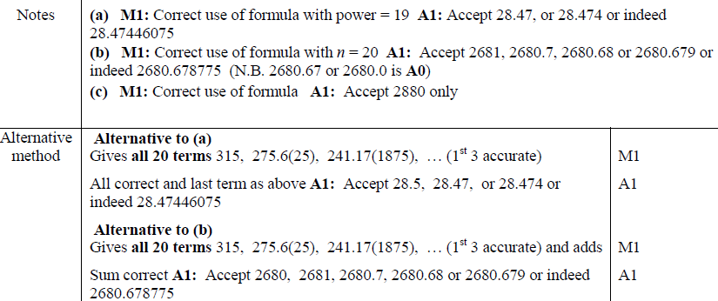
Jan 2012
A
B
C
A
B
C
A
B

Slide 70
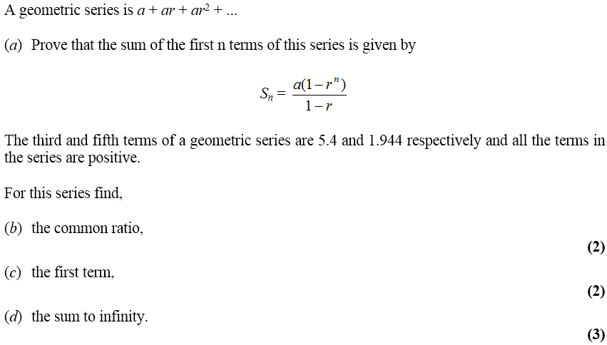
May 2012

Slide 71
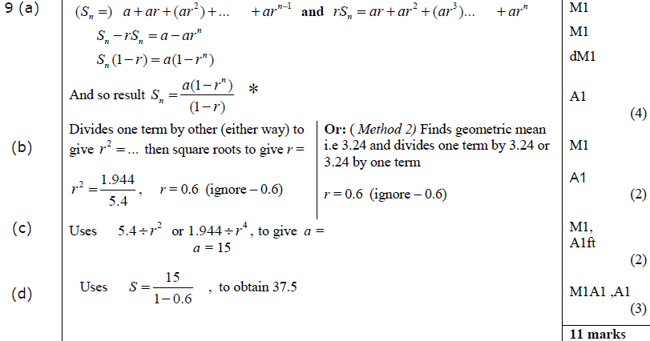
May 2012
A
B
C
D

Slide 72
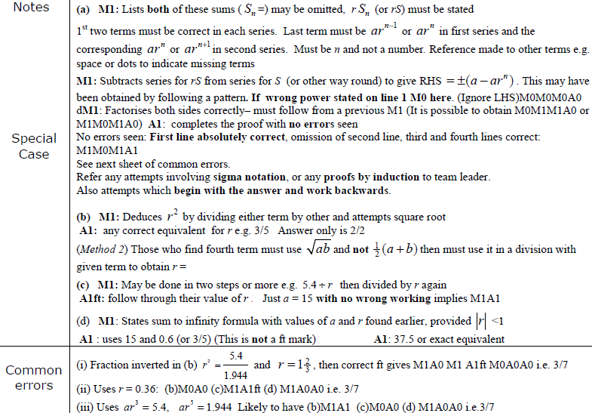
May 2012
A
B
C
D
COMMON ERRORS

Slide 73
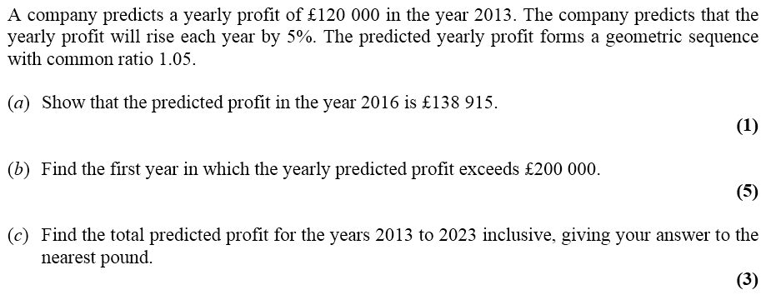
Jan 2013

Slide 74
Jan 2013
A
B
C

Slide 75
May 2013

Slide 76
May 2013
A
B
C

Slide 77
May 2014

Slide 78
May 2014
A
B

Slide 79
May 2014
C

Slide 80
May 2014
Trial and Improvement for C

Slide 81
May 2015

Slide 82
May 2015
(i) A
(i) B
(i) Alternative, part B first
(ii)

Slide 83
May 2015
(i) notes
(i) Alternative notes
(ii)

Slide 84
May 2016

Slide 85
May 2016
A
A Alternative 1
A Alternative 2

Slide 86
May 2016
B
C

Slide 87
May 2016
A notes
B notes

Slide 88
May 2016
C notes

Slide 89
May 2017

Slide 90
May 2017
A
B

Slide 91
May 2017
C (i)
C (ii)

Slide 92
May 2017
A notes
B notes
C notes

Slide 93
May 2018

Slide 94
May 2018
A
B
C

Slide 95
May 2018
A notes
B notes
C notes

Slide 96
Jan 2006

Slide 97
Jan 2006
A
B

Slide 98
Jan 2006

Slide 99
Jan 2006
A
B
C
D

Slide 100
May 2006

Slide 101
May 2006
A
B

Slide 102
May 2006

Slide 103
May 2006
A
Alternative method

Slide 104
Jan 2007

Slide 105
Jan 2007
A
B
C
D

Slide 106
Jan 2007
A notes
B notes
C notes
D notes

Slide 107
May 2007

Slide 108
May 2007
A
B
Alternative A
Alternative B

Slide 109
May 2007
A notes
B notes

Slide 110
May 2007

Slide 111
May 2007
A
B
C

Slide 112
May 2007
B notes
C notes

Slide 113
Jan 2008

Slide 114
Jan 2008
A
B
C
D

Slide 115
Jan 2008
B
C
D

Slide 116
Jan 2008

Slide 117
Jan 2008
A
B
C
A notes
B notes
C notes

Slide 118
Jan 2008
Alternative A
Alternative B
Alternative C

Slide 119
June 2008

Slide 120
June 2008
A
B
C

Slide 121
June 2008

Slide 122
June 2008
A
B
C
D
E

Slide 123
Jan 2009

Slide 124
Jan 2009
A
B
C
D
A notes

Slide 125
Jan 2009
B notes
C notes
D notes

Slide 126
June 2009

Slide 127
June 2009
A
B
C

Slide 128
June 2009

Slide 129
June 2009
A
B
C

Slide 130
Jan 2010

Slide 131
Jan 2010
A
B
C

Slide 132
Jan 2010
A
B
C
D

Slide 133
June 2010

Slide 134
June 2010
A
B

Slide 135
June 2010

Slide 136
June 2010
A
B
C

Slide 137
Jan 2011

Slide 138
Jan 2011
A
B
A notes

Slide 139
Jan 2011

Slide 140
Jan 2011
A
B
C
A notes
C notes

Slide 141
May 2011

Slide 142
A
May 2011
B
C (i)
C (ii)
A notes
B notes
C (i) notes
C (ii) notes

Slide 143
May 2011

Slide 144
A
May 2011
B (i)
B (ii)
C
A notes
B (ii) notes
C notes

Slide 145
Jan 2012

Slide 146
Jan 2012
A
B
C

Slide 147
Jan 2012

Slide 148
Jan 2012
A
B
C

Slide 149
May 2012

Slide 150
May 2012
A
B
C

Slide 151
May 2012
A notes
B notes
C notes

Slide 152
May 2012

Slide 153
May 2012
A
B
C
D

Slide 154
May 2012
A notes
B notes

Slide 155
May 2012
C notes
D notes

Slide 156
Jan 2013

Slide 157
Jan 2013
A
B

Slide 158
Jan 2013

Slide 159
Jan 2013
A
B
C

Slide 160
May 2013

Slide 161
May 2013
A
B

Slide 162
May 2013

Slide 163
May 2013
A
B

Slide 164
May 2014

Slide 165
May 2014
A
B

Slide 166
May 2014
A Notes
B Notes
Special Cases

Slide 167
May 2014

Slide 168
May 2014
A
B
C

Slide 169
May 2014
A Notes
B Notes
C Notes

Slide 170
May 2015

Slide 171
May 2015
(i) A
(i) B

Slide 172
May 2015
(ii) A
(ii) B

Slide 173
May 2015

Slide 174
May 2015
A

Slide 175
May 2015
B

Slide 176
May 2016

Slide 177
May 2016
A
B
C

Slide 178
May 2016

Slide 179
May 2016
A
B
C

Slide 180
May 2016
D
E
Lists

Slide 181
May 2017

Slide 182
May 2017
A

Slide 183
May 2017
B

Slide 184
May 2017

Slide 185
May 2017
A

Slide 186
May 2017
B

Slide 187
May 2017
B notes

Slide 188
May 2018

Slide 189
May 2018
A

Slide 190
May 2018
B

Slide 191
May 2018
B notes

Slide 192
May 2018

Slide 193
May 2018
A

Slide 194
May 2018
B
C

