Slide 1
Old Spec Q’s
Projectiles
Practice G
Practice H
Practice I
SAM
2018

Slide 2
Practice Paper G

Slide 3
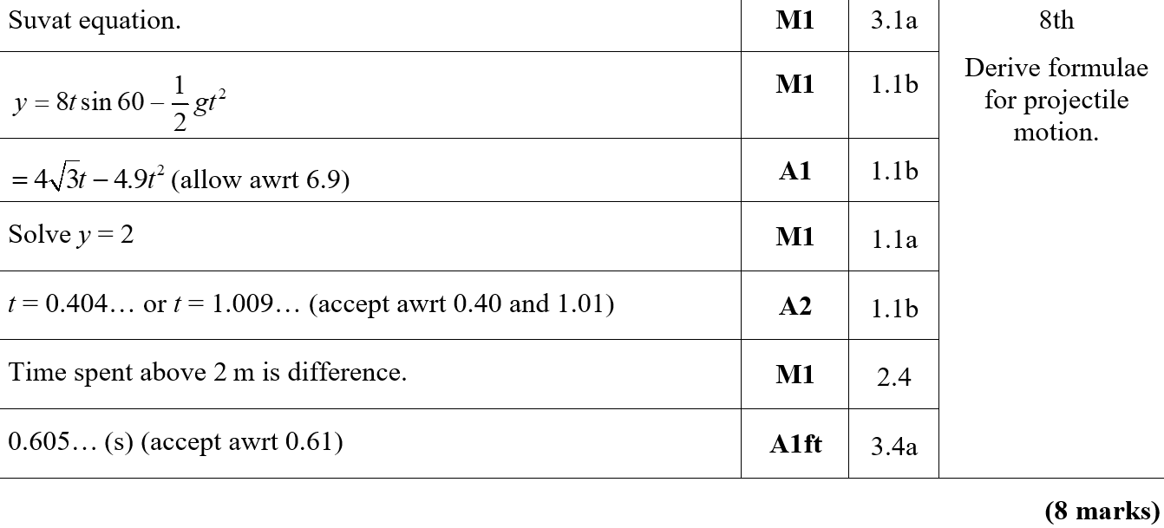
Practice Paper G
A

Slide 4
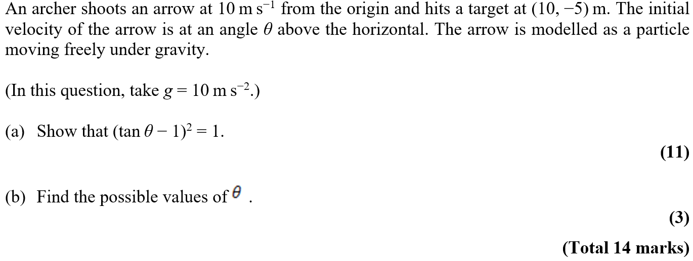
Practice Paper H

Slide 5
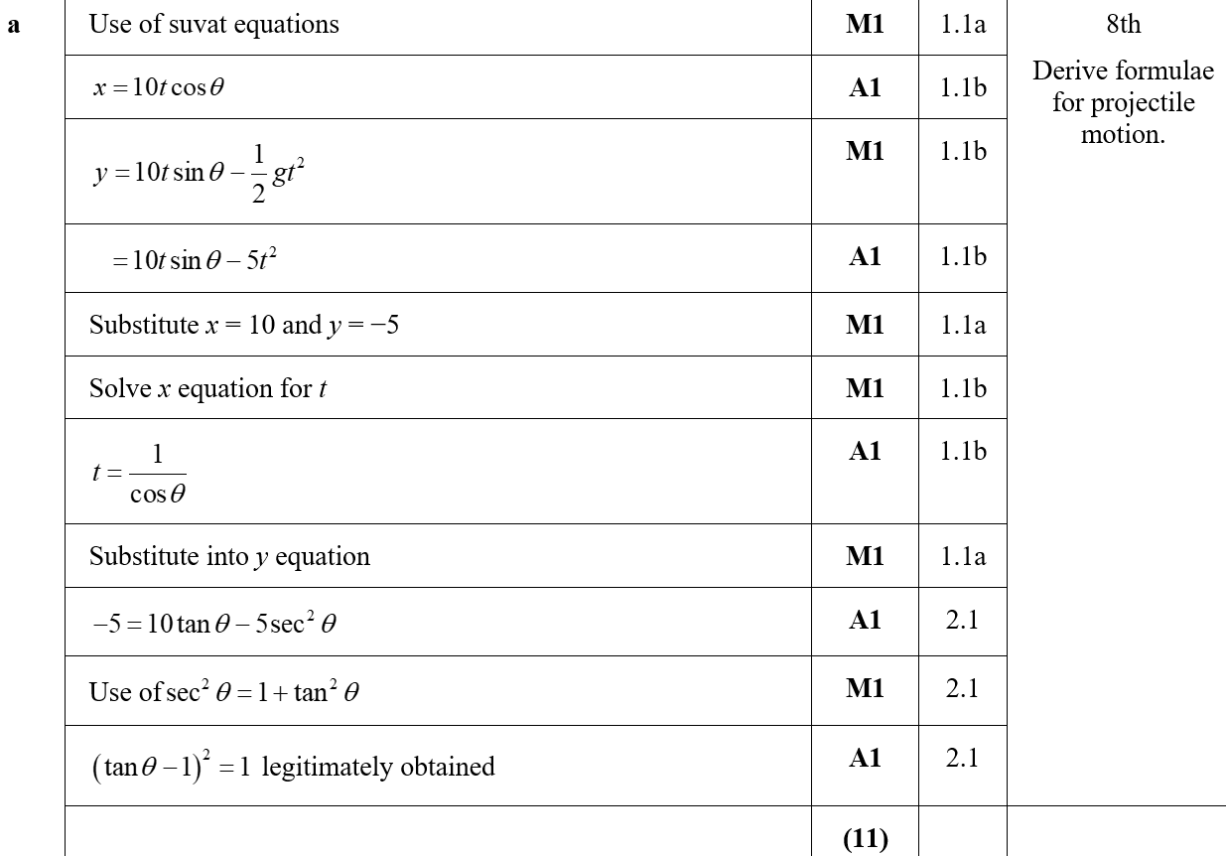
Practice Paper H
A

Slide 6
Practice Paper H
C

Slide 7
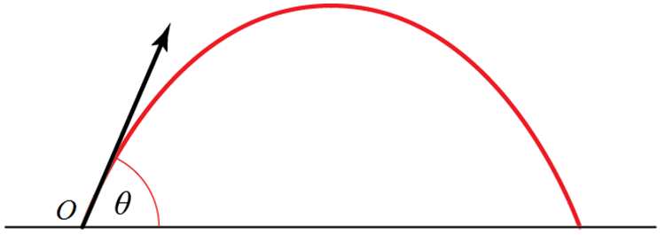
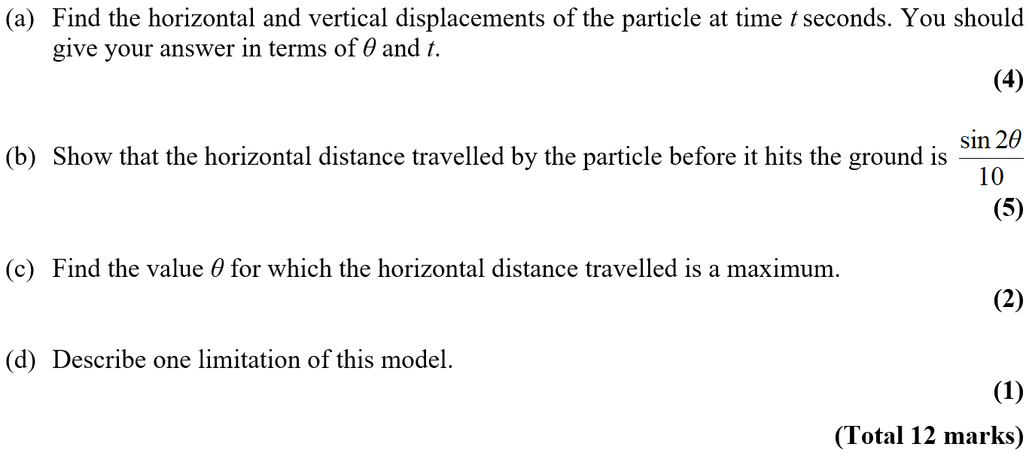
Practice Paper I

Slide 8
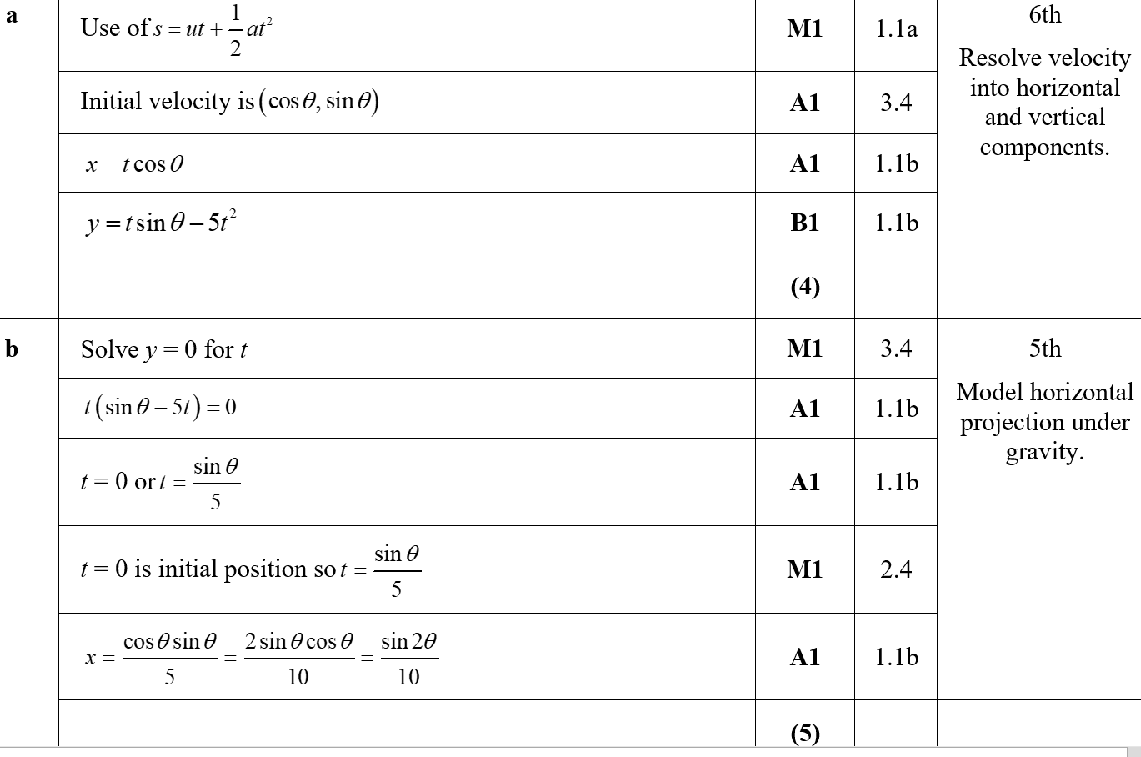
Practice Paper I
A
B

Slide 9
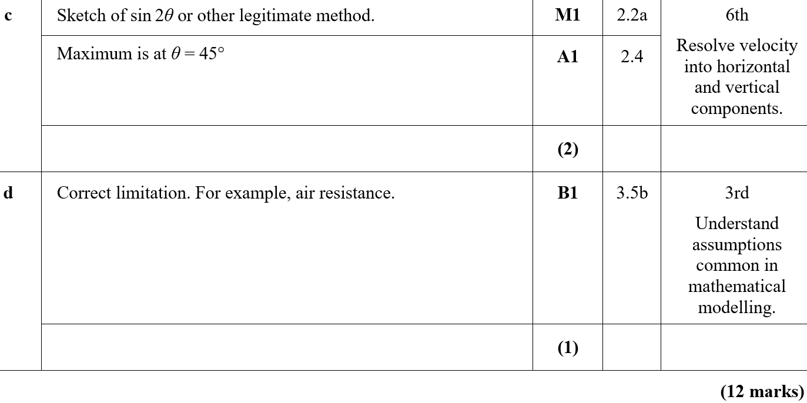
Practice Paper I
C
D

Slide 10
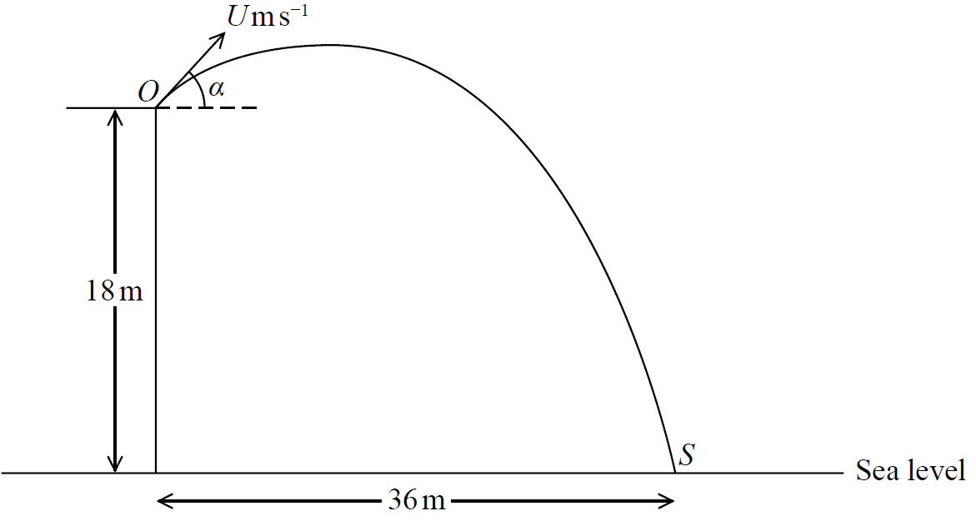
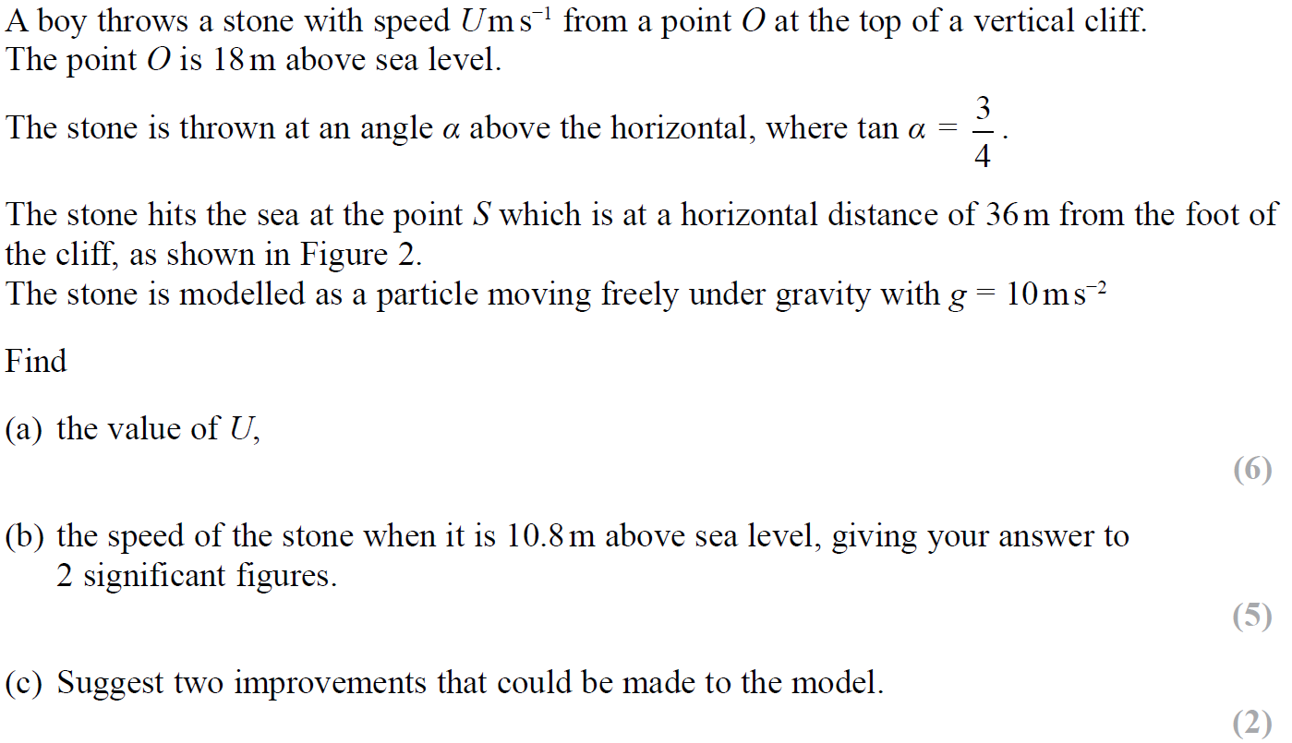
SAM

Slide 11
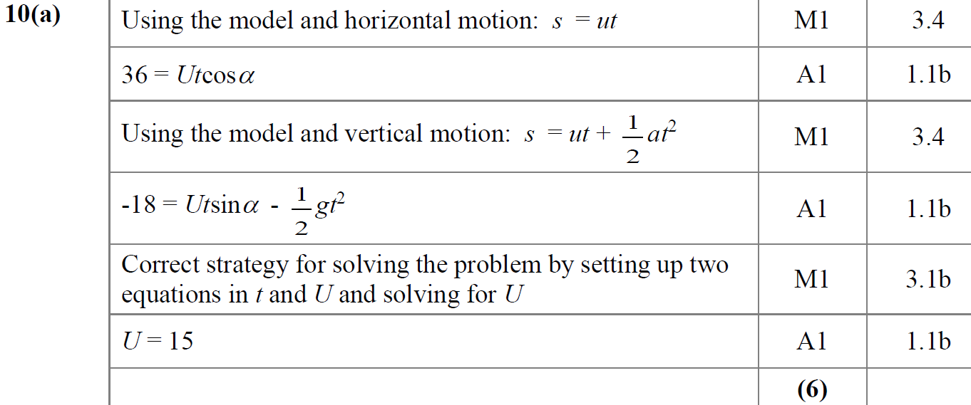
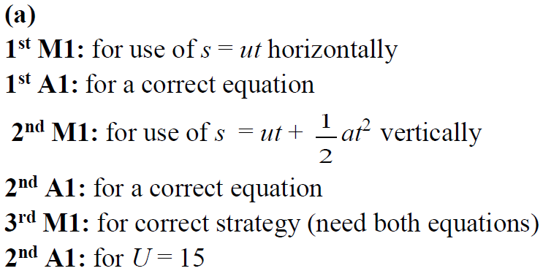
SAM
A
A notes

Slide 12
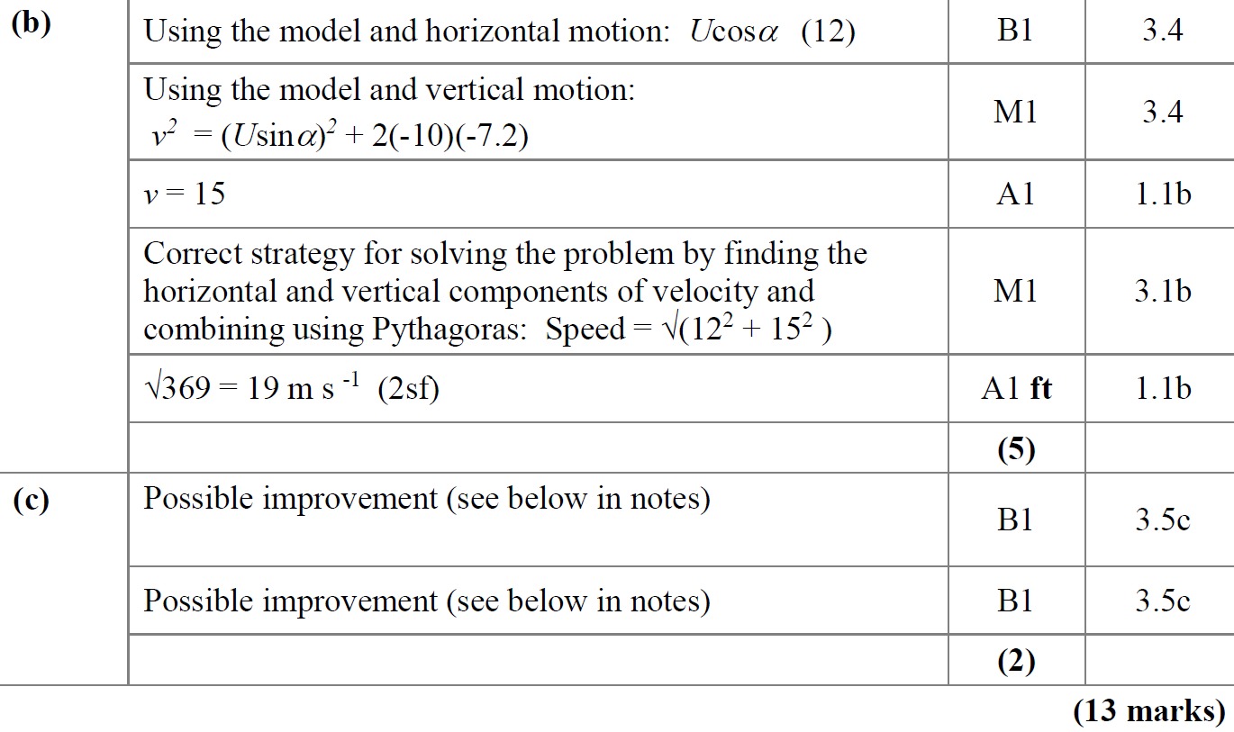
SAM
B
C

Slide 13
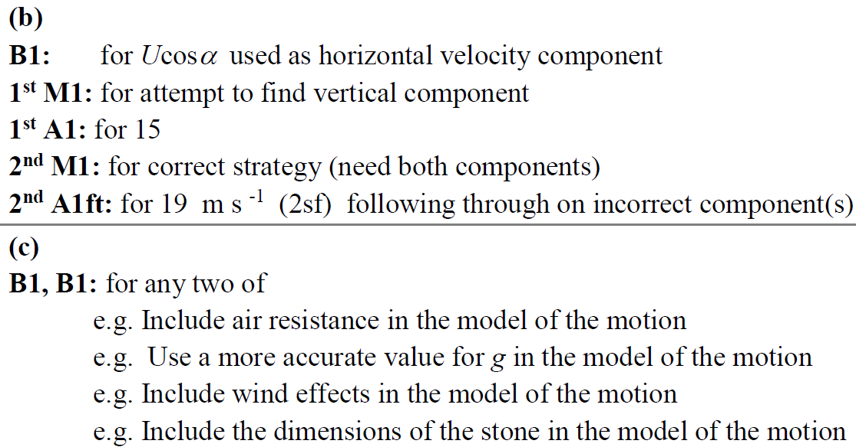
SAM
B notes
C notes

Slide 14
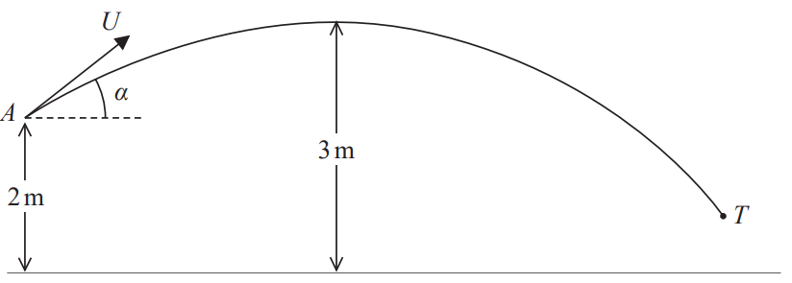
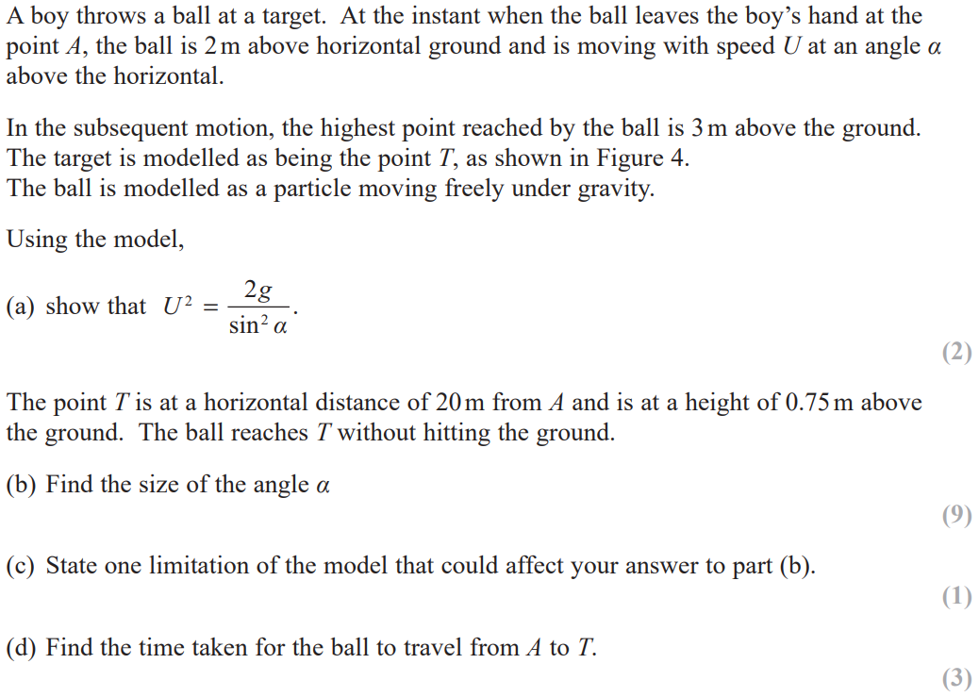
2018

Slide 15
2018
A

Slide 16
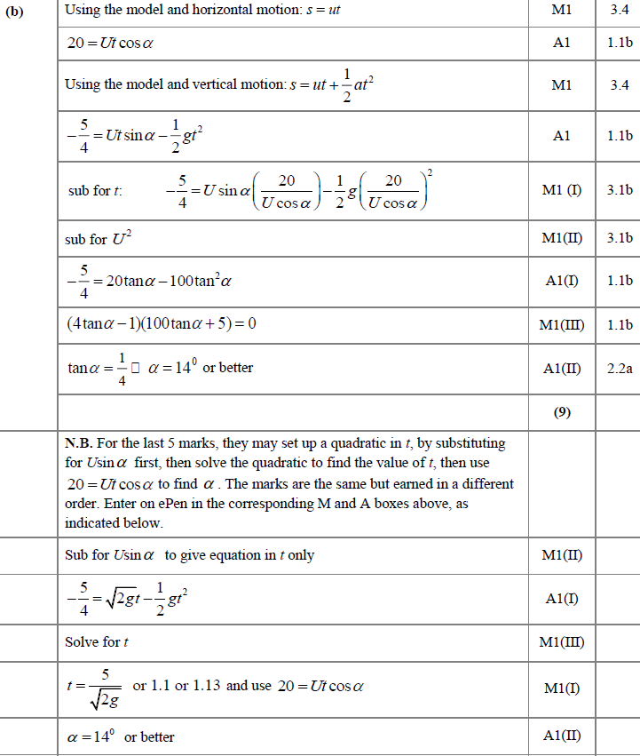
2018
B

Slide 17
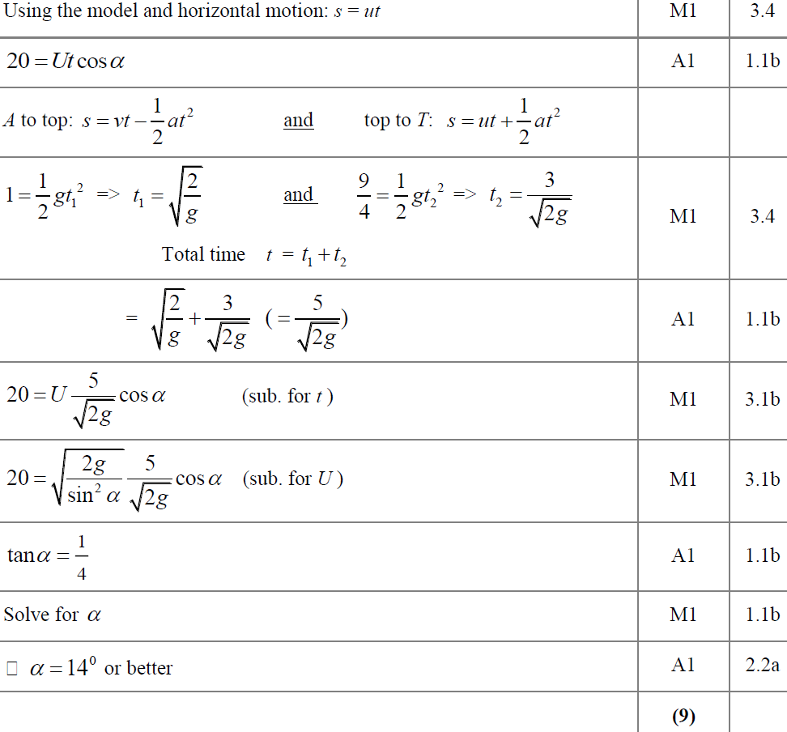
2018
B Alternative

Slide 18
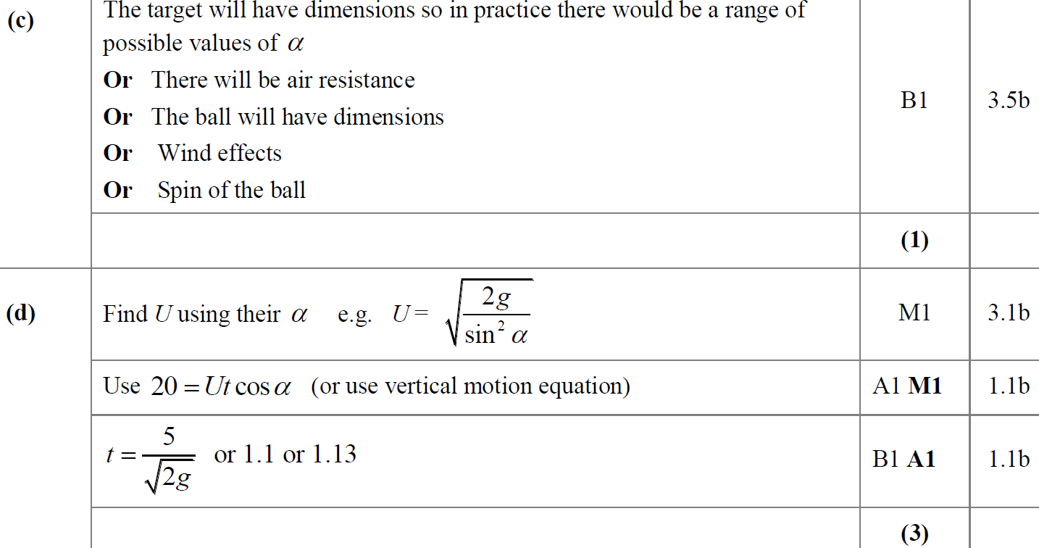
2018
C
D

Slide 19
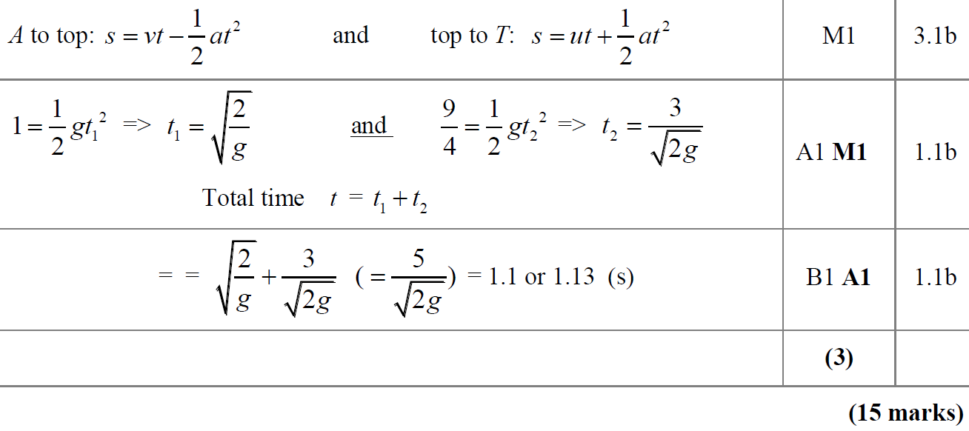
2018
D Alternative
A (SF)

Slide 20
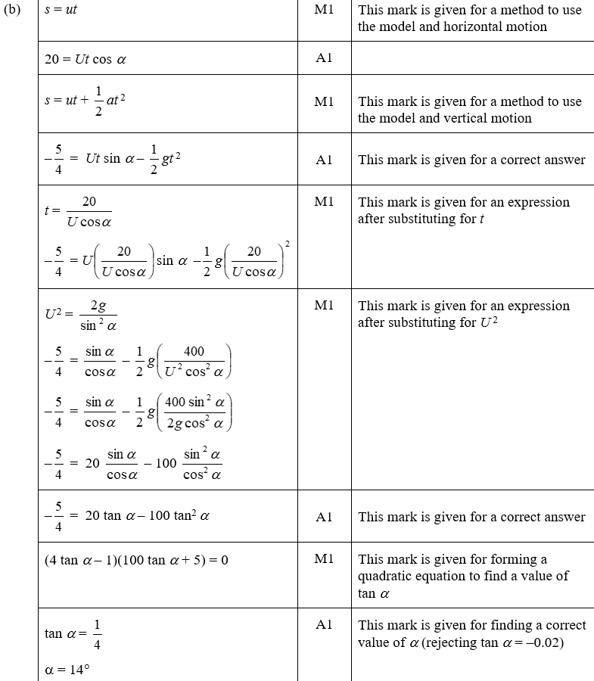
2018
B (SF)

Slide 21
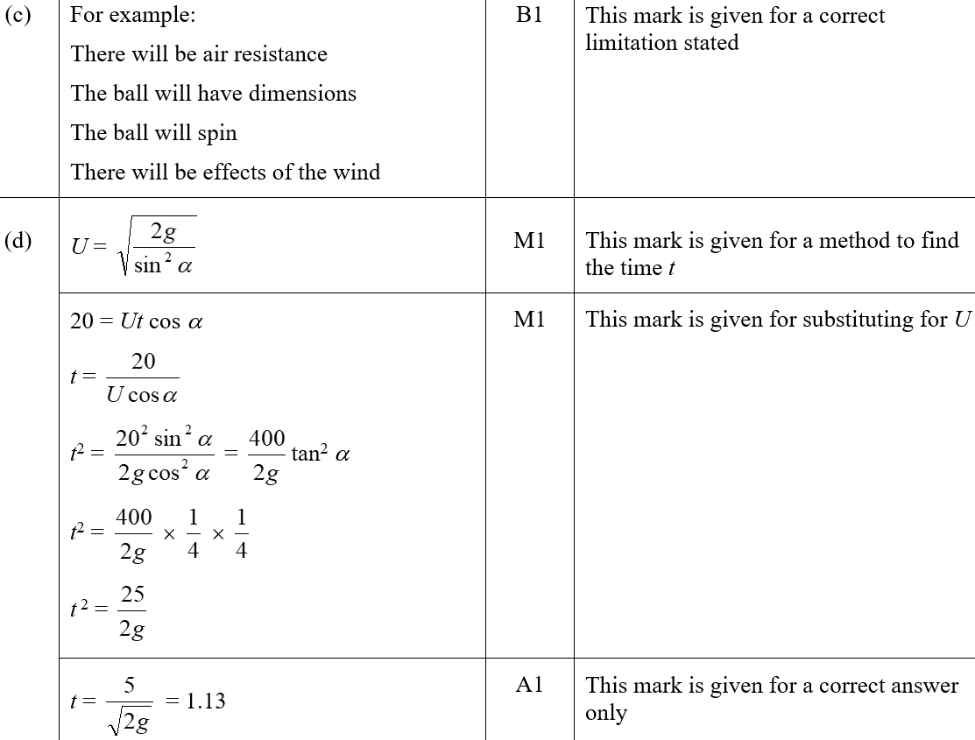
2018
C (SF)
D (SF)

Slide 22
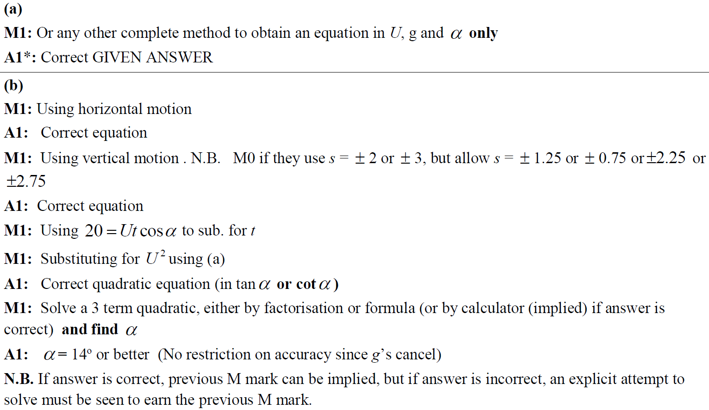
2018
A notes
B notes

Slide 23
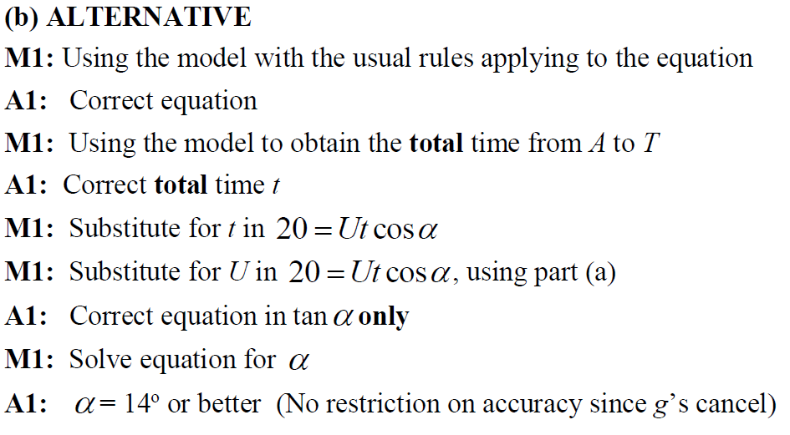
2018
B Alternative notes

Slide 24
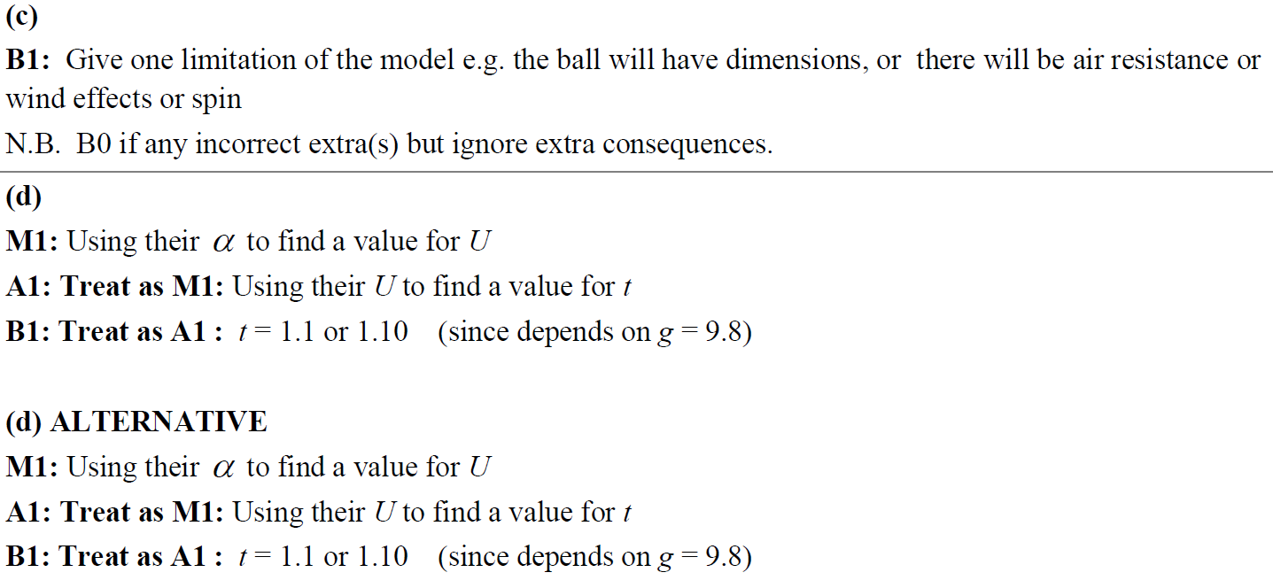
2018
C notes
D notes
D Alternative notes

Slide 25
New Spec Q’s
note* ignore parts of questions involving energy (or solve using a different approach)
Old Spec Projectiles
Jan 2006
Jan 2013
June 2006
June 2013*
Jan 2007*
June 2014
June 2007*
June 2015
Jan 2008
June 2016
May 2008
Jan 2010
June 2011
June 2017
Jan 2009
June 2010
Jan 2012
June 2018
May 2009
Jan 2011
May 2012

Slide 26
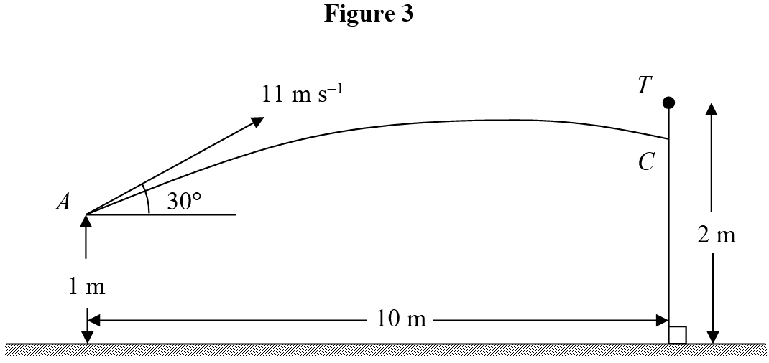
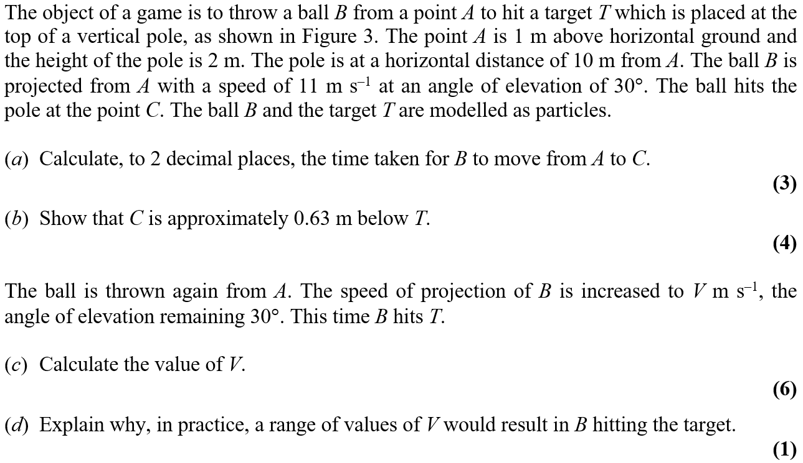
Jan 2006

Slide 27
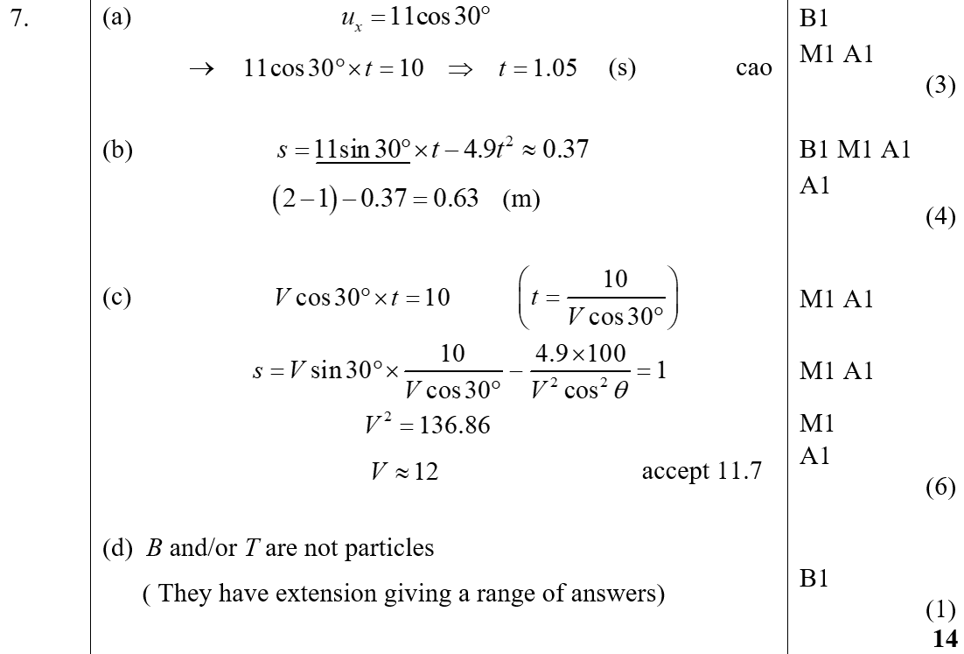
Jan 2006
A
B
C
D

Slide 28
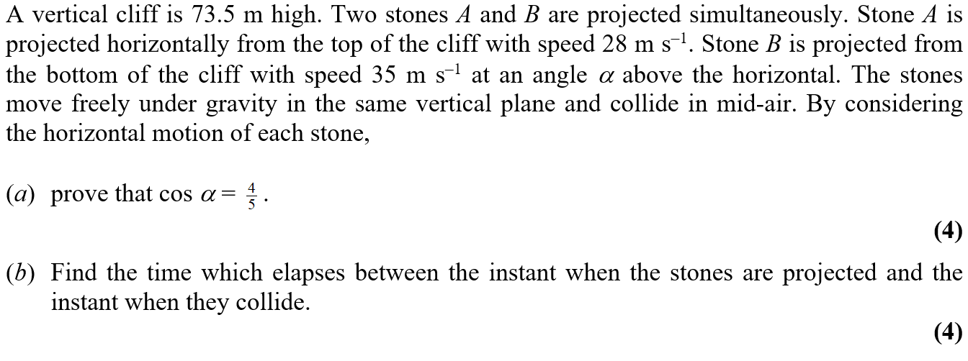
June 2006

Slide 29
June 2006
A
B

Slide 30
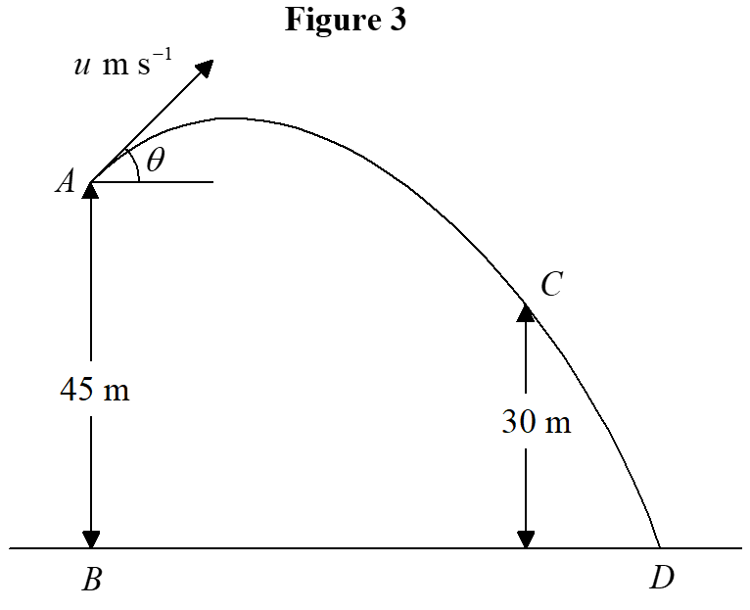
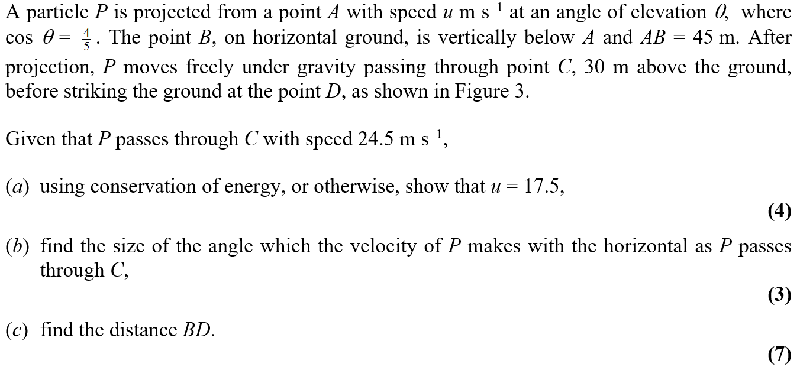
Jan 2007

Slide 31
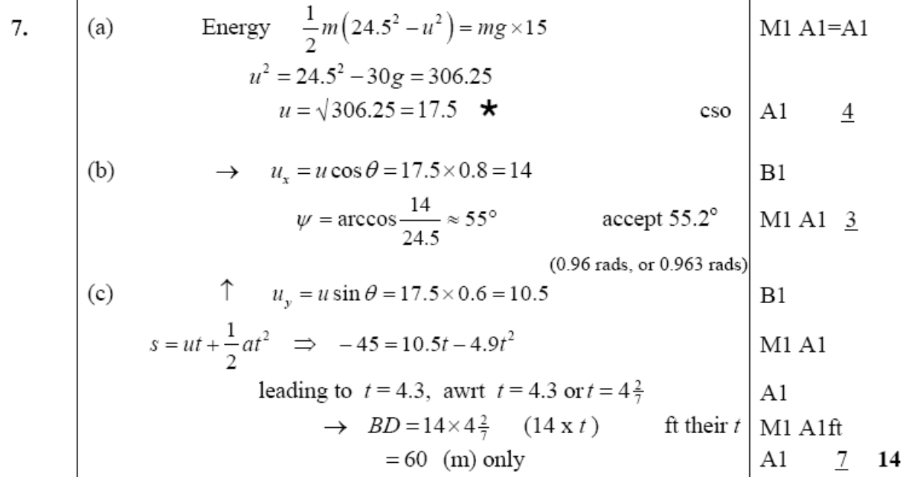
Jan 2007
A
B
C

Slide 32
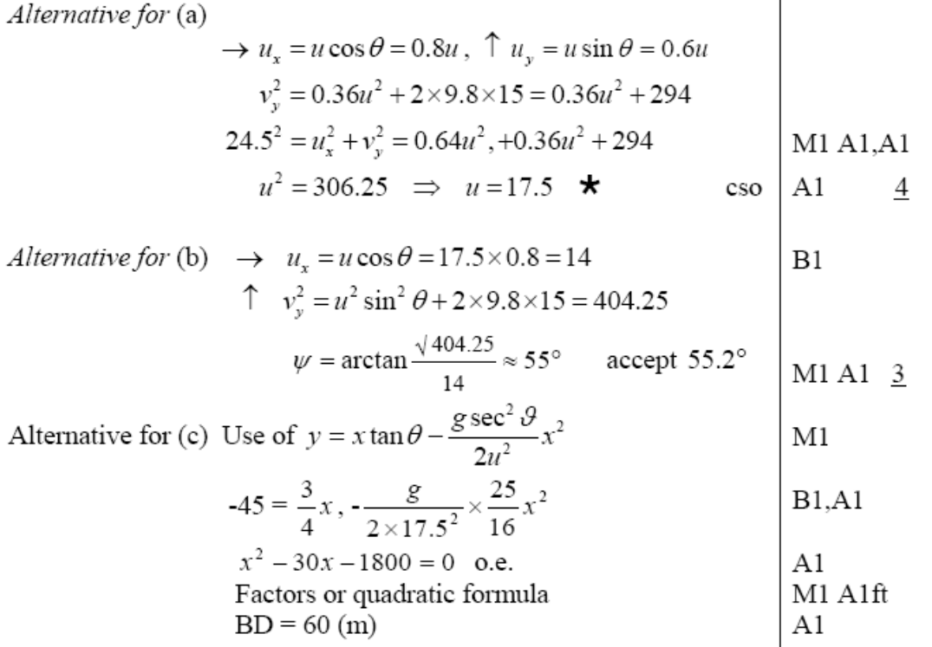
Jan 2007
A
B
C

Slide 33
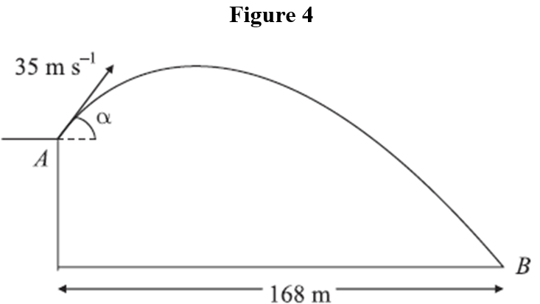
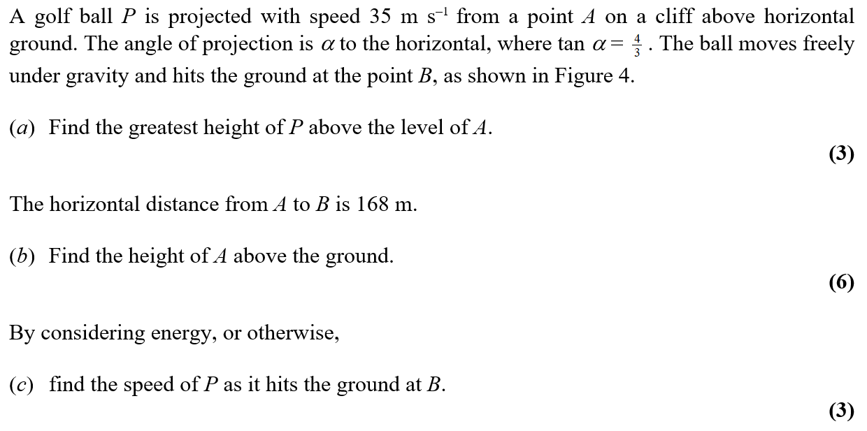
June 2007

Slide 34
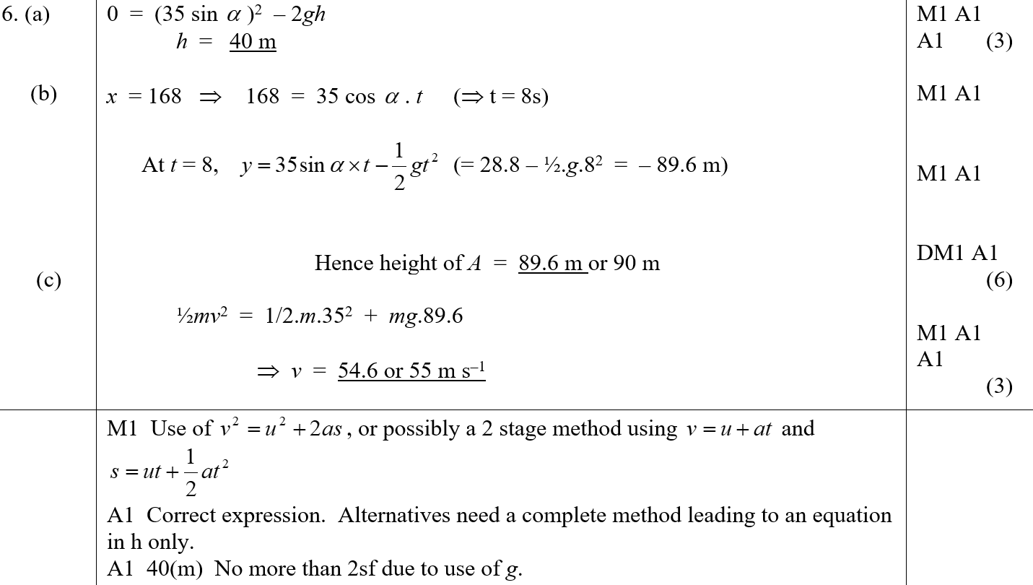
June 2007
A
B
C
A notes

Slide 35
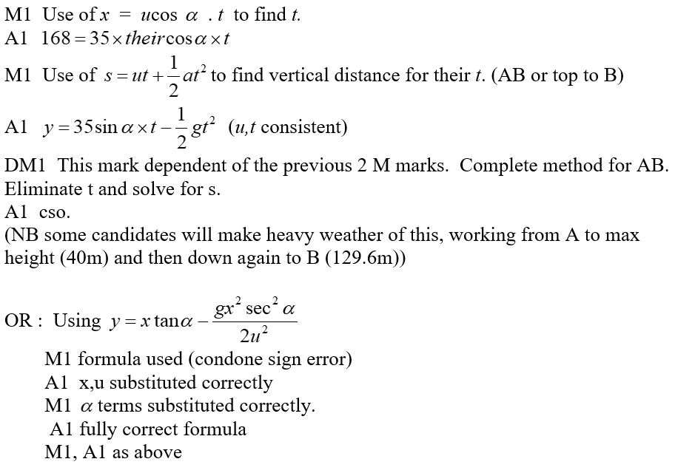
June 2007
B notes

Slide 36
June 2007
C notes

Slide 37
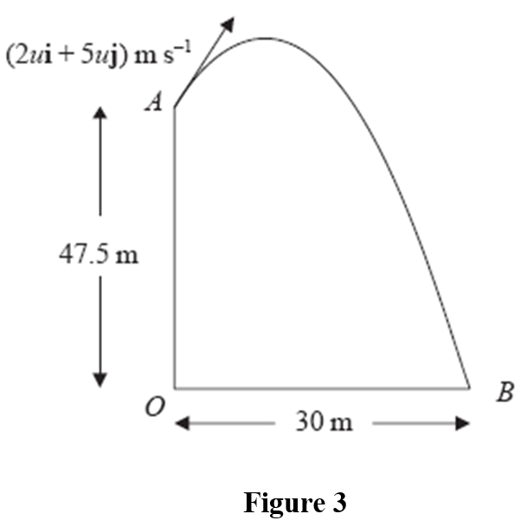
Jan 2008

Slide 38
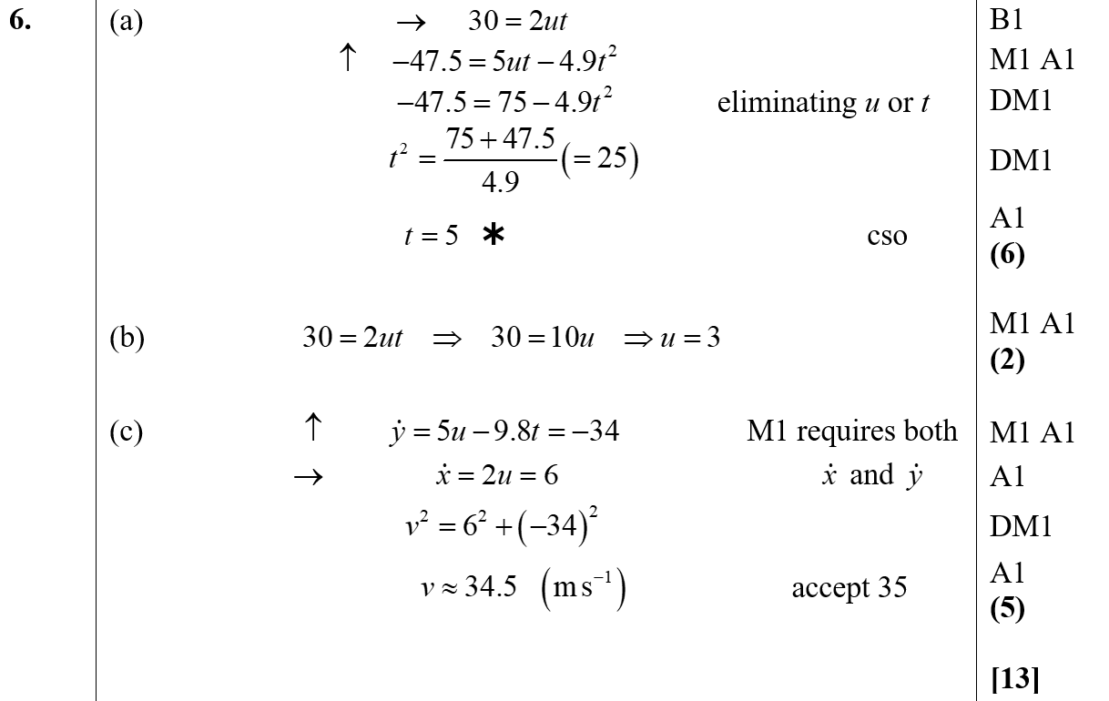
Jan 2008
A
B
C

Slide 39
Jan 2008
C Alternative

Slide 40
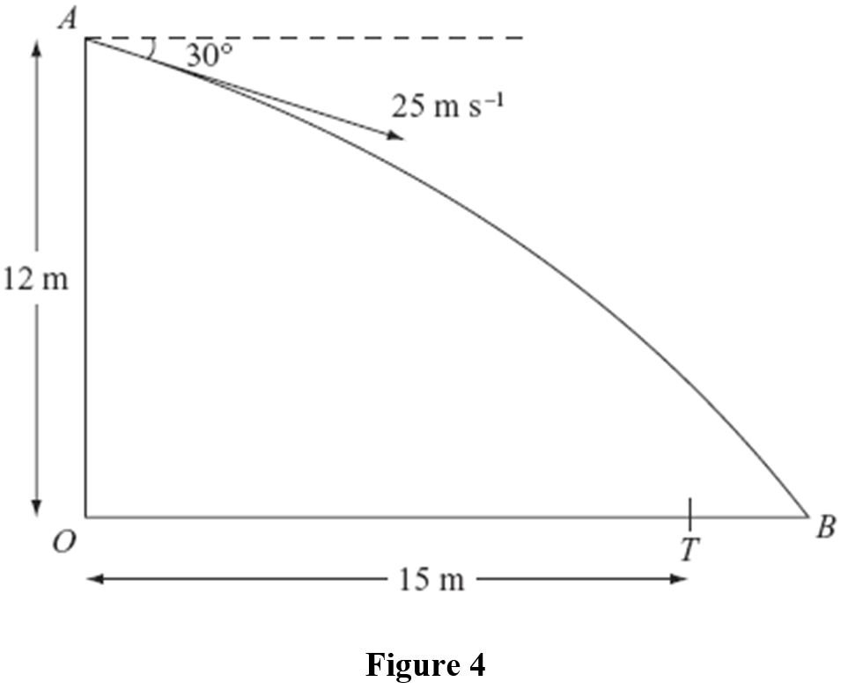
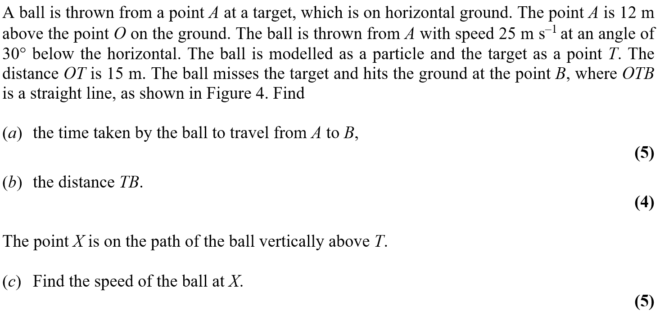
May 2008

Slide 41
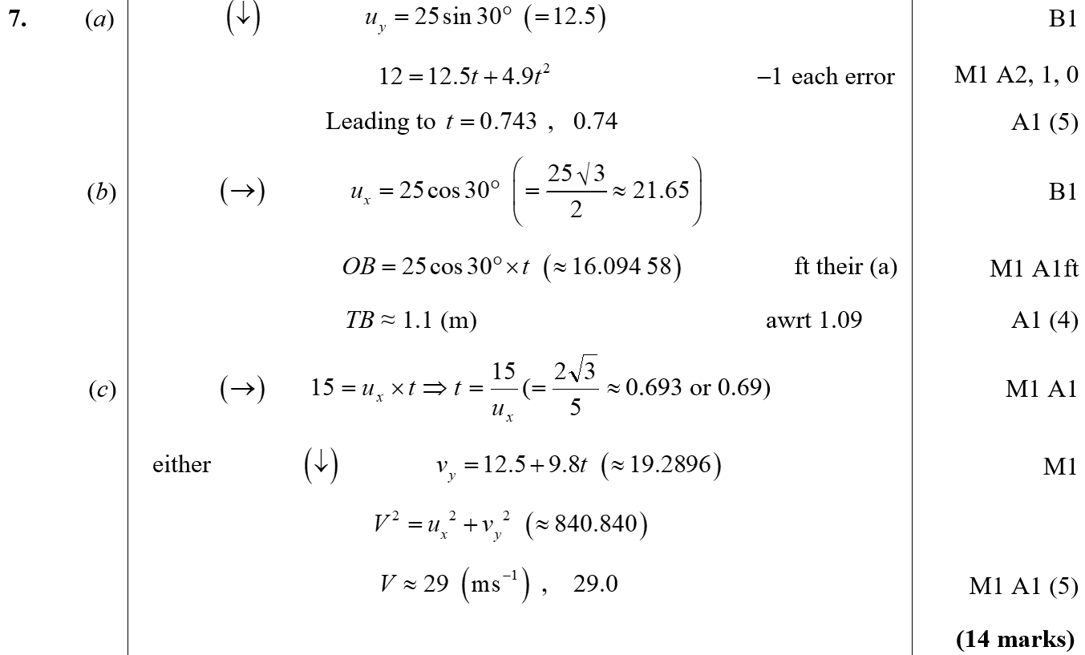
May 2008
A
B
C

Slide 42
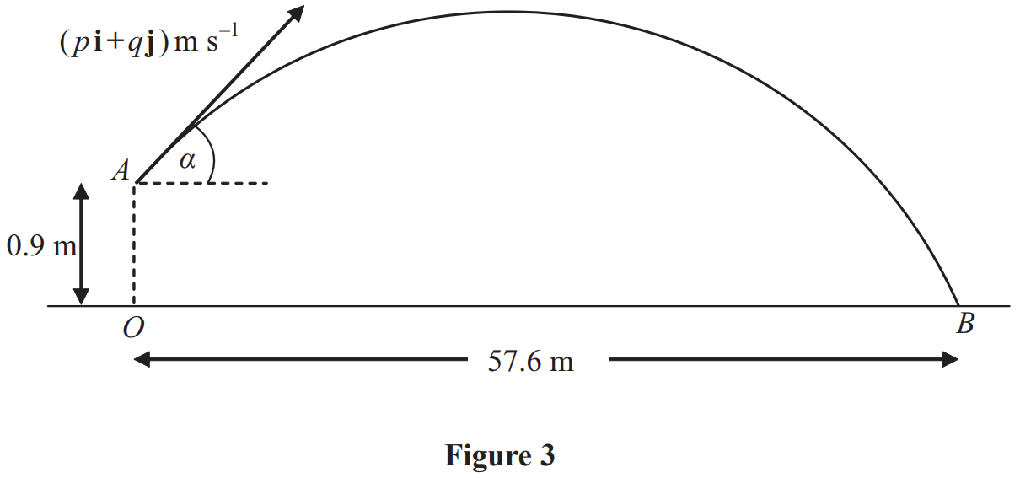
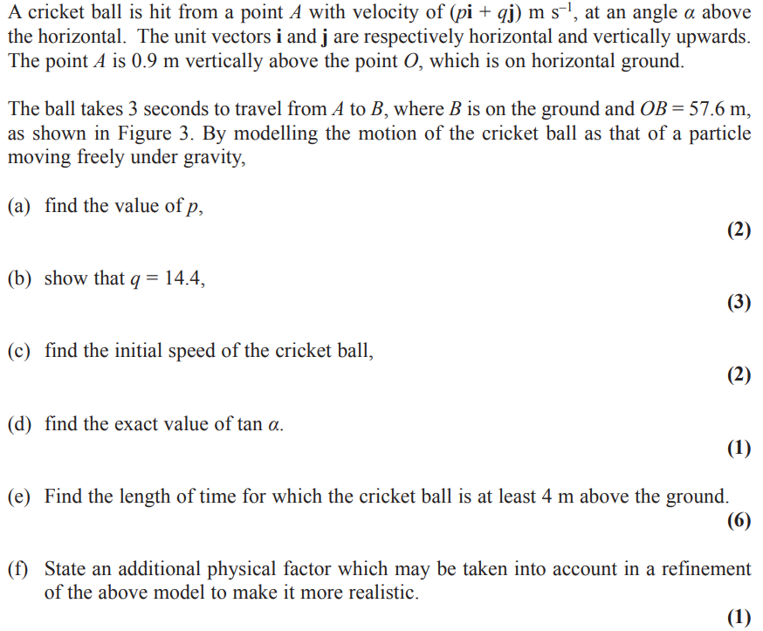
Jan 2009

Slide 43
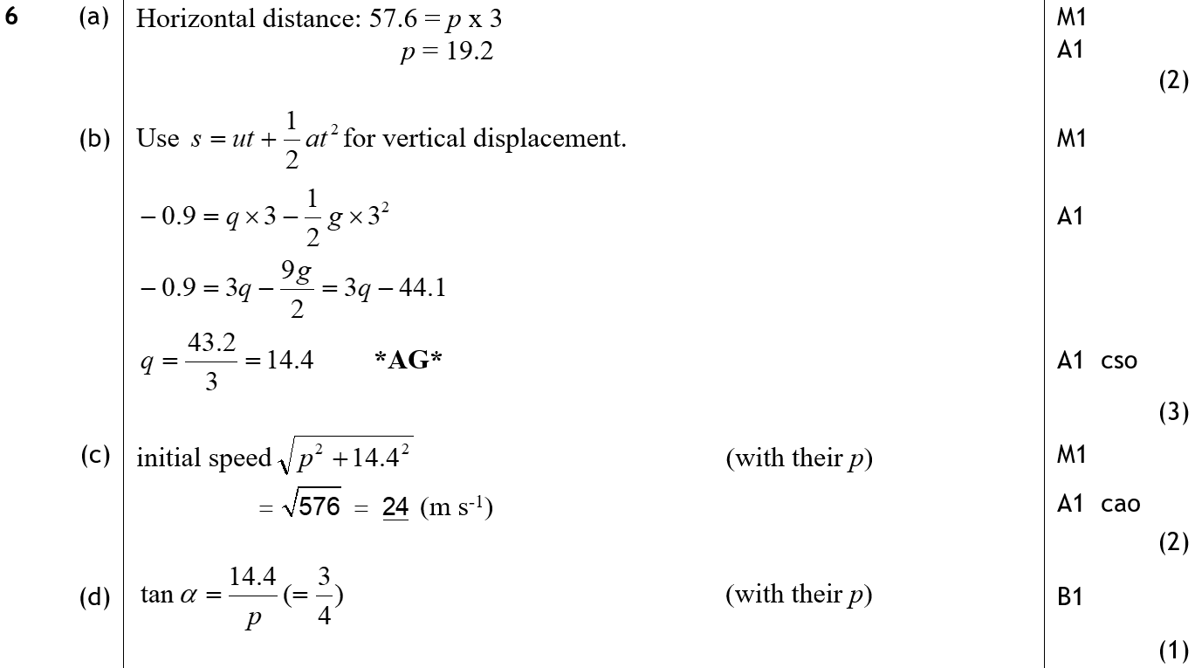
Jan 2009
A
B
C
D

Slide 44
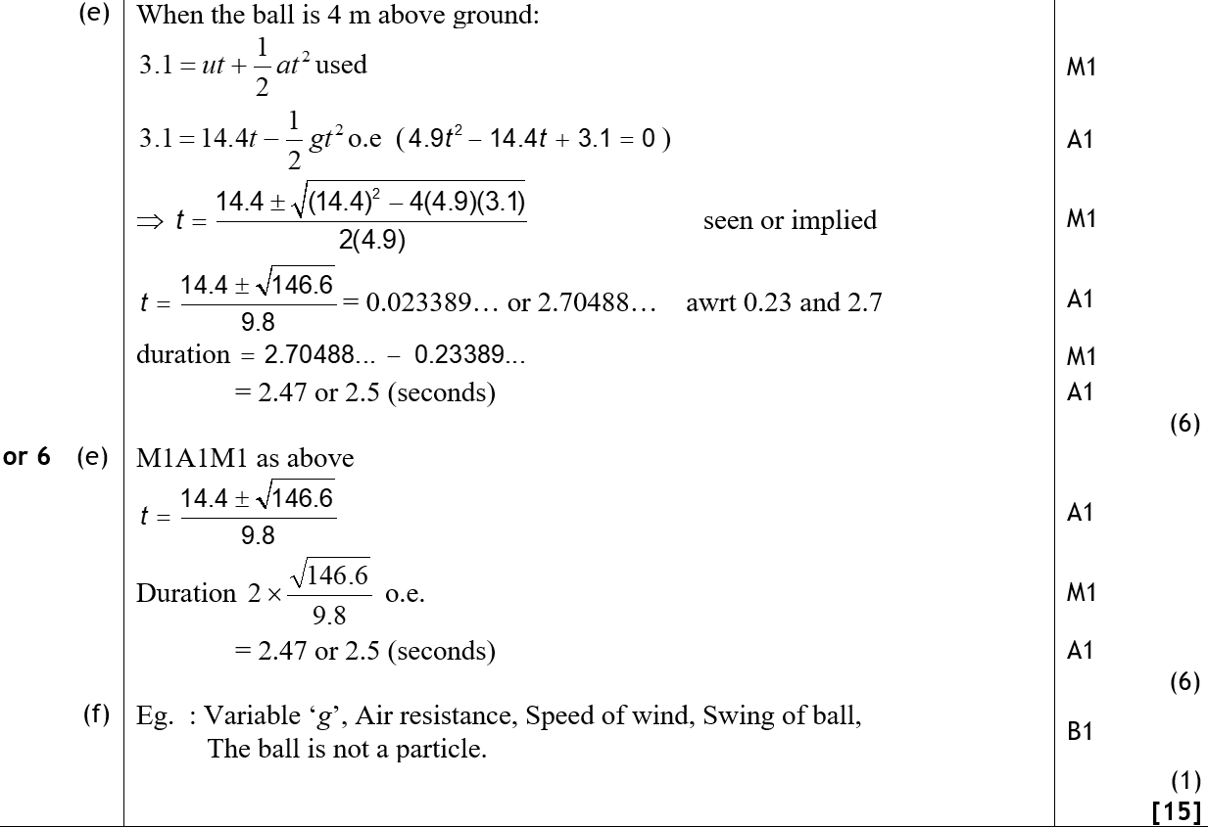
Jan 2009
E
E Alternative
F

Slide 45
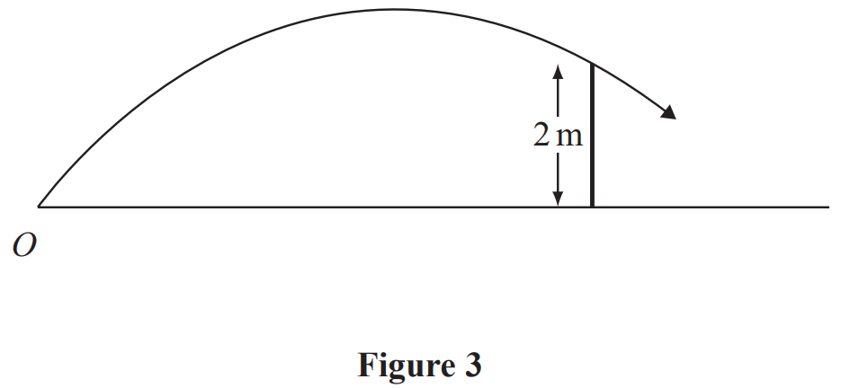
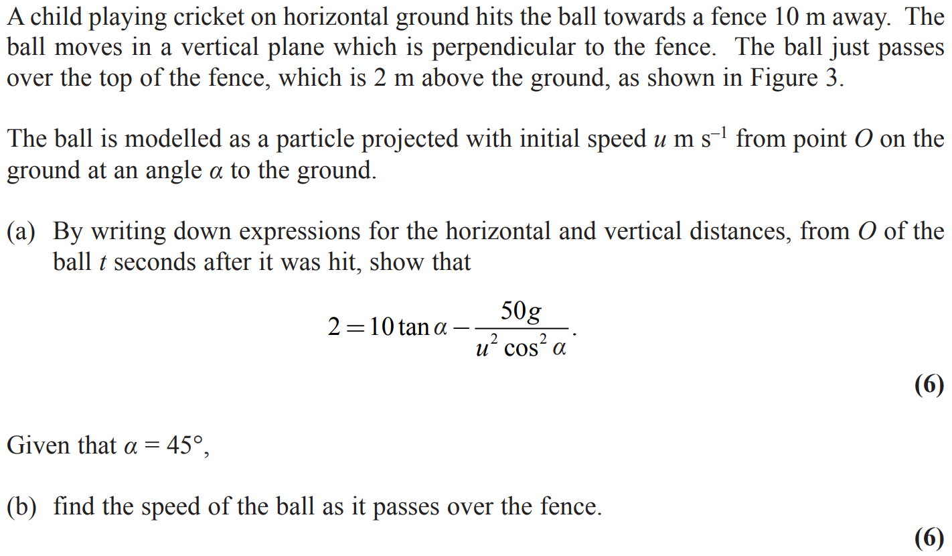
May 2009

Slide 46
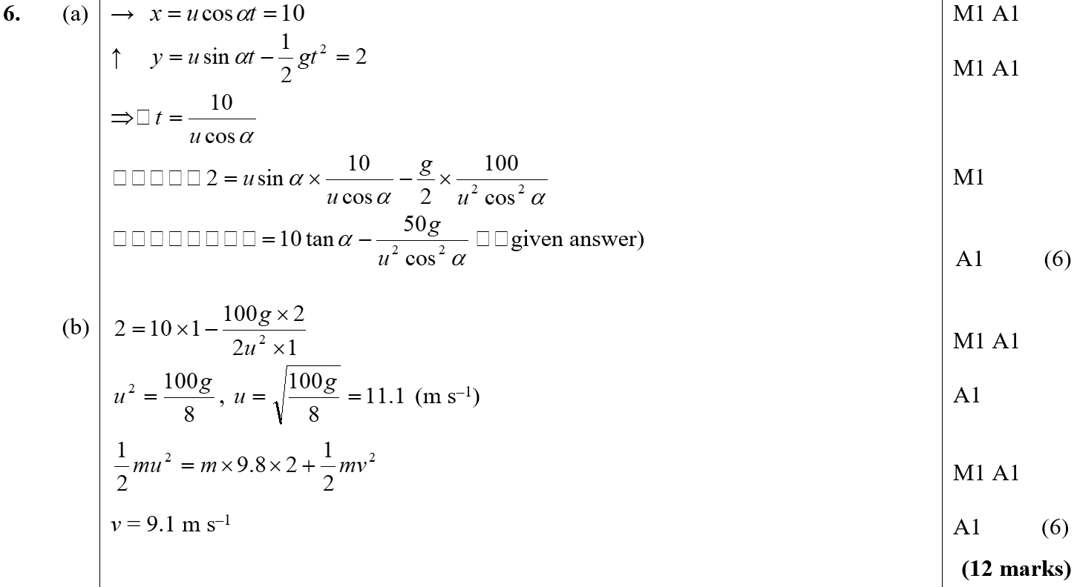
May 2009
A
B

Slide 47
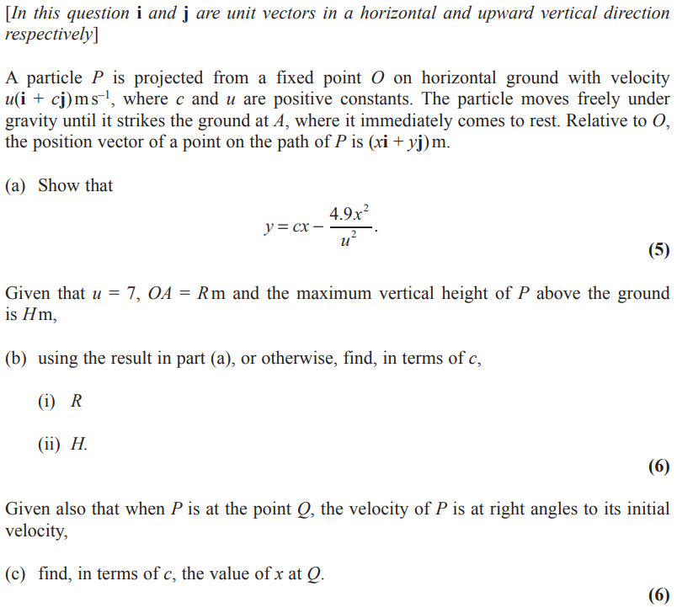
Jan 2010

Slide 48
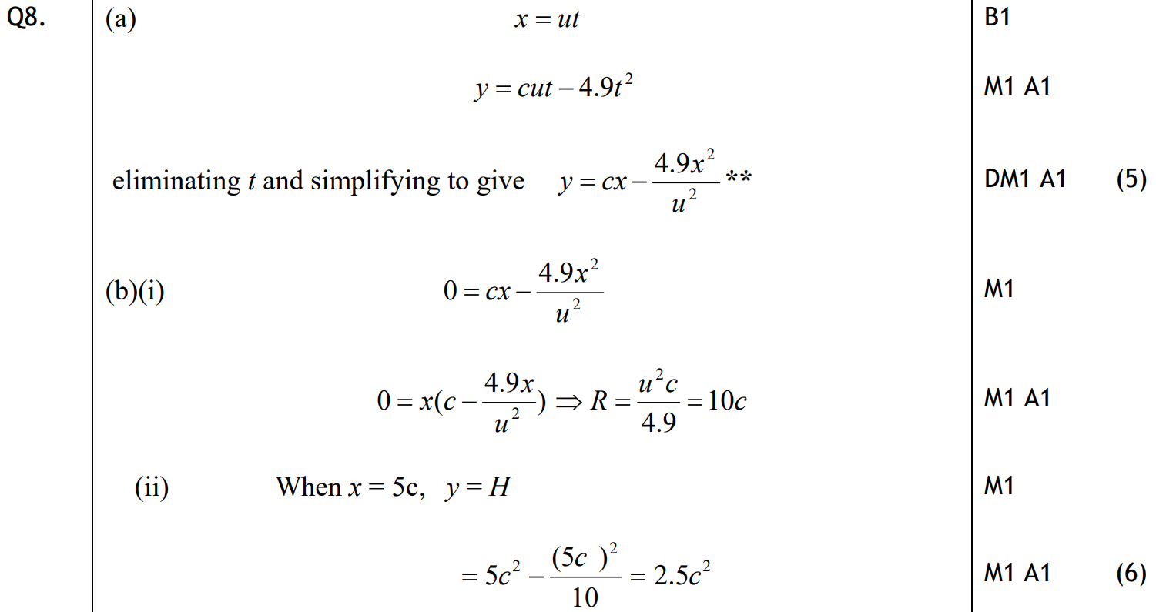
Jan 2010
A
B (i)
B (ii)

Slide 49
Jan 2010
C
C Alternative

Slide 50
June 2010

Slide 51
June 2010
A
B

Slide 52
June 2010
C

Slide 53
Jan 2011

Slide 54
Jan 2011
A
B
C

Slide 55
Jan 2011
D
E

Slide 56
June 2011

Slide 57
June 2011
A

Slide 58
June 2011
B
C

Slide 59
Jan 2012

Slide 60
Jan 2012
A
B
C

Slide 61
May 2012

Slide 62
May 2012
A
A Alternative
B

Slide 63
May 2012
B Alternative
C

Slide 64
Jan 2013

Slide 65
Jan 2013
A
B

Slide 66
Jan 2013
C
D

Slide 67
June 2013

Slide 68
June 2013
A
B
C

Slide 69
June 2014

Slide 70
June 2014
A
A Alternative
B

Slide 71
June 2014
B Alternative

Slide 72
June 2015

Slide 73
June 2015
A
A Alternative
B
C

Slide 74
June 2016

Slide 75
June 2016
A
A Alternative

Slide 76
June 2016
B
B Alternative

Slide 77
June 2017

Slide 78
June 2017
A

Slide 79
June 2017
B
B Alternative

Slide 80
June 2018

Slide 81
June 2018
A
B

Slide 82
June 2018
C
C Alternative

Slide 83
June 2018
D
D Alternative 1

Slide 84
June 2018
D Alternative 2
D Alternative 3

