Slide 1
Old Spec Q’s
Parametric Equations
Practice A
SAM 1
(i)
Practice B
SAM 1
(ii)
Practice C
2018 1
Practice D
Practice E
Practice F (i)
Practice F (ii)

Slide 2
Practice A

Slide 3
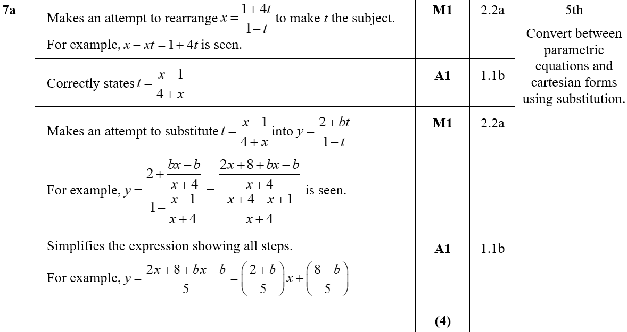
Practice A
A

Slide 4
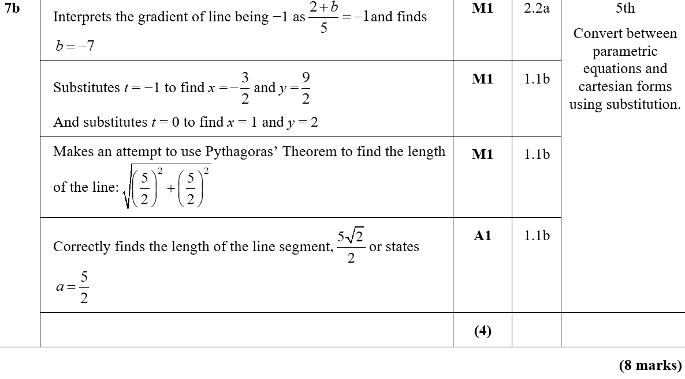
Practice A
B

Slide 5
Practice B

Slide 6
Practice B
A

Slide 7
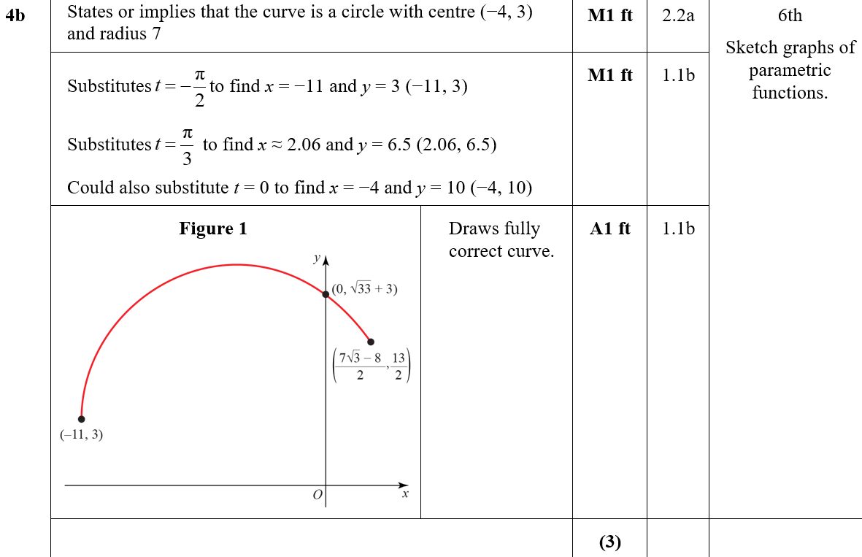
Practice B
B
B notes

Slide 8
Practice B
C
C notes

Slide 9
Practice C

Slide 10
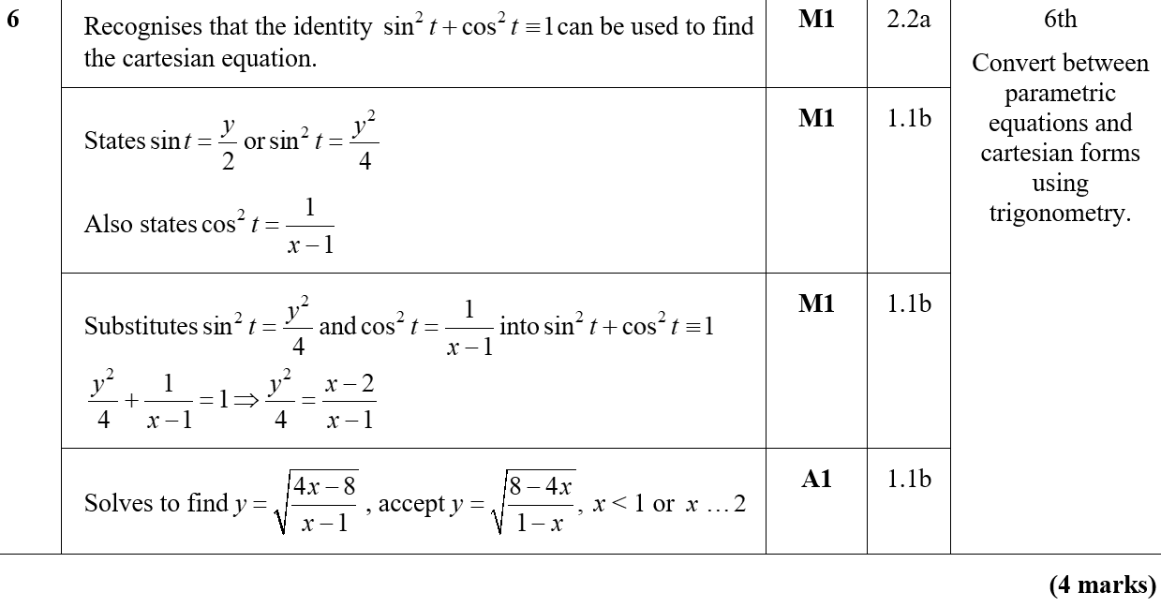
Practice C
A

Slide 11
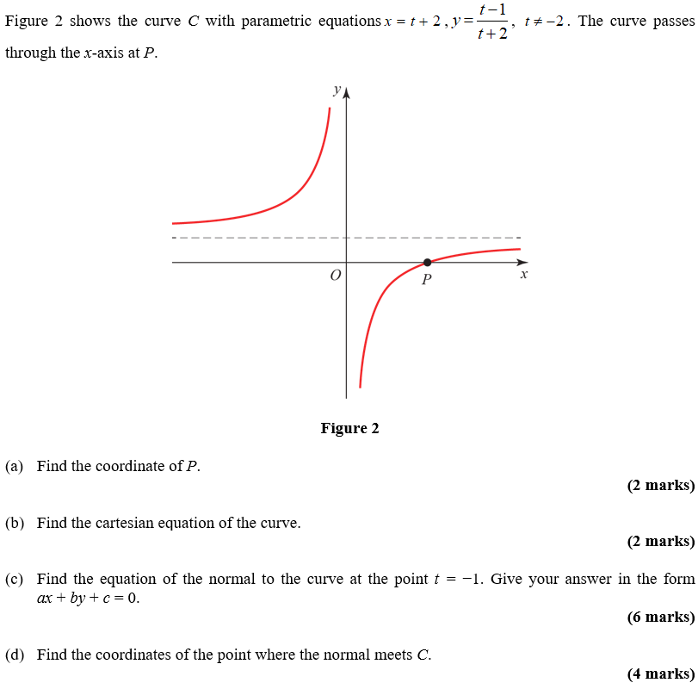
Practice D

Slide 12
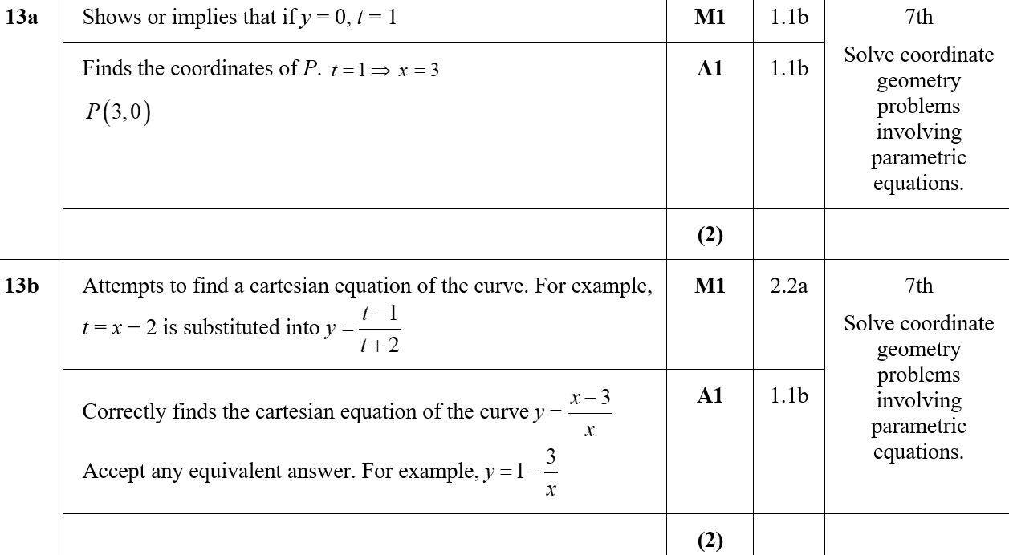
Practice D
A
B

Slide 13
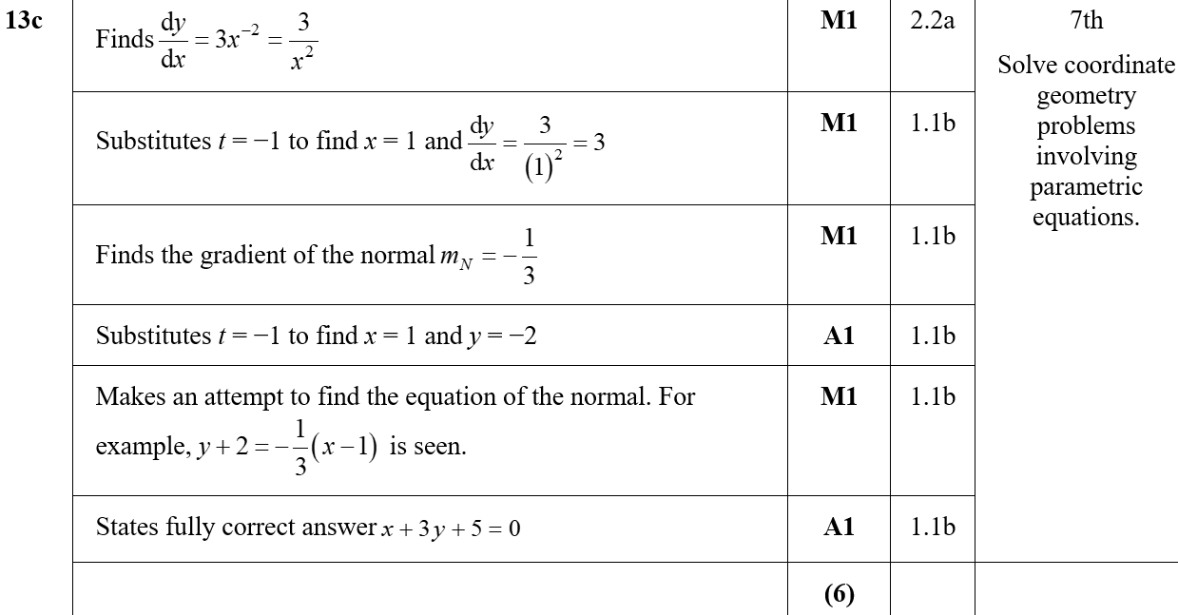
Practice D
C
C notes

Slide 14
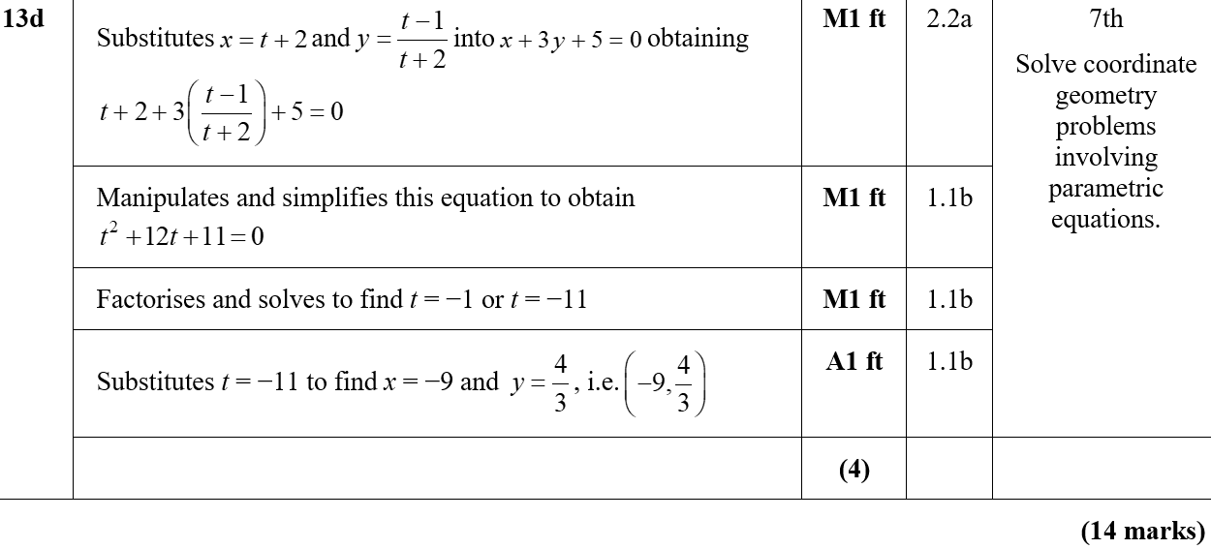
Practice D
D

Slide 15
Practice E

Slide 16
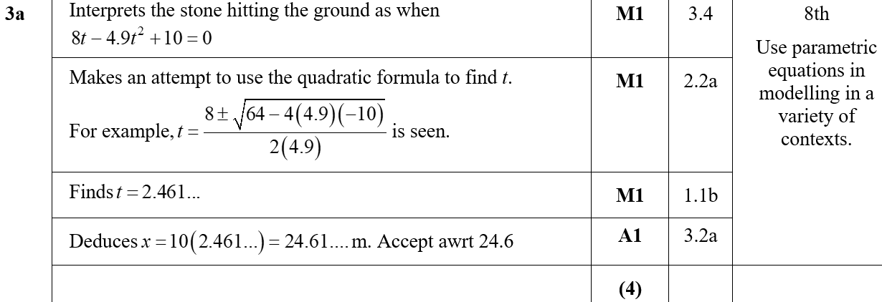
Practice E
A

Slide 17
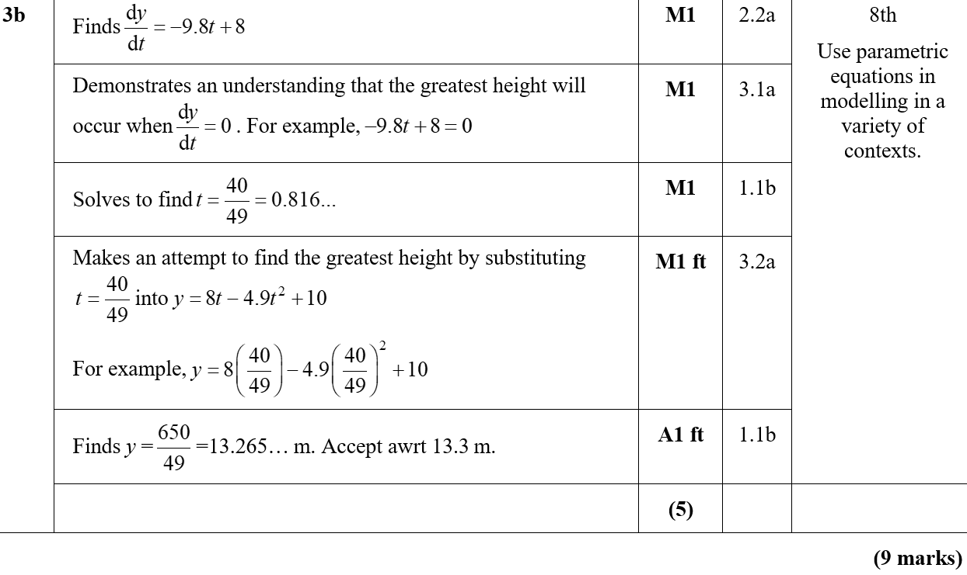
Practice E
B
B notes

Slide 18
Practice F

Slide 19
Practice F
A

Slide 20
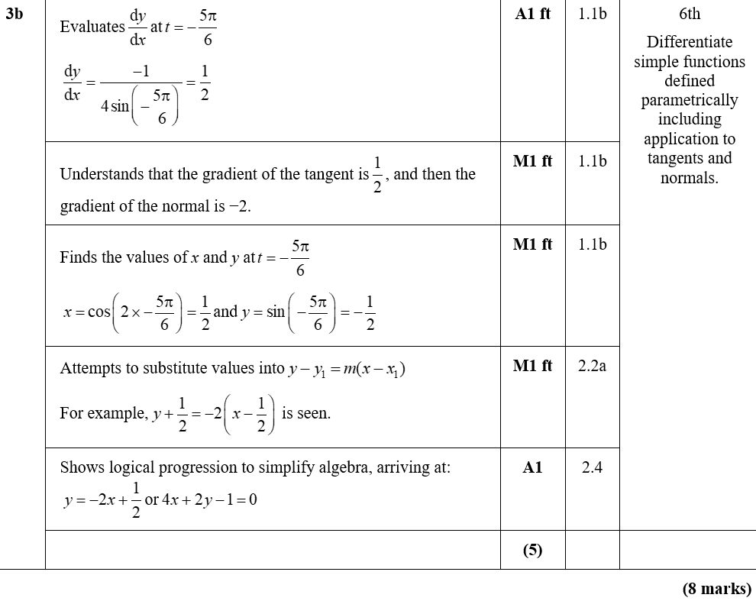
Practice F
B
B notes

Slide 21
Practice F

Slide 22
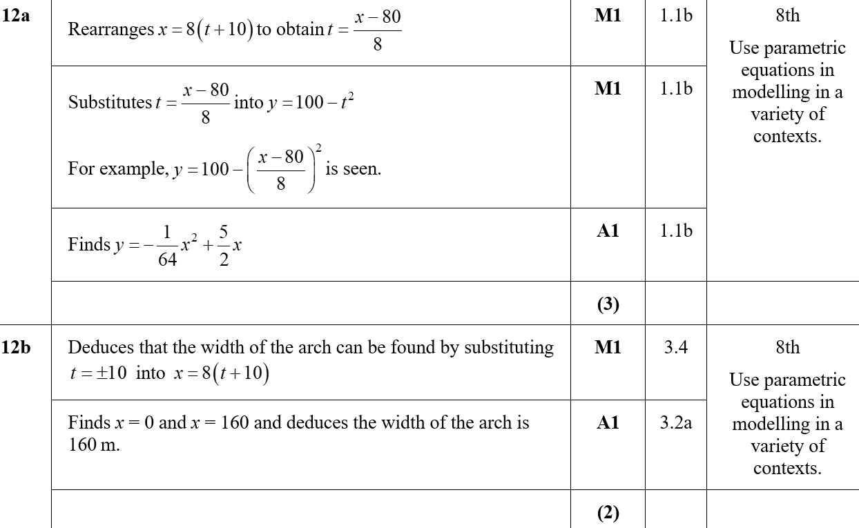
Practice F
A
B

Slide 23
Practice F
C

Slide 24
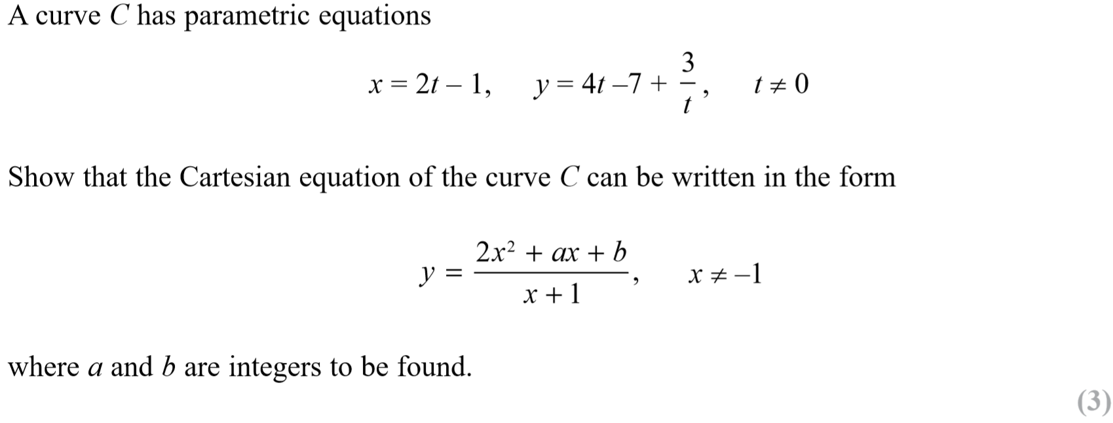
SAM Paper 1

Slide 25
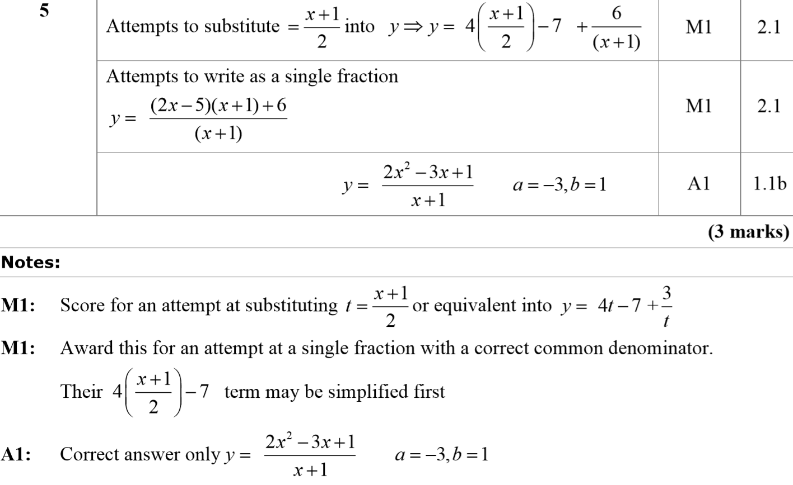
SAM Paper 1
A
A notes

Slide 26
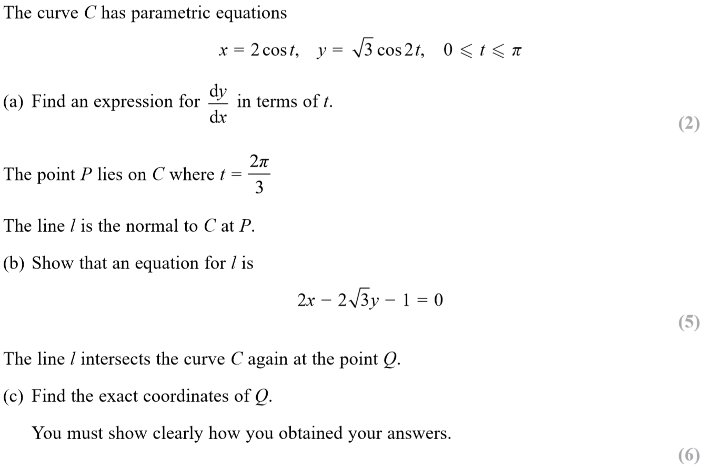
SAM Paper 1

Slide 27
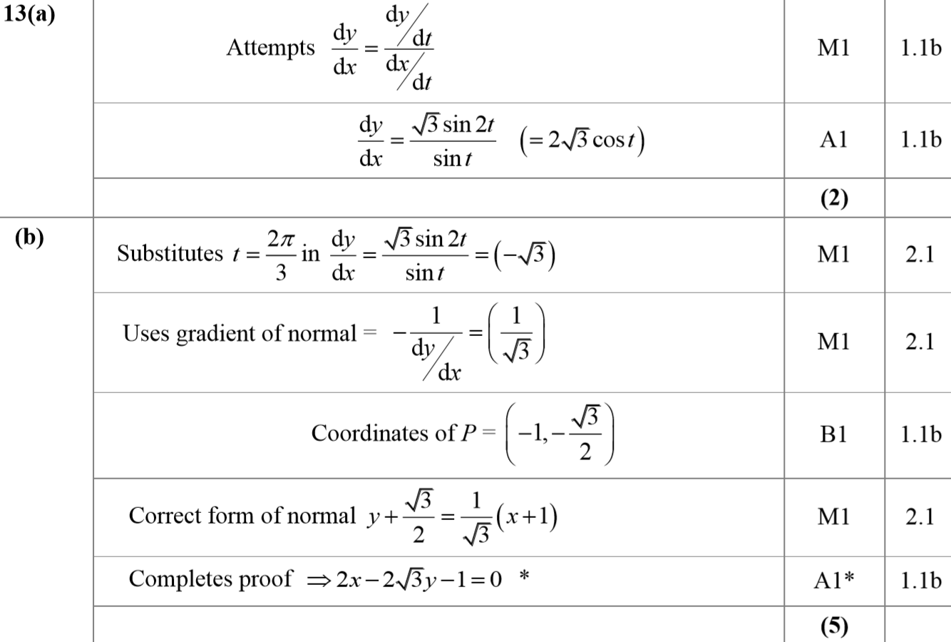
SAM Paper 1
A
B

Slide 28
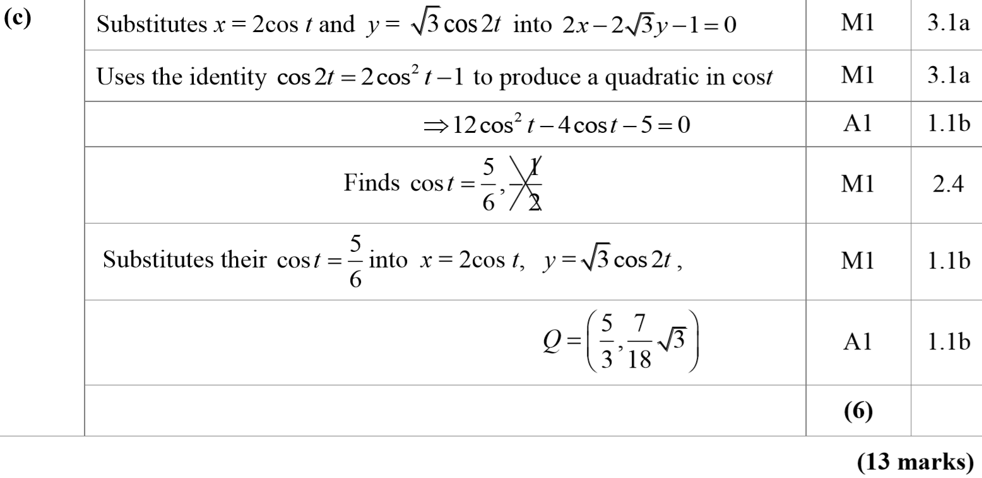
SAM Paper 1
C

Slide 29
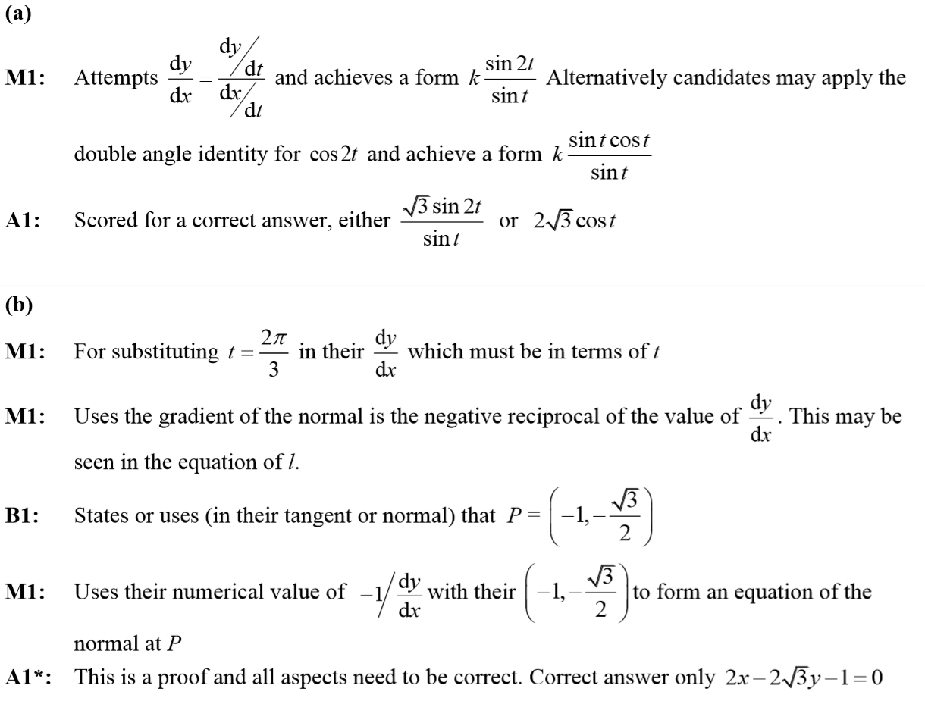
SAM Paper 1
A notes
B notes

Slide 30
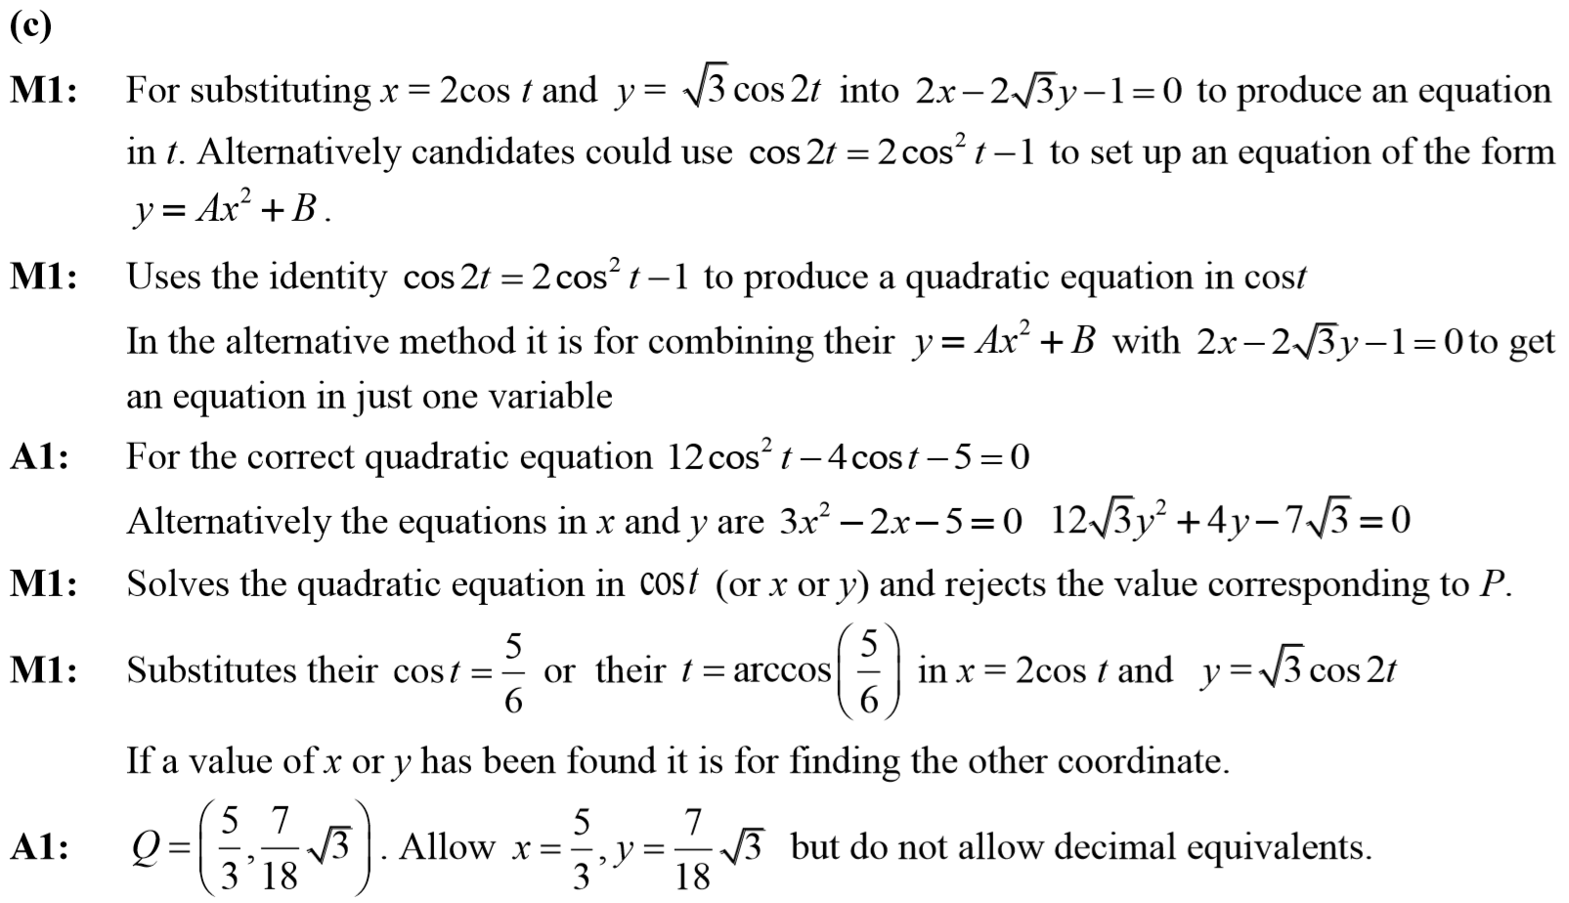
SAM Paper 1
C notes

Slide 31
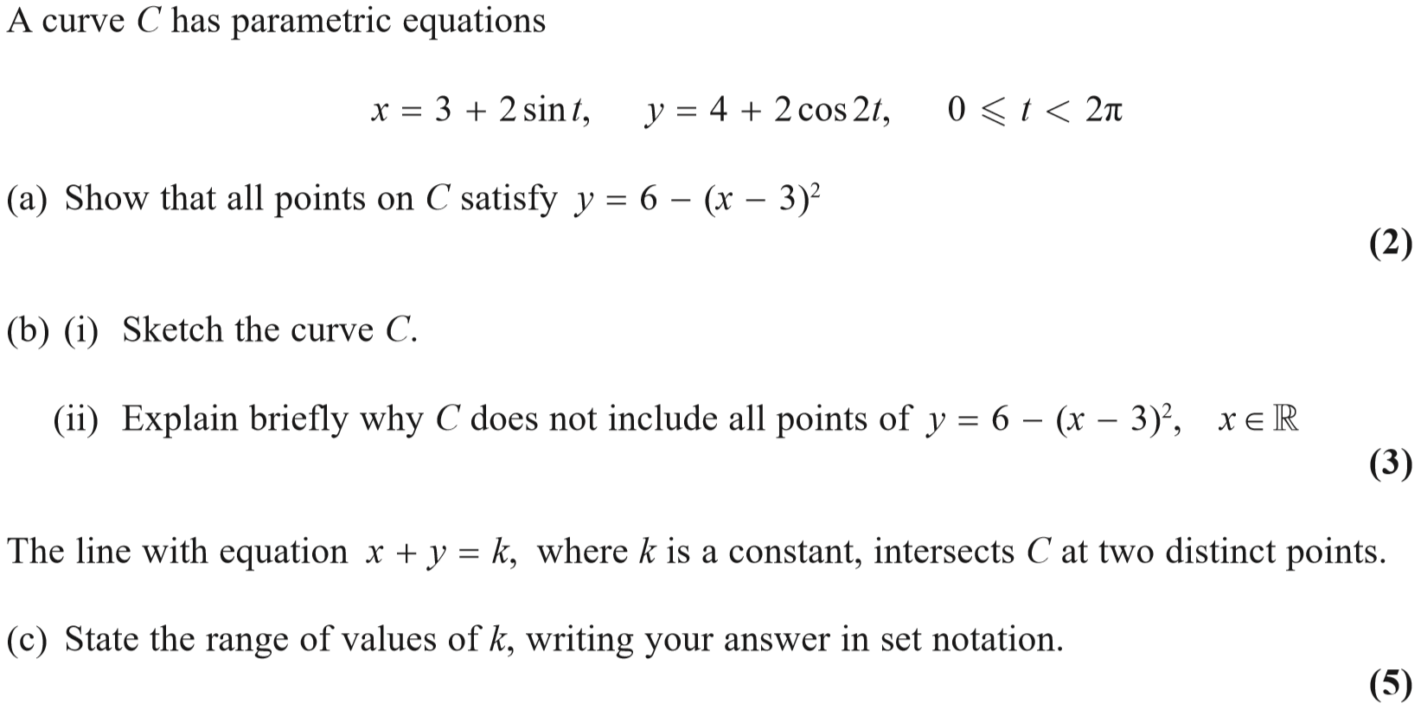
2018 Paper 1

Slide 32
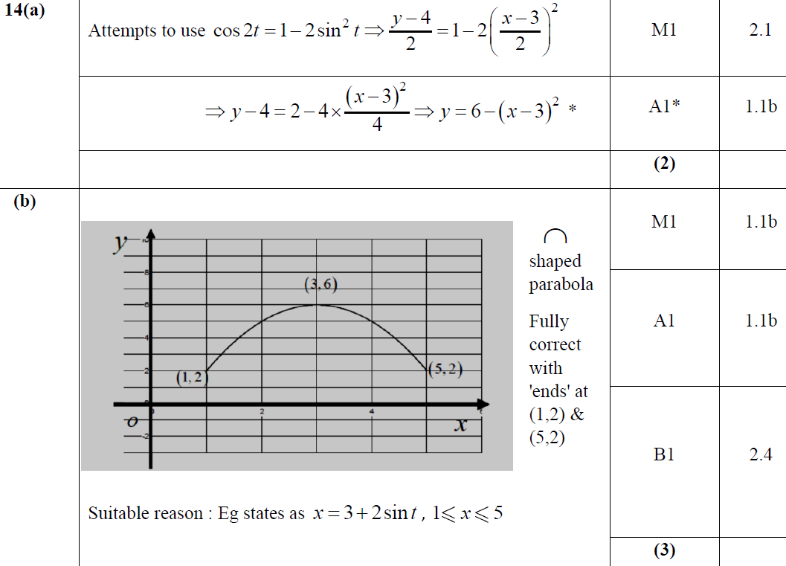
2018 Paper 1
A
B

Slide 33
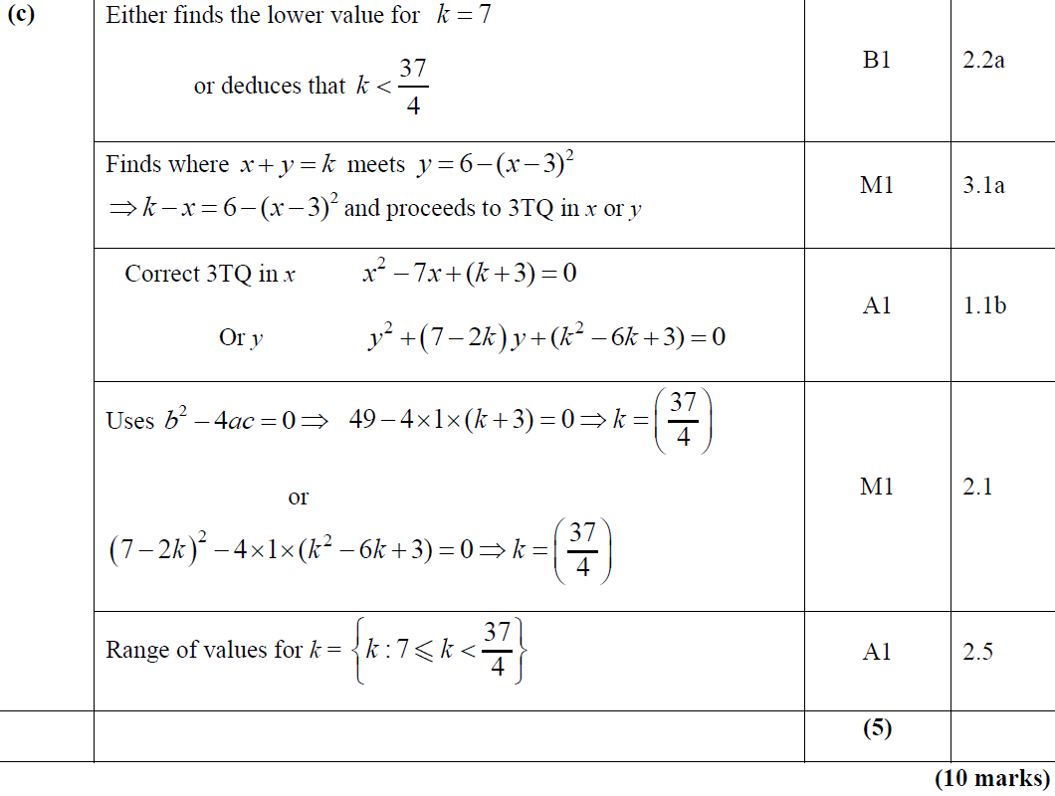
2018 Paper 1
C

Slide 34
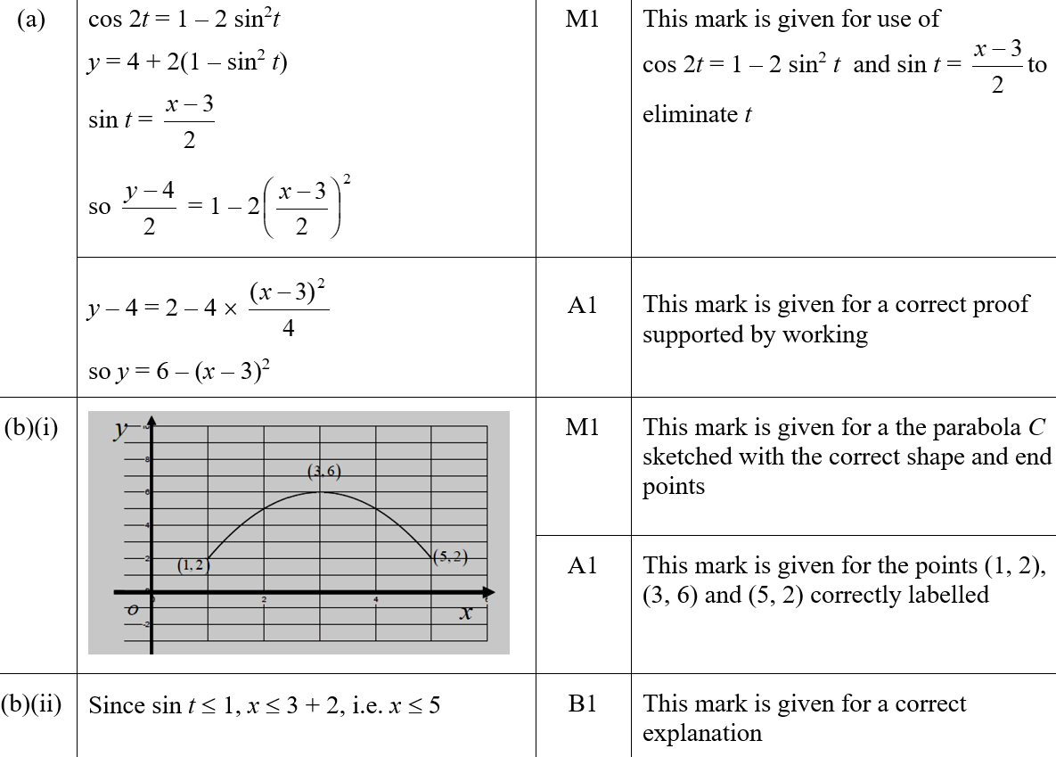
2018 Paper 1
A (SF)
B (i) (SF)
B (ii) (SF)

Slide 35
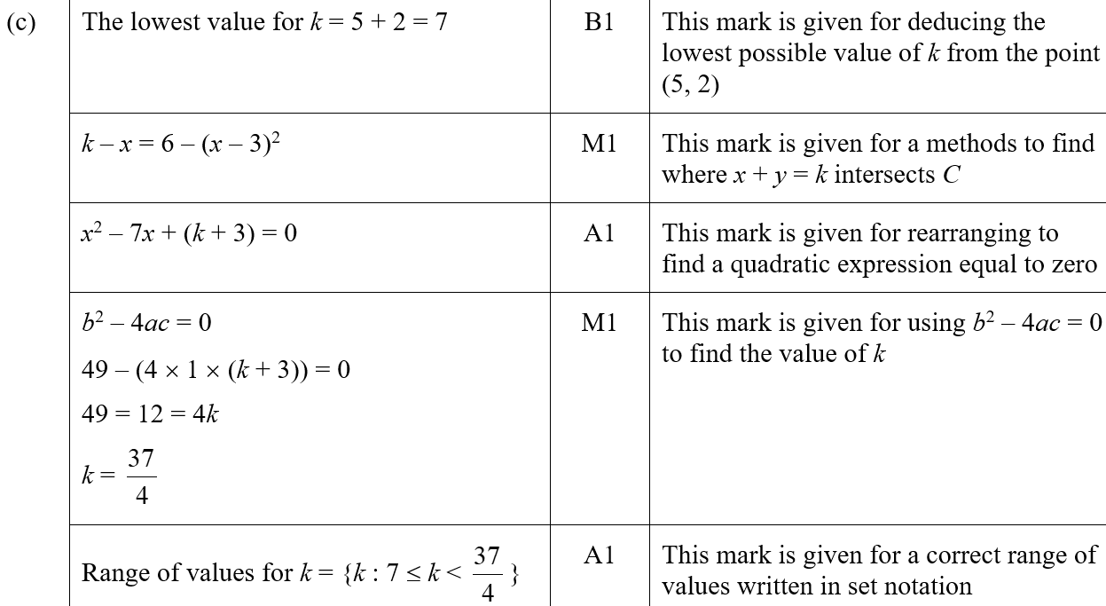
2018 Paper 1
C (SF)

Slide 36
2018 Paper 1
A notes
B notes

Slide 37
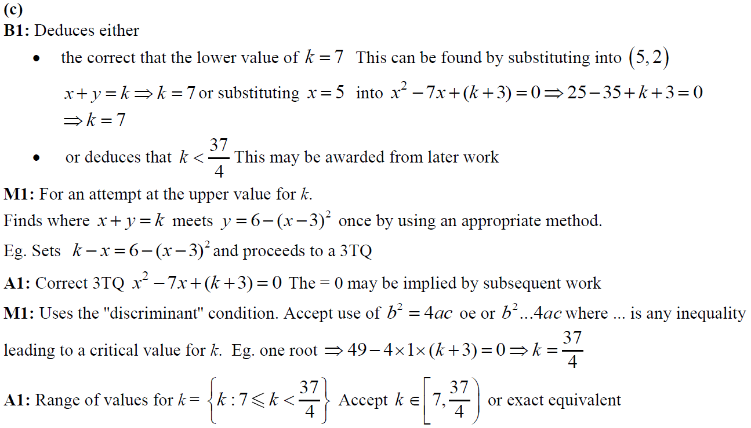
2018 Paper 1
C notes

Slide 38
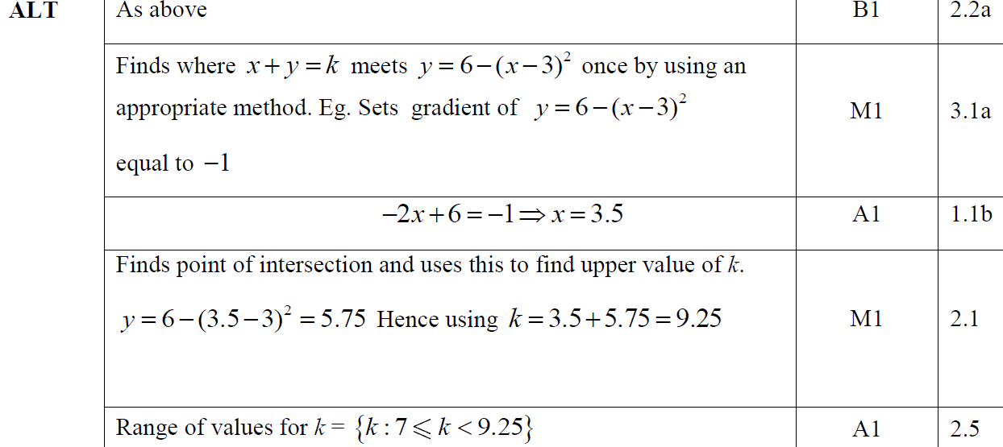
2018 Paper 1
C Alternative notes

Slide 39
Old Spec Parametric Equations
New Spec Q’s
Jan 2006
June 2009 (ii)
June 2013
June 2006
Jan 2010
June 2014 (i)
Jan 2007
June 2010
June 2014 (ii)
June 2007
Jan 2011
June 2015
Jan 2008
June 2011
June 2016
June 2008
Jan 2012
June 2017 (i)
Jan 2009
June 2012
June 2017 (ii)
June 2009 (i)
Jan 2013
June 2018

Slide 40
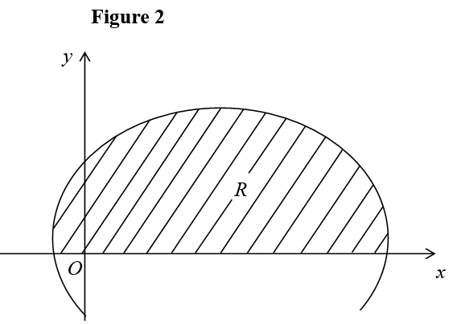
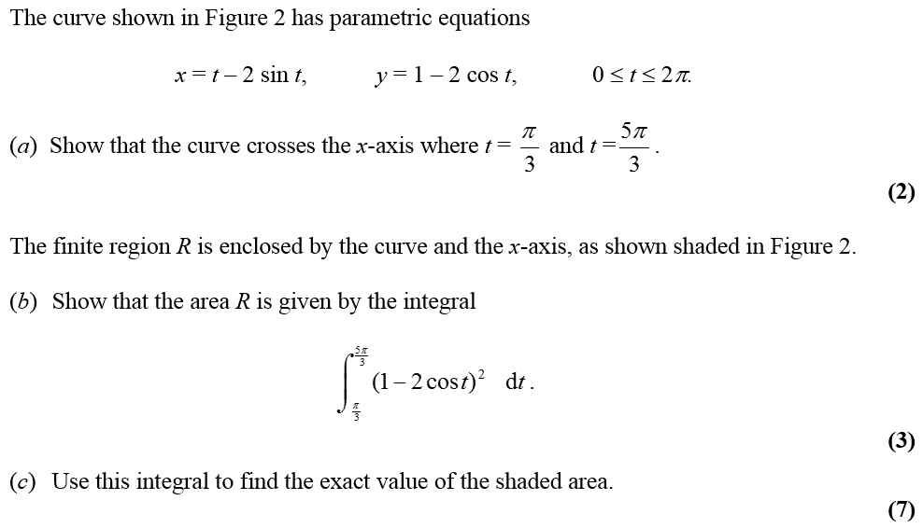
Jan 2006

Slide 41
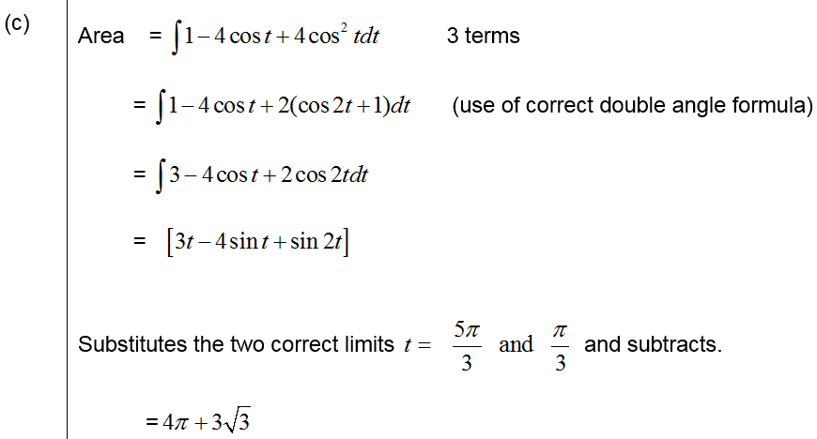
Jan 2006
A
Apologies, could not find designation of marks, but hope this still helps!
B
C

Slide 42
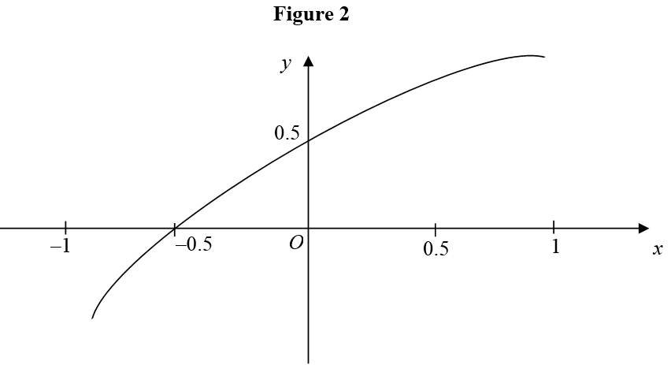
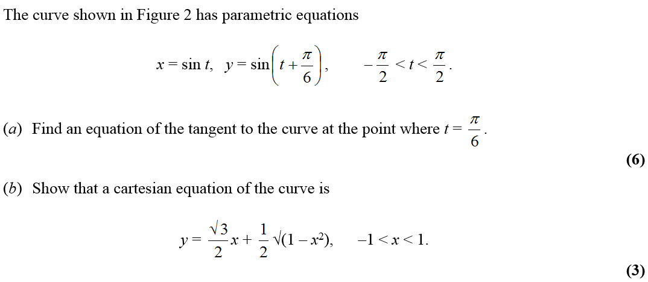
June 2006

Slide 43
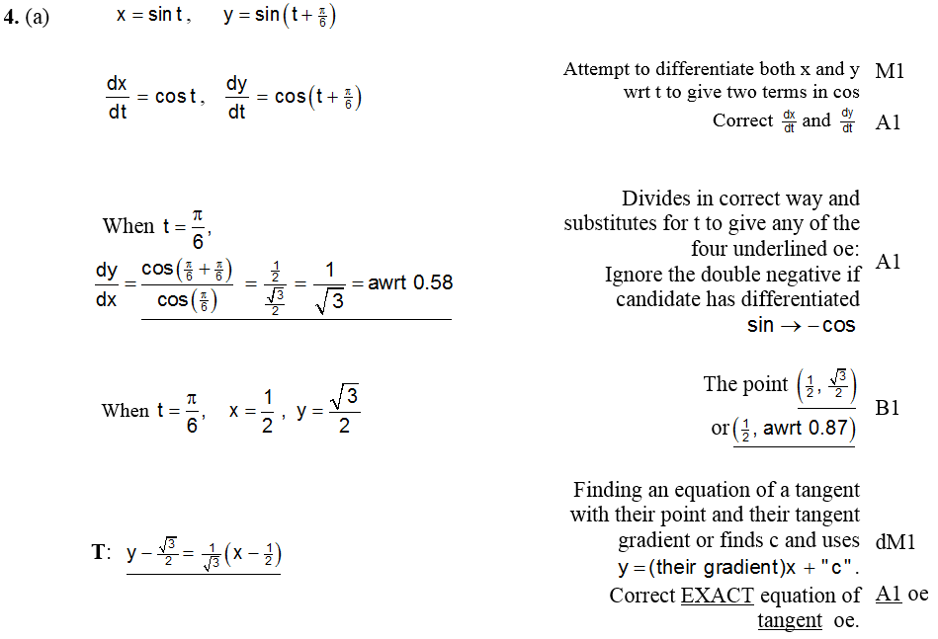
June 2006
A

Slide 44
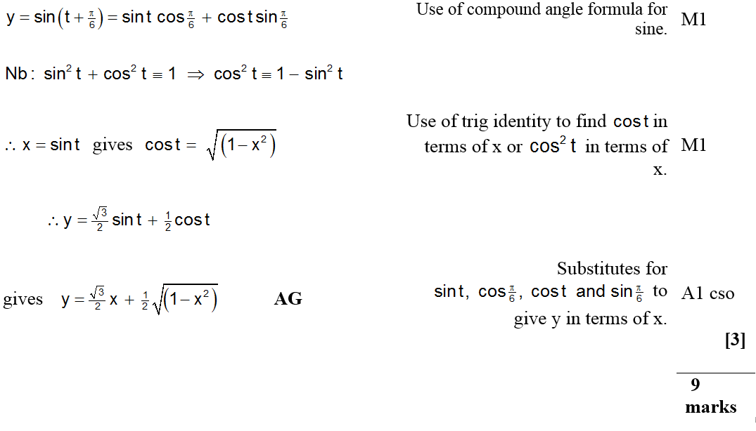
June 2006
B

Slide 45
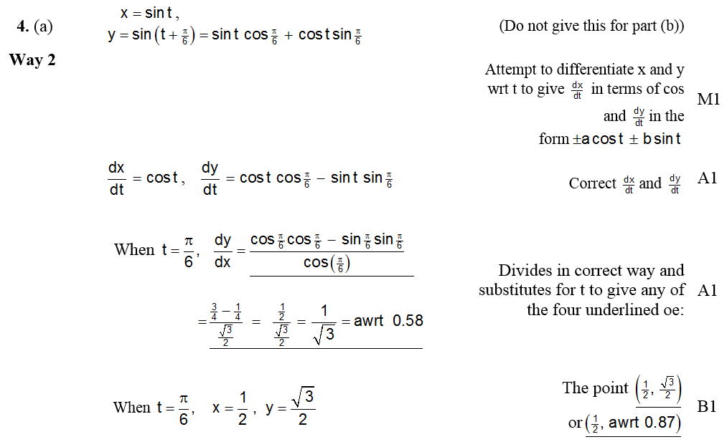
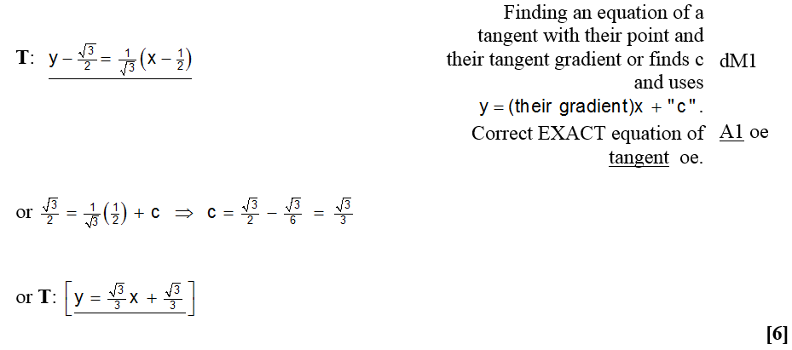
June 2006
A Alternative (i)

Slide 46
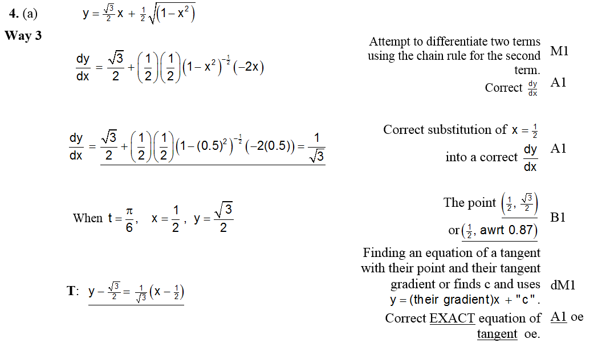
June 2006
Alternative A (ii)

Slide 47
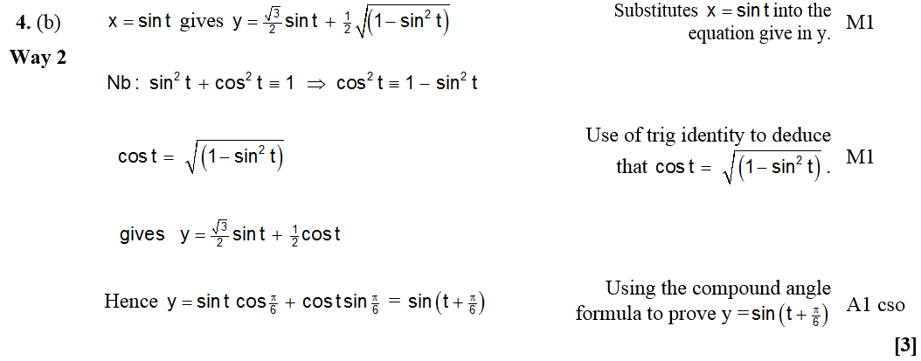
June 2006
Alternative B

Slide 48
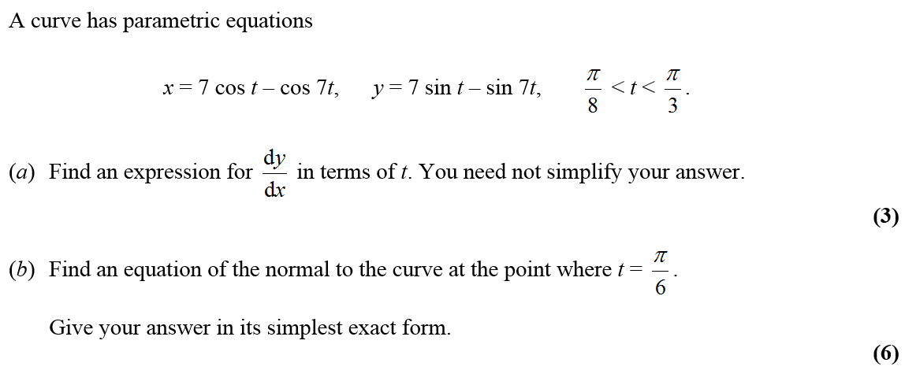
Jan 2007

Slide 49
Jan 2007
A
A Alternative

Slide 50
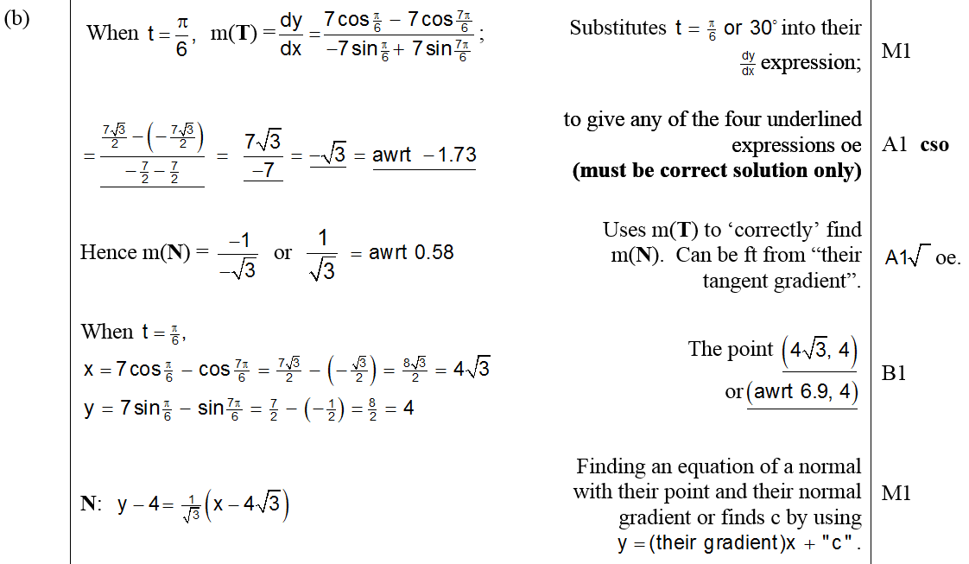
Jan 2007
B

Slide 51
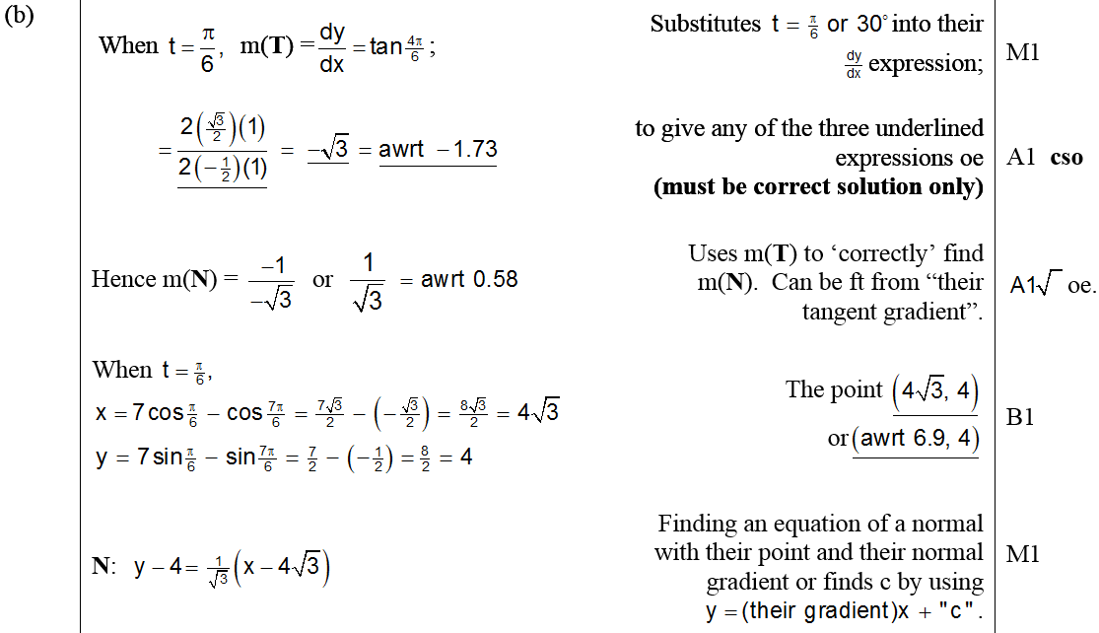
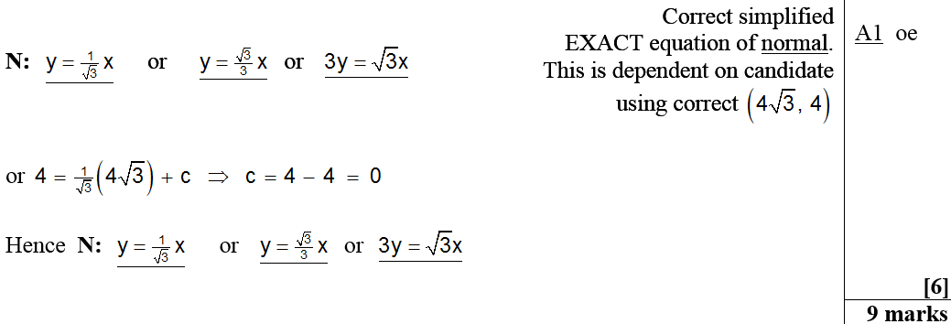
Jan 2007
B Alternative

Slide 52
Jan 2007
Beware

Slide 53
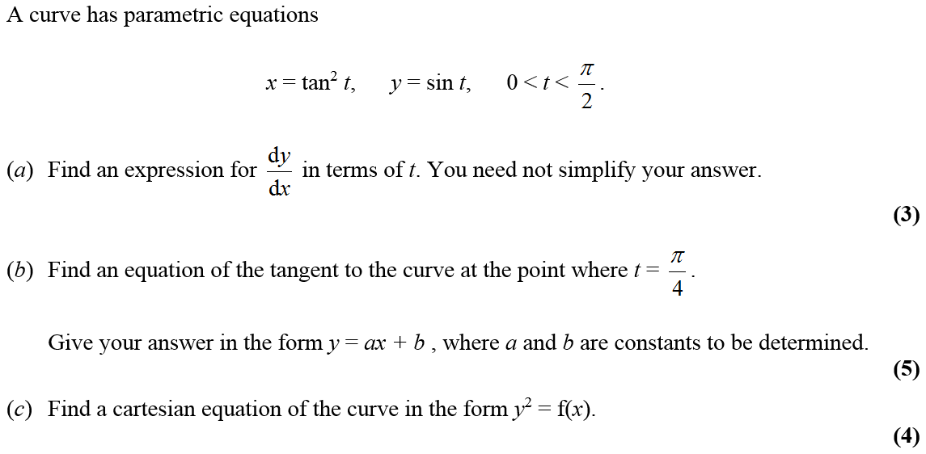
June 2007

Slide 54
June 2007
A

Slide 55
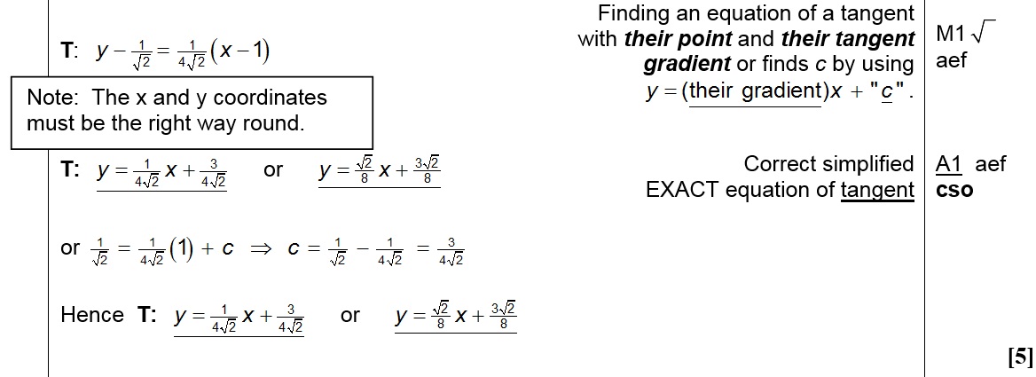
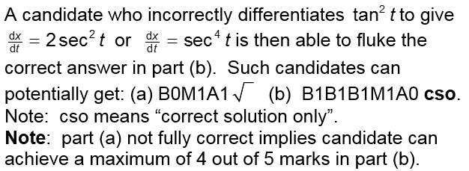
June 2007
B

Slide 56
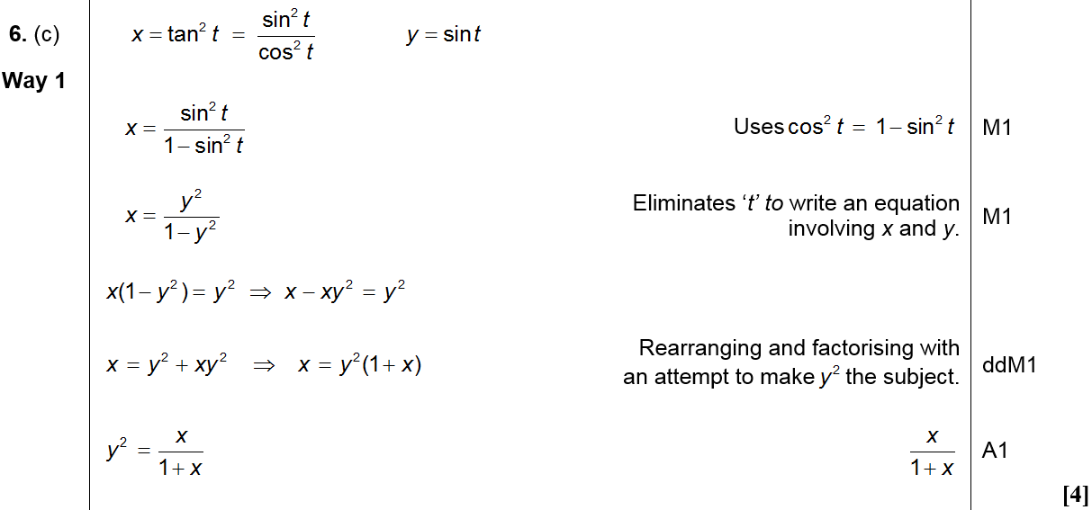
June 2007
C (Method 1)

Slide 57
June 2007
C (Method 2)

Slide 58
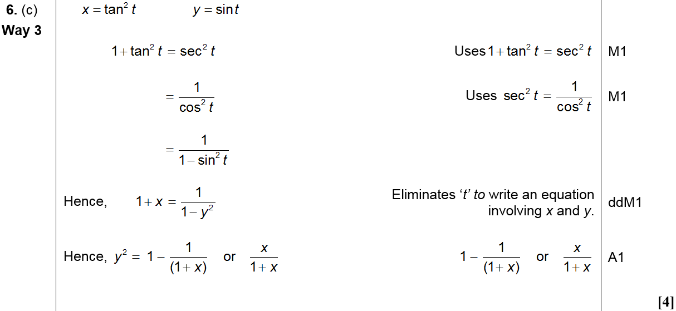
June 2007
C (Method 3)

Slide 59
June 2007
C (Method 4)

Slide 60
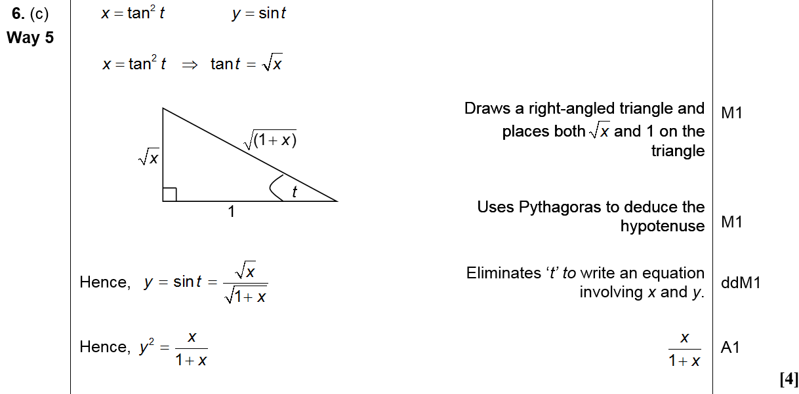
June 2007
C (Method 5)

Slide 61
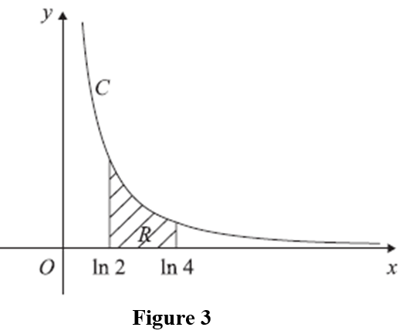
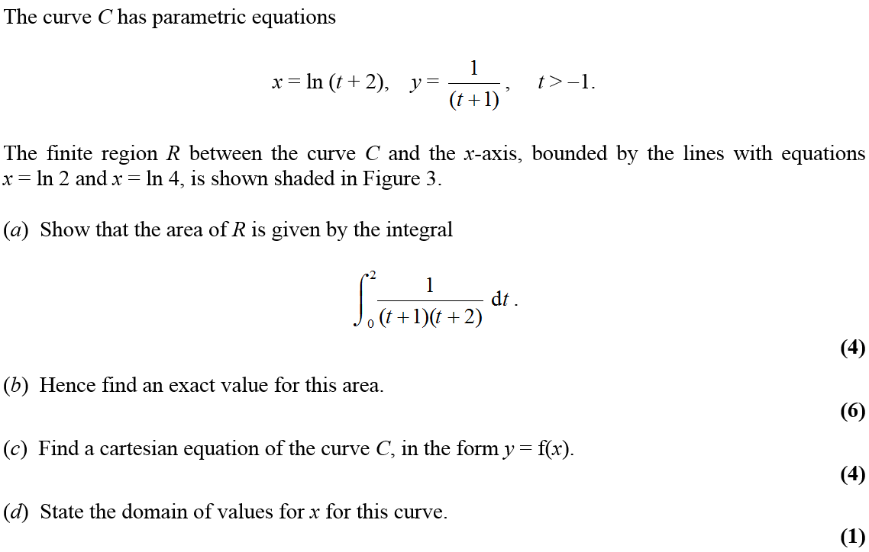
Jan 2008

Slide 62
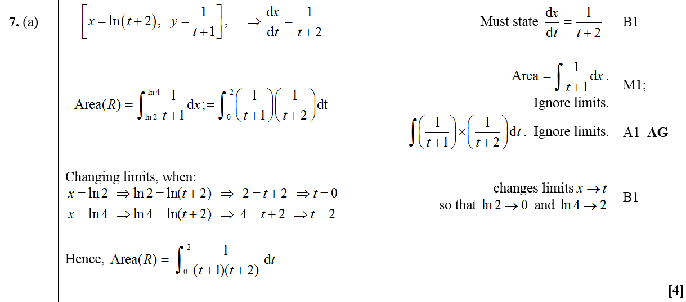
Jan 2008
A

Slide 63
Jan 2008
B

Slide 64
Jan 2008
C
Alternative C (i)

Slide 65
Jan 2008
Alternative C (ii)
Alternative C (iii)

Slide 66
Jan 2008
D

Slide 67
June 2008

Slide 68
June 2008
A
B

Slide 69
June 2008
C
D

Slide 70
Jan 2009

Slide 71
Jan 2009
A
B

Slide 72
Jan 2009
C

Slide 73
June 2009

Slide 74
June 2009
A
B
C

Slide 75
June 2009

Slide 76
June 2009
A
B

Slide 77
June 2009
C

Slide 78
Jan 2010

Slide 79
A
Jan 2010
B

Slide 80
June 2010

Slide 81
June 2010
A
B

Slide 82
Jan 2011

Slide 83
Jan 2011
A
B

Slide 84
C
Jan 2011
Alternative C

Slide 85
June 2011

Slide 86
June 2011
A
B

Slide 87
June 2011
C

Slide 88
Jan 2012

Slide 89
Jan 2012
A
B

Slide 90
Jan 2012
A Notes
Alternative differentiation for A

Slide 91
Jan 2012
B Notes

Slide 92
Jan 2012
Alternative B

Slide 93
June 2012

Slide 94
June 2012
A

Slide 95
June 2012
B
C

Slide 96
Jan 2013

Slide 97
Jan 2013
A
B
C

Slide 98
Jan 2013
D

Slide 99
June 2013

Slide 100
June 2013
A

Slide 101
June 2013
B
C

Slide 102
June 2014

Slide 103
June 2014
A
B

Slide 104
June 2014

Slide 105
June 2014
A

Slide 106
June 2014
B

Slide 107
June 2015

Slide 108
June 2015
A
A Alternative 1

Slide 109
June 2015
A Alternative 2
B

Slide 110
June 2015
B Alternative 1
B Alternative 2

Slide 111
June 2015
A notes

Slide 112
June 2015
B notes

Slide 113
June 2016

Slide 114
June 2016
A

Slide 115
June 2016
B
A notes

Slide 116
June 2016
B notes

Slide 117
June 2016
A Alternative 1

Slide 118
June 2016
A Alternative 2

Slide 119
June 2017

Slide 120
June 2017
A
A Alternative

Slide 121
June 2017
B
C

Slide 122
June 2017
C Alternative 1
C Alternative 2
A notes

Slide 123
June 2017
B notes
C notes

Slide 124
June 2017

Slide 125
June 2017
A
B

Slide 126
June 2017
C

Slide 127
June 2017
C Alternative

Slide 128
June 2017
A notes
B notes

Slide 129
June 2017
C notes

Slide 130
June 2017
C Alternative

Slide 131
June 2018

Slide 132
June 2018
A
A notes

Slide 133
June 2018
B

Slide 134
June 2018
B notes

